Slide 1

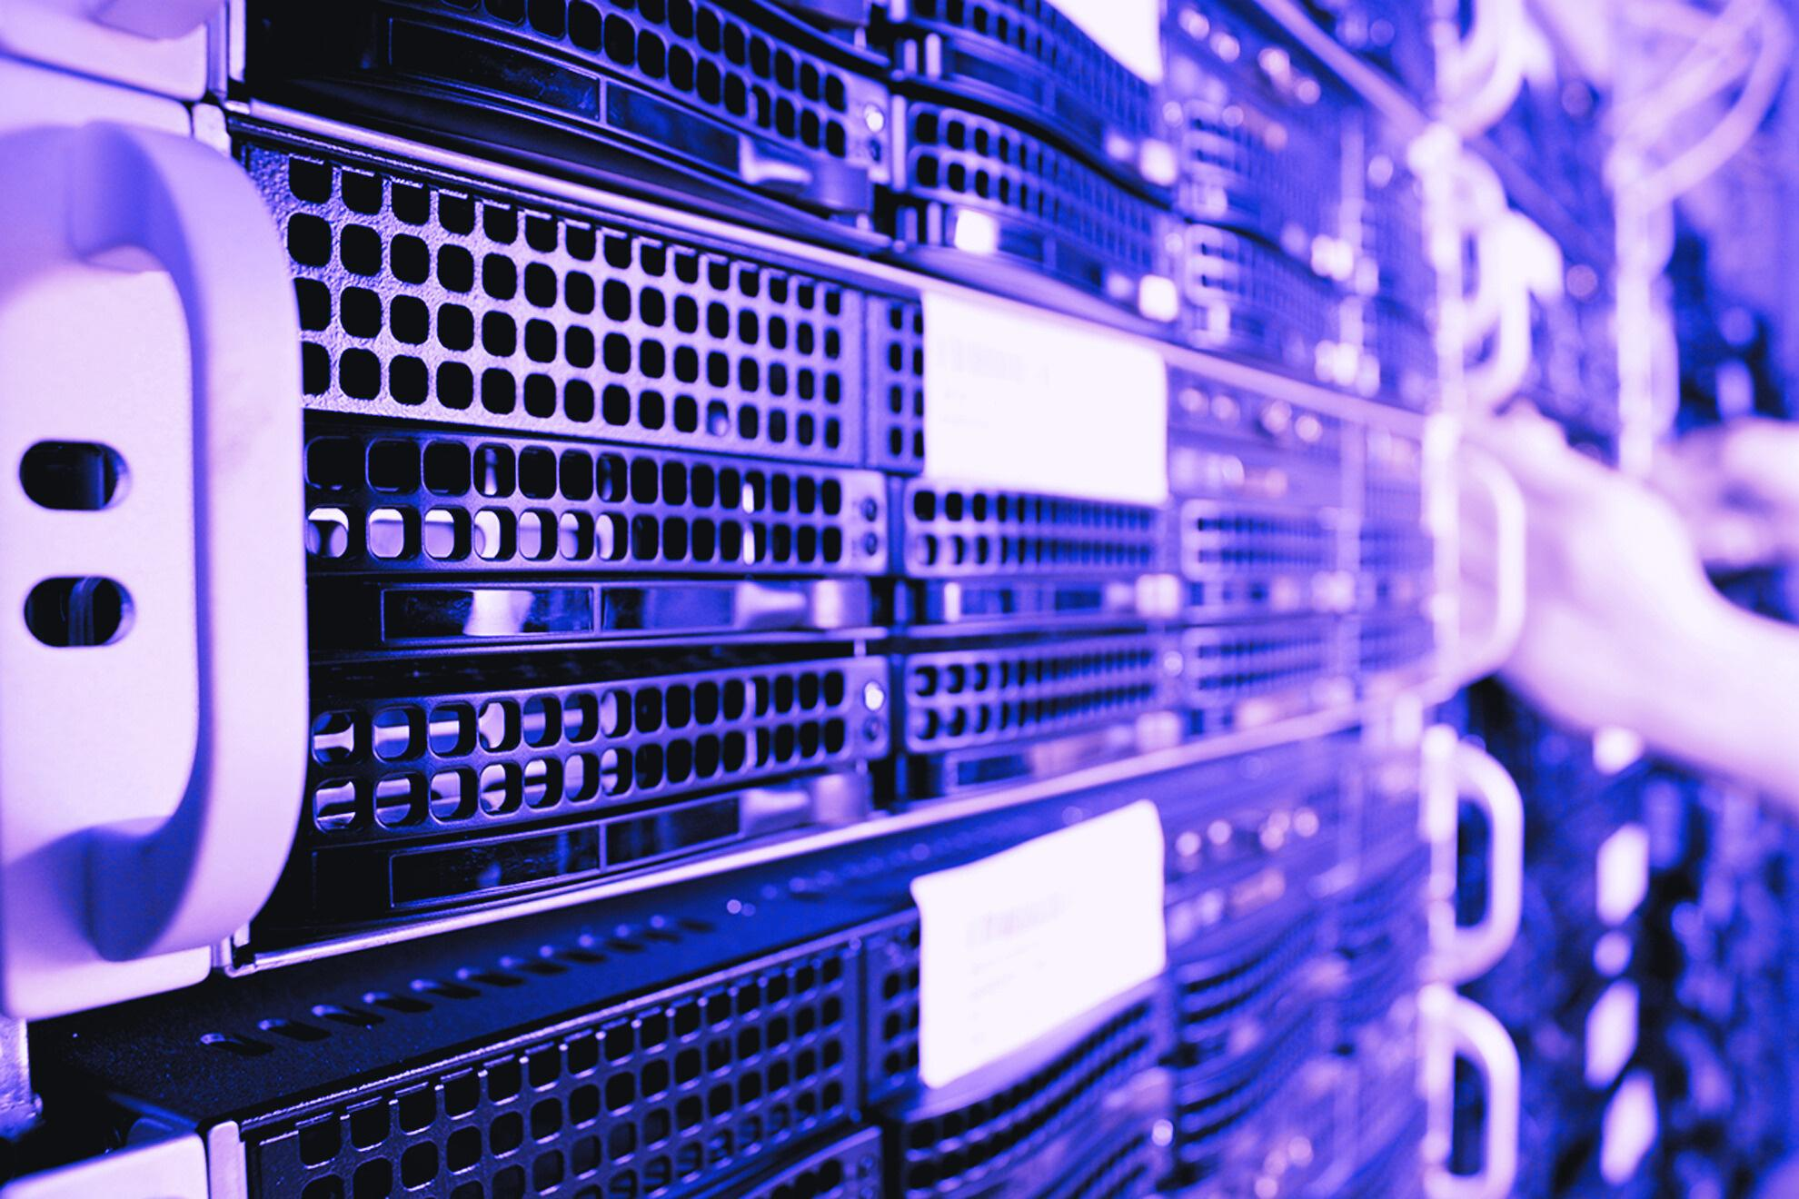
Speech Recognition System
Presentation

Slide 2
Md. Ahnaf Tajwar Khan
(ID: 1931447042)
Md. Shadman Sakib
(ID: 1911357042)
Zahid Al Razin
(ID: 1921046042)
T M Redwan Shahriar
(ID: 2021679642)
Group - 06

Slide 3
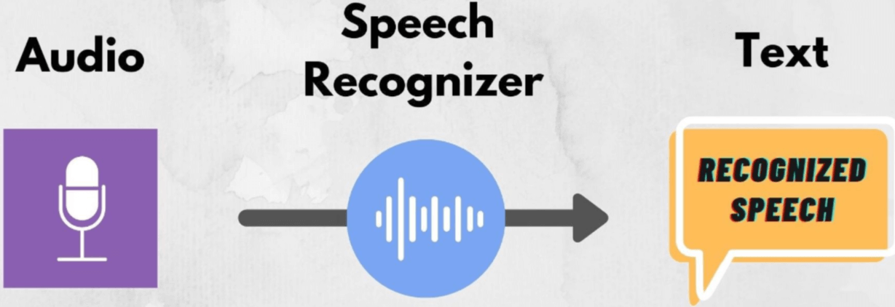
Introduction
What is Speech Recognition?
The automatic process of converting spoken language into text using computational models and algorithms.
Importance in Modern Applications:
Voice assistants (e.g., Siri, Alexa) enable hands‑free interaction.
Automated transcription services for meetings, lectures, and interviews.
Accessibility tools for the hearing impaired.
Project Overview: Implemented a speech-to-text system leveraging OpenAI's Whisper model, with evaluation metrics to measure transcription quality.

Slide 4
Objectives
Develop a speech-to-text pipeline using Whisper’s pretrained model.
Support dual input modes: upload audio files in Google Colab and live microphone recording on local machines
Evaluate transcription accuracy using Precision, Recall, and F1 Score.
Demonstrate deployment both in cloud (Colab) and on personal computers without a GPU.

Slide 5

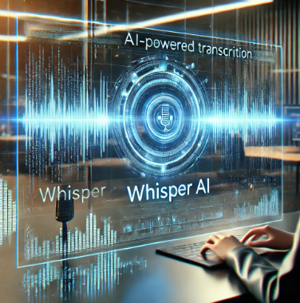
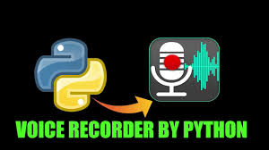
Tools & Technologies
Python: Primary language for scripting and prototyping.
Google Colab / Local Machine: Execution environments; Colab offers free GPU, local runs on CPU.
Neural network: Used to build our model
Libraries: librosa numpy pandas torch torchaudio tensorflow keras soundfile.
scikit-learn: Provides functions to calculate Precision, Recall, and F1 metrics.

Slide 6
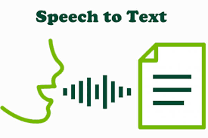
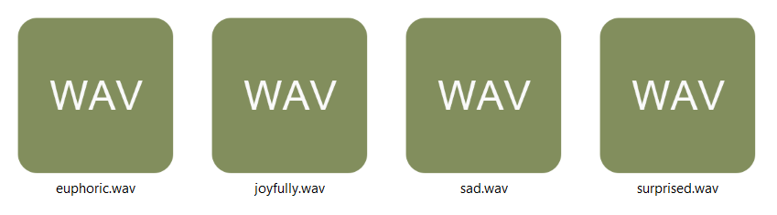
Dataset
The dataset used is from Kaggle with a 10 usability score
set_id: link to the set of audio files,
text: text spoken in the audio set,
gender: gender of the person,
age: age of the person,
country: country of the person https://www.kaggle.com/datasets/tapakah68/emotions-on-audio-dataset?resource=download

Slide 7
Dataset
The dataset used is from Kaggle with a 10 usability score
set_id: link to the set of audio files,
text: text spoken in the audio set,
gender: gender of the person,
age: age of the person,
country: country of the person https://www.kaggle.com/datasets/tapakah68/emotions-on-audio-dataset?resource=download

Slide 8
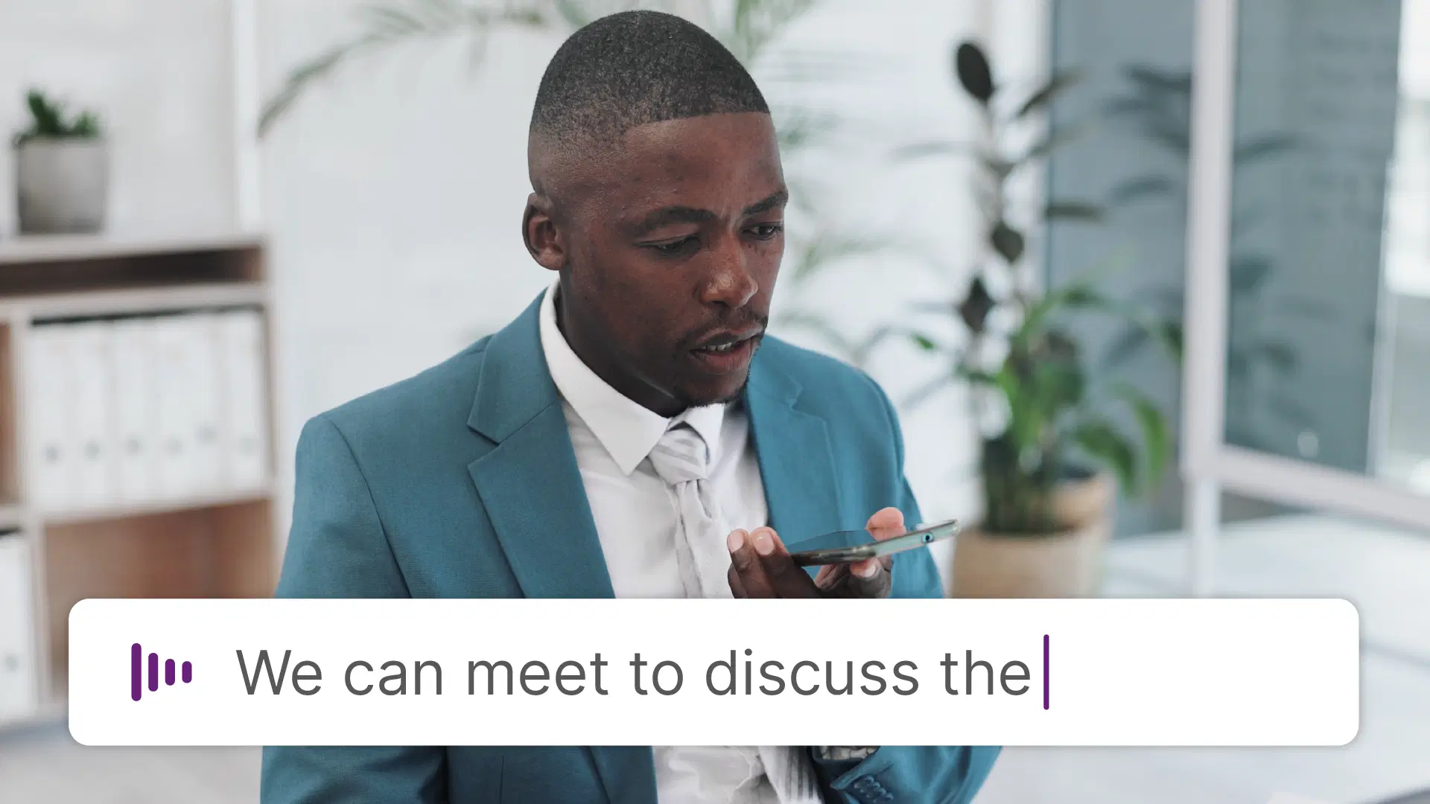
Preprocessing dataset
Used MFCC to convert from waveforms to model readable data.
Added paddings as required.
Building vocabulary and preparing them into lists.
Loading the data into batches for consistency with collate and wrapping with dataloader function.

Slide 9
Model Details
Two 1d convolution layers.
ReLU to add non linearity.
Transpose to LTSM (2 dim)
We apply Log-softmax to the out.
Trained for 10 epochs

Slide 10
Whisper Details
Google Colab: Use files.upload() to import .wav or .mp3 files.
Local Machine: Record live audio for 5 seconds using the sound device and save as recorded.wav.
Fallback Logic: Notebook detects the environment and switches between upload and recording.

Slide 11
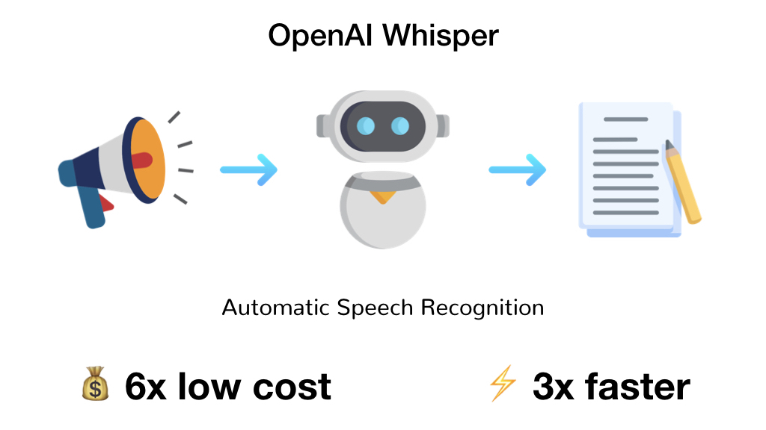
Transcription Process
Load the Whisper model: model
= whisper.load_model("tiny")
Transcribe audio file: result
= model.transcribe(audio_file)
Extract text: transcription
= result['text'].strip()
Display output in the console or notebook cell.

Slide 12
Sample Code Snippet
import whispermodel
= whisper.load_model("tiny")result
= model.transcribe("sample.wav")
print(result["text"])

Slide 13
Evaluation Metrics
Ground Truth vs Predicted: Compare the model’s output with the expected transcript.
Tokenization: Split both strings into word lists of equal length.
Binary Matching: Mark each word as correct (1) or incorrect (0).

Slide 14
Metric Formulas
Precision: TP / (TP + FP) — proportion of correctly transcribed words out of all predicted words.
Recall: TP / (TP + FN) — proportion of correctly transcribed words out of all actual words.
F1 Score: 2 * (Precision * Recall) / (Precision + Recall) — harmonic mean balancing precision and recall.

Slide 15
Output Example
Ground Truth: “Hello Hello, welcome to the speech recognition demo.”
Transcription: “Hello, welcome to the speech recognition demo.”
Computed Metrics: Precision: 0.91
Recall: 0.91F1 Score: 0.91

Slide 16
Challenges Faced
Environment
Differences: Port Audio issues in Colab vs local.
Model Download Time: Large model files take minutes to fetch.
Text Alignment: Minor spelling or punctuation errors affect metrics.
Resource Constraints: CPU-only inference is slower for larger models.

Slide 17
Conclusion & Future Scope
Conclusion: Successfully implemented a cross-platform speech recognition demo using Whisper and evaluated performance.
Future Work: Integrate a web UI for real-time transcription.Fine-tune Whisper on domain-specific datasets. Add multilingual support and translation. Deploy as a mobile app for on-device inference.

Slide 18
Thank you!

