Slide 1
Advance Database Management System Lecture 03: PL/SQL Operators & Conditions

Slide 2
Learning Objectives
To know about:
PL/SQL Operators
Types of PL/SQL Operators
Example Query
Operator Precedence
IF-THEN Statement
IF-THEN-ELSE Statement
IF-THEN-ELSIF Statement
CASE Statement
SEARCHED CASE Statement
Nested IF-THEN-ELSE

Slide 3
PL/SQL Operators
An operator is a symbol that tells the compiler to perform specific mathematical or logical manipulation. PL/SQL language is rich in built-in operators and provides the following types of operators −
Arithmetic operators
Relational operators
Comparison operators
Logical operators
String operators

Slide 4
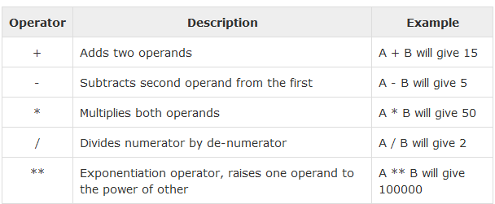
Arithmetic Operators
Following table shows all the arithmetic operators supported by PL/SQL. Let us assume variable A holds 10 and variable B holds 5, then

Slide 5
Arithmetic Operators Example
BEGIN
dbms_output.put_line( 10 + 5);
dbms_output.put_line( 10 - 5);
dbms_output.put_line( 10 * 5);
dbms_output.put_line( 10 / 5);
dbms_output.put_line( 10 ** 5);
END;
/

Slide 6
Arithmetic Operators Example (User Input)
DECLARE
a number:=:a;
b number:=:b;
c number;
BEGIN
c:=a+b;
dbms_output.put_line(c);
END

Slide 7
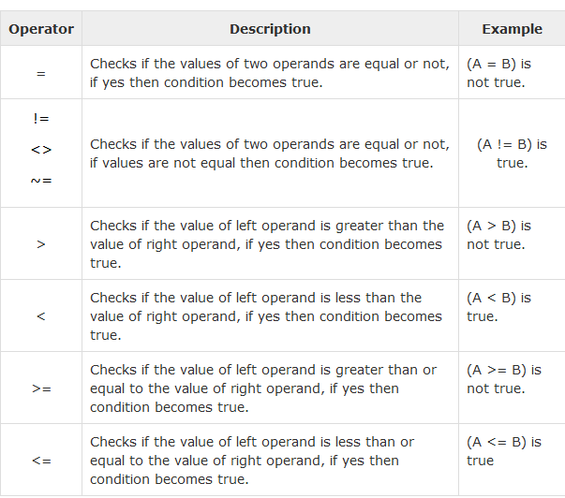
Relational Operators
Relational operators compare two expressions or values and return a Boolean result. Following table shows all the relational operators supported by PL/SQL. Let us assume variable A holds 10 and variable B holds 20, then −

Slide 8
Relational Operators Example
DECLARE
a number (2) := 21;
b number (2) := 10;
BEGIN
IF (a = b) then
dbms_output.put_line('Line 1 - a is equal to b');
ELSE
dbms_output.put_line('Line 1 - a is not equal to b');
END IF;
IF (a < b) then
dbms_output.put_line('Line 2 - a is less than b');
ELSE
dbms_output.put_line('Line 2 - a is not less than b');
END IF;
IF ( a > b ) THEN
dbms_output.put_line('Line 3 - a is greater than b');
ELSE
dbms_output.put_line('Line 3 - a is not greater than b');
END IF;
-- Lets change value of a and b
a := 5;
b := 20;
IF ( a <= b ) THEN
dbms_output.put_line('Line 4 - a is either equal or less than b');
END IF;
IF ( b >= a ) THEN
dbms_output.put_line('Line 5 - b is either equal or greater than a');
END IF;
IF ( a <> b ) THEN
dbms_output.put_line('Line 6 - a is not equal to b');
ELSE
dbms_output.put_line('Line 6 - a is equal to b');
END IF;
END;
/

Slide 9
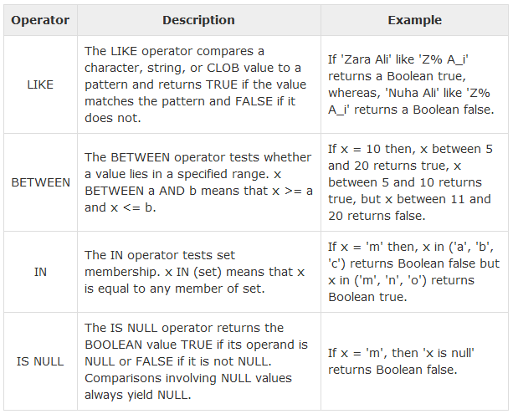
Comparison Operators
Comparison operators are used for comparing one expression to another. The result is always either TRUE, FALSE or NULL.

Slide 10
Like Comparison Operators Example
DECLARE
value varchar2(20):='Zara Ali';
pattern varchar2(20):='Z%A_i';
BEGIN
IF value LIKE pattern THEN
dbms_output.put_line ('True');
ELSE
dbms_output.put_line ('False');
END IF;
END;
/

Slide 11
Between Comparison Operators Example
DECLARE
x number(2) := 10;
BEGIN
IF (x between 5 and 20) THEN
dbms_output.put_line('True');
ELSE
dbms_output.put_line('False');
END IF;
IF (x BETWEEN 5 AND 10) THEN
dbms_output.put_line('True');
ELSE
dbms_output.put_line('False');
END IF;
IF (x BETWEEN 11 AND 20) THEN
dbms_output.put_line('True');
ELSE
dbms_output.put_line('False');
END IF;
END;
/

Slide 12
In and Is Null Comparison Operators Example
DECLARE
letter varchar2(1) := 'm';
BEGIN
IF (letter in ('a', 'b', 'c')) THEN
dbms_output.put_line('True');
ELSE
dbms_output.put_line('False');
END IF;
IF (letter in ('m', 'n', 'o')) THEN
dbms_output.put_line('True');
ELSE
dbms_output.put_line('False');
END IF;
IF (letter is null) THEN
dbms_output.put_line('True');
ELSE
dbms_output.put_line('False');
END IF;
END;
/

Slide 13
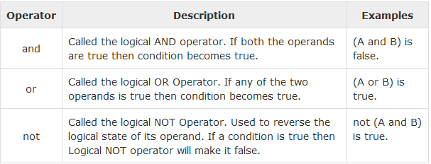
Logical Operators
Following table shows the Logical operators supported by PL/SQL. All these operators work on Boolean operands and produce Boolean results. Let us assume variable A holds true and variable B holds false, then −

Slide 14
Logical Operators Example
DECLARE
a boolean := true;
b boolean := false;
BEGIN
IF (a AND b) THEN
dbms_output.put_line('Line 1 - Condition is true');
END IF;
IF (a OR b) THEN
dbms_output.put_line('Line 2 - Condition is true');
END IF;
IF (NOT a) THEN
dbms_output.put_line('Line 3 - a is not true');
ELSE
dbms_output.put_line('Line 3 - a is true');
END IF;
IF (NOT b) THEN
dbms_output.put_line('Line 4 - b is not true');
ELSE
dbms_output.put_line('Line 4 - b is true');
END IF;
END;
/

Slide 15
PL/SQL Operator Precedence
Operator precedence determines the grouping of terms in an expression. This affects how an expression is evaluated. Certain operators have higher precedence than others; for example, the multiplication operator has higher precedence than the addition operator.
For example, x = 7 + 3 * 2; here, x is assigned 13, not 20 because operator * has higher precedence than +, so it first gets multiplied with 3*2 and then adds into 7.
Here, operators with the highest precedence appear at the top of the table, those with the lowest appear at the bottom. Within an expression, higher precedence operators will be evaluated first.
The precedence of operators goes as follows: =, <, >, <=, >=, <>, !=, ~=, ^=, IS NULL, LIKE, BETWEEN, IN.

Slide 16
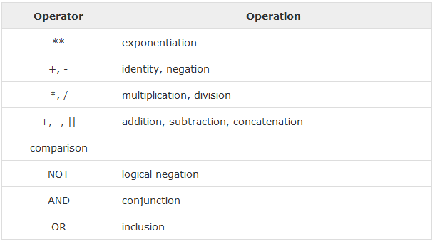
PL/SQL Operator Precedence

Slide 17
Operator Precedence Example
DECLARE
a number(2) := 20;
b number(2) := 10;
c number(2) := 15;
d number(2) := 5;
e number(2) ;
BEGIN
e := (a + b) * c / d; -- ( 30 * 15 ) / 5
dbms_output.put_line('Value of (a + b) * c / d is : '|| e );
e := ((a + b) * c) / d; -- (30 * 15 ) / 5
dbms_output.put_line('Value of ((a + b) * c) / d is : ' || e );
e := (a + b) * (c / d); -- (30) * (15/5)
dbms_output.put_line('Value of (a + b) * (c / d) is : '|| e );
e := a + (b * c) / d; -- 20 + (150/5)
dbms_output.put_line('Value of a + (b * c) / d is : ' || e );
END;
/

Slide 18
PL/SQL Conditions
Decision-making structures require that the programmer specify one or more conditions to be evaluated or tested by the program, along with a statement or statements to be executed if the condition is determined to be true, and optionally, other statements to be executed if the condition is determined to be false.
PL/SQL programming language provides following types of decision-making statements.
IF-THEN Statement
IF-THEN-ELSE Statement
IF-THEN-ELSIF Statement
CASE Statement
SEARCHED CASE Statement
Nested IF-THEN-ELSE

Slide 19
IF-THEN Statement
It is the simplest form of the IF control statement, frequently used in decision-making and changing the control flow of the program execution
The IF statement associates a condition with a sequence of statements enclosed by the keywords THEN and END IF
If the condition is TRUE, the statements get executed, and if the condition is FALSE or NULL, then the IF statement does nothing.
Syntax:
IF condition THEN
S;
END IF;
If the Boolean expression condition evaluates to true, then the block of code inside the if statement will be executed. If the Boolean expression evaluates to false, then the first set of code after the end of the if statement (after the closing end if) will be executed.

Slide 20
IF-THEN Statement Example
DECLARE
a number(2) := 10;
BEGIN
a:= 10;
-- check the boolean condition using if statement
IF( a < 20 ) THEN
-- if condition is true then print the following
dbms_output.put_line('a is less than 20 ' );
END IF;
dbms_output.put_line('value of a is : ' || a);
END;
/
Output:
a is less than 20 value of a is : 10

Slide 21
IF-THEN-ELSE Statement
A sequence of IF-THEN statements can be followed by an optional sequence of ELSE statements, which execute when the condition is FALSE.
Syntax:
IF condition THEN
S1;
ELSE
S2;
END IF;
Where, S1 and S2 are different sequence of statements. In the IF-THEN- ELSE statements, when the test condition is TRUE, the statement S1 is executed and S2 is skipped; when the test condition is FALSE, then S1 is bypassed and statement S2 is executed.

Slide 22
IF-THEN-ELSE Statement Example
DECLARE
a number(3) := 100;
BEGIN
-- check the boolean condition using if statement
IF( a < 20 ) THEN
-- if condition is true then print the following
dbms_output.put_line('a is less than 20 ' );
ELSE
dbms_output.put_line('a is not less than 20 ' );
END IF;
dbms_output.put_line('value of a is : ' || a);
END;
/
Output:
a is not less than 20 value of a is : 100

Slide 23
IF-THEN-ELSIF Statement
IF-THEN-ELSIF statement allows you to choose between several alternatives.
An IF-THEN statement can be followed by an optional ELSIF...ELSE statement.
The ELSIF clause lets you add additional conditions.
Syntax:
IF(boolean_expression 1)THEN
S1; -- Executes when the boolean expression 1 is true
ELSIF( boolean_expression 2) THEN
S2; -- Executes when the boolean expression 2 is true
ELSIF( boolean_expression 3) THEN
S3; -- Executes when the boolean expression 3 is true
ELSE
S4; -- executes when the none of the above condition is true
END IF;

Slide 24
IF-THEN-ELSIF Statement
When using IF-THEN-ELSIF statements there are a few points to keep in mind.
It's ELSIF, not ELSEIF.
An IF-THEN statement can have zero or one ELSE's and it must come after any ELSIF's.
An IF-THEN statement can have zero to many ELSIF's and they must come before the ELSE.
Once an ELSIF succeeds, none of the remaining ELSIF's or ELSE's will be tested.

Slide 25
IF-THEN-ELSIF Statement Example
DECLARE
a number(3) := 100;
BEGIN
IF ( a = 10 ) THEN
dbms_output.put_line('Value of a is 10' );
ELSIF ( a = 20 ) THEN
dbms_output.put_line('Value of a is 20' );
ELSIF ( a = 30 ) THEN
dbms_output.put_line('Value of a is 30' );
ELSE
dbms_output.put_line('None of the values is matching');
END IF;
dbms_output.put_line('Exact value of a is: '|| a );
END;
/
Output:
None of the values is matching
Exact value of a is: 100

Slide 26
CASE STATEMENT
Like the IF statement, the CASE statement selects one sequence of statements to execute.
However, to select the sequence, the CASE statement uses a selector rather than multiple Boolean expressions. A selector is an expression whose value is used to select one of several alternatives.

Slide 27
CASE STATEMENT EXAMPLE
DECLARE
grade char(1) := 'A';
BEGIN
CASE grade
when 'A' then dbms_output.put_line('Excellent');
when 'B' then dbms_output.put_line('Very good');
when 'C' then dbms_output.put_line('Well done');
when 'D' then dbms_output.put_line('You passed');
when 'F' then dbms_output.put_line('Better try again');
else dbms_output.put_line('No such grade');
END CASE;
END;
/
Output:
Excellent

Slide 28
SEARCHED CASE STATEMENT
The searched CASE statement has no selector, and it's WHEN clauses contain search conditions that yield Boolean values.

Slide 29
SEARCHED CASE STATEMENT Example
DECLARE
grade char(1) := 'B';
BEGIN
case
when grade = 'A' then dbms_output.put_line('Excellent');
when grade = 'B' then dbms_output.put_line('Very good');
when grade = 'C' then dbms_output.put_line('Well done');
when grade = 'D' then dbms_output.put_line('You passed');
when grade = 'F' then dbms_output.put_line('Better try again');
else dbms_output.put_line('No such grade');
end case;
END;
/
Output:
Very good

Slide 30
NESTED IF-THEN- ELSE
You can use one IF-THEN or IF-THEN-ELSIF statement inside another IF-THEN or IF-THEN-ELSIF statement(s).

Slide 31
NESTED IF-THEN-ELSE Example
DECLARE
a number(3) := 100;
b number(3) := 200;
BEGIN
-- check the boolean condition
IF( a = 100 ) THEN
-- if condition is true then check the following
IF( b = 200 ) THEN
-- if condition is true then print the following dbms_output.put_line('Value of a is 100 and b is 200' ); END IF;
END IF;
dbms_output.put_line('Exact value of a is : ' || a );
dbms_output.put_line('Exact value of b is : ' || b );
END;
/
Output:
Value of a is 100 and b is 200
Exact value of a is : 100
Exact value of b is : 200

Slide 32
THANK YOU

