Slide 1
Introduction to Reinforcement Learning
Shadma Nafis
Project Assistant – II
CSIR-IGIB

Slide 2
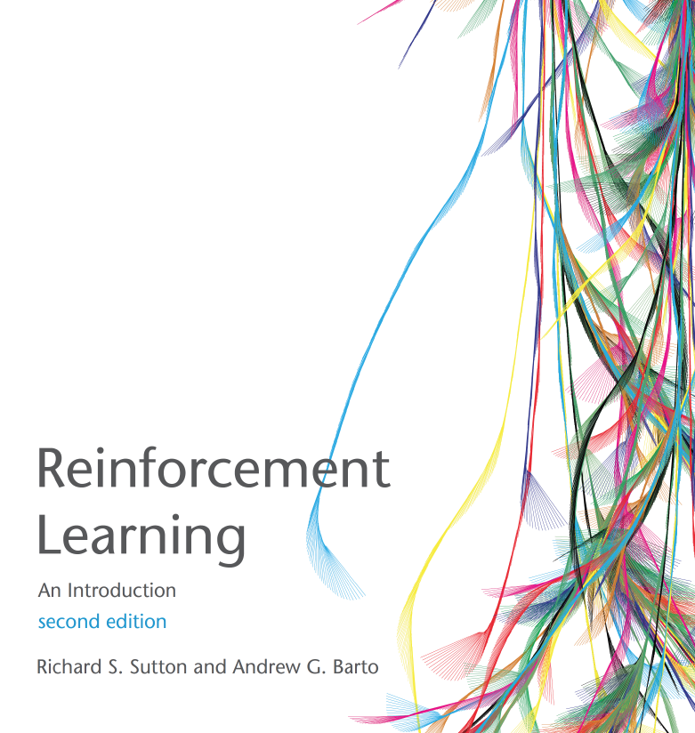
Reference book on reinforcement learning

Slide 3
Branches of Machine Learning
Supervised learning
Unsupervised learning
Reinforcement
Learning
Machine learning

Slide 4
Many faces of Reinforcement Learning
Reinforcement
Learning
Computer Science
Neuroscience
Psychology
Economics
mathematics
Engineering

Slide 5
Reinforcement learning
Reinforcement learning is learning what to do—how to map situations to actions - so as to maximize a numerical reward signal.
The learner is not told which actions to take, but instead must discover which actions yield the most reward.
Reinforcement learning is an area of Machine Learning.
Machine learning is one of the most exciting technologies that one would have ever come across. As it is evident from the name, it gives the computer that which makes it more similar to humans: The ability to learn.

Slide 6
Characteristics of Reinforcement Learning
What makes reinforcement learning different from other machine
learning paradigms?
There is no supervisor, only a reward signal
Feedback is delayed, not instantaneous
Time really matters
Agent's actions affect the subsequent data it receives

Slide 7
Examples of Reinforcement Learning
Fly stunt manoeuvres in a helicopter
Manage an investment portfolio
Control a power station
Make a humanoid robot walk
Play many different Atari games better than humans

Slide 8

Agent and Environment
Observation
Action
Ot
At
Reward
Rt

Slide 9


Agent and Environment
At each step t the agent:
Executes action At
Receives observation Ot
Receives scalar reward Rt
The environment:
Receives action At
Emits observation Ot+1
Emits scalar reward Rt+1
t increments at env. step
Action
Observation
Ot
At
Reward
Rt

Slide 10
REWARDS
A reward Rt is a scalar feedback signal
Indicates how well agent is doing at step t
The agent's job is to maximize cumulative reward
Reinforcement learning is based on the reward hypothesis
Definition (Reward Hypothesis)
All goals can be described by the maximization of expected
cumulative reward

Slide 11
Sequential Decision Making
Goal: select actions to maximize total future reward
Actions may have long term consequences
Reward may be delayed
It may be better to sacrifice immediate reward to gain more
long-term reward
Examples:
A financial investment (may take months to mature)
Refueling a helicopter (might prevent a crash in several hours)
Blocking opponent moves (might help winning chances many
moves from now)

Slide 12
History
The history is the sequence of observations, actions, rewards
H_{t} = O1; R1;A1;.................;At;Ot ; Rt
i.e. all observable variables up to time t
i.e. the sensorimotor stream of a robot or embodied agent
What happens next depends on the history:
The agent selects actions
The environment selects observations/rewards
State is the information used to determine what happens next
Formally, state is a function of the history:
S_{t} = f (H_{t} )

Slide 13
State
State is the information used to determine what happens next
Formally, state is a function of the history:
St = f (Ht)
Types of state:
Agent state
Environment state
Informative state

Slide 14

Types of environment
Fully Observable Environment
agent directly observes environment state
Agent state = environment state = information state
Formally, this is a Markov decision process (MDP)
MDP is provides a mathematical framework for modeling decision making in situations where outcomes are partly random and partly under the control of a decision maker.
Observation
Action
O_{t} = AS_{t} = ES_{t}
Ot
A_{t}
Reward
R_{t}

Slide 15
Partially Observable Environments
Agent indirectly observes environment:
A robot with camera vision isn't told its absolute location
A trading agent only observes current prices
A poker playing agent only observes public cards
Now agent state != environment state
Formally this is a partially observable Markov decision process(POMDP)

Slide 16
Major Components of an RL Agent
An RL agent may include one or more of these components:
Policy: agent's behavior function, decide from the current state which actions to take.
Value function: estimate how well we will do in the future state, how good is each state and/or action, what reward we get.
Model: agent's representation of the environment.

Slide 17
POLICY
A policy is the agent's behaviour
It is a map from state to action
Two types of policy:
Deterministic policy: a = π(s)
Fixed for a particular state
Stochastic policy: π(a/s) = P[A_{t} = a / S_{t} = s]
Based on the probabilistic distribution

Slide 18
Value function & Model
Value function is a prediction of future reward.
Used to evaluate the goodness/badness of states.
Therefore to select between actions.
The value of a state is the total amount of reward an agent can expect to accumulate over the future, starting from that state.
A model predicts what the environment will do next.
This is something that mimics the behavior of the environment, or more generally, that allows inferences to be made about how the environment will behave.
For example, given a state and action, the model might predict the resultant next state and next reward.

Slide 19
RL AGENT TAXONOMY
MODEL
POLICY
VALUE FUNCTION
MODEL
FREE
ACTOR CRITIC
MODEL BASED
VALUE BASED
POLICY BASED

Slide 20
Two fundamental problems in sequential decision making
Reinforcement Learning:
The environment is initially unknown
The agent interacts with the environment
The agent improves its policy
Planning:
A model of the environment is known
The agent performs computations with its model (without any external interaction)
The agent improves its policy a.k.a. deliberation, reasoning, introspection, pondering, thought, search

Slide 21


