Slide 1
AI-Driven Agriculture
Cultivating a Smarter, More Sustainable Future

Slide 2

Problem: The Agricultural Challenge
Global food demand rising, while resources diminish.
Climate change causes unpredictable yields and increased risks.
Inefficient resource use (water, fertilizer) drives up costs and waste.
Labor shortages impact farm productivity and scalability.
Traditional farming lacks data for precise, proactive decision-making.

Slide 3
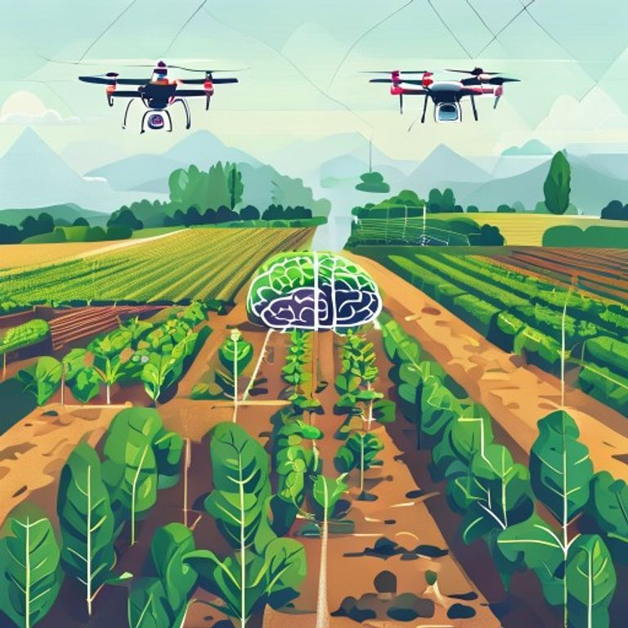
Solution: Intelligent Farm Management
AI-powered platform for real-time monitoring and predictive analytics.
Optimizes irrigation, fertilization, and pest control with precision.
Early detection of crop diseases and environmental stressors.
Automates routine tasks, addressing labor scarcity challenges.
Delivers actionable insights for maximizing yield and minimizing waste.

Slide 4
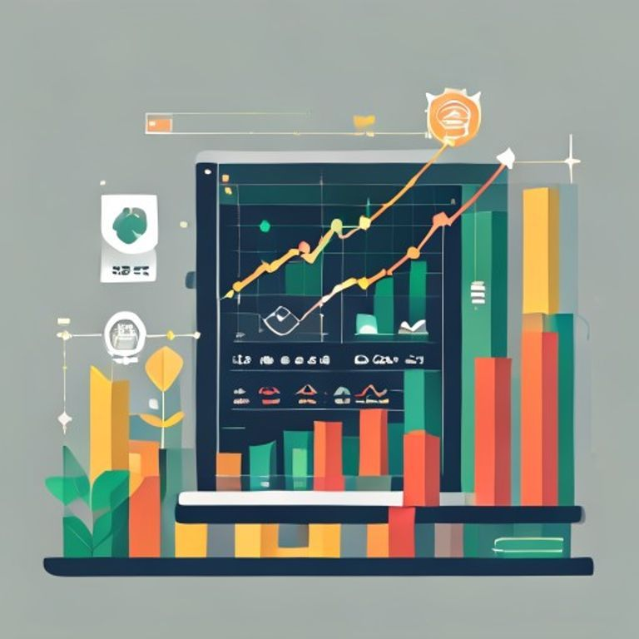
Market Opportunity & Product
Multi-billion dollar AgTech market growing at a rapid pace.
Our product: integrated hardware (sensors, drones) and cloud-based software.
Machine learning models analyze soil, weather, and crop health data.
User-friendly dashboards and mobile alerts empower farmers.
Scalable solution for diverse farms, from smallholders to large enterprises.

Slide 5

Business Model & Traction
Subscription-based SaaS model with tiered service packages.
Revenue from hardware sales and installation; ongoing support fees.
Pilot programs with 3 regional farms showing 15% yield increase.
Secured Letters of Intent from 5 additional agricultural partners.
Projected ARR of $XM in Year 3 based on current growth trajectory.

Slide 6

Team & The Ask
Experienced team in AI, agriculture, and SaaS development.
Seeking $2.5M seed funding to accelerate product development.
Funds will expand our engineering team and market reach.
Targeting nationwide expansion and new crop-specific AI models.
Invest in the future of food security and sustainable farming.

