Slide 1
AI-Powered Personalized Education
Revolutionizing Learning Through Adaptive Intelligence

Slide 2
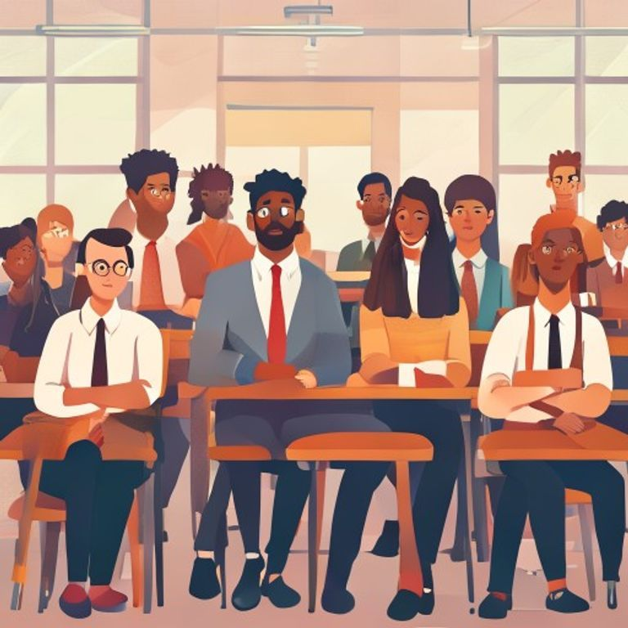
Problem
• Current education is a one-size-fits-all model.
• Diverse student learning styles and paces ignored.
• Lack of personalized attention leads to disengagement.
• Inefficient learning outcomes and unrealized potential.

Slide 3
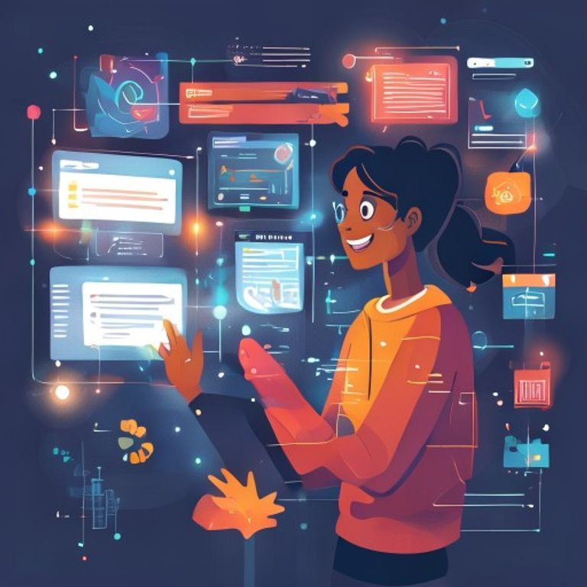
Solution
• AI-driven adaptive learning paths for every student.
• Personalized content, pace, and assessment.
• Real-time feedback and progress tracking.
• Engaging, gamified, and interactive learning experiences.

Slide 4

Market Opportunity
• Global EdTech market projected for significant growth.
• Rising demand for effective online learning solutions.
• Parents and institutions seeking personalized academic support.
• Untapped potential for AI in K-12, higher ed, and corporate training.

Slide 5
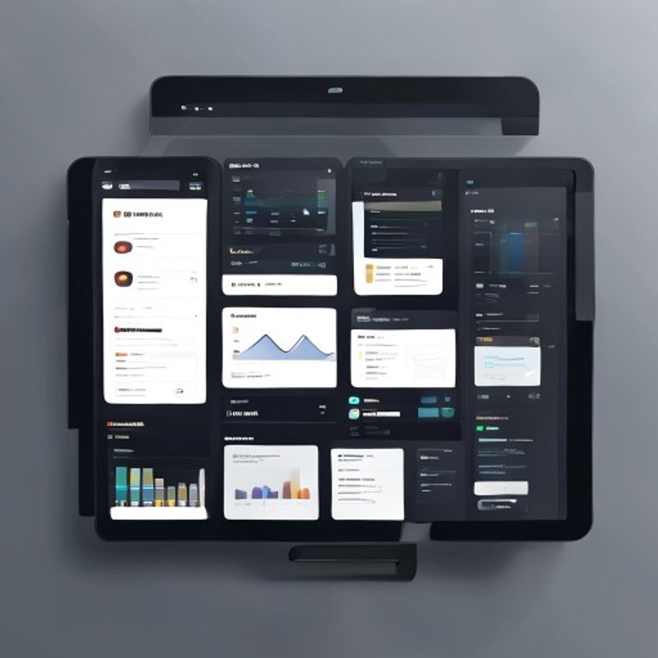
Product
• Intelligent AI tutor adapting to individual student needs.
• Comprehensive curriculum library across all subjects.
• User-friendly interface for students, parents, and educators.
• Advanced analytics dashboard for performance insights.

Slide 6

Business Model
• Subscription-based model for individual students/families.
• Tiered pricing for premium features and content access.
• Licensing agreements with educational institutions.
• Strategic partnerships with content providers.

