Slide 1
AI-Powered Personalized Learning
Revolutionizing Education Through Adaptive Intelligence

Slide 2
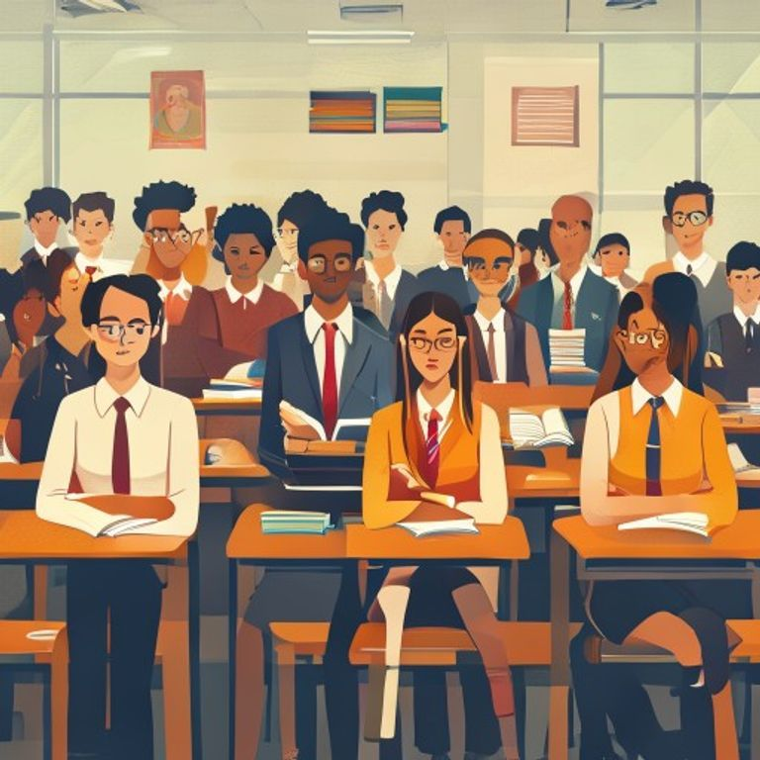
The Obsolete One-Size-Fits-All
• Traditional education struggles with diverse learning styles.
• Students face disengagement, frustration, and knowledge gaps.
• Educators lack tools for truly individualized support.
• High student dropout rates and poor learning outcomes persist.

Slide 3
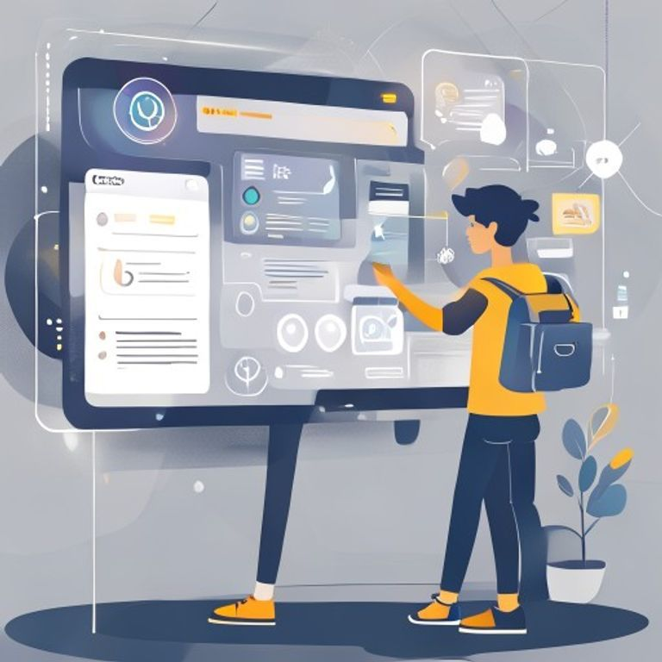
Intelligent Learning for Every Student
• AI-driven adaptive learning paths tailored to individual needs.
• Real-time performance analytics guide content delivery.
• Personalized feedback and resource recommendations.
• Foster engagement and accelerate mastery for all learners.

Slide 4
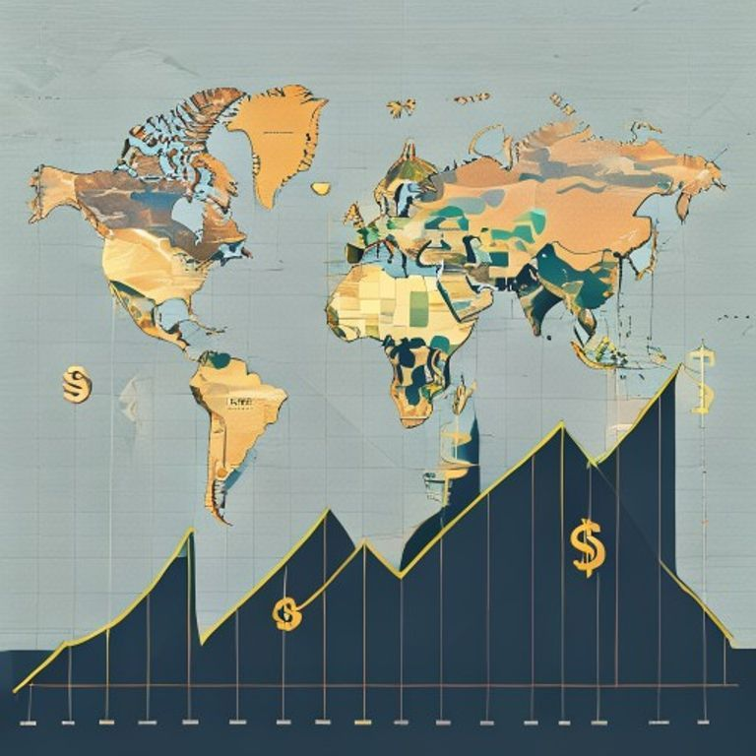
A Trillion-Dollar Market Ripe for Disruption
• Global EdTech market projected to reach $600B by 2027.
• Massive demand for effective online and blended learning.
• Parents and institutions prioritize personalized education.
• Untapped potential for AI to redefine learning outcomes.

Slide 5

Our AI Platform: Precision Learning
• Proprietary AI algorithms continuously assess student progress.
• Curriculum dynamically adapts to strengths and weaknesses.
• Gamified modules and interactive content enhance engagement.
• Analytics dashboard provides insights for educators and parents.

Slide 6

Scalable Impact, Clear Revenue
• Subscription-based SaaS for educational institutions (B2B).
• Premium individual plans for direct-to-consumer learners (B2C).
• Partnerships with content providers for extended offerings.
• Achieved 20% MoM user growth in pilot programs.

