Slide 1
Industrial Intelligence: Transforming Operations
AI-Powered Software for Enhanced Industrial Efficiency

Slide 2

The Industrial Efficiency Gap
• Outdated legacy systems hinder operational insights.
• Manual processes lead to human error and productivity loss.
• Lack of real-time data visibility across complex operations.
• High maintenance costs and unexpected equipment downtime.

Slide 3
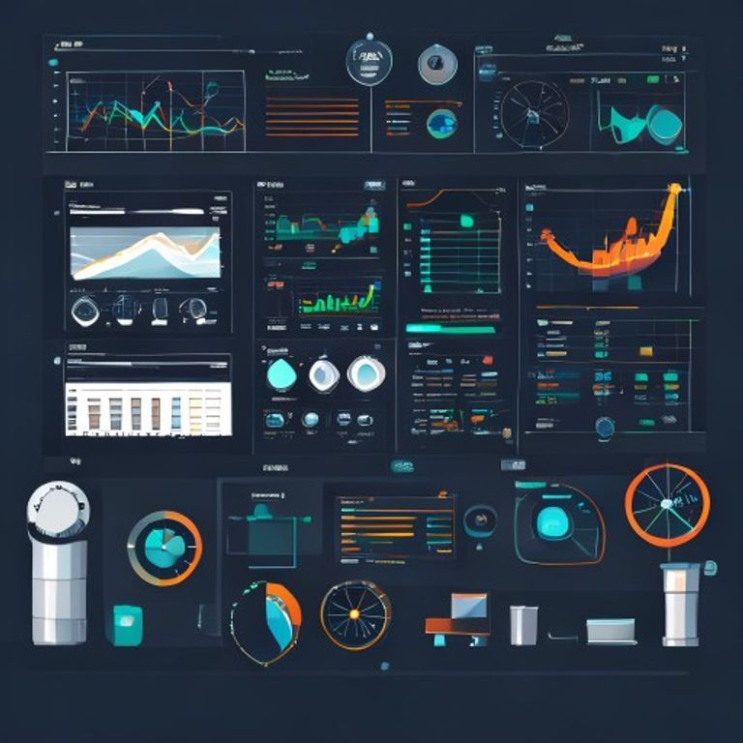
AI-Driven Operational Intelligence
• Automated data collection and predictive analytics platform.
• Real-time monitoring and proactive issue detection.
• Optimized resource allocation and process automation.
• Reduced operational costs and improved uptime.

Slide 4

Untapped Industrial Software Market
• $500B+ global industrial software market, growing rapidly.
• Strong demand for digital transformation in manufacturing, logistics, energy.
• Enterprises seek solutions to enhance competitiveness and sustainability.
• Significant whitespace for intelligent, industry-agnostic platforms.

Slide 5
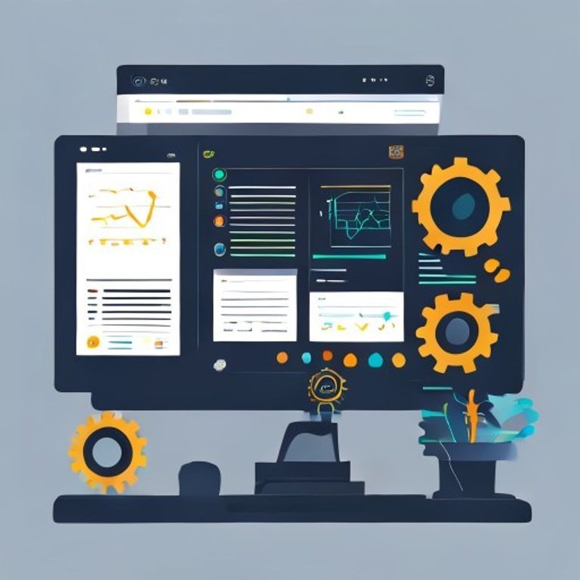
Core Platform: "OptiFlow AI"
• Modular SaaS platform with customizable industry-specific modules.
• Integrates seamlessly with existing ERP and IoT infrastructures.
• Predictive maintenance, supply chain optimization, and quality control.
• User-friendly interface with actionable insights for decision-makers.

Slide 6

Scalable SaaS & Early Success
• Subscription-based SaaS model with tiered pricing.
• Annual contracts, driving predictable recurring revenue.
• Pilots underway with 3 major industrial clients.
• Achieved 20% efficiency gains in initial deployments.

