Slide 1

Lung cancer prediction using Machine Learning
Presented by :
Shadman & Sathvik K S

Slide 2
Table of contents
01
02
03
04
Introduction
Problem Statement
Brief Intro about Current Research and Development in AI
Lung Cancer Prediction using ML
Decision Tree
Theory lesson
Practical Explanation
Introduction
Working of the Model

Slide 3
Introduction
Machine learning is a type of artificial intelligence that allows computer systems to learn and improve their performance without being explicitly programmed. It involves training a machine using data, allowing the machine to learn for itself and make decisions based on that learning.

Slide 4
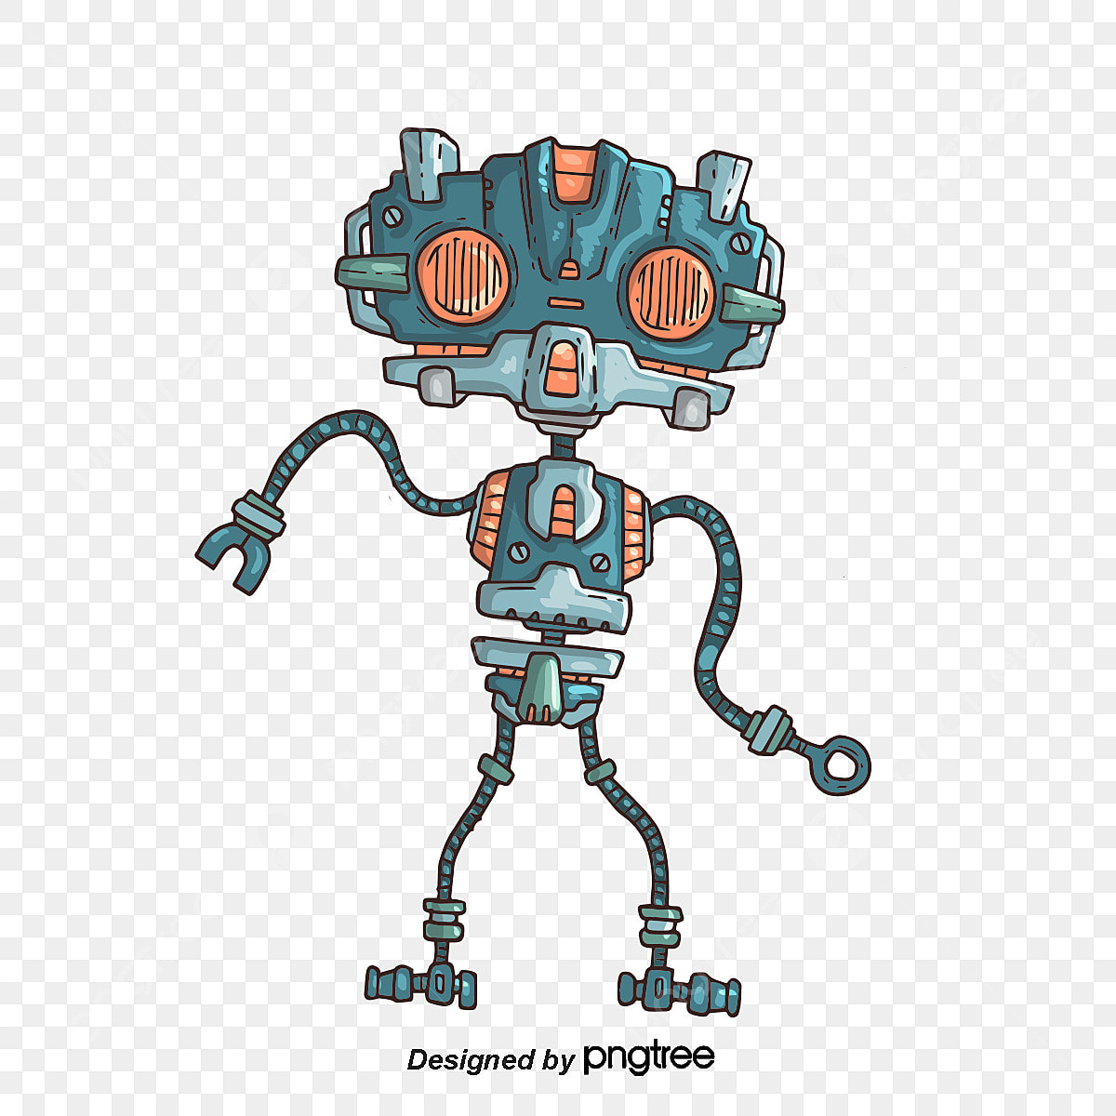
01
Video on :
Real World Application of AI/ML
https://youtu.be/s0dMTAQM4cw?t=240

Slide 5
02
Problem Statement :
Lung Cancer Prediction

Slide 6

Problem Statement :
Lung Cancer Prediction using RandomForest Classifier :
Why Random Forest Classifier
What are the alternatives to RFC
What are some other real world problems that can be solved using RFC
And the most important thing: Why are we even solving problems using Machine Learning ?

Slide 7
Why use Random Forest Classifier ?
Among all the available classification methods, random forests provide the highest accuracy. The random forest technique can also handle big data with numerous variables running into thousands. It can automatically balance data sets when a class is more infrequent than other classes in the data.

Slide 8
Some Alternative to Random Forest Classifier are:
Extreme Gradient Boosting ( XG BOOST )
Adv. ( block structure that supports parallelization of tree construction and DFS )
Ada Boost ( Adaptive Boosting )
Adv. (It combines poorly performing classifier to provide better accuracy)
LightGBM ( light gradient boosting machine )
Adv. ( Low memory usage allows large-scale data quite easily )
CatBoost
Adv. (reduces the necessity to tune hyperparameters for better performance )

Slide 9
03
Decision Tree :
Introduction

Slide 10
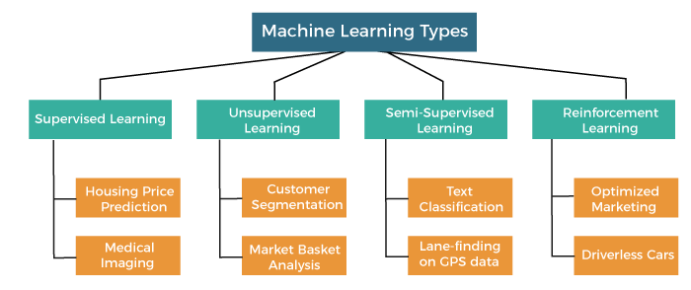
Machine Learning Types

Slide 11
Supervised Learning
Two types under Supervised Learning:
Classification
Regression

Slide 12
Decision Trees
It is a tree-structured classifier, where internal nodes represent the features of a dataset, branches represent the decision rules and each leaf node represents the outcome.
In a Decision tree, there are two nodes, which are the Decision Node and Leaf Node.
In order to build a tree, we use the CART algorithm, which stands for Classification and Regression Tree algorithm.

Slide 13
Why use Decision Trees?
Decision Trees usually mimic human thinking ability while making a decision, so it is easy to understand.
The logic behind the decision tree can be easily understood because it shows a tree-like structure.

Slide 14
Attribute Selection Measures
The are two popular techniques for ASM:
Information Gain
Gini Index

Slide 15
Example for a Decision Tree
Outlook | Temperature | Humidity | Wind | Answer
sunny | hot | high | weak | no
sunny | hot | high | strong | no
overcast | hot | high | weak | yes
rain | mild | high | weak | yes
rain | cool | normal | weak | yes
rain | cool | normal | strong | no
overcast | cool | normal | strong | yes
sunny | mild | high | weak | no
sunny | cool | normal | weak | yes
rain | mild | normal | weak | yes
sunny | mild | normal | strong | yes
overcast | mild | high | strong | yes
overcast | hot | normal | weak | yes
rain | mild | high | strong | no

Slide 16
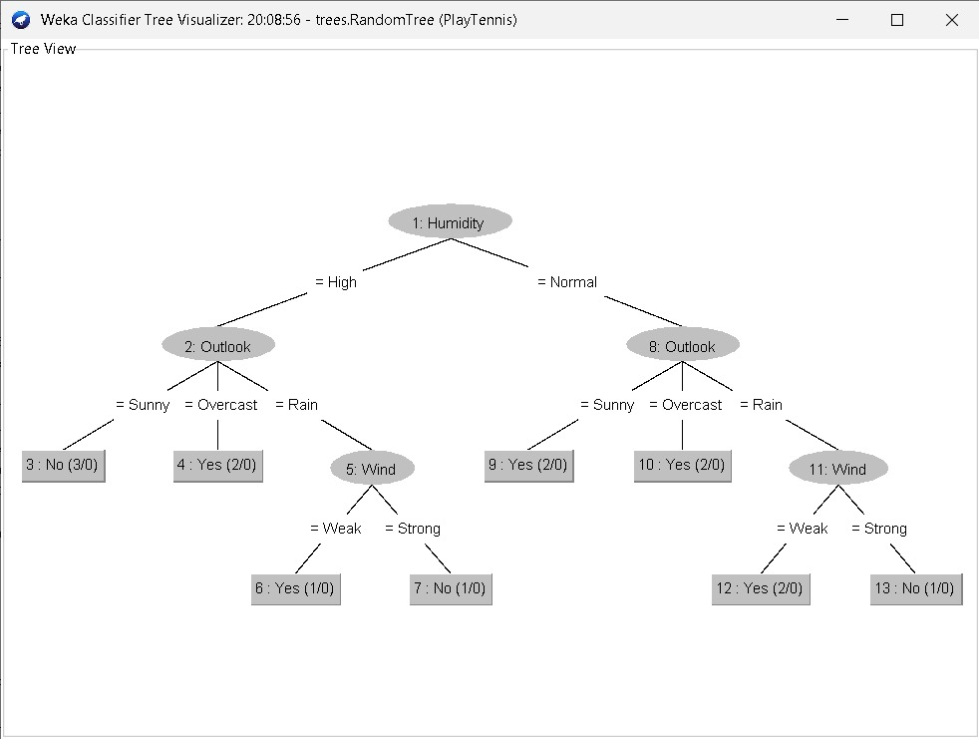
Outlook | Temperature | Humidity | Wind | Answer
sunny | hot | high | weak | no
rain | cool | normal | weak | yes
overcast | hot | high | weak | yes

Slide 17
The Overfitting issue with Decision Tree

Slide 18
Random Forest
A random forest is simply a collection of decision trees whose results are aggregated into one final result.
It is based on the concept of ensemble learning, which is a process of combining multiple classifiers to solve a complex problem and to improve the performance of the model.

Slide 19
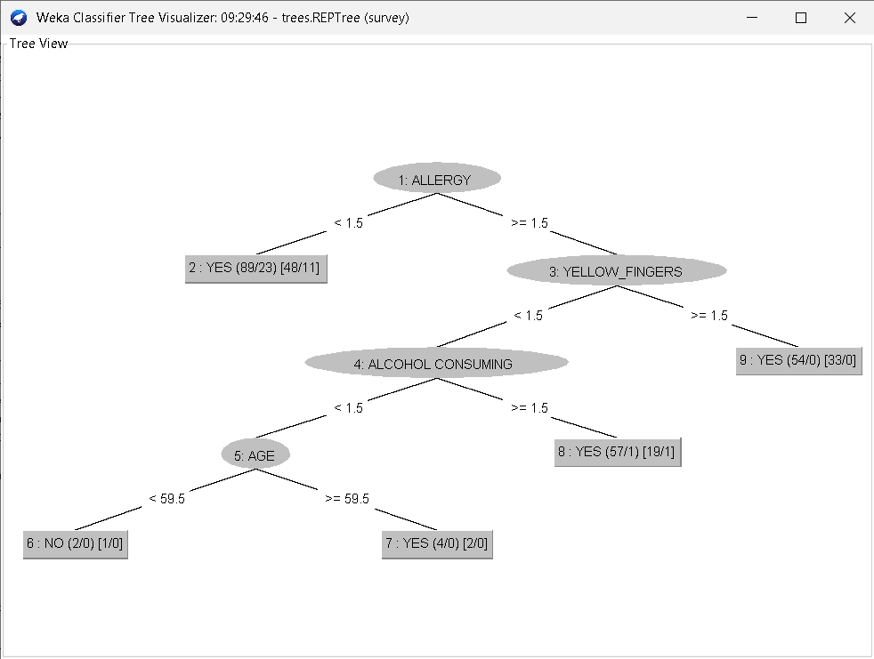
Decision Tree : Visualization

Slide 20
How does Random Forest algorithm work?
One way Random Forests reduce variance is by training on different samples of the data.
A second way is by using a random subset of features.

Slide 21
Algorithm
Step-1: Select random K data points from the training set.
Step-2: Build the decision trees associated with the selected data points (Subsets).
Step-3: Choose the number N for decision trees that you want to build.
Step-4: Repeat Step 1 & 2.
Step-5: For new data points, find the predictions of each decision tree, and assign the new data points to the category that wins the majority votes.

Slide 22
04
Code Explanation :
Understanding the Code

Slide 23

— Stephen Hawking told the BBC
“The development of full artificial intelligence could spell the end of the human race….It would take off on its own, and re-design itself at an ever increasing rate. Humans, who are limited by slow biological evolution, couldn’t compete, and would be superseded.”

Slide 24
Lastly Lets watch a video on Latest Development in AI :
THANK YOU

