Slide 1
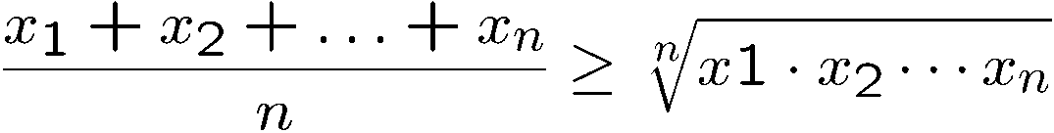

Introduction to Discrete Mathematics
A
B
C
a = qb+r gcd(a,b) = gcd(b,r)

Slide 2
Continued from Part A

Slide 3
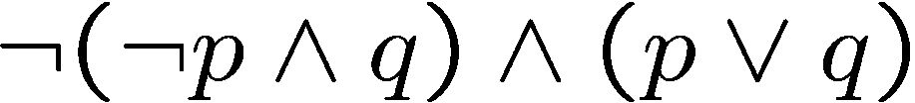
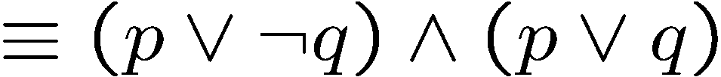
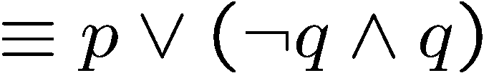


Simplifying Statement
DeMorgan
Distributive law
Please practice more identities.

Slide 4
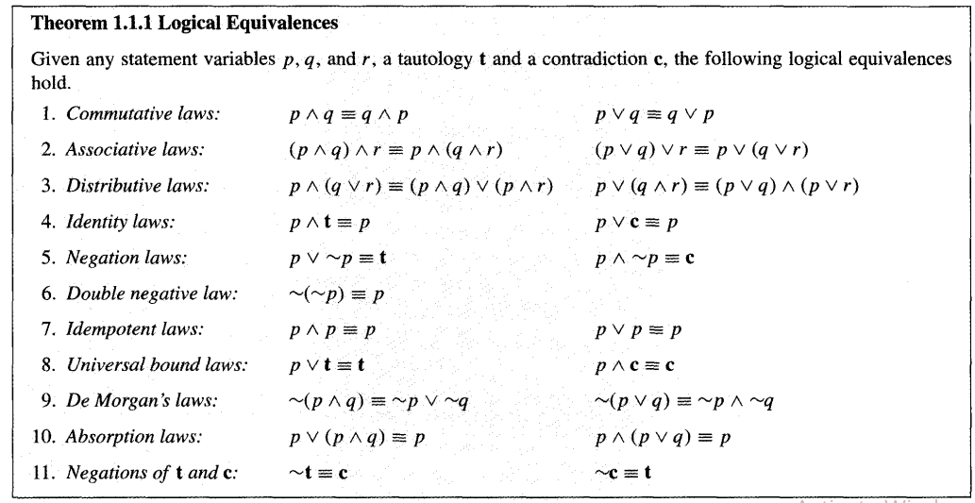

Slide 5
Negation Exercise
Jim is tall and thin
~(Jim is tall and thin)
How to do this negation?
Jim is NOT tall and thin
Actually we should proceed as follows:
Original Statement: Jim is tall and Jim is thin
~(Jim is tall and Jim is thin)
Jim is Not tall or Jim is Not thin

Slide 6


Tautology, Contradiction
A tautology is a statement that is always true.
A B C D

Slide 7

Tautology, Contradiction
A tautology is a statement that is always true.
DeMorgan
DeMorgan
A contradiction is a statement that is always false.
(negation of a tautology)
((p ∧ r) ∨ (q ∧ r)) ∧ (¬(p ∨ q) ∧ r)

Slide 8
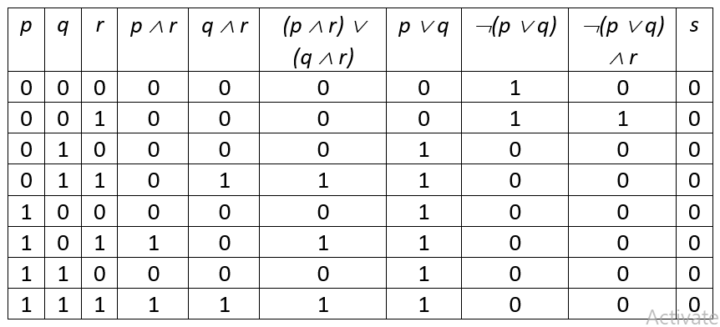
s = ((p ∧ r) ∨ (q ∧ r)) ∧ (¬(p ∨ q) ∧ r)

Slide 9
Quick Summary
Key points to know.
Write a logical formula from a truth table.
Check logical equivalence of two logical formulas.
DeMorgan’s rule and other simple logical rules (e.g. distributive).
Use simple logical rules to simplify a logical formula.

