Slide 1

Propositional Logic

Slide 2
This Lecture
In the last lecture we introduced logic formulas.
In this lecture we are going to use logic to derive things.
The two important components in this lecture are:
Conditional Statements
Arguments

Slide 3

Conditional Statement (Implication)
If p then q
p implies q
p is called the hypothesis; q is called the conclusion
antecedent
consequent
The department says:
“If your GPA is 4.0, then you will have full scholarship.”
When is the above sentence false?
It is false when your GPA is 4.0 but you don’t receive full scholarship.
But it is not false if your GPA is below 4.0.
So, if your GPA is below 4.0, it is true irrespective of whether you receive full scholarship or not.
Another example: “If there is a match of Bangladesh, then there is no class.”
When is the above sentence false?

Slide 4

Logic Operator
P
Q
P Q
Q is true:
T
T
T
T
F
F
F
T
T
P is false
F
F
T
Convention: if we don’t say anything wrong, then it is not false, and thus true.
An implication is true provided P is false or Q is true (or both), and false otherwise.

Slide 5
Example Implications
The most common type of statement in mathematics is the implication.
Consider the Pythagorean Theorem:
The equation is true as long as a and b are the legs or a right triangle and c is the hypotenuse.
We thus make it a statement:
Would you agree that this is the theorem?
Is this a statement?
NO
If a and b are the legs of a right triangle with hypotenuse c, then

Slide 6
Implications
This is a reasonable way to think about implications:
our claim is that the conclusion (“then” part) is true, but on the assumption that the hypothesis (“if” part) is true.
We make no claim about the conclusion in situations when the hypothesis is false.
This is why when the hypothesis is false, we don’t say anything wrong, i.e., our statement is NOT false, and thus true.

Slide 7
Implication
What do you mean if you say, p → q is false?
You mean:
p is true and
q is false

Slide 8


Implication Exercise
Which of the following are True/False?
If 1 = 1, then most horses have 4 legs.
If 0 = 1, then 1 = 1.
If 8 is a prime number, then the 7624th digit of π is an 8.
If the 7624th digit of π is an 8, then 2 + 2 = 4.
An implication is true provided P is false or Q is true (or both), and false otherwise.

Slide 9
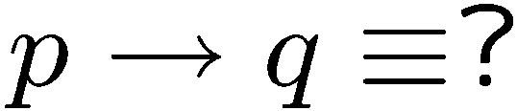
Logical Equivalence
We want a (compound) statement equivalent to left hand side
If you see a question in the above form,
there are usually 3 ways to deal with it.
Truth table
Use logical rules
Intuition

Slide 10


If-Then as Or
An implication is true provided P is false or Q is true (or both), and false otherwise.
P
Q
P Q
Idea 2: Look at the false rows,
negate and take the “and”.
T
T
T
T
F
F
F
T
T
DeMorgan’s
Laws
F
F
T
If you don’t give me all your money, then I will kill you.
Either you give me all your money or I will kill you (or both).
If you talk to her, then you can never talk to me.
Either you don’t talk to her or you can never talk to me (or both).

Slide 11
If-Then as Or
P → Q ≡ ~P or Q
P
Q
If you don’t give me all your money, then I will kill you.
Either you give me all your money or I will kill you (or both).
~P
P
Q
If you talk to her, then you can never talk to me.
Either you don’t talk to her or you can never talk to me (or both).
~P

Slide 12
Direct proofs of implications
To prove an implication P → Q:
it is enough to assume P, and from it, deduce Q.
i.e., you must explain why Q is true, but you get to assume P is true first.
Direct proof is the easiest style of proof and has the advantage that such a proof often does a great job of explaining why the statement is true.

Slide 13
Direct proofs of implications
If two numbers a and b are even, then their sum a + b is even.
Proof:
Suppose the numbers a and b are even.
This means that a = 2k and b = 2j for some integers k and j.
The sum is then a + b = 2k + 2j = 2(k + j).
Since k + j is an integer, this means that a + b is even.
P
Q
assume P
Deduce Q
QED

Slide 14
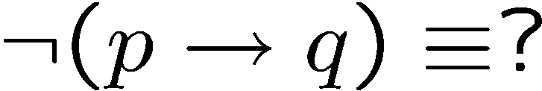

Negation of If-Then
¬(if p then q) ≡
p ∨ q ≡
(if ¬p then q)
p ∨ ¬ q ≡
(if ¬p then ¬ q)
¬p ∨ ¬ q ≡
(if p then ¬ q)
p → q ≡ ¬p ∨ q

Slide 15




Negation of If-Then
previous slide
DeMorgan

Slide 16
Negation of If-Then
P
Q
If you eat an apple everyday, then you have no toothache.
You eat an apple everyday but you have toothache.
~Q
negate
P
Q
If my computer is not working, then I cannot finish my homework.
My computer is not working but I can finish my homework.
~Q
negate

Slide 17
Contrapositive
The contrapositive of “if p then q” is “if ~q then ~p”.
Statement: If you are a CS year 1 student,
then you are taking CSC 2110.
Contrapositive: If you are not taking CSC 2110,
then you are not a CS year 1 student.
Statement: If x² is an even number,
then x is an even number.
Contrapositive: If x is an odd number,
then x² is an odd number.
Fact: A conditional statement is logically equivalent to its contrapositive.
Often it is easier to analyze the contrapositive.

Slide 18










Proofs
Statement: If P, then Q
Contrapositive: If Q, then P.
T | T | T
T | F | F
F | T | T
F | F | T
F | F | T
T | F | F
F | T | T
T | T | T
Proof using the Truth table
Proof using logical rules…

Slide 19
Inverse
The Inverse of an implication P → Q is the implication ~P → ~Q .
The inverse is NOT logically equivalent to the original implication.
That is, whether the inverse of an implication is true is independent of the truth of the implication

Slide 20
Converse
The converse of an implication P → Q is the implication Q → P.
The converse is NOT logically equivalent to the original implication.
That is, whether the converse of an implication is true is independent of the truth of the implication

Slide 21
Converse and Inverse
Converse and Inverse of a statement are logically equivalent to each other…
Why/How?
P -> Q
Inverse: ~P -> ~Q
Converse: Q -> P
Contrapositive of ~P -> ~Q is ~~Q -> ~~P, i.e., Q -> P.

Slide 22
Converse
Mathematics is overflowing with examples of true implications which have a false converse.
If a number greater than 2 is prime, then that number is odd.
CONVERSE: If a number (>2) is odd, then it is a prime
However, just because a number is odd does not mean it is prime.
If a shape is a square, then it is a rectangle.
CONVERSE: If a shape is a rectangle, then it is a square
But it is false that if a shape is a rectangle, then it is a square.

Slide 23
Converse
Sometimes the converse of a true statement is also true.
For example, the Pythagorean theorem has a true converse: if a² + b² = c², then the triangle with sides a, b, and c is a right triangle.
Whenever you encounter an implication in mathematics, it is always reasonable to ask whether the converse is true.
When both P → Q and Q → P are true, we say that P and Q are equivalent and write P ↔ Q. This is also called the biconditional. We will come back to this soon….

Slide 24

Implication and Converse
and contrapositive
True or False: If you draw any nine playing cards from a regular deck, then you will have at least three cards all of the same suit.
contrapositive: If you don’t have at least three cards all of the same suit, then you don’t have nine cards.
True: you can at most have two cards of each of the four suits, for a total of eight cards (or fewer).

Slide 25
Understanding implications
P
Q
P
Suppose I tell Rimpi that if she gets a 93% on her final, then she will get an A in the class. Assuming that what I said is true, what can you conclude in the following cases:
Rimpi gets a 93% on her final.
Rimpi gets an A.
Rimpi gets an A in the class.
Cannot conclude anything.
Rimpi does not get a 93% on her final.
Cannot conclude anything.
Rimpi does not get an A in the class.
Rimpi does not get a 93% on her final.
Q
P is true; since P → Q is true; Q must be true
Q is true; P → Q is given true; But P still can be both true or false.
P is false; P → Q is (automatically) true; Q can be both true or false.
Q is false; P → Q is given true; P then must be false.

Slide 26
Implies, if, only if
We can say: Q if P (i.e., if P then Q)
P is a sufficient condition for Q
Or we can say P only if Q.
i.e., if not q, then not p.
(i.e., contrapositively: if p then q.)
Q is a necessary condition for P
P
Q
P Q
T
T
T
T
F
F
F
T
T
F
F
T
Look at the True rows;
When P is true,
what about Q? Q is also true!
So, P is sufficient to make Q true
(Note that Q can still be true when P is not.)
Look at the True rows;
Can P be true without Q being true?
No! So, Q is necessary for P to be true.

Slide 27
If you work hard., you will succeed
S → R
If, Only-If
R = you will succeed
You will succeed if you work hard.
You will succeed only if you work hard.
S = you work hard
R if S means “if S then R” or equivalently “S implies R”
We also say S is a sufficient condition for R.
R only if S means “if R then S” or equivalently “R implies S”
We also say S is a necessary condition for R.
You will succeed if and only if you work hard.
P if and only if (iff) Q means P and Q are logically equivalent.
That is, P implies Q and Q implies P.

Slide 28





Math vs English
Parent: if you don’t clean your room, then you can’t watch a DVD.
C
D
contrapositive
This sentence says
D → C
In real life it also means
So
Mathematician: if a number x greater than 2 is not an odd number,
then x is not a prime number.
O = x > 2 is an odd number
This sentence says
P = x > 2 is a prime number
But of course it doesn’t mean

Slide 29
Necessary, Sufficient Condition
Mathematician: if a number x greater than 2 is not an odd number,
then x is not a prime number.
O = x > 2 is an odd number
P = x > 2 is a prime number
This sentence says
But of course it doesn’t mean
Contrapositive
Mathematician: if a number x greater than 2 is a prime number
then x is a odd number.
Being an odd number > 2 is a necessary condition for this number to be prime.
Being a prime number > 2 is a sufficient condition for this number to be odd.
P only if O
THIS WAS MISTAKENLY DISCUSSED AS
“O only if P” IN THE LECTURE
O if P

Slide 30




Necessary AND Sufficient Condition
P
Q
P Q
T
T
T
T
F
F
F
T
F
F
F
T
Note: P Q is equivalent to (P Q) (Q P)
Note: P Q is equivalent to (P Q) ( P Q)
Is the statement “x is an even number if and only if x² is an even number” true?

Slide 31
Another Proof!
x is an even number if and only if x² is an even number.
p = x is an even number
q = x² is an even number
So we need to prove: p ↔ q
i.e., p → q and q → p

Slide 32
x is an even number if and only if x² is an even number
Proof:
p = x is an even number
q = x² is an even number
a. p → q
x is even ⇒ x = 2k
∴ x² = (2k) ² = 4k², which is even
b. q → p
x² is even ⇒ x² = 2k
∴ x = √(2k) =
b. q → p ≡ ¬p → ¬q
CONTRAPOSITIVE
x is NOT even ⇒ x = 2k + 1
∴ x² = (2k + 1) ² = 4k² + 2k + 1, which is NOT even

Slide 33
Hypothesis and Conclusion
May not be related
If 1 = -1, then I am the King of the world
If computers are machines, then Mashrafi is a Cricket Player
If 2+2 = 5, then Chandler is a girl.
But for meaningful statements, we formulate an implication when there is a relation between the hypothesis and conclusion.

Slide 34
This Lecture
Conditional Statements
The meaning of IF and its logical forms
Contrapositive
If, only if, if and only if
Arguments

Slide 35
Argument Form
An argument is a sequence of statements forms.
All statement forms but the final one are called assumptions or hypothesis or premises.
The final statement form is called the conclusion.
An argument form is valid if:
No matter what particular statements are substituted for the statement variables in its premises,
whenever all the assumptions are true, then the conclusion is true.

Slide 36

Argument
An argument is a sequence of statements.
All statements but the final one are called assumptions or hypothesis.
The final statement is called the conclusion.
An argument is valid if:
its form is valid
If today is Wednesday, then yesterday is Tuesday.
Today is Wednesday.
Yesterday is Tuesday.
This is valid, because its form is valid: See next slide…

Slide 37
Modus Ponens
If p then q.
p
q
If typhoon, then class cancelled.
Typhoon.
Class cancelled.
assumptions
conclusion
p | q | p→q | p | q
T | T | T | T | T
T | F | F | T | F
F | T | T | F | T
F | F | T | F | F
Modus ponens is Latin meaning “method of affirming”.

Slide 38
Modus Tollens
If p then q.
~q
~p
If typhoon, then class cancelled.
Class not cancelled.
No typhoon.
assumptions
conclusion
p | q | p→q | ~q | ~p
T | T | T | F | F
T | F | F | T | F
F | T | T | F | T
F | F | T | T | T
Modus tollens is Latin meaning “method of denying”.

Slide 39
Equivalence
A student is trying to prove that propositions P, Q, and R are all true.
She proceeds as follows.
First, she proves three facts:
P implies Q
Q implies R
R implies P.
Then she concludes,
``Thus P, Q, and R are all true.''
Proposed argument:
assumption
Is it valid?
conclusion

Slide 40




Valid Argument?
Is it valid?
assumptions
conclusion
P | Q | R
T | T | T
T | T | F
T | F | T
T | F | F
F | T | T
F | T | F
F | F | T
F | F | F
T | T | T
T | F | T
F | T | T
F | T | T
T | T | F
T | F | T
T | T | F
T | T | T
 | OK?
T | yes
F | yes
F | yes
F | yes
F | yes
F | yes
F | yes
F | no
Assumptions are true, but not the conclusion.
To prove an argument is not valid, we just need to find a counterexample.

Slide 41

Valid Arguments?
assumptions
conclusion
p | q | p→q | q | p
T | T | T | T | T
T | F | F | F | T
F | T | T | T | F
F | F | T | F | F
If p then q.
q
p
Assumptions are true, but not the conclusion.
If you are a fish, then you drink water.
You drink water.
You are a fish.

Slide 42
Valid Arguments?
assumptions
conclusion
p | q | p→q | ~p | ~q
T | T | T | F | F
T | F | F | F | T
F | T | T | T | F
F | F | T | T | T
If p then q.
~p
~q
Assumptions are true, but not the conclusion.
If you are a fish, then you drink water.
You are not a fish.
You do not drink water.

Slide 43


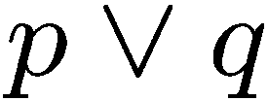
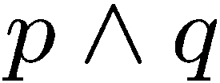



Exercises

Slide 44


Exercises

Slide 45



More Exercises

Slide 46
More Exercises
Valid argument True conclusion
True conclusion Valid argument
REMOVE THIS RECTANGLE TO READ THE CONTENTS

Slide 47
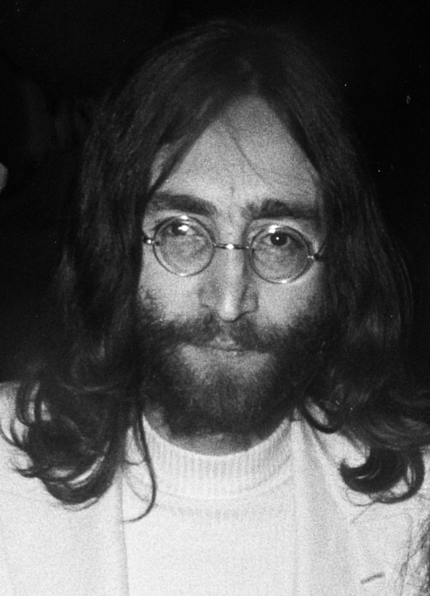
Valid argument → True conclusion
If John Lennon was a Rock Star, then John Lennon had red hair.
John Lennon was a Rock Star.
John Lennon had red hair
modus ponens
But Conclusion is False!!!
True conclusion → Valid argument
If New York is a big city, then New York has tall buildings.
New York has tall buildings.
∴ New York is a big city.
But Conclusion is True!!!

Slide 48
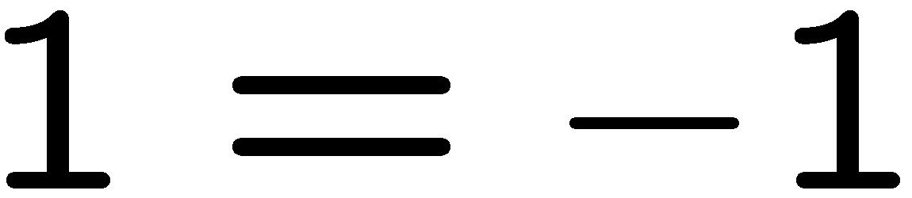
∴
Which form is this?
P ≡
∴
Q ≡

Slide 49

Contradiction
Here C means Contradiction
If you can show that the assumption that the statement
p is false leads logically to a contradiction,
then you can conclude that p is true.
This is similar to the method of denying (modus tollens)

Slide 50
Knights and Knaves
Knights always tell the truth.
Knaves always lie.
A says: B is a knight.
B says: A and I are of opposite type.
Suppose A is a knight.
Then B is a knight (because what A says is true).
Then A is a knave (because what B says is true)
A contradiction.
So A must be a knave.
So B must be a knave (because what A says is false).

Slide 51
Complex Deductions
You are about to leave for BUET in the morning and discover that you don’t have your glasses. You know that the following statements are true:
If my glasses are on the dining table, then I saw them at breakfast.
I was reading the newspaper in the living room or I was reading the newspaper in the dining room.
If I was reading the newspaper in the living room, then the glasses are on the coffee table.
I did not see my glasses at breakfast
If I was reading Sohel sir’s lecture in bed, then my glasses are on the bed side table
If I was reading the newspaper in the dining room, then my glasses are on the dining table.
The glasses are on the coffee table.

Slide 52

Complex Deductions
p → q
~q
∴ ~p
You are about to leave for BUET in the morning and discover that you don’t have your glasses. You know that the following statements are true:
If my glasses are on the dining table, then I saw them at breakfast.
I was reading the newspaper in the living room or I was reading the newspaper in the dining room.
If I was reading the newspaper in the living room, then the glasses are on the coffee table.
I did not see my glasses at breakfast
If I was reading Sohel sir’s lecture in bed, then my glasses are on the bed side table
If I was reading the newspaper in the dining room, then my glasses are on the dining table.
By A and D and modus tollens:
1. My glasses are not on the dining table
By F and 1 and modus tollens:
2. I was not reading the newspaper in the dining room
By B and 2 and elimination:
3. I was reading the newspaper in the living room
By C and 3 and modus ponens:
4. The glasses are on the coffee table.
p → q
p
∴ q
The glasses are on the coffee table.

Slide 53
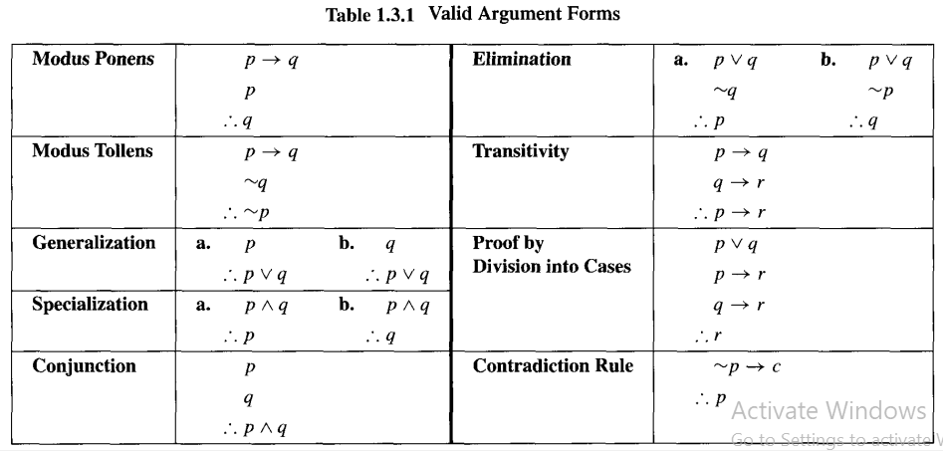

Slide 54
Quick Summary
Conditional Statements
The meaning of IF and its logical forms
Contrapositive
If, only if, if and only if
Arguments
definition of a valid argument
method of affirming, denying, contradiction
Key points:
Make sure you understand conditional statements and contrapositive.
Make sure you can check whether an argument is valid.

Slide 55
Which is true?
Which is false?
“The sentence below is false.”
“The sentence above is true.”

