Slide 1
Generating Functions

Slide 2
Today’s Plan
Generating functions for basic sequences
Operations on generating functions
Counting
Solve recurrences

Slide 3
Generating Functions
a sequence of numbers
a function
a polynomial
Through this mapping, we can apply our techniques for manipulating functions.
Generating functions for basic sequences
Operations on generating functions
Counting
Solve recurrences

Slide 4
Ordinary Generating Functions
Given a sequence <g0,g1,g2,g3,………>
the ordinary generating function is:
We use a double sided arrow to indicate the correspondence.

Slide 5
Simple Examples
The pattern here is simple:
the i-th term in the sequence (indexing from 0) is the coefficient of x^{i} in the generating function.
What is the generating function for <1,1,1,1,1,1,1,………………………>?

Slide 6
Geometric Series
What is the generating function for <1,1,1,1,1,1,1,………………………>?
……
+ ……
What is the closed form expression of G_{n}?
……
+ ……
……
+ ……
G_{n}−xG_{n}=
1

Slide 7

More Examples
Follows easily from first one.
Will show an easy proof soon
These are all closed form generating functions.

Slide 8
Today’s Plan
Generating functions for basic sequences
Operations on generating functions
Counting
Solve recurrences

Slide 9
Operations on Generating Functions
manipulations on sequences
manipulations on functions
There are a few basic operations we’ll learn.
Scaling
Addition
Right shift
Differentiation
Product
We can use these operations to get new sequences from known sequences,
and new generating functions from known generating functions.

Slide 10
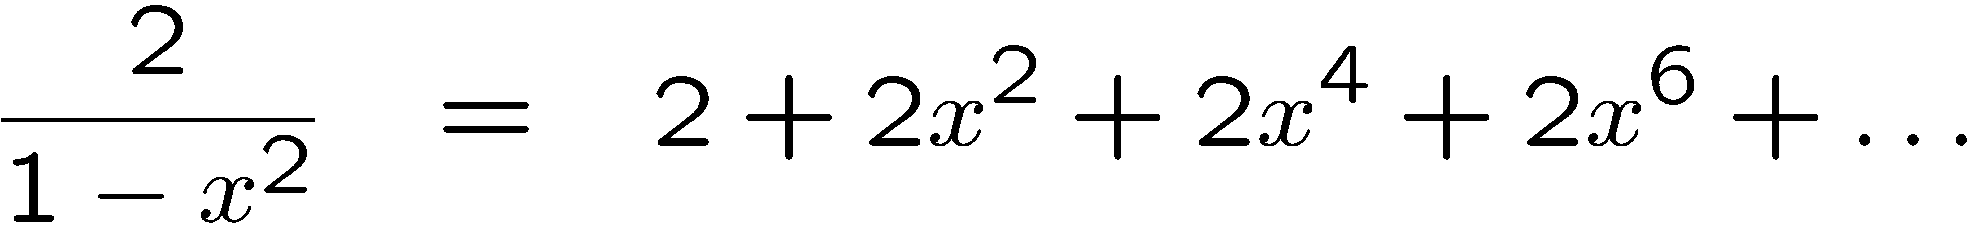

Scaling
Multiplying a generating function by a constant
=> scales every term in the associated sequence by the same constant.
Multiply the generating function by 2 gives
which generates the sequence:

Slide 11
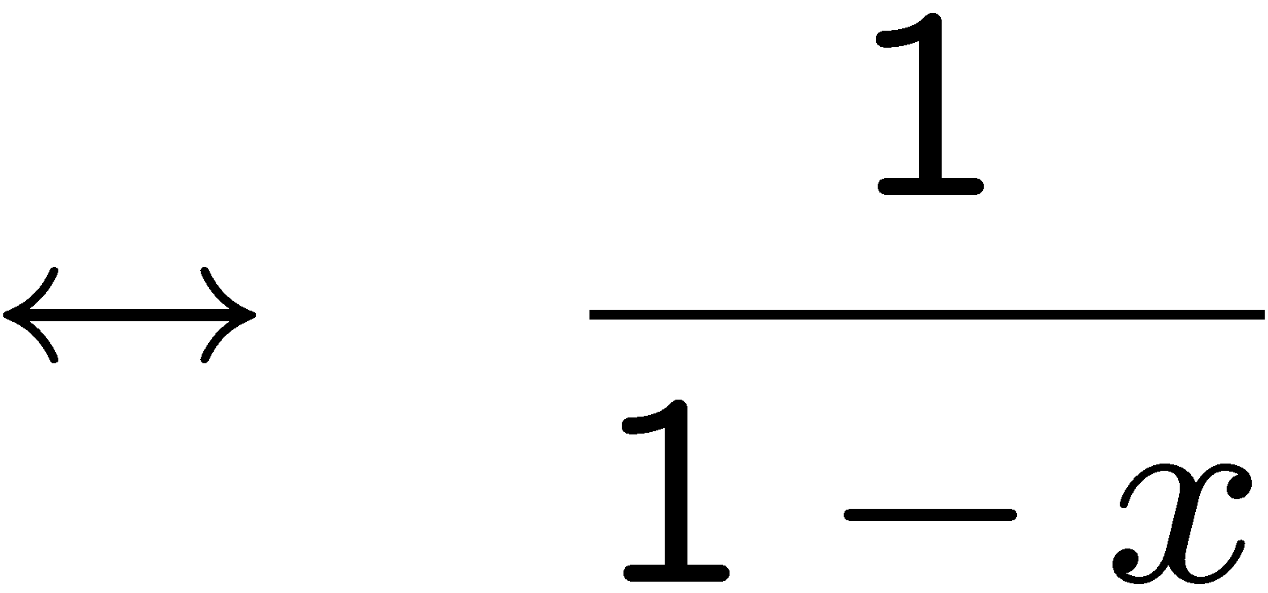
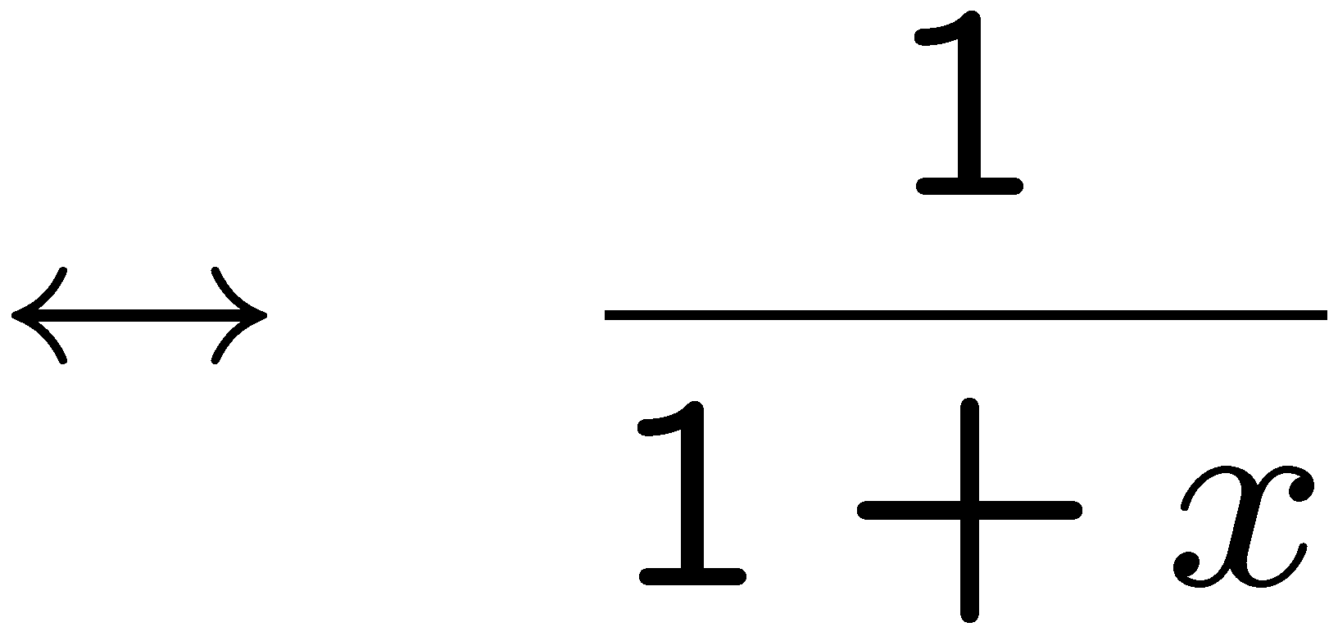
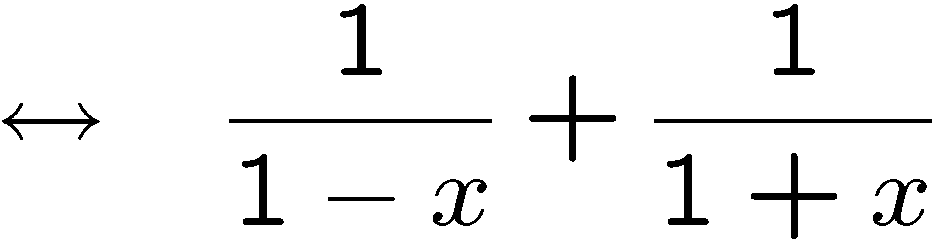
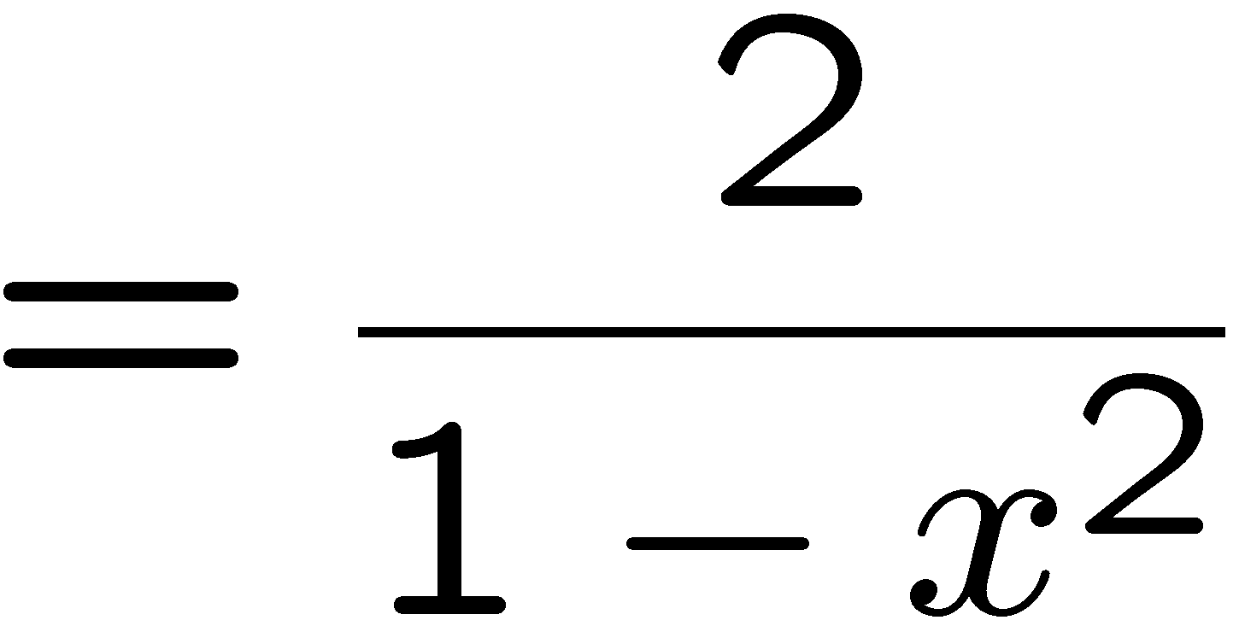
Addition
Adding generating functions corresponds to adding sequences term by term.
The same result as in the previous slide.

Slide 12
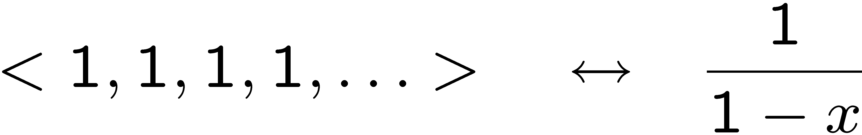

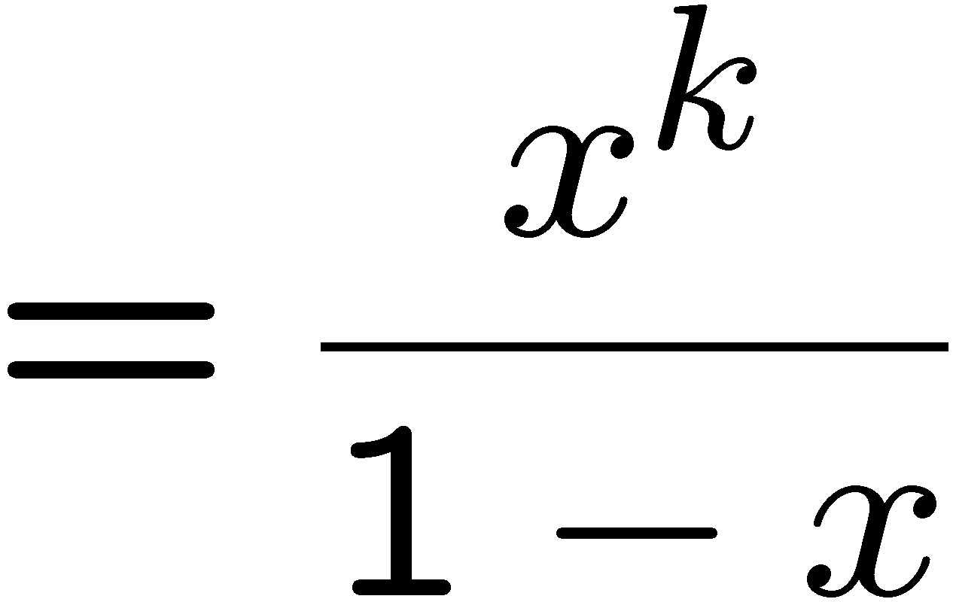
Right Shift
How to generate the sequence <0, 0, …, 0, 1, 1, 1, 1, 1…>?
k zeros
k zeros
Putting k zeros in front through k right shift
⬄ multiplying x^{k} on the generating function.

Slide 13
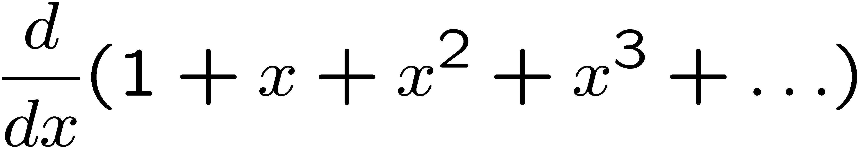
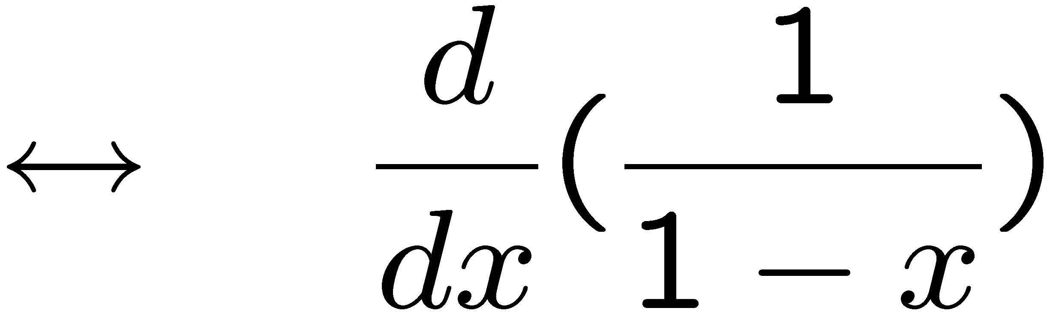
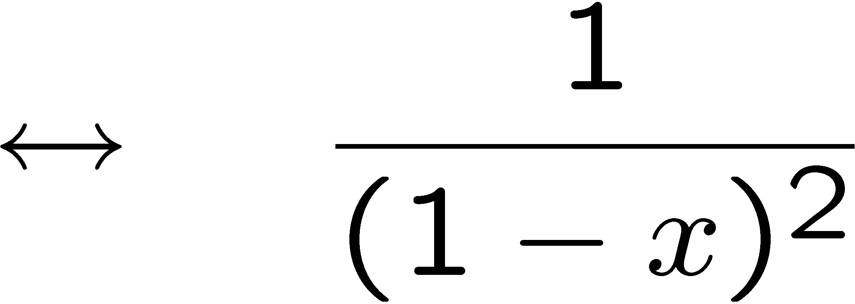
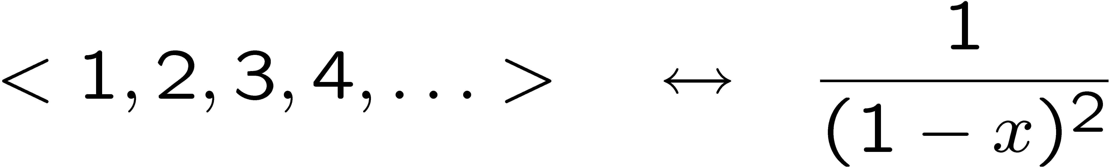
Differentiation
How to generate the sequence <1, 2, 3, 4, 5, …>?
The generating function is
How to obtain a closed form of this function?
We found a generating function for the sequence <1,2,3,…> of positive integers!

Slide 14
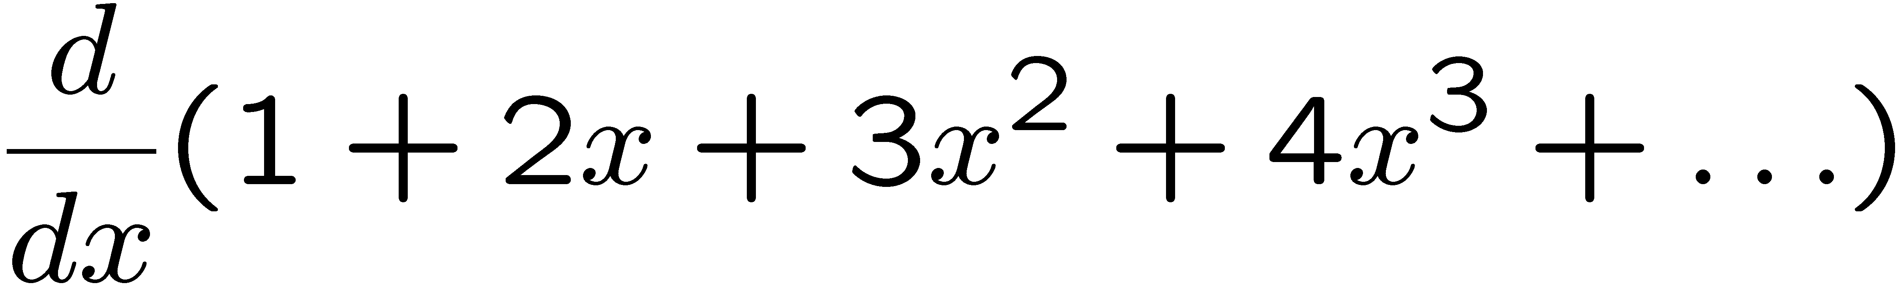
More Differentiation
How to generate the sequence <1, 4, 9, 16, 25, …>?
Nice idea. But not what we want.

Slide 15
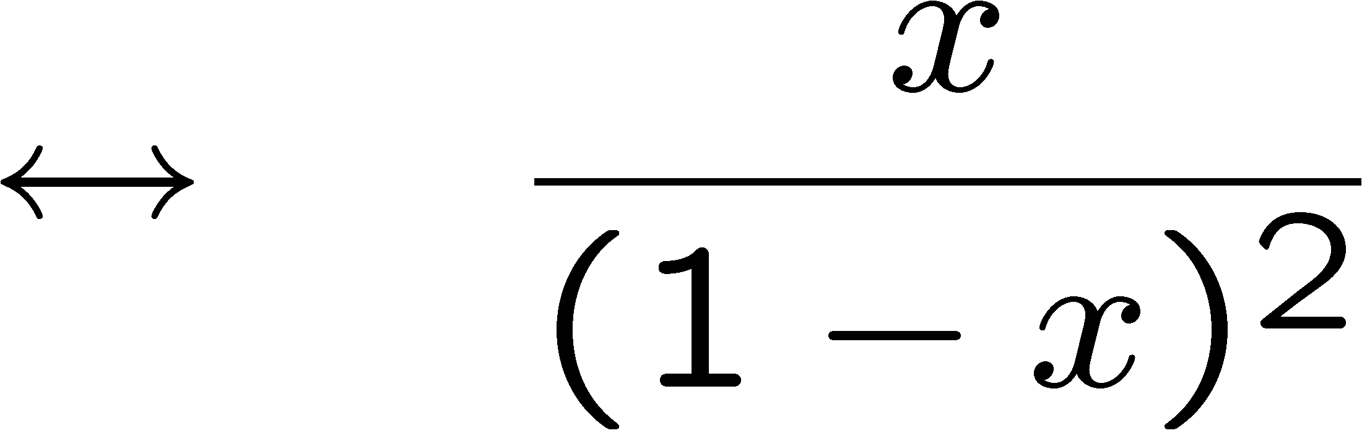
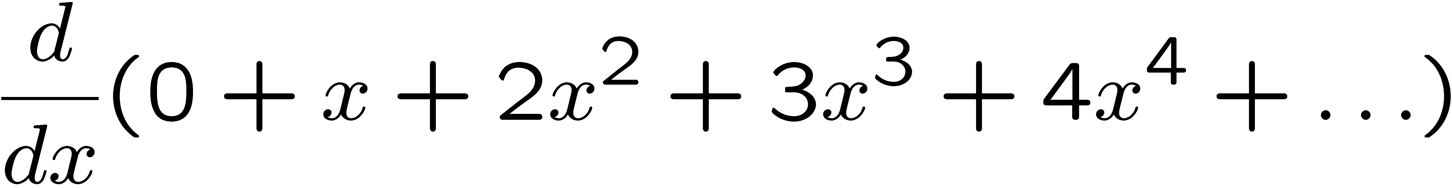
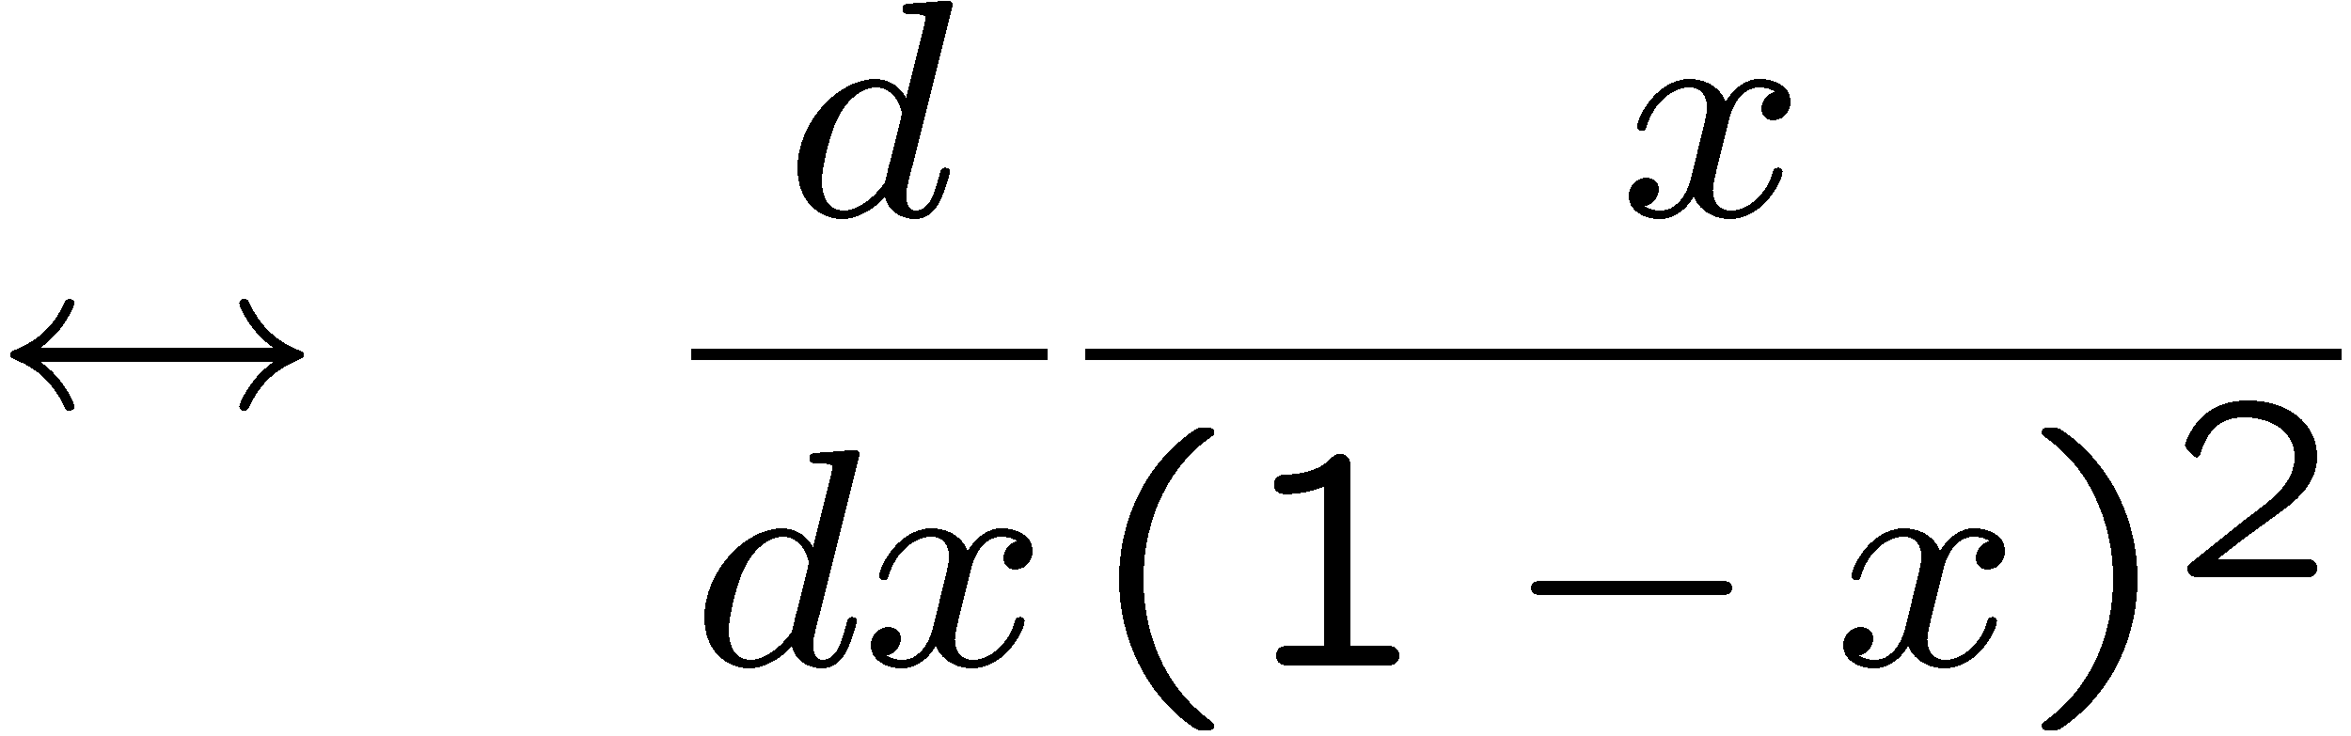
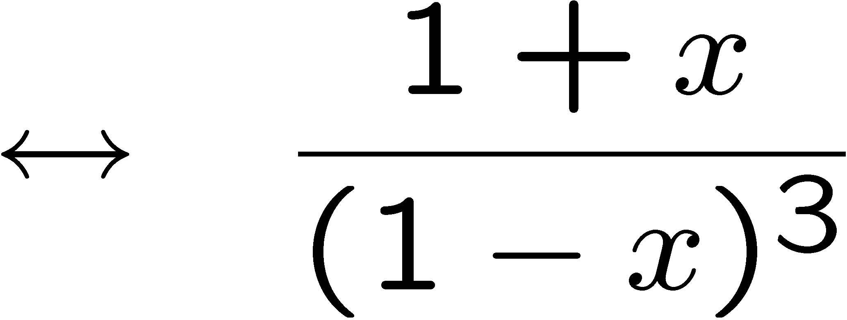
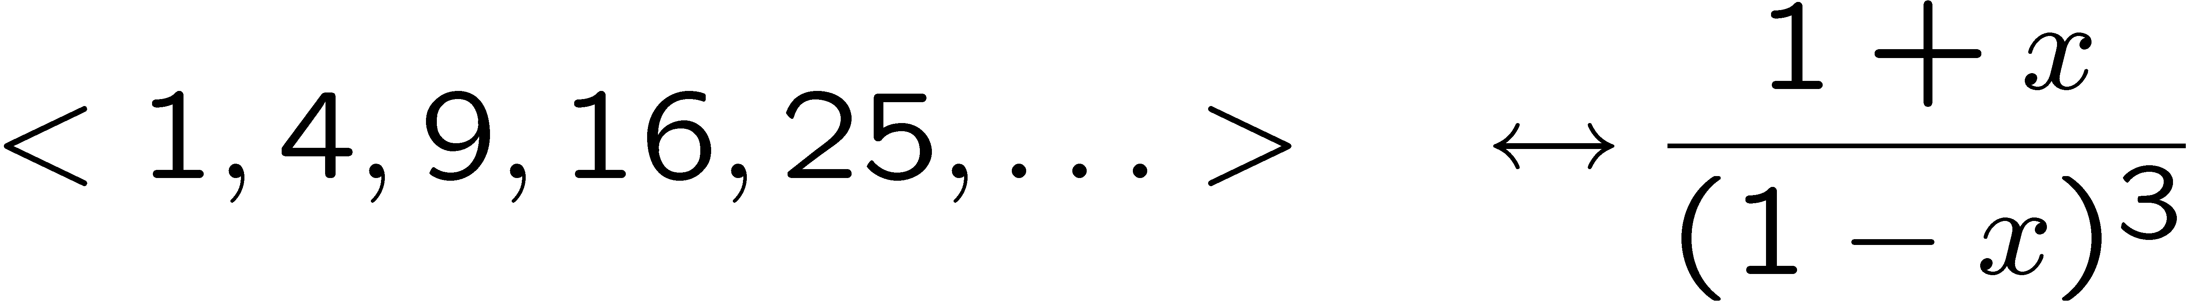
More Differentiation
How to generate the sequence <1, 4, 9, 16, 25, …>?
< 1, 2, 3, 4, … , >
2x,
3x² ,
4x³ , …,
Putting k zeros in front through k right shift
⬄ multiplying x^{k} on the generating function.
<0, 1, 2, 3, … , >
1x,
2x² ,
3x³ , …,

Slide 16
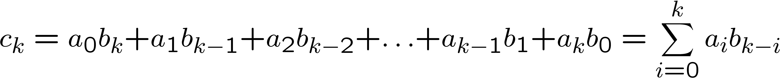
Product
What is the sequence corresponding to the polynomial C(x) = A(x)B(x)?
Coefficient of x³

Slide 17
Today’s Plan
Generating functions for basic sequences
Operations on generating functions
Counting
Solve recurrences

Slide 18
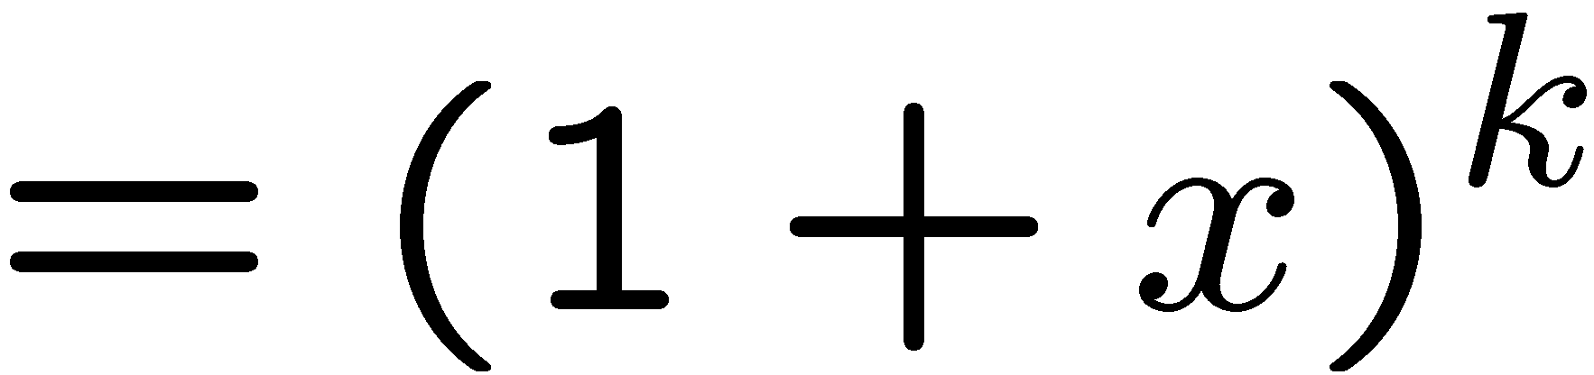
Counting with Generating Functions
General strategy:
coefficient of x^{n} = number of ways to choose n items.
A simple example:
the coefficient of x^{n} in (1 + x)^{k} is the number of ways
to choose n distinct items from a set of size k.

Slide 19
Convolution Rule
Let A(x) be the generating function for selecting items from set A.
Let B(x) be the generating function for selecting items from set B.
If A and B are disjoint,
then the generating function for selecting items from the union A U B
is the product A(x) · B(x).

Slide 20
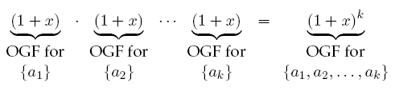
Choosing Subsets
Choose n items from k distinct elements {a1, a2, …, ak}
How many ways to choose from single element set {a1}?
There is one way to choose 0 item, one way to choose 1 element.
So the generating function for {a1} is <1, 1> ↔ (1+x)
So the generating function for {a2} is <1, 1> ↔ (1+x)
……………
By convolution rule, the generating function for
choosing items in a k-element set {a1,a2,…,ak} is:

Slide 21
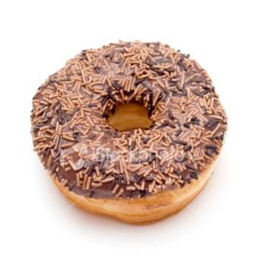
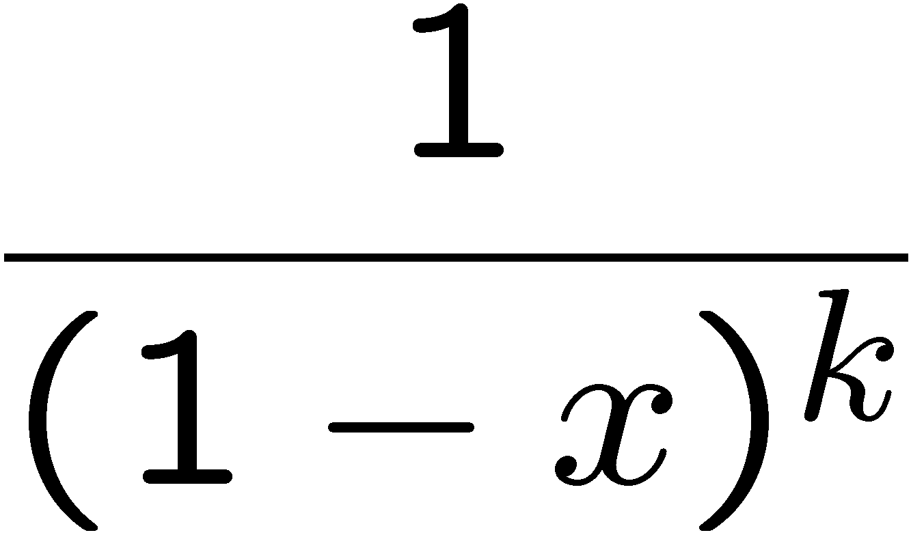
Choosing Doughnuts
How many ways can we select n doughnuts with k varieties?
Suppose there is only chocolate doughnuts.
How many ways can we select n doughnuts?
Well there is only one way to choose zero, one, two, three, ……, chocolate doughnuts.
So the generating function for choosing chocolate doughnuts is:
The generating function for choosing doughnuts with k varieties is:
By convolution rule:

Slide 22
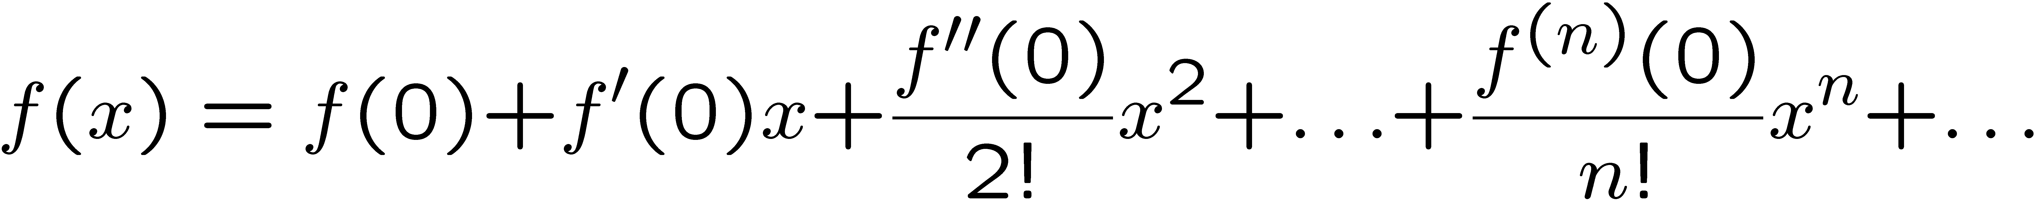
Choosing Doughnuts
The generating function for choosing doughnuts with k varieties is:
By convolution rule:
Now what? How do we obtain the answer?
Taylor’s Theorem
where f^{(n)}(x) is the n-th derivative of f(x).

Slide 23
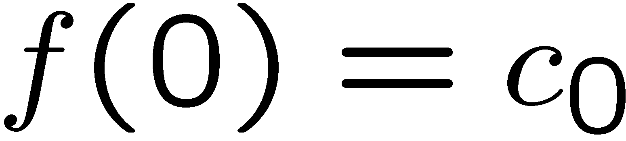
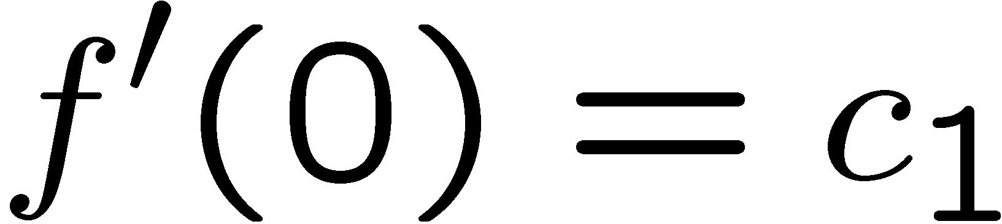
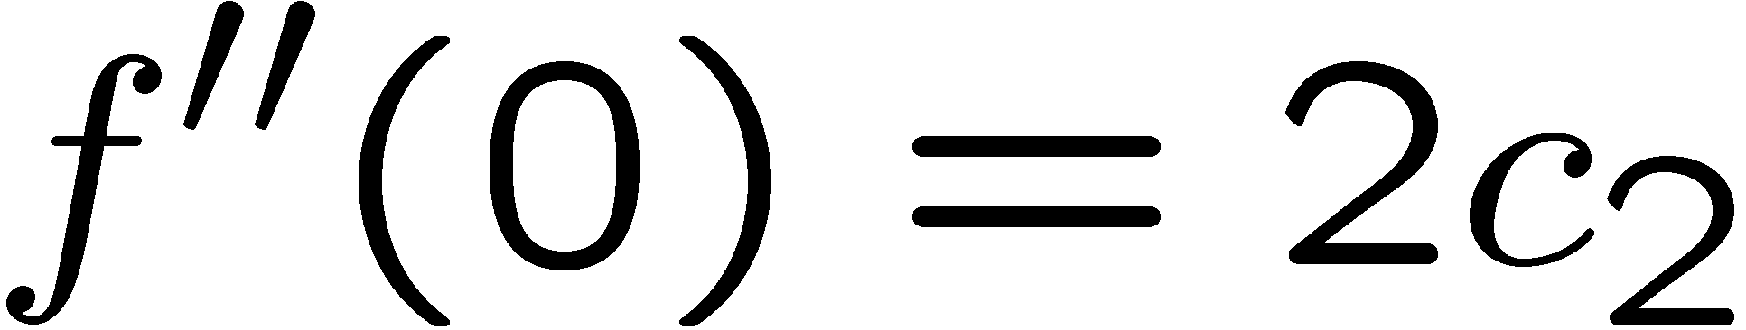
Taylor’s Theorem

Slide 24
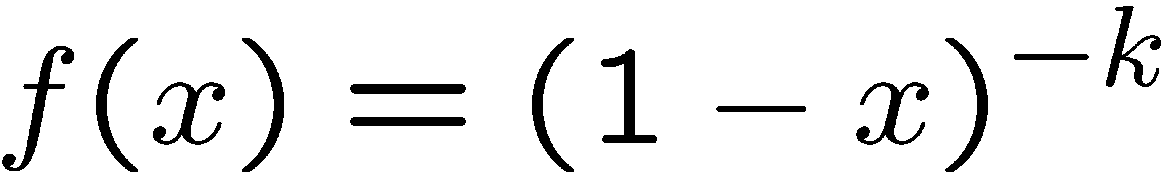
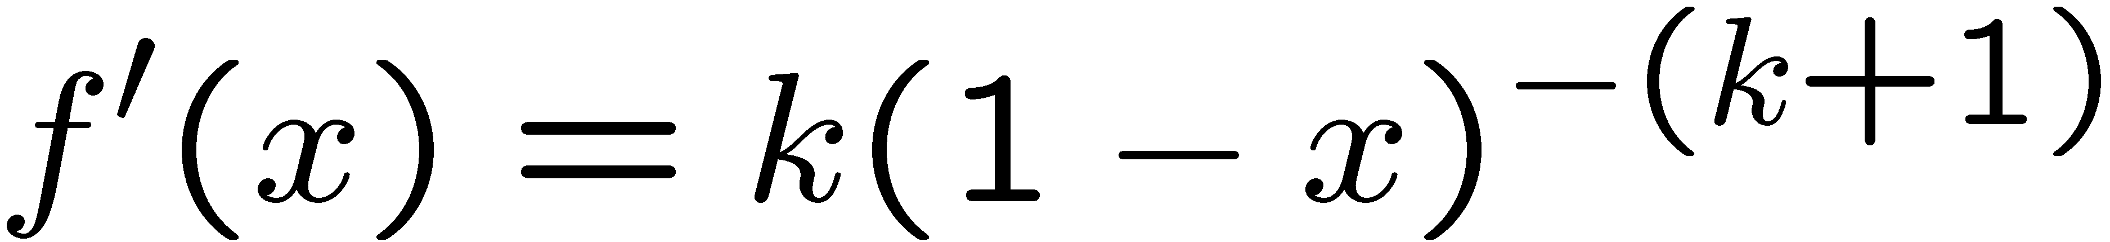
Choosing Doughnuts
The generating function for choosing doughnuts with k varieties is:
……

Slide 25
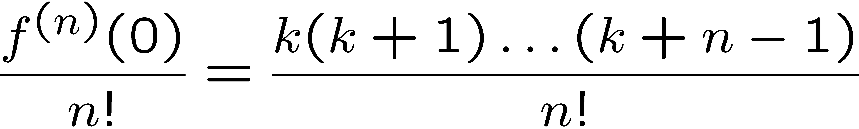
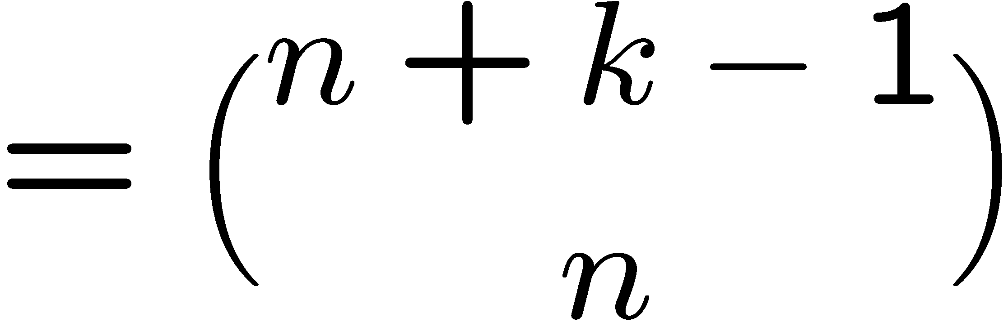
Choosing Doughnuts
The generating function for choosing doughnuts with k varieties is:
The number of ways to choose n doughnuts with k varieties is:
This is what we get before. Now there is a general method to derive it.

Slide 26
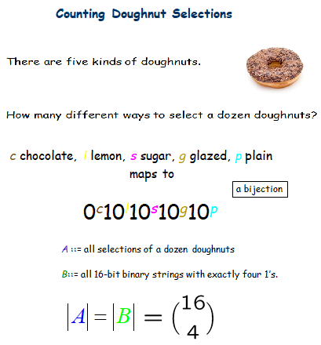
Choosing Doughnuts
The generating function for choosing doughnuts with k varieties is:
The number of ways to choose n doughnuts with k varieties is:
n = 12
k= 5
This is what we get before. Now there is a general method to derive it.

Slide 27
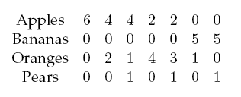
Choosing Fruits
This is an “impossible” counting problem…
How many ways can we fill a bag with n fruits with the following constraints?
• The number of apples must be even.
• The number of bananas must be a multiple of 5.
• There can be at most four oranges.
• There can be at most one pear.
For example, there are 7 ways to form a bag with 6 fruits

Slide 28
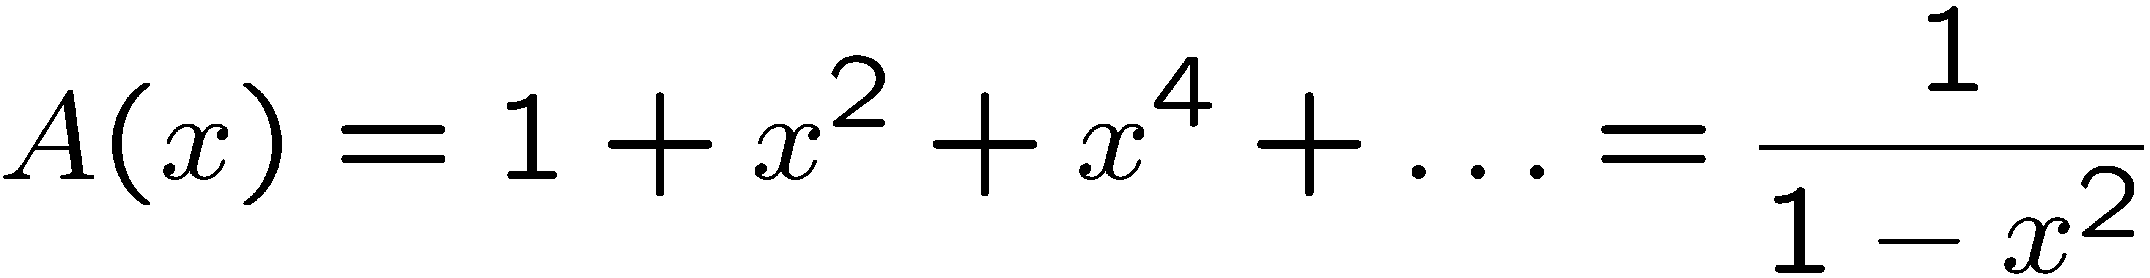
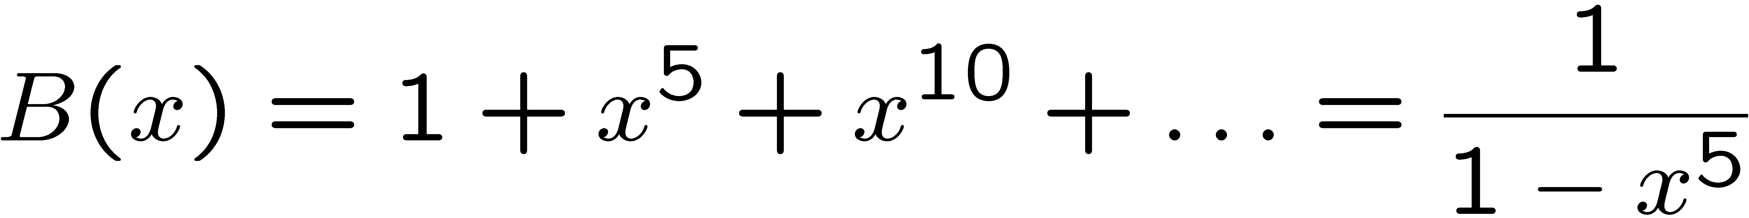
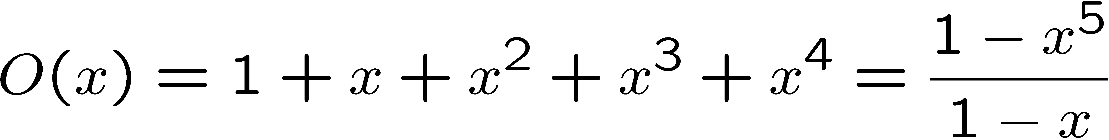
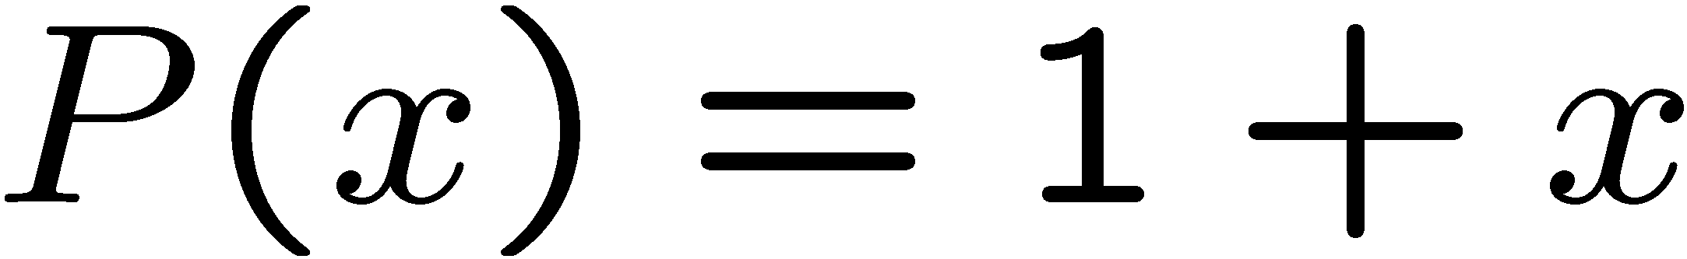
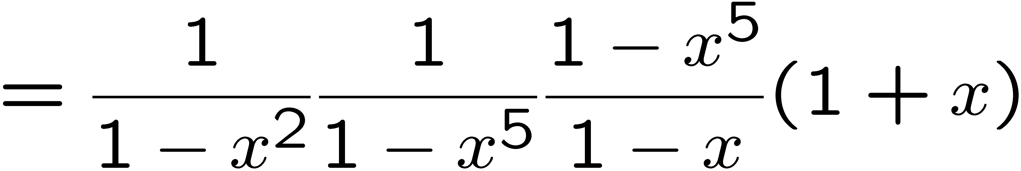
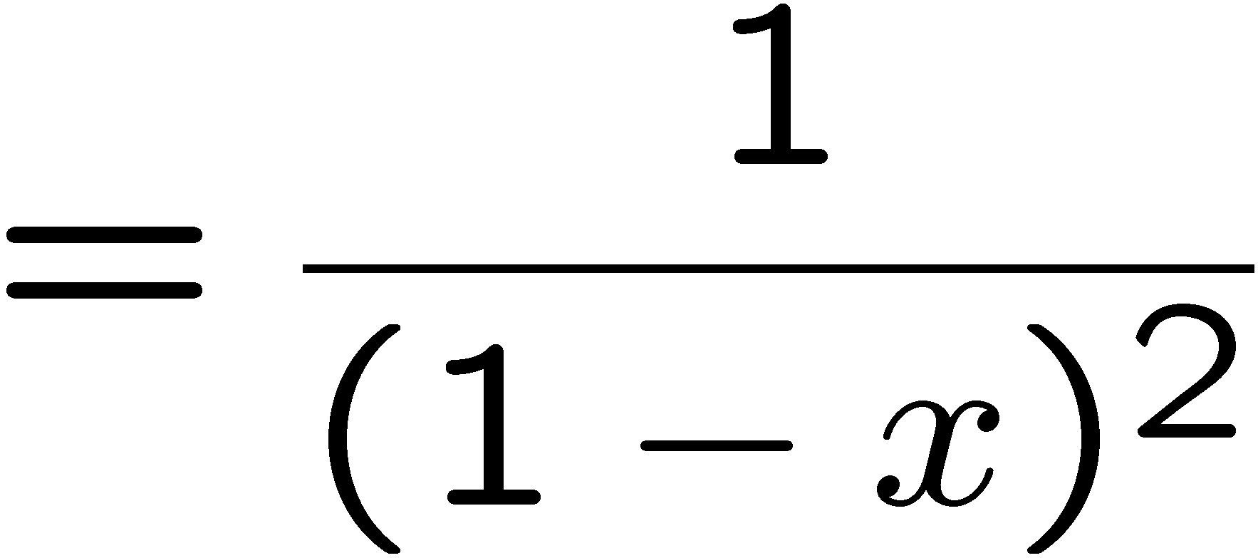
Choosing Fruits
• The number of apples must be even.
• The number of bananas must be a multiple of 5.
• There can be at most four oranges.
• There can be at most one pear.
GF for apples:
GF for bananas:
GF for oranges:
GF for pears:
By convolution rule
GF for fruits:

Slide 29
Choosing Fruits
Generating function for fruits:
How many ways can we fill a bag with n fruits with the following constraints?
The answer is exactly n+1
(as this is the coefficient of x^{n})
We solve an impossible counting problem in a routine way…

Slide 30
Today’s Plan
Generating functions for basic sequences
Operations on generating functions
Counting
Solve recurrences

Slide 31
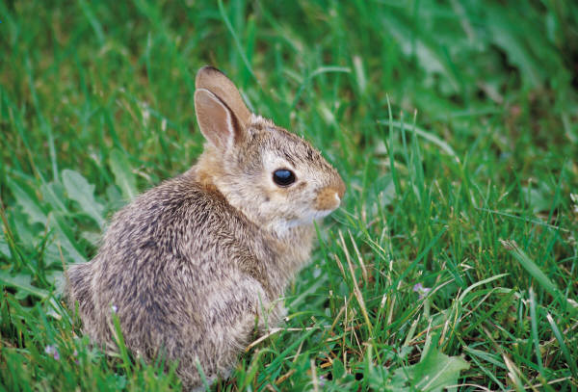
Solving Recurrences with Generating Functions
The Rabbit Population
A mature boy/girl rabbit pair reproduces every month.
Rabbits mature after one month.
w_{n}::= # newborn pairs after n months
r_{n}::= # reproducing pairs after n months
Start with a newborn pair: w₀ =1, r₀ = 0

Slide 32
Rabbit Populations
w_{n}::= # newborn pairs after n months
r_{n}::= # reproducing pairs after n months
r₁ = 1
r_{n} = r_{n-1} + w_{n-1}
w_{n} = r_{n-1} so
r_{n} = r_{n-1} + r_{n-2}
How many rabbits after n months?
It was Fibonacci who was studying rabbit population growth.

Slide 33
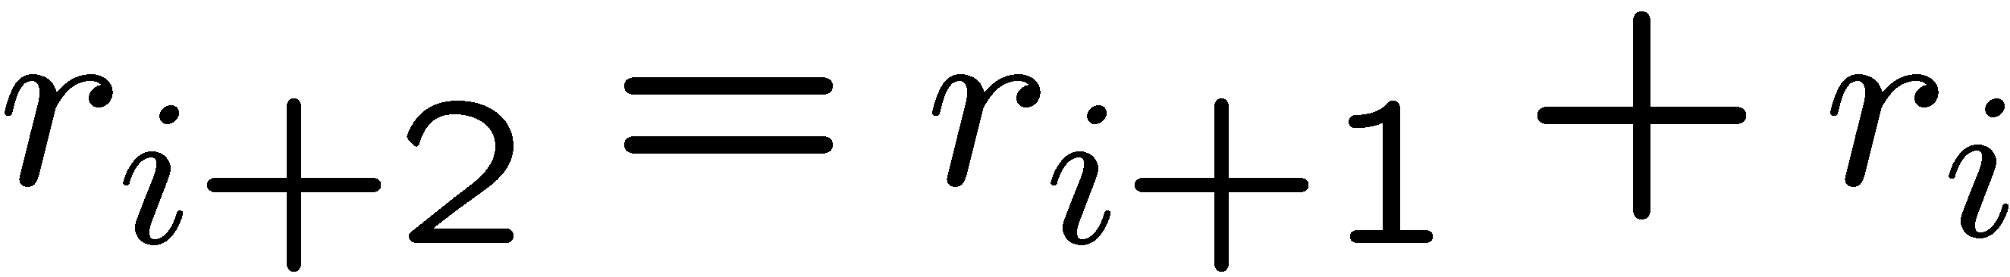
Fibonacci Sequence
The Fibonacci sequence we want to analyze is:
Define a generating function for this sequence:
Remember
First we want to obtain a closed form for R(x)

Slide 34
Generating Function for Rabbits
R(x)::= r₀+r₁x+r₂x² +r₃x³+…
-xR(x) = - r₀x-r₁x² -r₂x³ -…
-x²R(x) = -r₀x²-r₁x³-…
0
Remember

Slide 35
Generating Function for Rabbits
R(x)::= r₀+r₁x+r₂x² +r₃x³+…
-xR(x) = - r₀x-r₁x² -r₂x³ -…
-x²R(x) = -r₀x²-r₁x³ -…
0
0 …

Slide 36
Generating Function for Rabbits
R(x)::= r₀+r₁x
-xR(x) = - r₀x
-x²R(x) =
R(x)-xR(x)-x²R(x) =
r₀+r₁x-r₀x = x
=>R(x) = x/(1-x-x²)

Slide 37





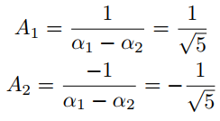

Closed Form for R(x)
What is the closed form of r_{n}?
We factor the denominator:
Next we find A₁ and A₂ such that:
How do you find the values of A₁ and A₂?
We plug in various values of x to generate linear equations in A₁ and A₂:

Slide 38
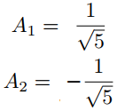


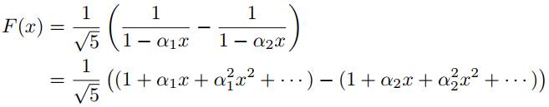
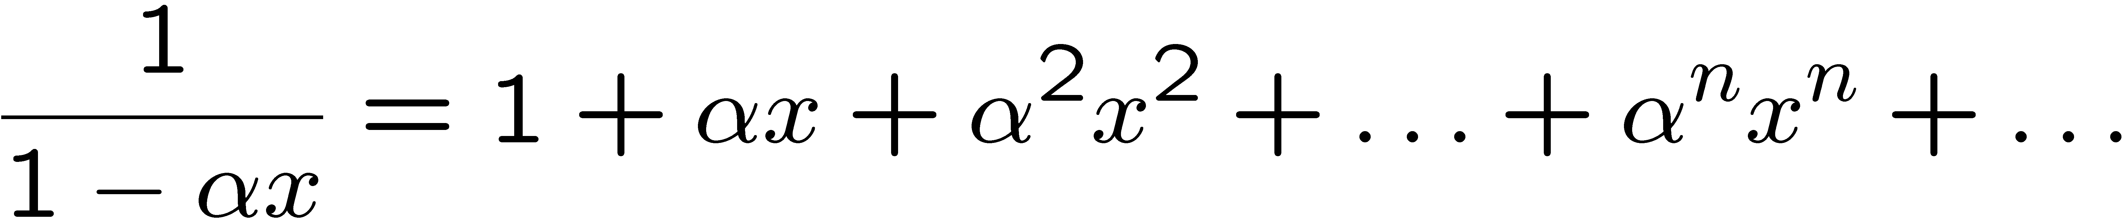
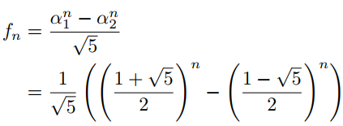
Closed Form for R(x)
What is the closed form of r_{n}?
We factor the denominator:
Next we find A₁ and A₂ such that:
closed form of r_{n}

Slide 39
Tower of Hanoi
Move_{1,2}(n)::= Move_{1,3}(n-1);
big disk 12;
Move_{3,2}(n-1)

Slide 40
Generating Function
s_{n}::=# steps by Move_{1,2}(n)
s_{n} = 2s_{n-1} + 1
s₀ = 0
The sequence we want to analyze is:
Define a generating function for this sequence:
First we want to obtain a closed form for S(x)

Slide 41
Generating Function
S(x)::= s₀+ s₁x+ s₂x² + s₃x³+…
-2xS(x)= -2s₀x-2s₁x² -2s₂x³-…
-x/(1-x)= -1x - 1x² - 1x³-…
0
0
0 …
s_{n} = 2s_{n-1} + 1
S(x) - 2xS(x) - x/(1-x) = s₀ = 0
Putting k zeros in front through k right shift
⬄ multiplying x^{k} on the generating function.

Slide 42

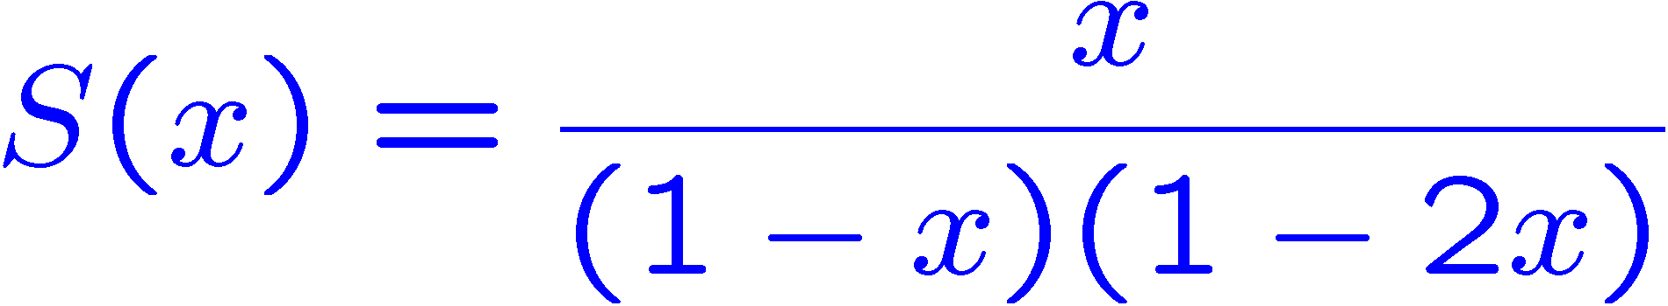


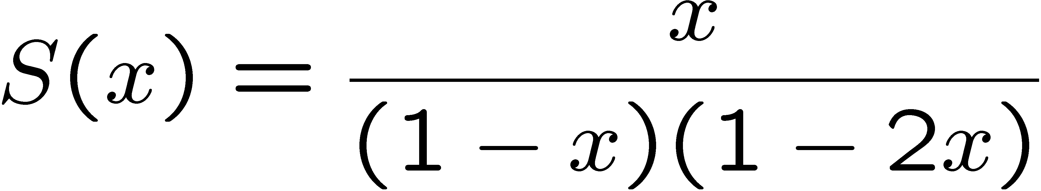
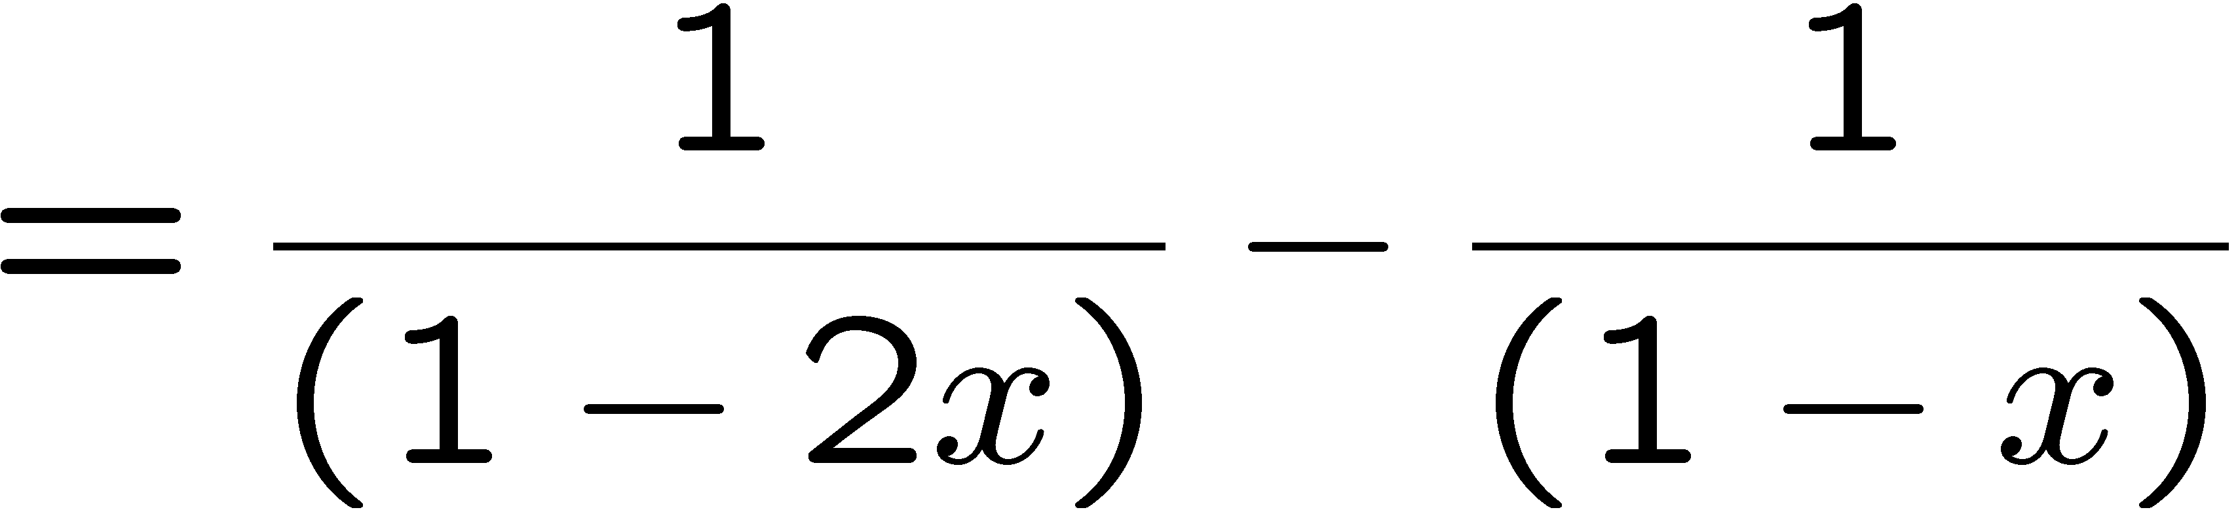
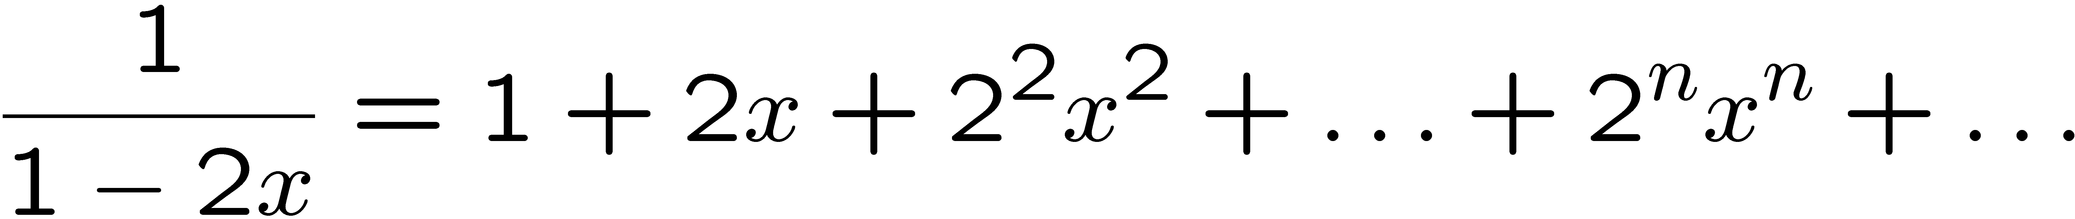
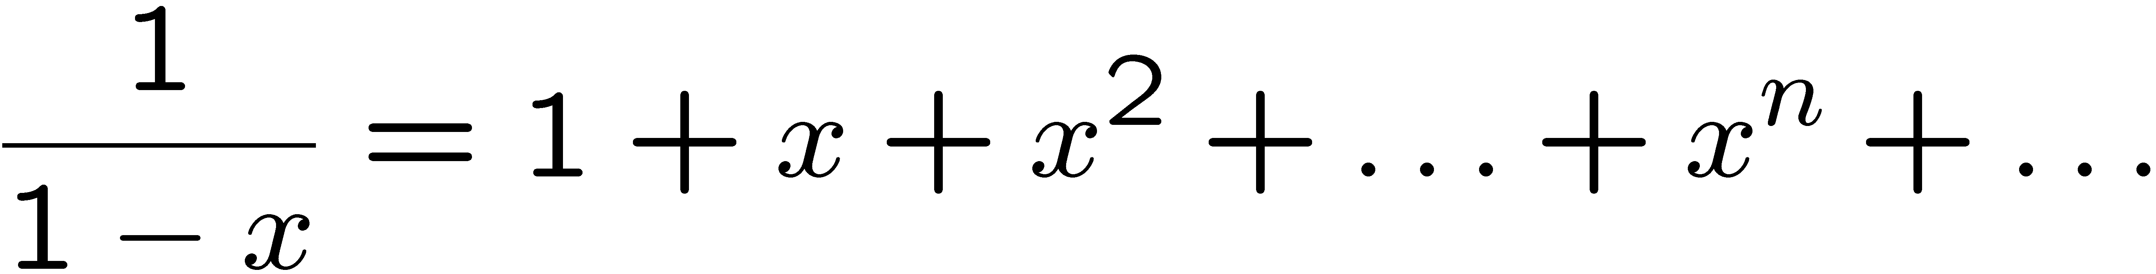
Closed Form for S(x)
S(x) - 2xS(x) - x/(1-x) = s₀ = 0
What is the closed form of s_{n}?
so s_{n} = 2^{n} - 1

Slide 43



Slide 44




We factor the denominator:
=>
=>
x=1 => a = -1
=>
x=1/2 => b = 2
So,

Slide 45

=
Coefficient of x^{n} is -1.
Coefficient of x^{n} is 2^{n+1}.

Slide 46

Find the coefficient of x¹⁷ in the expansion of
How can you get x¹⁷ using x⁵ and x⁷?
The only way is to take two x⁵ and one x⁷.
Since we are talking about:
, we have 20 multiplicands in a term
Ways to choose two x⁵ from 20 multiplicands:
Subsequently, ways to choose one x⁷ from the rest:
So, the coefficient of x¹⁷ is:
You could have done is the other way: =

Slide 47
There are 60 students in this class. Now, 6 of you are to be selected to represent this class in an event. How many ways are there to select them?
We easily can say the answer is:
Can we compute this using Generating Function, G(x)?
Each student can either be
not selected
or
selected.
So, the generating function for each student is 1 + x
Therefore , by convolutional rule, G(x) = (1 + x)⁶⁰
So, the answer is the coefficient of x⁶ =
x⁰ ↔ occupies 0 place
x¹ ↔ occupies 1 place.

Slide 48





How many integer solutions to the equation a + b + c = 6 satisfy
-1 <= a <= 2 and
1 <= b, c <=4?
Variable a contributes:
Variable b contributes:
Variable c contributes:
A
B
How can we get the coefficient of x⁶?
Case 1: x⁵ @ A × x¹ @ B =>
Case 2: x¹ @ A × x⁵ @ B =>

Slide 49






Coefficient of
x³ is 0
In the numerator of
x² is 0
x¹ is 0
x⁰ is 1

Slide 50







What will be the closed form of:
Putting x = 0 in G(x)
= 0
Putting x = 0 in

Slide 51


There are 30 identical souvenirs, to be distributed among the 50 trainees, and each trainee may get more than one souvenir. How many ways are there to distribute the 30 souvenirs among the 50 trainees?
Each student may get 0 OR 1 OR 2 OR … souvenirs, thus contributing a factor of:
We need to compute the coefficient of x³⁰
the coefficient of x³⁰ is:

Slide 52
There are 20 bags, each containing a $5 coin and a $7 coin. You can use at most one coin from each bag, in how many different ways can we pay $17, assuming that all coins are distinguishable (i.e. the $5 coin from the first bag is considered to be different from that in the second bag, and so on)?
How to pay $17?
You have to use two $5 coins and one $7 coin.
How many ways to choose two $5 coins from the 20 bags?
How many ways to choose a $7 coin from the remaining 18 bags?
So, the result is
This is in fact the coefficient of x¹⁷ in

