Slide 1

SUST_AGILE_TEAM
Solution Review
9.24.XX

Slide 2
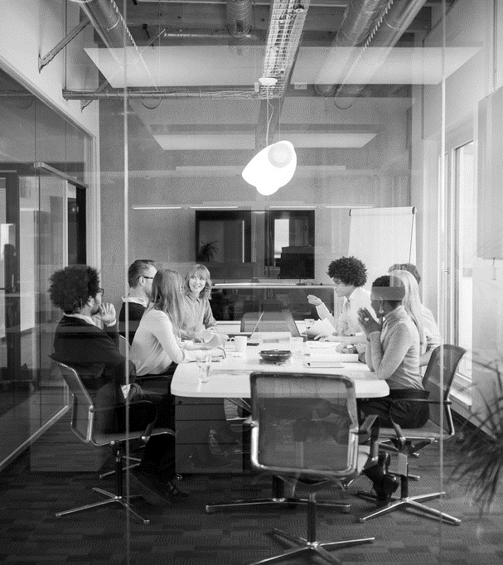
Agenda
The Problem
Problem Statement
Solution Proposal
Objective
Technology Stack
Blah blah added later

Slide 3
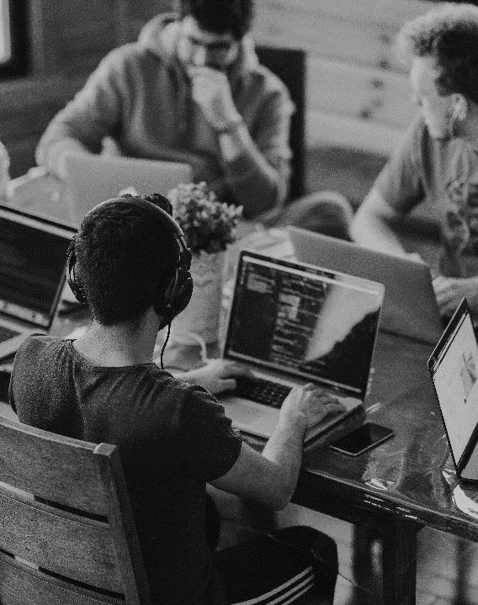
INTRODUCTION
The Problem
If someone purchases a ticket from a train and for some reason is unable to make the journey, the seat remains officially empty for the rest of the whole journey.
It causes a lot of people to suffer and wastage of resource, although they could have travelled in that seat.
For instance,
If I issue a ticket from Dhaka to Sylhet and cannot make the journey, then a person who needs to travel from Brahmanbaria to Sylhet can easily go in the seat that I booked. But due to the lack of a proper management system, he is unable to get that ticket.
Scope : Transport Efficiency In Bangladesh

Slide 4
BRIEF DISCUSSION ON
The Solution
Online Ticket Service
Transactions between :
Server and user
User and user
If someone cancels a ticket, this will be informed to the first user of the queue who requested for a ticket.
Transaction between the two users and the user can also travel with the ticket from his station.

Slide 5

C U T T I C K
Let’s Dive In

Slide 6
F E A T U R E
Purchasing e-Tickets.
Directly Selling e-Tickets to another end user if someone is unable to travel with a ticket.
If someone is unable to make the journey then, he can cancel the ticket and this will be informed through email or SMS to all the users who had requested for the ticket.
If any user buy the ticket, there will be a transaction between these two users. Thus, the user who could not travel will also get a refund. Along with that, user also gets a seat.
An user will get an email or SMS to confirm their onboarding and ask him to cancel the ticket if he is unable to travel for some reason at the same time of the train departure.

Slide 7
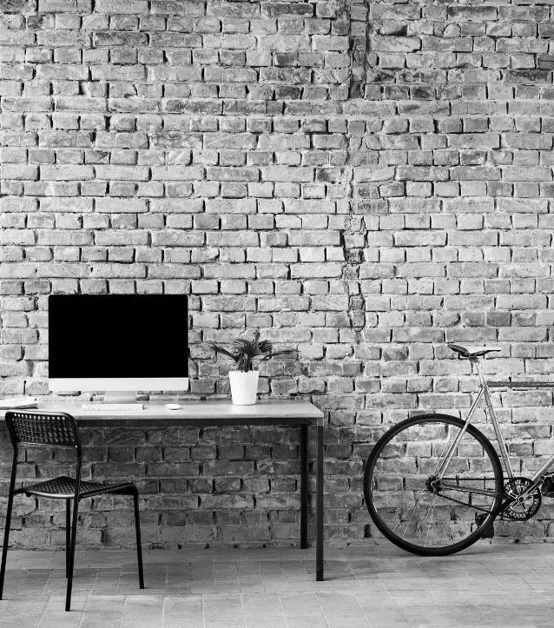
TECHNOLOGY STACK
ANDROID CLIENT : Flutter
WEB CLIENT : React.js
WEB SERVER : Node.js
DATABASE : MongoDB
VERSION CONTROL : Git
COLLABORATION : Github

Slide 8
System architecture
User
Server

Slide 9
prototype
Database (SQL for transactions and strong consistency)
Ticket purchasing(For any kind of monetary transactions we will be using a wallet point in the prototype).
Ticket requesting system.
Ticket cancellation and sending notifications to the requested users.
Lock based protocol for handling concurrency in transactions.

Slide 10


No unused tickets
Beneficial for both the kind of users :
User who is getting a refund when unable to travel.
User who is getting the ticket can travel legally.
Minimizes wastage of railway resources

Slide 11
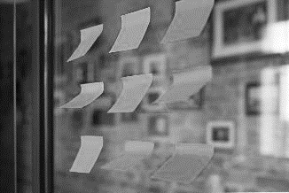
Not fully refundable
BUT
WE HAVE A SOLUTION!!

Slide 12
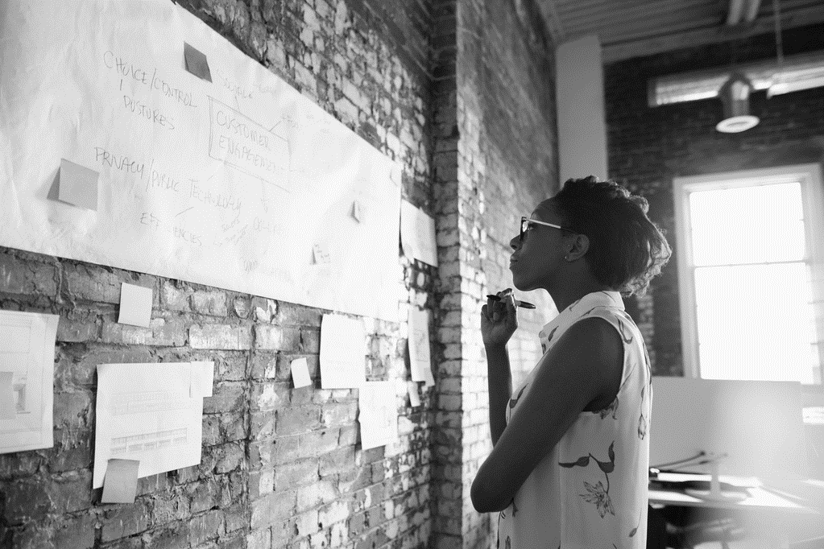
Apply Blockchain Technology
Expandable

Slide 13

HACKING !!

Slide 14
SWOT ANALYSIS
Strength | Weakness | Opportunity | Threat
No unused ticket in the train Beneficial for both the kind of users Minimizes wastage of railway resources. | Not fully refundable at times | Application of Blockchain Technology Expandable | Hacking Threat in database usage

Slide 15
Growth by sector
 | Q1 | Q2 | Q3 | Q4
SERIES 1 | 4.3 | 2.5 | 3.5 | 4.5
SERIES 2 | 2.4 | 4.4 | 1.8 | 2.8
SERIES 3 | 2 | 2 | 3 | 5

Slide 16


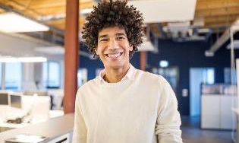
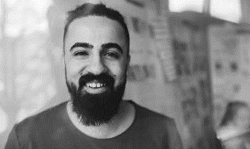
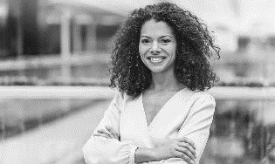
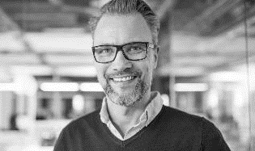
Meet the team
ZHALOK RAHMAN
CEO
NAHIAN BEENTE FIRUJ
CFO
RIDDHIMAN SWANAN DEBNATH
CTO
TITHI SAHA SARA
CPO
FARZANA REEFAT RAHA
CMO

Slide 17
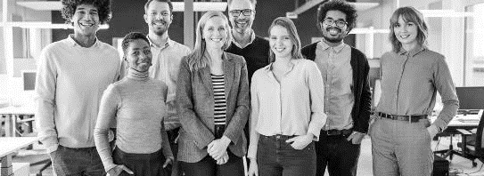
Goals for q2
EMPLOYEE OPPORTUNITIES
BUSINESS PRIORITIES
End of fiscal celebration on July 15th
Employee day of learning on August 14th
Employee Yoga on September 3rd
Seminar series begins September 10th
Increase customer satisfaction by 2%
Maintain growth
Initiative partnership with 3rd party organizations

Slide 18


Goals for q2
BUSINESS PRIORITIES
Increase customer satisfaction by 2%
Maintain growth
ADDED PRIORITIES
Improve social media presence
Ensure the cost of development stays below budget
EMPLOYEE OPPORTUNITIES
Interns begin
Indoor rec leagues
Chess tournaments
Big Game watching party

Slide 19
SUMMARY
OUR BUSINESS IS GOOD
Profits are up in the last quarter by 3%
WE’RE GETTING OUR WORK DONE
We finished the consolidation project
WE’RE DELIVERING FOR OUR CUSTOMERS
Customer satisfaction increased from 70 to 80%
OUR CUSTOMERS KEEP COMING BACK
We increased customer retention by 4%

Slide 20



THANK YOU
VICTORIA LINDQVIST
+1 (589) 555-0199
victoria@fabrikam.com
WWW.FABRIKAM.COM

