Slide 1

SUST_AGILE_TEAM
Solution Review

Slide 2
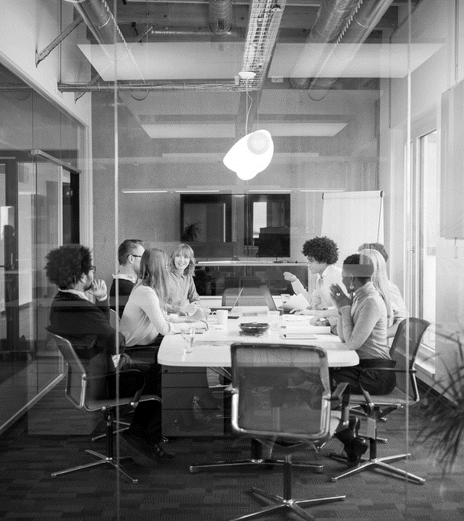
Agenda
The Problem
Solution Proposal
Feature
Technology Stack
System Architecture
Prototype
SWOT Analysis

Slide 3
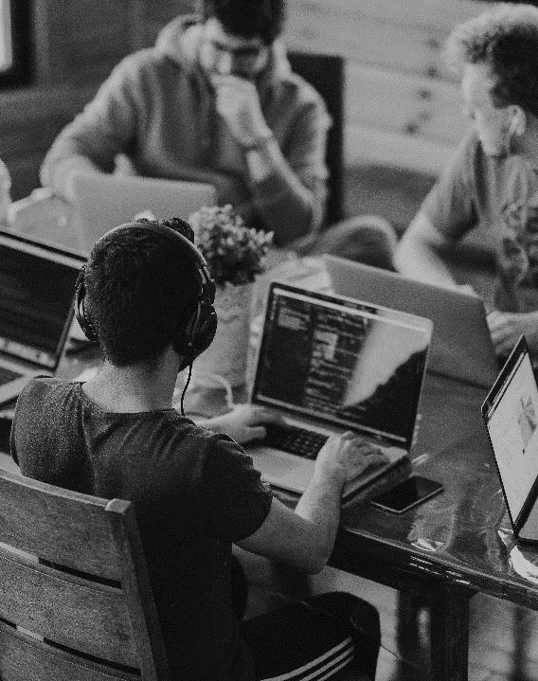
INTRODUCTION
The Problem
If someone purchases a ticket from a train and for some reason is unable to make the journey, the seat remains officially empty for the rest of the whole journey.
It causes a lot of people to suffer and wastage of resource, although they could have travelled in that seat.
For instance,
If I issue a ticket from Dhaka to Sylhet and cannot make the journey, then a person who needs to travel from Brahmanbaria to Sylhet can easily go in the seat that I booked. But due to the lack of a proper management system, he is unable to get that ticket.
Scope : Transport Efficiency In Bangladesh

Slide 4
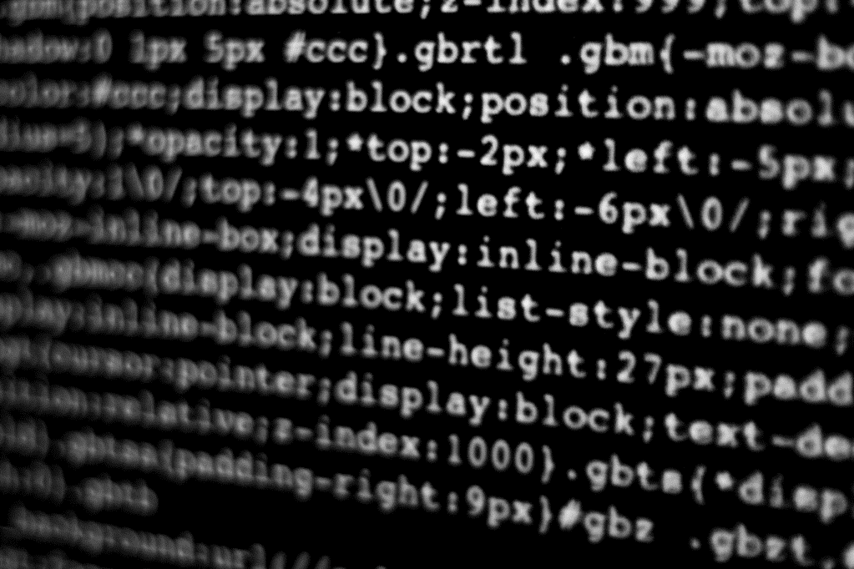
C U T T I C K
Let’s Dive In

Slide 5
BRIEF DISCUSSION ON
The Solution
Online Ticket Service
Transactions between :
Server and user
User and user
If someone cancels a ticket, this will be informed to the first user of the queue who requested for a ticket.
Transaction between the two users and the user can also travel with the ticket from his station.

Slide 6
F E A T U R E
Purchasing e-Tickets.
Directly Selling e-Tickets to another end user if someone is unable to travel with a ticket.
If someone is unable to make the journey then, he can cancel the ticket and this will be informed through email or SMS to all the users who had requested for the ticket.
If any user buy the ticket, there will be a transaction between these two users. Thus, the user who could not travel will also get a refund. Along with that, user also gets a seat.
An user will get an email or SMS to confirm their onboarding and ask him to cancel the ticket if he is unable to travel for some reason at the same time of the train departure.

Slide 7
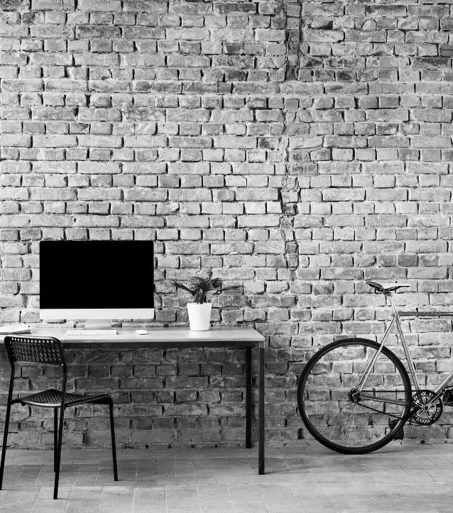







TECHNOLOGY STACK
ANDROID CLIENT :
WEB CLIENT :
WEB SERVER :
DATABASE :
Payment Gateway :
VERSION CONTROL :
COLLABORATION :

Slide 8
System architecture
User
Server

Slide 9
prototype
Database (SQL for transactions and strong consistency)
Ticket purchasing(For any kind of monetary transactions we will be using a wallet point in the prototype).
Ticket requesting system.
Ticket cancellation and sending notifications to the requested users.
Lock based protocol for handling concurrency in transactions.

Slide 10
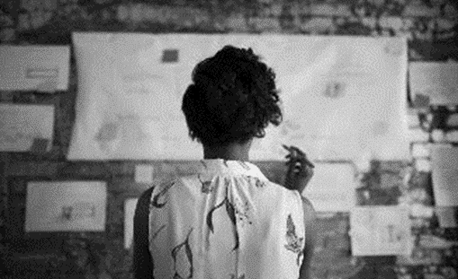

No unused tickets
Beneficial for both the kind of users :
User who is getting a refund when unable to travel.
User who is getting the ticket can travel legally.
Beneficial for government
Minimizes wastage of railway resources and elimination of corruption

Slide 11
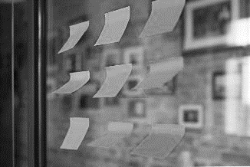
Not fully refundable
BUT
WE HAVE A SOLUTION!!

Slide 12
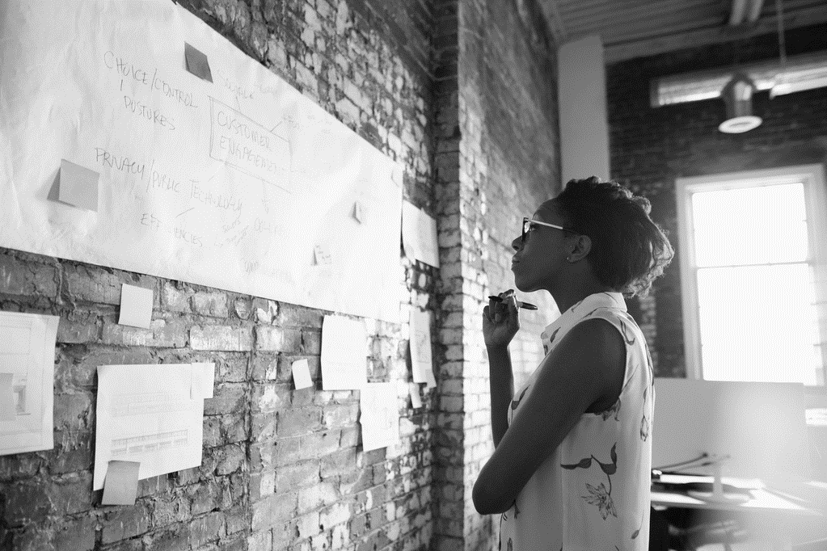
Application of Blockchain Technology
Scalable

Slide 13

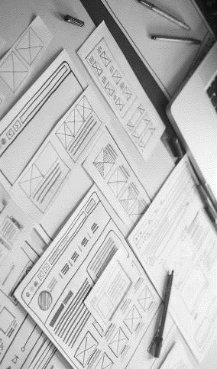
So what are our threats and how do we tackle them?
HACKING !!
BUT WE CAN TACKLE IT TOO

Slide 14
SWOT ANALYSIS
Strength | Weakness | Opportunity | Threat
No unused ticket in the train Beneficial for both the kind of users Minimizes wastage of railway resources. | Not fully refundable at times | Application of Blockchain Technology Expandable | Hacking Threat in database usage

Slide 15
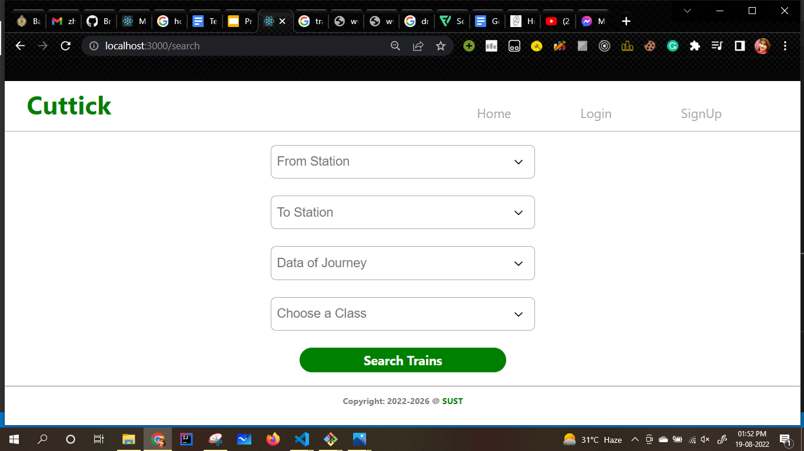
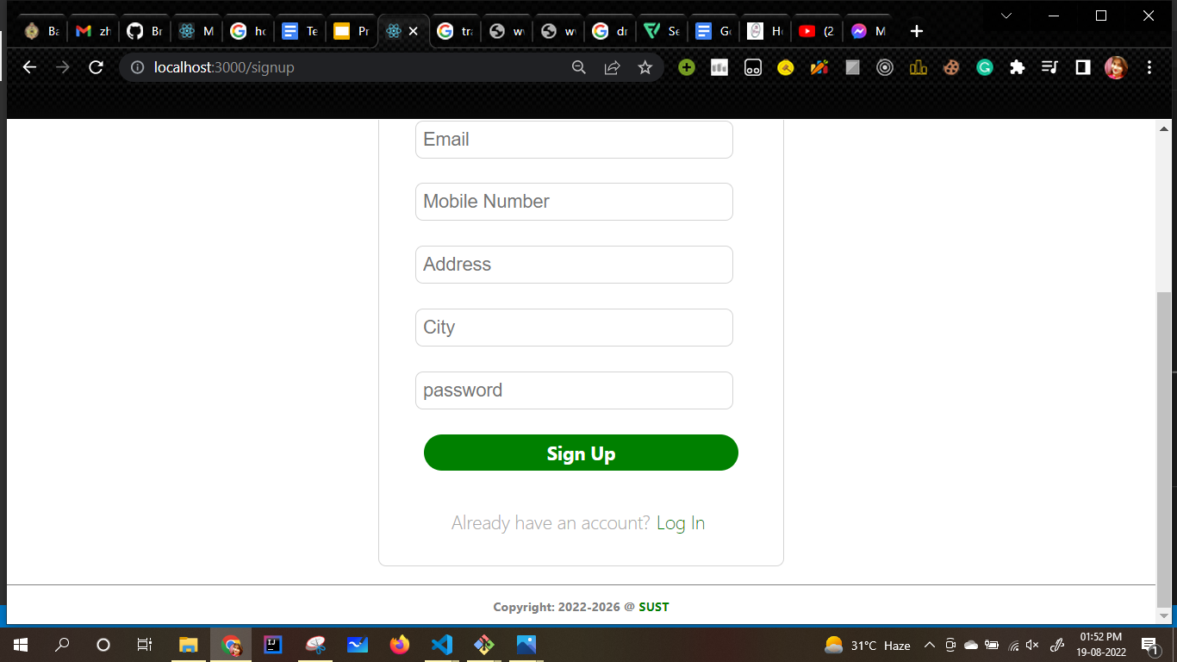
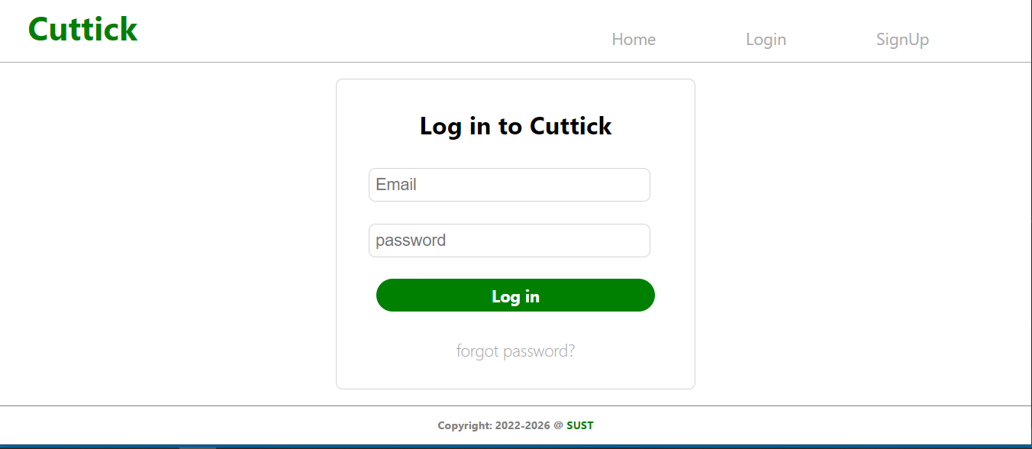
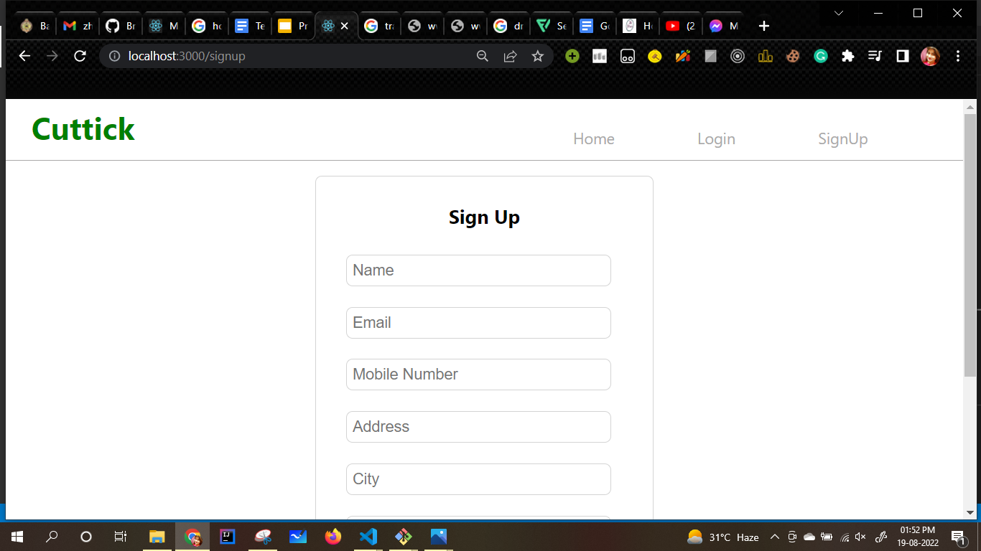
Functionalities of our web application

Slide 16
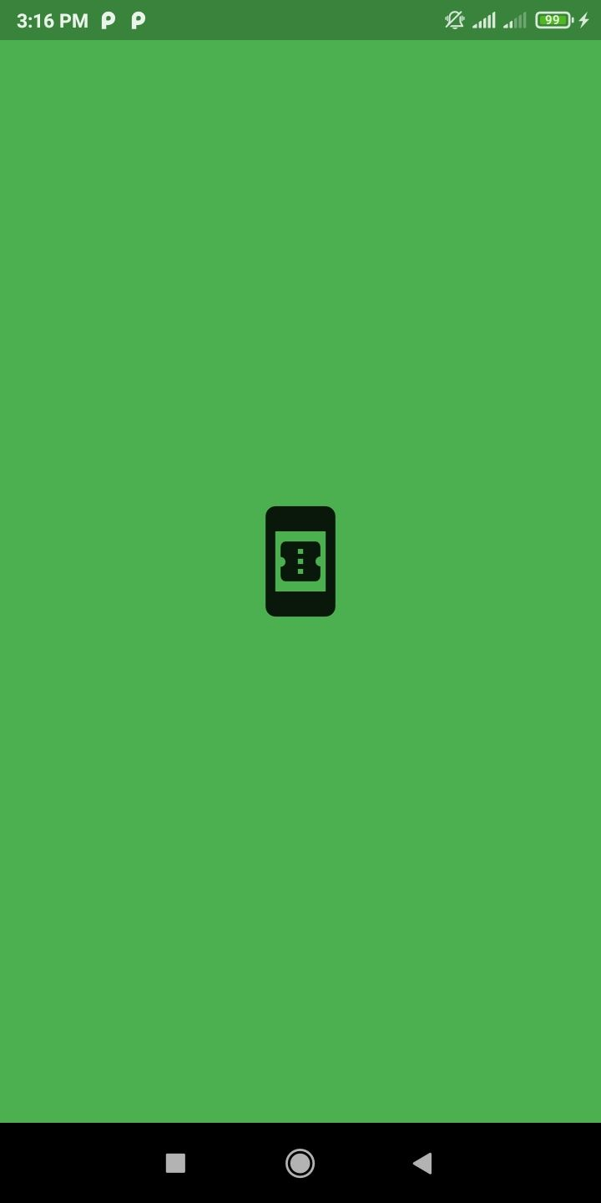
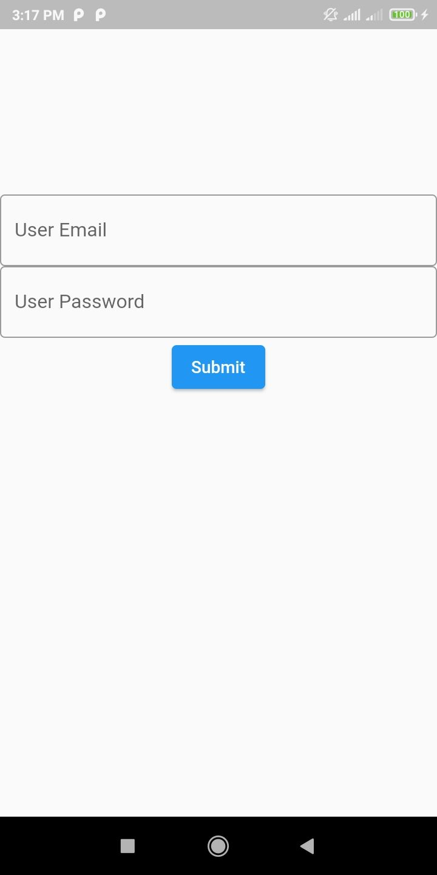
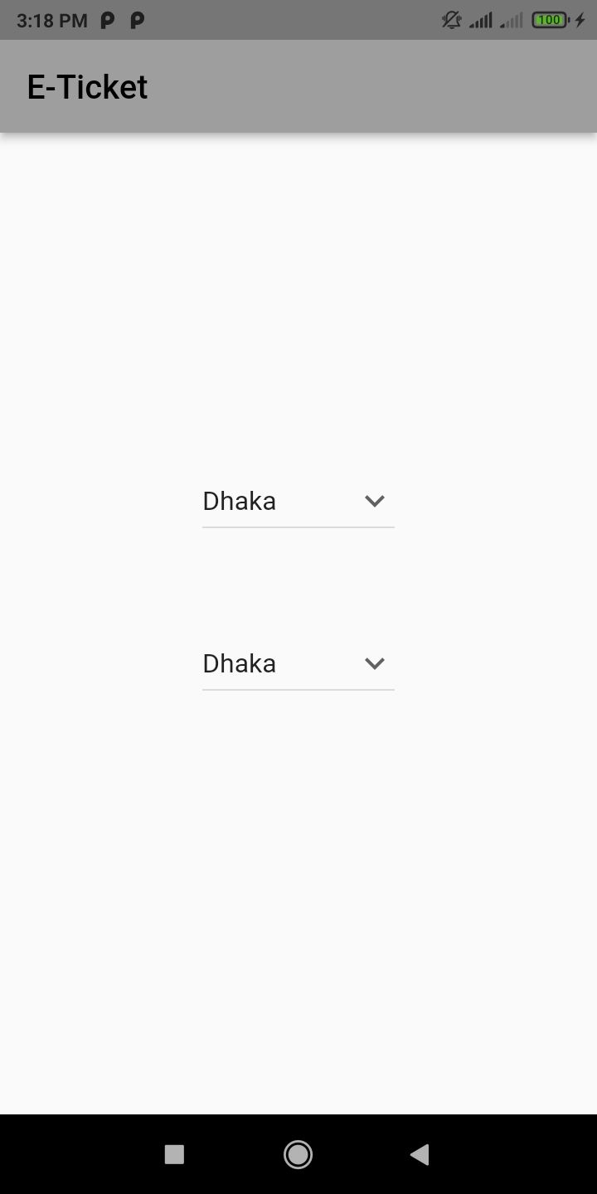
Layout of our android app

Slide 17
SUMMARY
MAKE TRAIN JOURNEY EASIER
As there will be NO unused tickets.
ATTRACT MORE CUSTOMERS
As it will minimize resource wastage and customer can easily refund.
BENEFICIAL FOR CUSTOMERS
As user who cannot travel can get refund and the other user who gets the ticket can travel legally.
INCREASES GOVERNMENT TRANSPARENCY
As this technology will reduce black-market of tickets at a larger scale, it will help government to ensure transparency.
INCREASES EMPLOYMENT AND RESEARCH SCOPE
As Blockchain Technology can be applied to this technology, hence hiring of blockchain engineers will increase employment and elevate research scope.

Slide 18
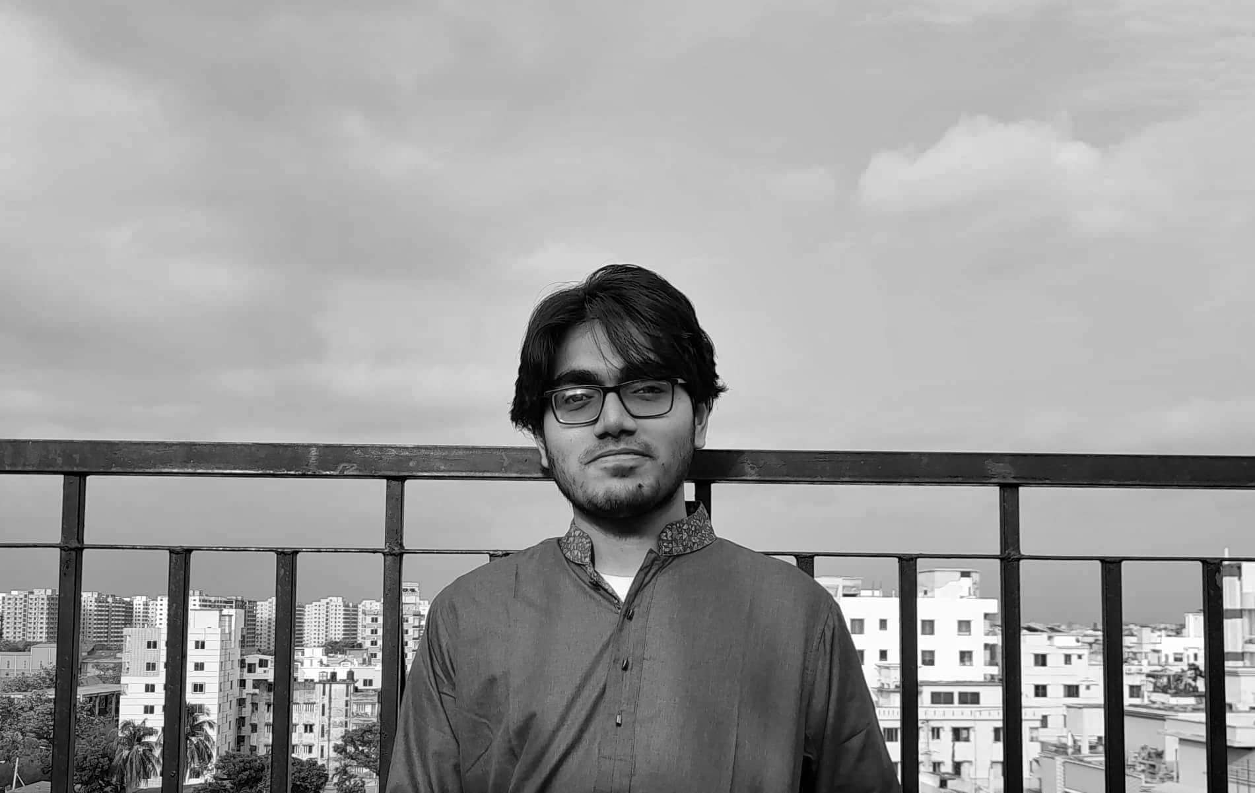
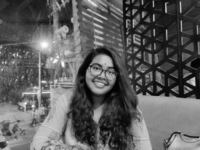
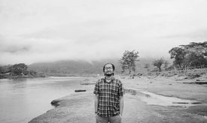
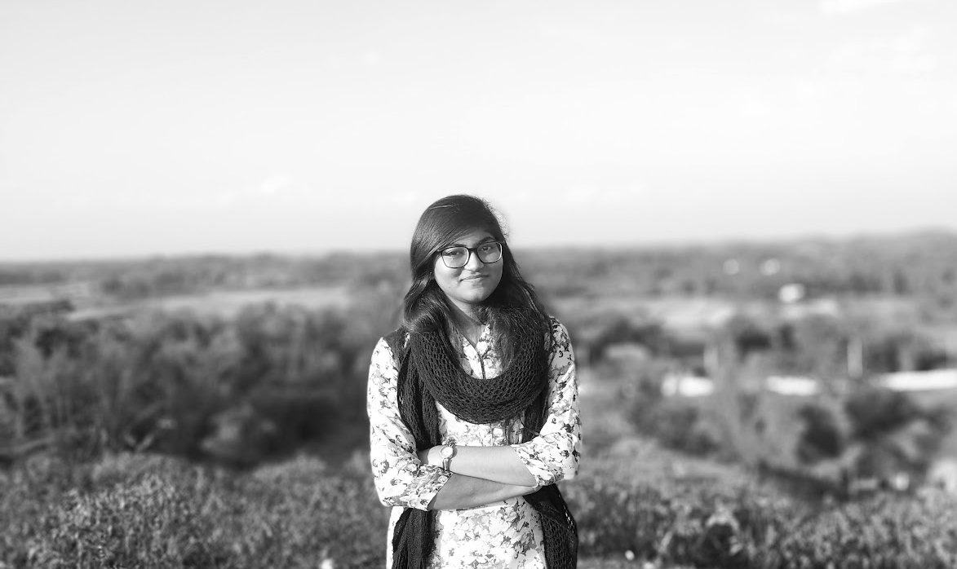
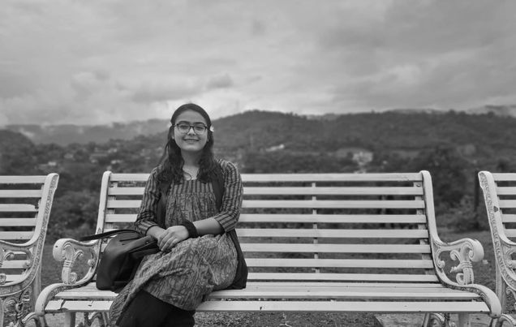
Meet the team
ZHALOK RAHMAN
Back-end developer
NAHIAN BEENTE FIRUJ
Android developer
RIDDHIMAN SWANAN DEBNATH
Case Study and researcher
TITHI SAHA
Front-end developer
FARZANA REEFAT RAHA
Case Study and researcher

Slide 19
QUESTIONS?
.

Slide 20
THANK YOU
.

