Slide 1
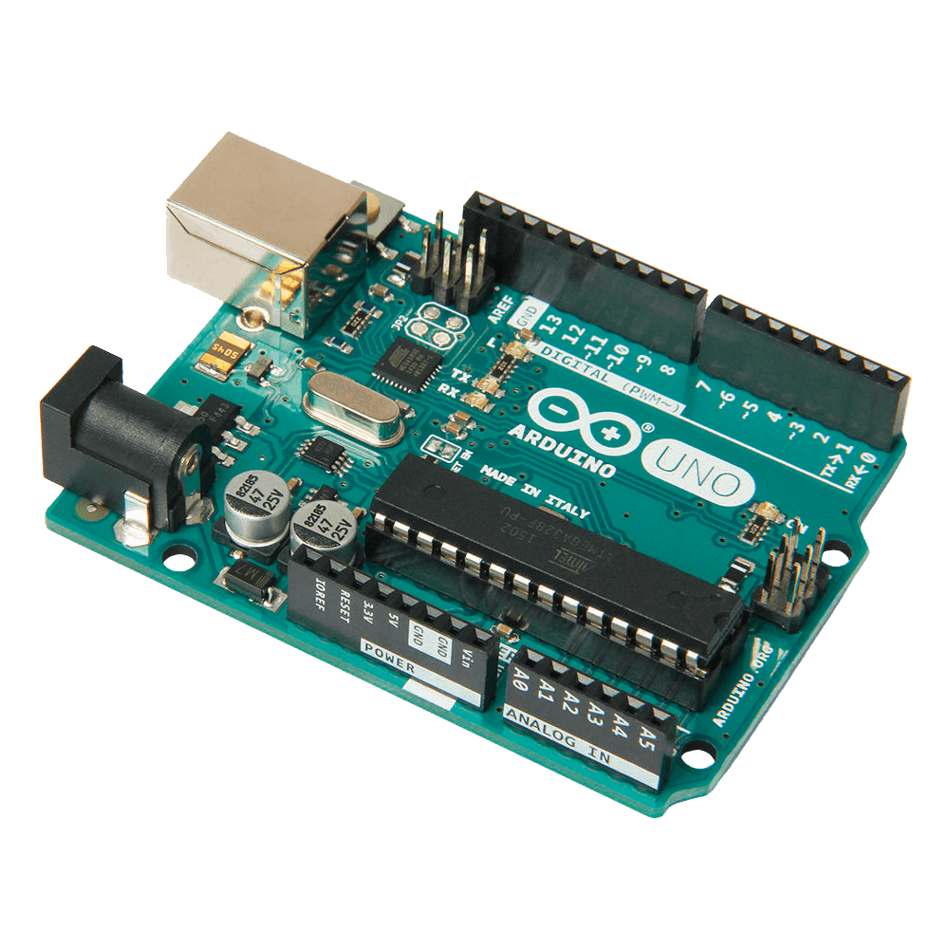

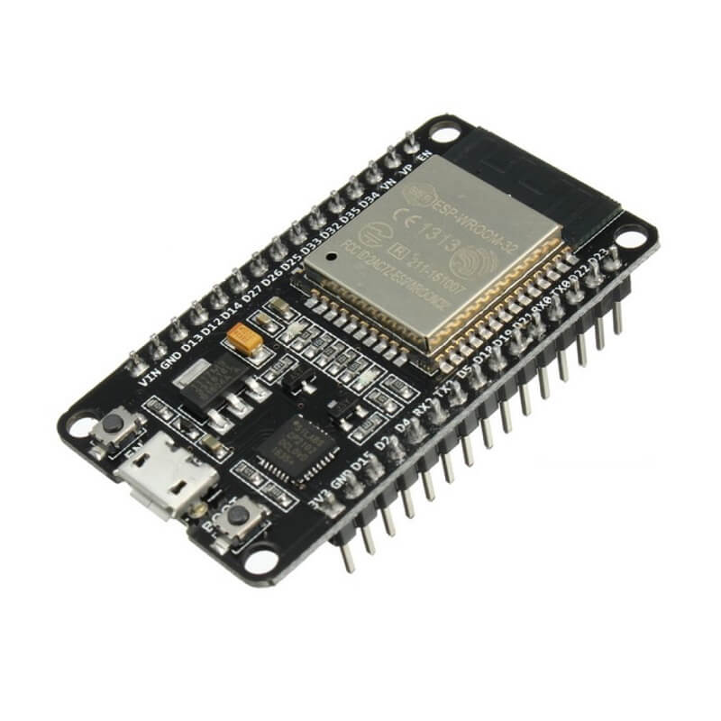
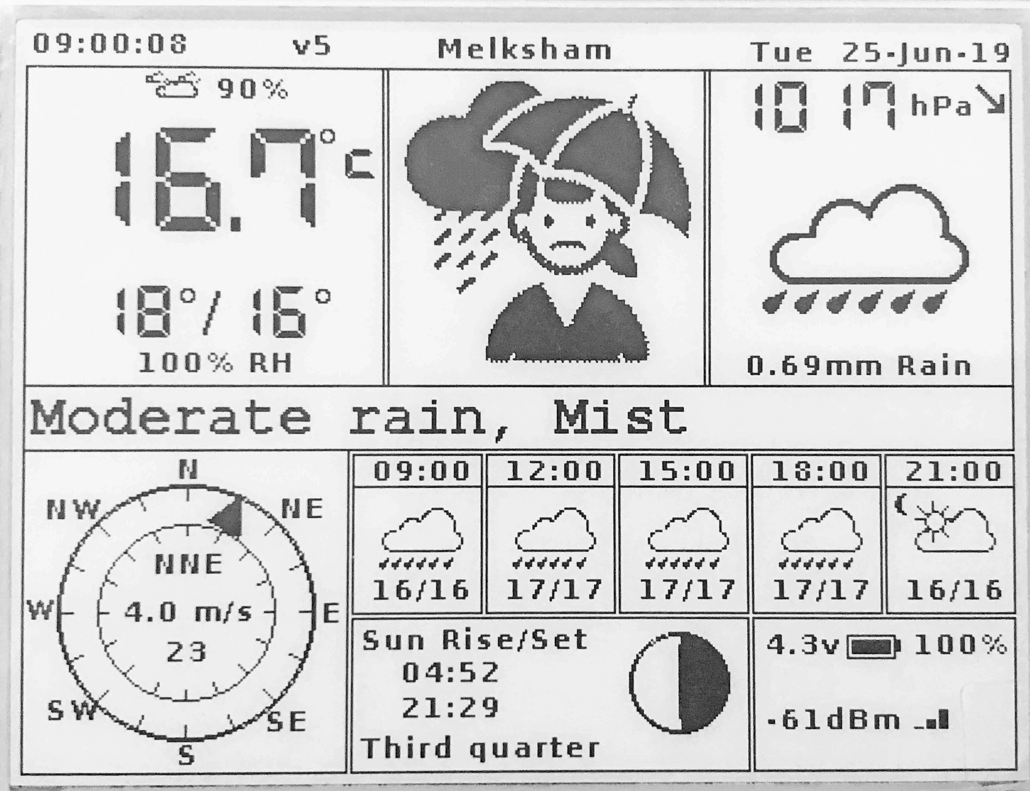
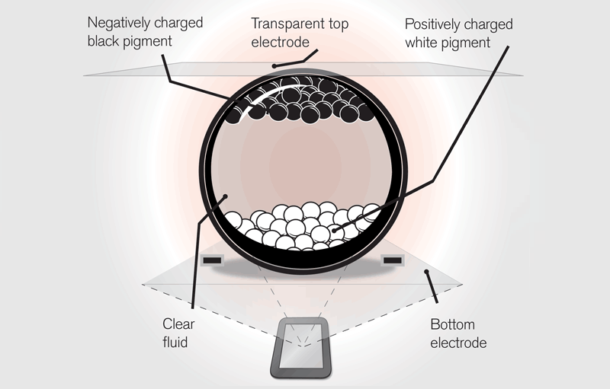
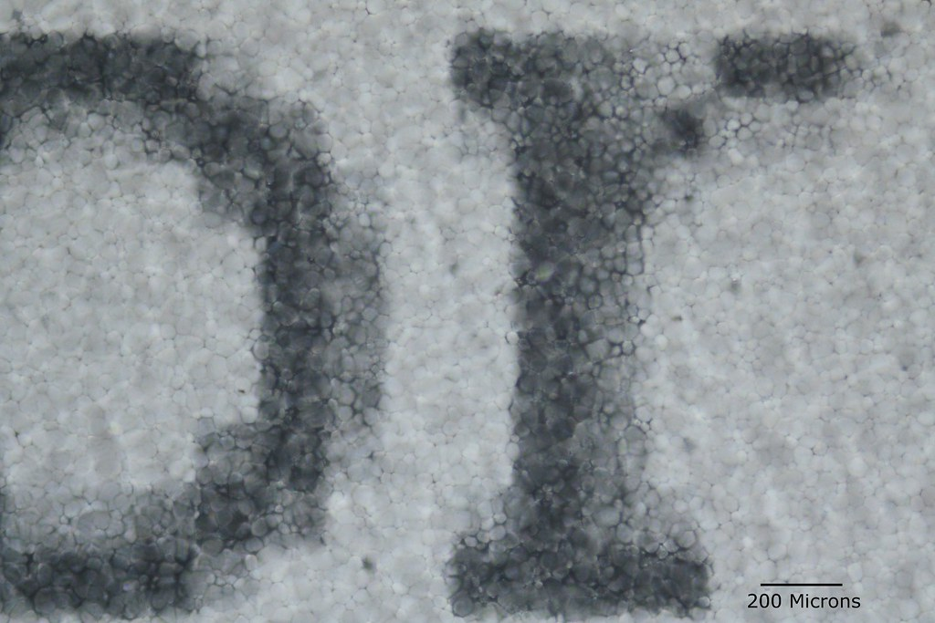
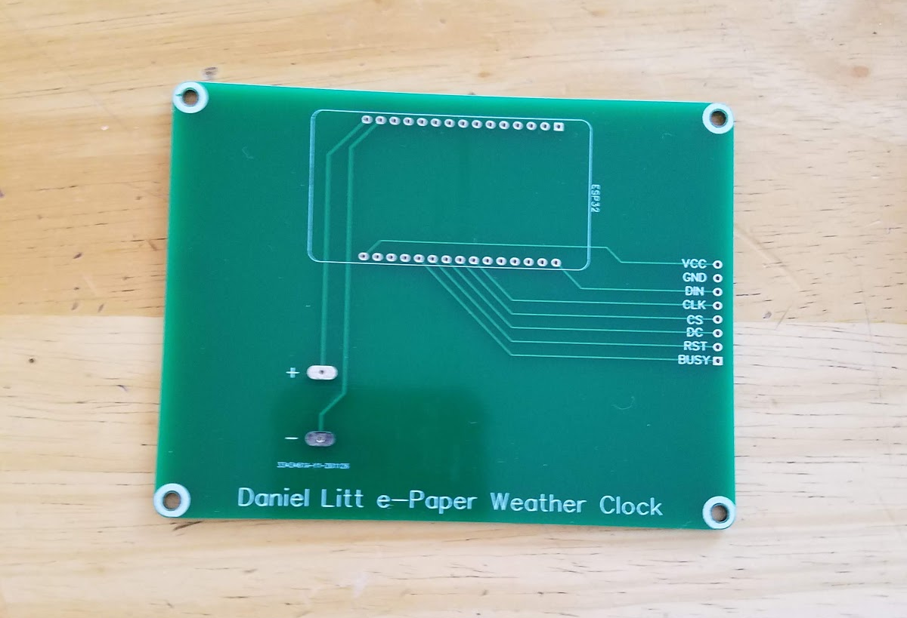
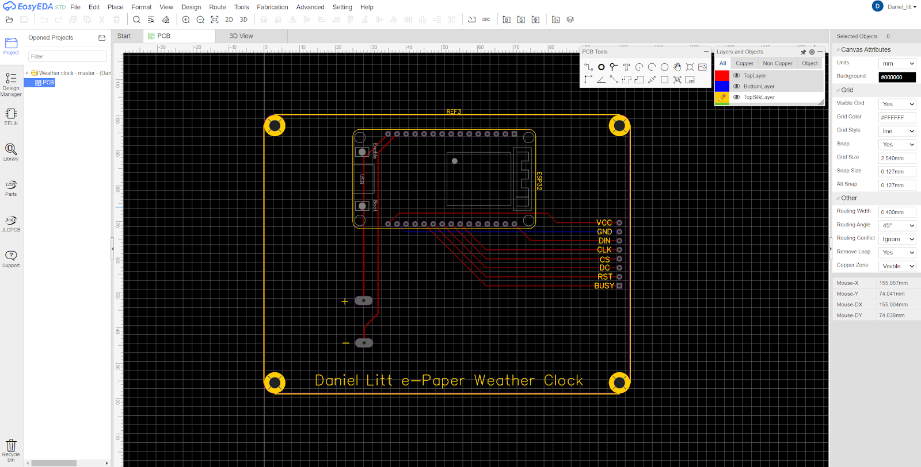
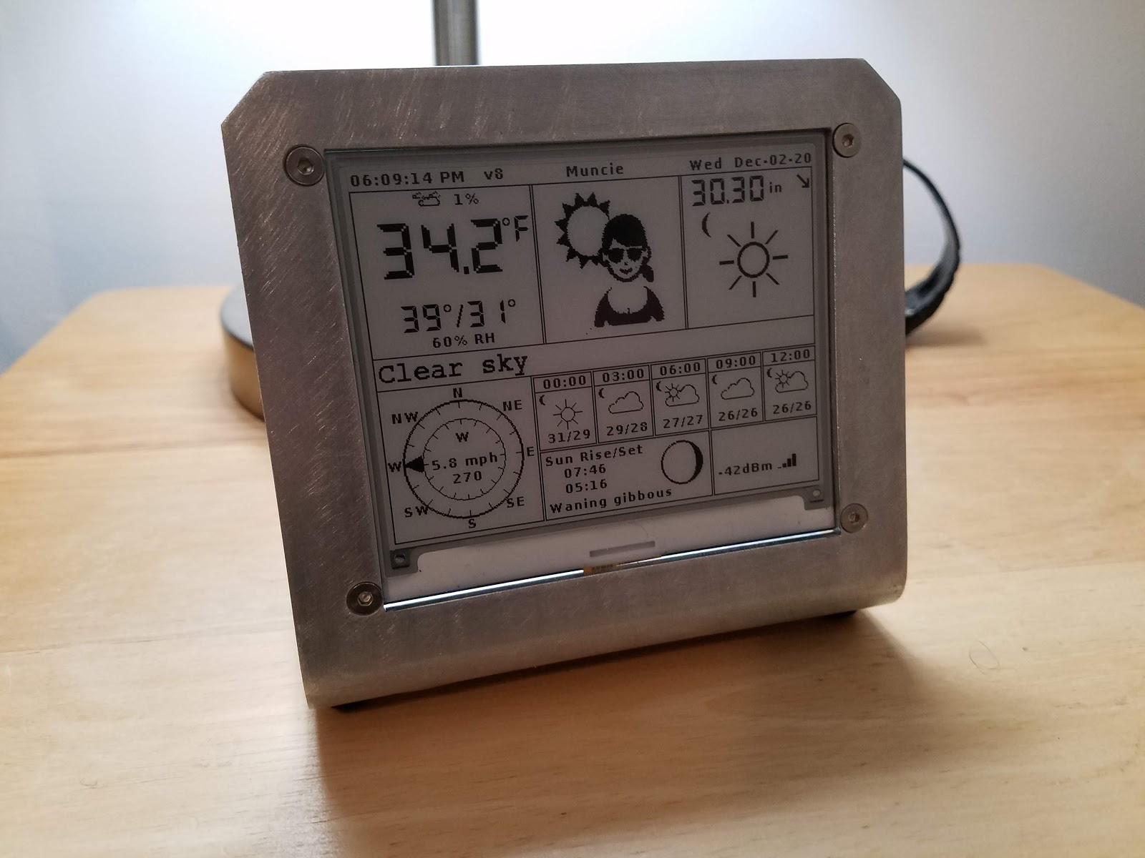
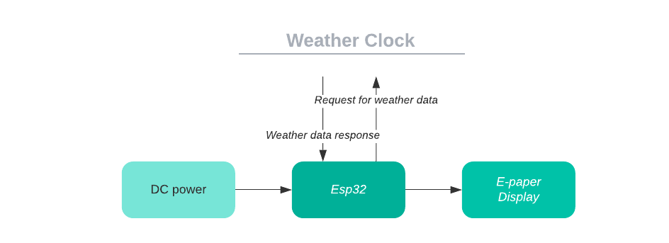
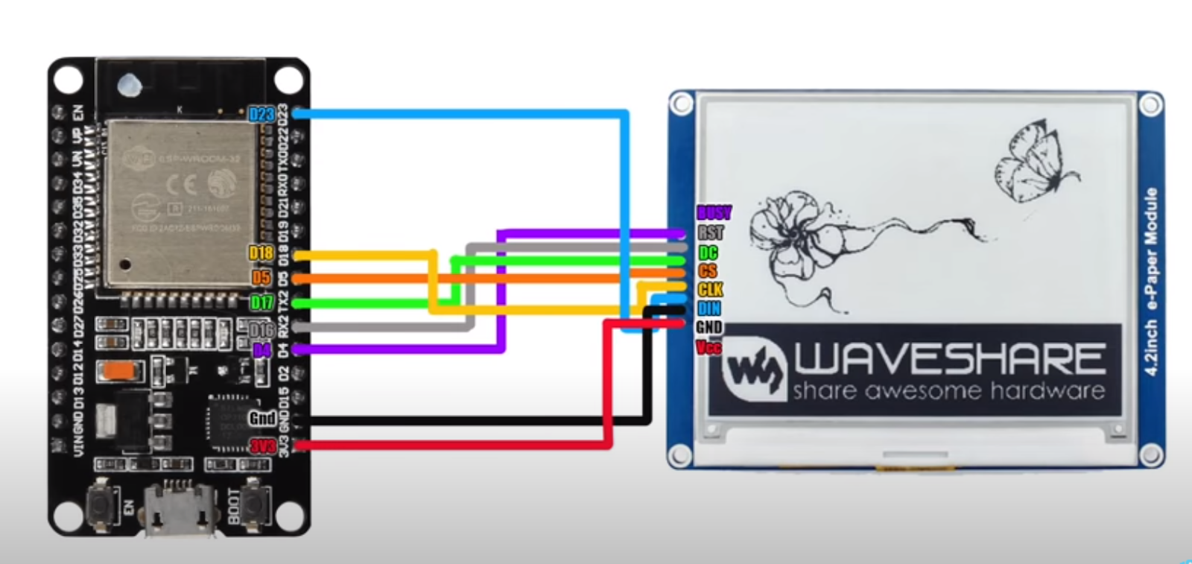
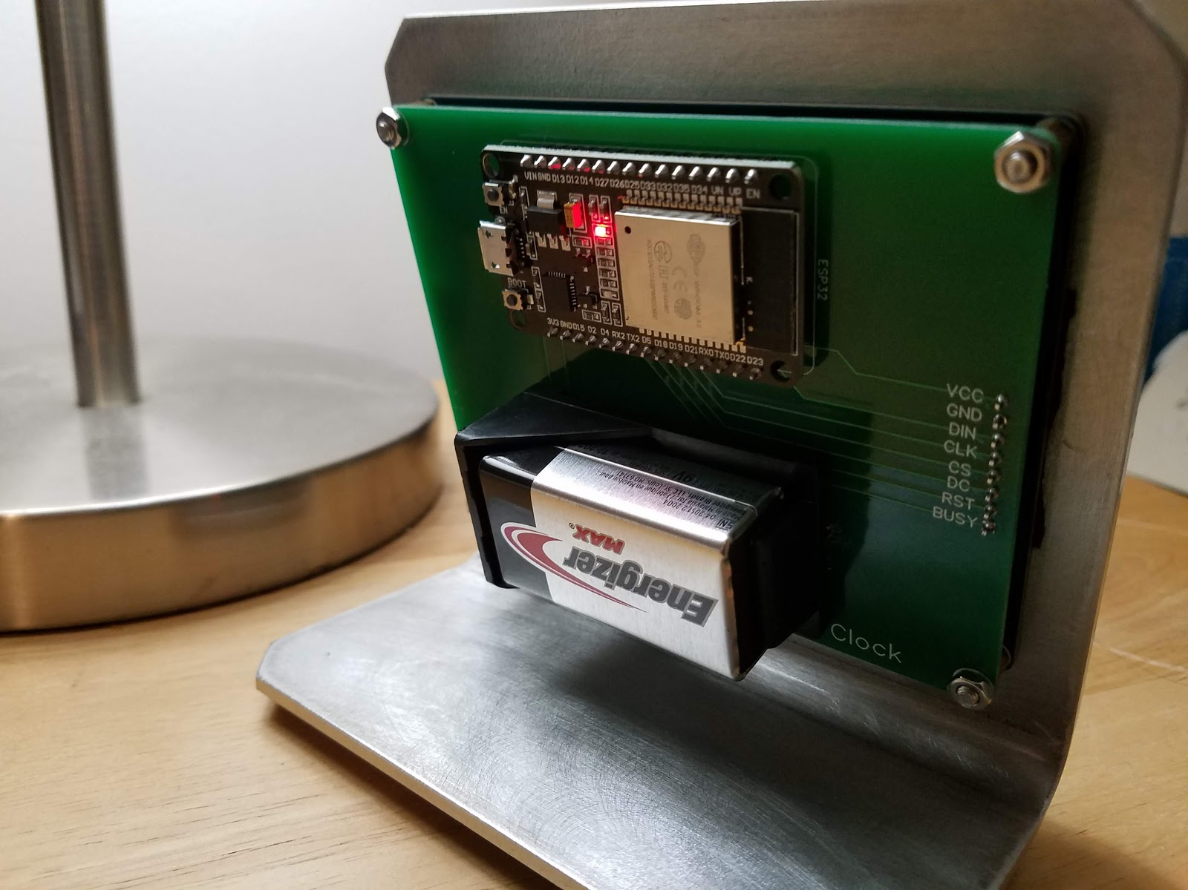
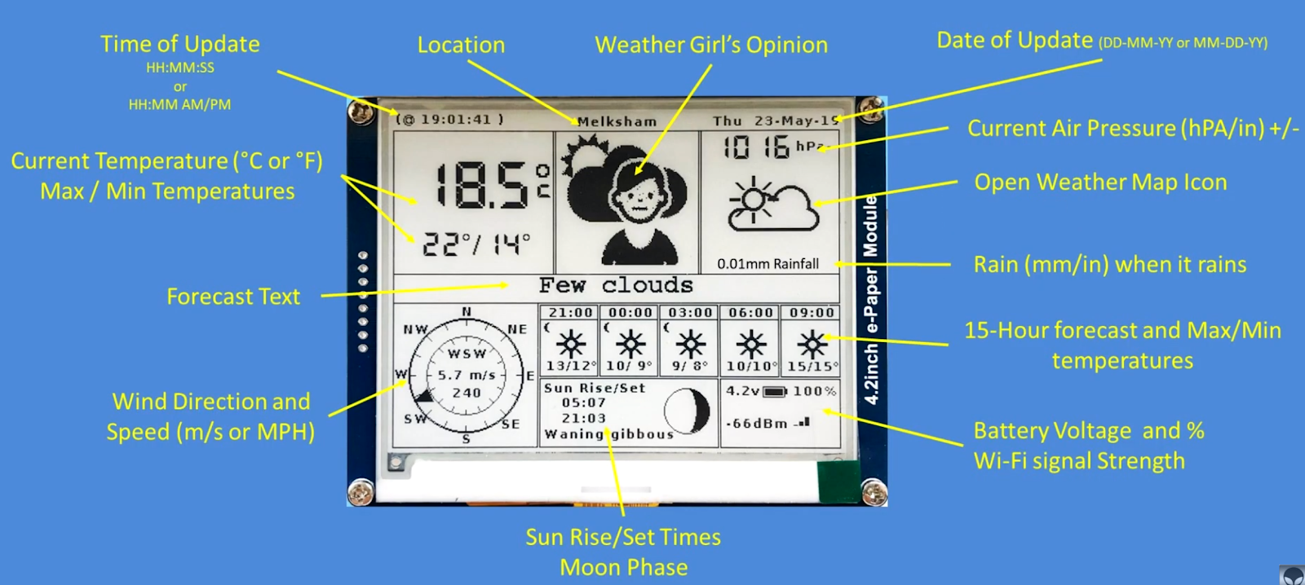
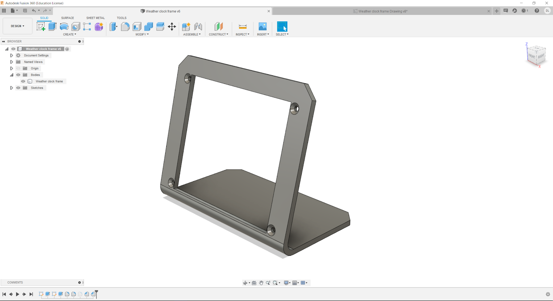
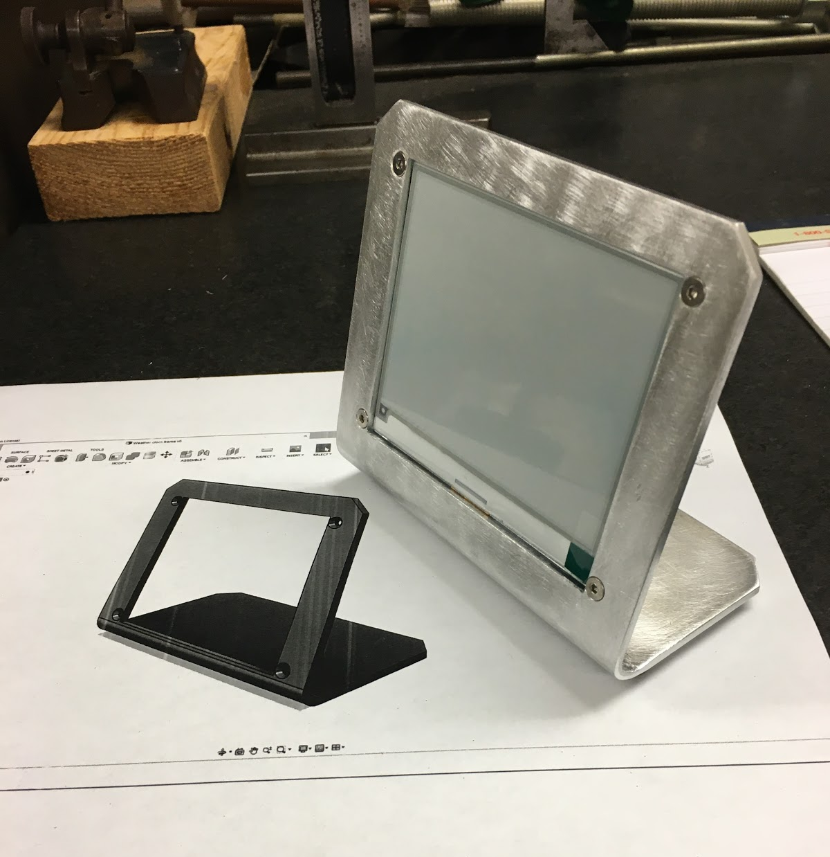
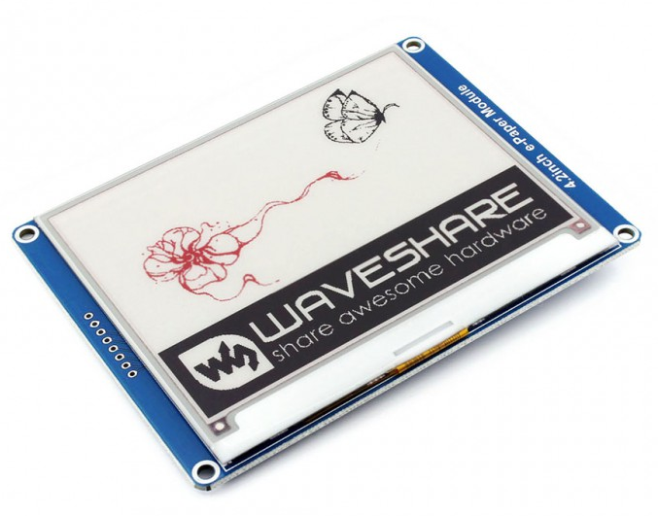
Learning Electronics Through Projects
Departmental of Physics and Astronomy
Ball State University
By Daniel Litt
Advisor Dr. Feng Jin
Software
Next, I started working on the software that would display the weather information. I stumbled upon a GitHub repository that had a well written script that was very close to the application that I was shooting for. I lightly modified the program to work for my situation and I now had a working weather clock, although it still had to be powered by cable and the circuitry was very messy and temporary.
Parts research
Extra care was taken to better understand the two main components, the esp32 and the e-paper panel.
E-paper display:
Advantages
Paper like display without glare
Have a very low power consumption
Retain an image without power
Disadvantages
Slow refresh rate
Limited colors
Workings
Pixels are small capsules filled with negatively changed white pigment and positively charged white pigment. A charge is applied to move the pigment and change the pixel.
FIG. 8. Weather display
Circuit design
I delved into learning electronic design automation (EDA) so that I could design a PCB to mount all my parts to. I went with a program called EasyEDA and designed a board to mount right behind the display and connect everything together. The design can be seen below. I next sent my design to a PCB manufacturing company. This company cheaply produced a small batch of my board and shipped them to me.
FIG. 1. esp32 microcontroller (left) and Arduino Uno microcontroller (right)
FIG. 3. Macro view of single e-paper pixel
Abstract
Key elements of an Independent Studies in Physics, taken by the author under Dr. Feng Jin in Fall, 2020, including the project selection process, major hardware components and software designs of the device, is presented along with the actual product of the project, a functioning WiFi-connected internet weather clock. The focus for this independent studies project is electronics and the intent was to learn more about electronics through a personal project with some tangible product in the end. Several project ideas were researched and examined, and the weather clock project was ultimately selected because of its feasibility and involvement of various aspects of electronics. An Arduino compatible board is used, an esp32 microcontroller, which serves as the brain of the device. A low power E-paper display is used to display the weather information. The hardware interface between the esp32 and the e-paper display is through a custom designed and fabricated PCB, and control software is written in C++ using the Arduino API (application programming interface). The metal frame that holds the clock was designed by the author and made by the department machinist John Decker.
Esp32:
Advantages
Compatible with the Arduino ecosystem
Relatively fast hardware
Disadvantages
Less documentation than name brand Arduino hardware
Workings
The small development board consisted of a programmable micro-controller, a Wi-Fi/Bluetooth module and other features. Also included are many GPIO pins.
FIG. 4. Close up of e-paper panel
FIG. 9. PCB design in EasyEDA
FIG. 10. Manufactured PCB from JLCPCB
Results
Finally, I started assembling all the components. I soldered the board to the PCB and attached the screen and the battery and put it in the frame and I had a working final product.
Initial display experiments
With these parts on hand, I started doing some initial tests to familiarize myself with the display and how to drive it with the esp32. I wired the display to the esp32 as can be seen in the image to the left. Some example code was uploaded to the esp32 to display some example images.
Project Ideation
FIG. 12. Block diagram of Weather Clock components
To start the process, I produced a small set of project Ideas the list included:
Cleaning up the circuitry on an older project of mine
Building a small drone
Creating a nixie tube clock
Building a weather clock
From these I ended up choosing the weather clock.
FIG. 5. Wiring between esp32 and e-paper panel
FIG. 11. Front view of finished Weather Clock
Frame design
After getting a foundation for how to program for and drive the display I started work on a frame to hold the display. I came up with a simple design using a computer aided design program called Fusion 360. The design can be seen below. I sent a dimension document to a machinist in the physics department, and he put together a metal construction of the frame.
Parts list
FIG. 13. Back view of finished Weather Clock
FIG. 14. Weather display info modules with labels
After picking the project I started doing research into what parts I would need and what I would need to learn to use them.
The part list I came up is below:
Esp32 microcontroller (the brain)
4.2-inch e-paper panel (the display)
Frame to hold the electronics
9V battery
Conclusion
I enjoyed the process I went through to create this weather clock. Along the way I would say I learned a great deal about many things. I learned a lot about how microcontrollers work and how they interface with other electronics I learned a lot about different types of batteries. I got the basics of PCB design and would now say I am capable of creating simple boards. In topics less related to physics I learned more about software and how to work on the programming of microcontrollers. I gained more experience in mechanical design and outsourcing the creation of my designs. I also became better at documenting my work. I enjoy creating things. This project was a good learning experience for me, and I am happy with the end product.
FIG. 2. 4.2-inch Waveshare e-paper panel
FIG. 6. Frame design in Fusion 360
FIG. 7. Constructed frame made by the department machinist John Decker

