Slide 1


XAI
XAI-Based Intelligent Disease Prediction System with Transparent Decision Insights
Project Guide:
KIRUBHANANDHAN CG,
Assistant Professor,
Department of Artificial Intelligence and Data Science,
Easa College of Engineering and Technology
Presented by
Arunpandian P
Reg.no :720522243009

Slide 2
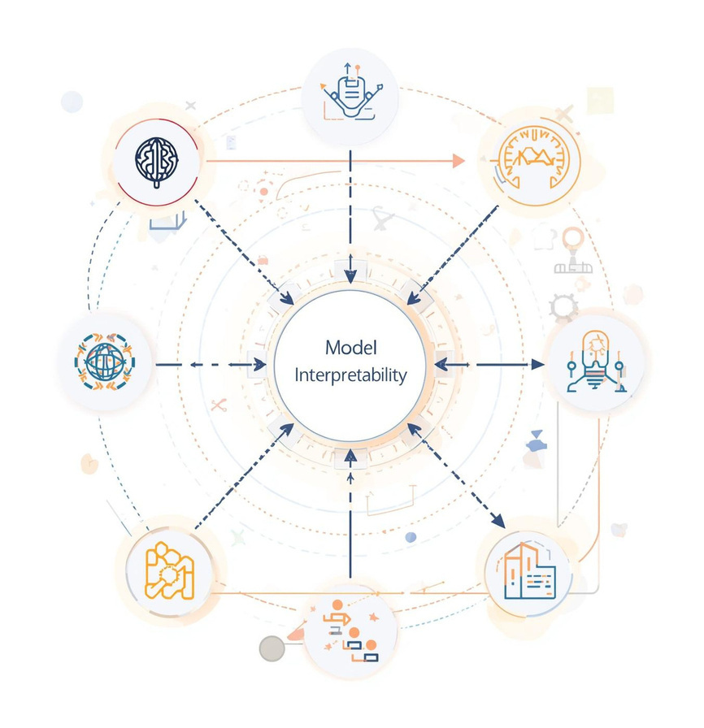
Introduction to XAI
Epilepsy is a serious neurological disorder that requires early detection. Traditional EEG-based diagnosis is time-consuming and depends on experts. AI improves prediction speed and accuracy, but many models lack transparency. Explainable AI helps make predictions understandable and trustworthy. Our project combines machine learning with XAI for accurate and interpretable disease prediction.

Slide 3

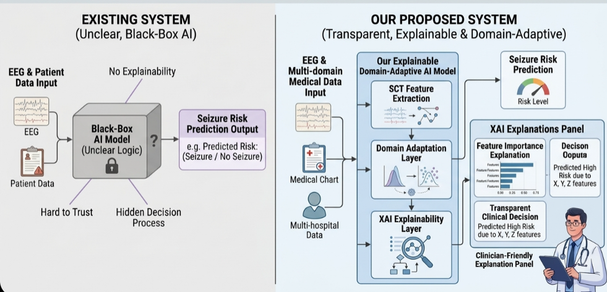
PROBLEM STATEMENT
Existing System
Current AI models give predictions but do not clearly explain their decisions.
Most systems are complex and difficult for doctors to interpret.
Proposed System
Uses Explainable AI to provide clear and transparent seizure predictions.
Helps doctors understand important EEG features behind each result.

Slide 4

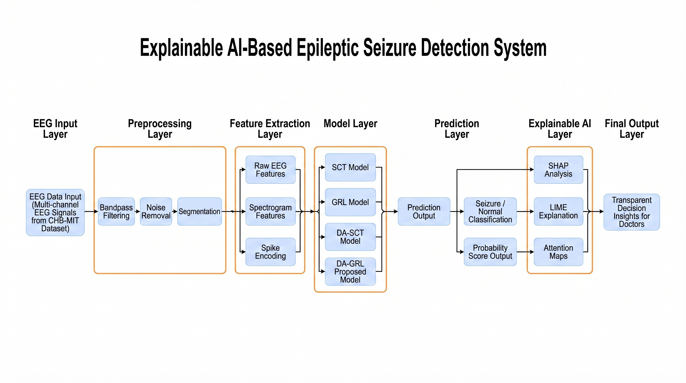
System Architecture
EEG Data Input
Multi-channel EEG signals from CHB-MIT dataset (18 channels, 256 Hz)
Signal Preprocessing
Bandpass & notch filtering, artifact removal, window segmentation, seizure labeling
Feature Generation
Raw EEG, Spectrogram, Spike Encoding representations
Model Layer
SCT, GRL, DA-SCT, Federated Learning models
Prediction Layer
Seizure / Normal classification with probability score
Explainable AI (XAI)
Grad-CAM, SHAP, Attention Maps for interpretability
Deployment Layer
FastAPI API, Streamlit dashboard, Cloud deployment

Slide 5

Literature Survey
S.No | Author & Year | Title of the Paper | Publication | Dataset | Findings / Contribution
1 | Y. Zhao, B. Li, H. Wan, H. Peng, Y. Zhou, and H. | EEG-based seizure detection using linear graph convolution network with focal loss | Computers in Biology and Medicine / IEEE indexed | CHB-MIT EEG Dataset | Proposed Linear Graph Convolution Network (LGCN) with focal loss for seizure detection; improved seizure classification performance by modeling spatial EEG channel relationships and handling class imbalance effectively
2 | Ruifeng Zheng et al. (2025) | EEG-based Epileptic Prediction via a Two-Stage Channel-Aware Set | arXiv Preprint | CHB-MIT EEG Dataset | Proposed two-stage transformer model reducing EEG sensors from 18 to 2.8 while maintaining 80.1% sensitivity and 95.5% specificity.
3 | S. Mekruksavanich, W. Phaphan, and A. Jitpattanakul (2025) | Epileptic Seizure Detection via Enhanced Hybrid Convolutional Neural Network with Attention Mechanism | Mathematical Biosciences and Engineering | CHB-MIT EEG Dataset | Developed hybrid CNN with attention mechanism to enhance seizure feature extraction; achieved improved detection accuracy by focusing on discriminative EEG temporal-spatial patterns.

Slide 6
Literature Survey
S.No | Author & Year | Title of the Paper | Publication | Dataset | Findings / Contribution
4 | I. Jemal, A. Subasi, and F. Cote-Allard (2024) | Domain Adaptation for EEG-Based Cross-Subject Epileptic Seizure Prediction | Frontiers in Neuroinformatics | Cross-subject EEG Dataset | Introduced domain adaptation framework to improve seizure prediction across different patients; reduced subject variability and enhanced model generalization.
5 | D. Kostas, S. Aroca-Ouellette, and F. Bhatt (2021) | BENDR: Using Transformers and Contrastive Self-Supervised Learning to Learn from Massive EEG Data | Frontiers in Human Neuroscience | Large-scale EEG Corpus | Proposed transformer-based self-supervised EEG representation learning model; enabled strong transfer learning performance for downstream seizure tasks.

Slide 7
Summary of Literature Survey
Title | Stroke Prediction on Healthcare Data Using SMOTE and Explainable Machine Learning | XAI-Based Intelligent Disease Prediction System with Transparent Decision Insights
Author Name | Ruifeng Zheng et al. (2025) | Arun Pandian et al. (2026)
Model | LSTM, CNN, Basic ML models | Spiking Convolutional Transformer (SCT) Gradient Reversal Layer(GRL) Privacy-Preserved Federated Learning Gradient Reversal Layer Domain Adaptation Network (GRL-DAN) Domain-Adaptive Spiking Conv Transformer (DA-SCT) Shap XAI + Bestmodel(GRL-DAN) combined learning
Dataset | PhysioNet CHB-MIT Pediatric EEG Dataset (23 patients, ~900+ hours EEG, 198 seizures) | PhysioNet CHB-MIT Pediatric EEG Dataset (23 patients, ~900+ hours EEG, 198 seizures)
Accuracy | 97.08% | 99.06%
Explainability | Not aplicable | SHAP feature interpretation for seizure risk

Slide 8
Project Objectives
Build an AI system for epileptic seizure detection from EEG signals.
Extract meaningful EEG features to improve predictive performance.
Improve classification using advanced hybrid deep learning models.
Provide transparent predictions using Explainable AI techniques.
Support secure, privacy-preserving federated learning.
Enable deployment for clinical seizure monitoring.

Slide 9
Current Implementation
(1)
EEG datasets for epilepsy were collected from trusted sources and preprocessed.
Baseline SCT and GRL-DAN models were implemented, normalized using StandardScaler, and split into training, validation, and testing sets.
The models were successfully trained and achieved promising accuracy for seizure prediction

Slide 10
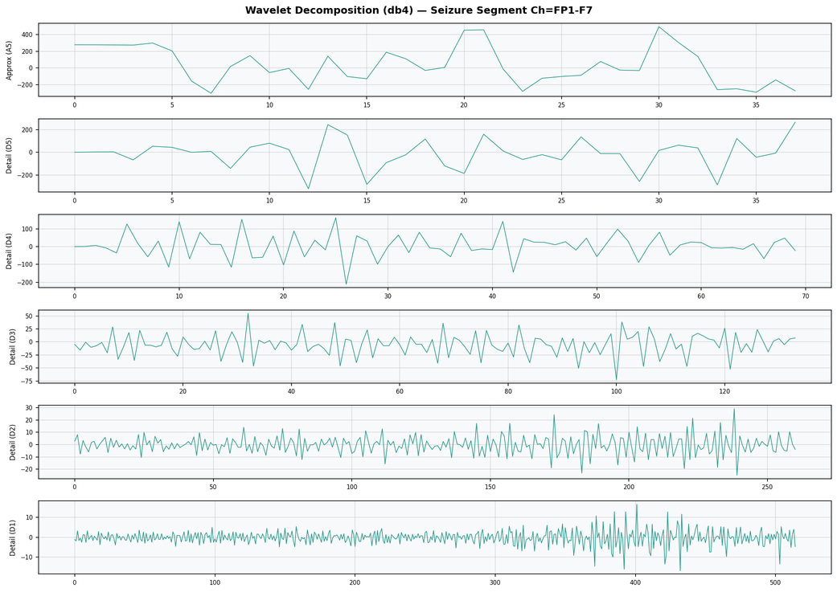
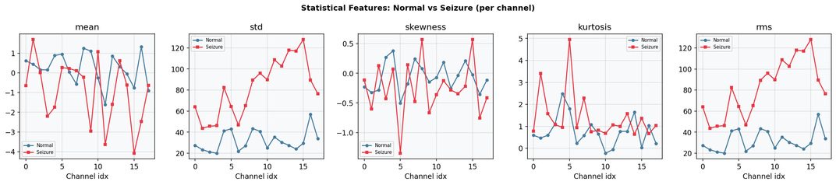
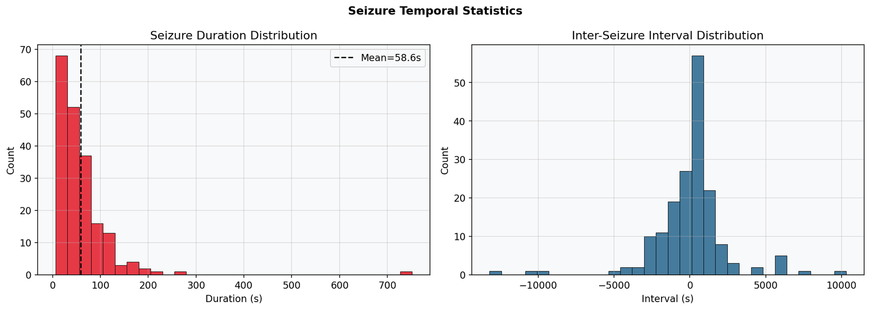
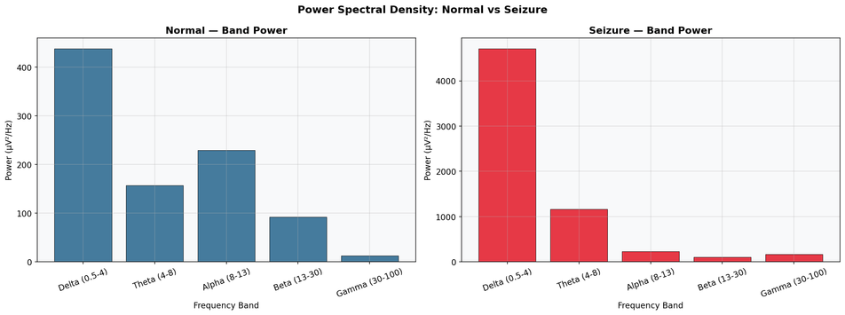
Preprocessing Techniques
EEG signals are preprocessed using wavelet decomposition, statistical feature extraction, Power Spectral Density (PSD) analysis, channel correlation mapping, and Synthetic Minority Over-sampling Technique (SMOTE) balancing.
These steps enhance signal quality and capture key EEG patterns for seizure detection
(2)
(3)
(1)
Statistical features capture differences between normal and seizure EEG signals to detect abnormal patterns
Seizure temporal statistics analyze seizure duration and intervals to understand seizure occurrence patterns over time.
Wavelet decomposition splits EEG signals into multiple frequency bands to remove noise and highlight seizure patterns.
(4)
Power Spectral Density (PSD) shows frequency-band power differences, revealing stronger abnormal activity in seizure EEG signals

Slide 11
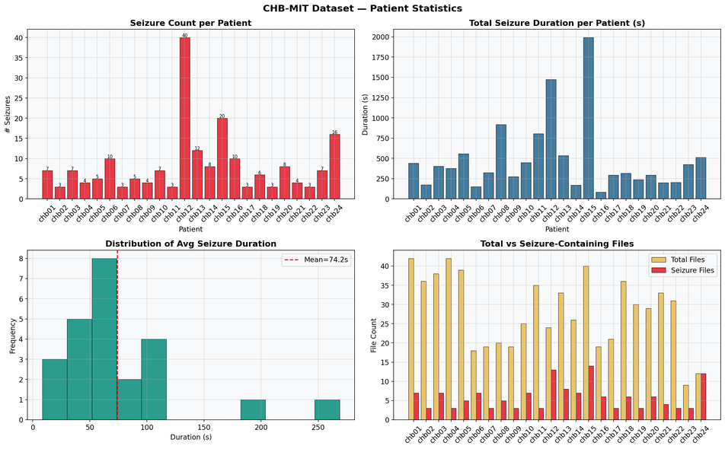
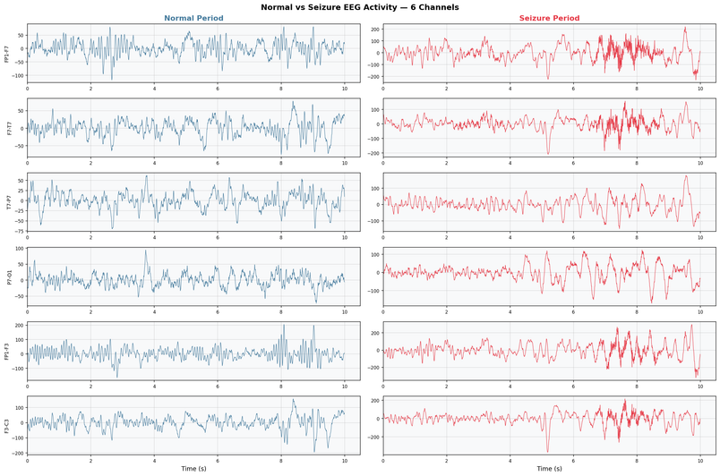
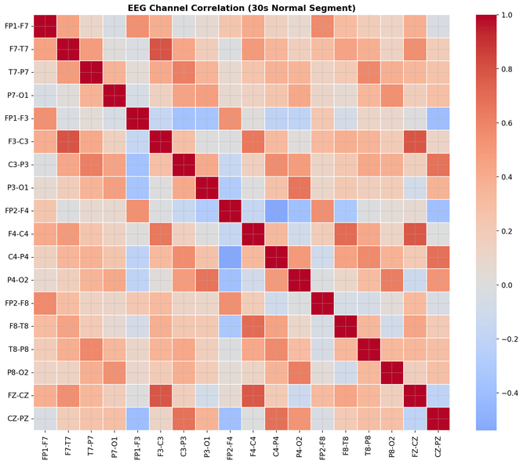
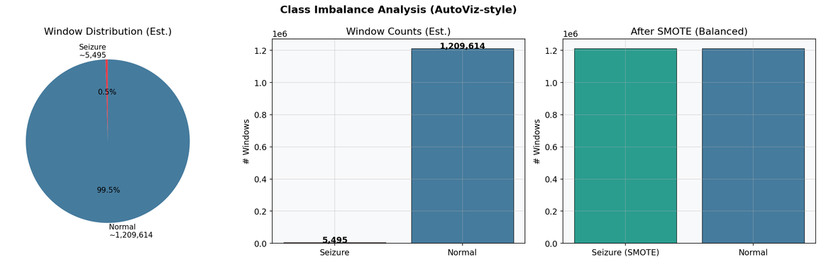
Preprocessing Techniques (II)
Patient statistics analysis shows seizure frequency and duration vary significantly across patients, highlighting dataset diversity and imbalance in seizure distribution.
Seizure EEG shows higher amplitude with sharp abnormal spikes.
Irregular rhythms clearly indicate seizure-related brain activity
Patient statistics analysis shows seizure frequency and duration vary significantly across patients, highlighting dataset diversity and imbalance in seizure distribution.
(5)
(6)
(7)
Before SMOTE: 824 seizure, 5800 normal samples (imbalanced dataset).
After SMOTE: Both classes balanced to 5800 each.
Total training samples increased to 11,600 for better model accuracy.
(8)

Slide 12
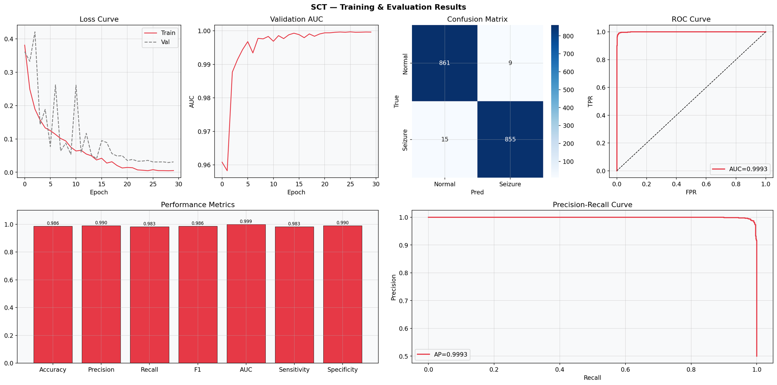
Model (I)
Spiking Convolutional Transformer (SCT)
(1.1)
(1.2)
SCT model achieved 98.6% accuracy with strong seizure detection performance.
Low misclassification rate shows stable and reliable prediction capability.

Slide 13
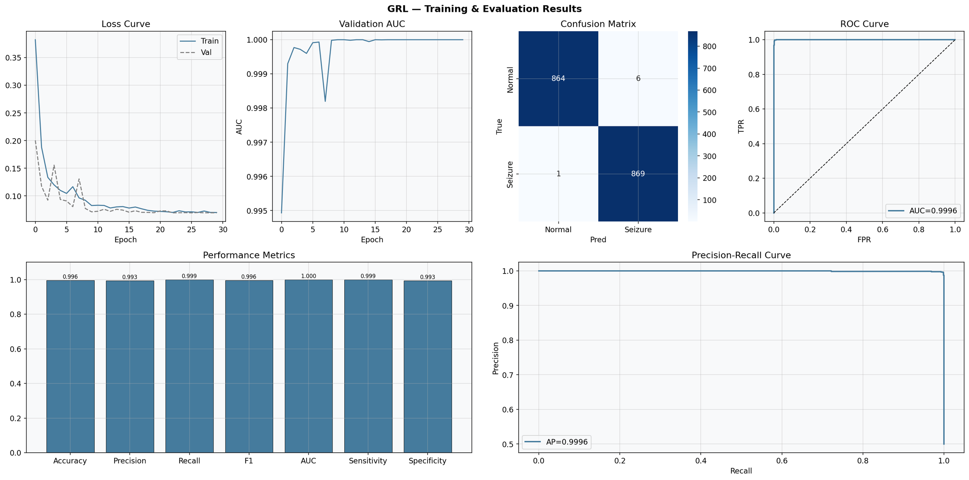
Model (II)
GRADIENT REVERSAL LAYER(GRL)
(2.1)
(2.2)
GRL model achieved 99.6% accuracy with excellent seizure classification performance.
Very few misclassifications indicate strong reliability and stable prediction.

Slide 14
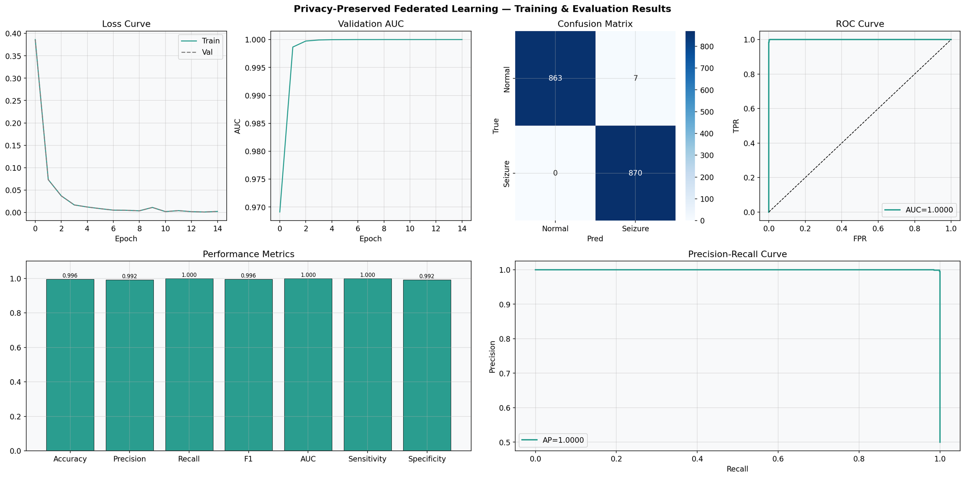
Model (III)
Privacy Preserved Federated learning
(3.1)
(3.2)
Federated learning model achieved 99.6% accuracy with secure and privacy-preserving seizure detection.
Zero false negatives show highly reliable prediction across distributed EEG data.

Slide 15
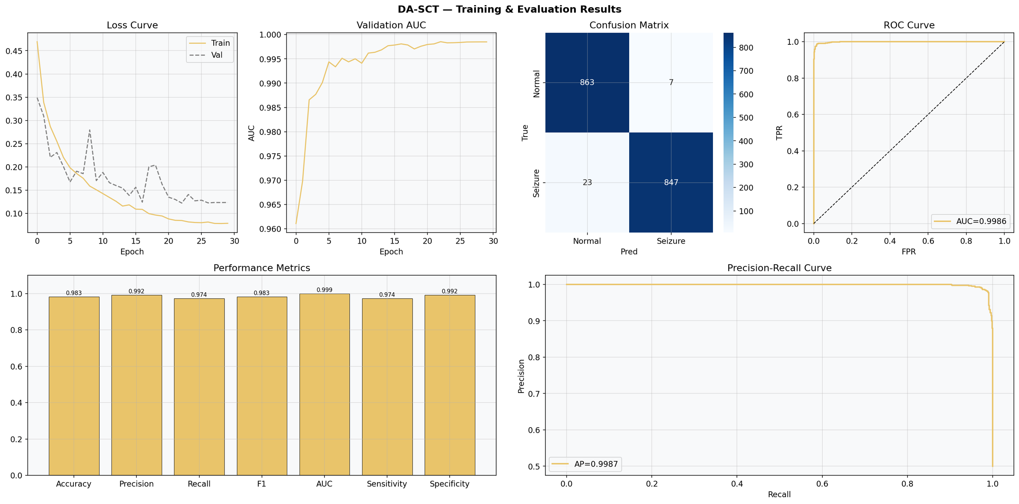
Domain Adaptaion SCT (DA-SCT)
Model (IV)
(4.1)
(4.2)
DA-SCT model achieved 98.3% accuracy with strong domain-adaptive seizure detection performance.
Stable convergence and low error rate indicate reliable cross-domain prediction capability.

Slide 16
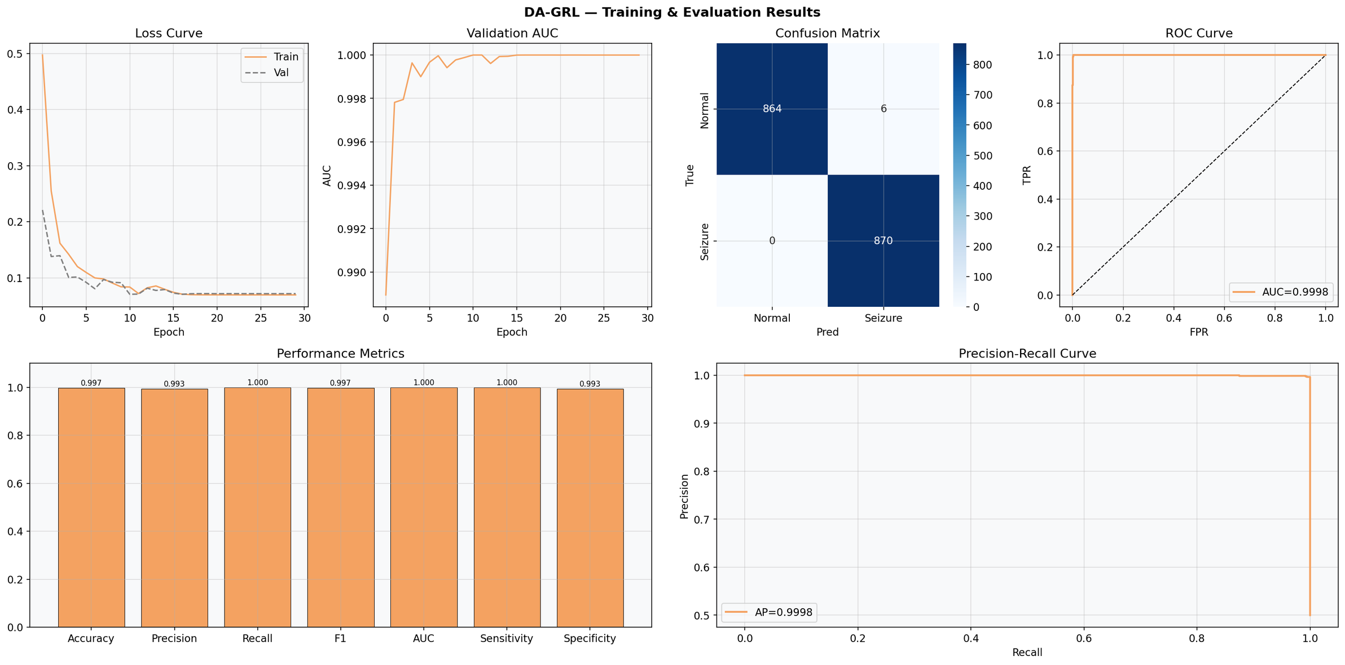
Domain Adaptation GRL (DA-GRL)
Model (V)
(2.1)
(2.2)
DA-GRL model achieved 99.7% accuracy, delivering the best seizure detection performance among all models.
Near-zero misclassification and excellent stability confirm superior cross-domain prediction reliability.

Slide 17
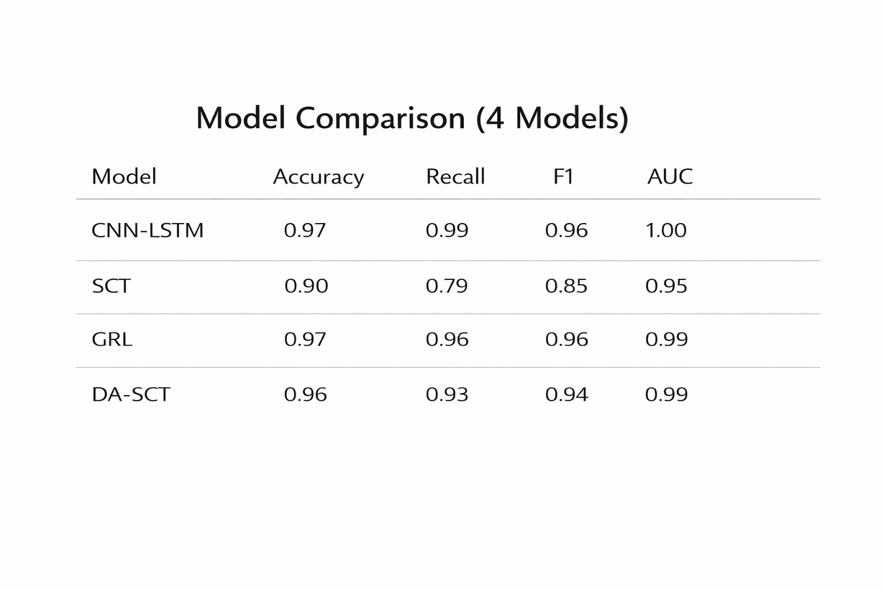
Model Comparision
This table compares four deep learning models:
CNN-LSTM
Spiking Convolutional Transformer (SCT)
Gradient Reversal Layer Network (GRL)
Domain Adaptation Spiking Conv Transformer (DA-SCT)
Evaluation Metrics Used:
Accuracy
Recall (Sensitivity)
F1 Score
AUC (Area Under ROC Curve)
Purpose:
To analyze detection capability, generalization performance, and seizure sensitivity across models.

Slide 18
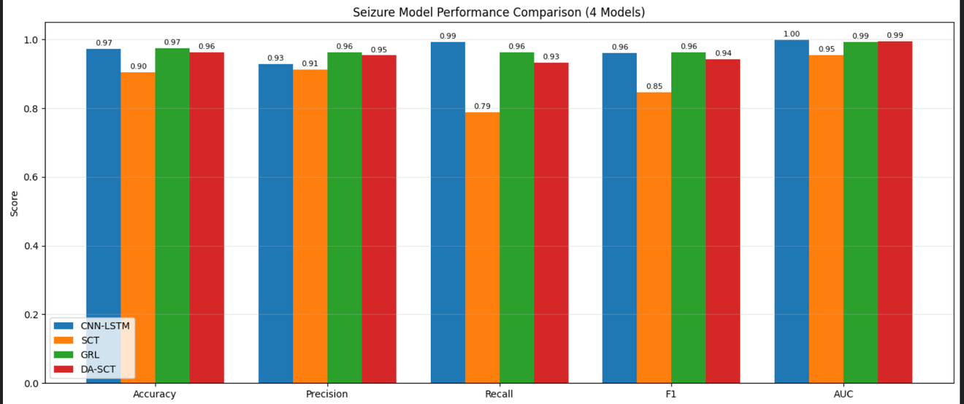
Model Comparision II
XAI
This graph compares four seizure prediction models across Accuracy, Precision, Recall, F1-score, and AUC.
CNN-LSTM and GRL show the best overall performance with 97% accuracy and very high F1-scores (0.96). CNN-LSTM achieves the highest recall (0.99), meaning it detects almost all seizures. GRL performs nearly as well (0.96 recall) while improving generalization through domain adaptation.
DA-SCT delivers balanced performance across all metrics, while SCT shows lower recall (0.79), indicating more missed seizures.
Overall, CNN-LSTM and GRL are the strongest models, with GRL offering better cross-patient robustness.

Slide 19
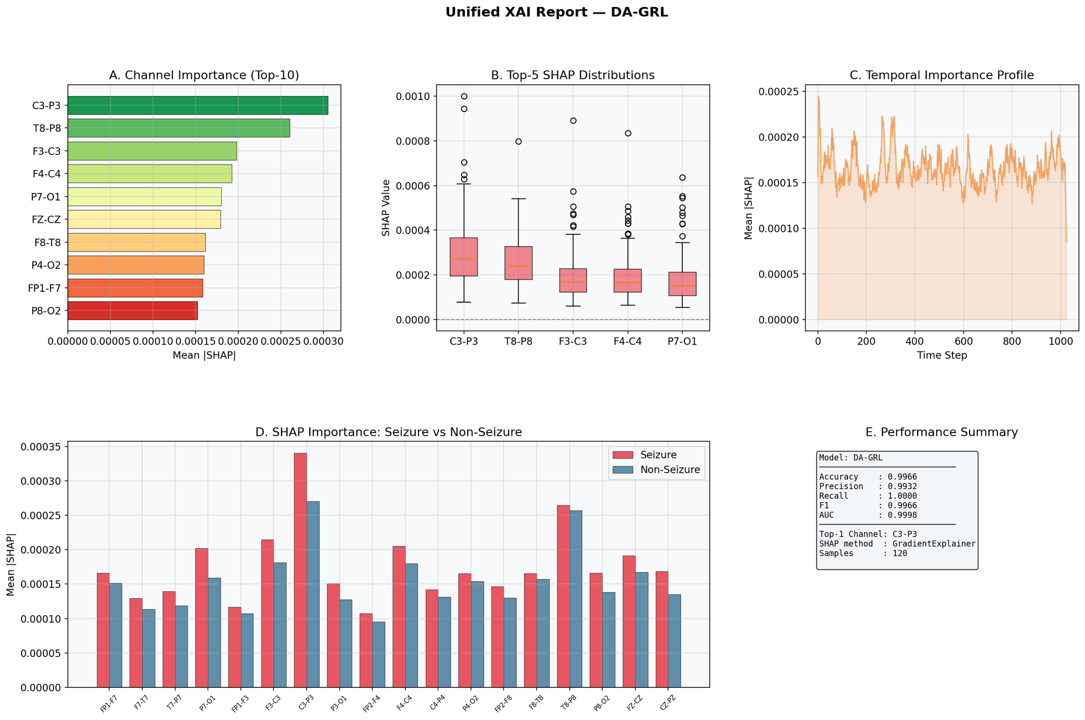
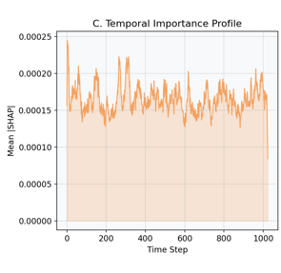
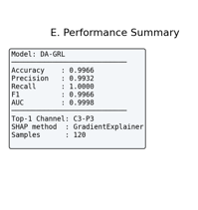
Explainable AI Report
XAI
Best model(DA-GRL)
SHAP analysis identifies C3-P3, T8-P8, and F3-C3 as the most influential EEG channels in seizure prediction.
Temporal importance profile highlights key time segments where the DA-GRL model focuses during seizure detection

Slide 20
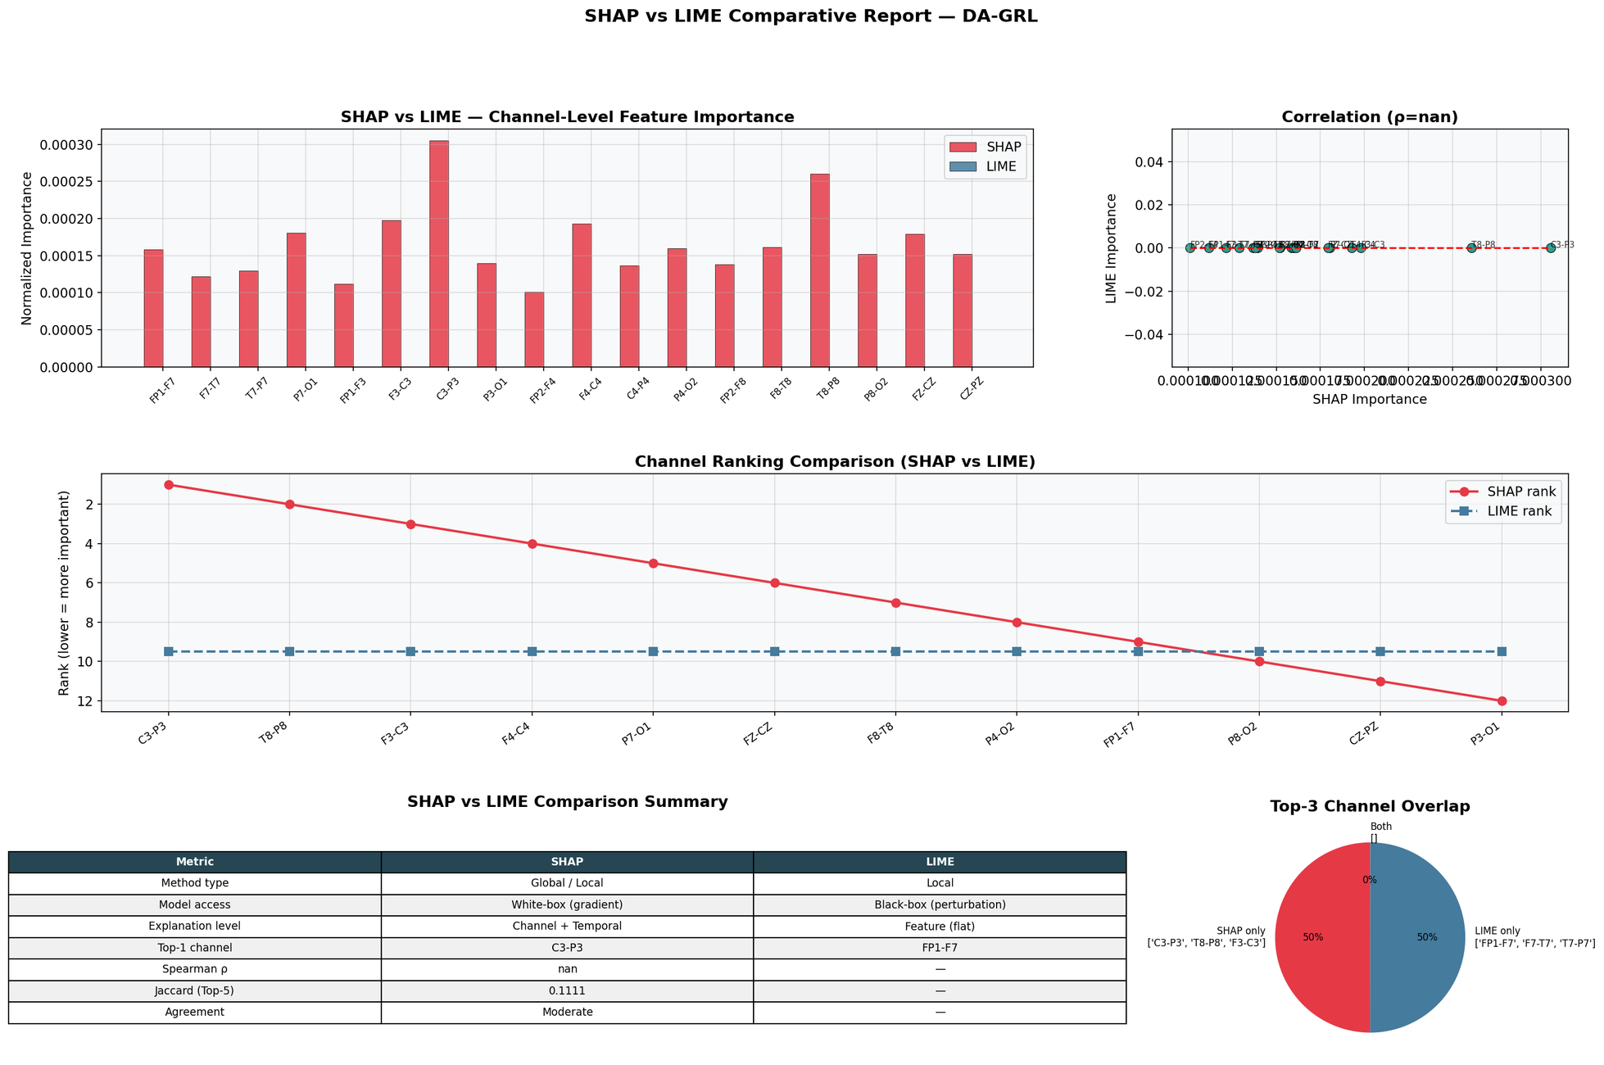
XAI
Why SHAP is Preferred Over LIME?
SHAP (SHapley Additive exPlanations) provides more consistent and detailed channel-level feature importance than LIME (Local Interpretable Model-agnostic Explanations) for EEG seizure analysis.
SHAP offers both global and local interpretability, making model decisions more reliable for clinical understanding

Slide 21
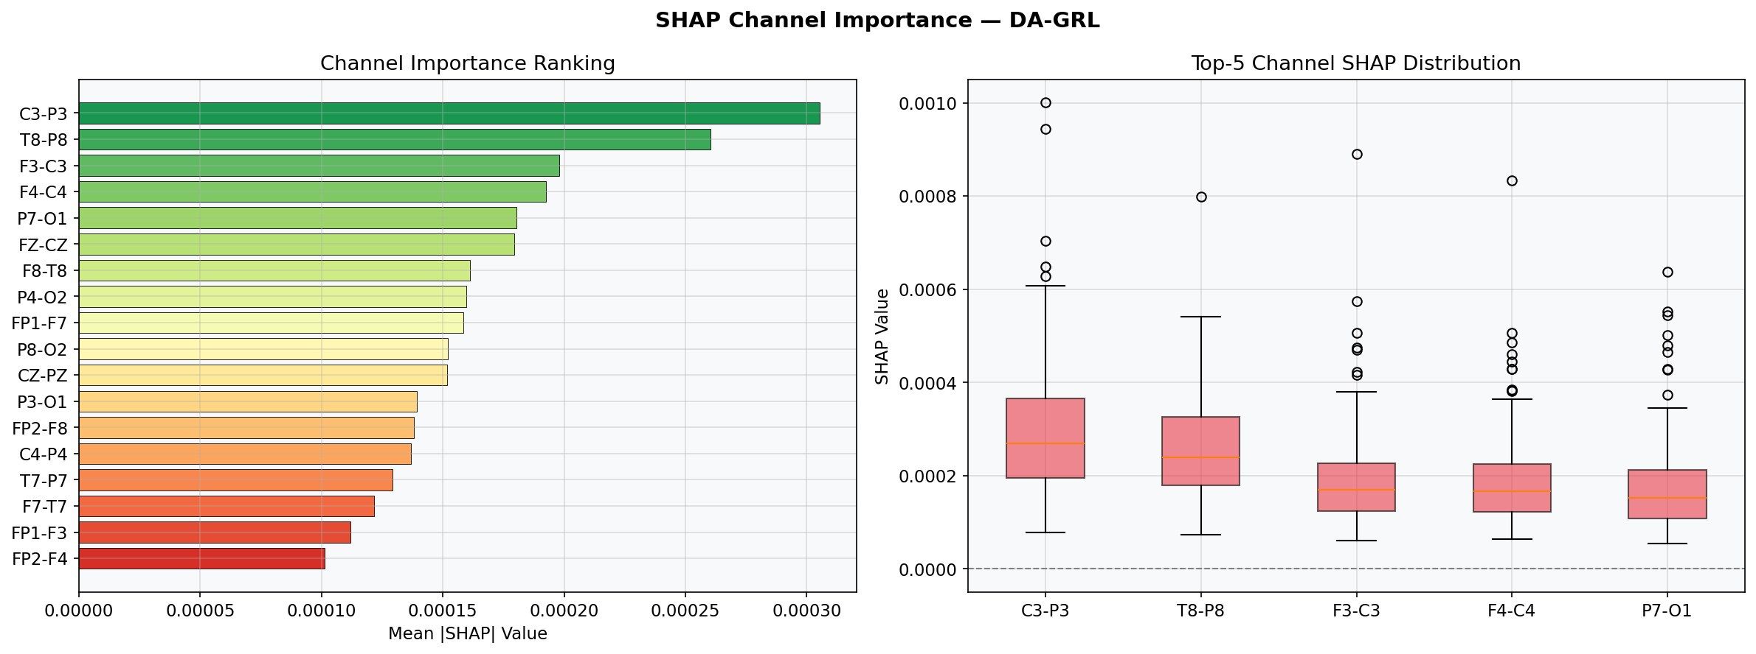
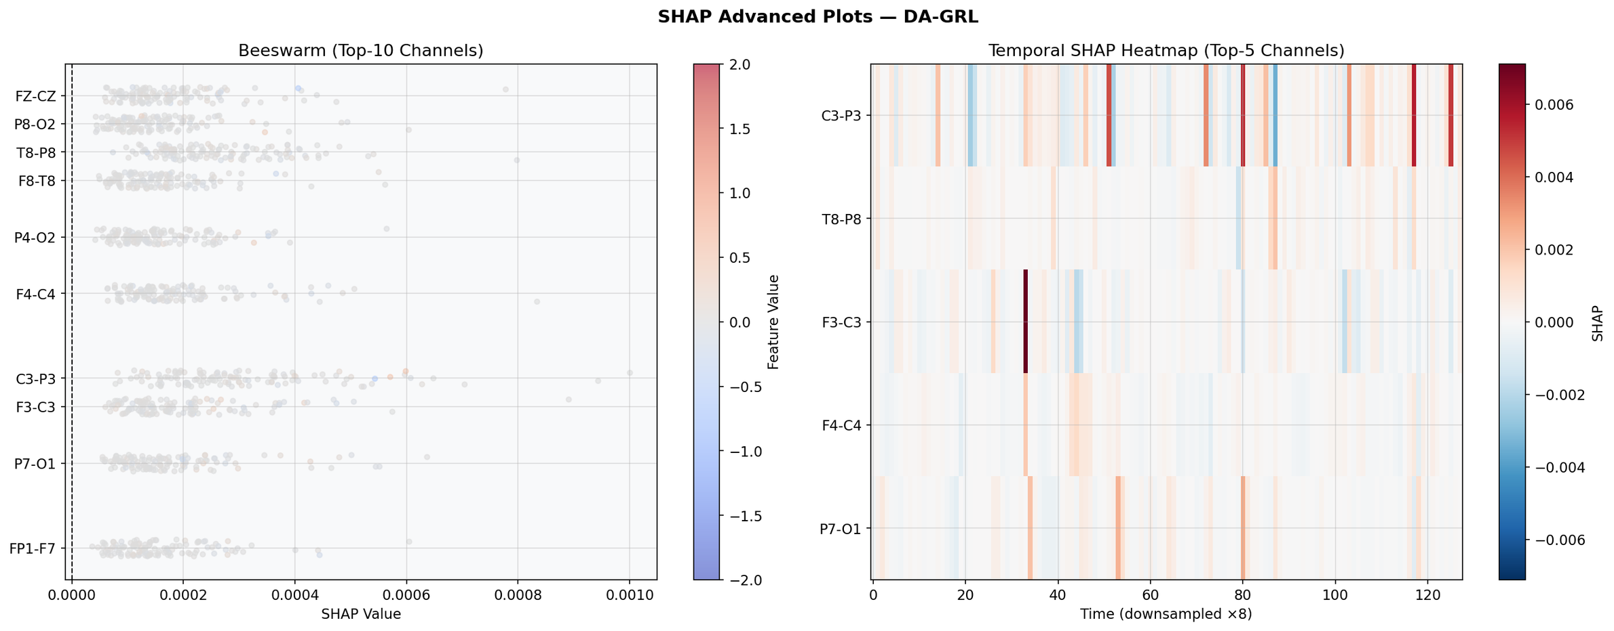
XAI
SHapley Additive exPlanations(SHAP) Analysis
SHAP analysis identifies C3-P3, T8-P8, and F3-C3 as the most influential EEG channels contributing to seizure prediction in the DA-GRL model.
The SHAP distribution plot shows stable and consistent feature impact across top channels, confirming reliable model interpretabilit
The SHAP beeswarm plot highlights how top EEG channels contribute differently across samples, revealing variation in feature influence for seizure detection.
The temporal SHAP heatmap shows when important seizure-related patterns occur over time, helping identify critical moments in EEG signal prediction.

Slide 22
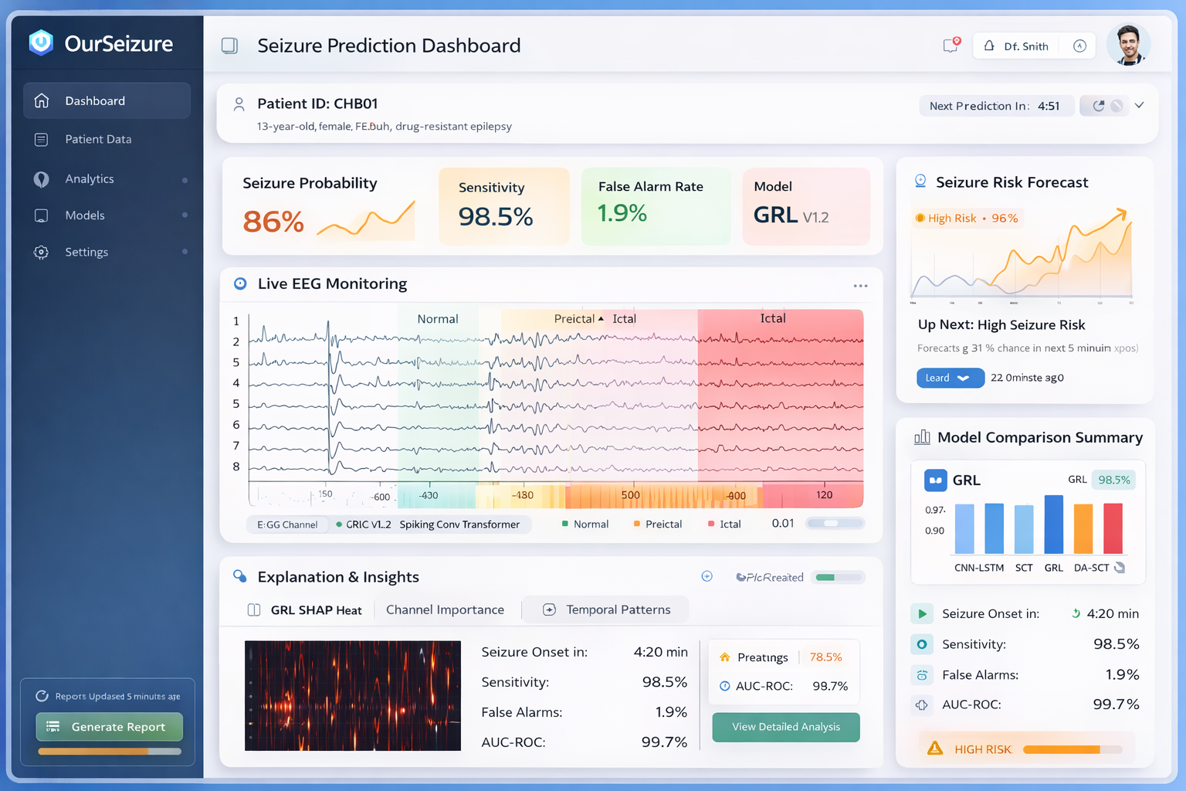
Future Implementation
XAI
AI-powered seizure prediction dashboard designed for hospitals and research environments. It integrates advanced deep learning models, including GRL-based domain adaptation, into a clean and scalable web interface.
🔹 Core Functionalities
Seizure Risk Forecast
Real-time seizure probability display
Time-to-onset estimation
High-risk alerts for early intervention
Performance Summary
Sensitivity: 98.5%
False Alarm Rate: 1.9%
AUC close to 0.99
Confusion matrix and ROC tracking
Explainable AI Module
SHAP heatmaps for channel-wise importance
Temporal pattern visualization
Transparent decision support for clinicians
Model Comparison
CNN-LSTM
Spiking Convolutional Transformer (SCT)
GRL (Domain Adaptation)
DA-SCT

Slide 23

Project Timeline
Baseline Model Training
RandomForest baseline model trained and initial performance evaluated.
14.02.2026 – I Review
SCT Model Development
SCT model built and compared with baseline for improved prediction.
21.04.2026 – III Review
Data Collection & Preprocessing
XAI Explainability Integration
Final Documentation & Submission
EEG datasets collected, cleaned, and baseline model prepared.
22.01.2026 – 0th Review
SHAP and LIME applied to explain model predictions and validate relevance.
04.04.2026 – II Review
Project report and presentation finalized and submitted.
29.04.2026 – Project Submission

Slide 24

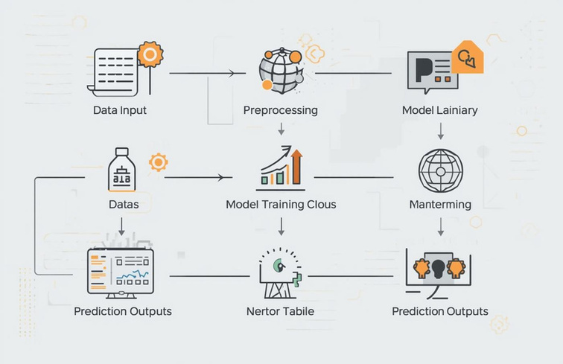
XAI
THANK YOU

