Slide 1
Data Mining
Group 14
林晓涛 Justin 1930026081
辜怡婷 Tina 1930026037
王乔一 Joey 1930026118

Slide 2
CONTENTS
1
2
3
4
5
PART ONE
PART TWO
PART THREE
PART FOUR
PART FIVE
KNN and ARIMA
GBDT Model
Random Forest
Deep Forest
Visualization
and
Examination

Slide 3
PART Zero
Introduction
Get information: baostock package
Stock: China Minsheng Bank (Code: 600016).
Time ranges: 2020/7/22 - 2021/7/21
Dependent variable: Closing price
Independent variable:
Transaction date, opening price, highest price, lowest price, transaction quantity (shares), transaction amount (yuan)

Slide 4
PART ONE
KNN and ARIMA

Slide 5
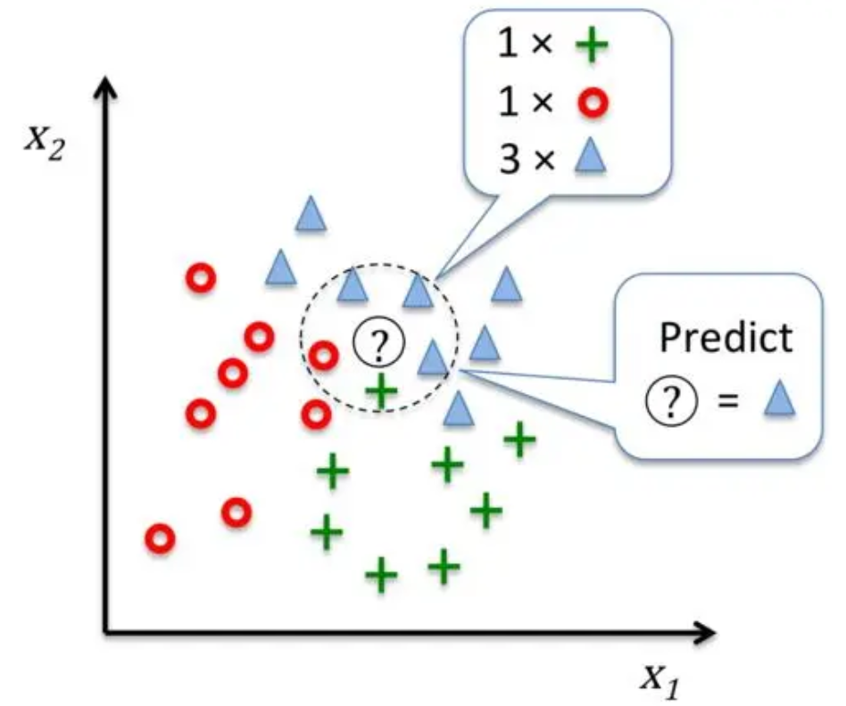
PART one
KNN
1. Calculate Distance
Euclidean distance
2. Kth Nearest neighbor
k=5
3. Get Results

Slide 6
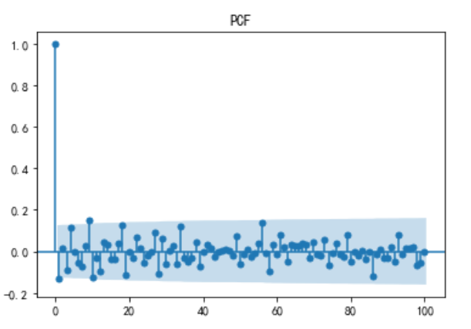
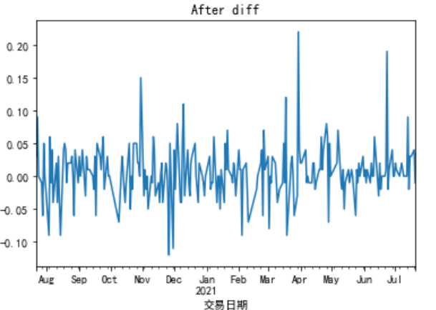
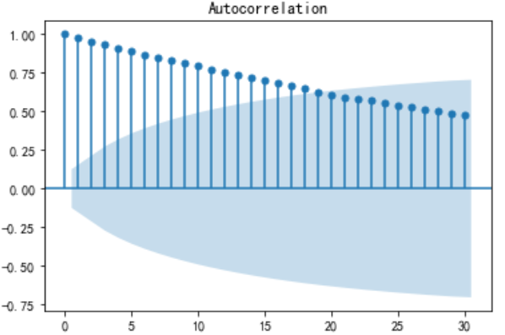
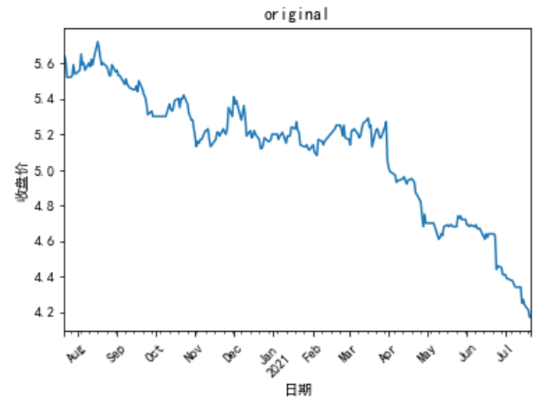
PART one
ARIMA
Time series method
1. Sequence stationarity
2. Determine the d value : d=1
The number of differential operations performed on the sequence
3. Make ACF and PACF diagrams for p and q: p=2, q=2
P: Used to predict the past value of the next value
q: The number of past prediction errors
4. Values forecast

Slide 7
PART TWO
GBDT
XGBoost and LightGBM

Slide 8
PART TWO
GBDT
Gradient boosting decision tree is a useful model developed on the basis of boosting tree. When dealing with regression problems, boosting tree can be regarded as a special case of gradient boosting tree. Since in each step of building the tree, the boosting tree is to fit the residual of the model in the training set obtained in the previous step.

Slide 9
PART TWO
Characteristic of GBDT
The decision tree model obtained in each iteration must be multiplied by a reduction coefficient, so as to reduce the role of each tree and improve the learning space.
Each iteration fits a step.

Slide 10
PART TWO
XGBoost
Gradient boosting decision tree is a useful model developed on the basis of boosting tree. When dealing with regression problems, boosting tree can be regarded as a special case of gradient boosting tree. Since in each step of building the tree, the boosting tree is to fit the residual of the model in the training set obtained in the previous step.

Slide 11
PART TWO
Characteristics of XGBoost
In addition to the reduction coefficient similar to GBDT, XGBoost penalizes the number and weight of leaf nodes of each tree to avoid over fitting.
Similar to random forest, XGBoost randomly selects some attributes for each tree as splitting attributes in the process of building the tree.
XGBoost adds support for sparse data.
XGBoost supports parallelization in implementation.
When implementing xgboost, you need to import all data into memory and do a pre sort (exact algorithm), which is faster when selecting split nodes.

Slide 12
PART TWO
Drawbacks of XGBoost
The level-wise tree building method treats all leaf nodes of the current layer equally. Some leaf nodes have very small splitting income and have no impact on the results, but they still have to be splitted, which increases the calculation cost.
The space consumption of the pre sorting method is relatively large. It is necessary to save not only the eigenvalues, but also the sorting index of the features. At the same time, it is also time-consuming. The splitting gain must be calculated when traversing each splitting point.

Slide 13
PART TWO
LightGBM
LightGBM (light gradient boosting machine) is a framework for implementing gbdt algorithm. It is considered as an improved model of XGBoost. It supports efficient parallel training, and has the advantages of faster training speed, lower memory consumption, better accuracy, distributed support, and better performance when data size is huge.

Slide 14
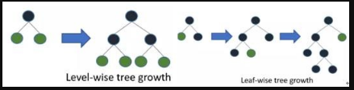
PART TWO
Some advantages of LightGBM
Accelerate the speed:
LightGBM model implements histogram algorithm, which view a histogram instead of view a table when reading the data.
Use leaf-wise method to create tree. Which decrease the calculation cost.
Save the memory
The histogram algorithm not only increase the speed, but also save the memory. It uses bin value to replace the specific value which was used in XGBoost.

Slide 15
PART TWO
Drawbacks of LightGBM
It may create a really deep decision tree which leads to overfitting. Therefore, LightGBM model adds a maximum depth limit on leaf-wise to ensure high efficiency and prevent overfitting.
Since LightGBM is an algorithm based on bias, it is really sensitive to noise point.
When doing optimization, the model relies on the optimal segmentation variable but ignore the idea that optimal solution is the set of all characteristics.

Slide 16
PART THREE
Random Forest

Slide 17
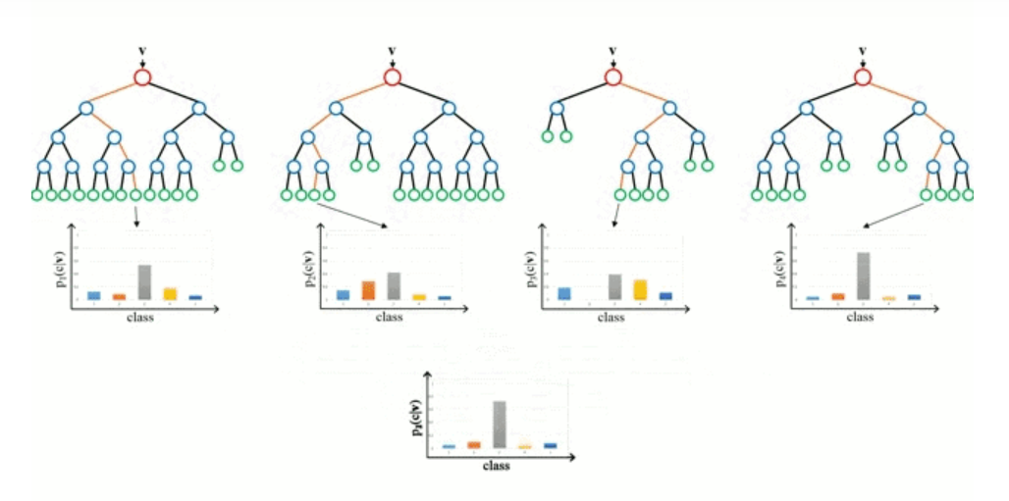
PART THREE
Definition of Random Forest
Random forest is a classifier that uses multiple decision trees to train and predict samples.
When an input enters the model, each tree in the forest would make a classification and consider the category which was classified by the trees the most time as the category of the sample.

Slide 18
PART THREE
Steps for building up a random forest
If the size of the training set is N, randomly select N training samples (with putting back) for each tree as the training set.
If each sample has M features, specify a constant m<<M. Randomly select m subsets from m features, and select the best one from these subsets each time the tree splits.
When creating trees, using step 2 to split each node of the trees. Until it cannot be splitted anymore.
Repeat step 1 to step 3, create trees to form a forest.

Slide 19
PART THREE
Advantages of random forest
It is unexcelled in accuracy among current algorithms.
It runs efficiently on large data bases.
It can handle thousands of input variables without variable deletion.
It gives estimates of what variables are important in the classification.
It generates an internal unbiased estimate of the generalization error as the forest building progresses.
It has an effective method for estimating missing data and maintains accuracy when a large proportion of the data are missing.

Slide 20
PART FOUR
Deep Forest

Slide 21
PART FOUR
Brief introduction to deep tree
The overall structure
Cascade Forest Structure
Multi-Grained Scanning

Slide 22
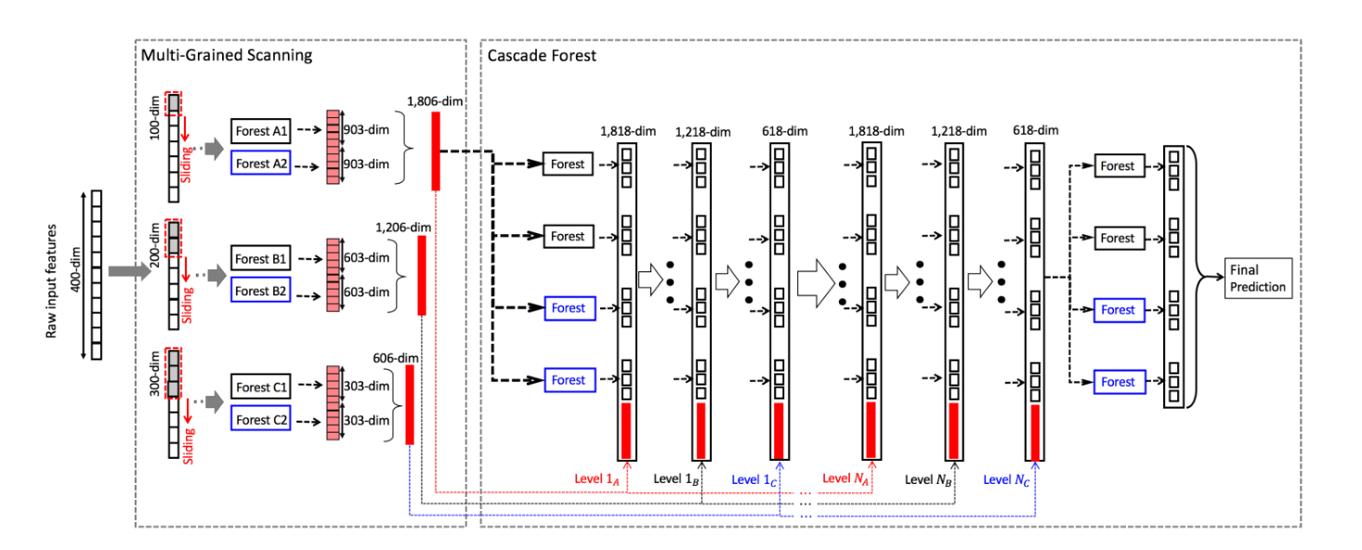
PART FOUR
The overall structure
It uses the Cascade structure, which is a multi-level structure. There are two steps:
Multi-Grained Scanning
Cascade Forest.

Slide 23
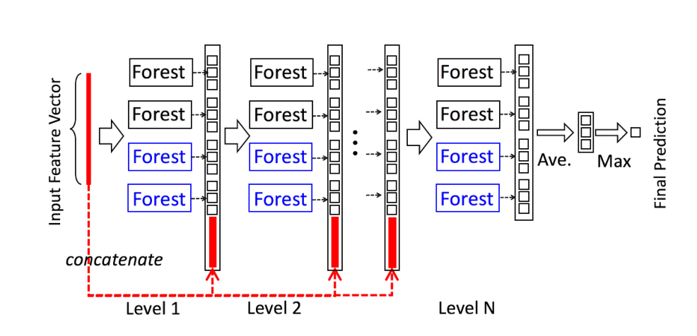
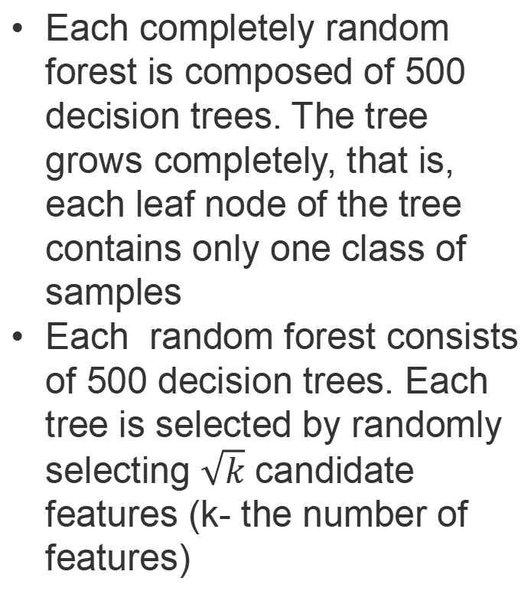
PART FOUR
Each completely random forest is composed of 500 decision trees. The tree grows completely, that is, each leaf node of the tree contains only one class of samples
Each random forest consists of 500 decision trees. Each tree is selected by randomly selecting $\sqrt{k}$ candidate features (k- the number of features)
Cascade forest Structure
Each layer consists of four random forests, two random forests (black) and two completely random forests (blue).

Slide 24
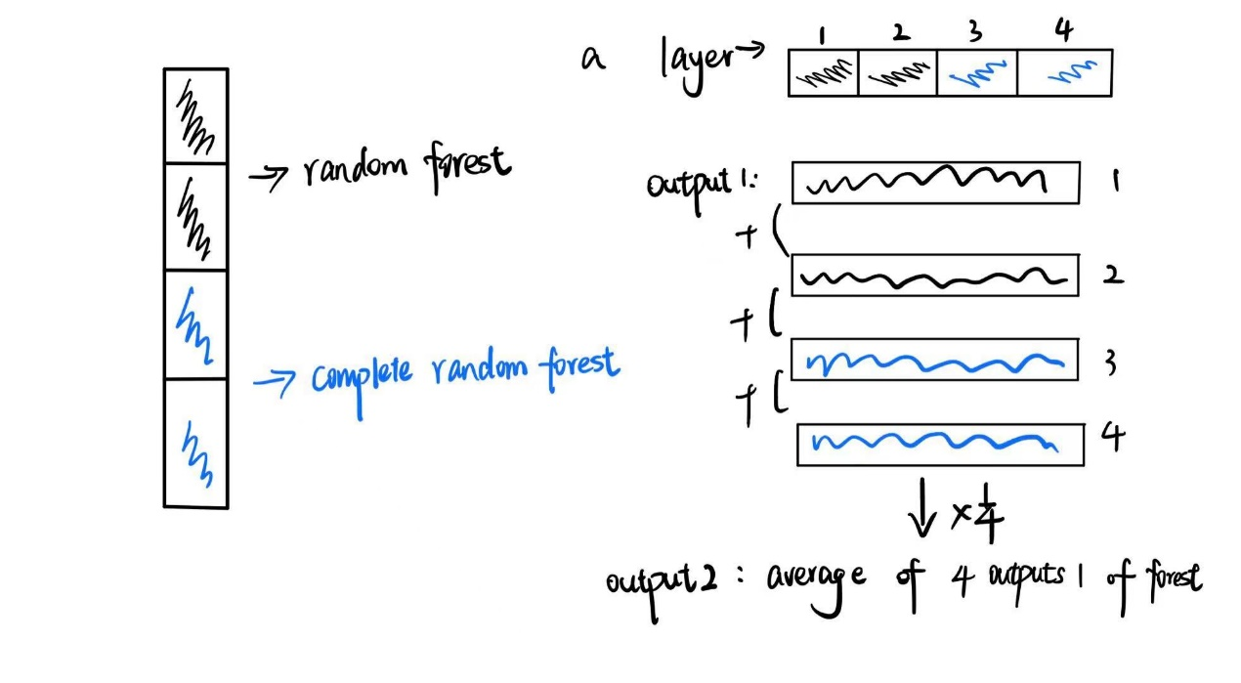
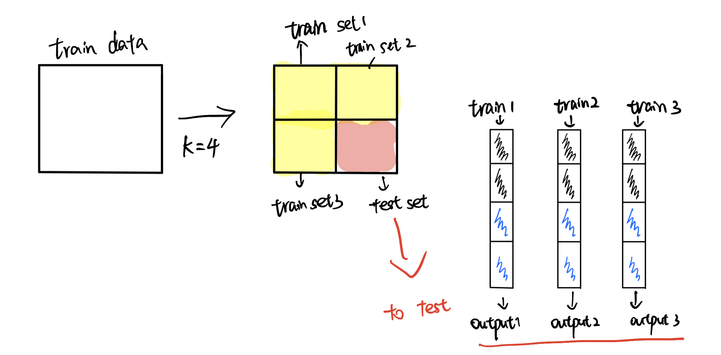
PART FOUR
Cascade forest Structure
Example for cascade forest structure
To reduce the risk of overfitting, class vector produced by each forest is generated by k-fold cross validation.

Slide 25
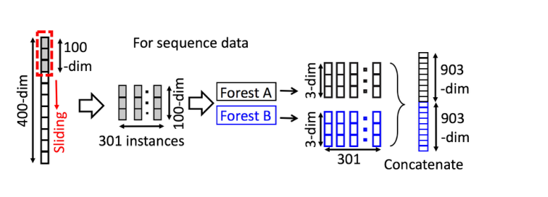
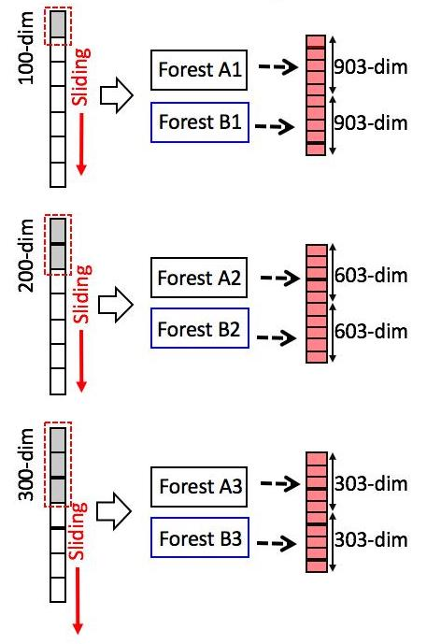
PART FOUR
Multi-Grained Scanning
Multi-granularity Scanning refers to using multiple sliding Windows of different sizes to take values on raw data.
Assume:
400 dimensions of sample input
The window size is 100 dimensions
So, number of sample is
(400-100)/1 + 1)=301

Slide 26
PART FIVE
Visualization and Examination

Slide 27
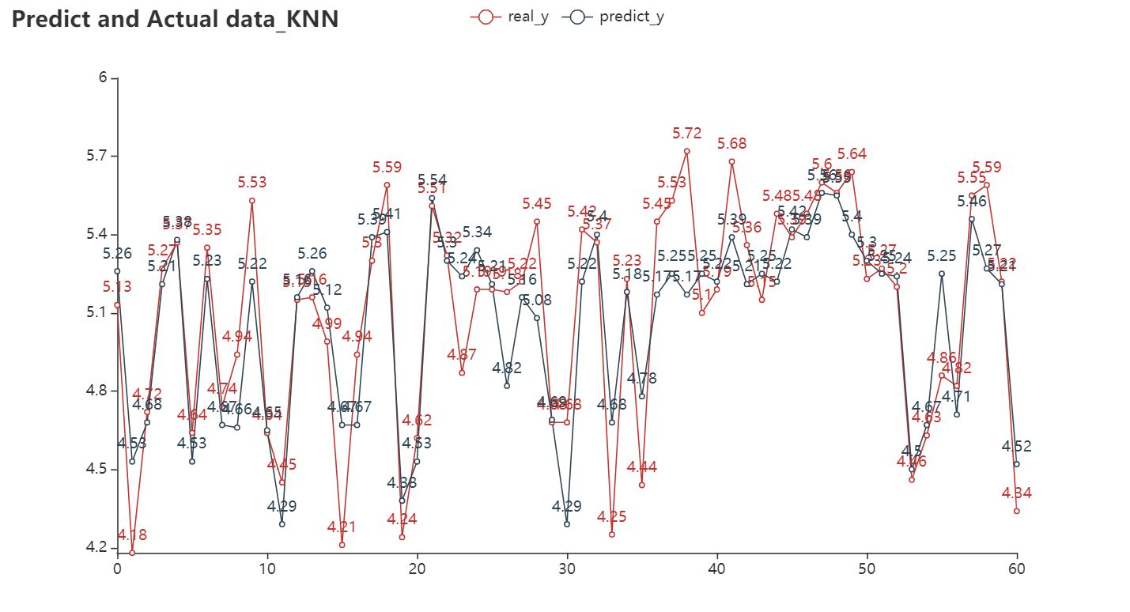
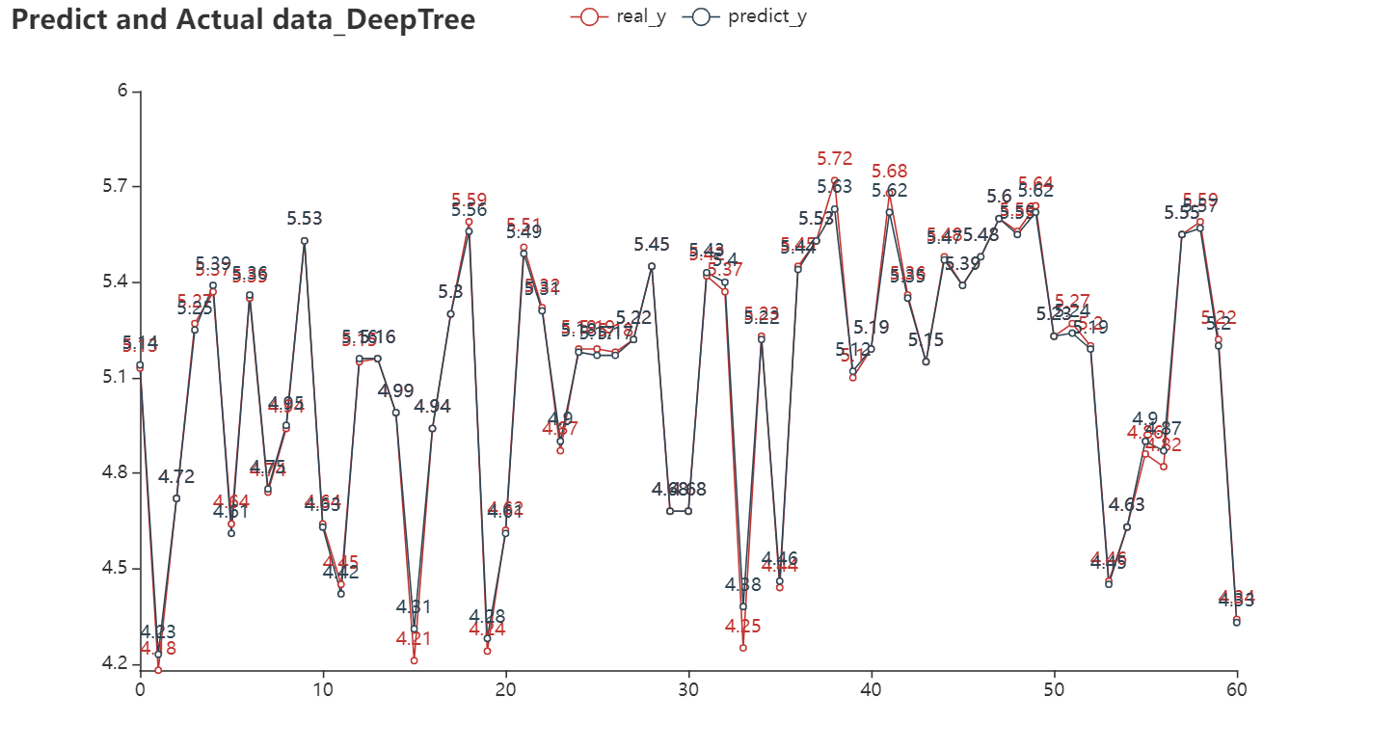
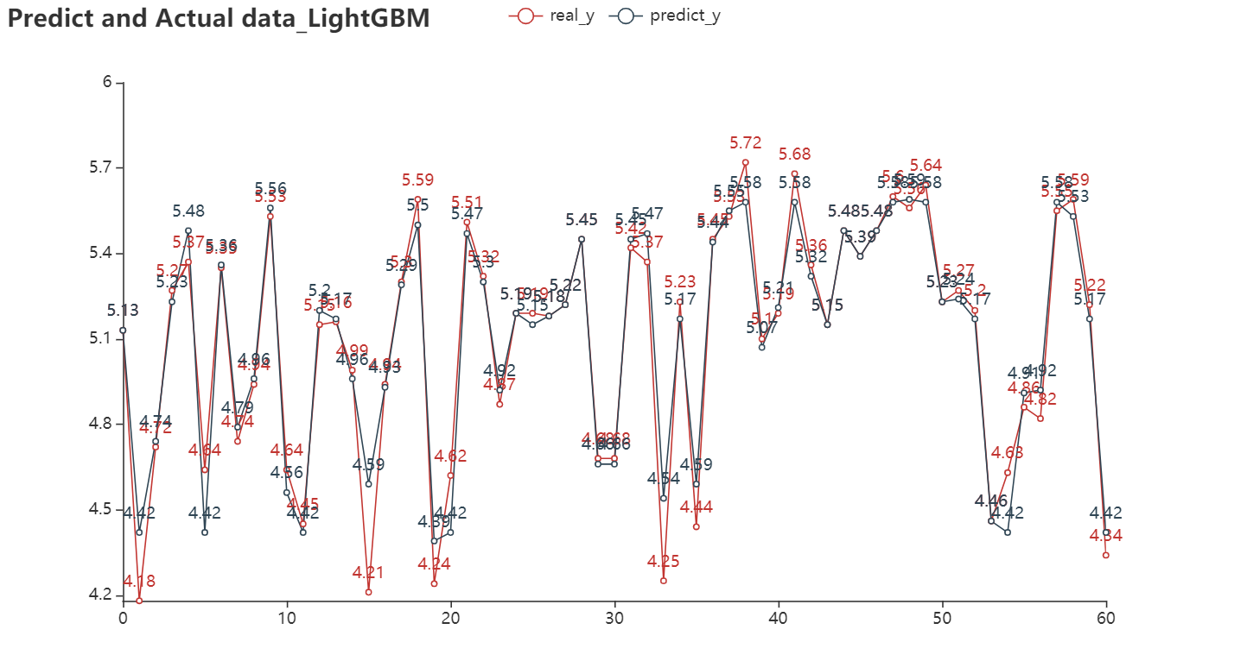
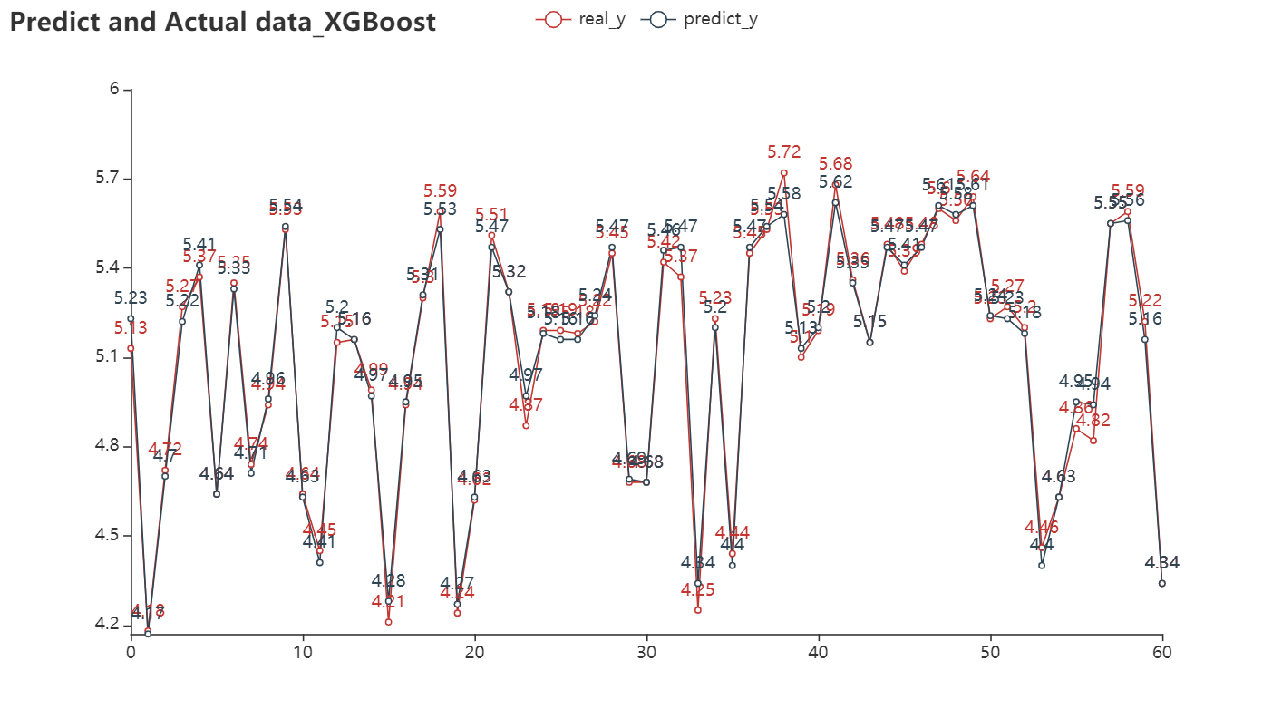
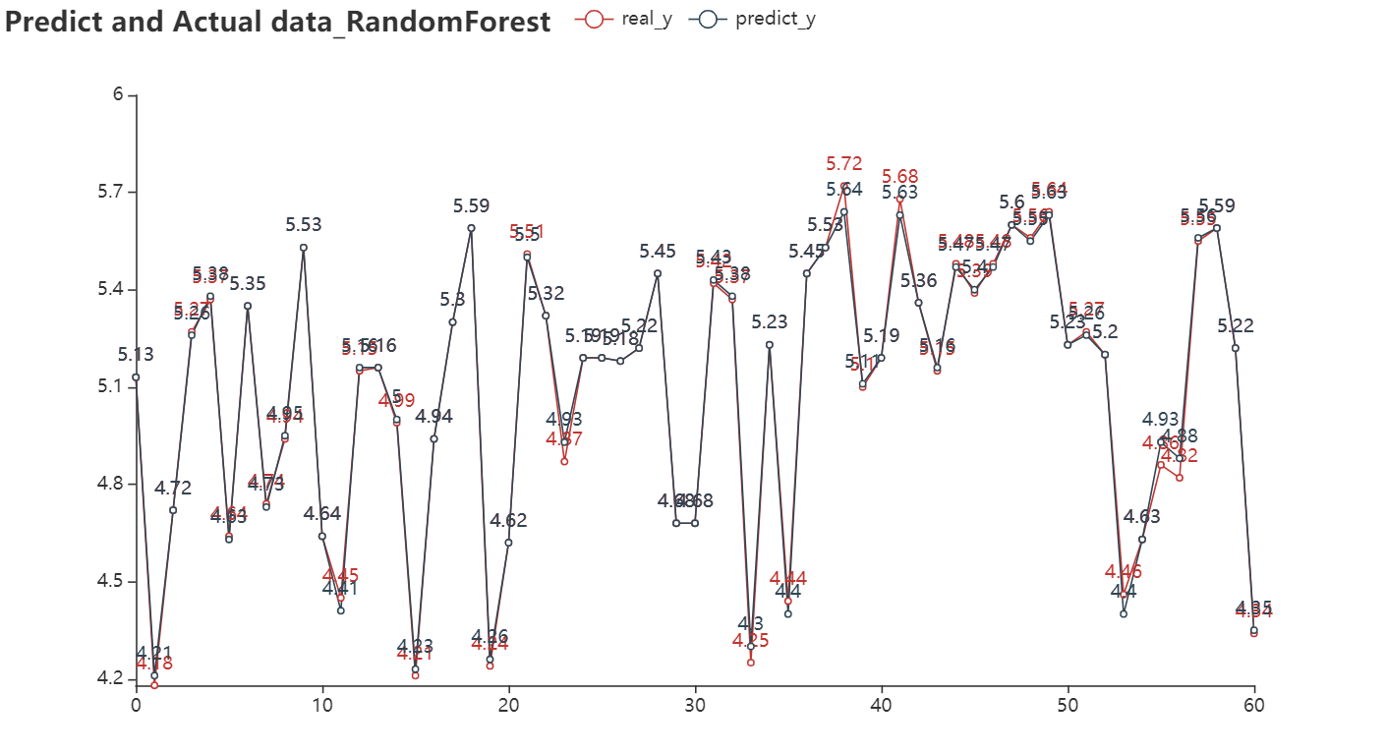
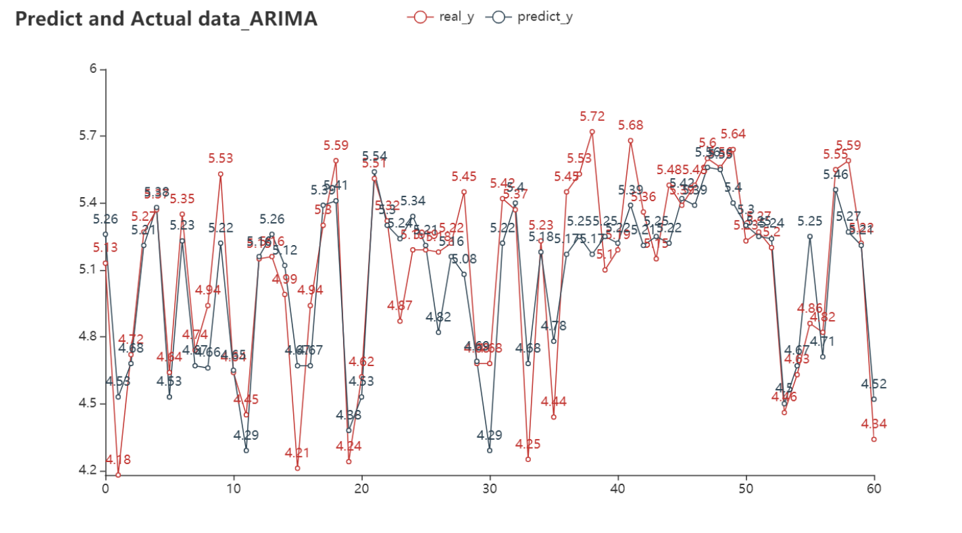
Examination

Slide 28
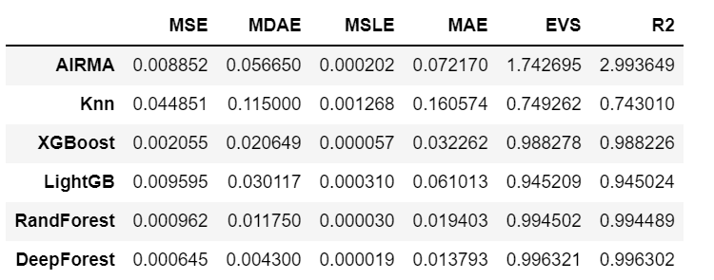
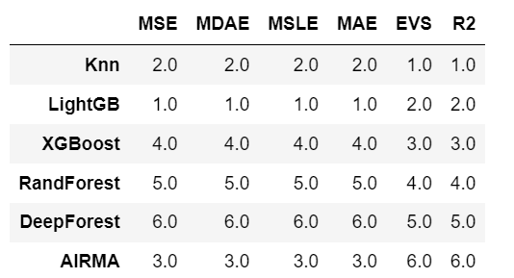
Visualization
Higher rank
== Better performance
Ranking
And Score

Slide 29
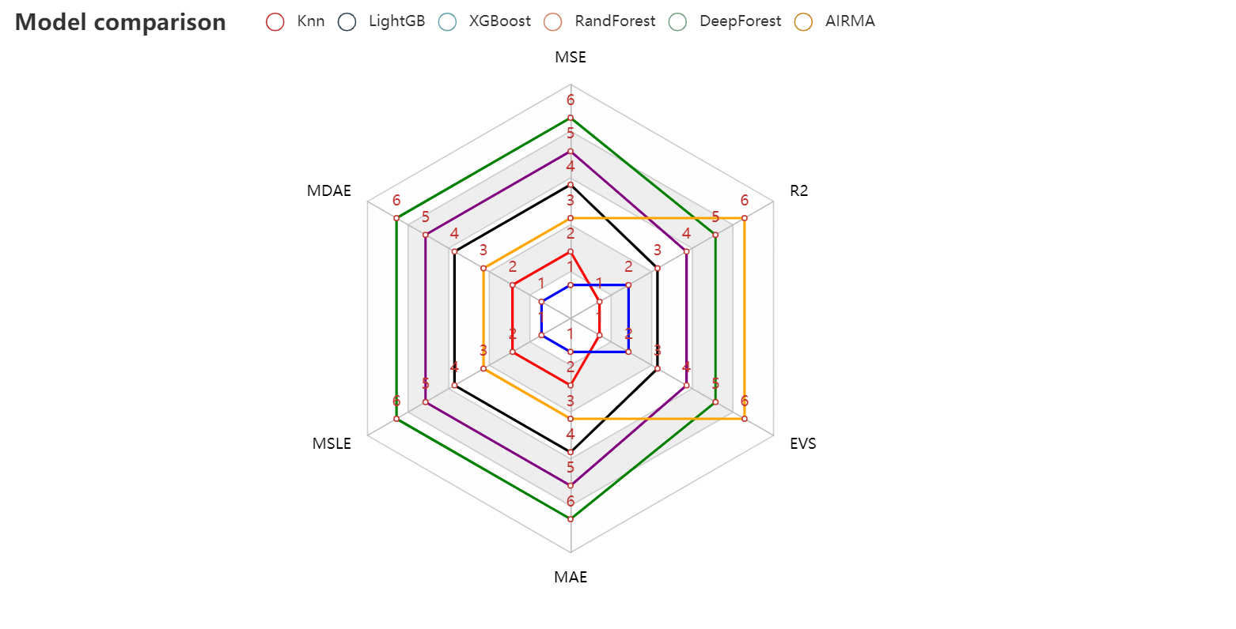
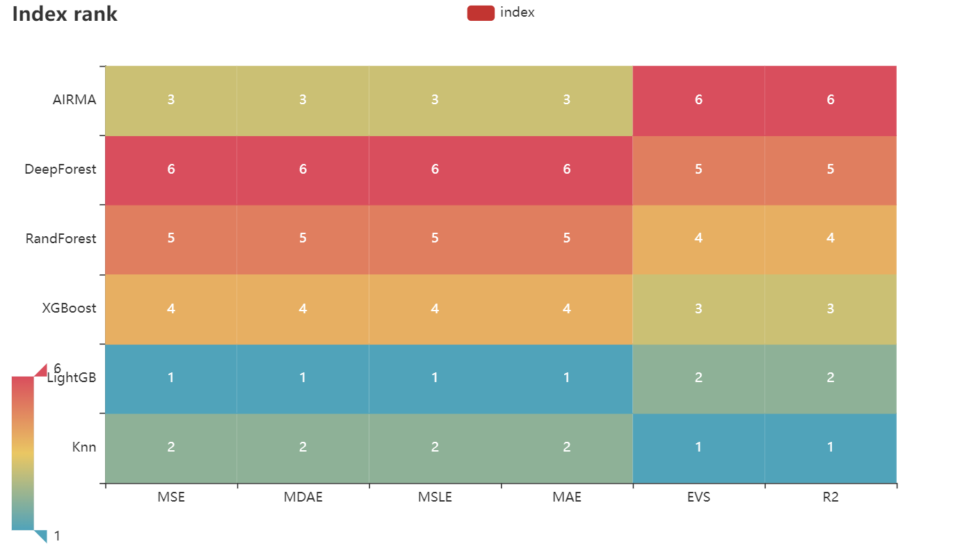
Visualization

Slide 30
Thanks for listening

