Slide 1
Research on Identification of Rumor Based on Different Models
Group 35
林晓涛 1930026081
陈熙林 1930004003
龚怡静 1930026034

Slide 2
Content
Model II
Introduction
Model III
Model I

Slide 3
Introduction: Background
The development of social media has accelerated the spread of information
Also brought about the proliferation of false rumor information
Which often triggers many instability factors and has a huge impact on the economy and society.
Identify false information
by using Machine Learning model
becomes a necessary need
Notes:
with The development of social media has accelerated the spread of information
it Also brought about the proliferation of false rumor information
Which often triggers many instability factors and has a huge impact on the economy and society.
so Identify false information by using Machine Learning model becomes a necessary need

Slide 4
Introduction: Data
Comes from Github
Contains 1538 rumors & 1849 non-rumors
Notes:
Firstly, let's introduce the data set we used. Our data set is the Chinese rumor data set from Github, each data is in JSON format, and they have been divided into rumor data set and non-rumor data set.

Slide 5
Data preprocessing
Generate a dictionary for all the words in the dataset Onde word corresponds to one number
Filling the length of the vectors to make them equilong Merge the vectors into Matrices
Word Dictionary
Length filling
Out-of-Order
word to vector
Merge the rumor and non-rumor Throw them out of order
Use the previously generated dictionary convert sentences into unequal length vectors
Notes:
Therefore, we first parse the data and label them as rumors, that is, 0 and 1, respectively.
We then used the entire data set to generate a dictionary with a number for each word. We used this dictionary to embed sentences to vectors which are unequal in length.
so we will add 0 to them to ensure they have same length
For the division of training set and test set, rumor data and non-rumor data were first scrambled and combined to ensure the randomness of data,
Then 80% of them are be used as training set, the rest are testing set
So we have a total of 3,387 vectors of varying lengths, about 80 percent of the training set.

Slide 6
Model I
Using:
SVM
Logistic Regression
Ensemble Learning - bootstarp
Notes:
in the first part, we use three kinds of model

Slide 7
Model I: SVM & LR
 | SVM | LR
Accuracy | 0.5802 | 0.5542
Precision | 0.5659 | 0.5811
Recall | 1.0 | 0.6638
Can EL makes result better?
Notes:
the first model we use is SVM, which is also used on classifying problem, by building the model and give it our training data, we got the prediction.
next one is logistic regression, based on sigmoid and regularized_gradient to find theta with lowest cost, and here are the results.
lastly, we hope ensemble learning can make the result better

Slide 8
Model I: EL - bootstrap
Choose index with replacement randomly
Create new data set based on index
Use new data set to train model
Store 101 results and voting
Notes:
how do we do ensemble learning:
first we Choose index with replacement randomly, the size is same with original data
then Create new data set based on index and Use new data set to train model
lastly we Store 101 results and voting

Slide 9
Model I: EL - bootstrap
 | SVM | LR
Accuracy | 0.5802 | 0.5590
Precision | 0.5659 | 0.5836
Recall | 1.0 | 0.6767
Notes:
here is the result, it`s so strange that result of SVM is same as above,
but by printing the result of each loop we can ensure that EL model works well,
we guess it`s because the recall is 1 already,
which means SVM always put non-rumous into rumous, so it`s hard to prove.
from the logistic regression we find that it`s result has been proved.

Slide 10
Question:
What about other models?

Slide 11
Model Ⅱ
Using:
RNN-LSTM
Notes:
Next, let's introduce the neural network of long and short term memory that we have configured.

Slide 12
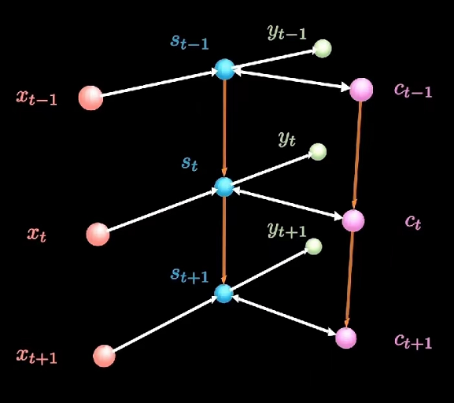
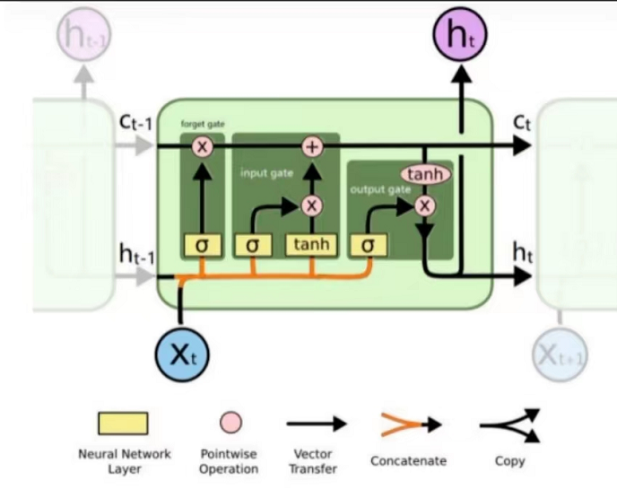
LSTM : Modelling
Embedding Layer : transfer the input sentences into vetors
1 Fully Connected Layer(128 inputs for each batch) 1 Long term Memory Chain
Max-Pooling : Retain key feture
Reduce the number of output eigenvalues
Softmax Layer : output layer with size of 2
Notes:
Long short-term memory records long-term memory on the basis of recurrent neural network. In other words, when we calculate the hidden layer state, we need to use not only the current input and the hidden layer information of the previous hidden state, but also the long-term memory information of the current state.
Therefore, our model combines a fully connected layer and a long term memory layer, and carries out maximum pooling operation on them respectively to reduce the parameters of training while retaining features. Finally, the output with 0 and 1 labels are acquire with a softmax layer.

Slide 13
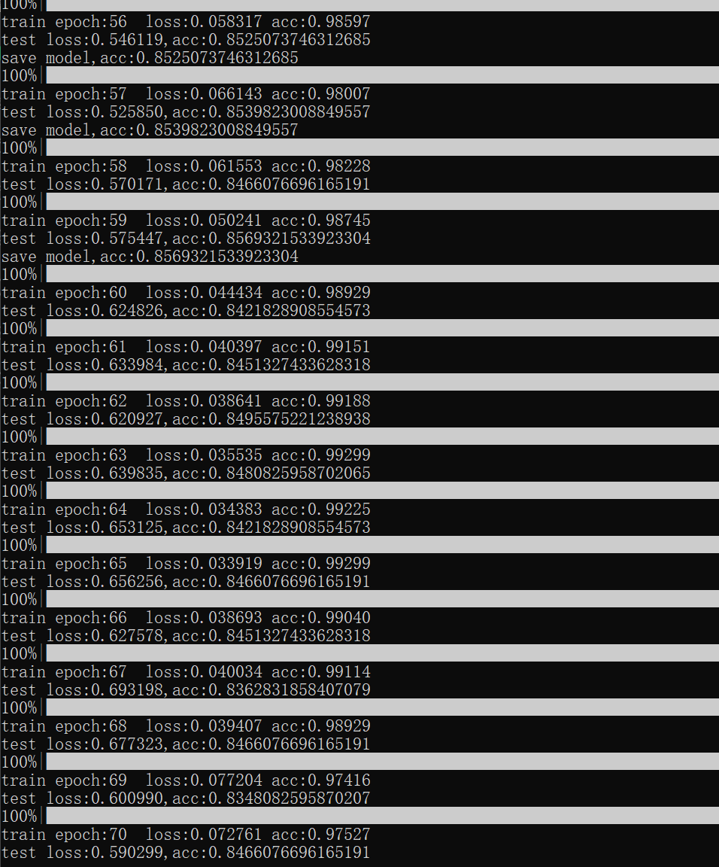
LSTM : Model Optimization
Optimizar : Adaptive Gradient Optimizer
Learning rate : 0.001
Epoch number : 70 Batch size : 128
Loss Function : Cross Entropy Loss Function
For the final term validation:
Accuracy = 0.85
CrossEntropyLoss = 0.59
Notes:
For the parameters, we basically use the learning rate of 0.001, epoch number of 70 and batch size of 128. The batch size is the number of input data for each iterations. After simply defining the Cross entropy loss function and accuracy, we can train the model with the Adaptive Gradient Optimizer. For each epochs , we print the training information and used the test set to calculate the current prediction loss and accuracy.

Slide 14
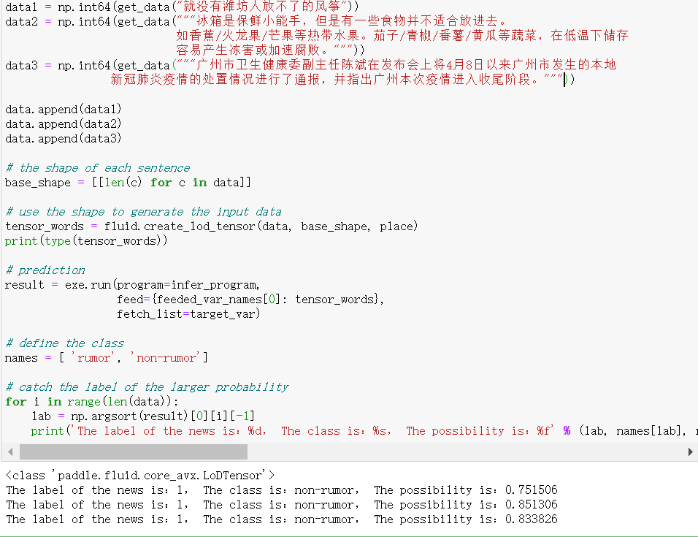
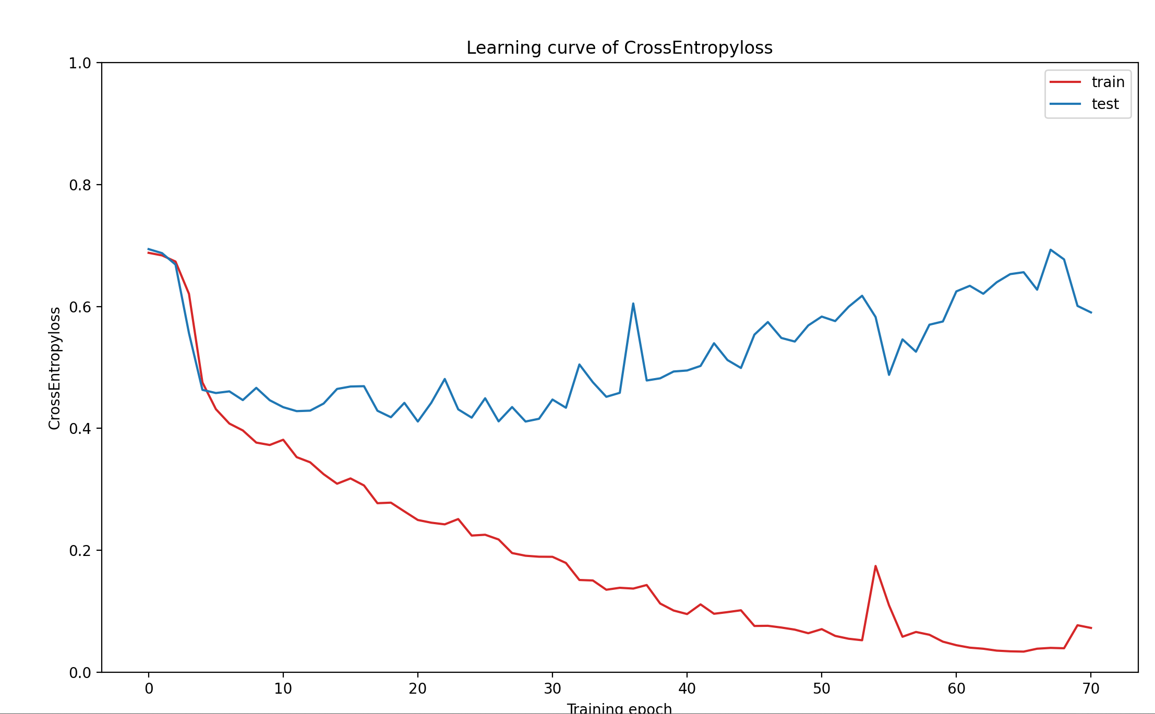
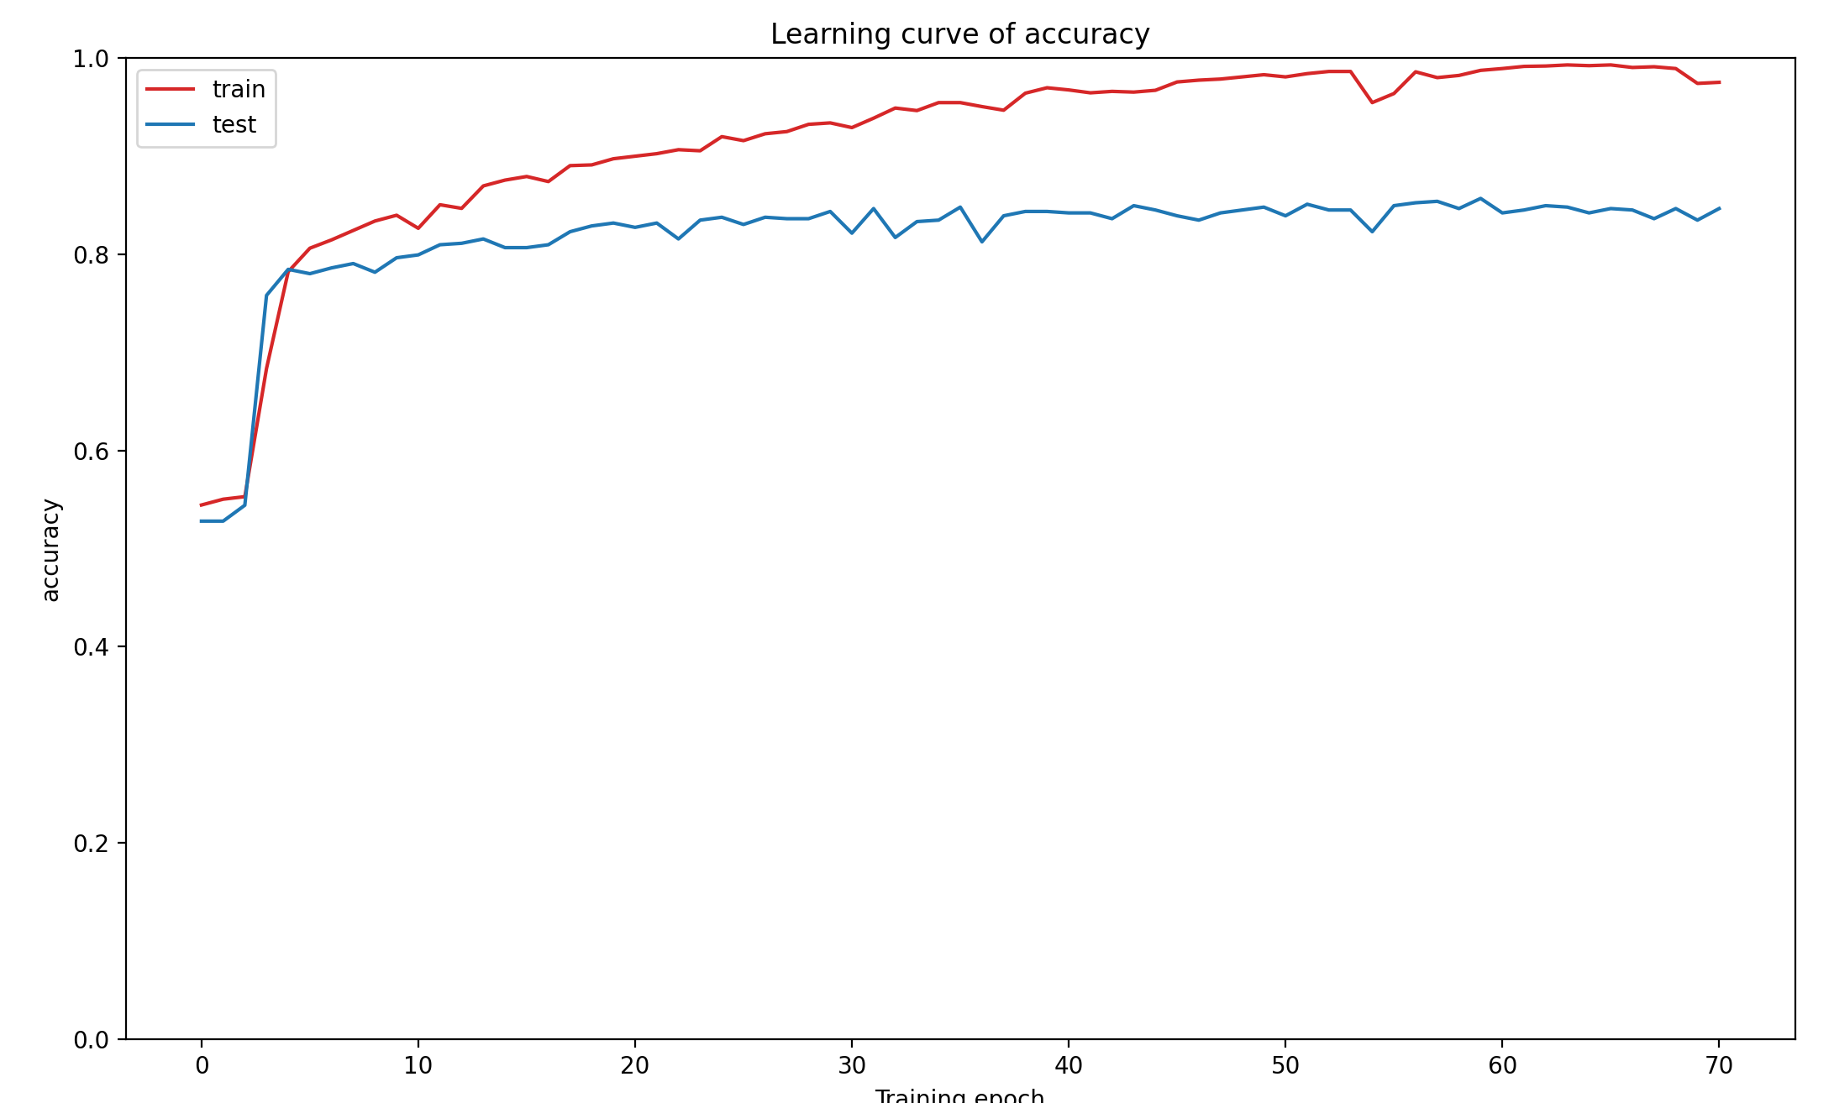

LSTM : Model Evaluation and Prediction
Visualize training results
The judgement are all reliable!
But the possibility is a bit low.
Notes:
We can see that after using the parameters defined by us, the accuracy of model training reaches to 0.85, and the prediction loss is reduced to 0.59 We should be able to reliably predict whether a sentence is a rumor or not. Here we can see we have successfully judge if a sentence is a rumor or not no matter it is a news or an entertainment.

Slide 15
Model Ⅲ
Using:
BERT
Bidirectional Encoder Representation from Transformers
Bidirectional
For embedding
Notes:
Then we try to use BERT for this task, BERT is derived from the encoder of Transformer with bidirectional direction and it can be used for the improvement of the embedding part. And the BERT is consisted of two parts, pre-training and the fine-tuning.

Slide 16
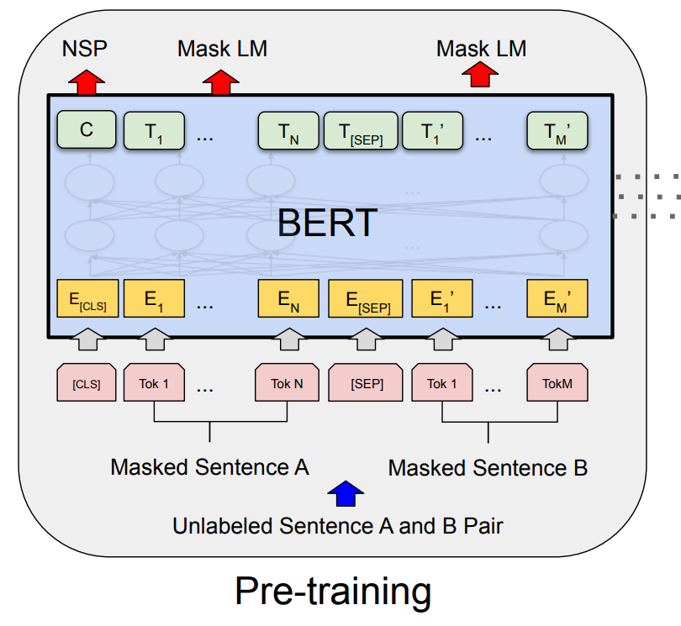
Pre-training
Goal
Predict masked words
Predict next sentences
Input
Unmarked sentence
(Select 15% of word)
80% mask, 10% replace, 10% remain
2. 50% of actual next sentences
Notes:
Pre-training has been trained by a lot of unmarked sentences. 15% of words in the sentences will be selected, for this selected word, 80% of it will be masked, 10% of it will be replaced by another word and 10% of it will be kept. The goal for it is to train a model which can predict the masked words and predict the next sentence.

Slide 17
Fine-tuning
Softmax
Cross entropy
Truth value
Goal
For corresponding exact mission
Linear
Input
Sentence in the task
input the weibo-rumor-dataset
null
Rumor dataset
Fine-tuning
Notes:
For fine-tuning, we training the model with the corresponding mission. Since we want to make a classify task with estimate the rumor sentences, this model is trained by the sentence of the weibo-rumor dataset.

Slide 18
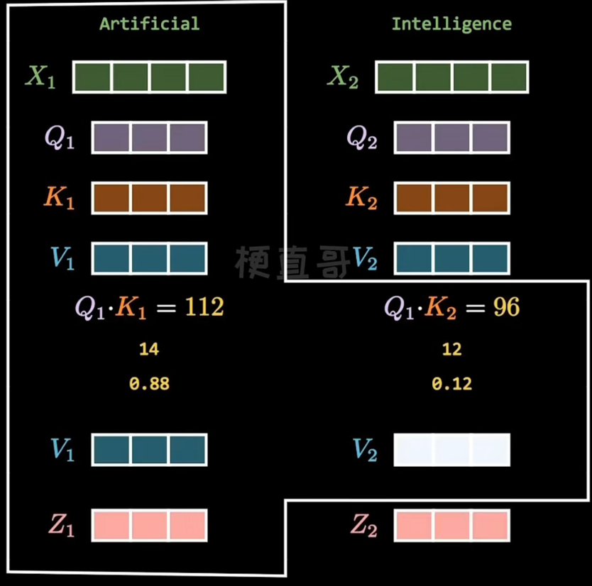
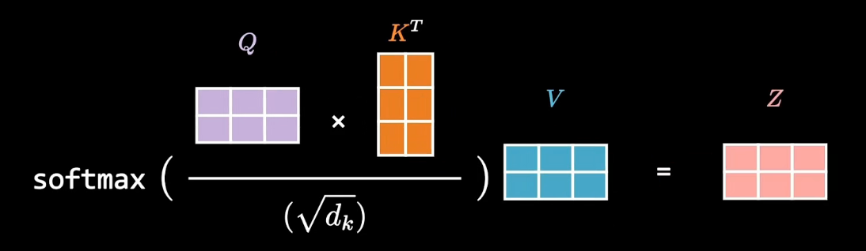
Important concept
Input
vector
Query matrix
1. Self attention
Key matrix
Value matrix
Attention weight
Normalization
Softmax
Value matrix
Sum
Notes:
Here is some important concept of this model
The first one is the self-attention, which is also a core of the Transformer. It is applied in the encoder part of the Transformer, which is append the position data and the relationship between each word by weight, output of single of it is Z

Slide 19
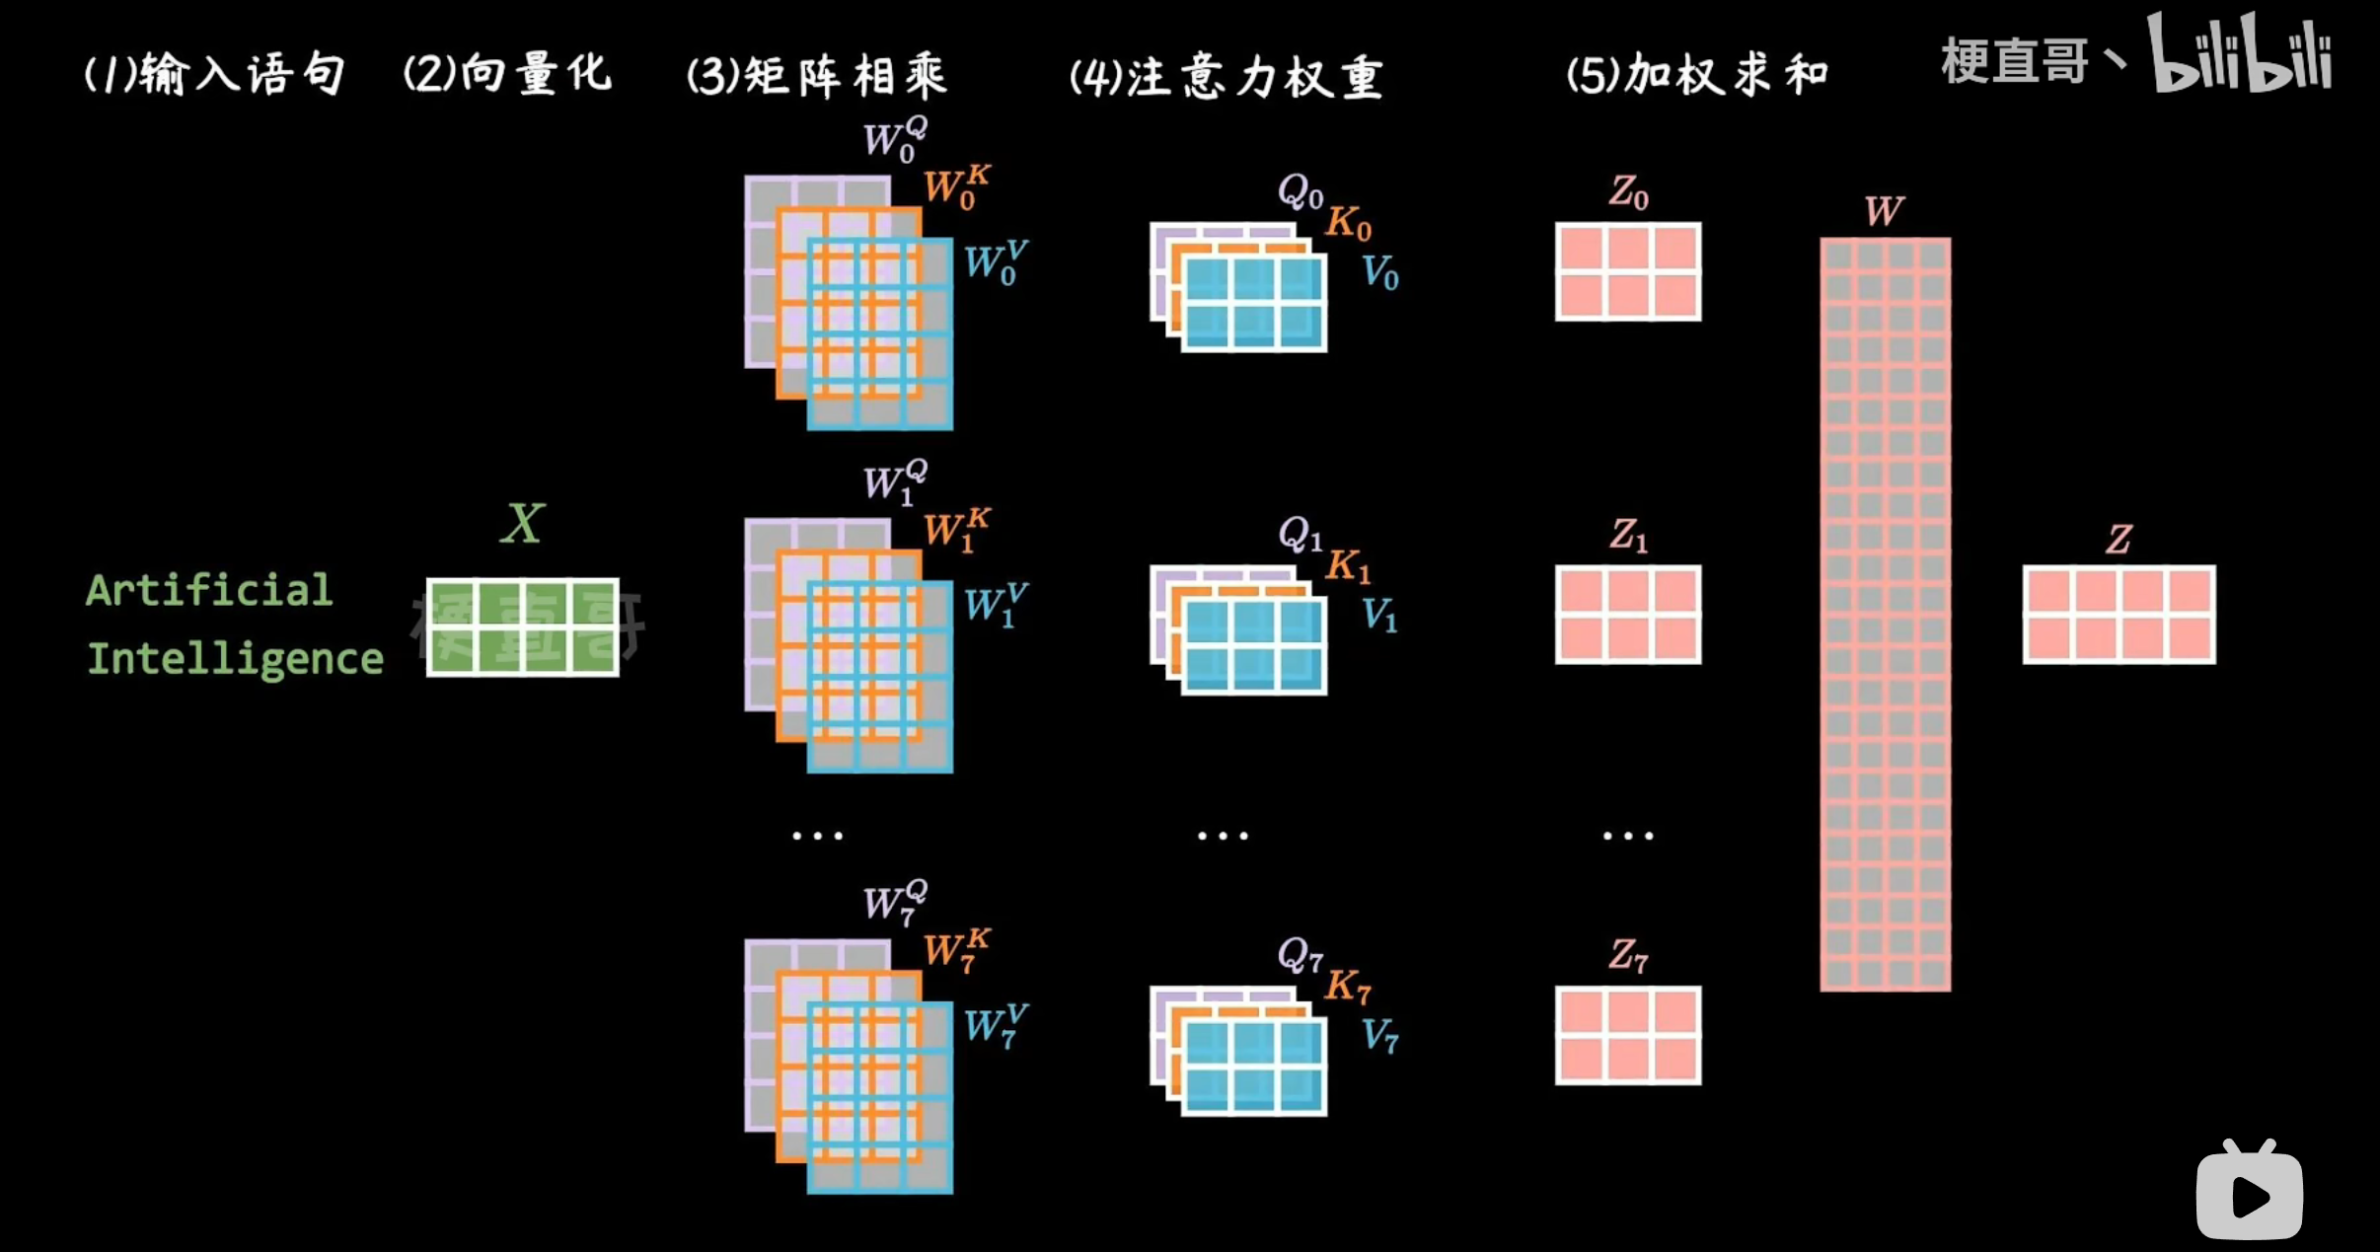
2. Multi-Head Attention
Input
Vectorization
Attention matrix
Concat
Linear
Calculates the Z for 8 times
Notes:
Based on it, it calculates the Z for 8 times with different weighted matrix Q K V. So, the whole structure of it is

Slide 20
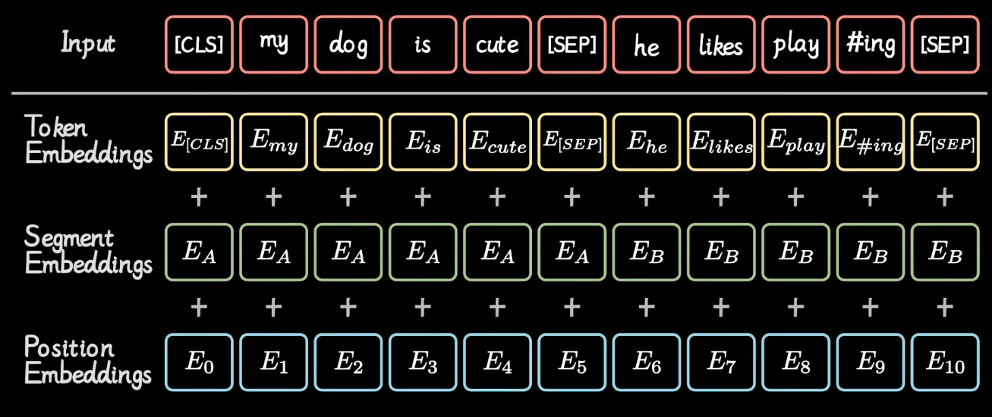
3. Embedding part
Notes:
Another one is embedding part, the procedure is generating the input by the token embeddings, segment embeddings and the position embeddings.

Slide 21
Workflow
Tokenizer: bert-base-chinese
Same length vector: Padding 0 or cutting information
Attention mask: indicate position and word
Embedding
Linear: Single layer of fully connected neural network
Notes:
For the coding, we use the bert-base-chinese from huggingface, the package transforming the Chinese sentences into the vector one word to one number.
We padding 0 or cutting information make the length of the vector be the same, and then get the attention mask which indicate the position with meaningful word.
We just apply the totally connected neural network after we confirm embedding, and after the training, we can get the result.

Slide 22
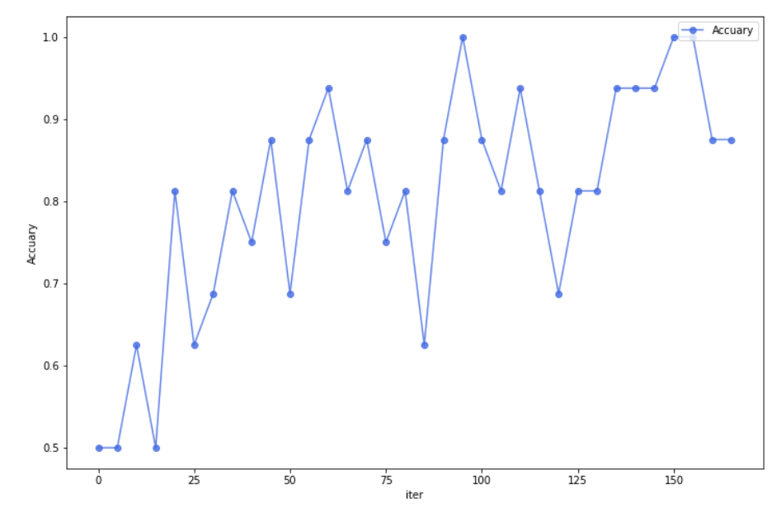
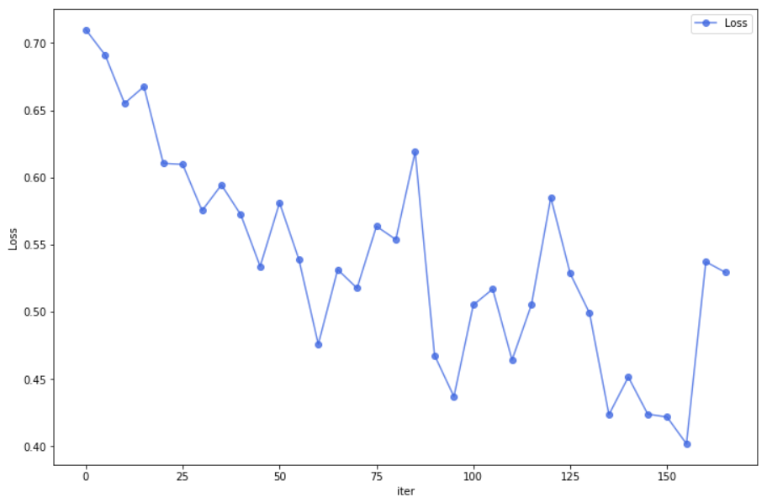
Performance
Confusion matrix for test set
Training loss and accuarcy
 | 0 | 1
0 | 150 | 41
1 | 18 | 215
Performance on test set
Accuracy | 0.861
Precision | 0.840
Recall | 0.923
F1 Score | 0.879
Notes:
The performance of the model is shown as follow for each epoch, which is the loss and the accuracy.

Slide 23
Conclusion
 | SVM | LR | EL-SVM | EL-LR | LSTM | BERT
Accuracy | 0.580 | 0.554 | 0.580 | 0.559 | 0.833 | 0.861
Precision | 0.566 | 0.581 | 0.566 | 0.584 | 0.825 | 0.840
Recall | 1.0 | 0.664 | 1.0 | 0.678 | 0.875 | 0.923
F1 Score | 0.723 | 0.620 | 0.723 | 0.627 | 0.849 | 0.879
Notes:
In conclusion, we apply the Linear regression, SVM, EL with SVM, LSTM and Bert for the weibo rumor detect, as we can see from the slides, the LSTM and the Bert have better performance. While there is still something we can make further improvements. For example, for the part of basic model, we can improve the embedding part instead of changing the word to number directly. Besides, we can use other advanced model after the word embedding by BERT.

Slide 24
Reference
1. John Duchi. Adaptive Subgradient Methods for Online Learning and Stochastic Optimization. Journal of Machine Learning Research 12 (2011) 2121-2159
2. Andrew L. Maas, Raymond E. Daly, Peter T. Pham, Dan Huang, Andrew Y. Ng, & Christopher Potts. Learning Word Vectors for Sentiment Analysis Stanford, CA 94305
3. Y. Bengio, R. Ducharme, P. Vincent, & C. Jauvin. 2003. a neural probabilistic language model. Journal of Machine Learning Research, 3:1137–1155, August
4. Vaswani, A., Shazeer, N., Parmar, N., Uszkoreit, J., Jones, L., Gomez, A. N., Kaiser, Ł., & Polosukhin, I. (2017). Attention is all you need. Paper presented at the , 2017- 5999-6009.
5. Jacob, D., Ming-Wei, C., Kenton, L., & Kristina T.(2018). BERT: Pre-training of Deep Bidirectional Transformers for Language Understanding.
6. Song, C., Tu, C., Yang, C., Liu, Z., & Sun, M.,(2018). CED: Credible Early Detection of Social Media Rumors.

Slide 25
THANK YOU
FOR WATCHING

