Slide 1
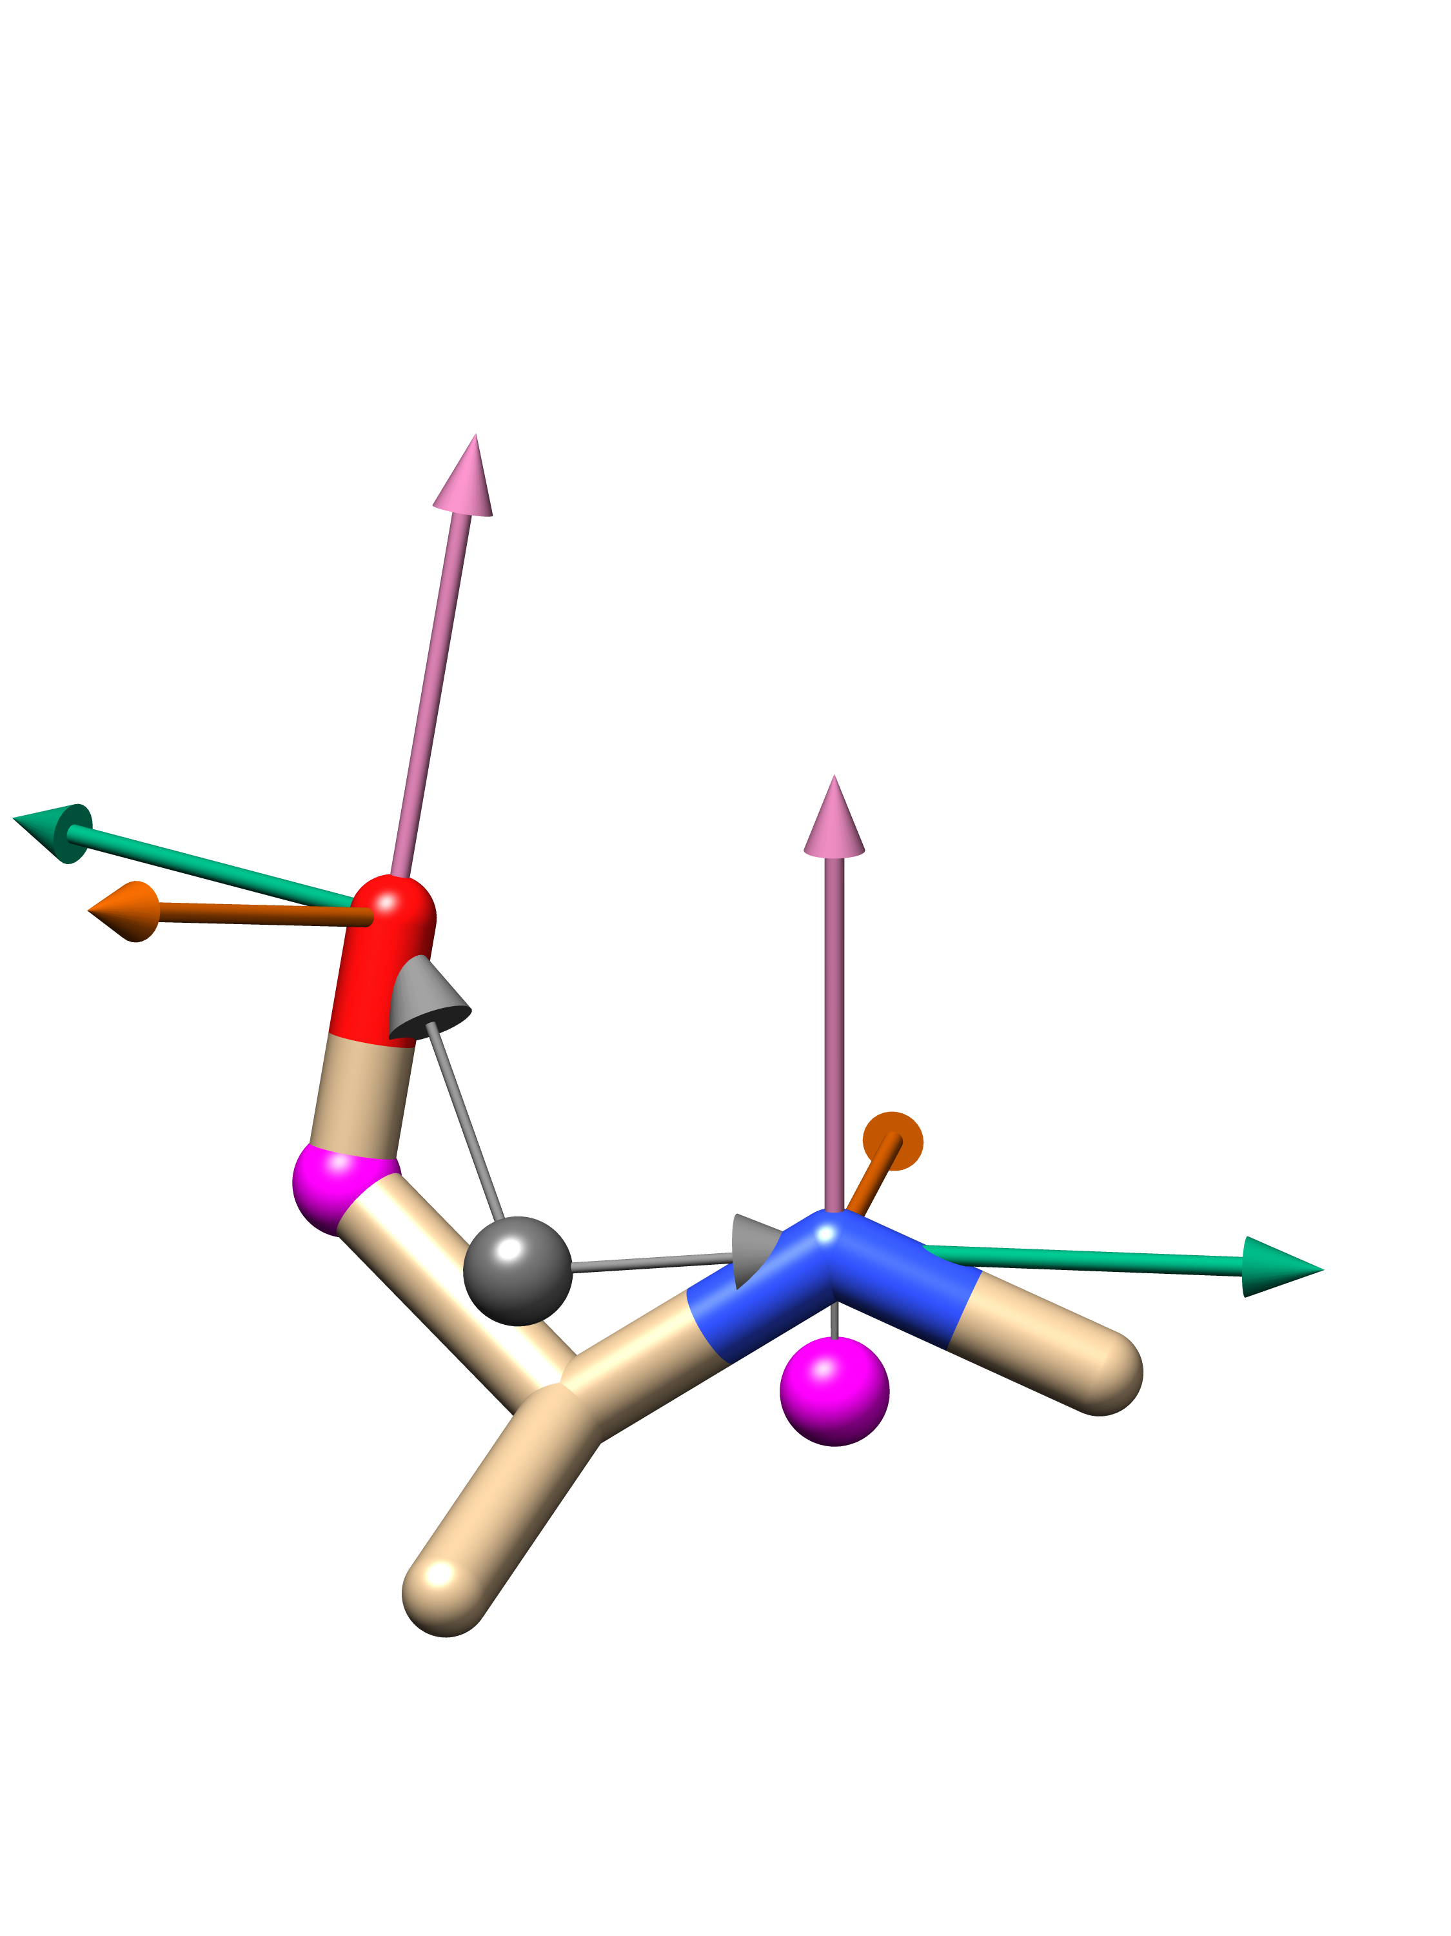
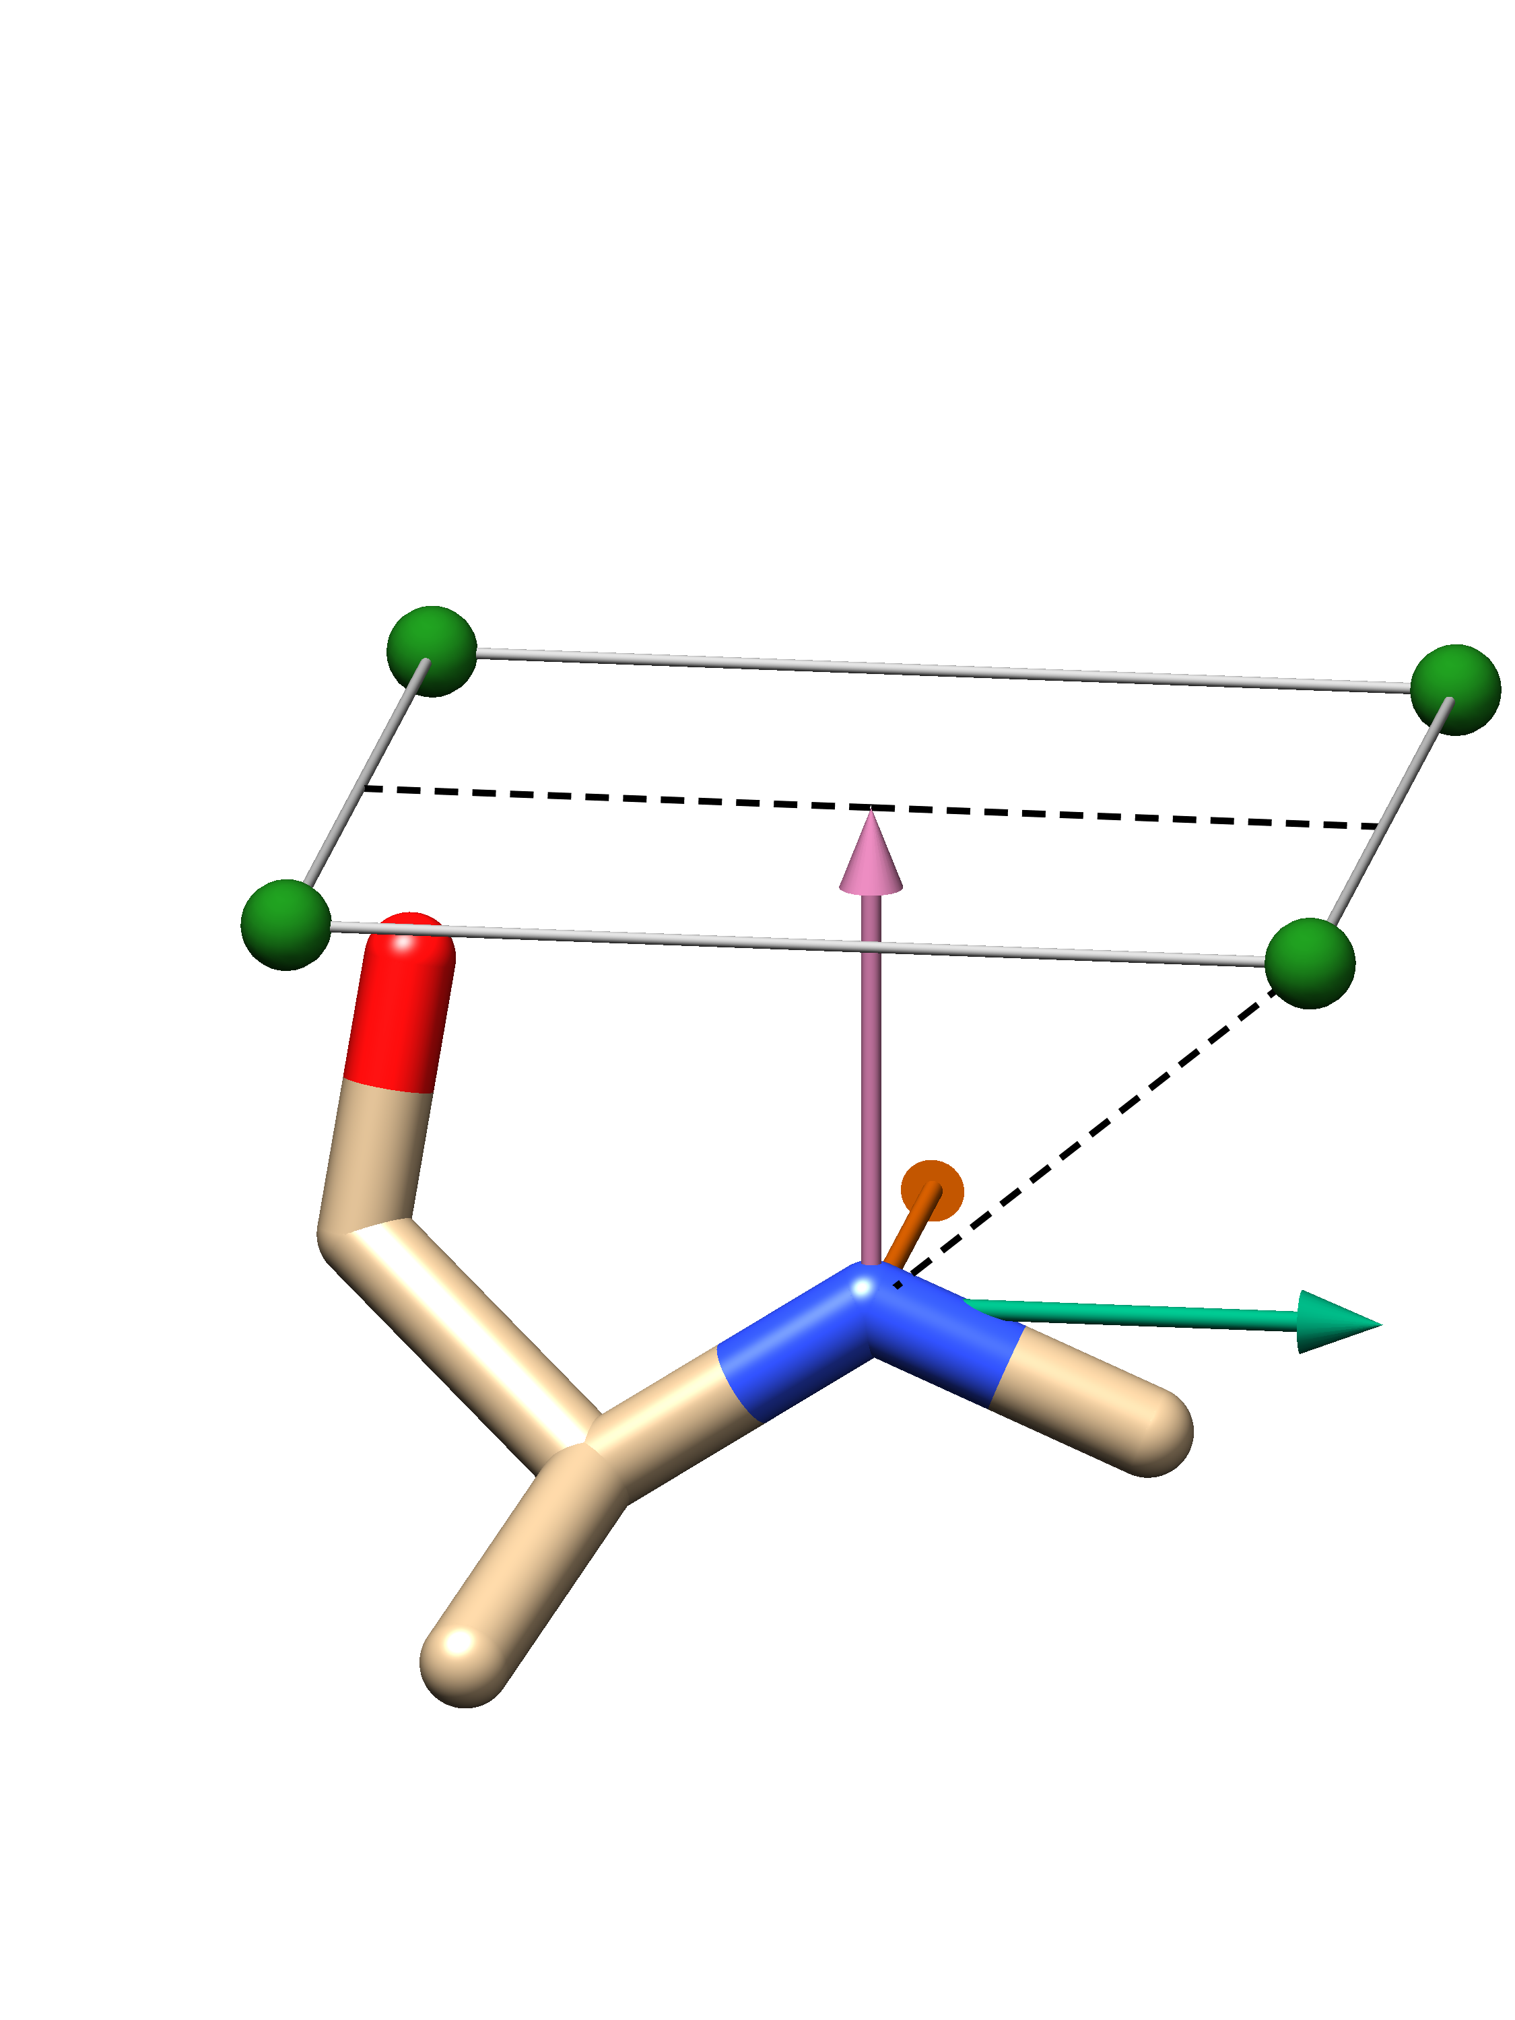


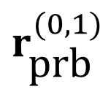

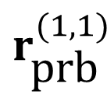

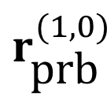
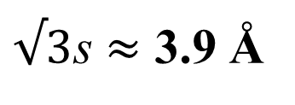
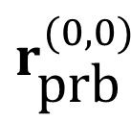
(a)
(b)
$$r_{\text{prb}}^{(1,0)}$$
$$r_{\text{prb}}^{(0,0)}$$
2s = 4.5 Å
$${\hat{a}}_{1}$$
s
s
$$r_{\text{prb}}^{(1,1)}$$
$$r_{\text{prb}}^{(0,1)}$$
$${\hat{a}}_{3}$$
s = 2.25 Å
$√3$s $≈$ 3.9 Å
$$\hat{c}$$
$${\hat{a}}_{2}$$
Centroid of the bonded heavy-atom neighbors
Probe node
Residue centroid

