Slide 2
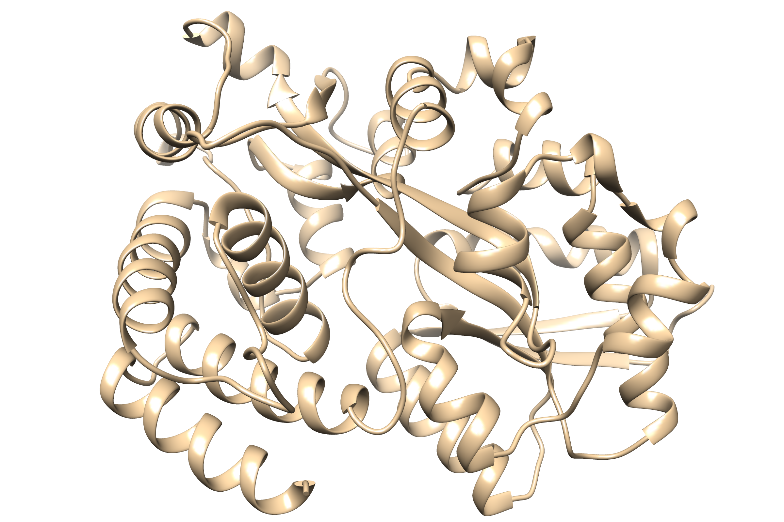
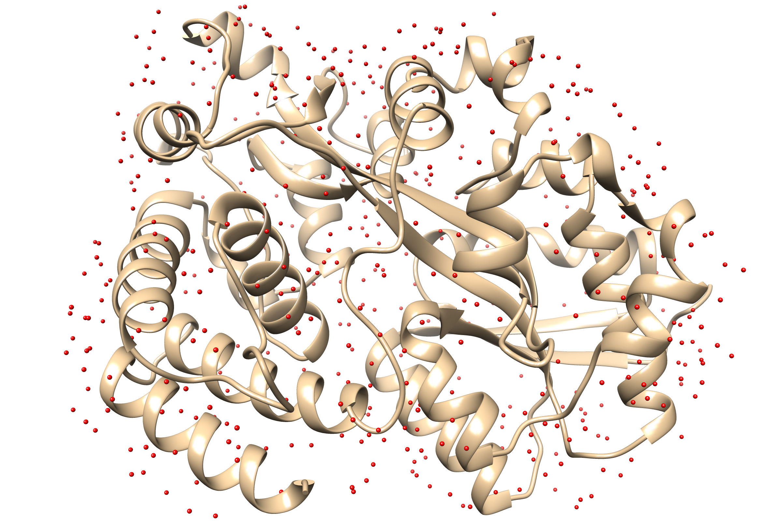
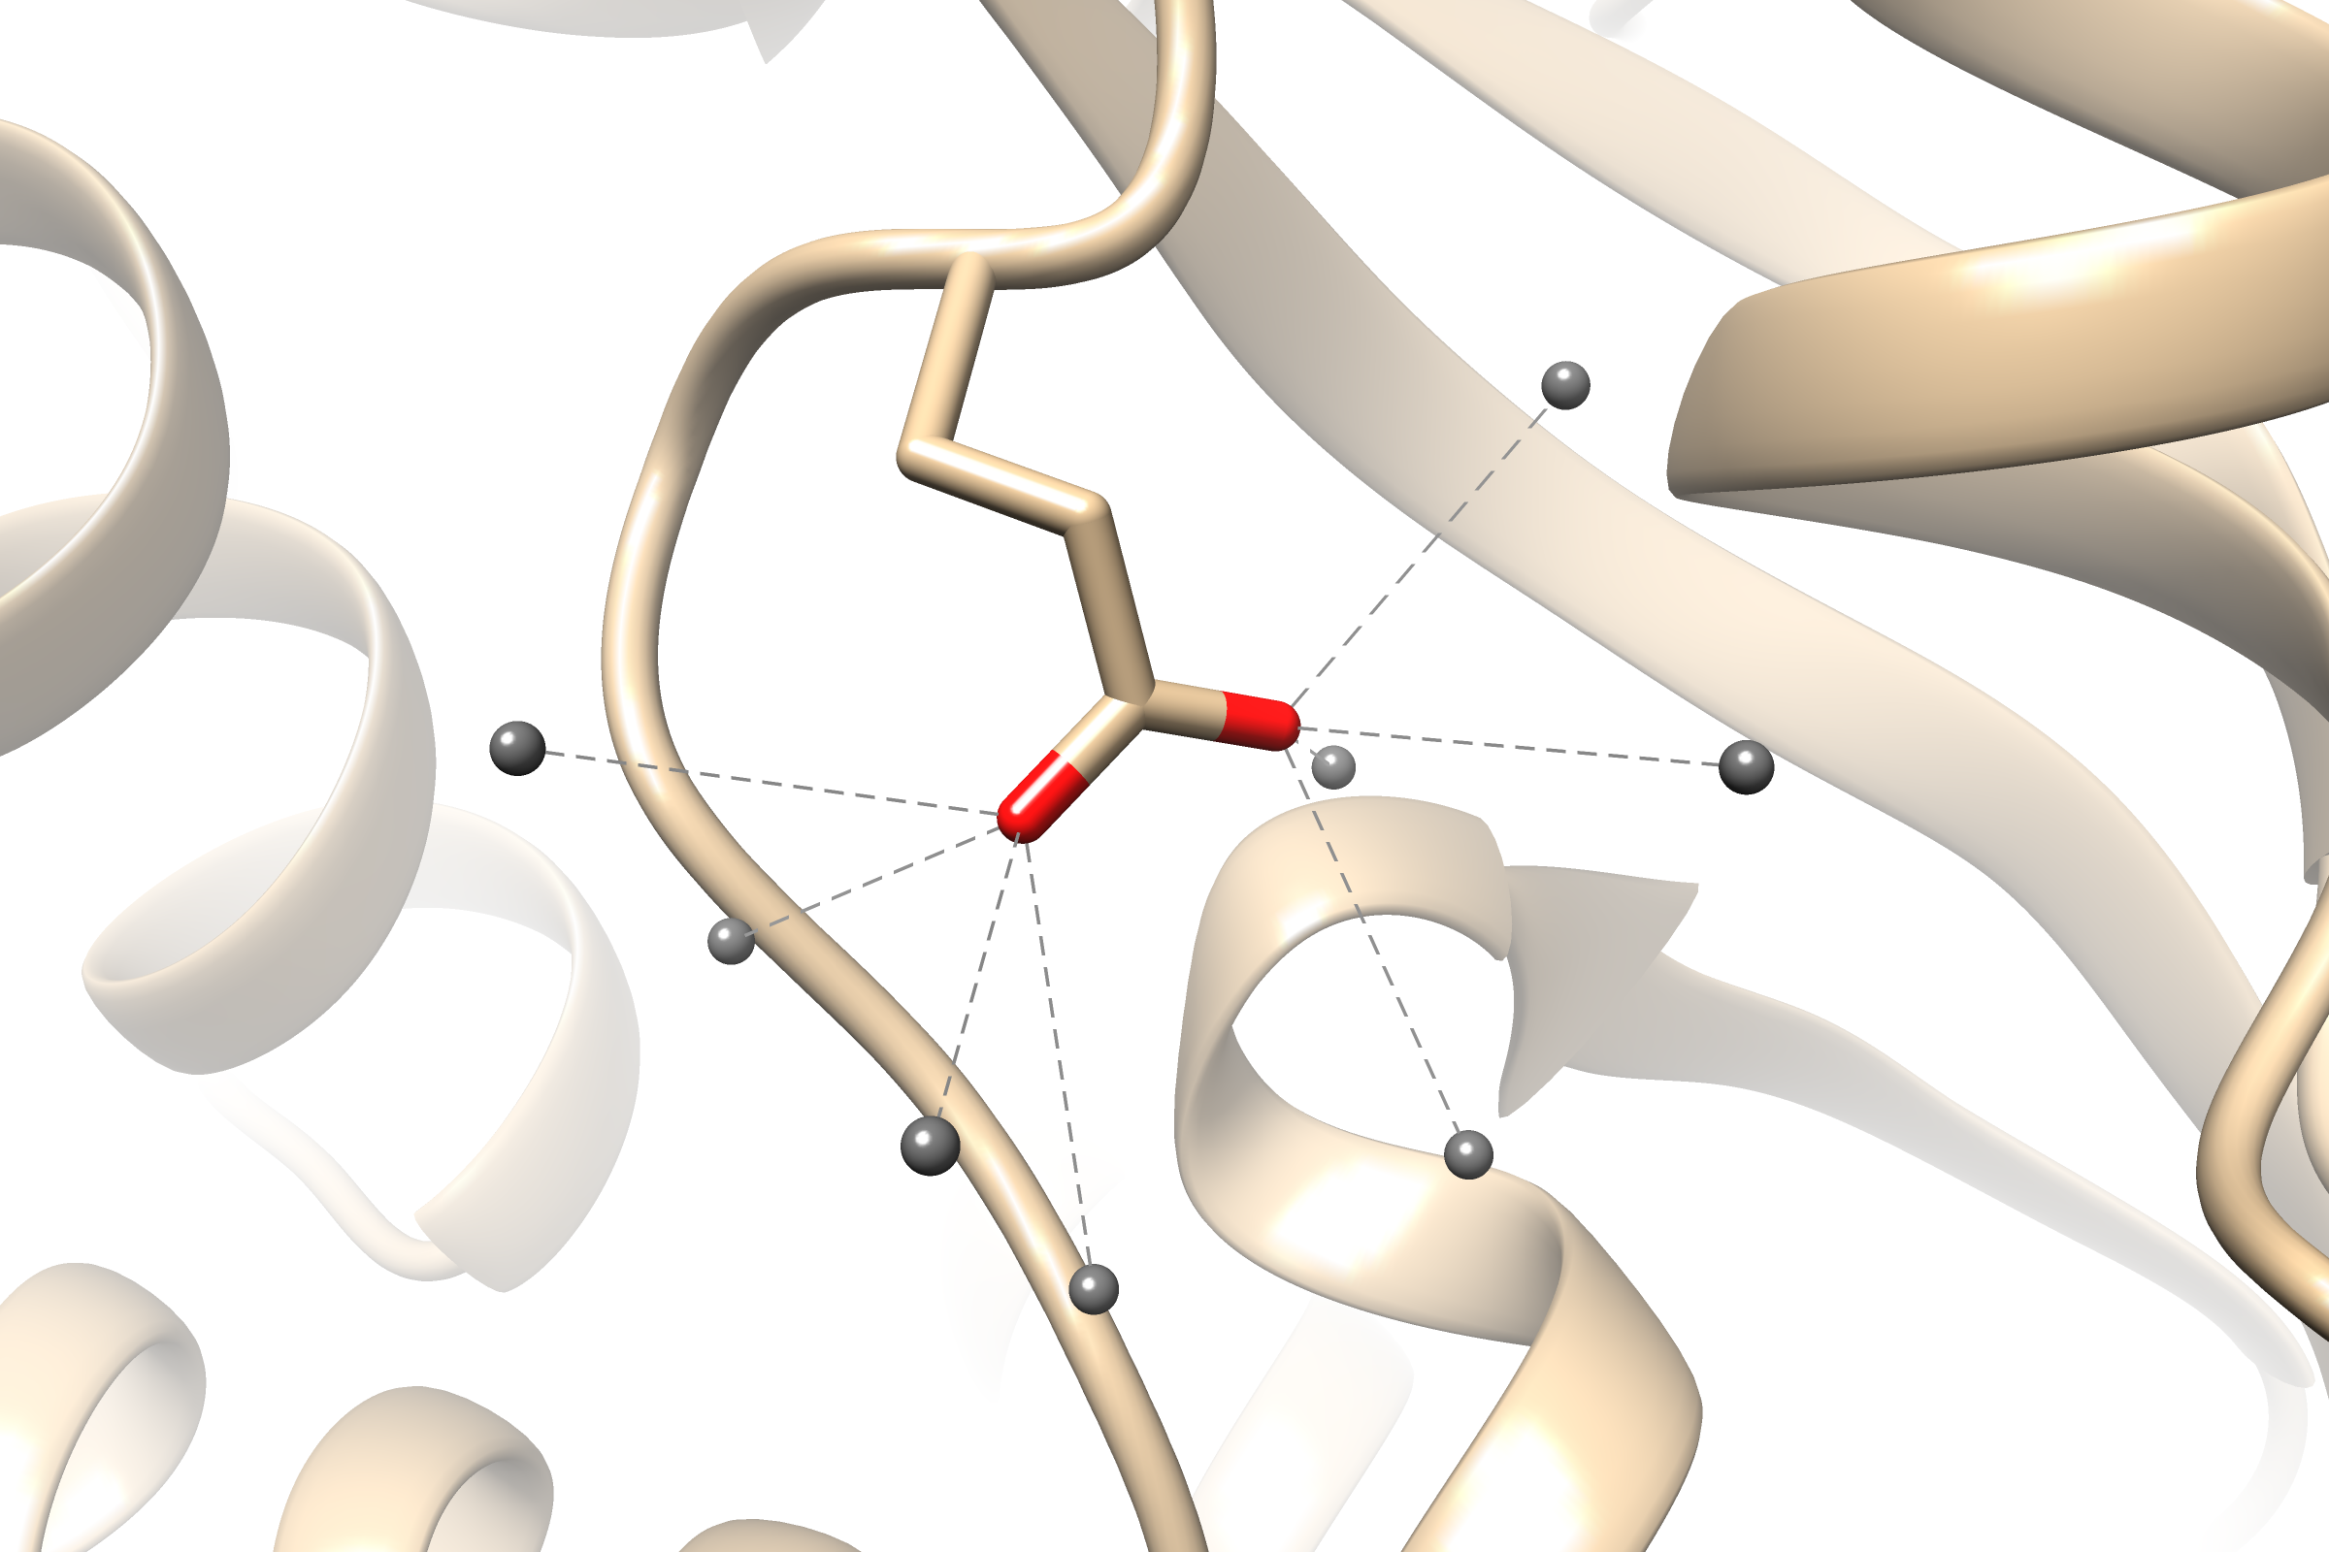
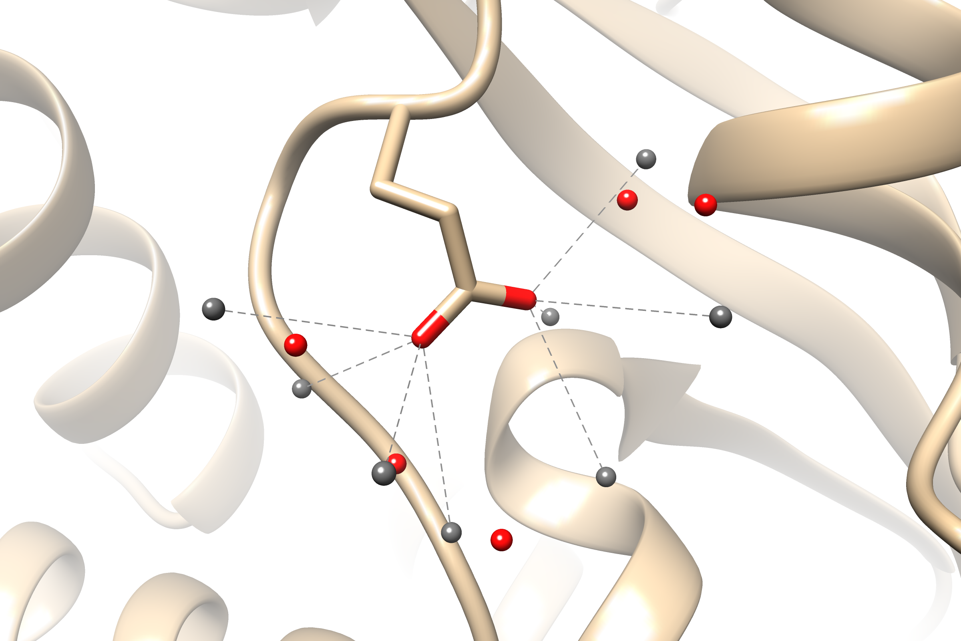
Fig 1
Probe building
Position clustering
SE(3)-GNN

Slide 3







Fig 2
(a)
(b)
$${\hat{a}}_{1}$$
$${\hat{a}}_{2}$$
$${\hat{a}}_{3}$$
4.5Å
First axis $\left({\hat{a}}_{1}\right)$
Probe-ineligible atom
Auxiliary direction ($\hat{c}$)
Probe-eligible atom
Second axis $\left({\hat{a}}_{2}\right)$
Residue centroid
Third axis $\left({\hat{a}}_{3}={\hat{a}}_{1}×{\hat{a}}_{2}\right)$
Probe

Slide 4
Input structure
Fig 3
Node features
Edge features
Atom type Embedding
SE(3)-Transformer
LayerNorm
Interaction module
ELU
6 SE(3)-Transformer
blocks
ConvSE3
LayerNorm
ELU
Structure module
6 linear blocks
LinearSE3
Displacement vector
Probability-like score
RMSD loss
Cross entropy loss

Slide 5
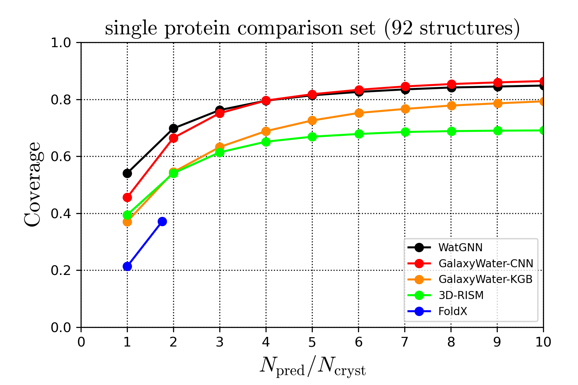
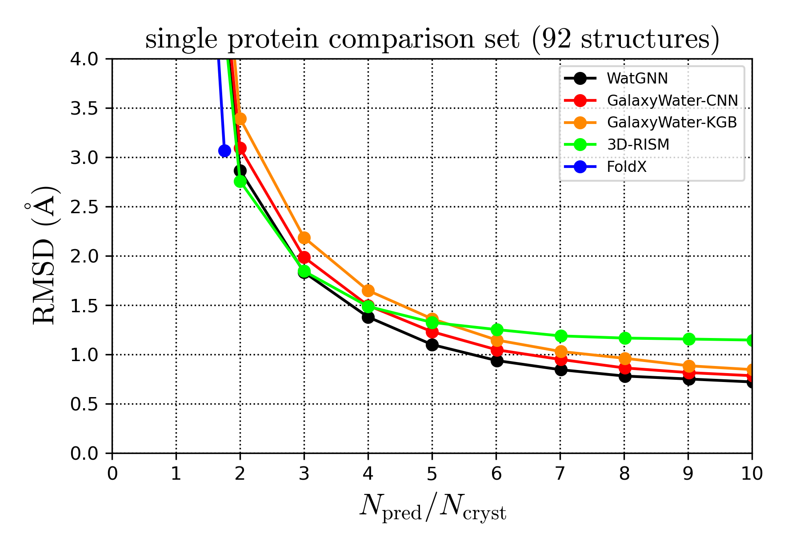
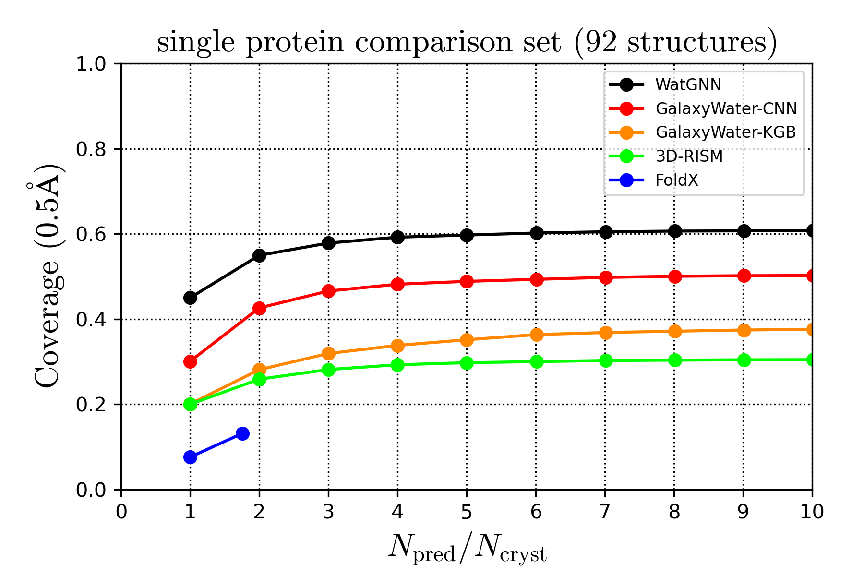
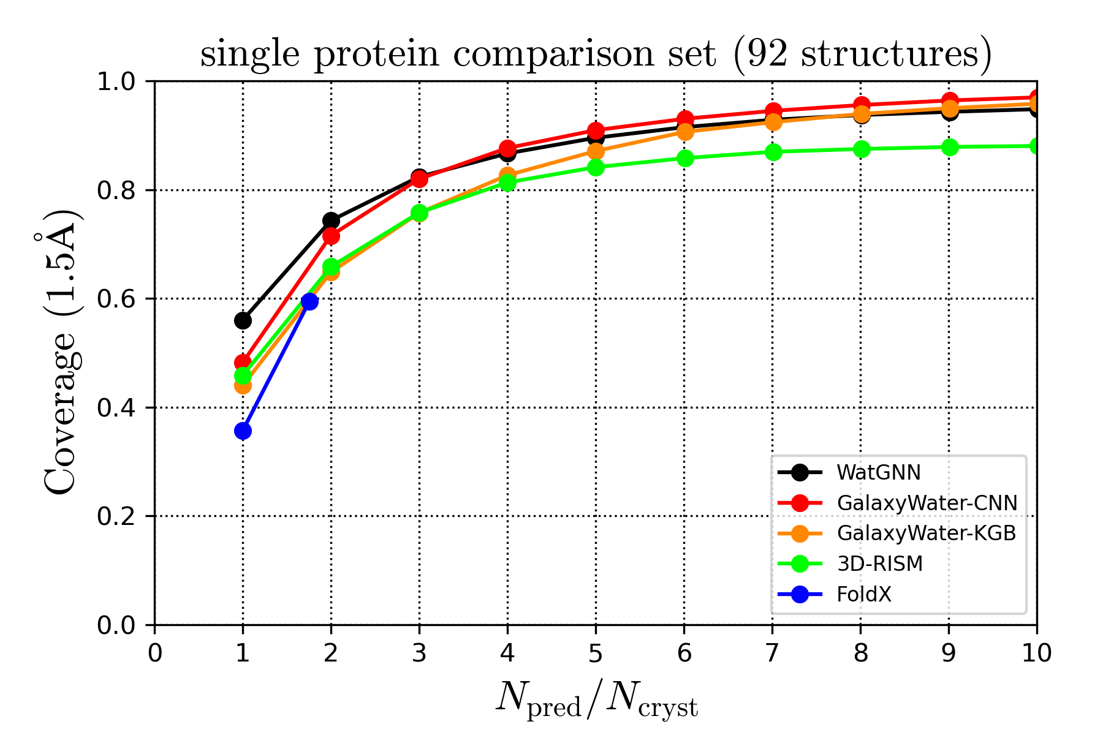
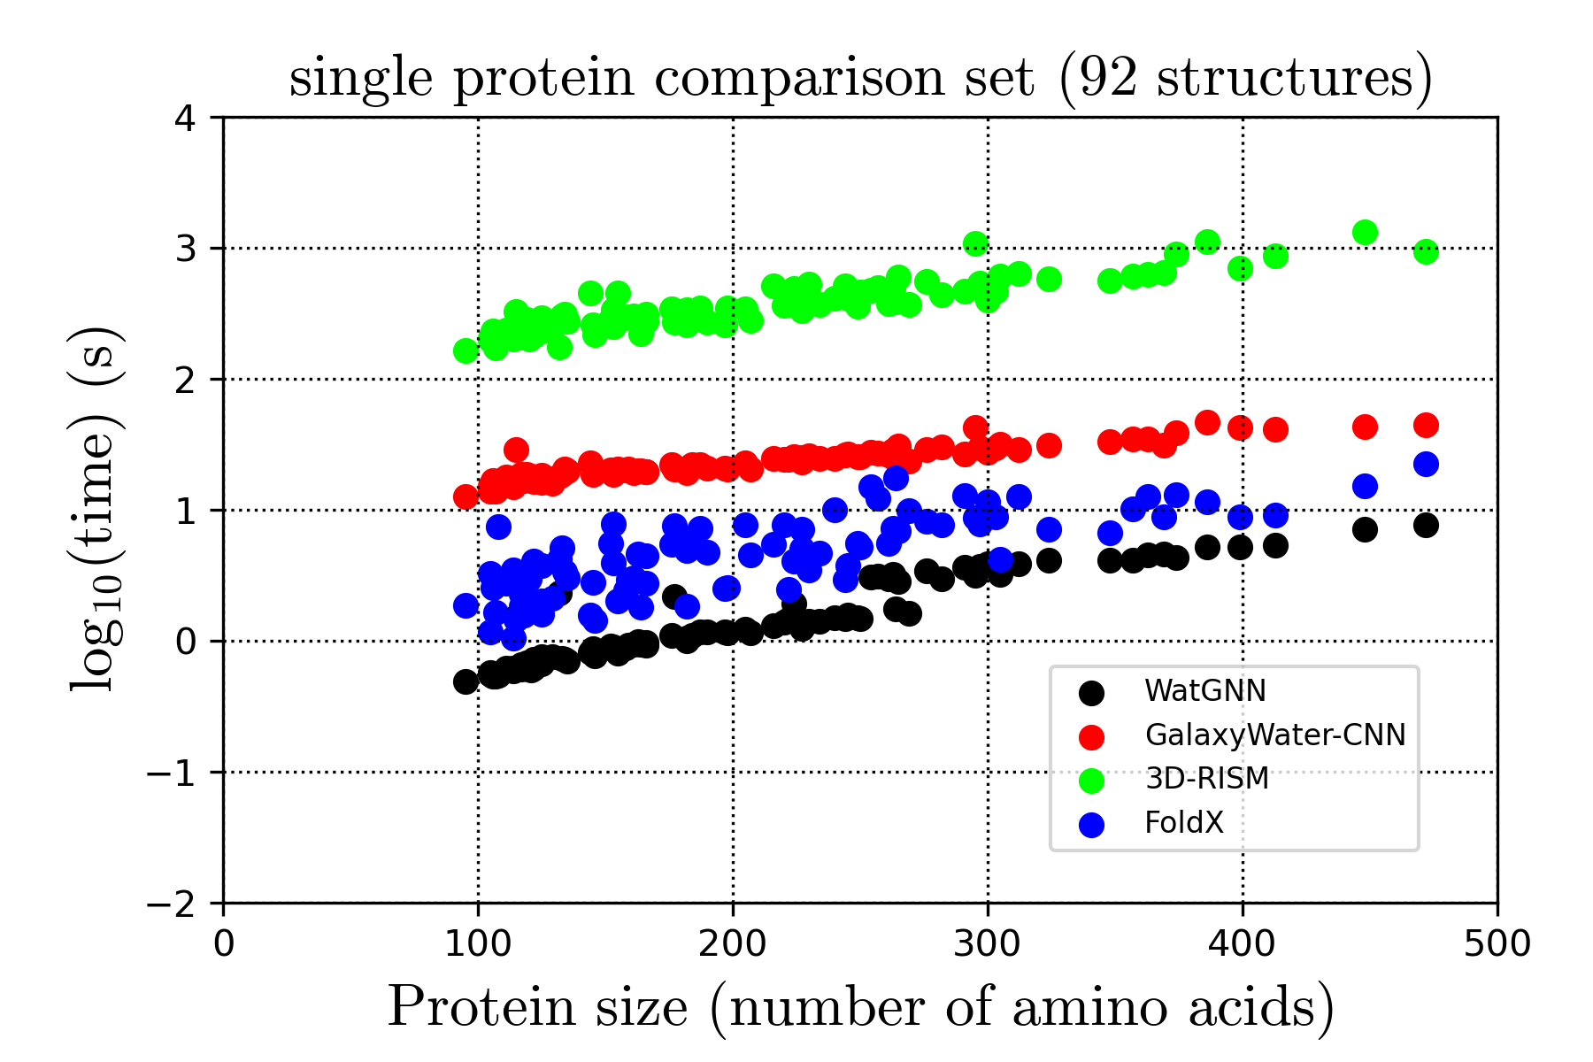
Fig 4
(a)
(b)
(c)
(d)
(e)

Slide 6
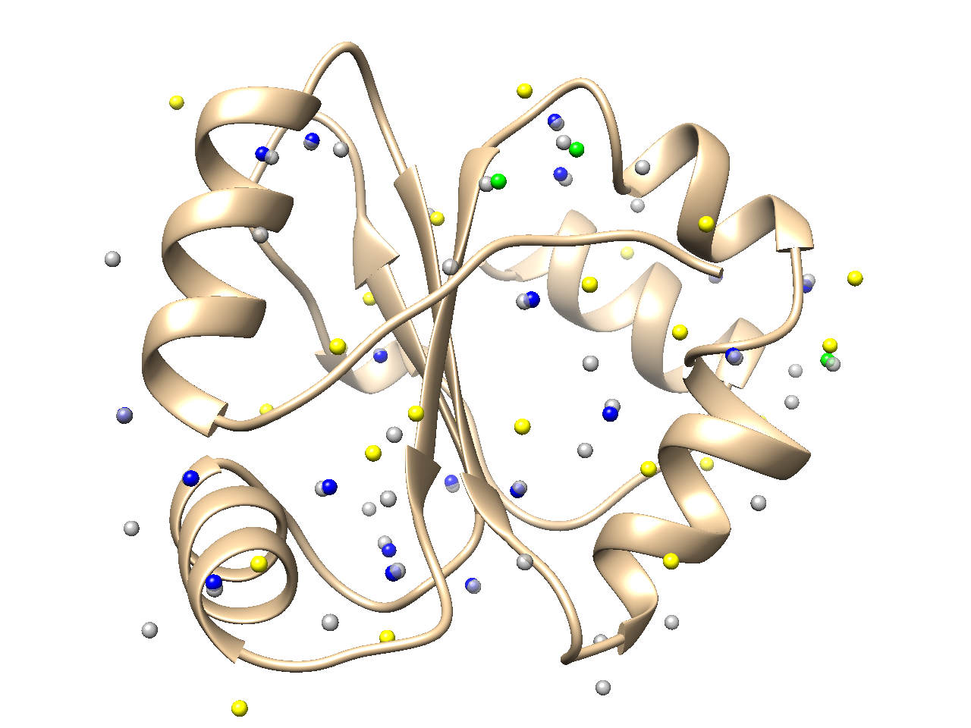
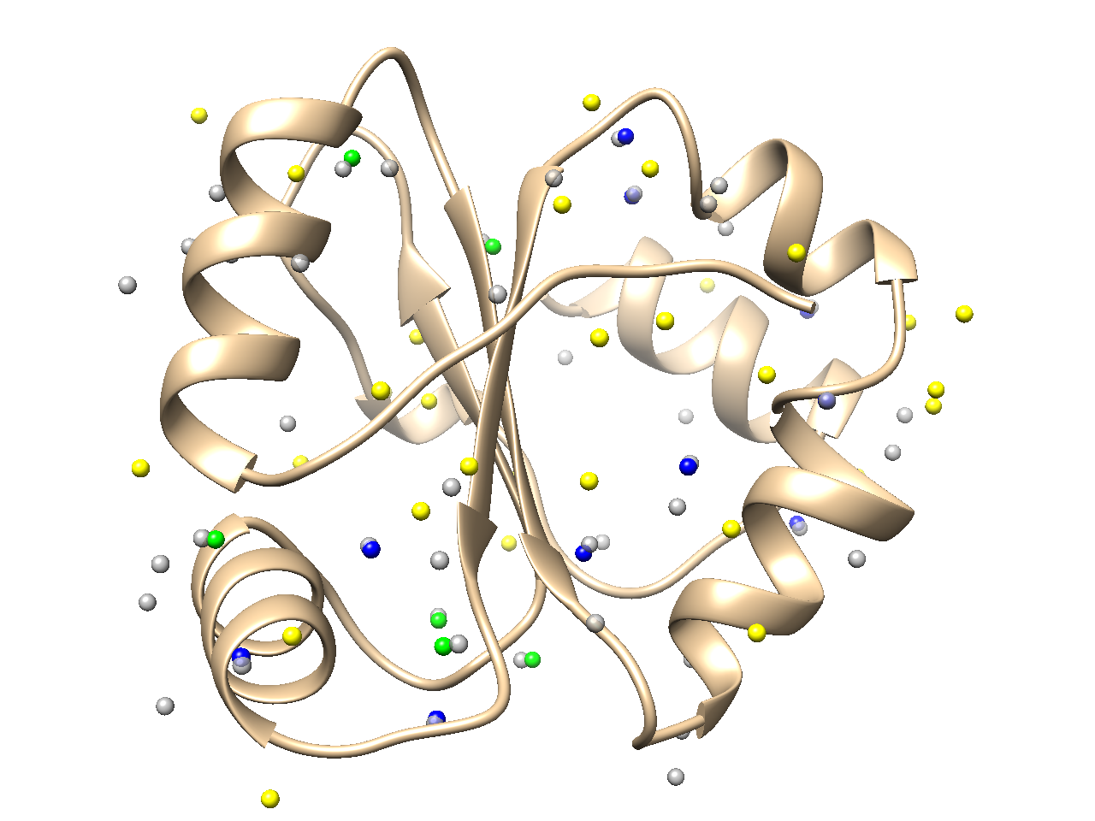
Fig 5
(a)
(b)

Slide 7
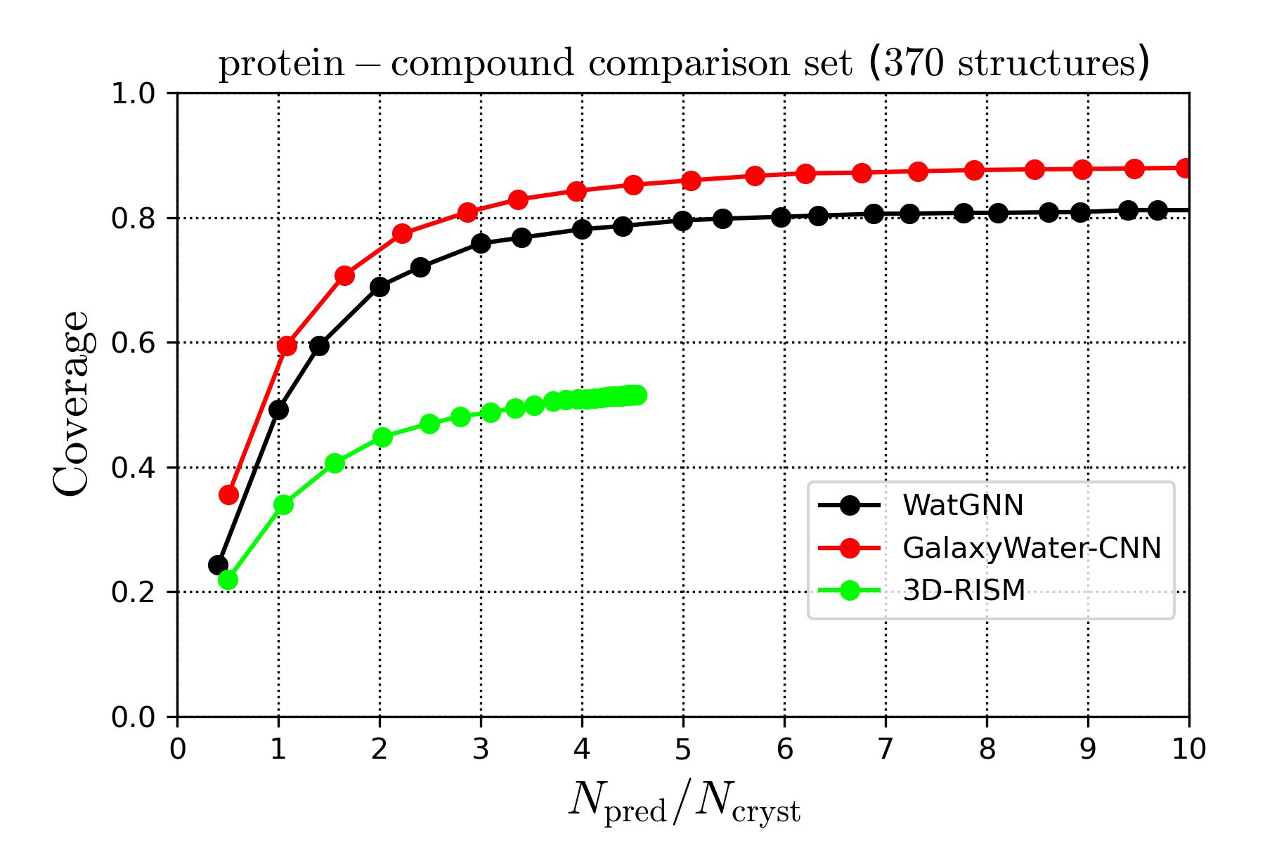
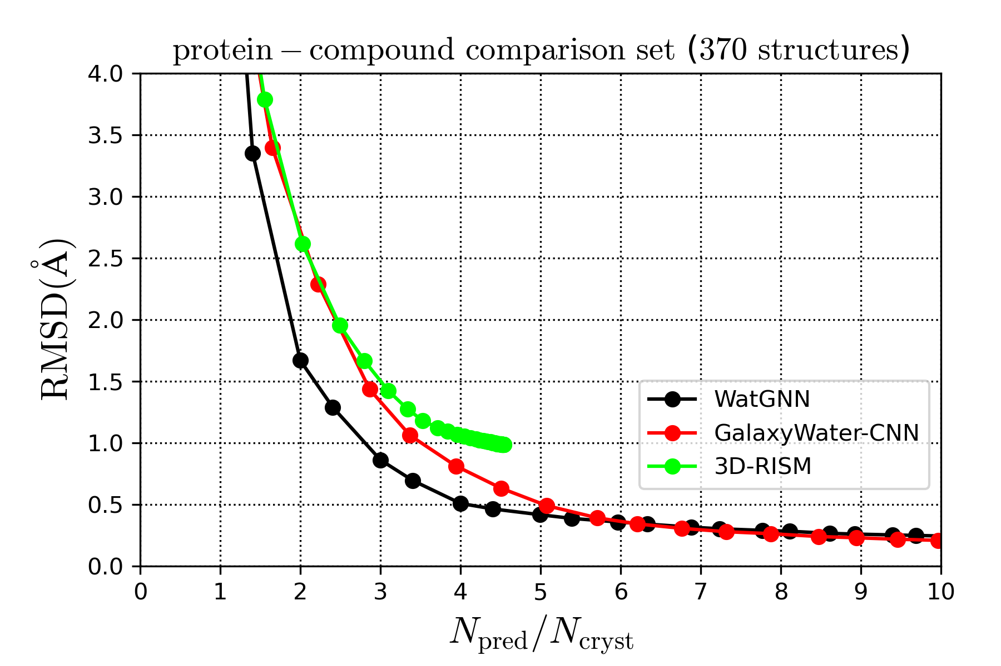
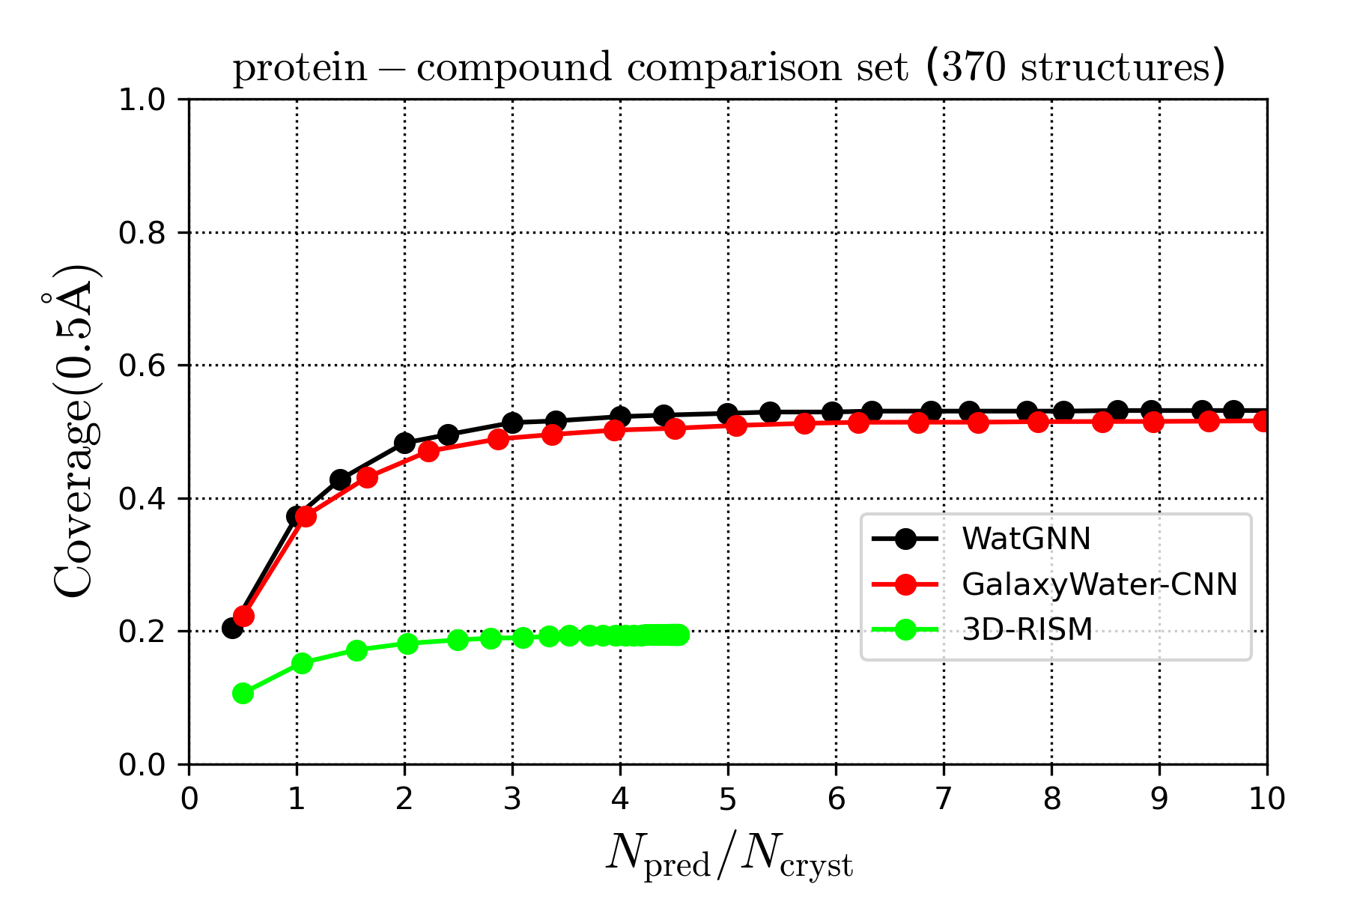
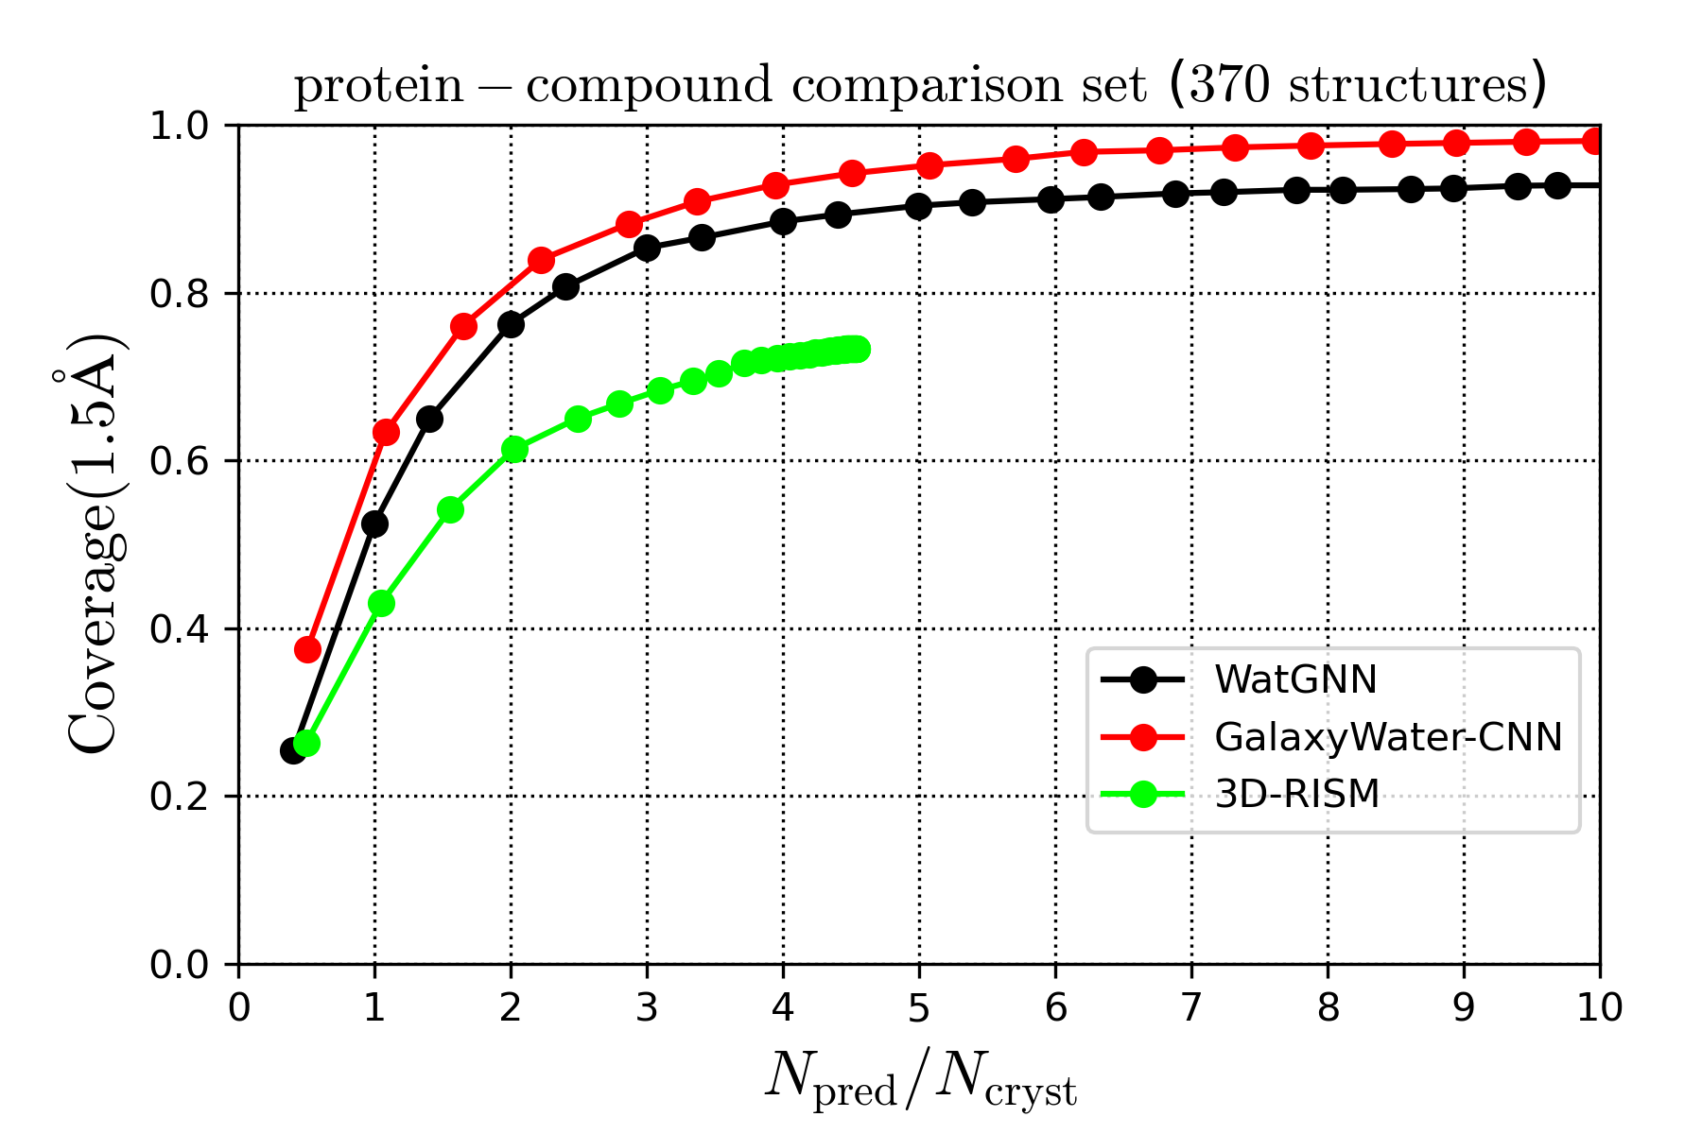
Fig 6
(a)
(b)
(c)
(d)

Slide 8
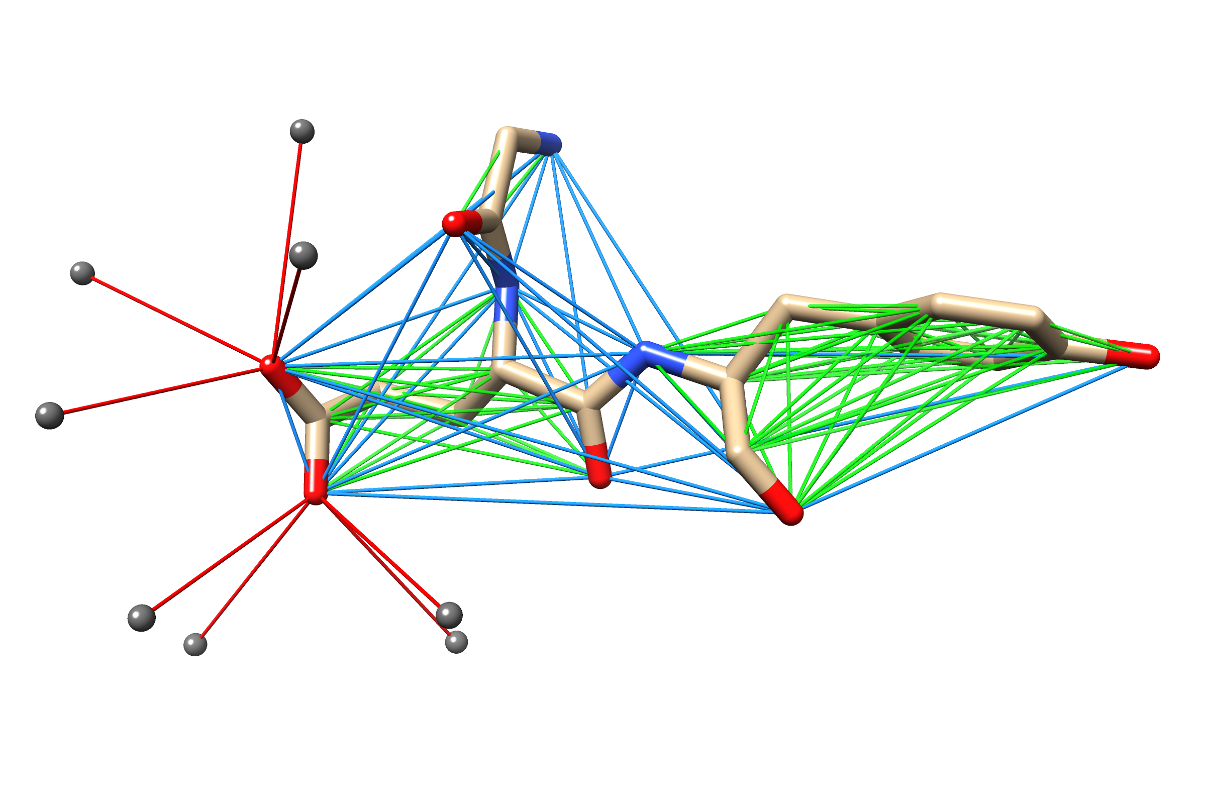
Fig S1
Atom - probe edge
Intra-residue atom-atom edge
Long-range edge

Slide 9
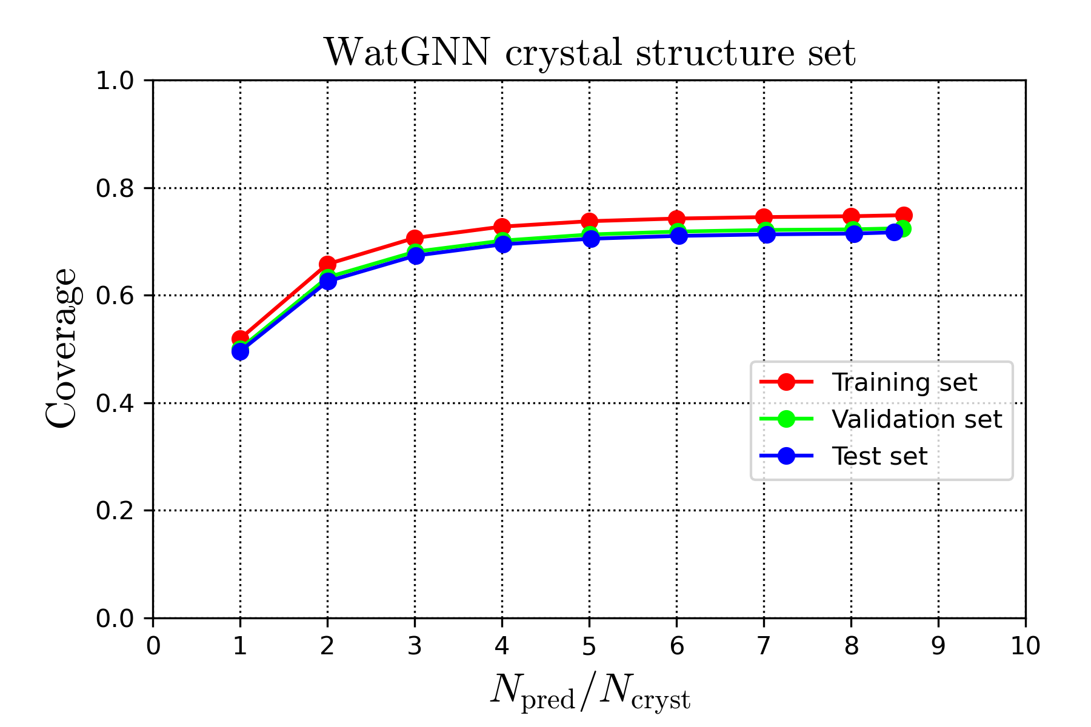
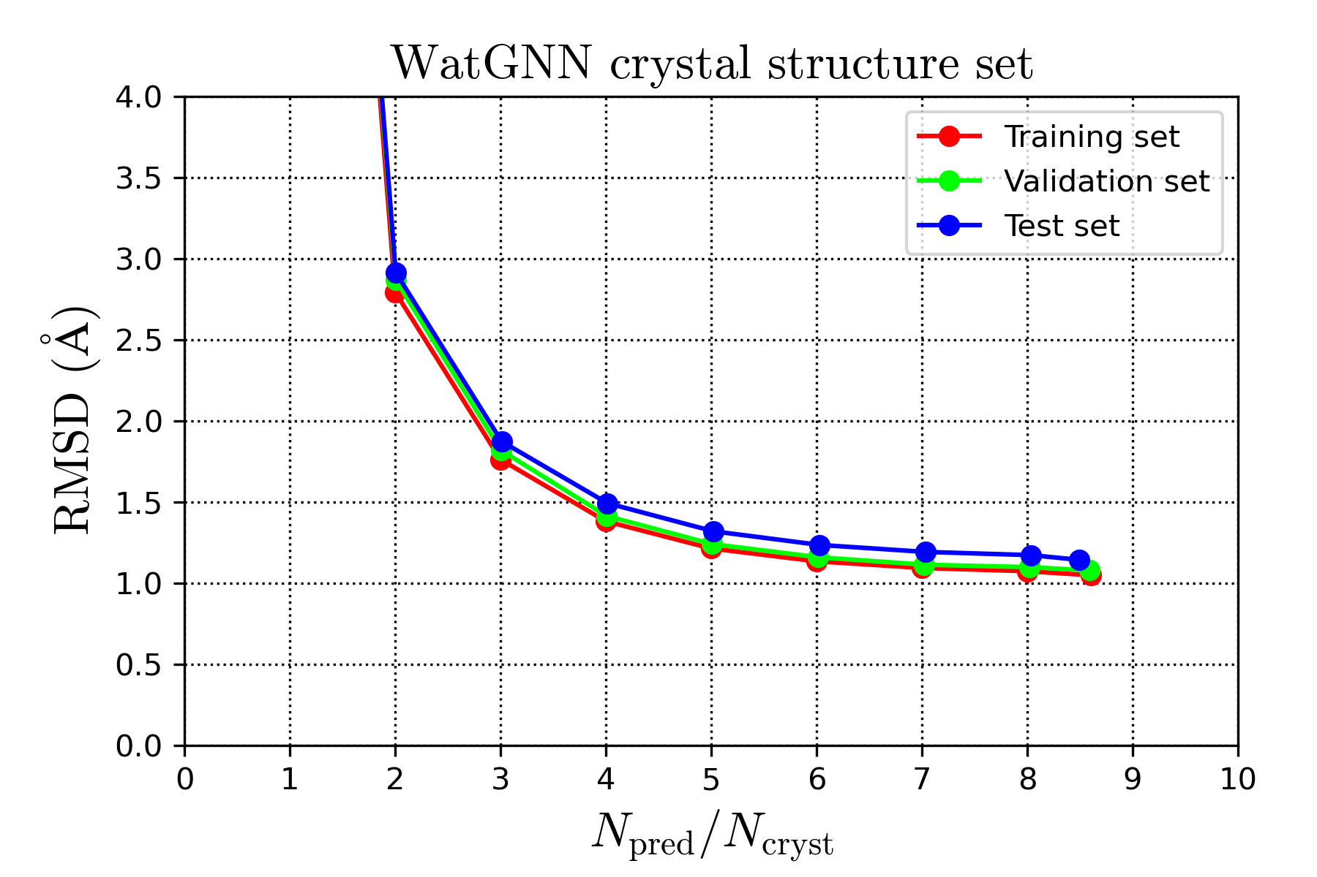
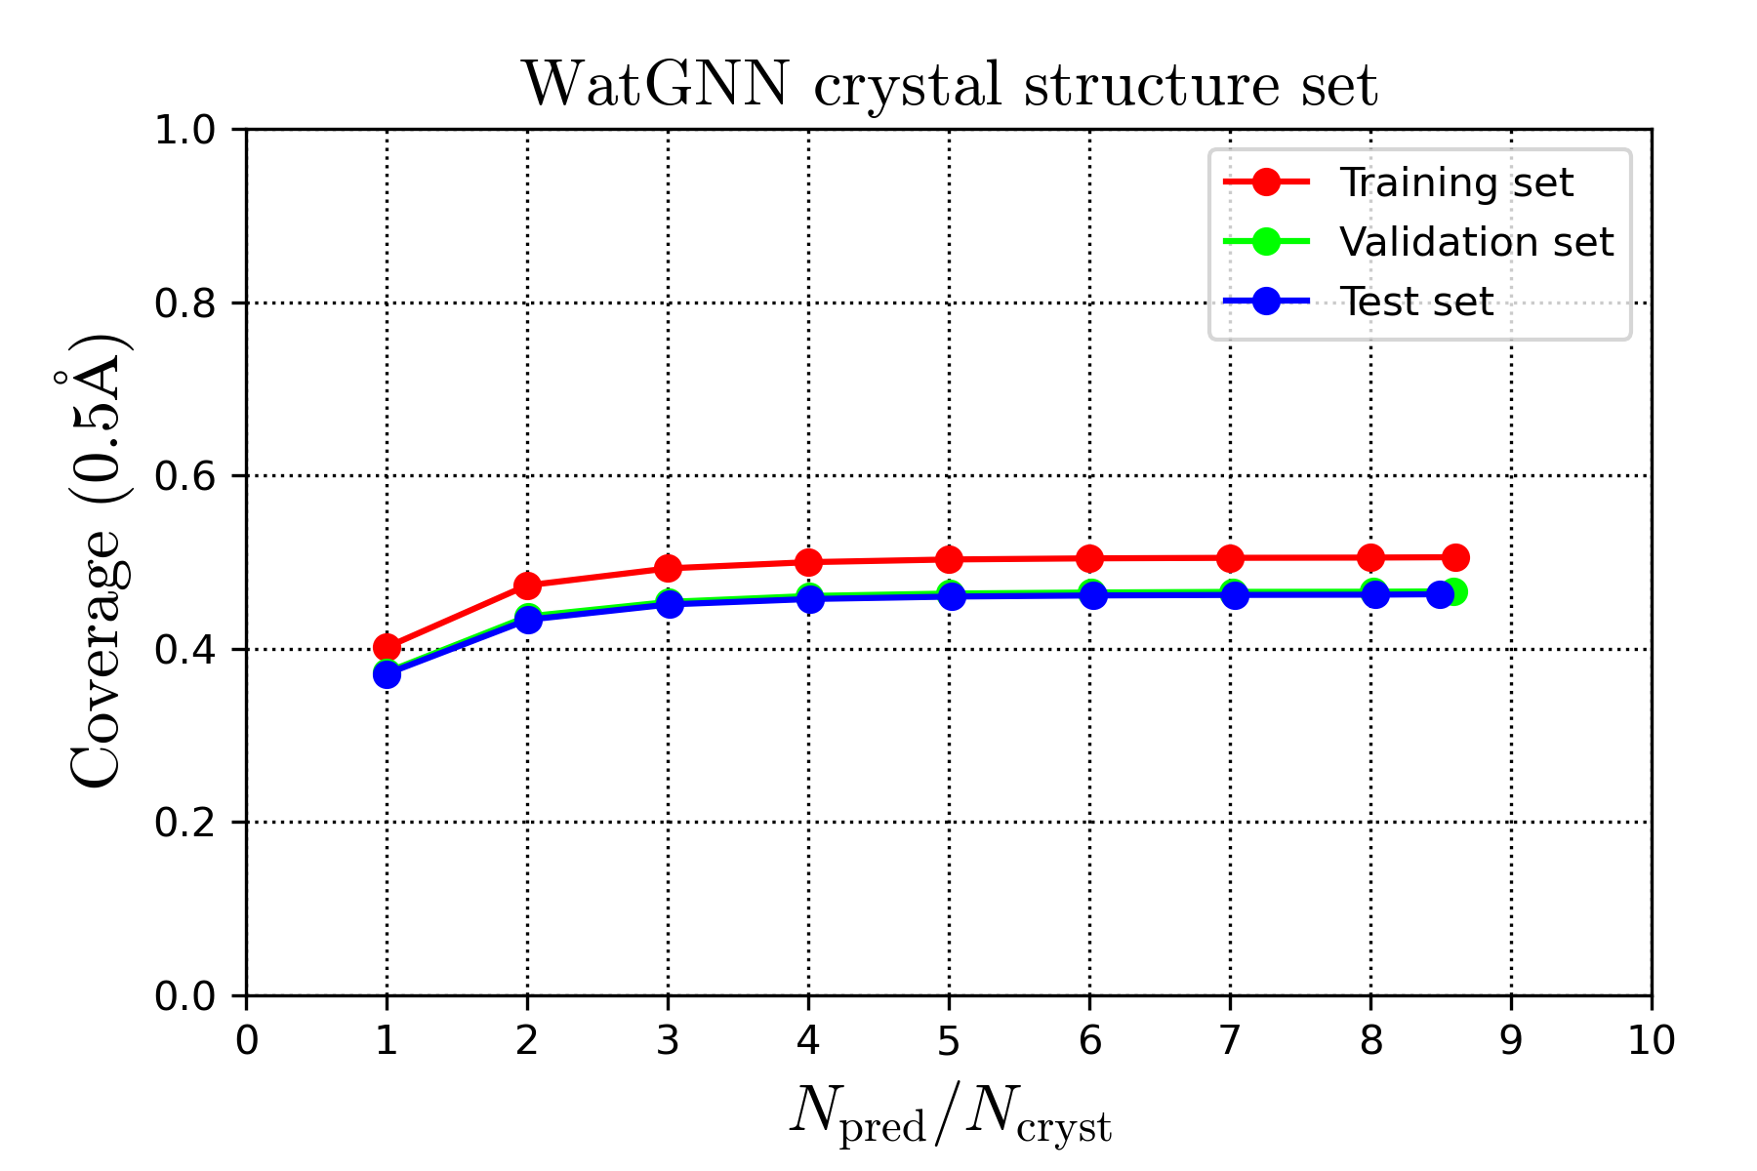
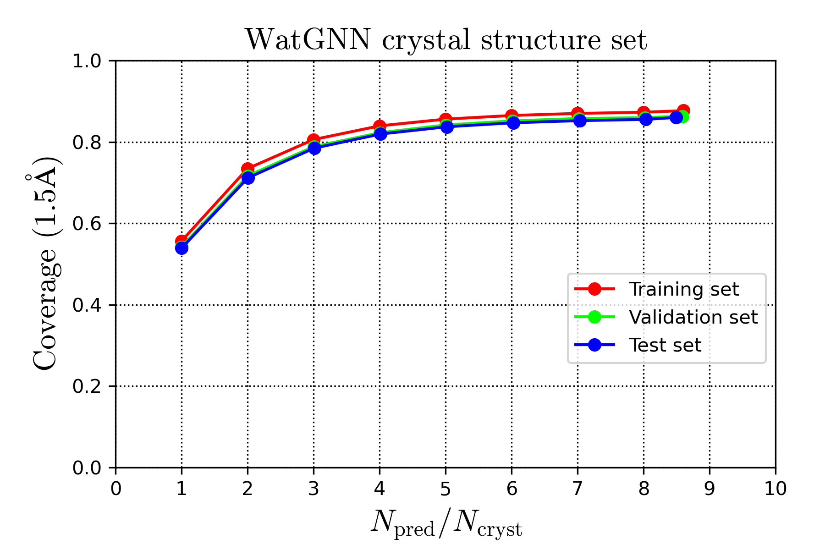
Fig S2
(a)
(b)
(c)
(d)

Slide 10
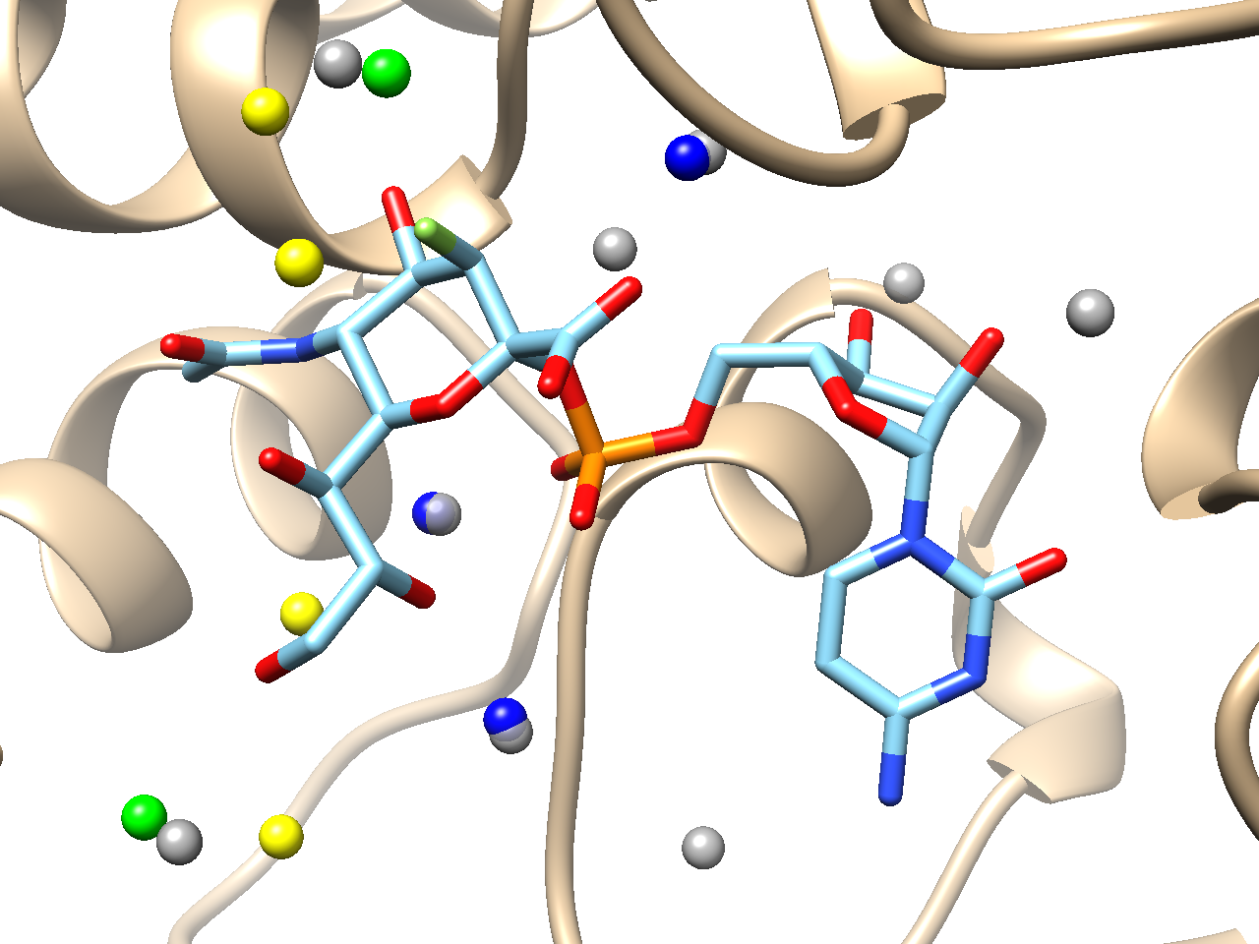
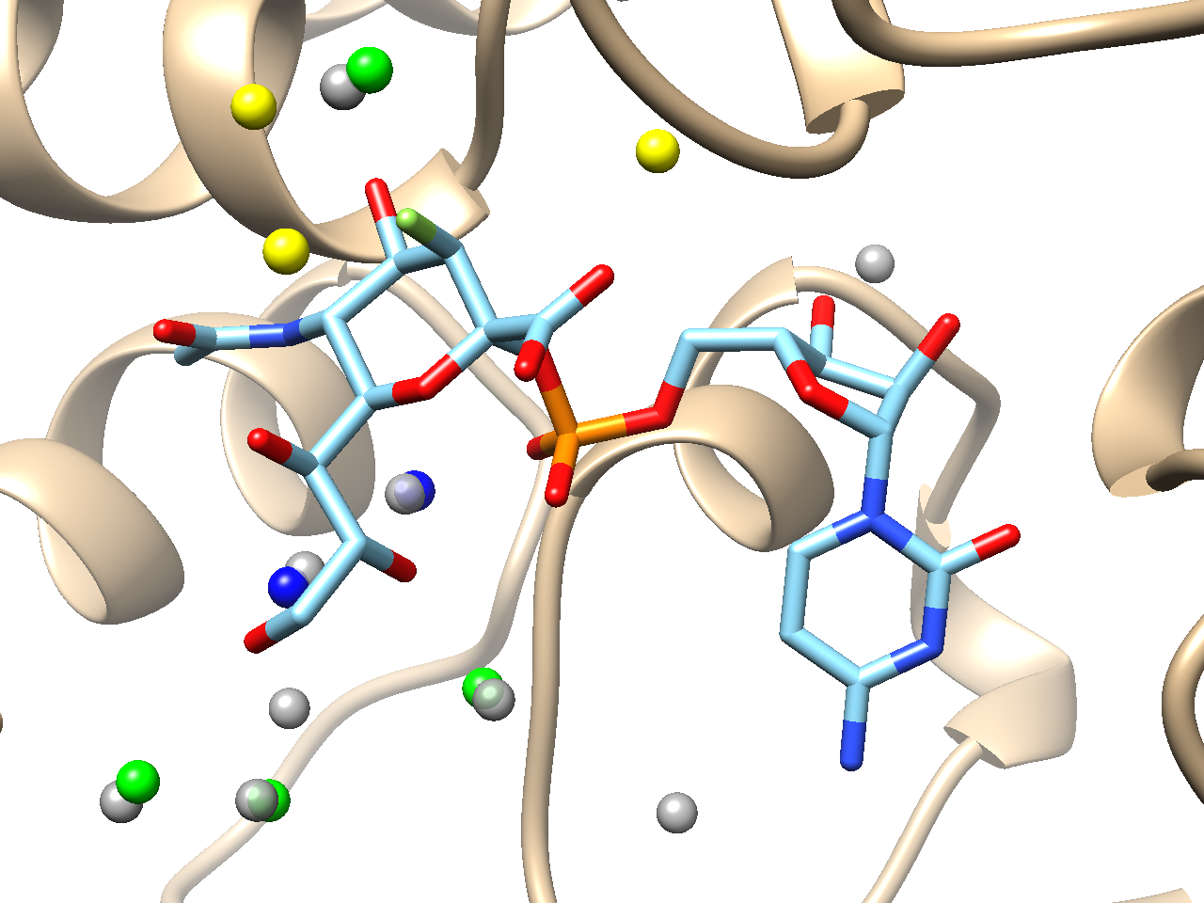
Fig S3
(a)
(b)

Slide 11
Table S1
Probe-ineligible Atom classes
C atom | Alkali metal atoms (Li, Na, K, Rb)
Probe-eligible Atom classes
N atom | O atom
P atom | S atom
Halogen atoms (F, Cl, Br, I) | Non-alkali metal atoms (Ca, Mg, Zn, Hg, Mn, Co, Fe, Ni, Cu, Cd)
Extra Atom classes (Probe-ineligible)
Probe class | Other atoms

