Slide 1
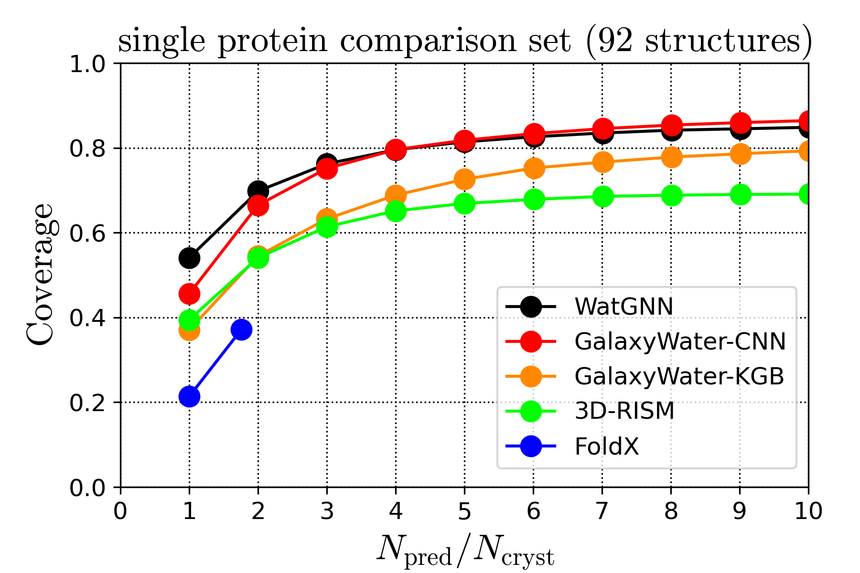
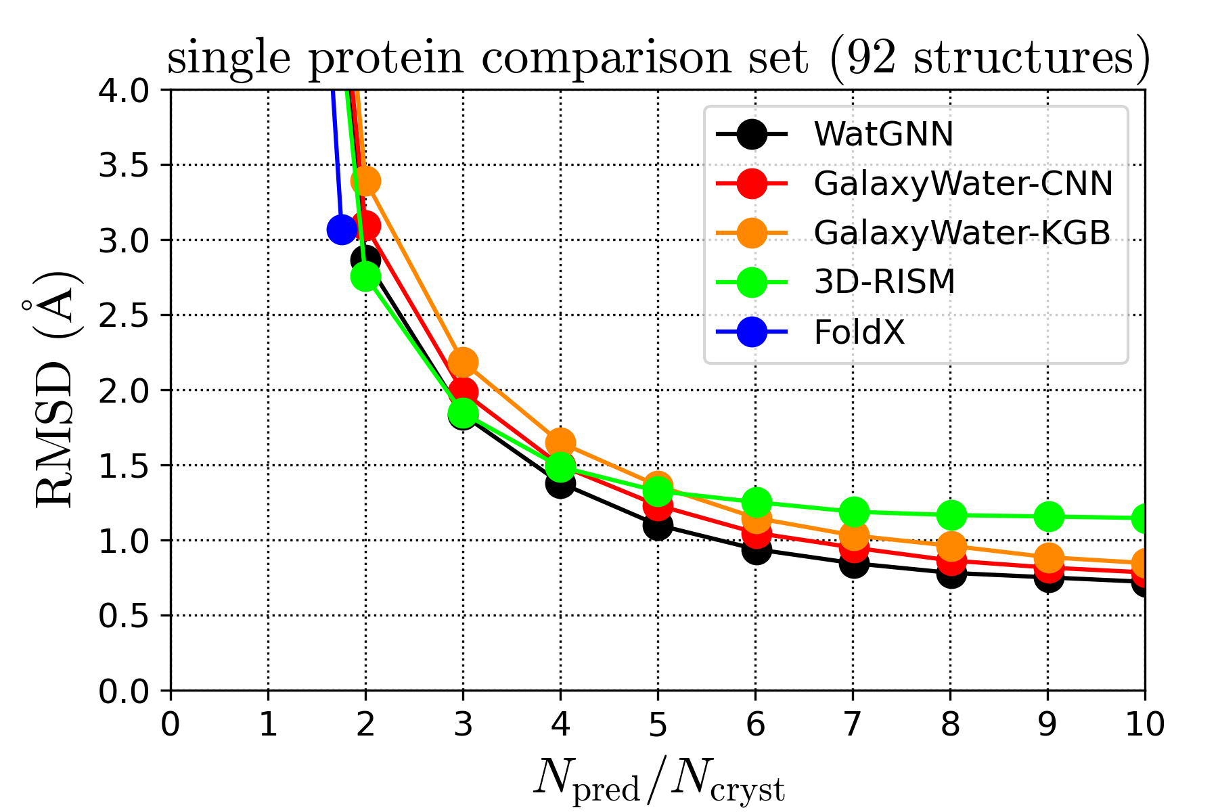
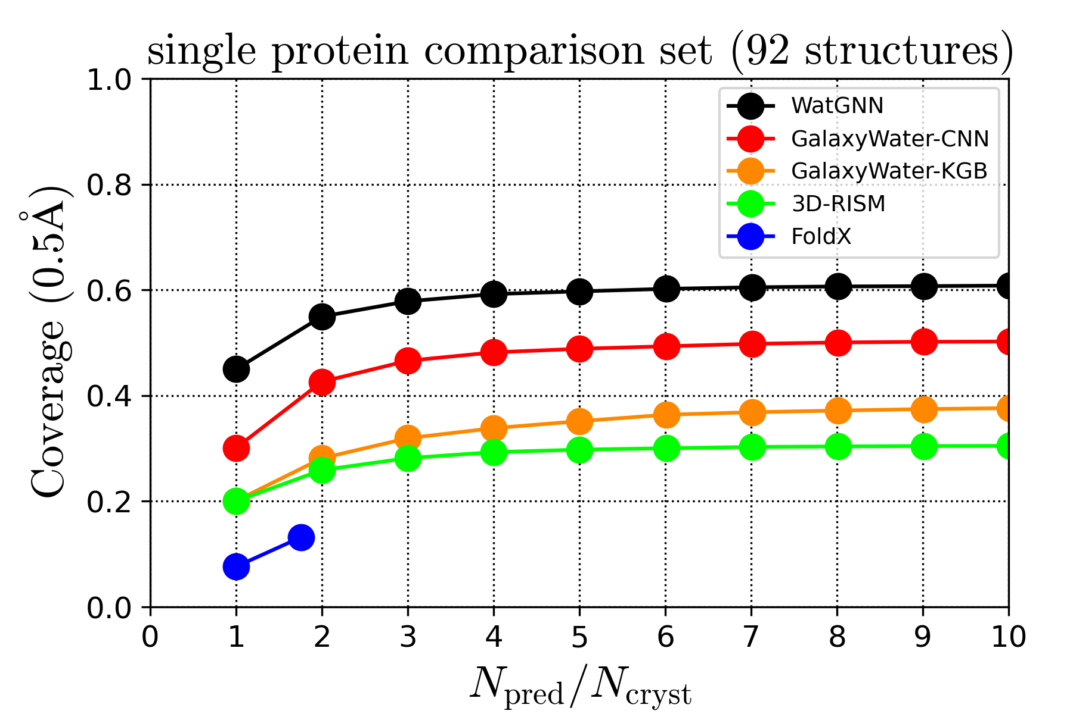
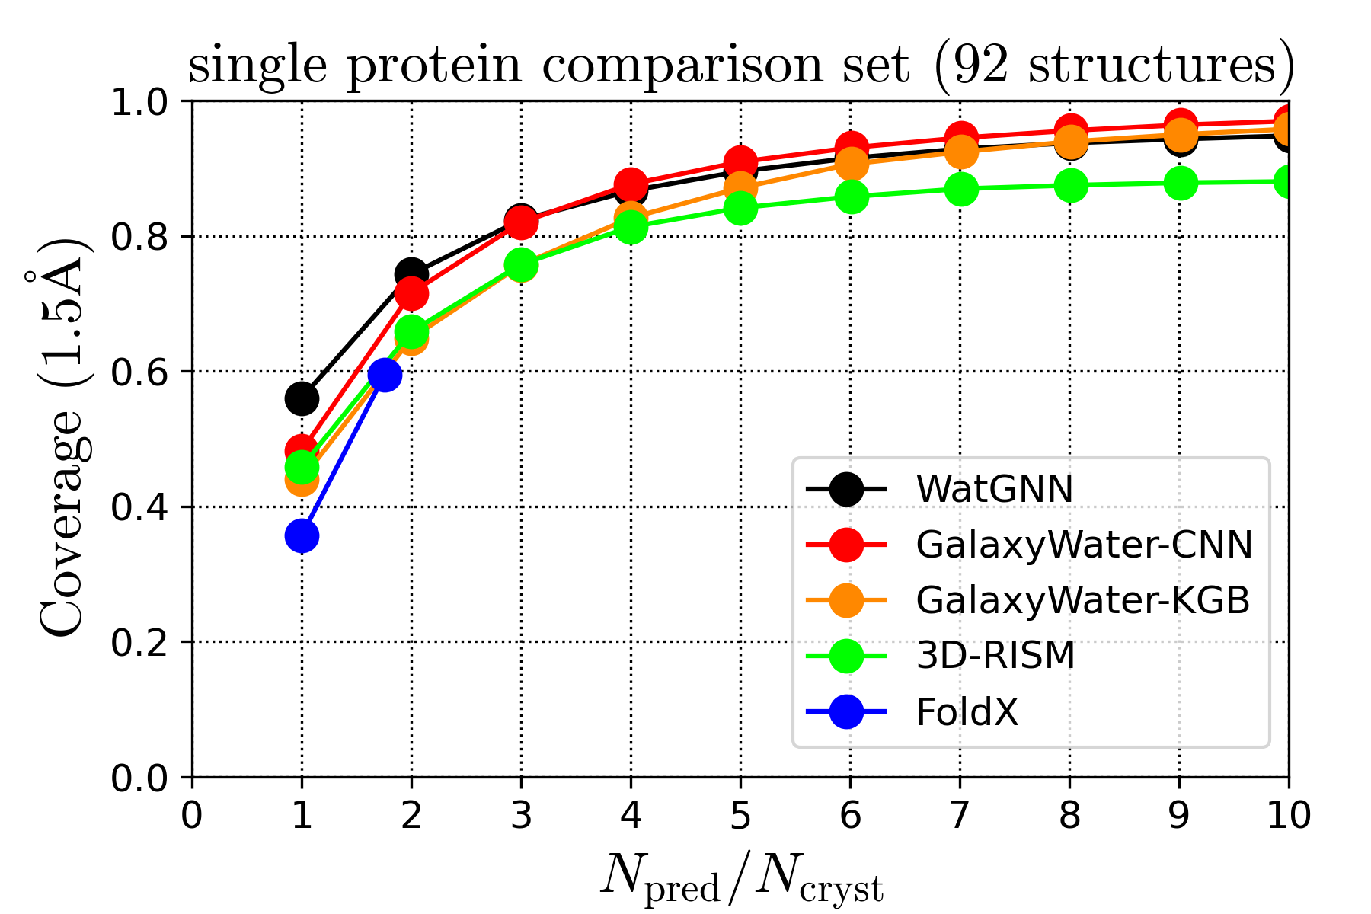
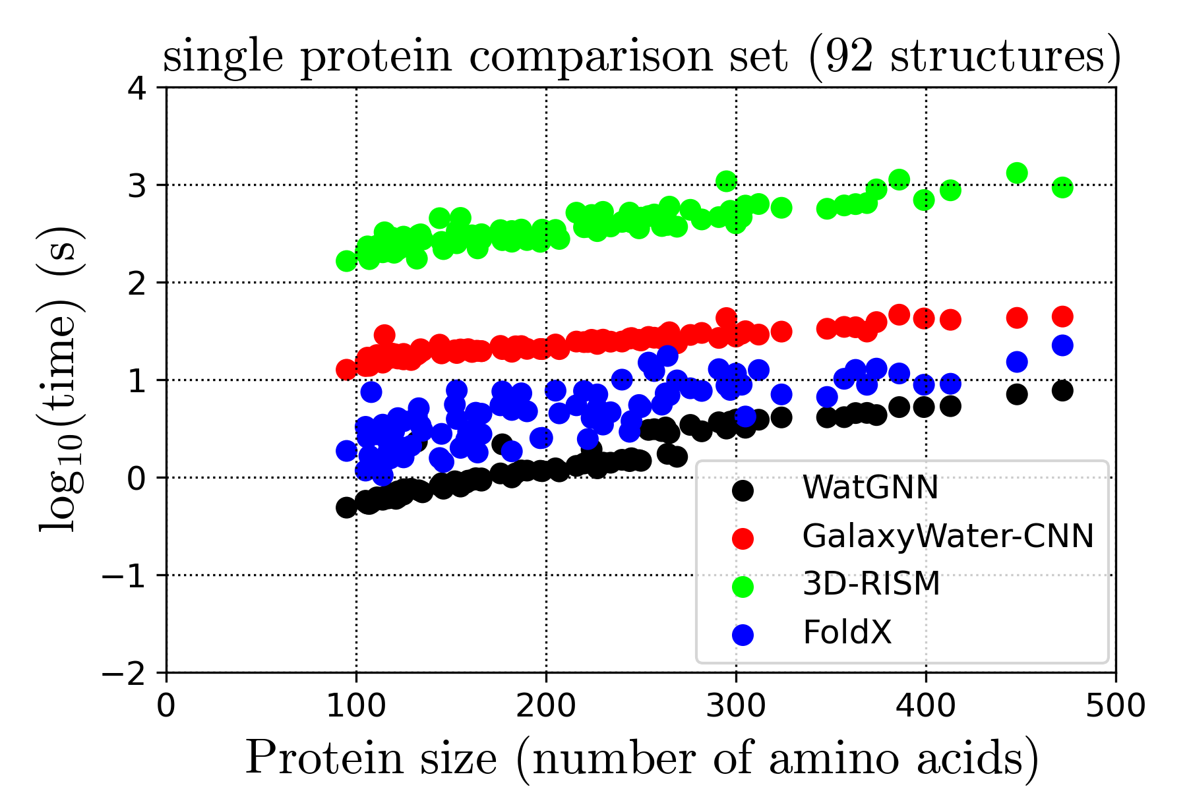


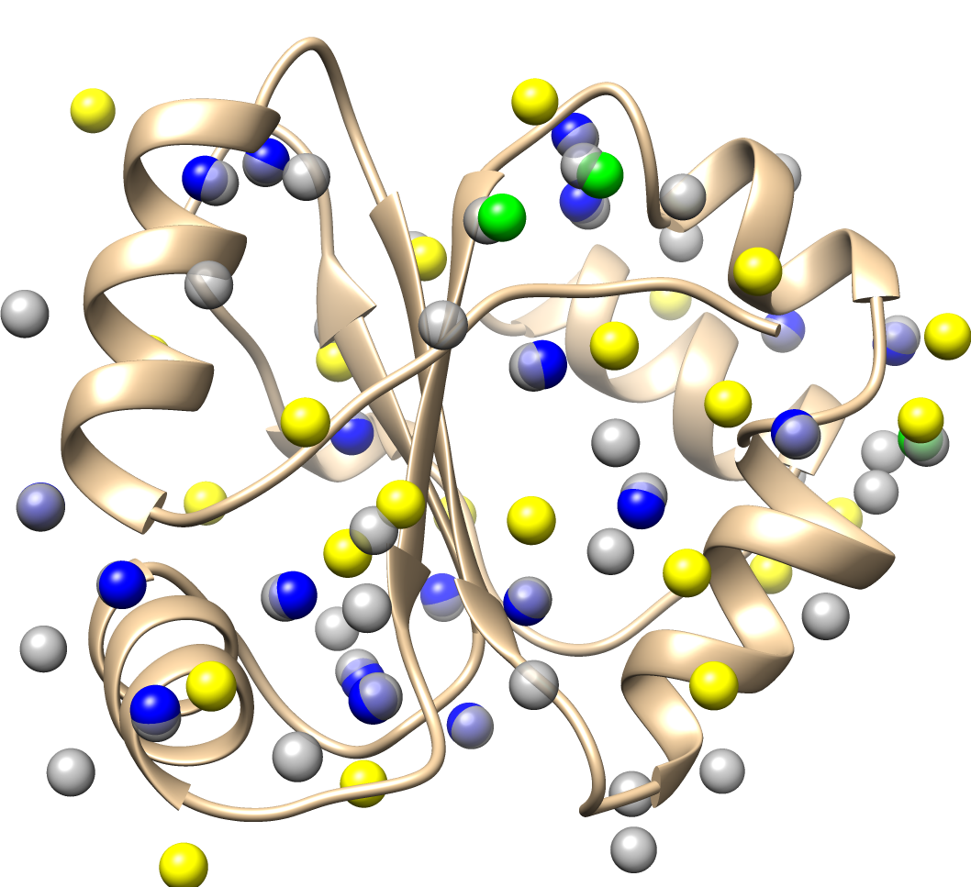
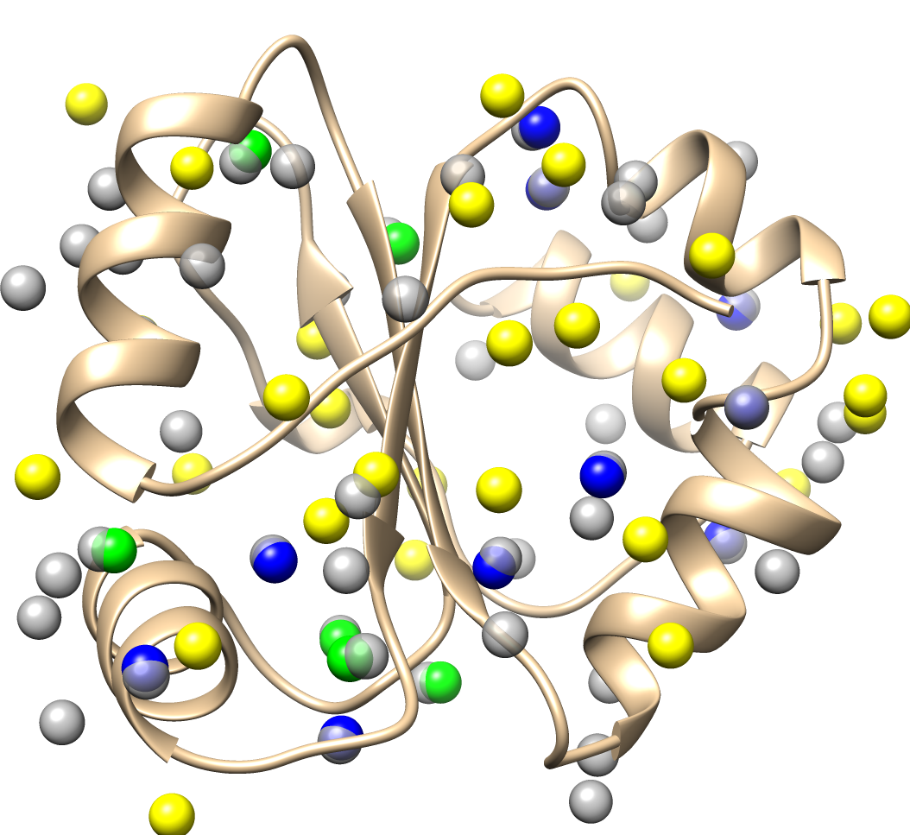
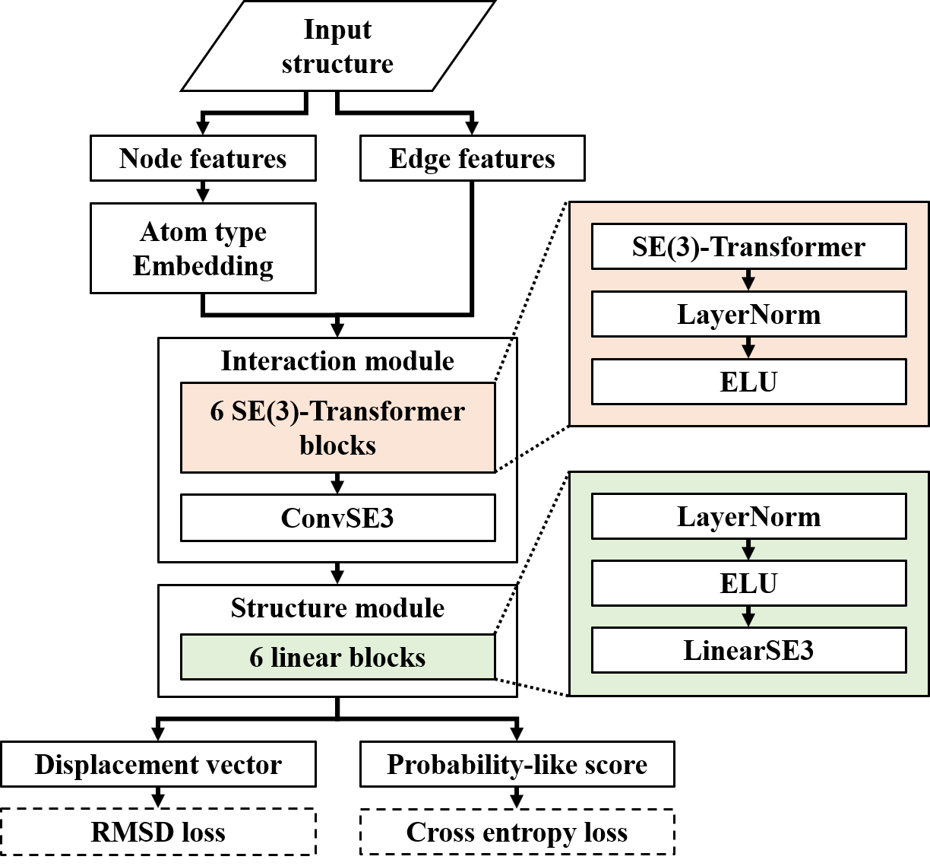
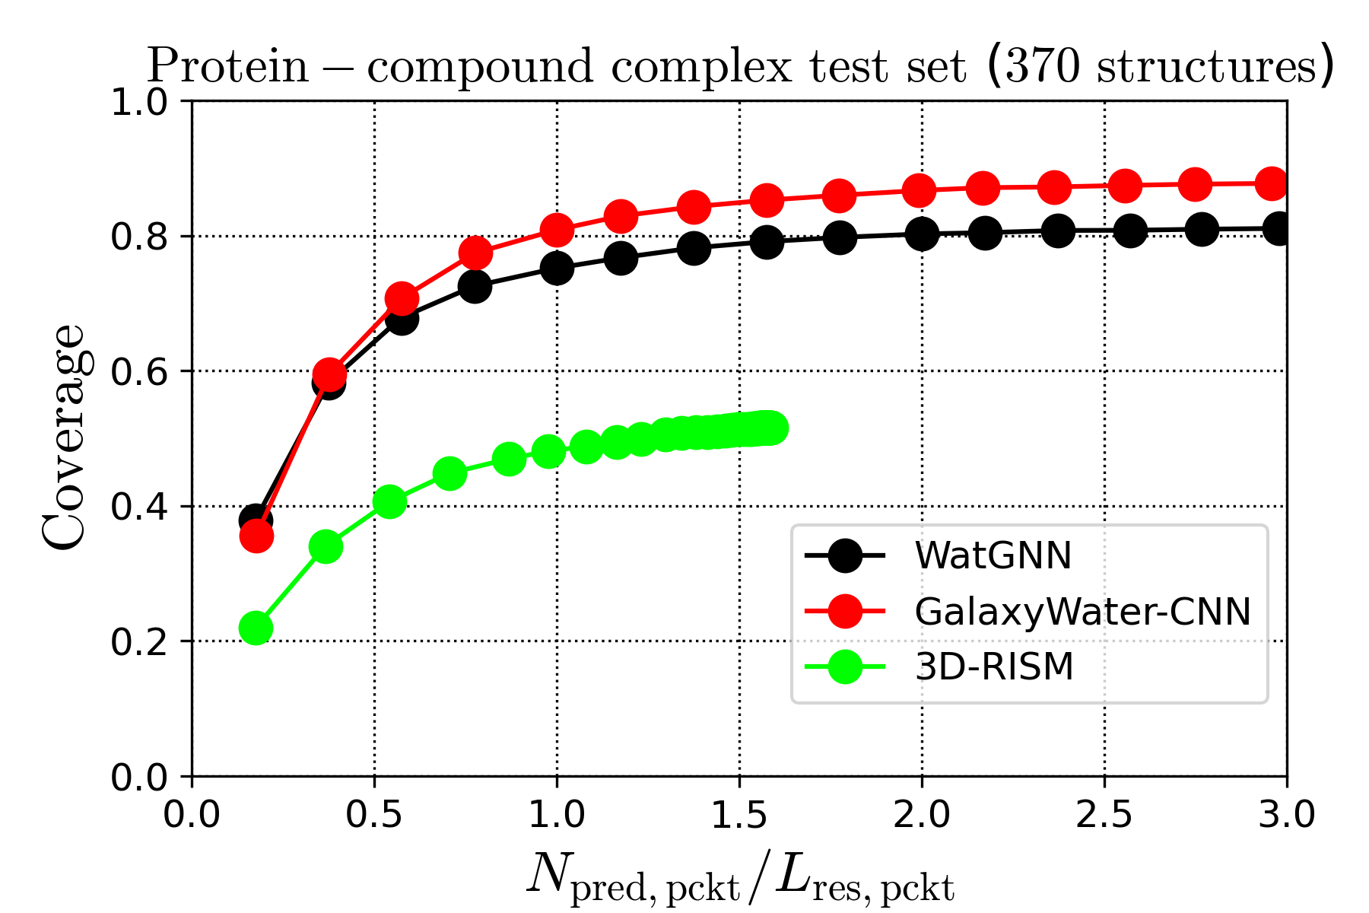
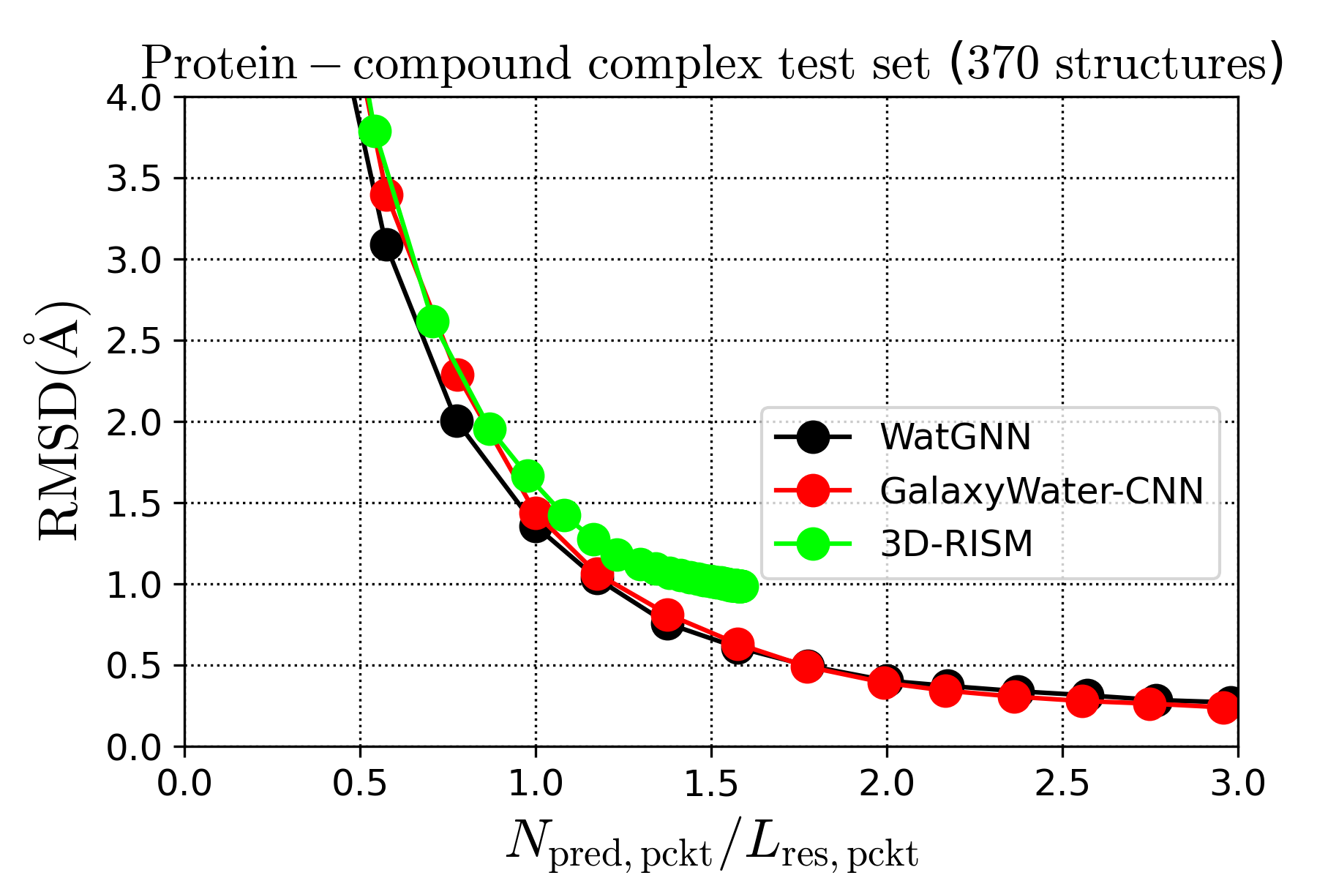
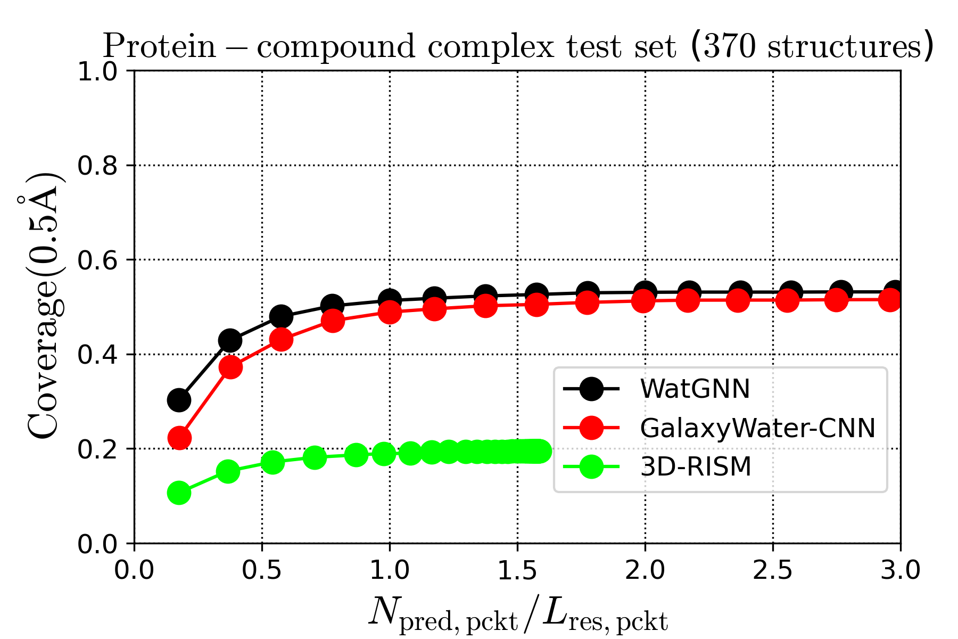
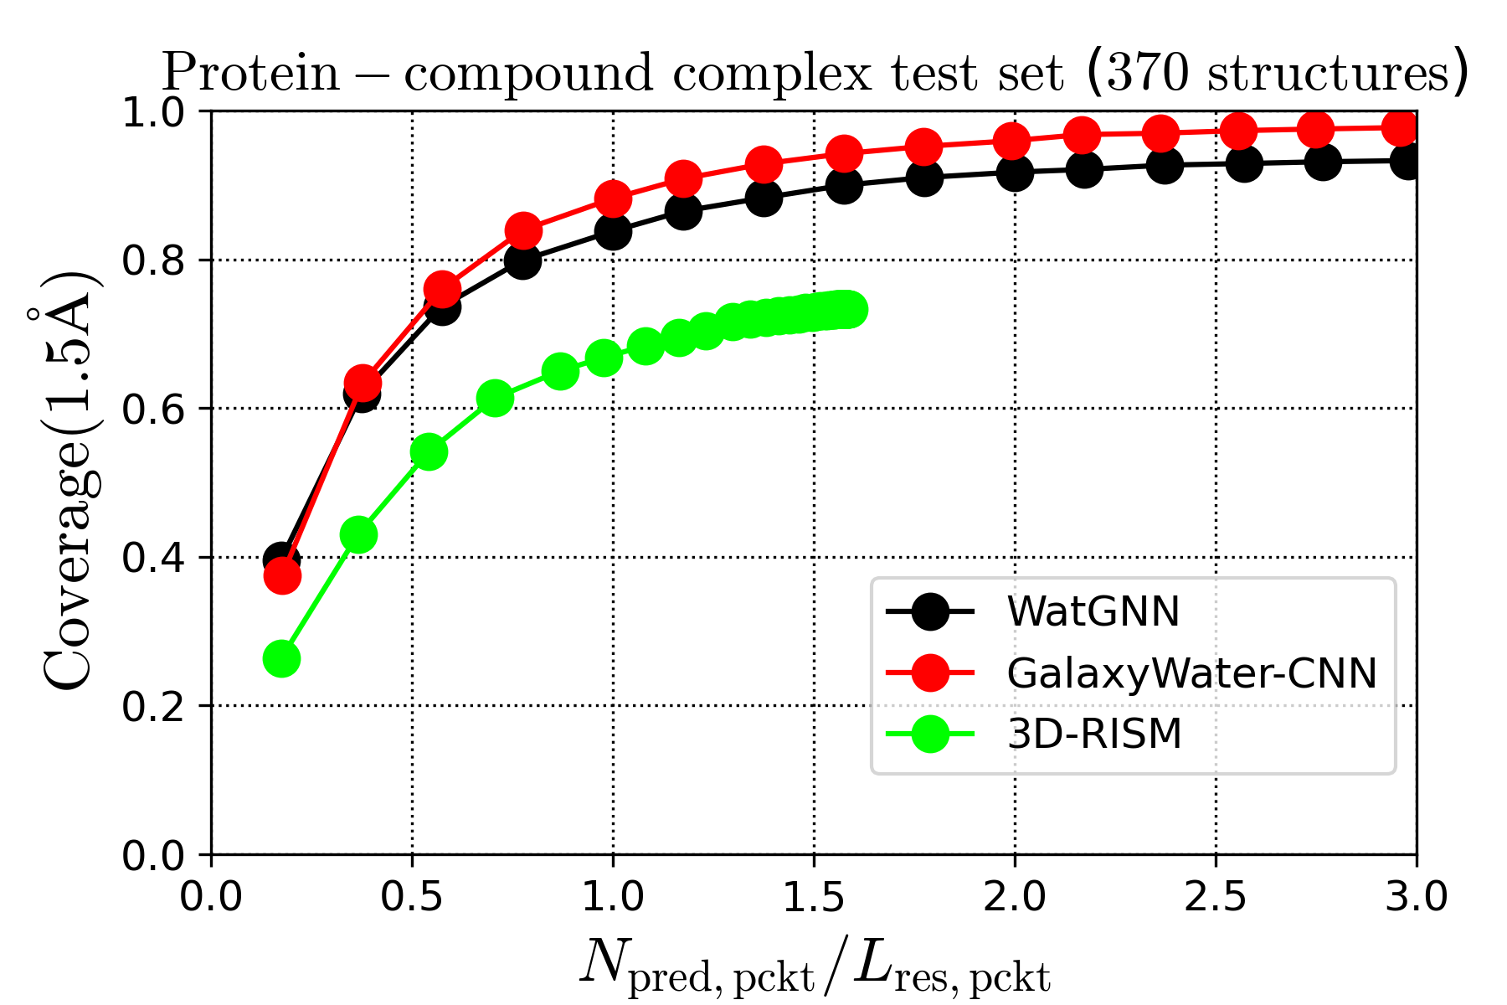
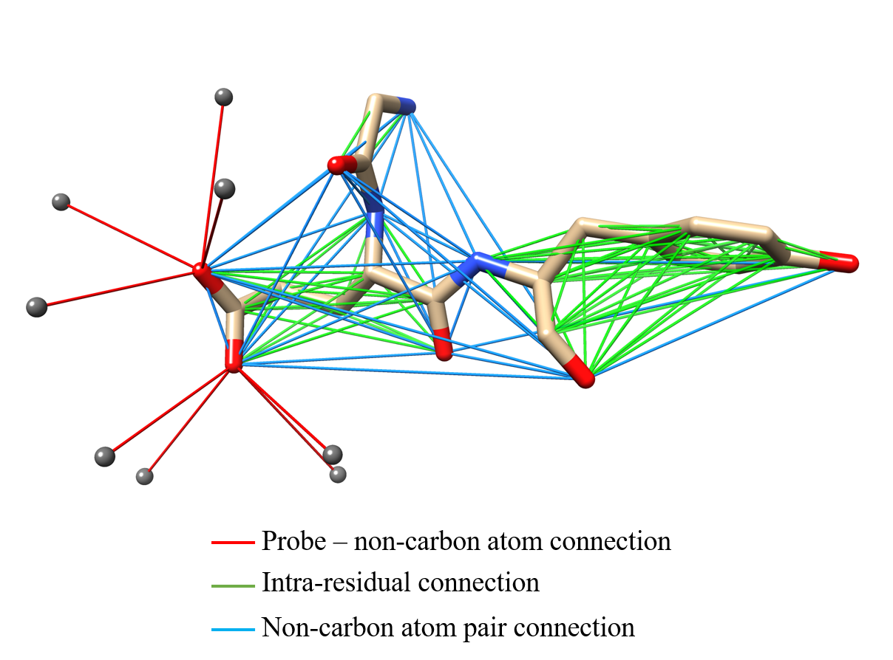
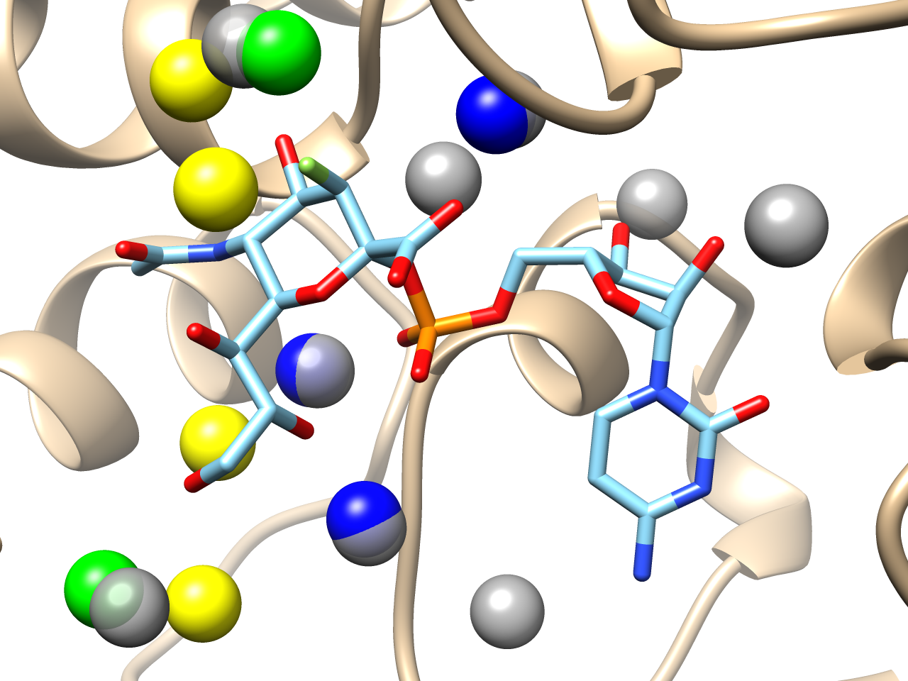
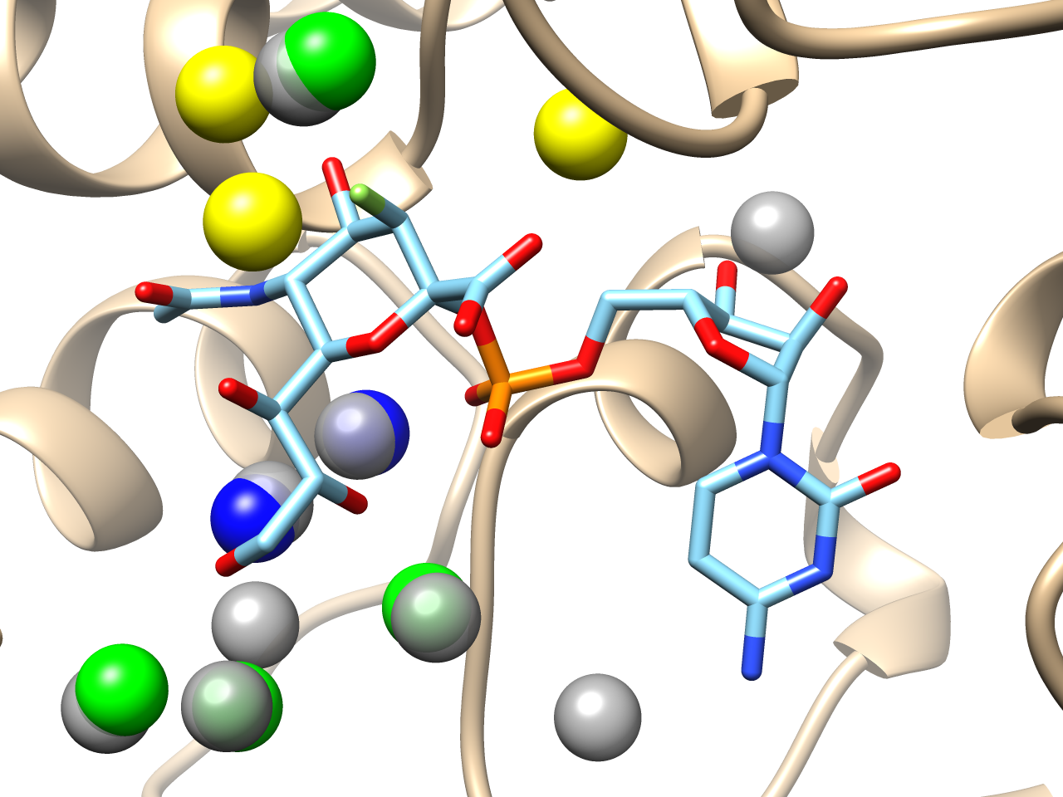
Water position prediction with SE(3)-Graph Neural Network
Sangwoo Park*
Department of Chemistry, Seoul National University, Seoul 08826, Republic of Korea
ABSTRACT
RESULT
Protein-bound water molecules affects the structure and function of the protein.
To consider such water molecules, positions of bound water from given protein structure should be known. If only protein structure is given, prediction of water molecule’s position could be done.
For fast and accurate prediction, WatGNN, water position prediction method using
SE(3)-Graph Neural Network (SE(3)-GNN) was developed in this research.
Prediction performance comparison
  Comparison set
    Single protein structure set
      92 X-ray crystal structures, 1Å resolution or better,
      released before March 14th, 2015.
    Protein-compound structure set
      397 structures curated from the PDBBind set,
      2Å resolution or better, sequence identity < 30%, tanimoto similarity < 50%
CNN (0.5Å spacing)
GNN
  Performance for single protein structure set
Multiple cells are needed for each atom
Single node is needed for each atom
With SE(3)-GNN based method, water position accuracy was better than state-of-art methods, while average computational cost was 1.86 seconds on i9-12900k CPU and
RTX-4090 GPU, which is 12.8 times faster than using our previous prediction method
using Convolutional Neural Network.
The preprint and prediction program is available on Biorxiv and Github, respectively.
  Preprint: www.biorxiv.org/content/10.1101/2024.03.25.586555v1
  Github: https://github.com/shadow1229/WatGNN (Github repository)
Average computation time
(i9-12900k + RTX4090)
WatGNN: 1.86s
GalaxyWater-CNN: 23.77s
3D-RISM: 398.77s
FoldX (CPU only): 5.72s
Preprint
Github
WatGNN Method
Network Structure
WatGNN
GalaxyWater-CNN
Predicted water sites Crystallographic water
w/ predicted sites within 0.5Å
Crystallographic water Crystallographic water
w/ predicted sites within 1.0Å w/o predicted sites within 1.0Å
  Performance for protein-compound structure set
Probe
Features
  Node features: Atom types only
    C,N,O,S,P, halogens, alkali metals,
    non-alkali metals, probes, other atoms
  Edge features
    Probe-non carbon atom connections
    Intra-residual connection
    Non-carbon atom pair connection within 10Å
WatGNN
GalaxyWater-CNN
Training set
  High resolution X-ray crystallography protein structure set
  2.0Å or better resolution, sequence identity < 30%, < 5000 heavy atoms
  7971 structures (curation date: Sep 21, 2023)
  training: 3971, validation: 300, test: 3700 structures
CONCLUSION
  Considering an atom as a single node for water position prediction via GNN
  greatly decreases computational cost compared with the previous method using CNN.
  Using GNN enables more accurate water position prediction without limited resolution
  due to CNN's grid representation.
  The limited amount of protein-ligand complex set for training limits the performance of WatGNN, which implies that the amount of training data impacts performance of WatGNN to what extent.

