Slide 2
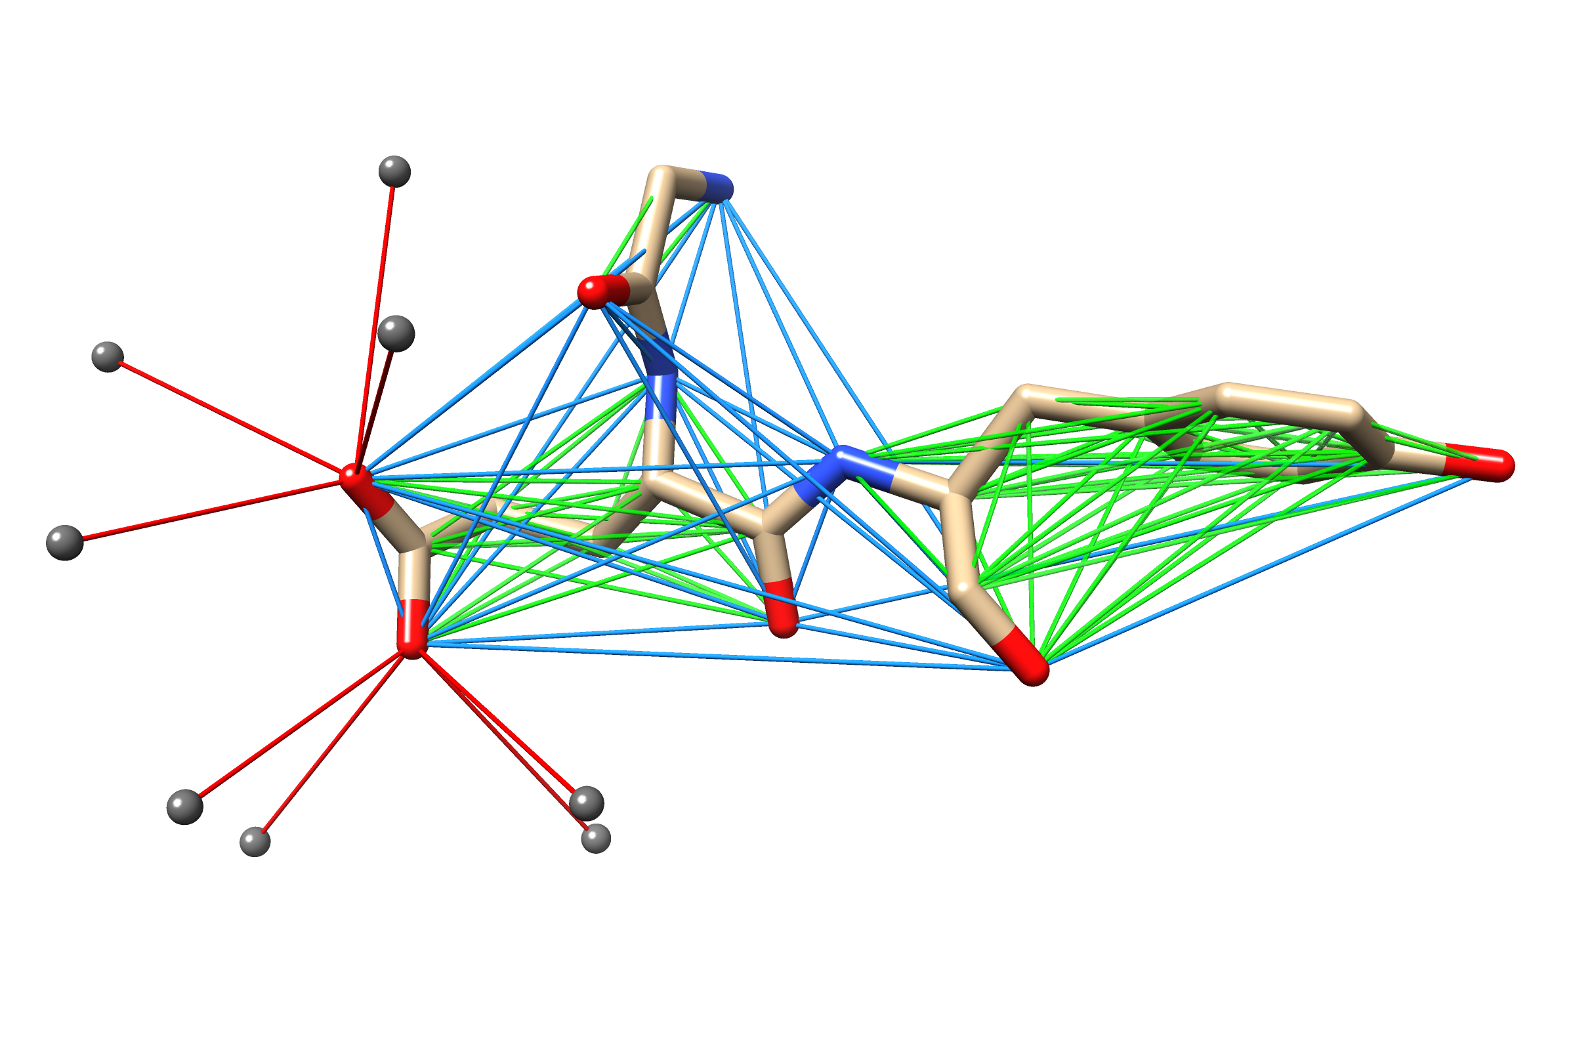
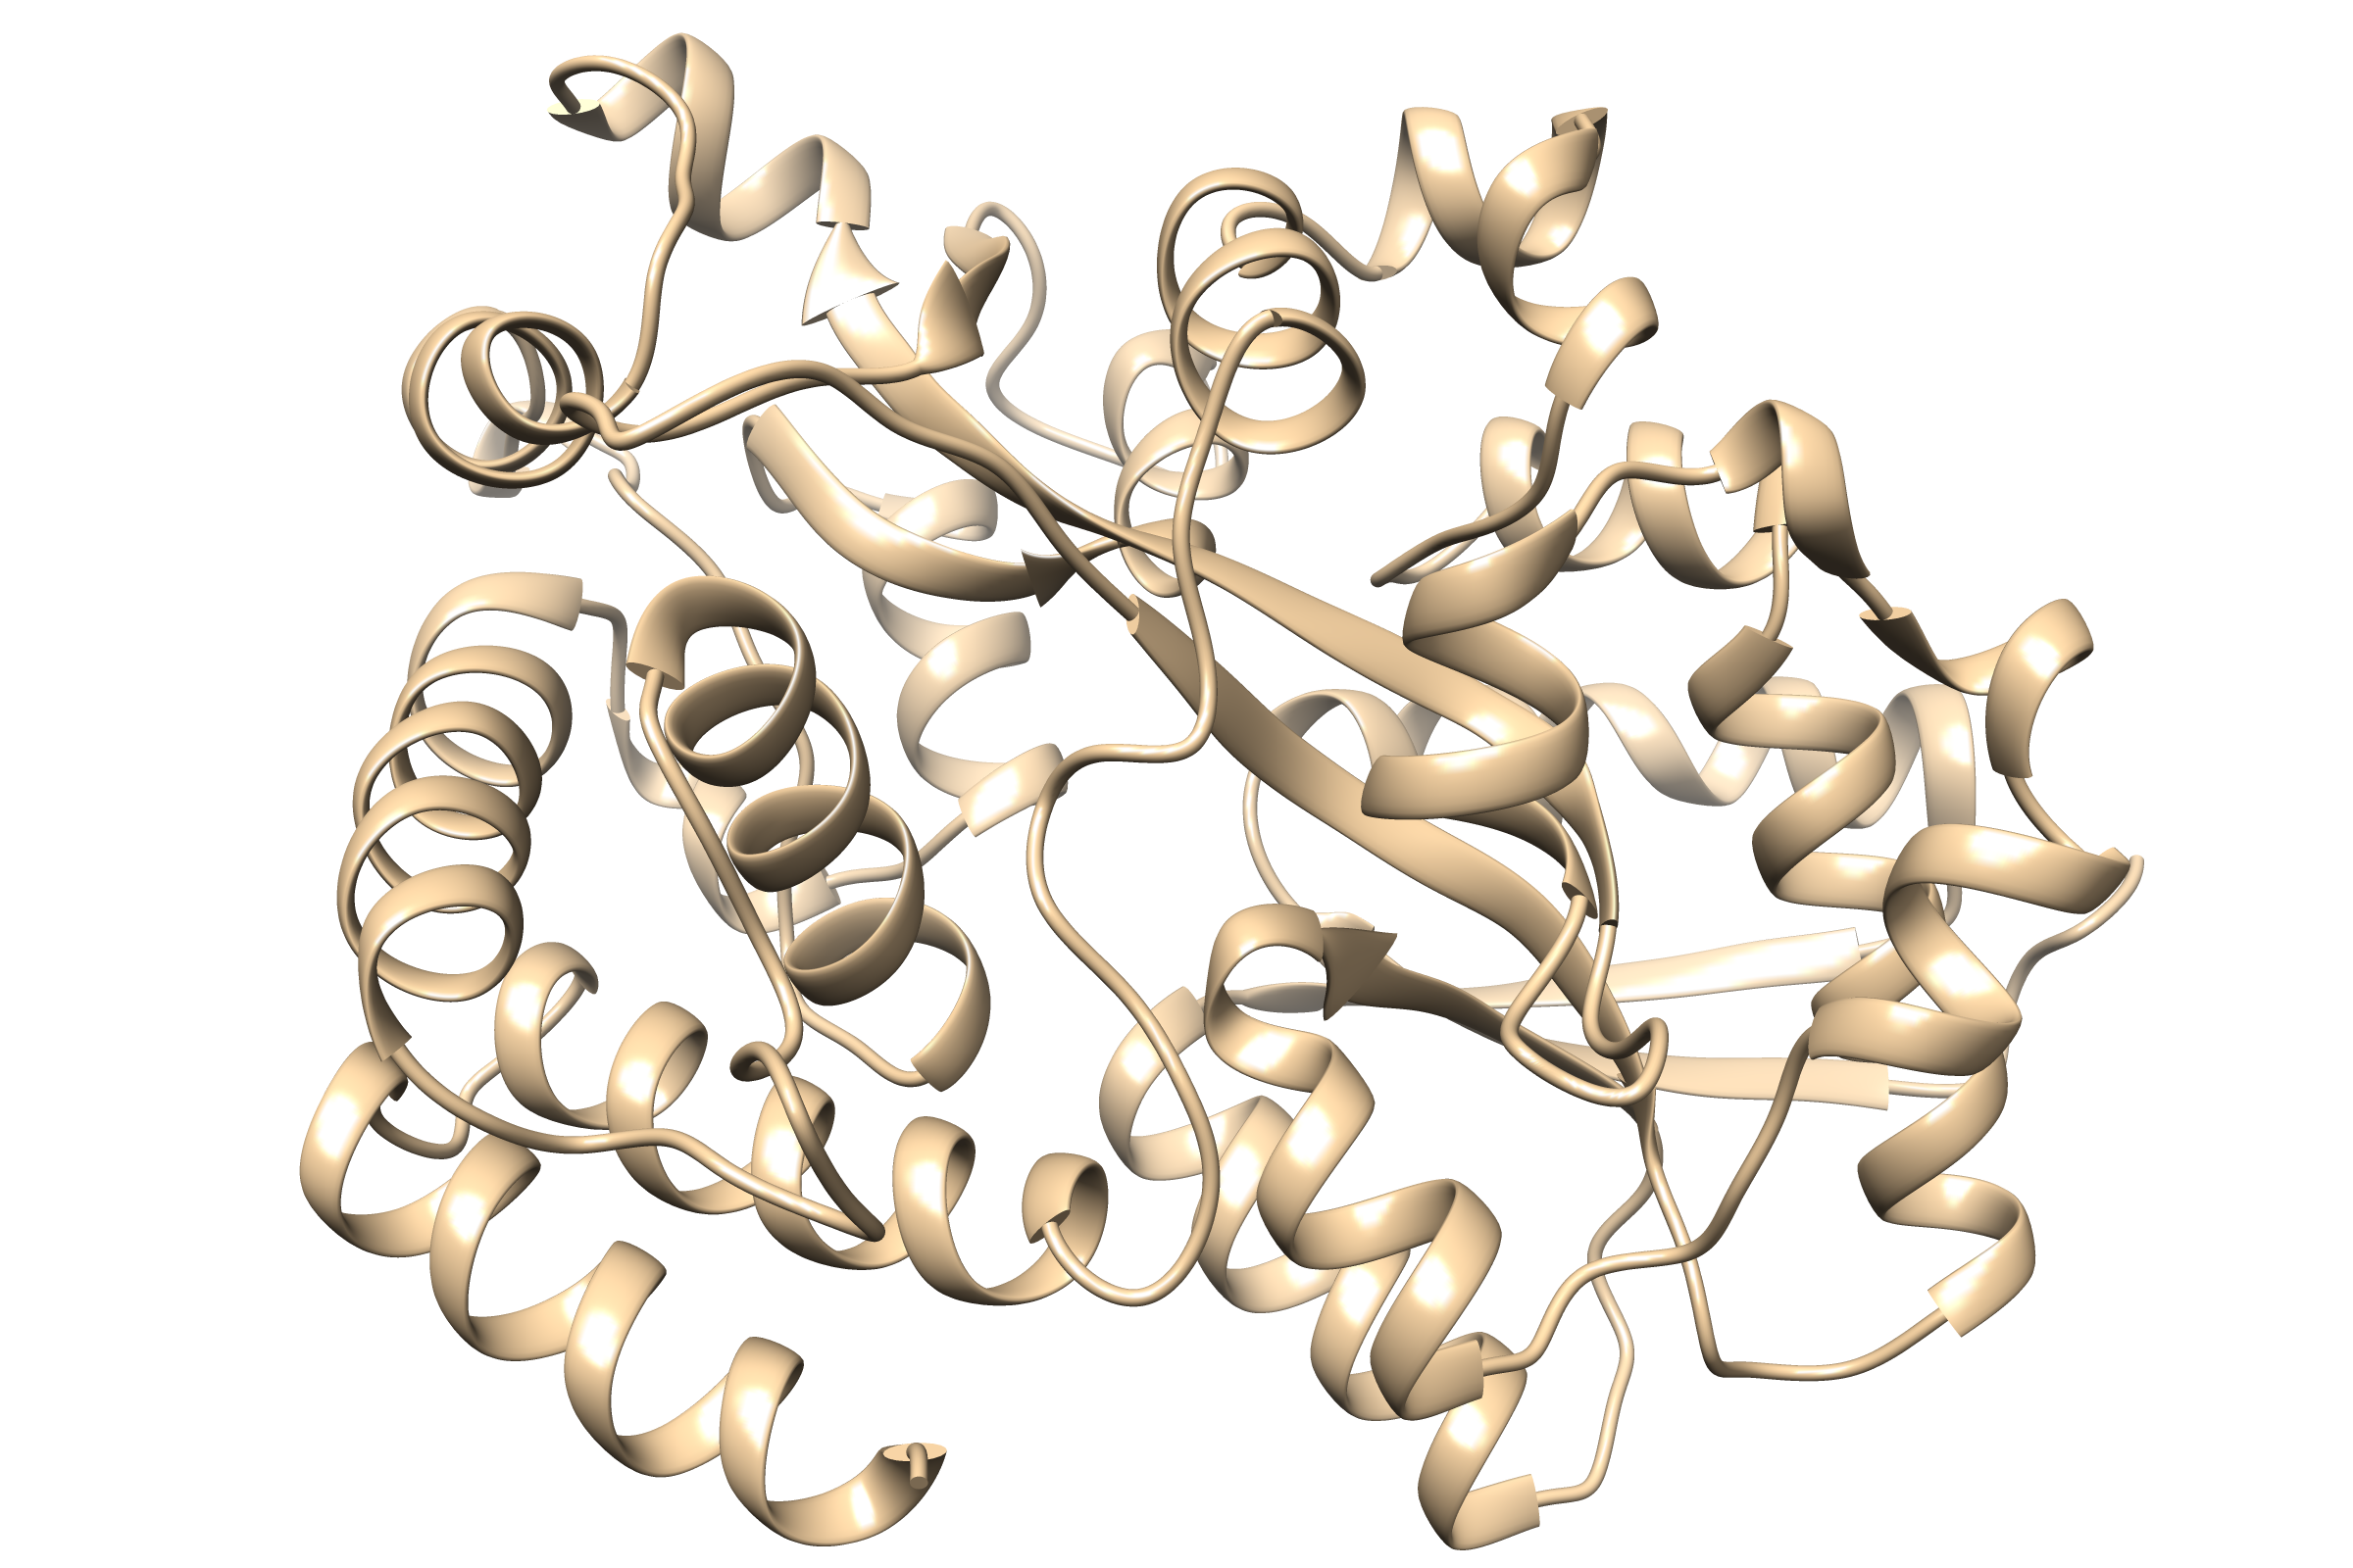
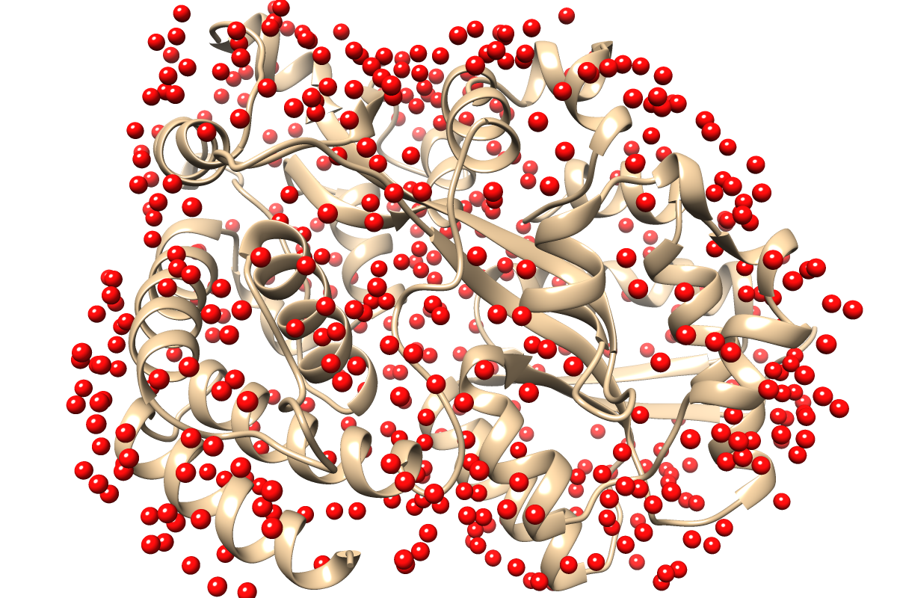
TOC Graphics
SE(3)-Equivariant
Graph Neural Network
WatGNN
Protein structure
Predicted water sites

Slide 3
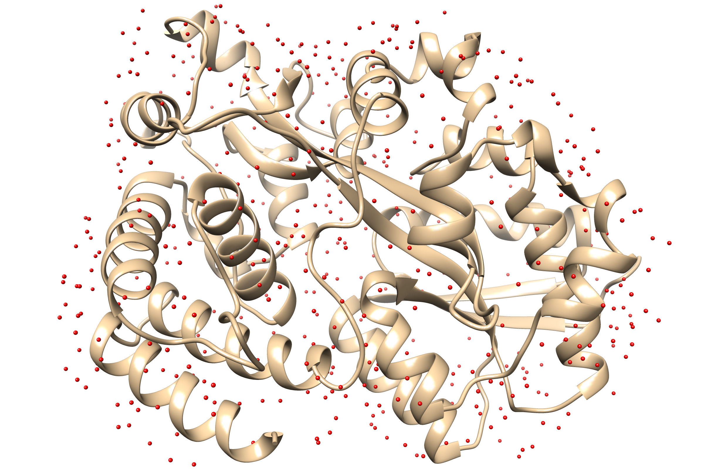
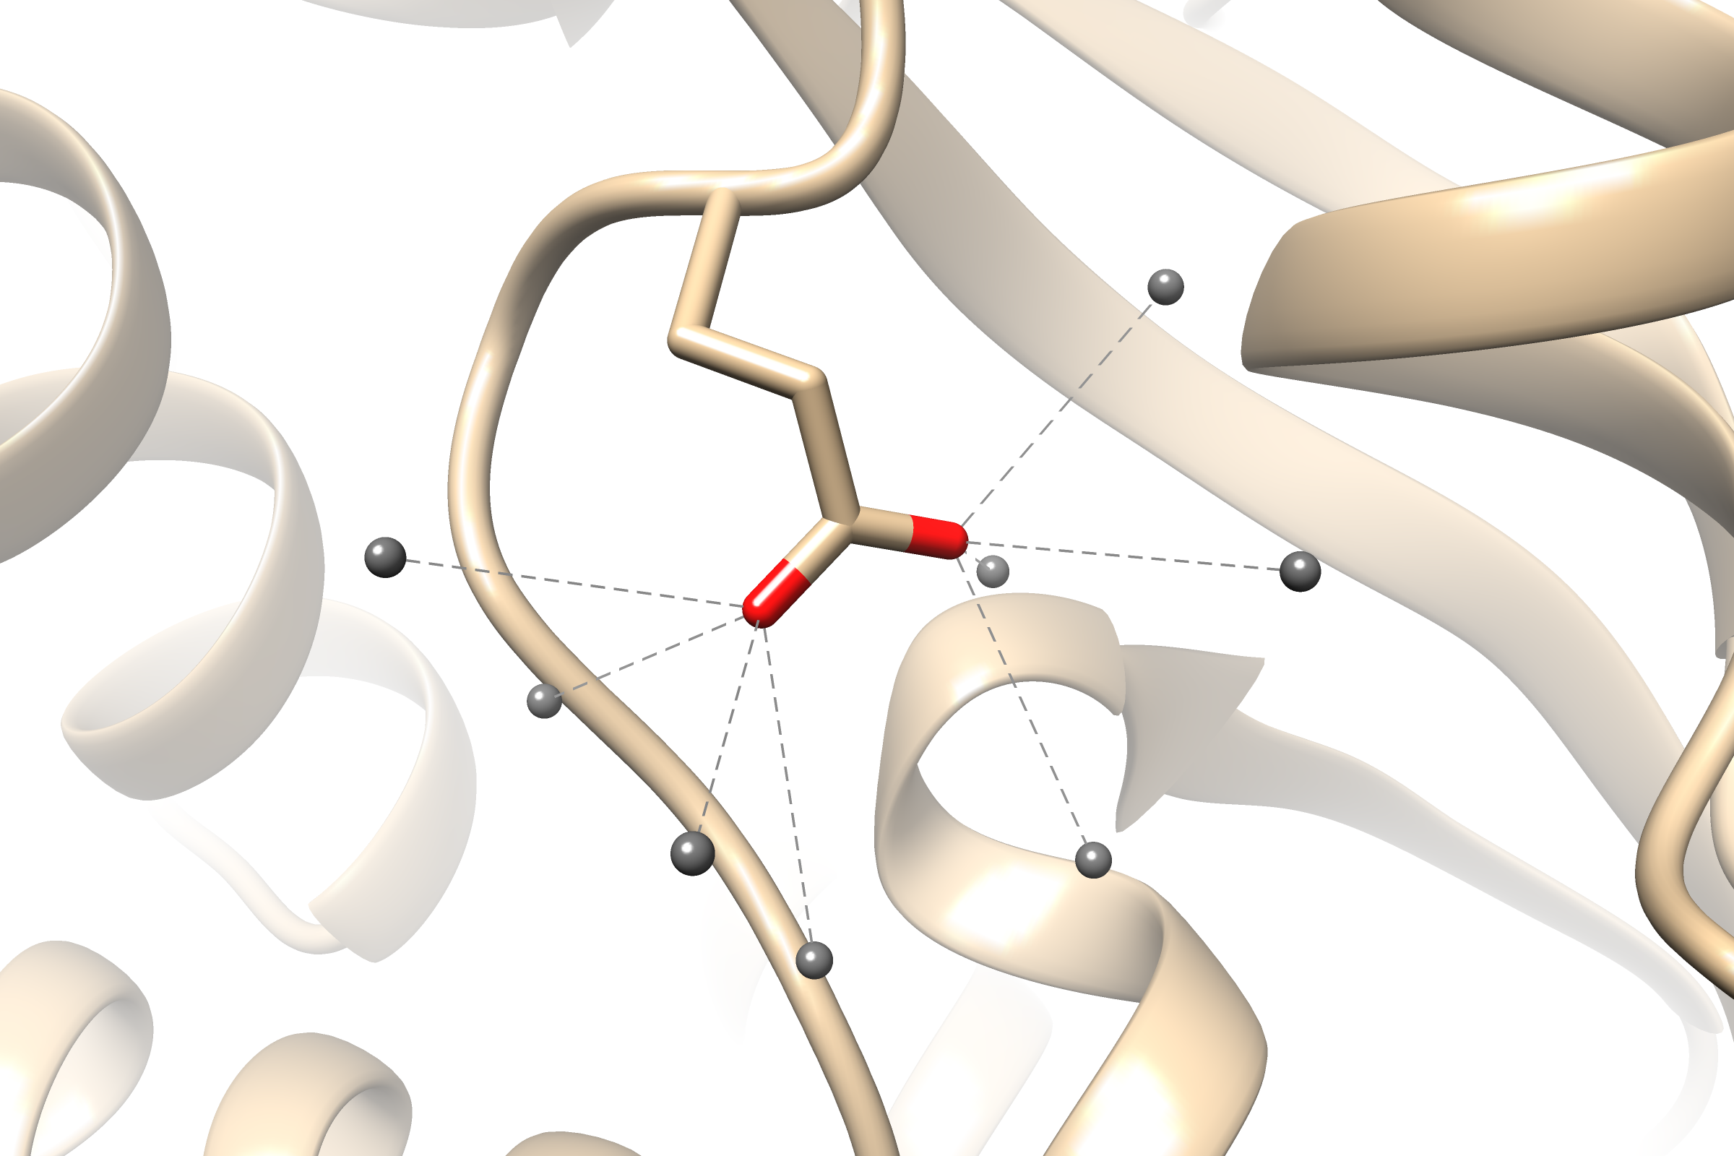
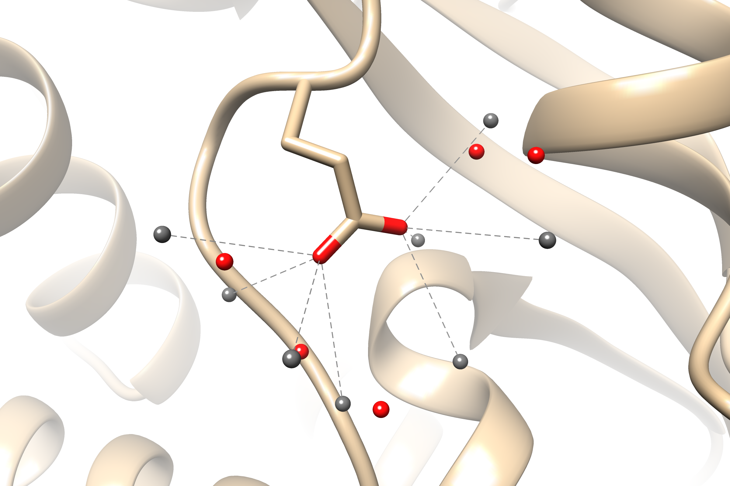
Fig 1
Probe building
Position clustering
SE(3)-GNN

Slide 4







Fig 2 (deprecated)
(a)
(b)
$${\hat{a}}_{1}$$
$${\hat{a}}_{2}$$
$${\hat{a}}_{3}$$
4.5Å
First axis $\left({\hat{a}}_{1}\right)$
Probe-ineligible atom
Auxiliary direction ($\hat{c}$)
Probe-eligible atom
Second axis $\left({\hat{a}}_{2}\right)$
Residue centroid
Third axis $\left({\hat{a}}_{3}={\hat{a}}_{1}×{\hat{a}}_{2}\right)$
Probe

Slide 5
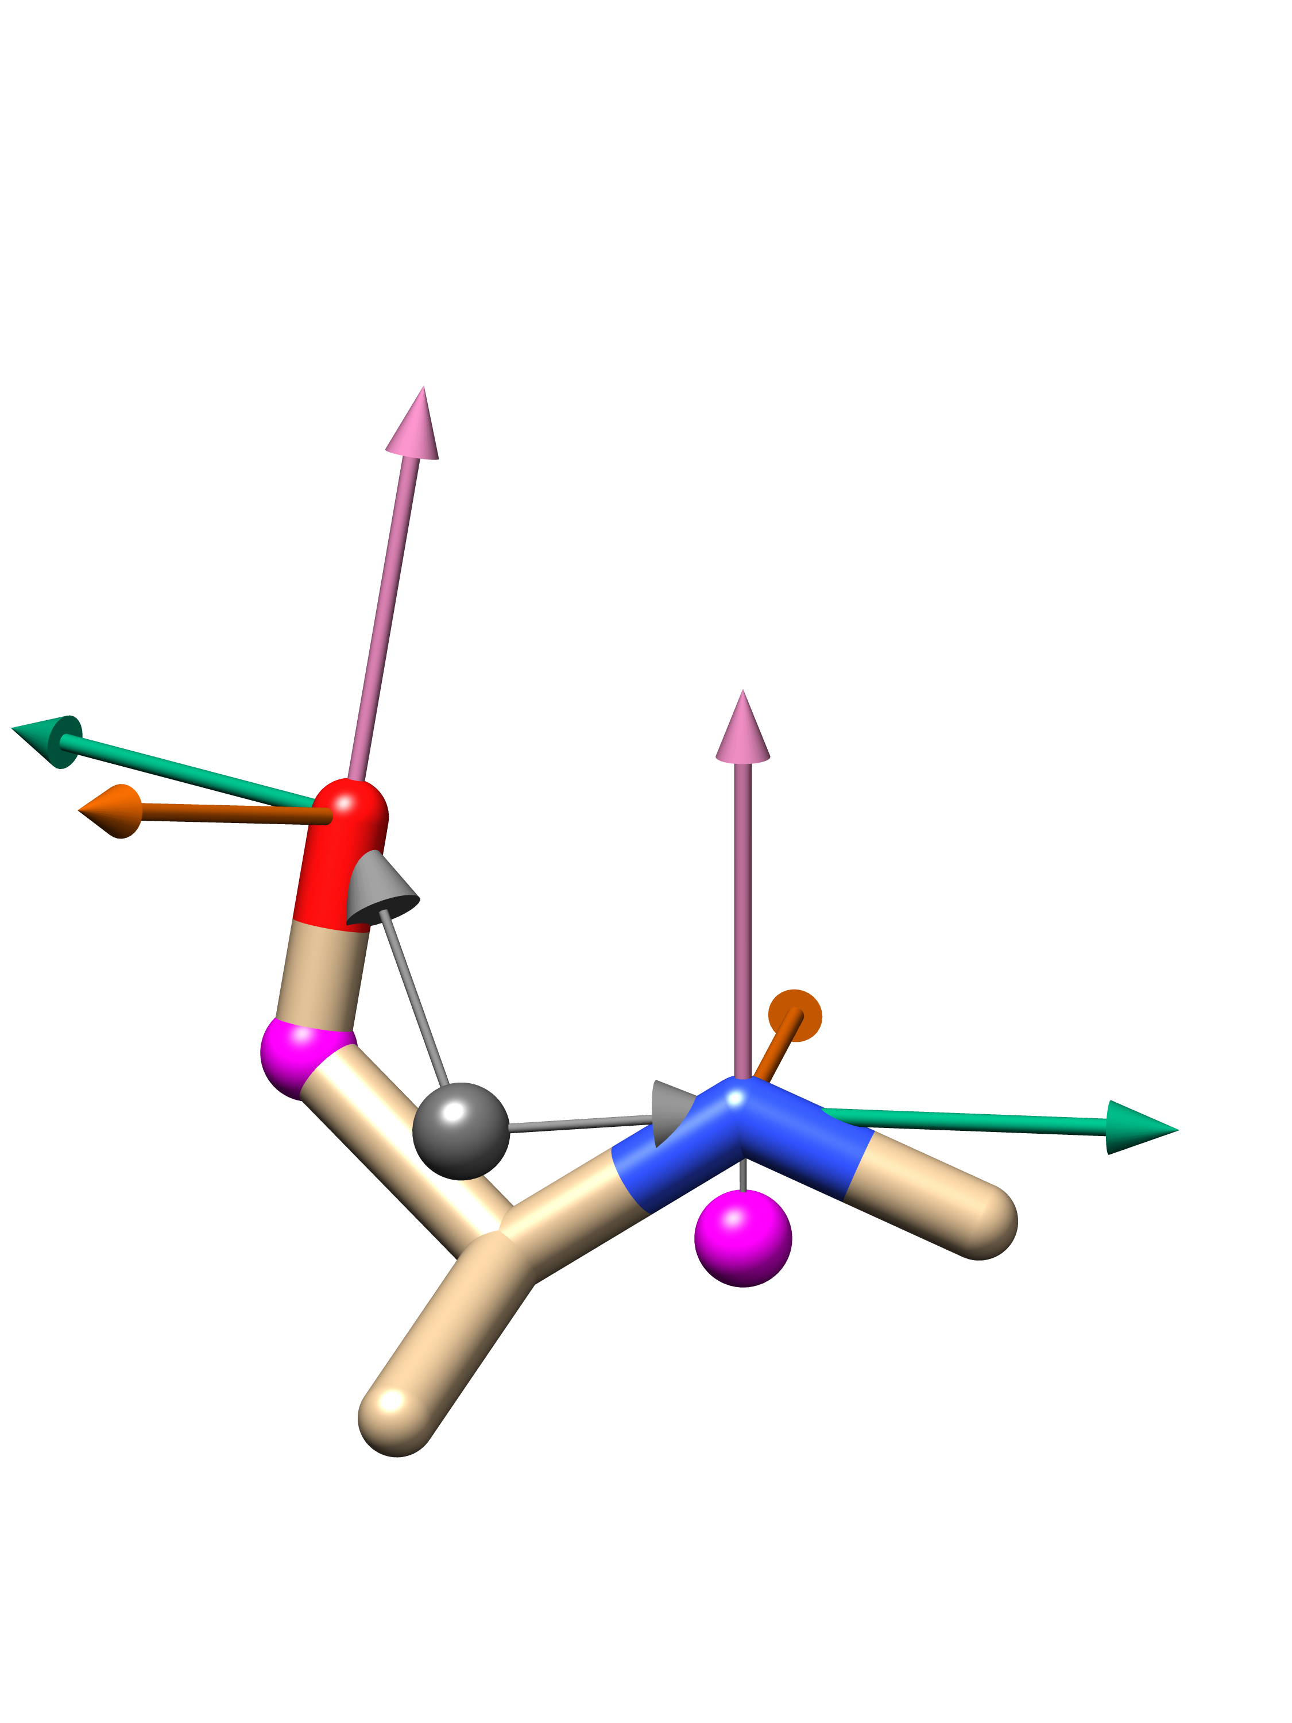
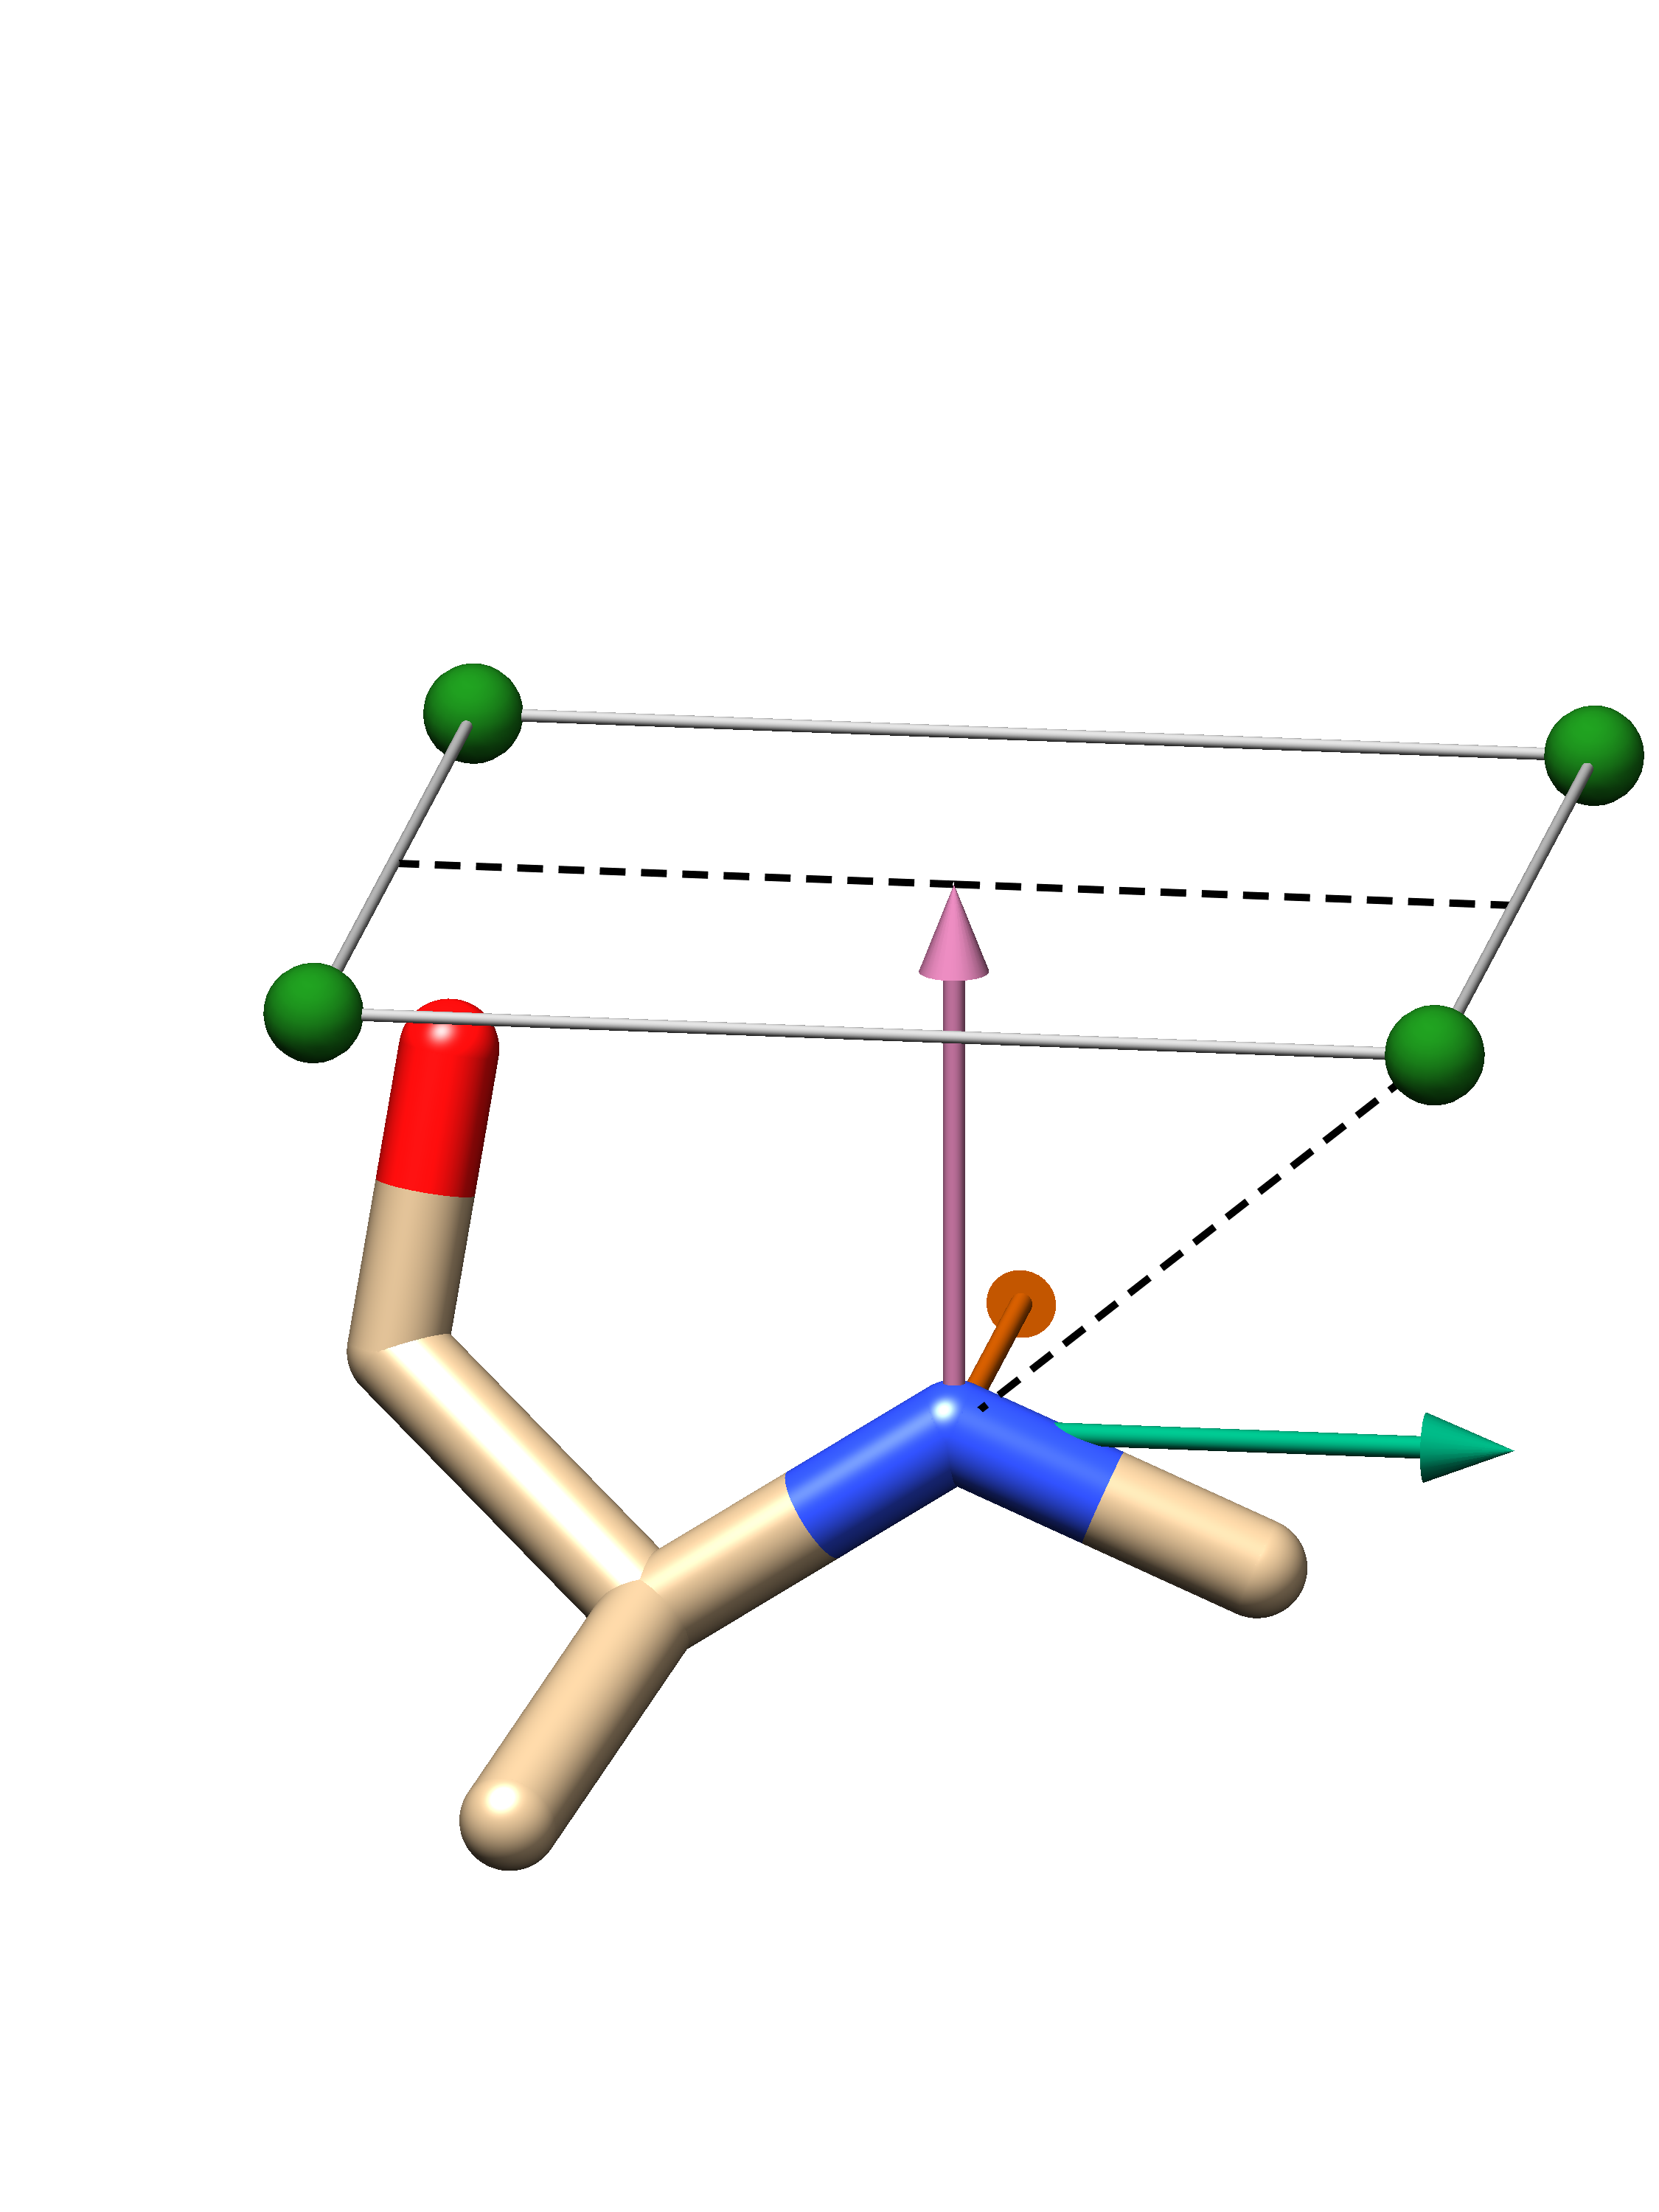


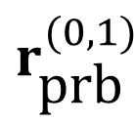

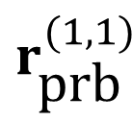

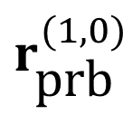
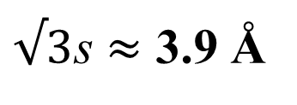
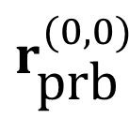
Fig 2
(a)
(b)
$$r_{\text{prb}}^{(1,0)}$$
$$r_{\text{prb}}^{(0,0)}$$
2s = 4.5 Å
$${\hat{a}}_{1}$$
s
s
$$r_{\text{prb}}^{(1,1)}$$
$$r_{\text{prb}}^{(0,1)}$$
$${\hat{a}}_{3}$$
s = 2.25 Å
$√3$s $≈$ 3.9 Å
$$\hat{c}$$
$${\hat{a}}_{2}$$
Centroid of the bonded heavy-atom neighbors
Probe node
Residue centroid

Slide 6
Input structure
Fig 3
Node features
Edge features
Atom type Embedding
SE(3)-Transformer
LayerNorm
Interaction module
ELU
6 SE(3)-Transformer
blocks
ConvSE3
LayerNorm
ELU
Structure module
6 linear blocks
LinearSE3
Displacement vector
Probability-like score
RMSD loss
Cross entropy loss

Slide 7
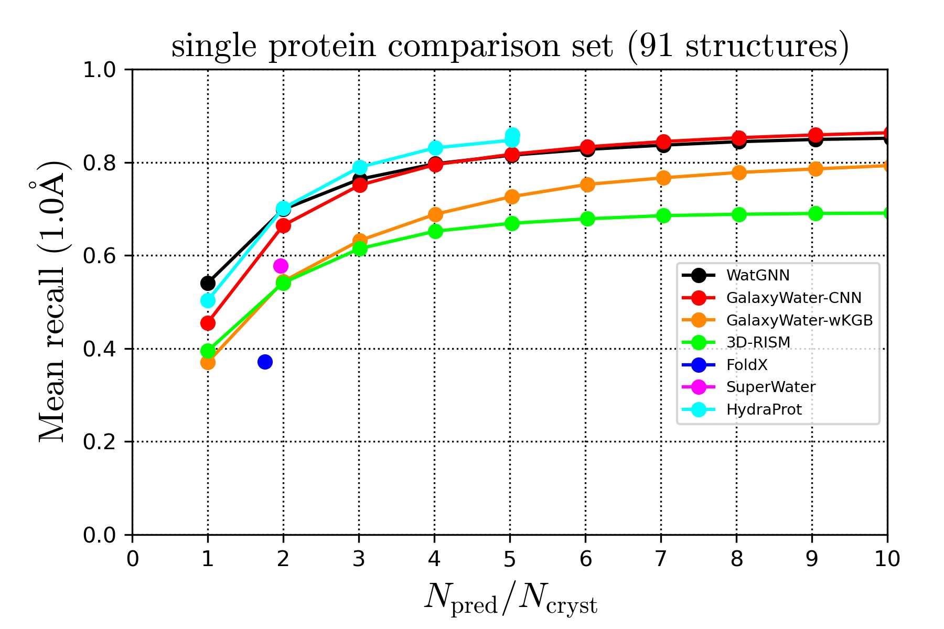
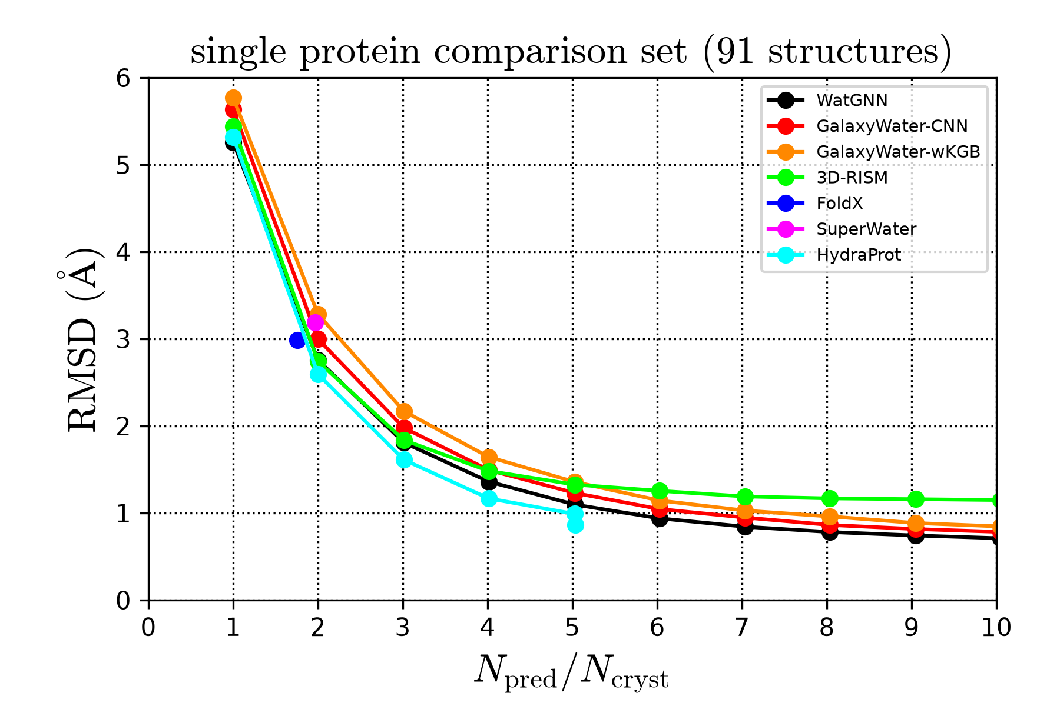
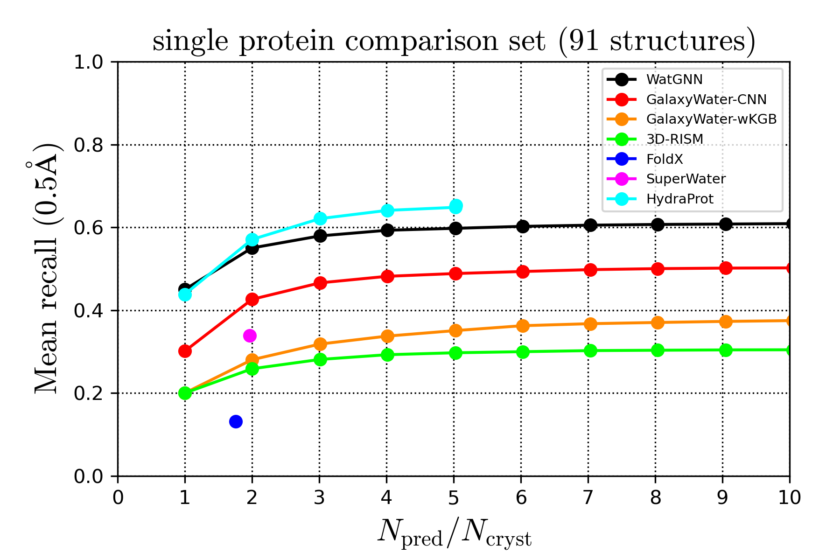
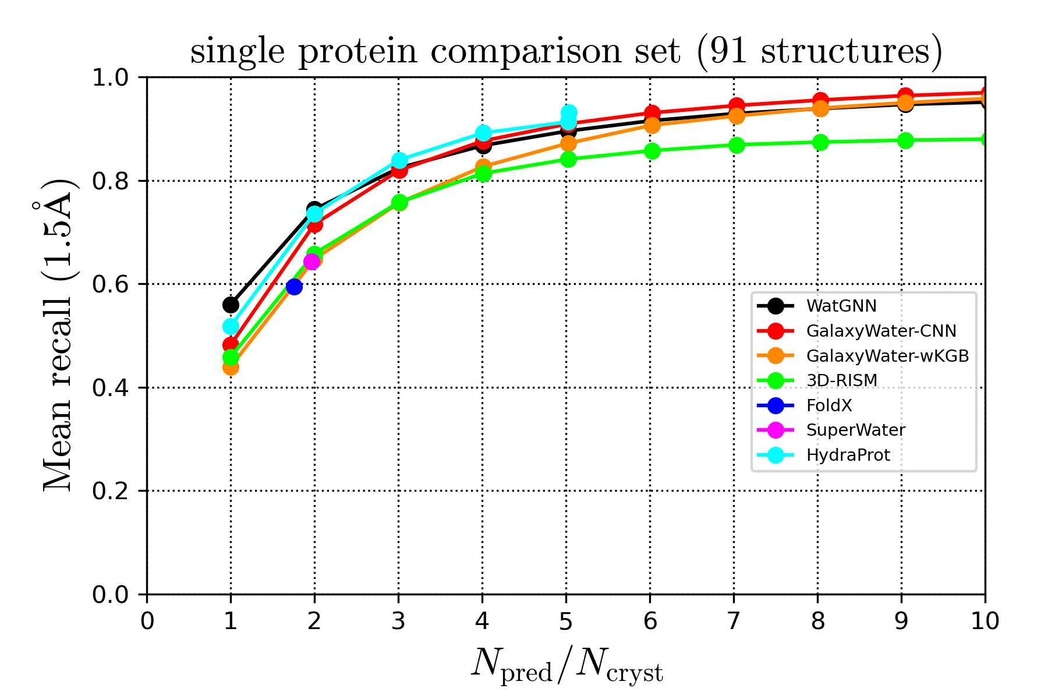
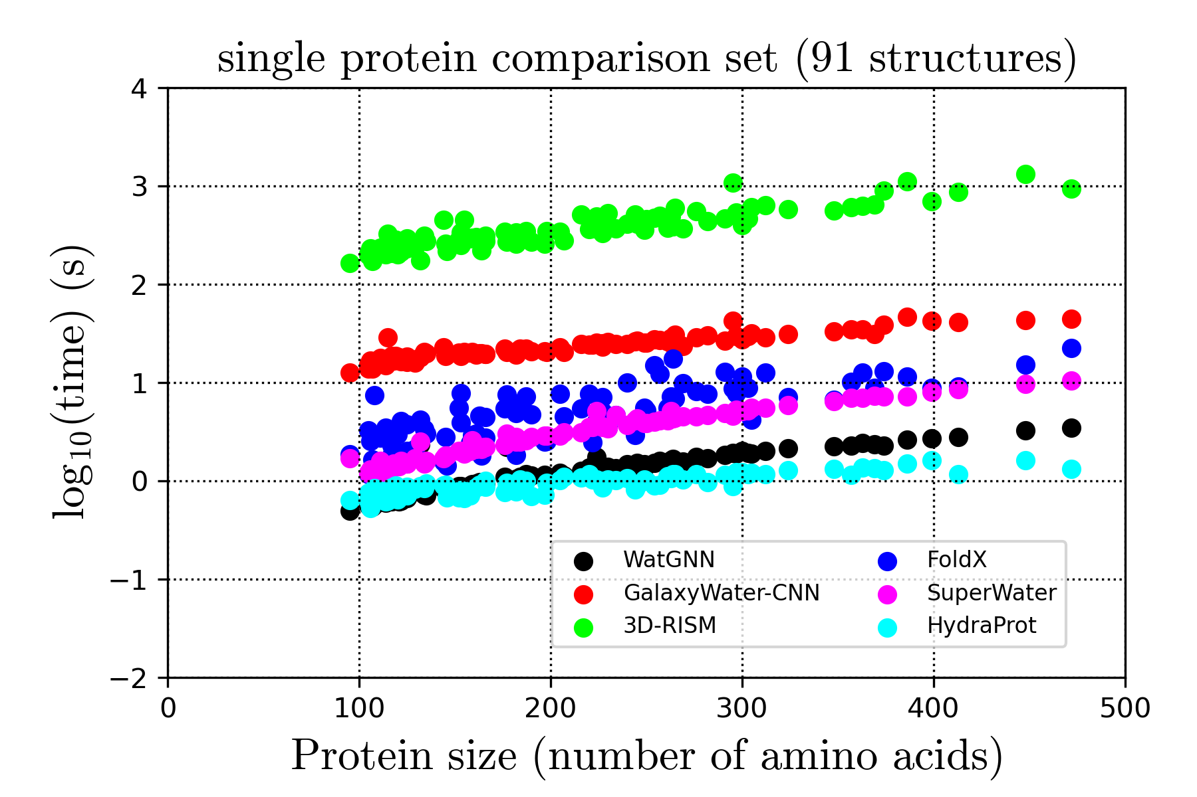
Fig 4
(a)
(b)
(c)
(d)
(e)

Slide 8
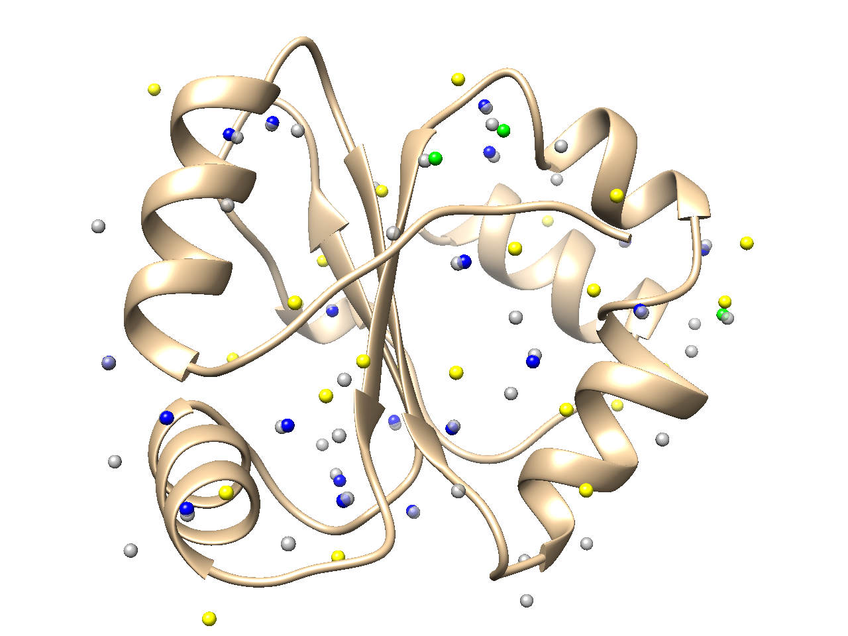
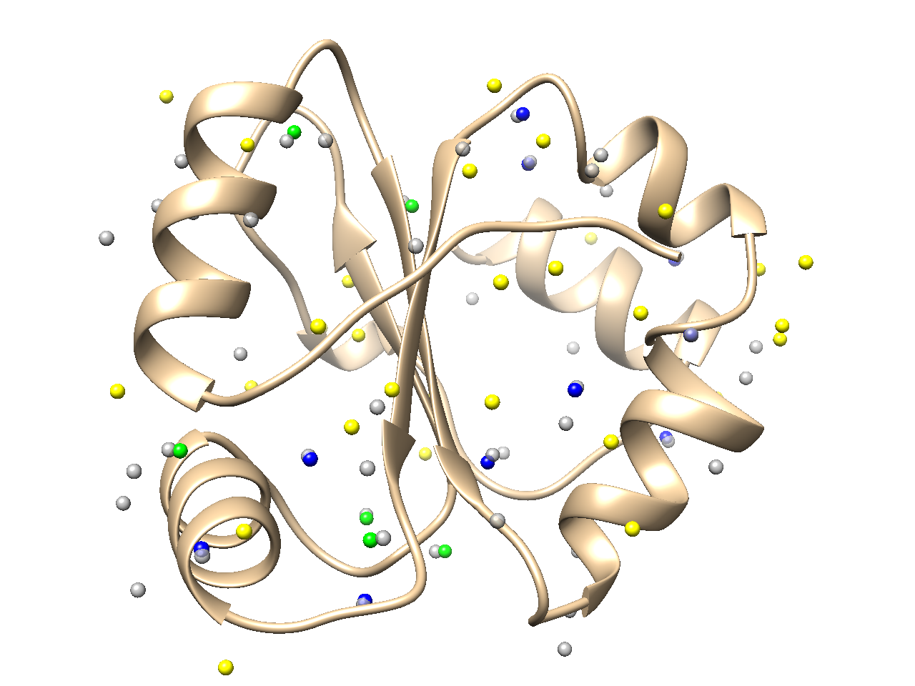
Fig 5
(a)
(b)

Slide 9
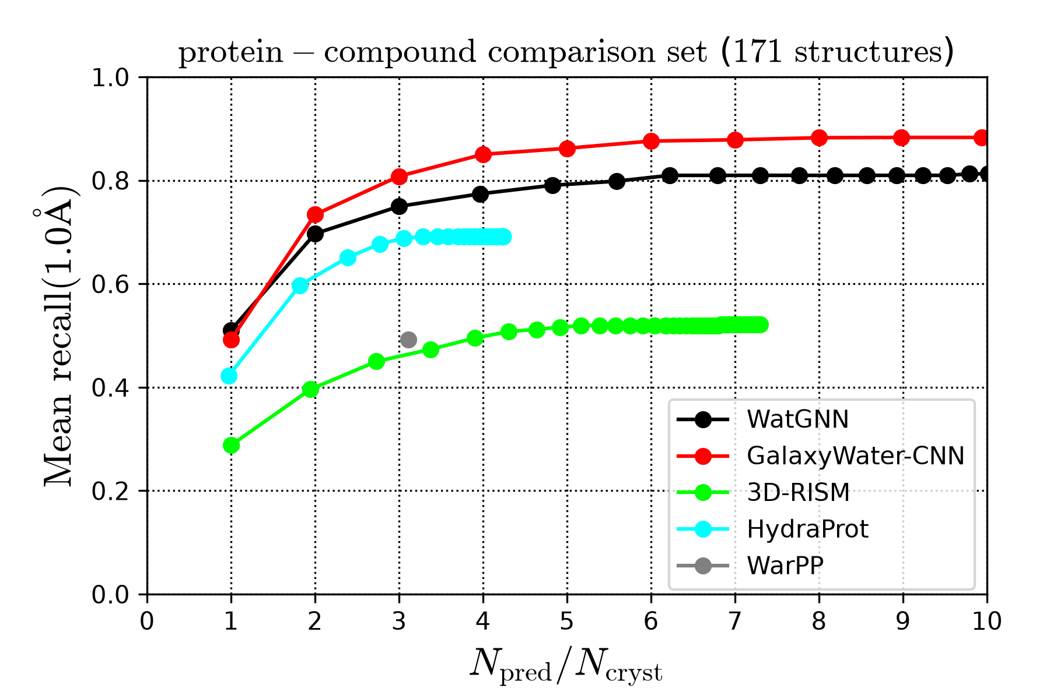
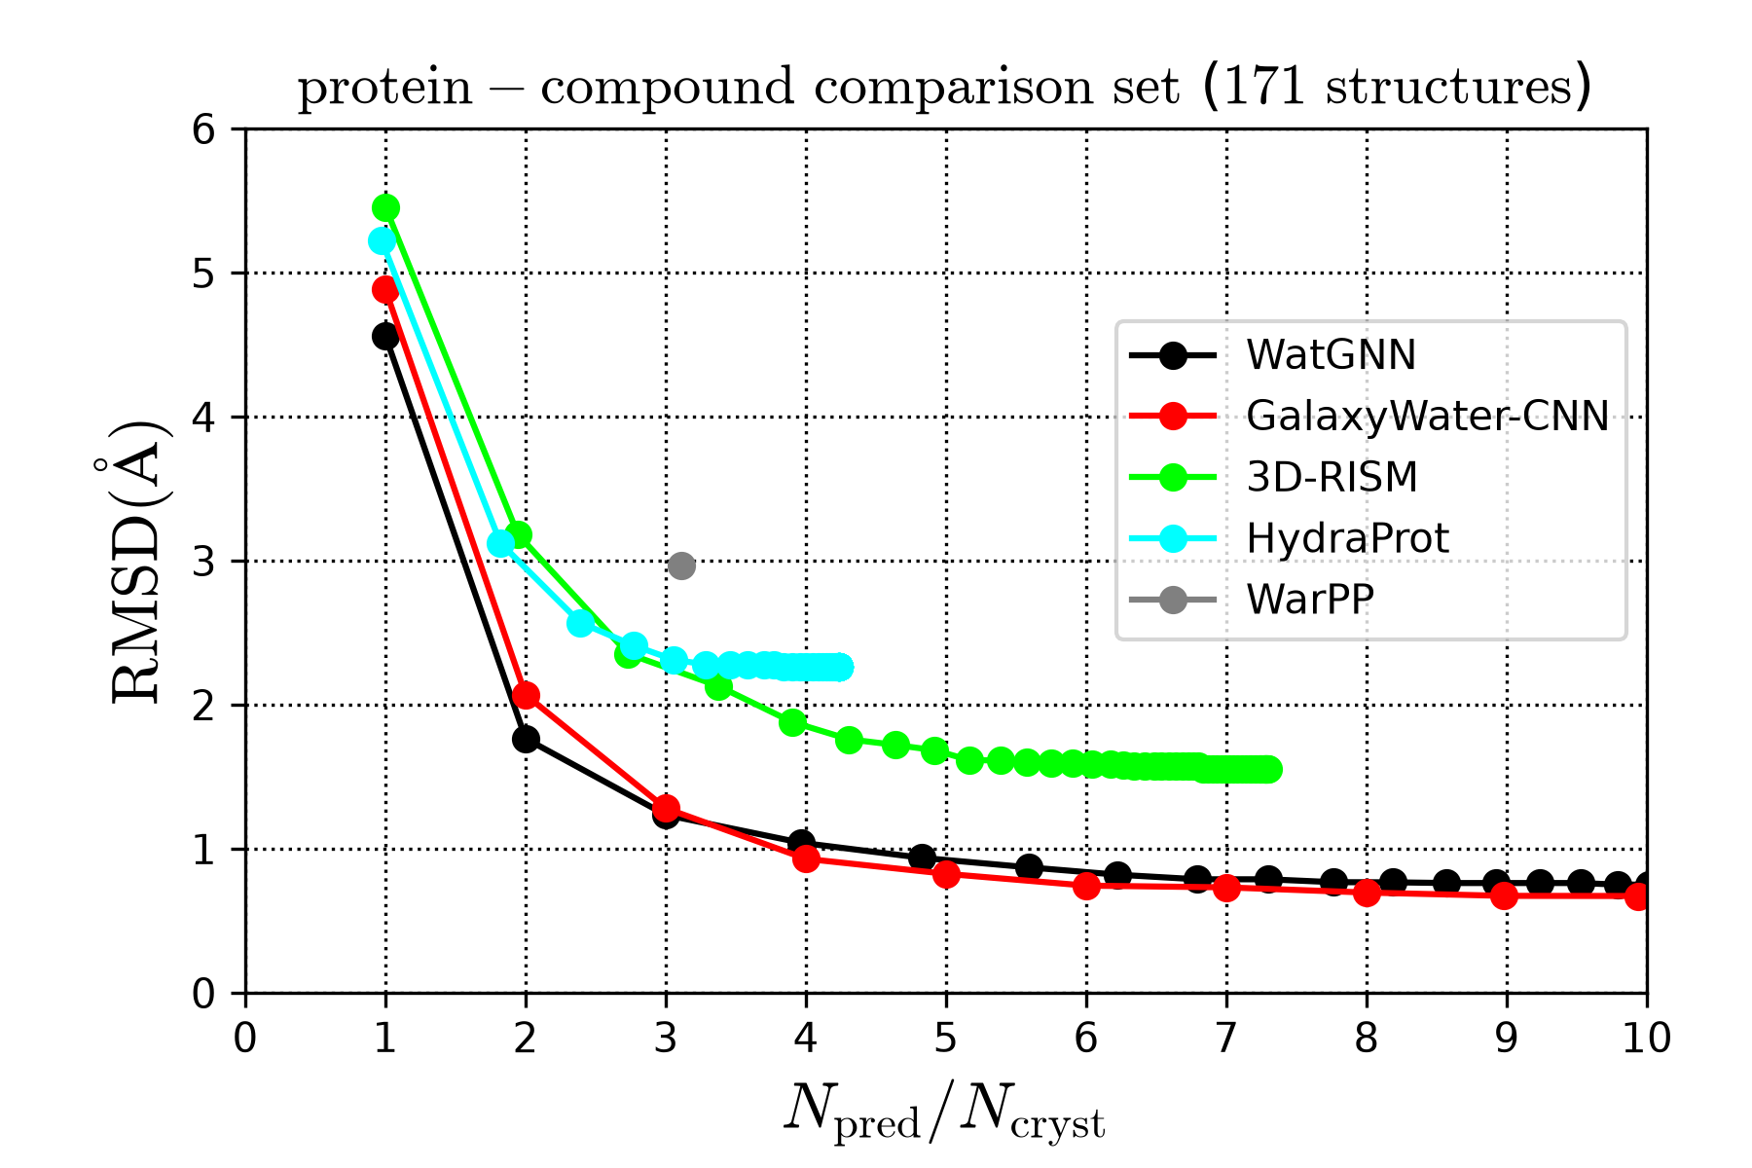
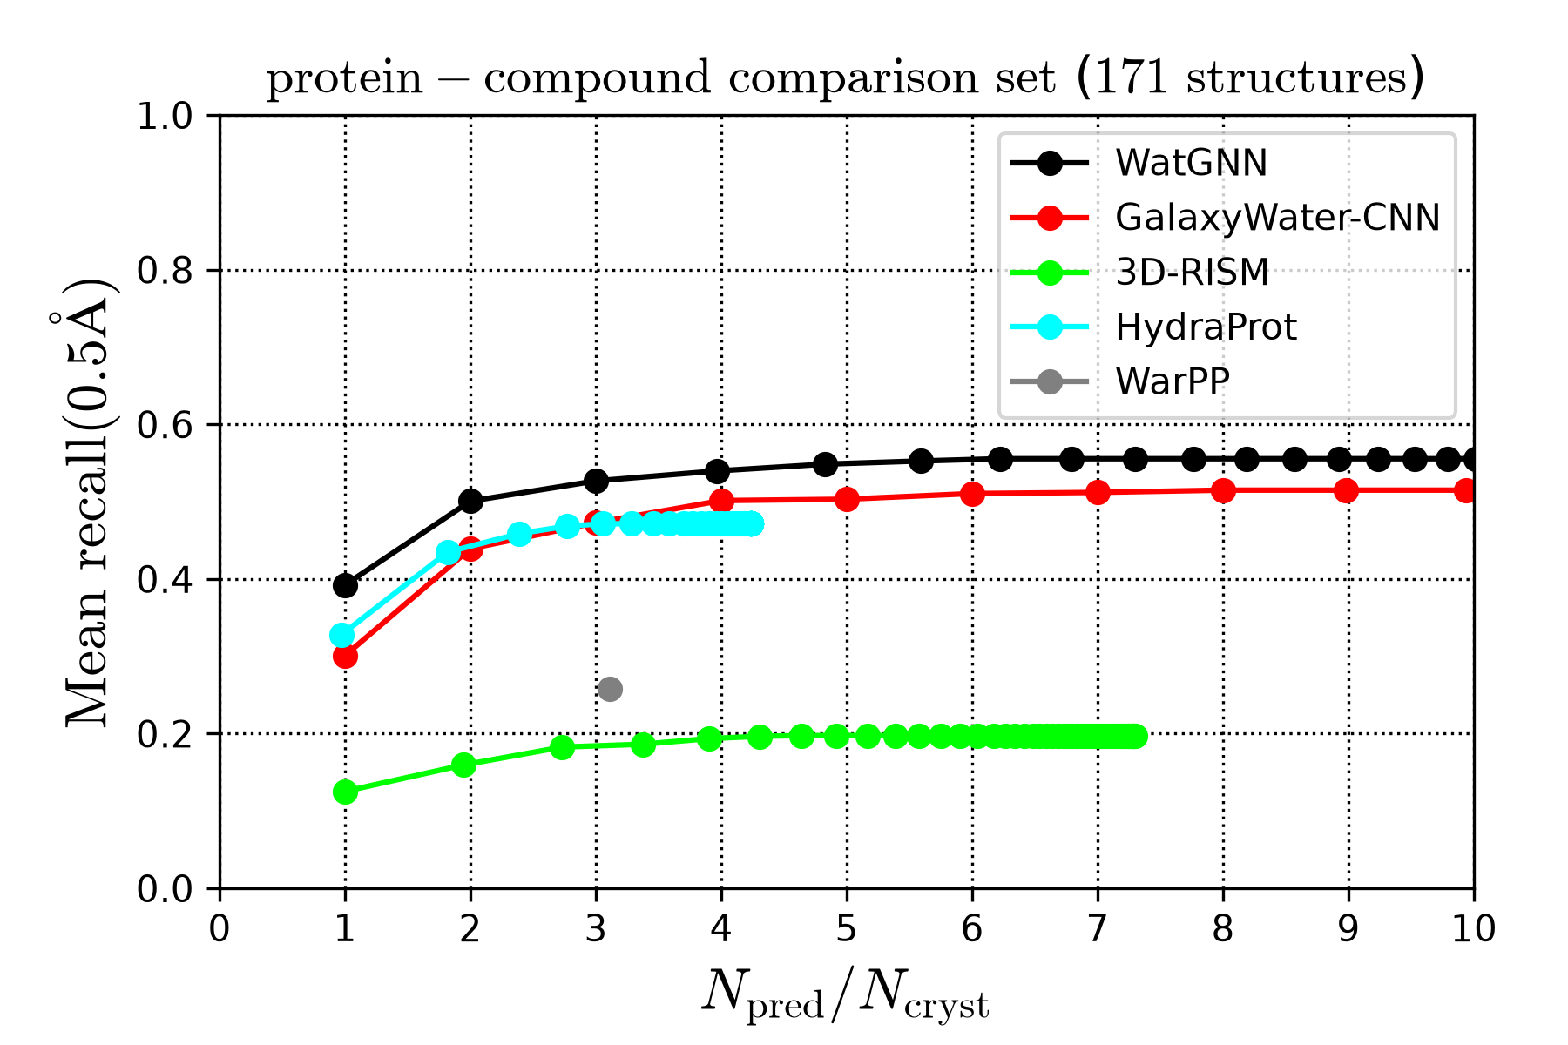
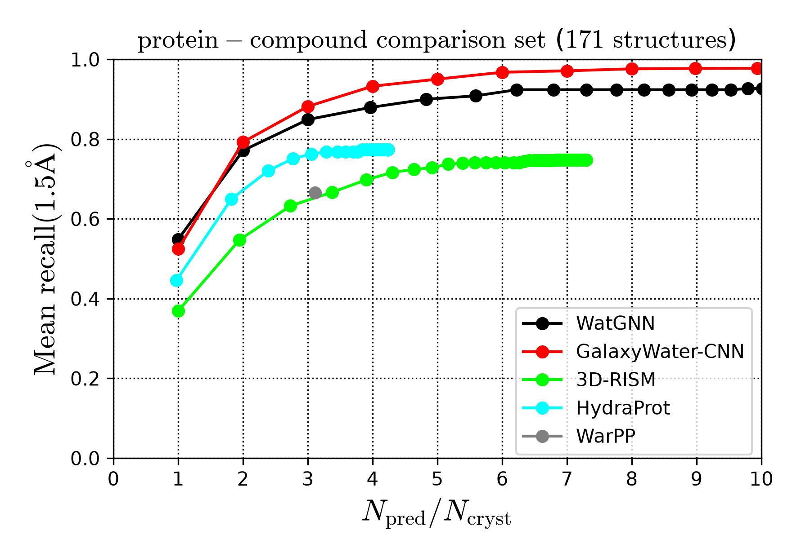
Fig 6
(a)
(b)
(c)
(d)

Slide 10
Fig S1
Atom - probe edge
Intra-residue atom-atom edge
Long-range edge

Slide 11
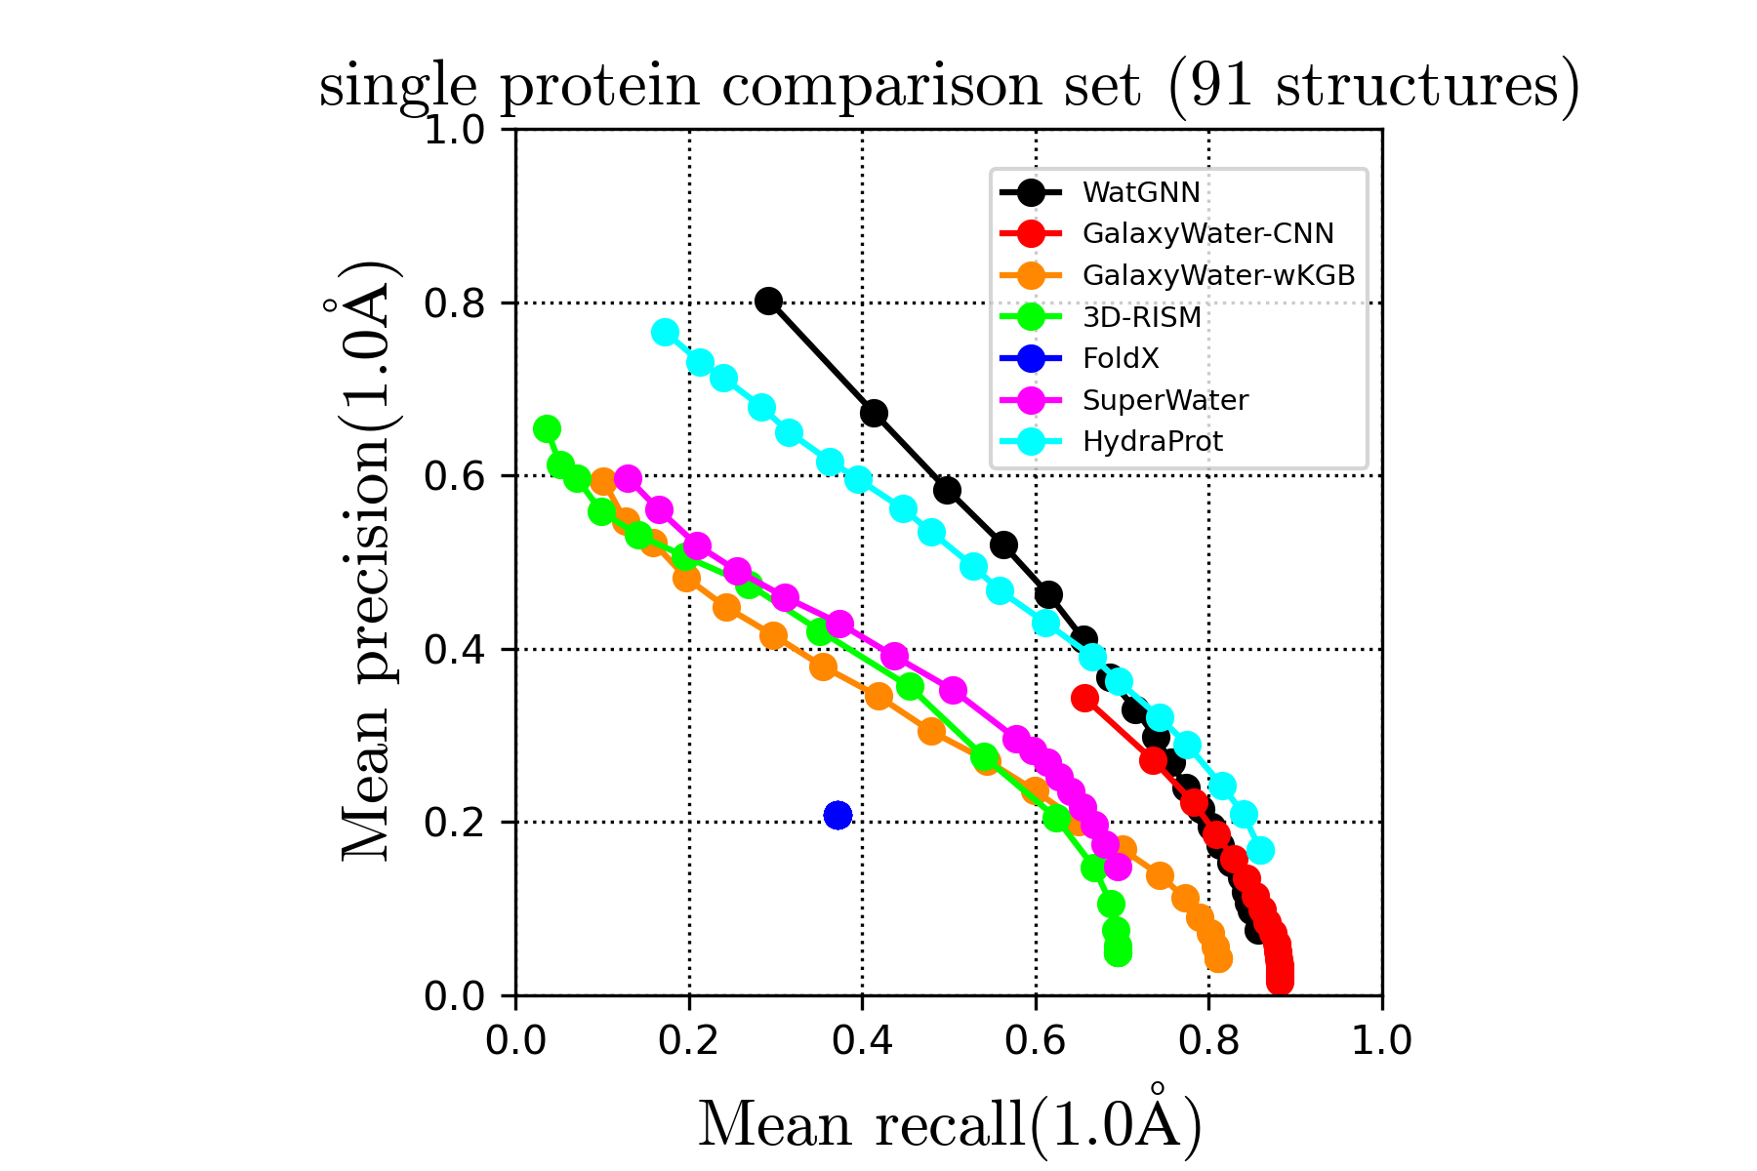
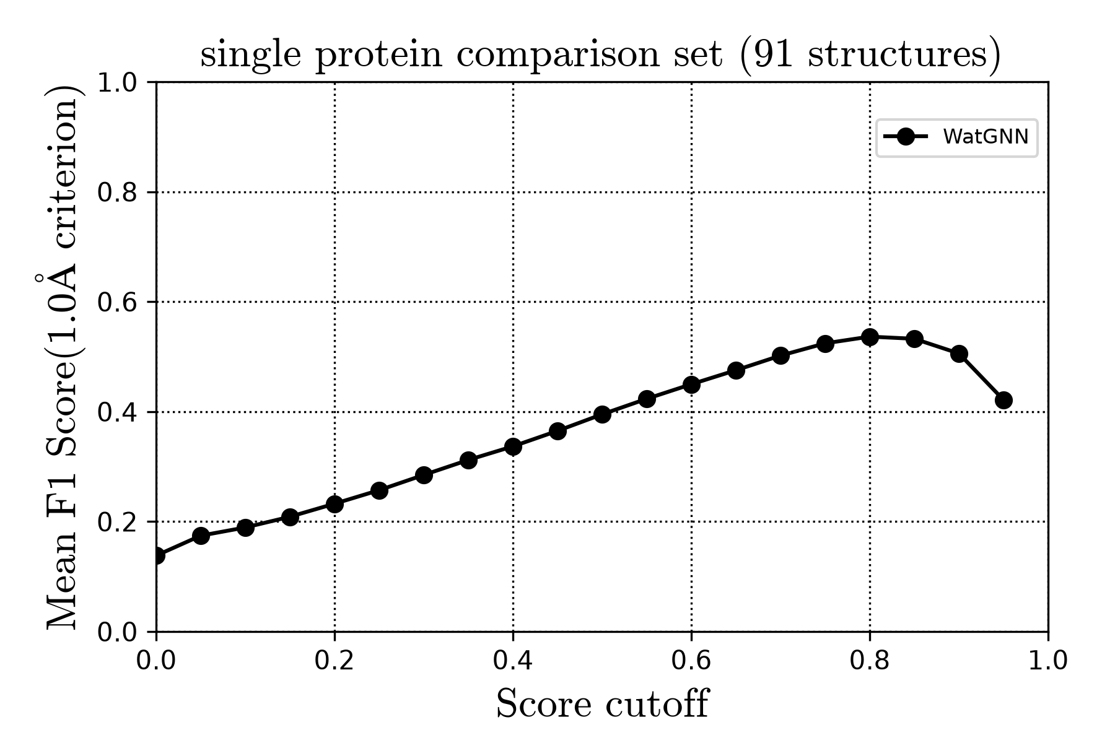
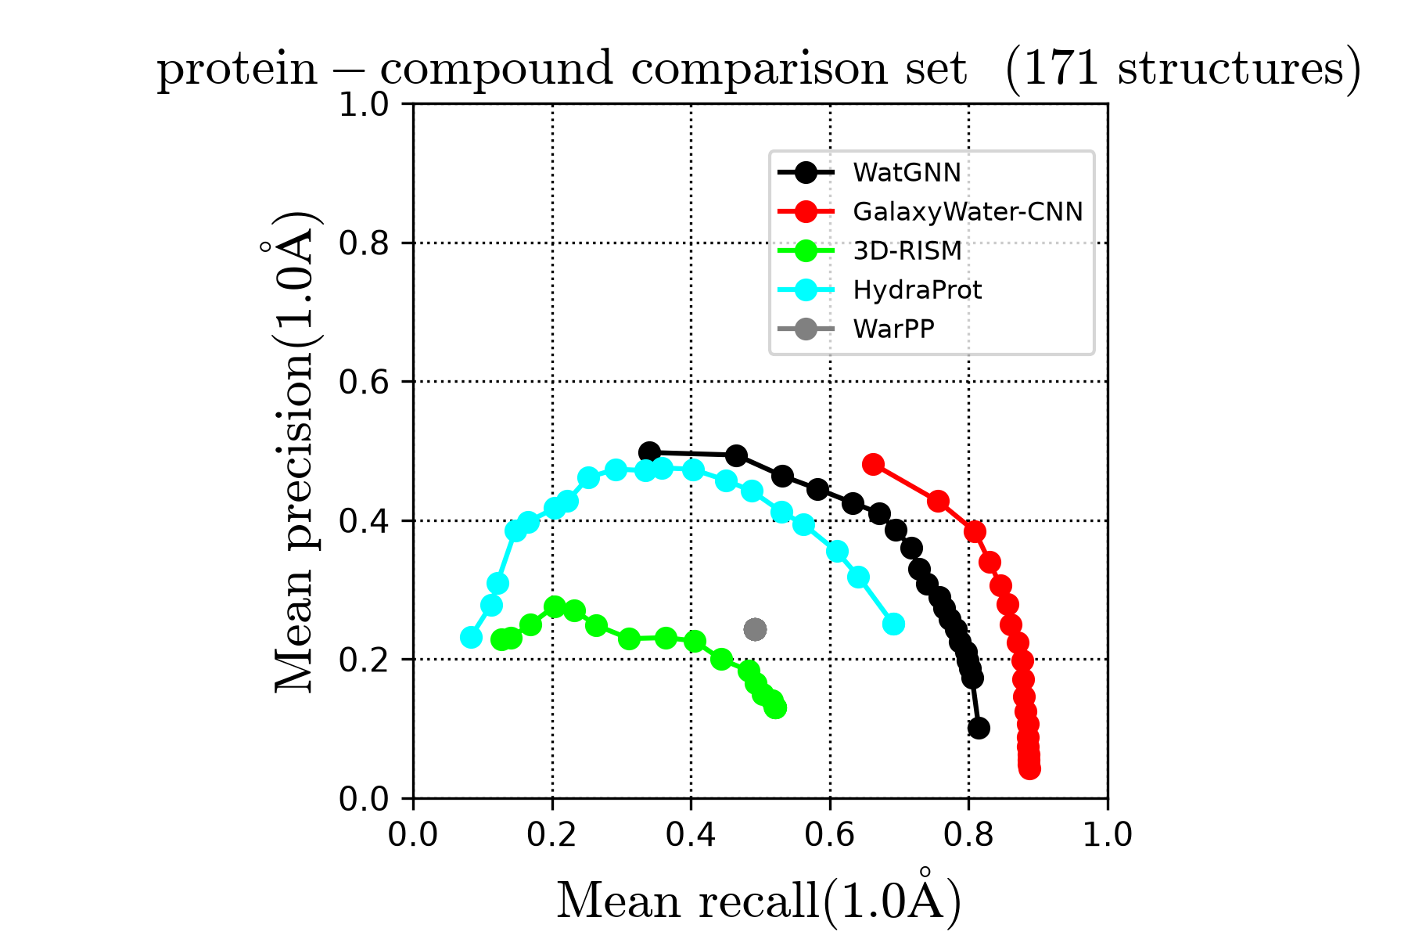
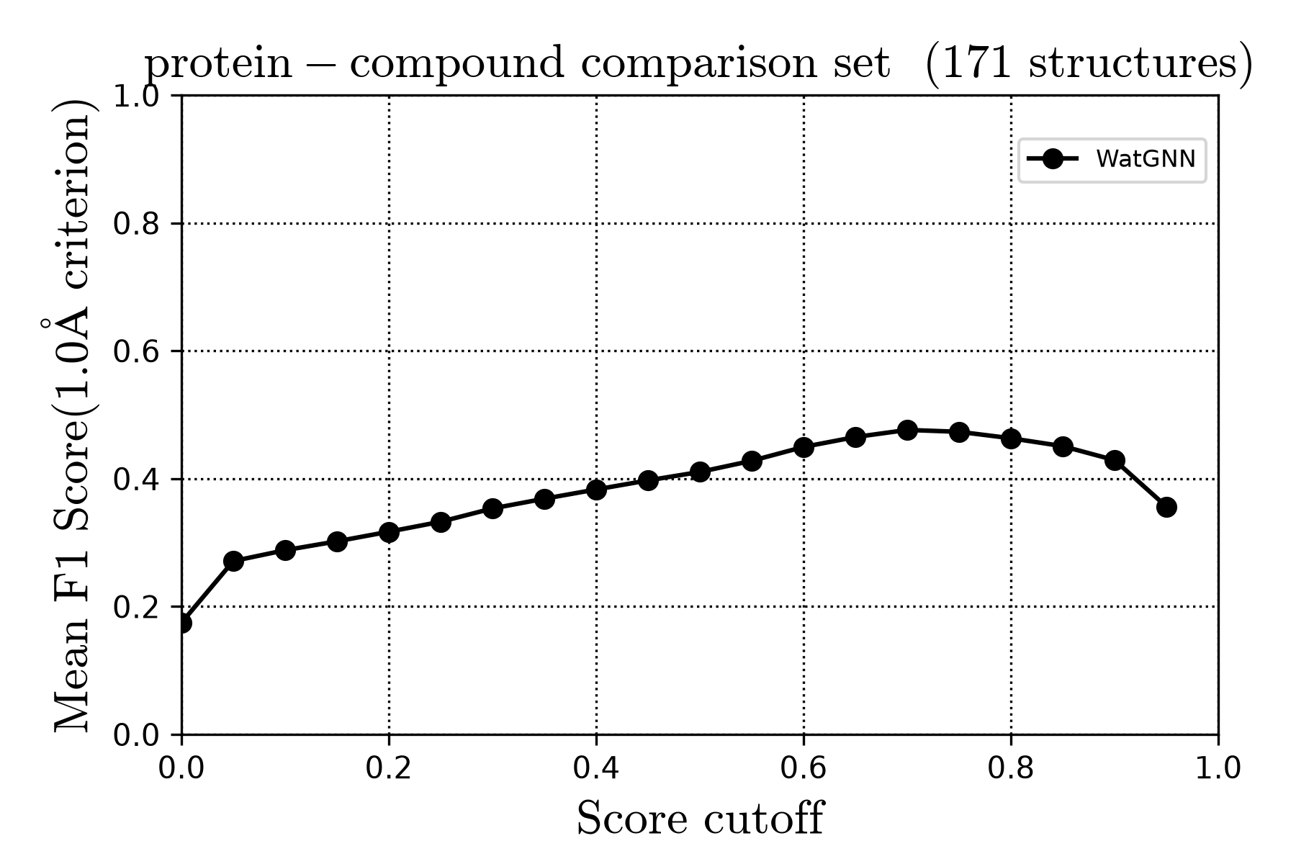
Fig 7
(a)
(b)
(c)
(d)

Slide 12
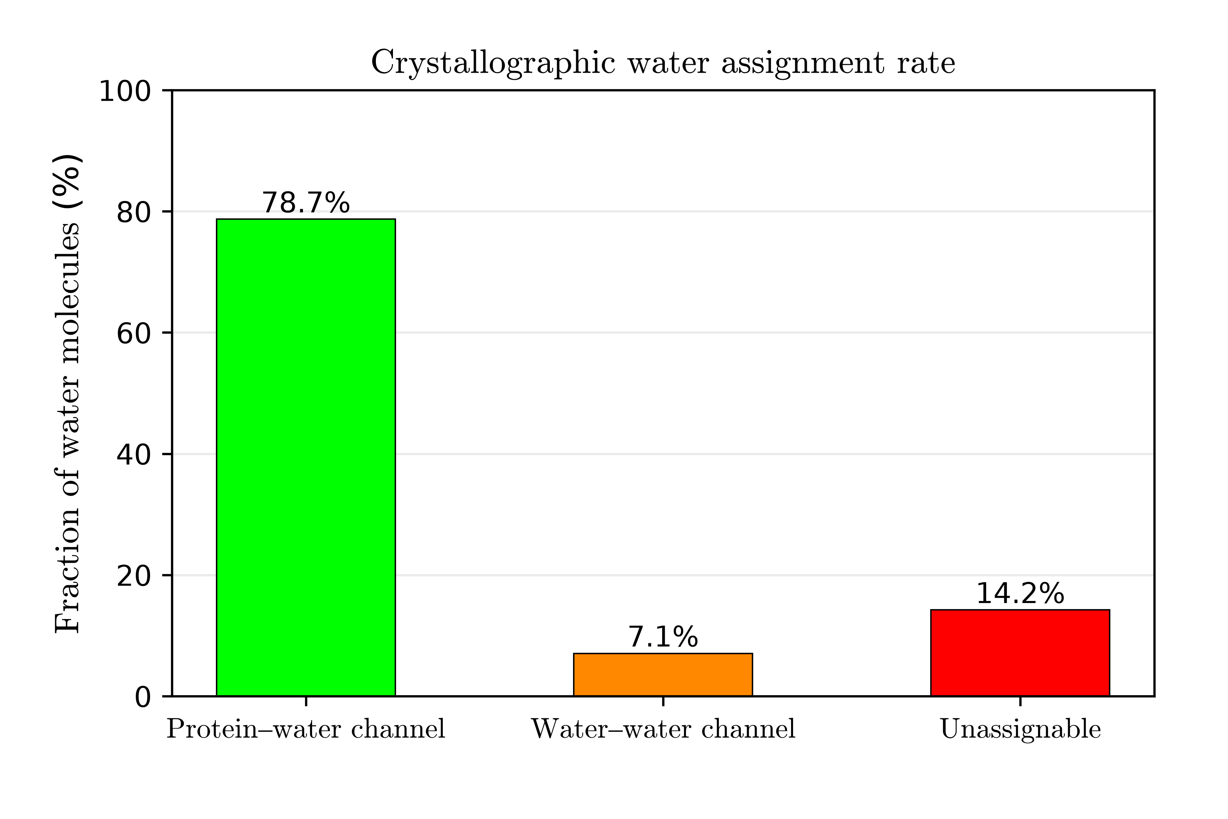
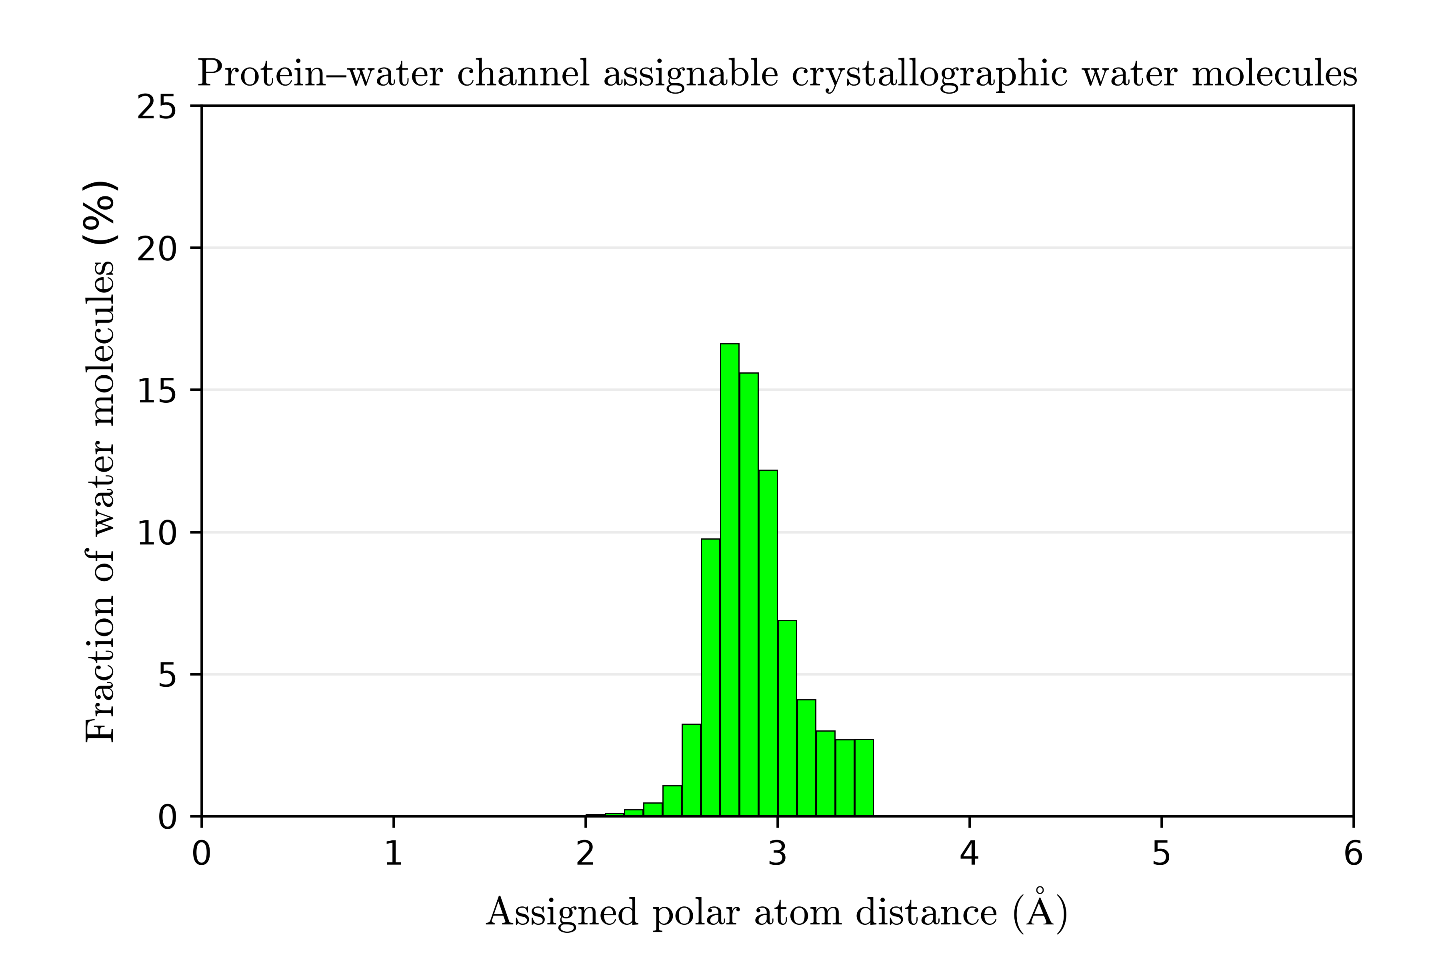
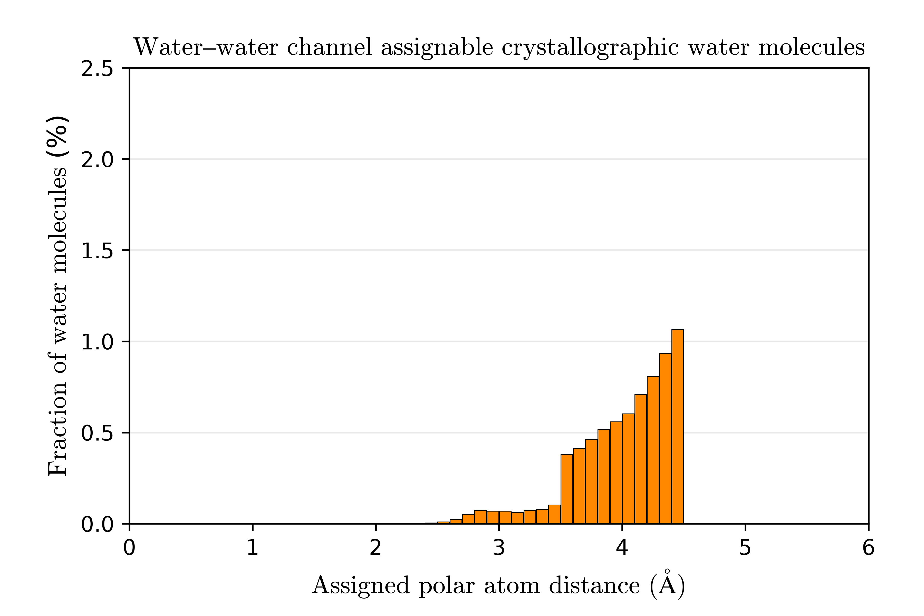
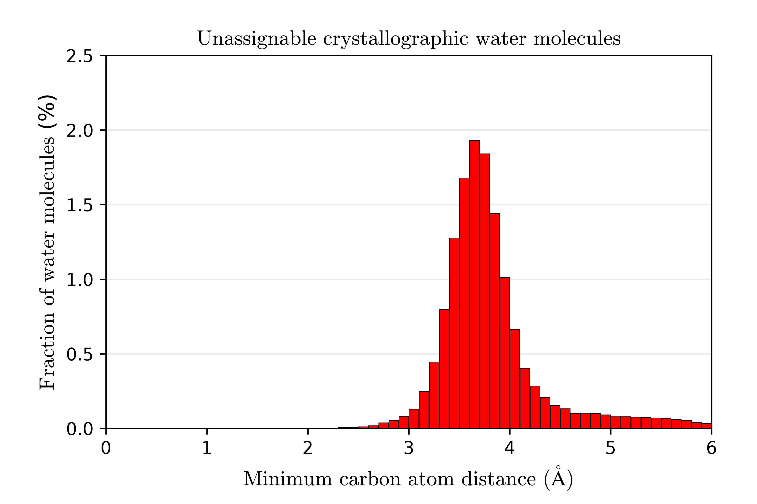
Fig S2
(a)
(b)
(c)
(d)

Slide 13
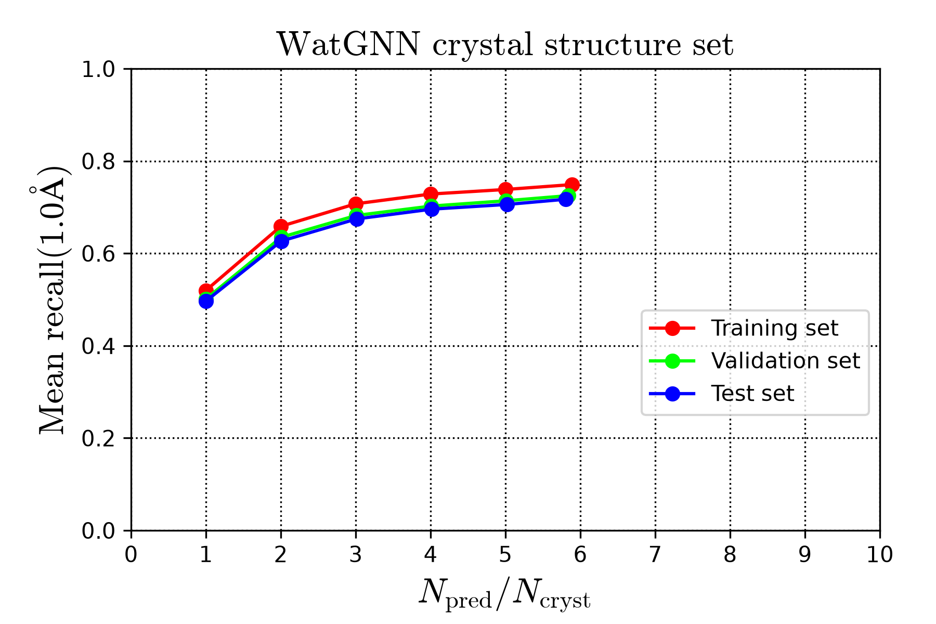
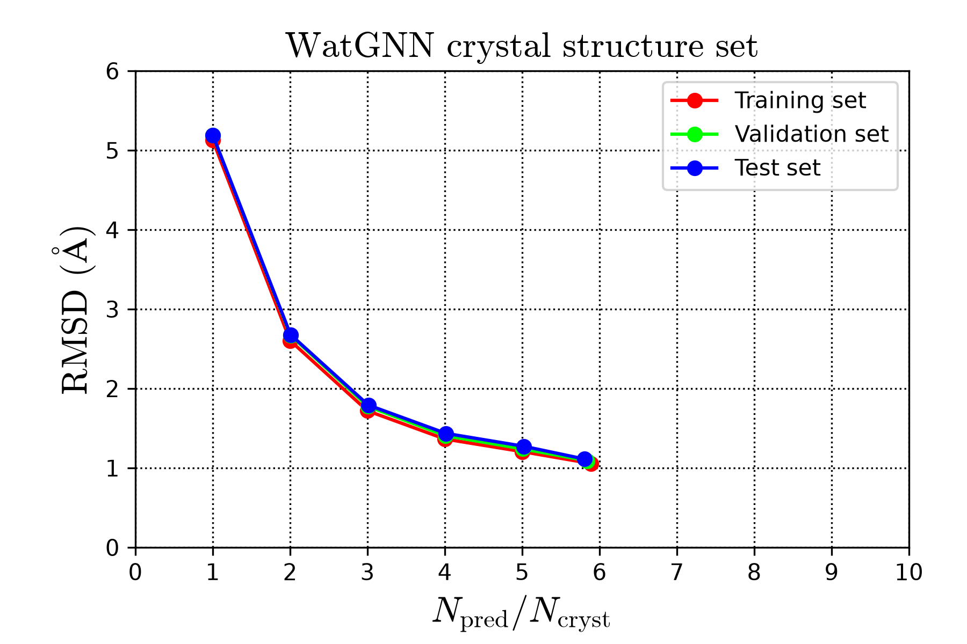
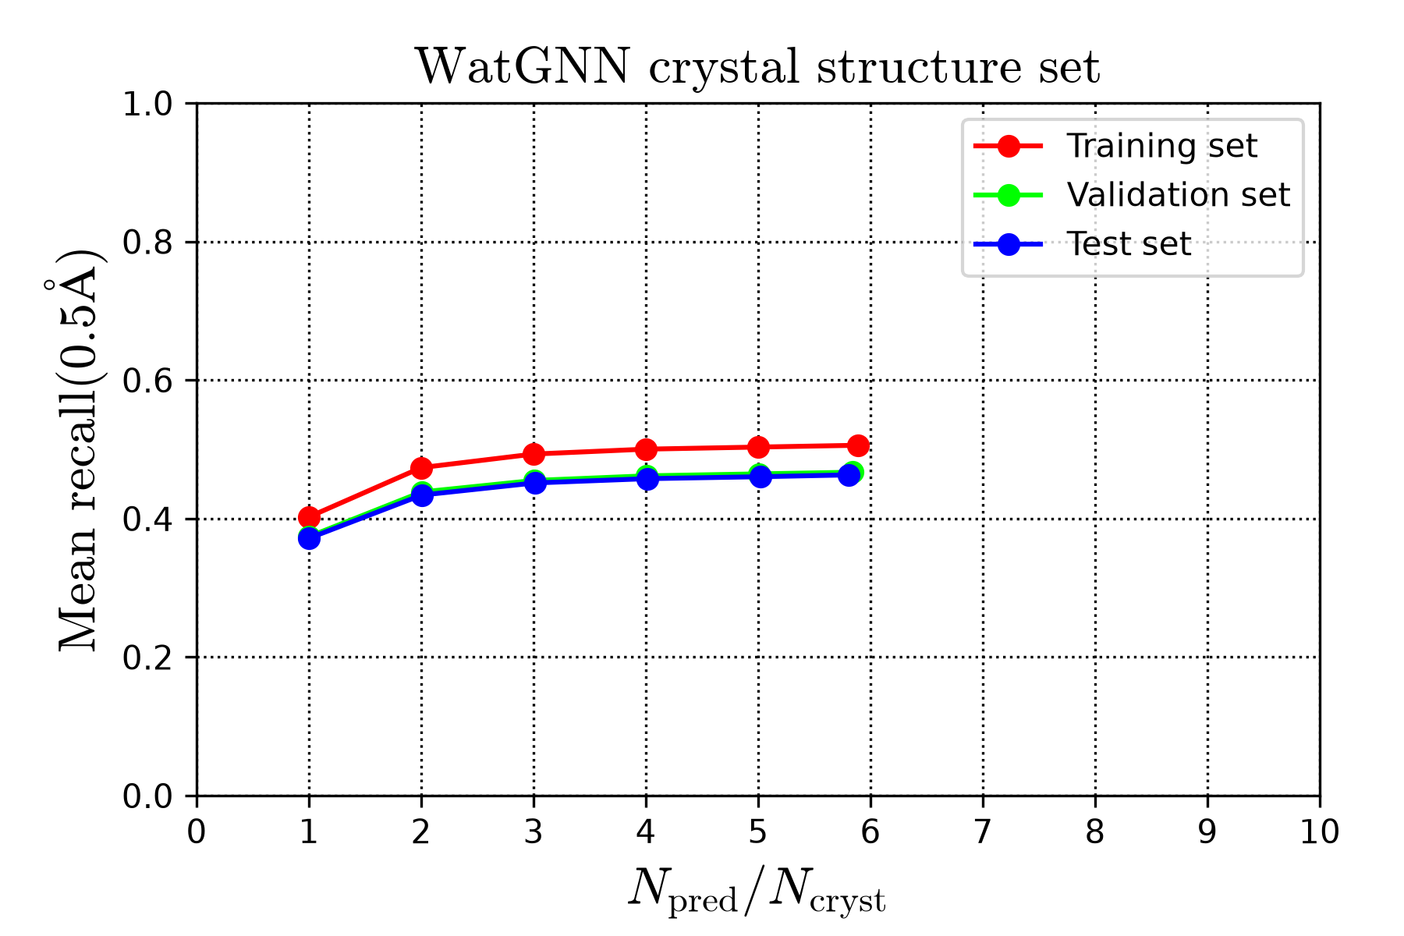
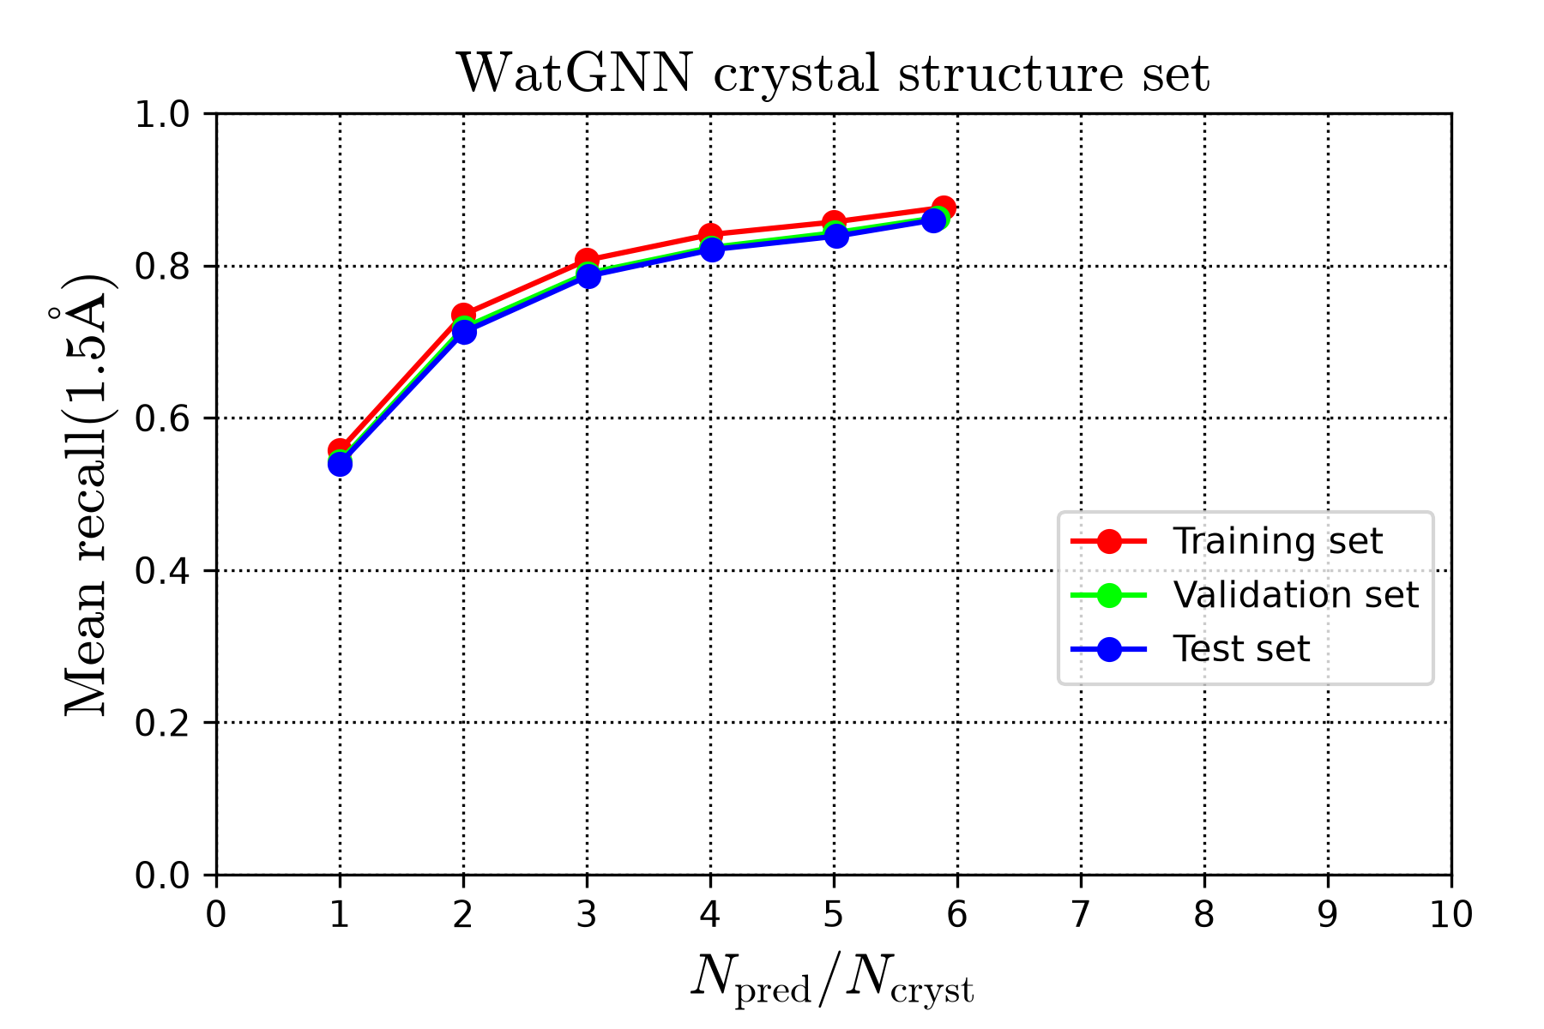
Fig S3
(a)
(b)
(c)
(d)

Slide 14
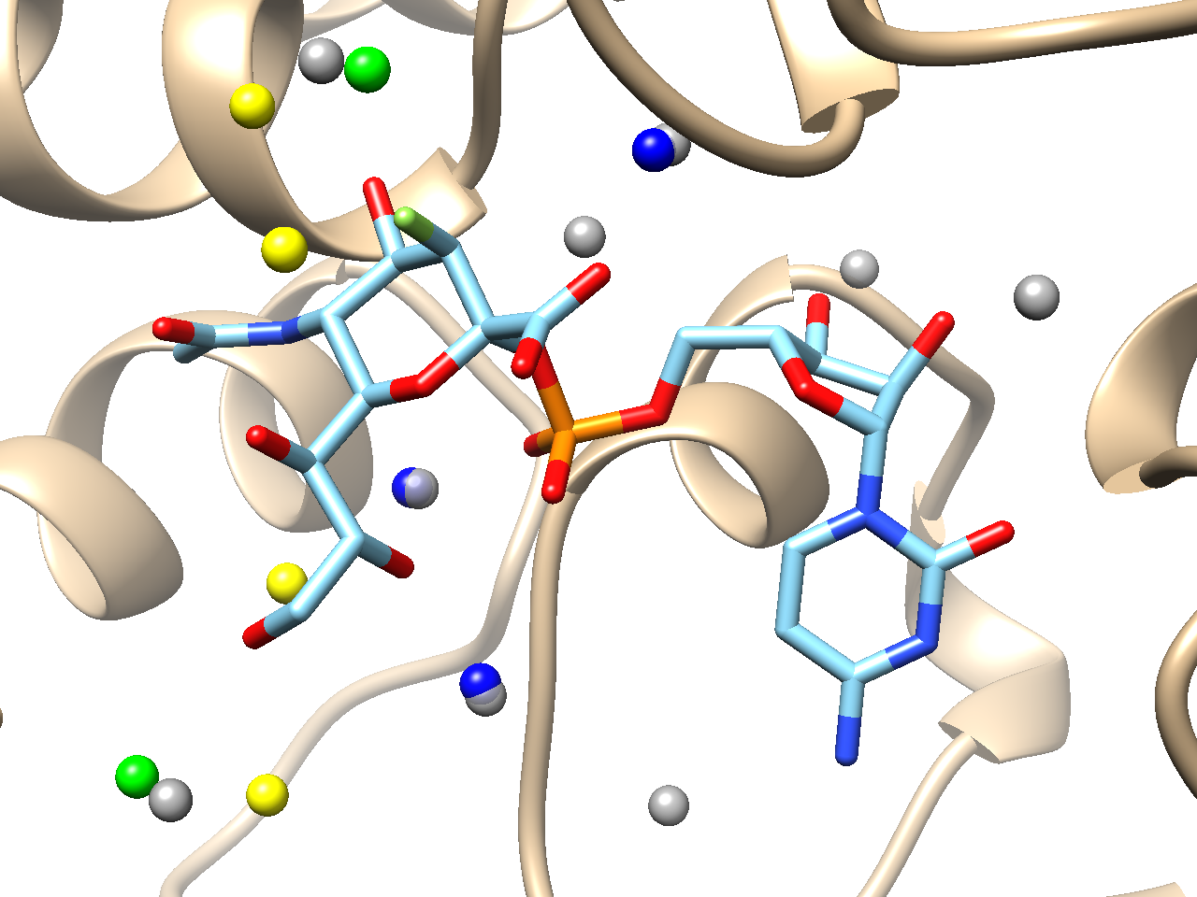
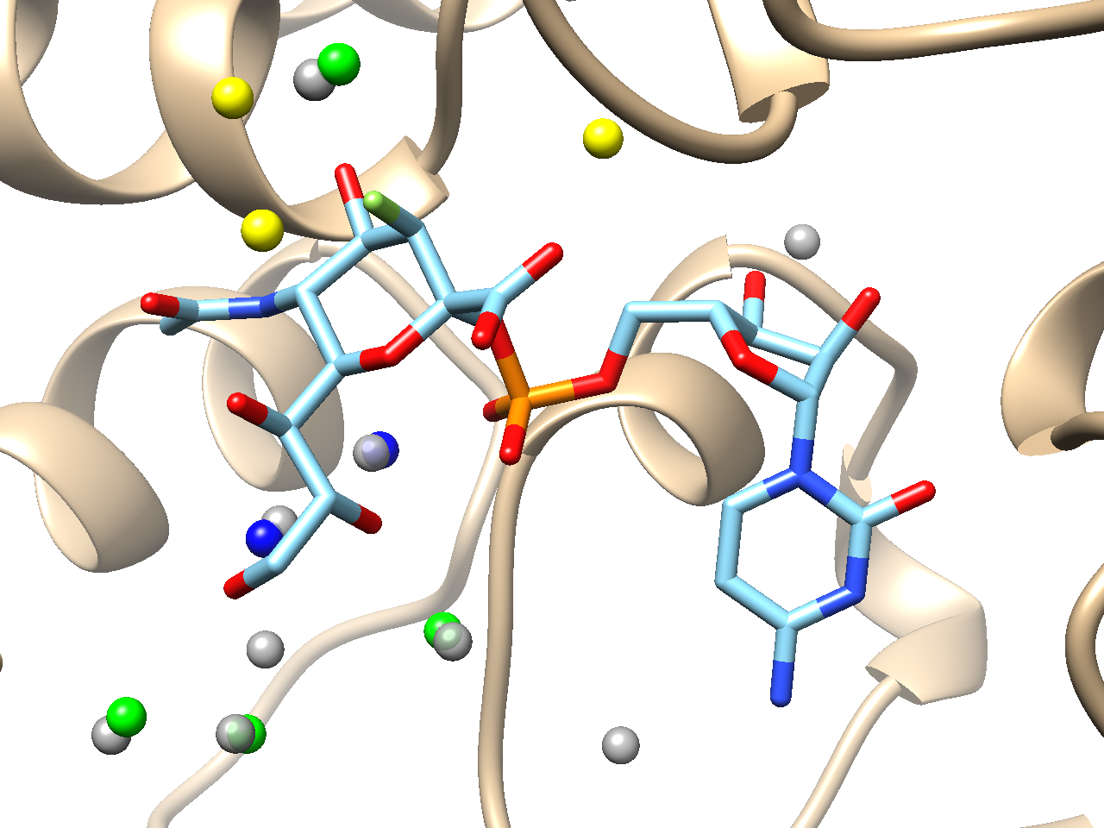
Fig S4
(a)
(b)

Slide 15
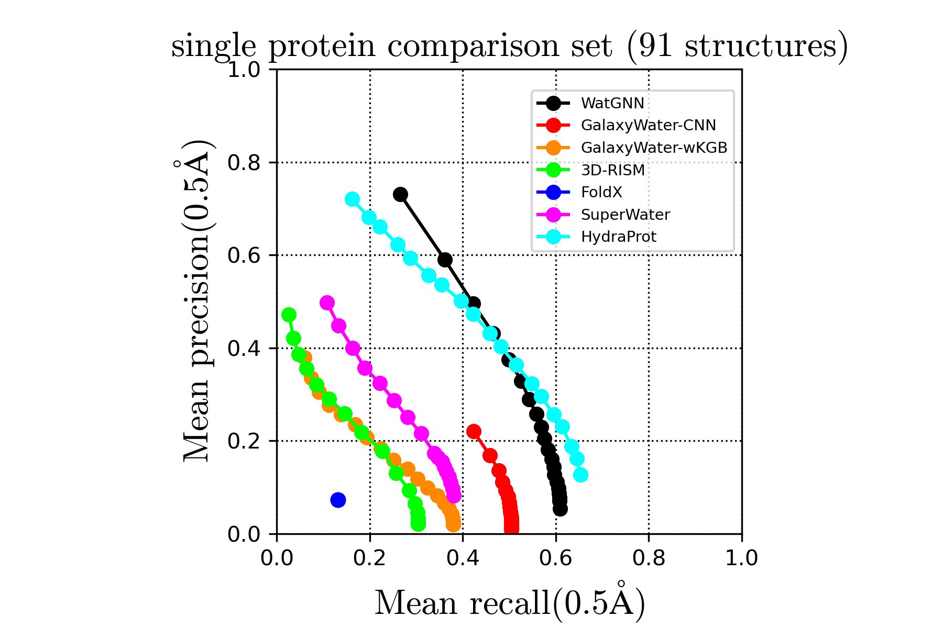
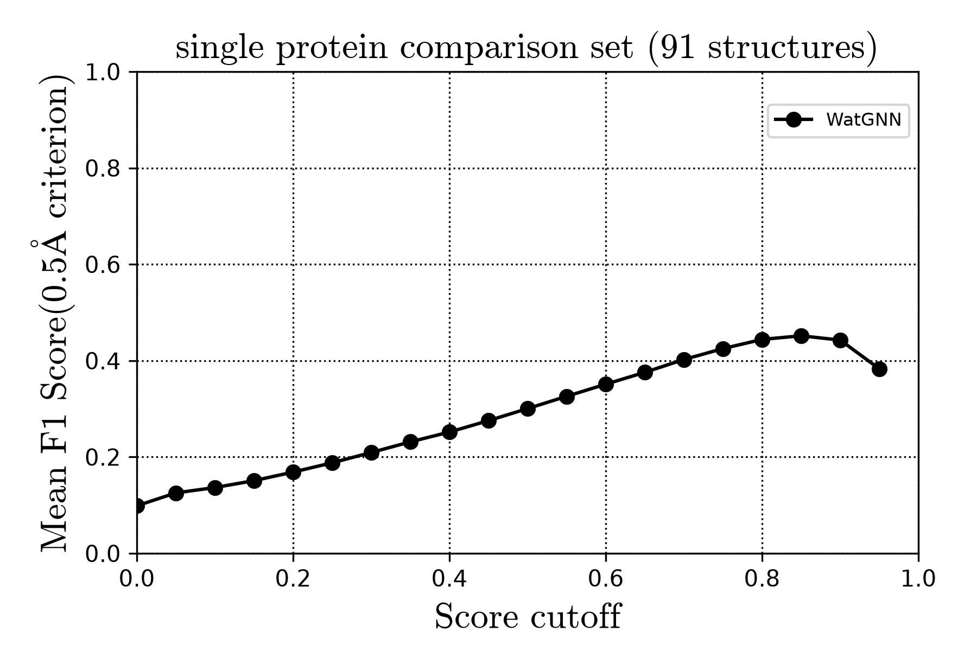
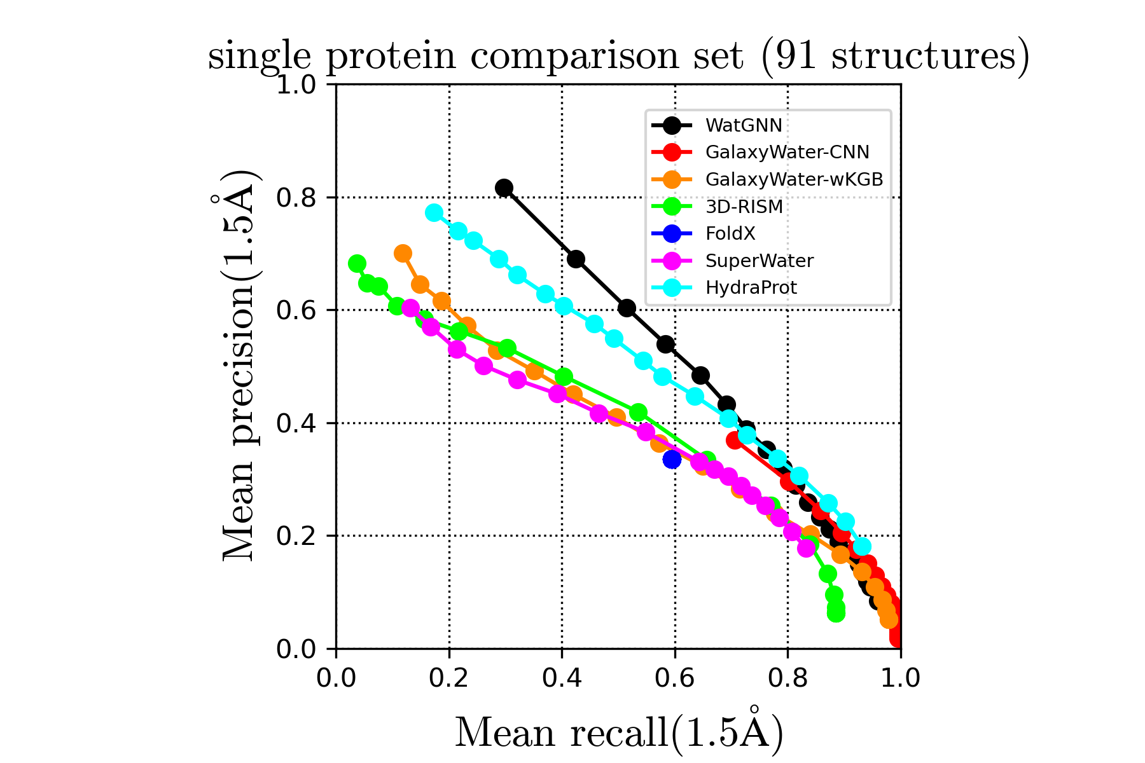
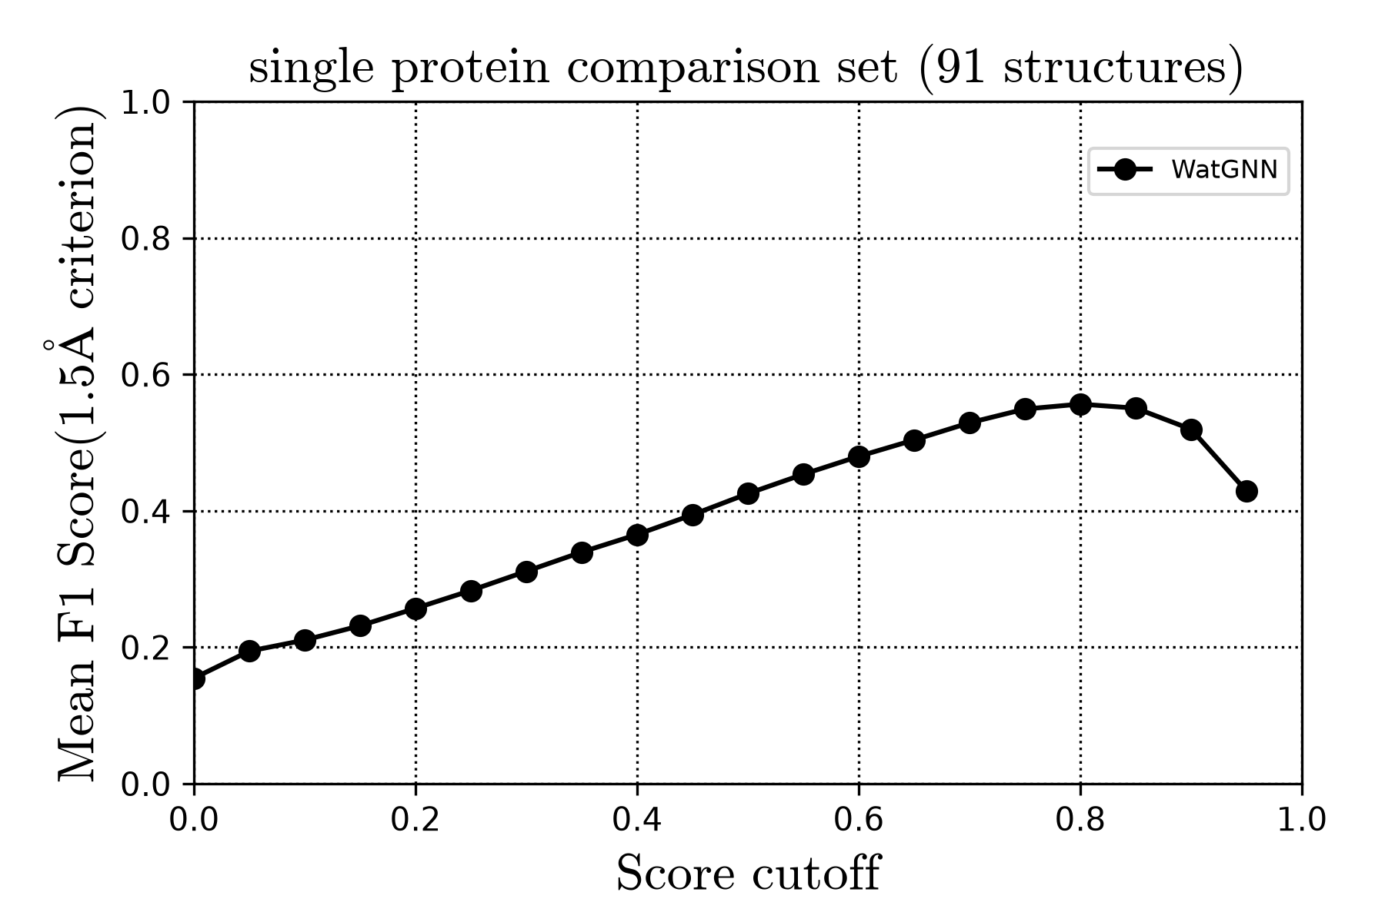
Fig S5
(a)
(b)
(c)
(d)

Slide 16
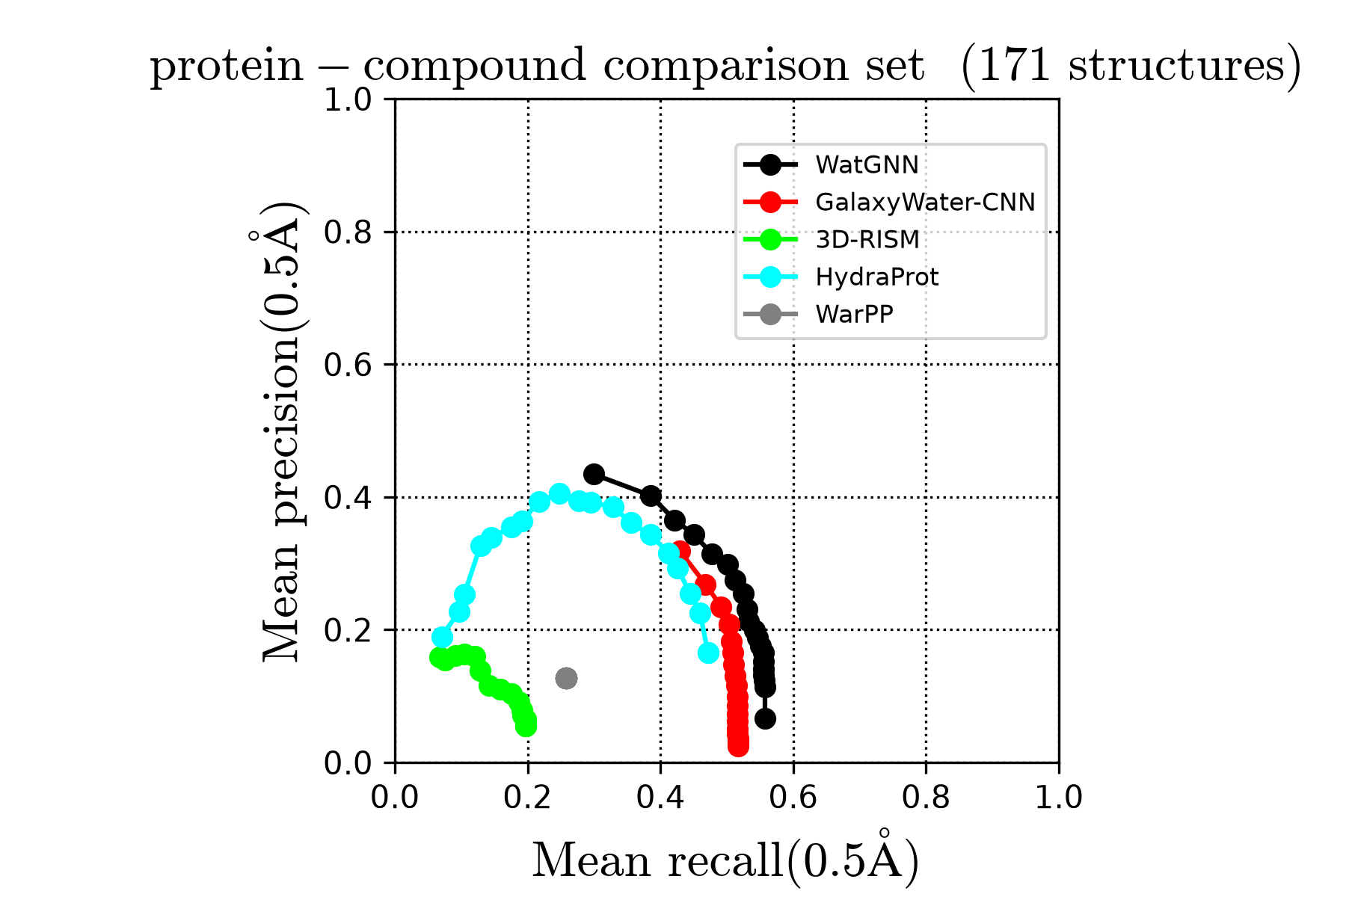
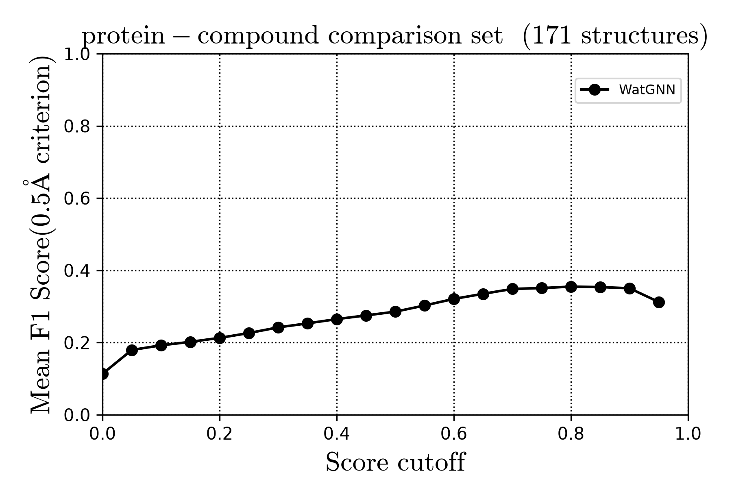
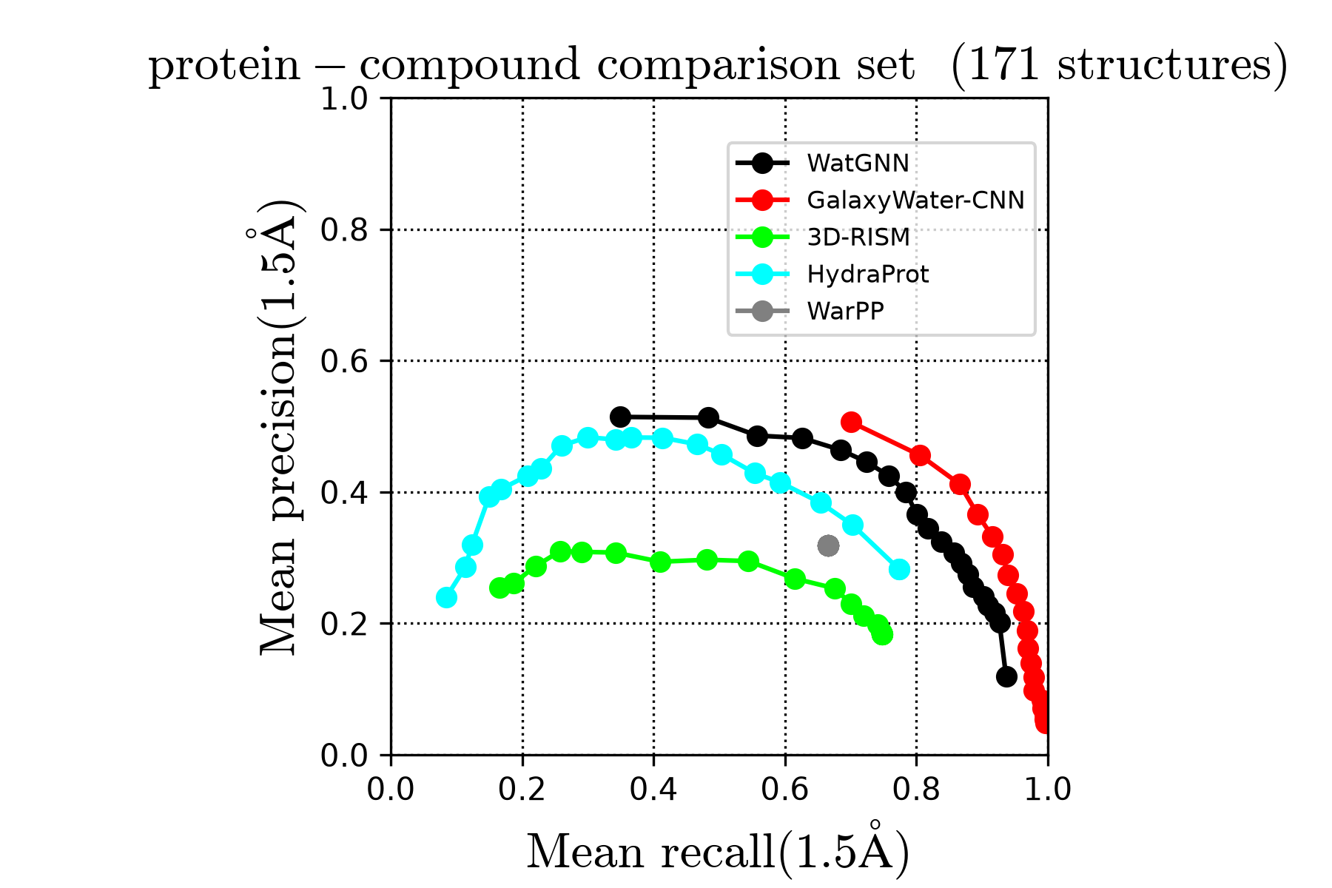
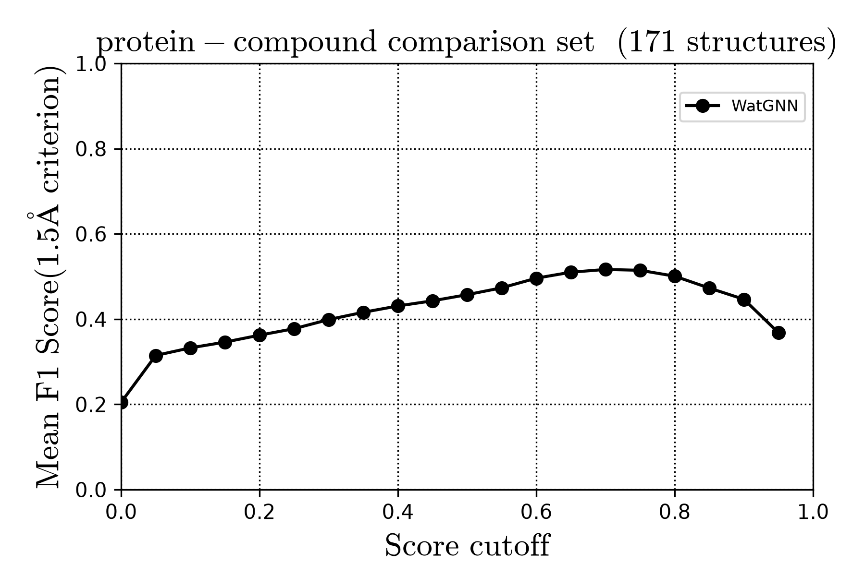
Fig S6
(a)
(b)
(c)
(d)

Slide 17
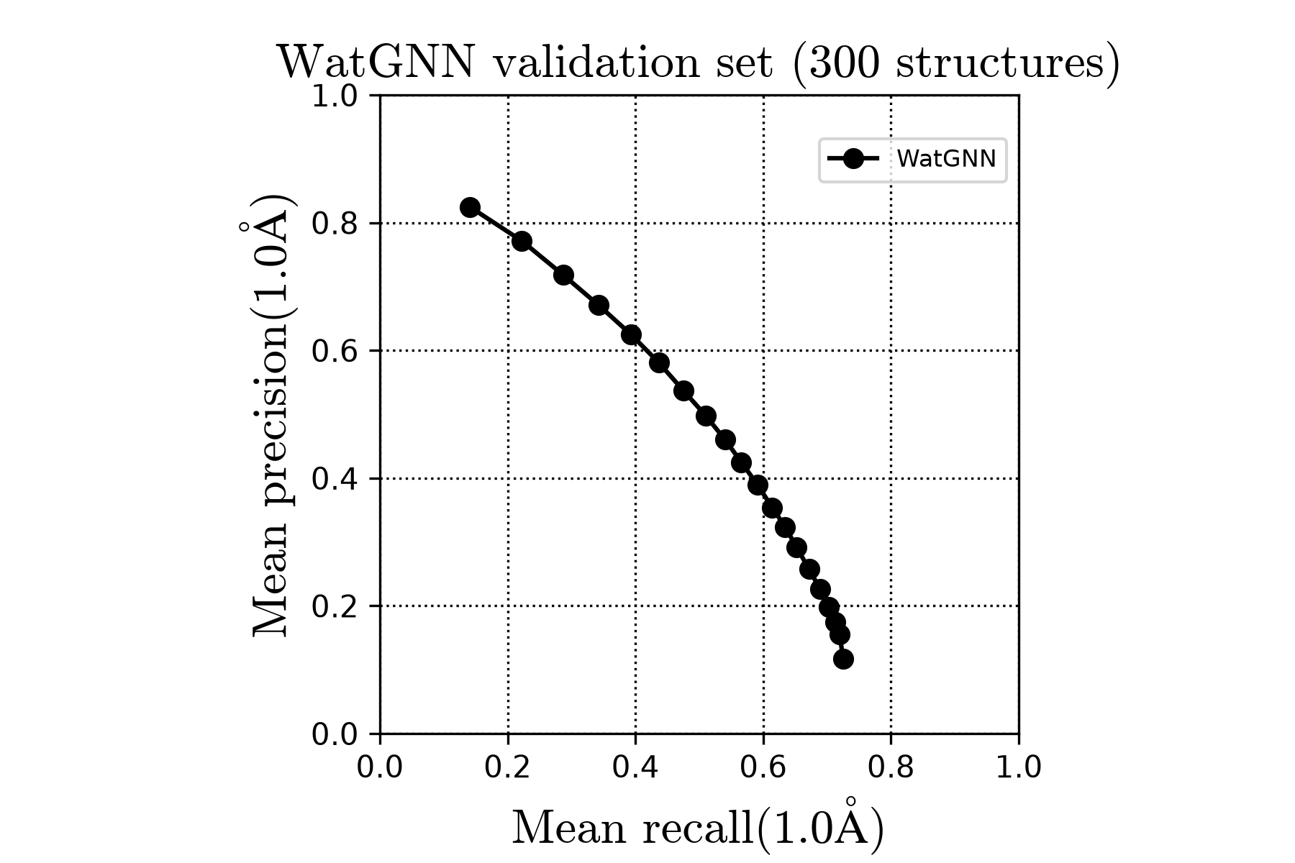
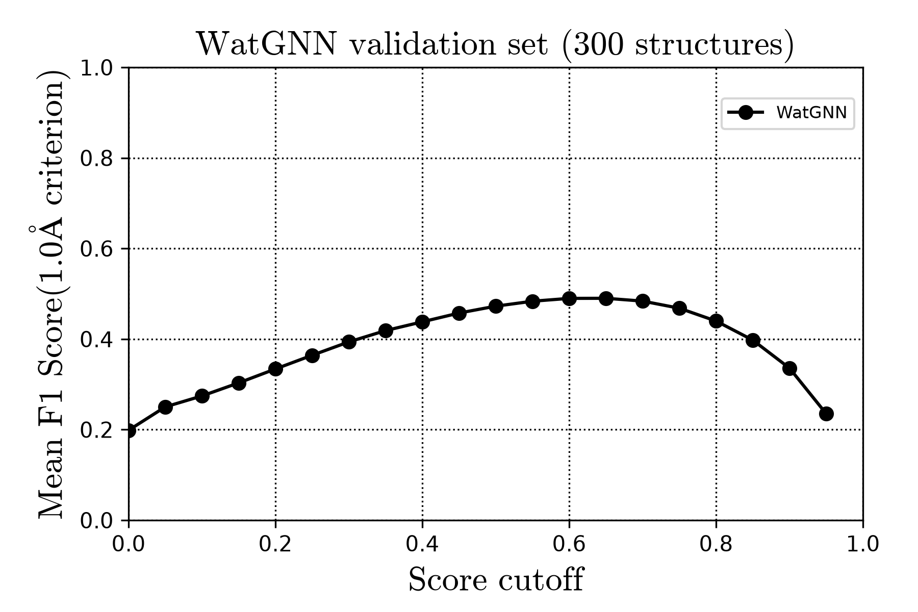
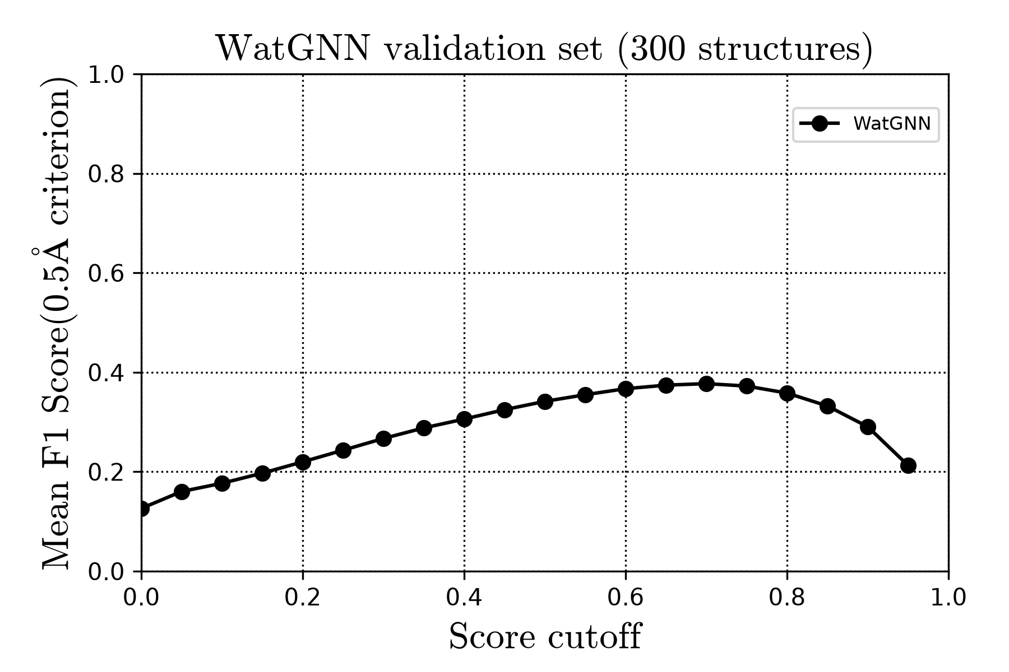
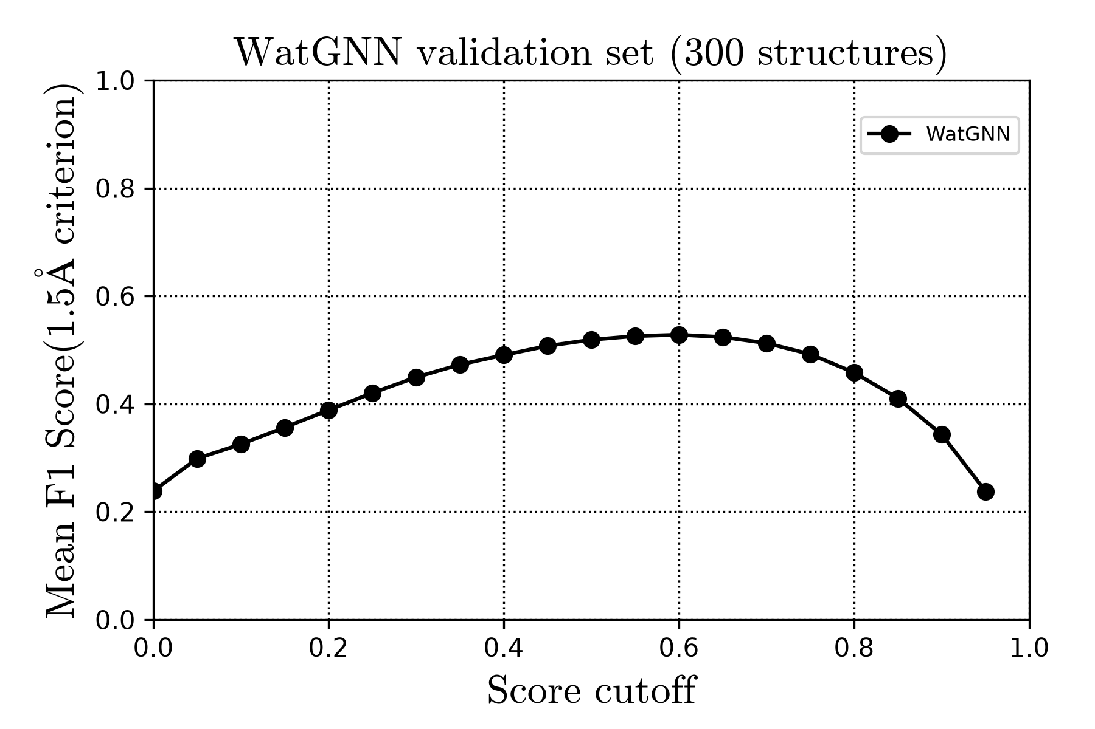
Fig S7
(a)
(b)
(c)
(d)

Slide 18

Fig S8

Slide 19
Table 1
Benchmark set | Score threshold | Mean precision | Mean recall | Mean F1
Single-protein | 0.1 (original) | 0.11 | 0.85 | 0.19
Single-protein | 0.65 (validation-selected) | 0.37 | 0.68 | 0.47
Protein–compound | 0.1 (original) | 0.17 | 0.80 | 0.27
Protein–compound | 0.65 (validation-selected) | 0.33 | 0.72 | 0.41

Slide 20
Table S2
Benchmark set | Score threshold | Mean precision (0.5Å) | Mean precision (1.5Å) | Mean recall (0.5Å) | Mean recall (1.5Å) | Mean F1 (0.5Å) | Mean F1 (1.5Å)
Single-protein | 0.1 (original) | 0.08 | 0.12 | 0.61 | 0.94 | 0.14 | 0.21
Single-protein | 0.65 (validation-selected) | 0.29 | 0.39 | 0.54 | 0.73 | 0.38 | 0.50
Protein–compound | 0.1 (original) | 0.12 | 0.20 | 0.56 | 0.92 | 0.18 | 0.31
Protein–compound | 0.65 (validation-selected) | 0.24 | 0.37 | 0.52 | 0.80 | 0.29 | 0.45

Slide 21
Table S1
Probe-ineligible Atom classes
C atom | Alkali metal atoms (Li, Na, K, Rb)
Probe-eligible Atom classes
N atom | O atom
P atom | S atom
Halogen atoms (F, Cl, Br, I) | Non-alkali metal atoms (Ca, Mg, Zn, Hg, Mn, Co, Fe, Ni, Cu, Cd)
Extra Atom classes (Probe-ineligible)
Probe class | Other atoms

Slide 22
 | Capped assignment RMSD (Å) |  | Recall at 1.0 Å (%)
training set size | n=1 | n=3 | n=1 | n=3
125 | 5.47 | 2.10 | 35 | 48
250 | 5.44 | 2.06 | 38 | 52
500 | 5.36 | 1.96 | 43 | 59
1000 | 5.32 | 1.91 | 45 | 62
2000 | 5.24 | 1.84 | 48 | 65
3971 | 5.19 | 1.79 | 50 | 67

