Slide 1




CV比赛课-工具介绍

Slide 2

¹ Tensorflow和Keras简介
Tensorflow学习
Keras学习
OpenCV介绍
目录

Slide 3




Tensorflow和Keras简介
Introduction to Tensorflow and Keras

Slide 4
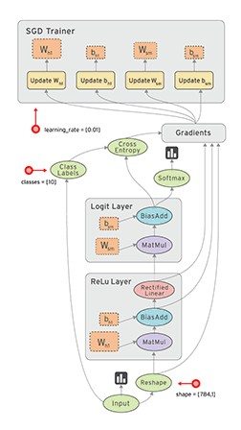

Tensorflow和Keras简介
Introduction to Tensorflow and Keras
Tensorflow
张量流动

Slide 5


Tensorflow和Keras简介
Introduction to Tensorflow and Keras
Keras

Slide 6
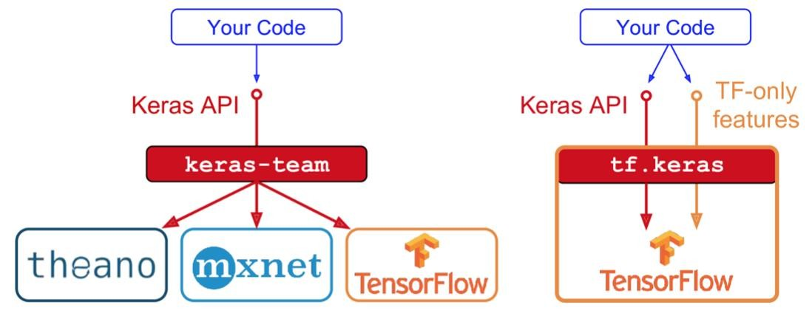
Tensorflow和Keras简介
Introduction to Tensorflow and Keras
Keras
# 从tensorflow导入keras
from tensorflow.python import keras
# 导入tf
import tensorflow as tf

Slide 7

Tensorflow和Keras简介
Introduction to Tensorflow and Keras
Tensorflow和Keras的关系
互补
底层计算
高阶API

Slide 8


OpenCV介绍
Introduction to OpenCV

Slide 9
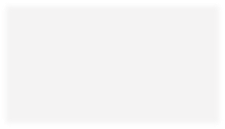
Open CV介绍
Introduction to OpenCV
# 导入opencv import cv2 # 读取图片
www.inspirasign.com
计算机视觉处理工具
img = cv2.imread(’***.jpg')
# 转化为灰度图
gray = cv2.cvtColor(img, cv2.COLOR_BGR2GRAY)
# 图片进行resize
img = cv2.resize(img,(256,256))
# 画矩形框
cv2.rectangle(img, (x, y), (x+w, y+h), (0, 255, 0), 2)
# 显示图片 cv2.imshow(’img',img) # 写入图片
cv2.imwrite(’img.png', img)
图片
视频

