Slide 1
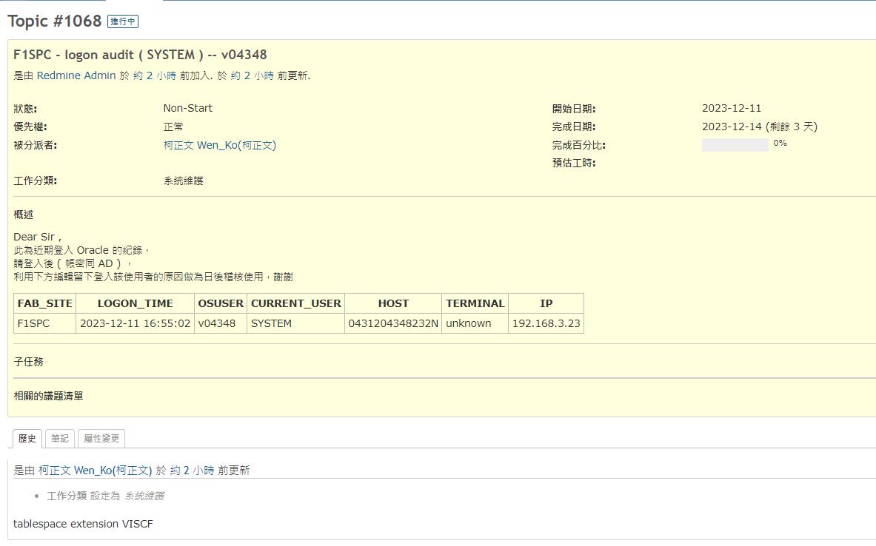

Slide 2
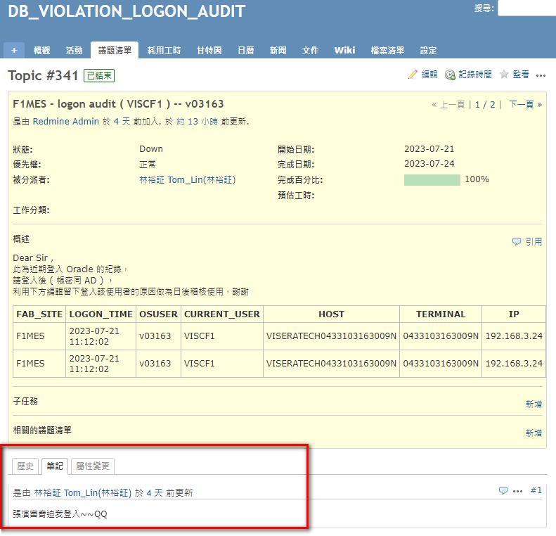


DB_LOGON_AUDIT
Login DB
Server login?
Y
End
N
Mail alert
White list?
N
Y
DB_LOGON_AUDIT
Report ticket
DB_VIOLATION_AUDIT

