Slide 1
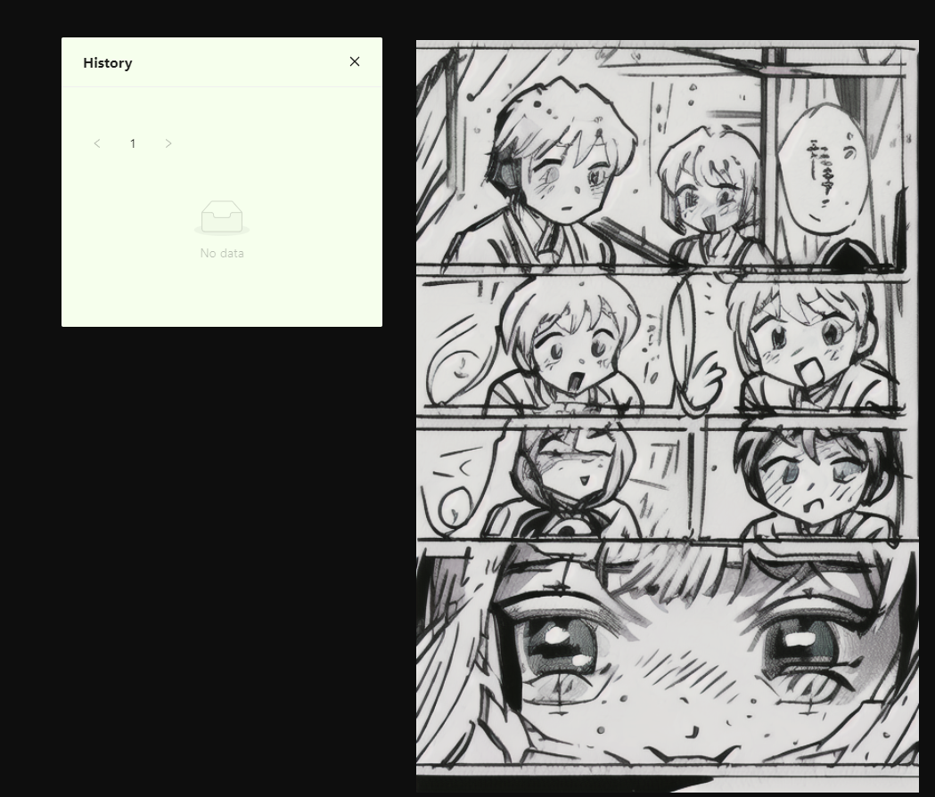
Prompt
masterpiece, best quality,ultra detail,1boy,15yo,blush,long,line art,3girls,1boy,comic,border,koma,Text bubble, <lora:LZ-comic strip:0.6> ,yagami-hayate,fighting
🚀生成

