Slide 1







Future Technology
Suki Lam
12th August 2024

Slide 2



OUTLINE
Executive Summary
Introduction
Methodology
Results
Visualization – Charts
Dashboard
Discussion
Findings & Implications
Conclusion
Appendix

Slide 3

EXECUTIVE SUMMARY
Current Technology
Future Technology
Distribution
Gender
Countries
Age

Slide 4

INTRODUCTION
Analyzing the trends in technology
Identify the technology for future

Slide 5

METHODOLOGY
Data Collection
Data Exploration
Data Visualization
Presentation

Slide 6
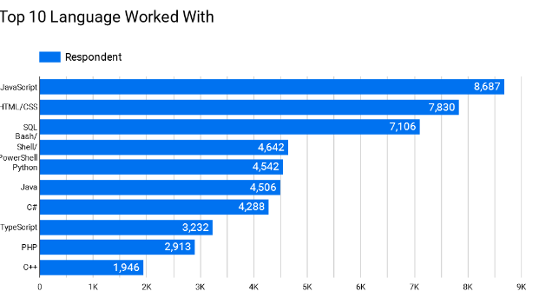
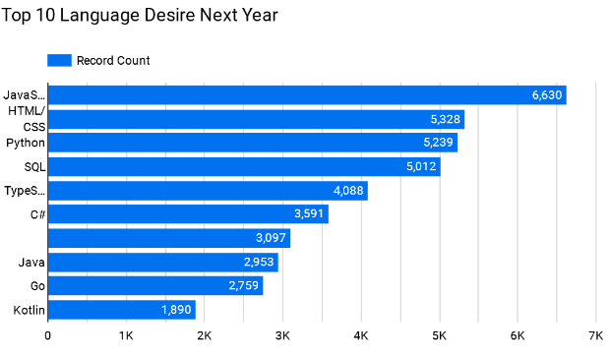
PROGRAMMING LANGUAGE TRENDS
Current Year
Next Year

Slide 7
PROGRAMMING LANGUAGE TRENDS - FINDINGS & IMPLICATIONS
Findings
Current top 3 programming language
JavaScript
HTML/CSS
SQL
Bash/Shell/PowerShell rate drop
Implications
Web Development is still in high demand
Python become the one of main programming language in future

Slide 8
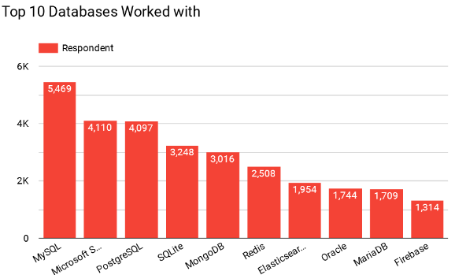
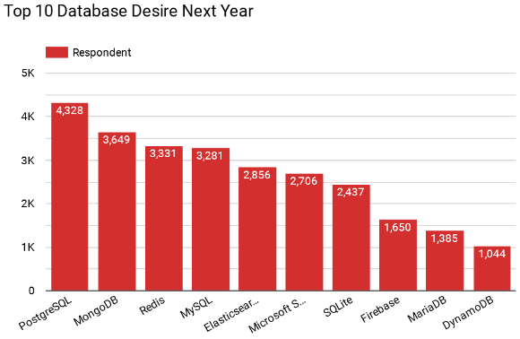
DATABASE TRENDS
Current Year
Next Year

Slide 9
DATABASE TRENDS - FINDINGS & IMPLICATIONS
Findings
MySQL is the topmost database used currently
PostgreSQL and MongoDB are upcoming favorites
Implications
Opensource database are still used by many
Other NoSQL databases are used majorly to store non relational data

Slide 10

DASHBOARD
https://github.com/shadowdk3/IBM/blob/main/Module5-Dashboard.pdf

Slide 11
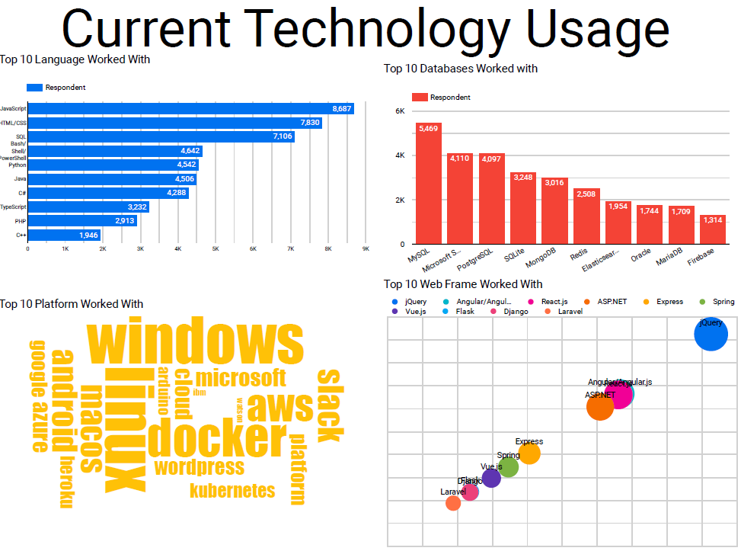
DASHBOARD TAB 1

Slide 12
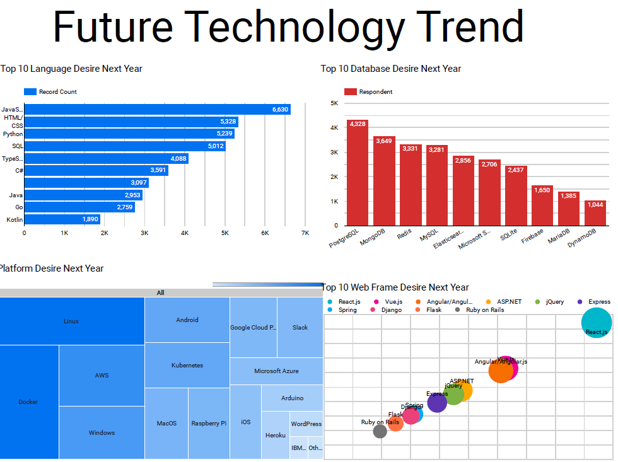
DASHBOARD TAB 2

Slide 13
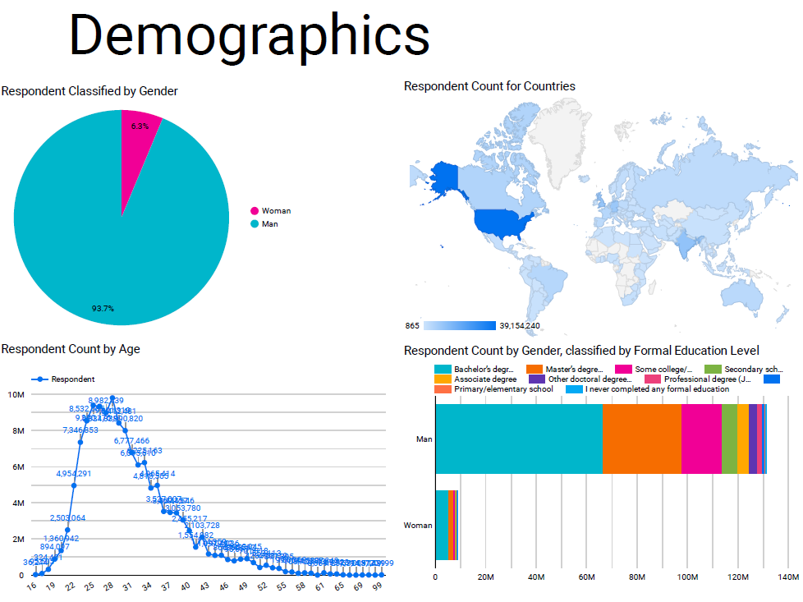
DASHBOARD TAB 3

Slide 14
DISCUSSION
Technology Trends
Reskilling Workers
Gender Equality
Adaptation of new Technology
Job opportunity

Slide 15
OVERALL FINDINGS & IMPLICATIONS
Findings
Rapid Changing Technology
Concentration on countries like USA and India
Age & Gender Gap
Implications
Companies should adapt new technologies
Introduce Schemes to bridge the age and gender gap
Increase the hiring for new Technology Jobs

Slide 16

CONCLUSION
Technology Trends
Demographics Overview
Future Skills and preferences
Technology to Adapt

Slide 17
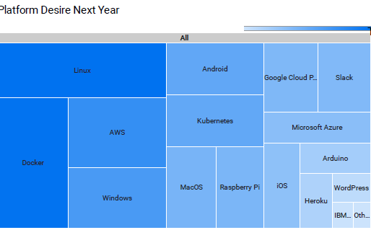

APPENDIX

Slide 18
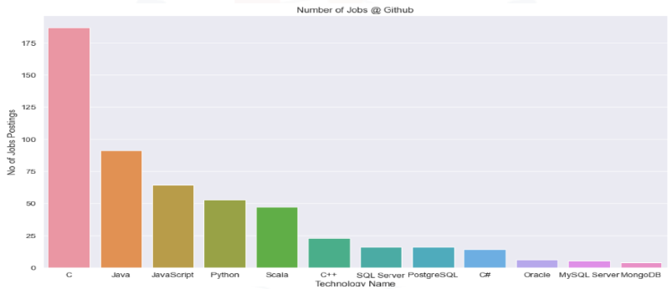
JOB POSTINGS

Slide 19
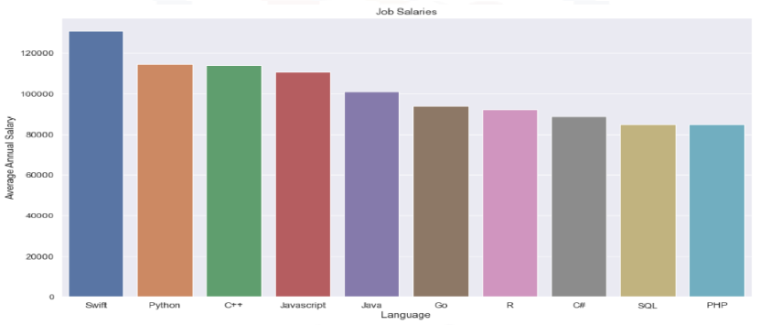
POPULAR LANGUAGES

