Slide 1
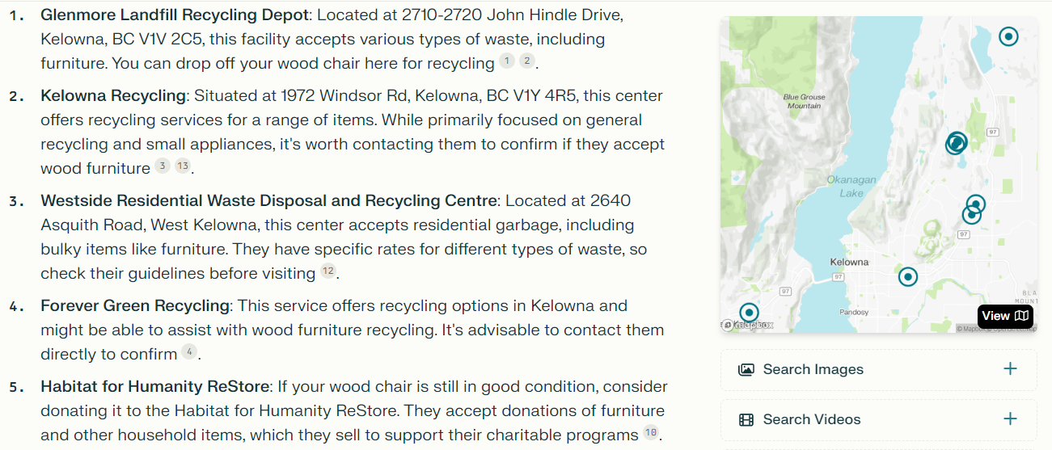

Slide 2
https://www.realtor.ca/real-estate/27210084/1505-hardy-street-kelowna-kelowna-north
https://www.realtor.ca/real-estate/27206897/310-hiram-walker-court-unit-107-kelowna-ellison
https://www.realtor.ca/real-estate/27100346/747-fitzpatrick-road-unit-b-kelowna-rutland-north

