Slide 1
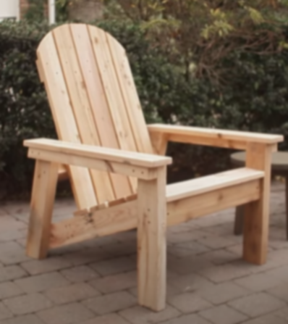
Goal: Select a proper location to start our wood chair factory, rather than parking lot H, by maximizing the supply chain

Slide 2












Quantity
Supplier 1..s..S
Landfill
$$U_{sf}$$
$$V_{rf}$$
$$Z_{r}$$
Recycle Center 1..r..R
Factory 1..f..F
$$W_{fd}$$
$$X_{mr}$$
$$Y_{dm}$$
Distributor 1..d..D
Market 1..m..M

Slide 3






Distance
Supplier 1..s..S
Landfill
$$L_{sf}$$
$$L_{rf}$$
$$L_{r}$$
Recycle Center 1..r..R
Factory 1..f..F
$$L_{fd}$$
$$L_{mr}$$
$$L_{dm}$$
Distributor 1..d..D
Market 1..m..M

Slide 4







Unit Transportation Cost
Supplier 1..s..S
Landfill
$$O_{1}$$
$$O_{1}$$
$$O_{1}$$
Recycle Center 1..r..R
Factory 1..f..F
$$O_{1}$$
$$O_{2}$$
$$O_{2}$$
Distributor 1..d..D
Market 1..m..M

Slide 5




Facility Capacity
Supplier 1..s..S
Landfill
$${CS}_{s}$$
$${CR}_{r}$$
$${CF}_{f}$$
Factory 1..f..F
Recycle Center 1..r..R
$${CD}_{d}$$
Distributor 1..d..D
Market 1..m..M

Slide 6



Demand & Return
& Recycle Rate
Supplier 1..s..S
Landfill
$$α$$
Recycle Center 1..r..R
Factory 1..f..F
$$R_{m}$$
$$D_{m}$$
Distributor 1..d..D
Market 1..m..M

Slide 7




Binary Variables
Supplier 1..s..S
Landfill
$${BS}_{s}$$
$${BR}_{r}$$
$${BF}_{f}$$
Factory 1..f..F
Recycle Center 1..r..R
$${BD}_{d}$$
Distributor 1..d..D
Market 1..m..M

Slide 8




Agreement Cost
Supplier 1..s..S
Landfill
$${AS}_{s}$$
$${AR}_{r}$$
$${AF}_{f}$$
Factory 1..f..F
Recycle Center 1..r..R
$${AD}_{d}$$
Distributor 1..d..D
Market 1..m..M

Slide 9



Unit Manufacturing and Recycle Cost
Supplier 1..s..S
Landfill
$$K_{s}$$
$$N_{r}$$
$$M_{f}$$
Factory 1..f..F
Recycle Center 1..r..R
Distributor 1..d..D
Market 1..m..M

Slide 10


Recycle Cost Saving and Disposal Cost
Supplier 1..s..S
Landfill
$$Q$$
$${−P}_{r}$$
Factory 1..f..F
Recycle Center 1..r..R
Distributor 1..d..D
Market 1..m..M

Slide 11
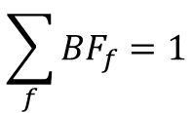
Additional Constrains
$${BF}_{f}$$
Factory 1..f..F
We select only one location for factory.
That is:
$$\sum_{f}{{BF}_{f}}=1$$

Slide 12




CO2 Emission
Supplier 1..s..S
Landfill
Recycle Center 1..r..R
Factory 1..f..F
 | Capacity | Emission kg per km
$$T_{1}$$
$$E_{1}$$
Distributor 1..d..D
Market 1..m..M
$$T_{2}$$
$$E_{2}$$

Slide 13


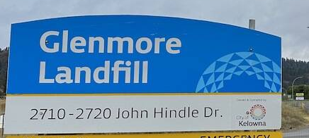




Summary of Facilities
2
1
Westside Residential Waste Disposal and Recycling Centre, 2640 Asquith Road
Glenmore Landfill, 2710 John Hindle Drive
Kelowna Recycling, 1972 Windsor Road
Habitat for Humanity, 2092 Enterprise Way
3
210 Lougheed Road
1465 Ellis Street
1505 Hardy Street
4
1650 Springfield Road
470 Highway #33 West
2515 Enterprise Way
2514 BC-97
1264 Ellis St
Downtown (200)
Glenmore (200)
Mission (300)
Rutland (350)
5
4

Slide 14
Distance Matrix
78.5 | 161
85.4 | 168
83.7 | 166
210 Lougheed Road
1465 Ellis Street
1505 Hardy Street

Slide 15
Distance Matrix
 | 210 Lougheed Road | 1465 Ellis Street | 1505 Hardy Street
1650 Springfield Road | 9.1 | 3.8 | 1.9
470 Highway #33 West | 5.5 | 8.3 | 5
2515 Enterprise Way | 6.2 | 5.5 | 1.9
2514 BC-97 | 5.3 | 6.5 | 2.9
1264 Ellis St | 11.1 | 0.6 | 4.2

Slide 16
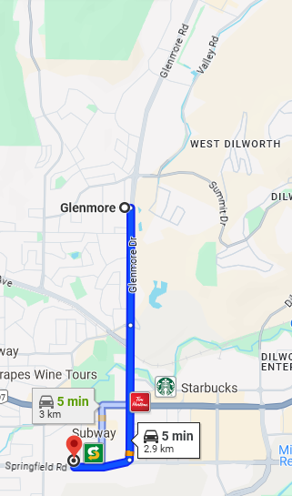
Distance Matrix
Assumption: Market distance estimated as center of the district
 | Downtown (200) | Glenmore (200) | Lower Mission (300) | Rutland (350)
1650 Springfield Road | 3.7 | 2.9 | 7.6 | 5.7
470 Highway #33 West | 8.3 | 7 | 13.4 | 0.7
2515 Enterprise Way | 5.5 | 3.8 | 9.1 | 2.9
2514 BC-97 | 6.5 | 4.8 | 10.1 | 2.7
1264 Ellis St | 1 | 3.7 | 8.6 | 8.3

Slide 17
Distance Matrix
 | Downtown (200) | Glenmore (200) | Lower Mission (300) | Rutland (350)
Westside Residential Waste Disposal and Recycling Centre | 16.6 | 20.8 | 24.6 | 24
Glenmore Landfill | 11.7 | 7.6 | 17.5 | 9
Kelowna Recycling | 3.6 | 2.4 | 8.4 | 5.1
Habitat for Humanity, restore | 4.2 | 2.6 | 8.1 | 4

Slide 18
Distance Matrix
 | Glenmore Landfill
Westside Residential Waste Disposal and Recycling Centre | 28.3
Glenmore Landfill | 0
Kelowna Recycling | 9.8
Habitat for Humanity, restore | 10

Slide 19
Distance Matrix
 | 210 Lougheed Road | 1465 Ellis Street | 1505 Hardy Street
Westside Residential Waste Disposal and Recycling Centre | 27.4 | 16.9 | 20.2
Glenmore Landfill | 4.4 | 11.6 | 9.8
Kelowna Recycling | 8.5 | 3.7 | 1.3
Habitat for Humanity, restore | 7 | 4.3 | 0.65

