Slide 1
Spatio-temporal analysis and interpolation of PM 10, PM 1 in Eindhoven
Ipsit Dash
s6019552

Slide 2
What?
To investigate potential of Spatio-temporal kriging approaches for hourly mean PM10 and PM2.5 concentration data.
Prediction and forecasting concentration levels of PM10 and PM2.5 for Eindhoven city and suburbs.
Incorporating other geo-ancilliary information like land cover, temperature to improve accuracy of prediction / validation
Evaluation of quality and comparision of spatio-temporal approaches

Slide 3
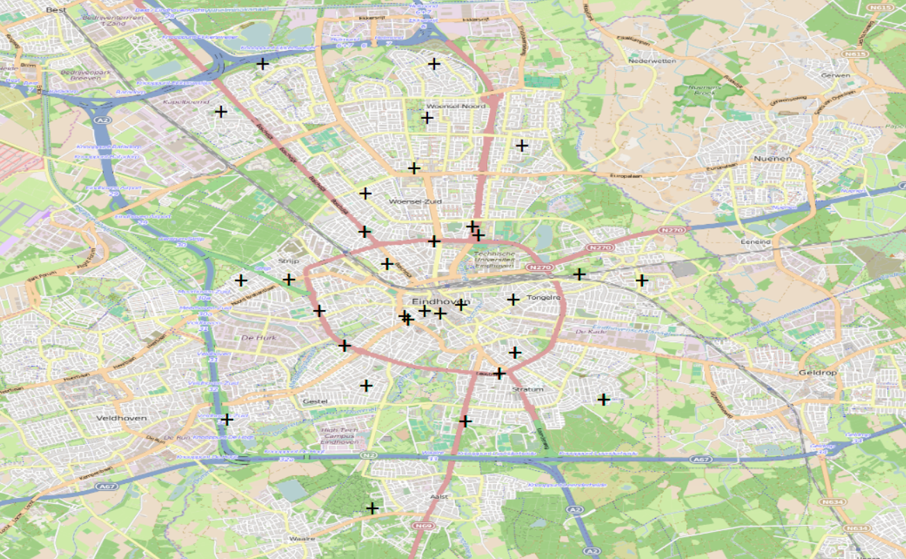
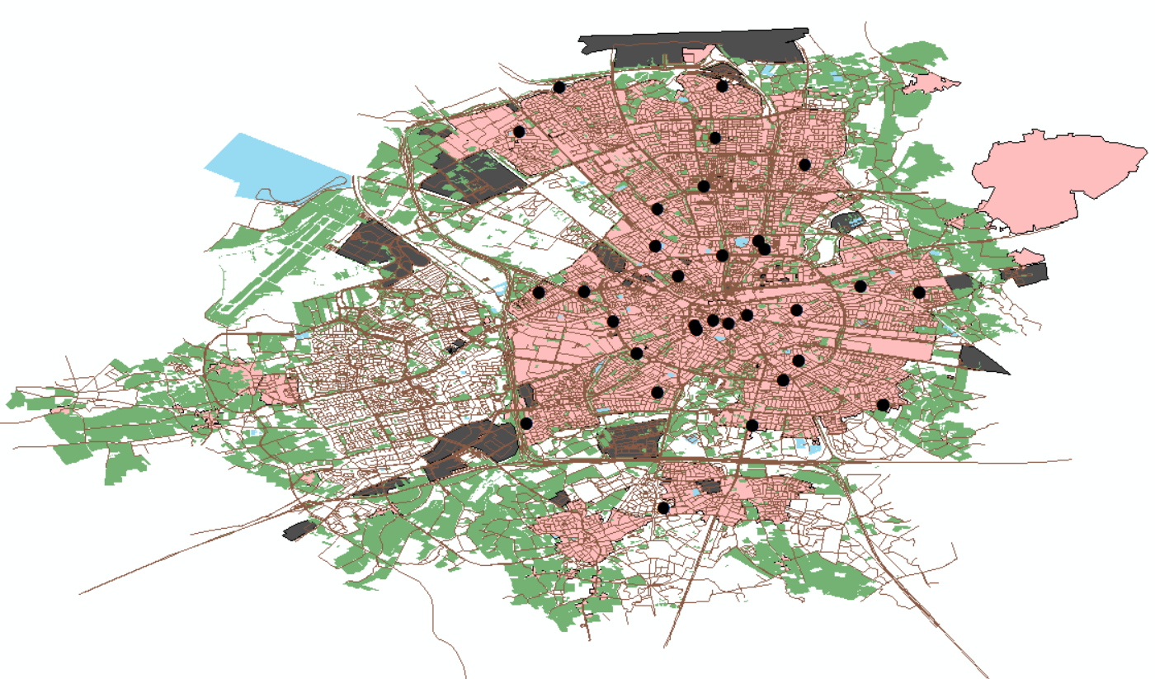
Describing the dataset
Observations
Residential
Industrial/Construction
Green Areas
Misc.
Road network

Slide 4
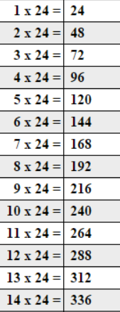
Oct 1 – Wed
Oct 2 – Thu
Oct 3 – Fri
Oct 4 – Sat
Oct 5 – Sun
Oct 6 – Mon
Oct 7 – Teu
Oct 8 – Wed
Oct 9 – Thu
Oct 10 – Fri
Oct 11 – Sat
Oct 12 – Sun
Oct 13 – Mon
Oct 14- Teu

Slide 5
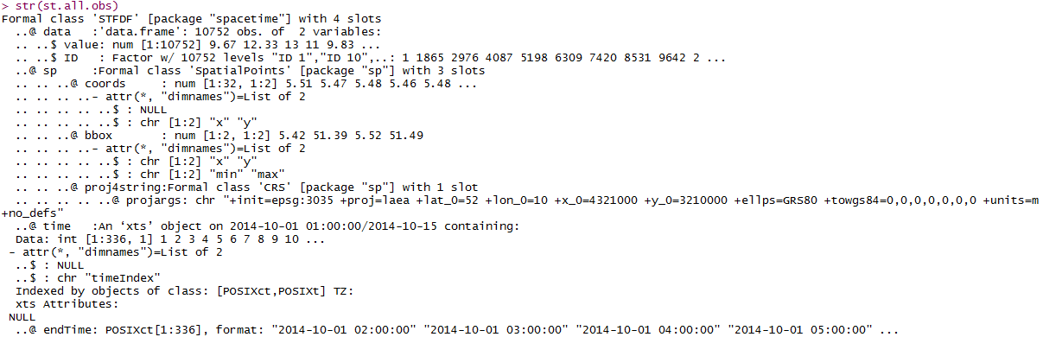
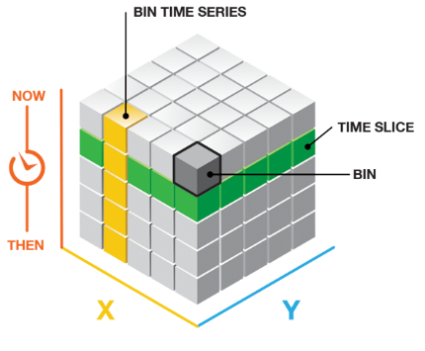
Dataset
Pre-processed Eindhoven averaged hourly dataset
32 stations – 336 time instances (24 x 14) – 2 weeks
PM1 , PM2.5, PM 10 values
Start time – 2014-10-01 00:00:00 to 2014-10-14 23:59:59
http://arcg.is/1I5rvzg

Slide 6
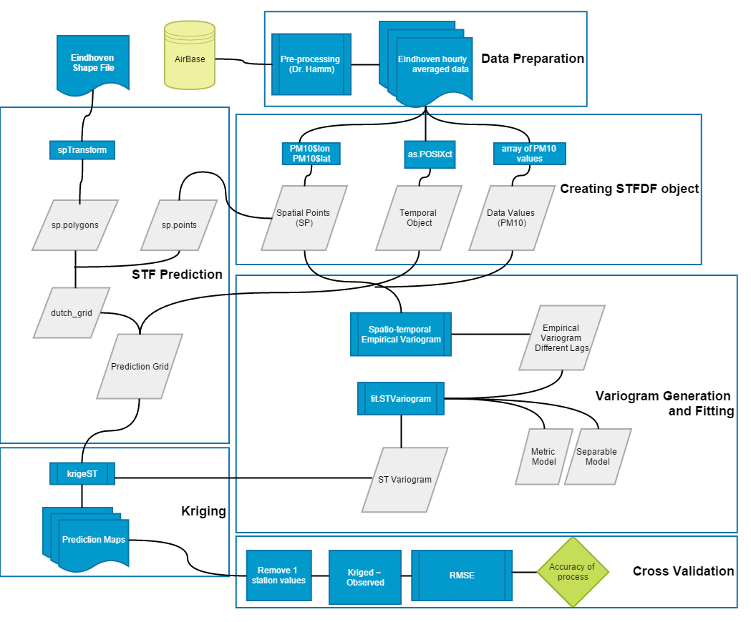
How?

Slide 7
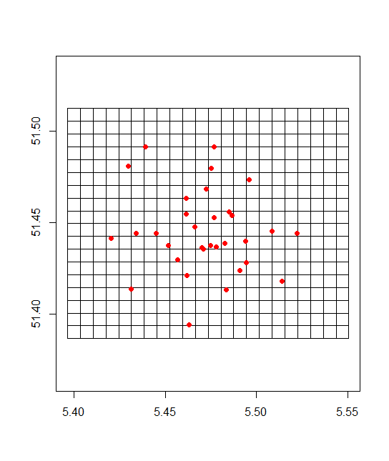
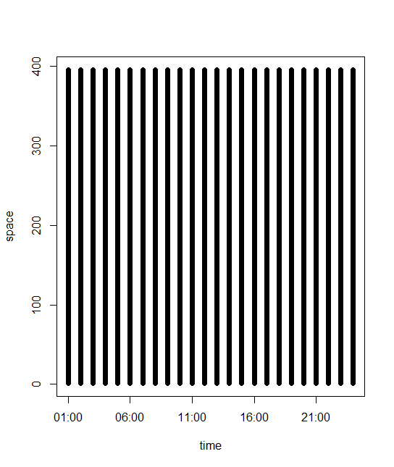
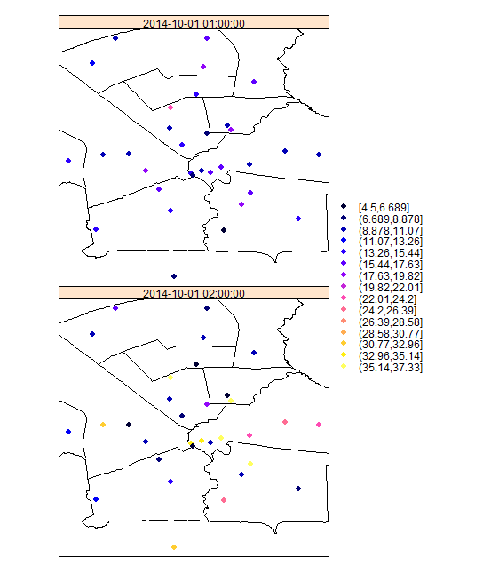
Intermediate Results
Observation Instances
Spatial grid
STF grid for prediction

Slide 8
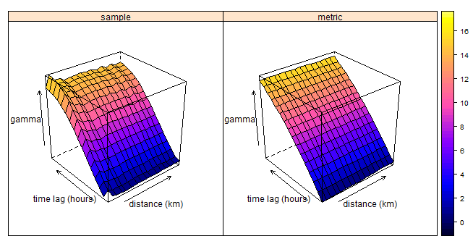
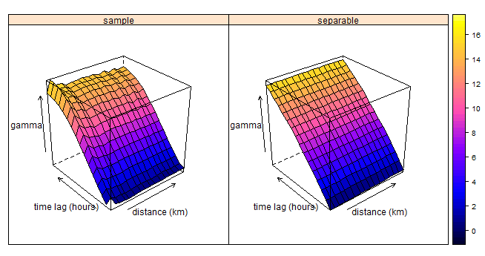
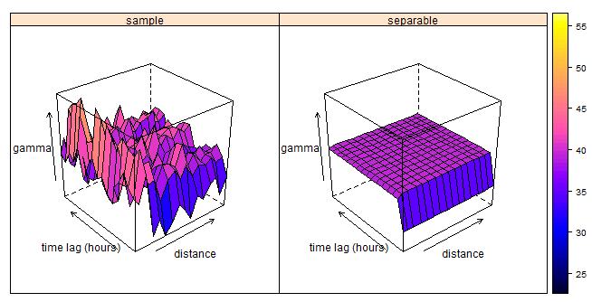
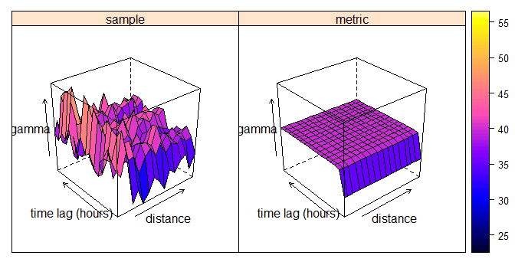
ST Variograms
PM1 variogram
PM10 variogram

Slide 9
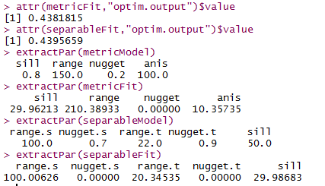
Discussions
PM1
PM1 empirical variogram showed no observational trends for default and 0:48 hours lag.
Metric model fitting and Separable model fitting were compared on basis of OPTIM (goodness of fit value for model and sample variogram calculated by RMS difference of surfaces)
separableFit model was utilized for kriging, due to issues with stAni parameter for Metric model ( manually calculated as 330 ).
Prediction was visually reasonable – need for Cross Validation.
PM10
Observation of trends and high fluctuation of γ values for default and even more for 0:48 hours lag.
Fitting of model was poor for pooled variogram, it was reflected in the metric model fitting and separable model fitting.
Issues with estimation parameters to be fixed first and then proceeded with kriging

Slide 10
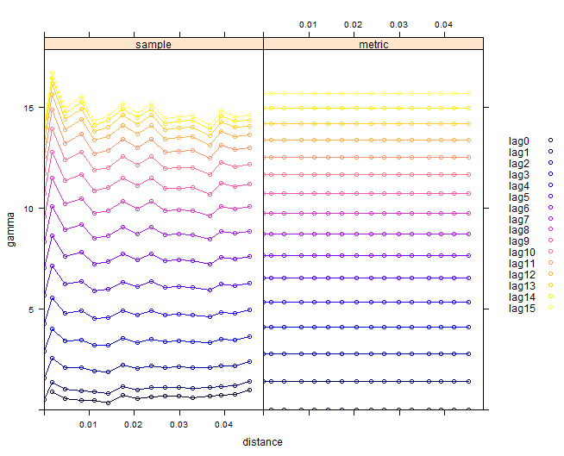

PM1 : Models

Slide 11
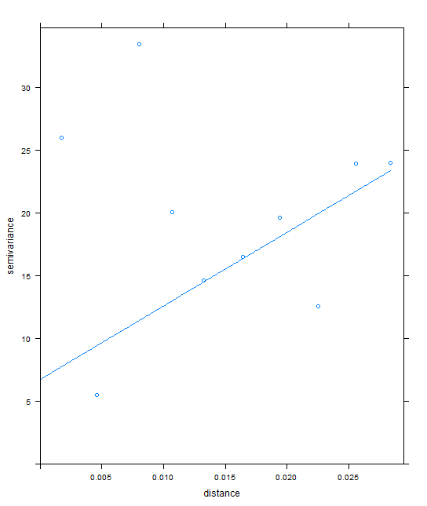
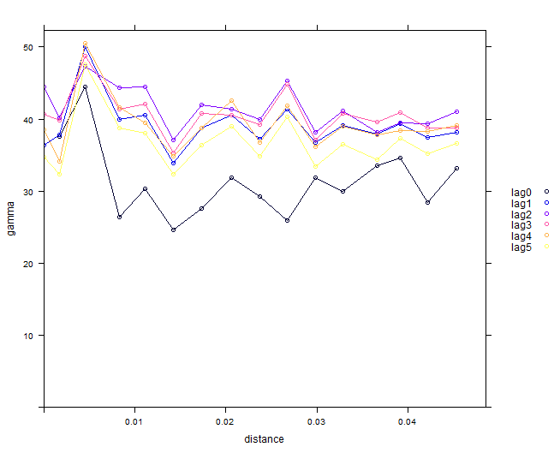
PM10 : Pooled Variograms

Slide 12
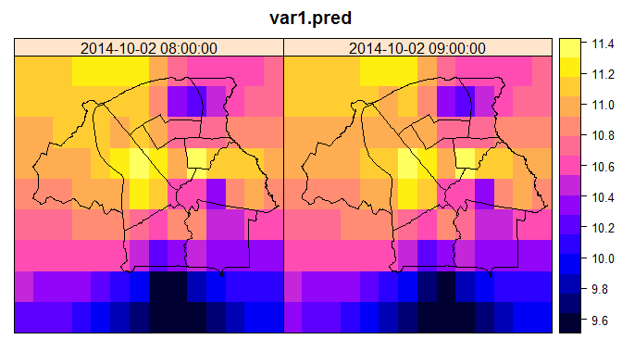
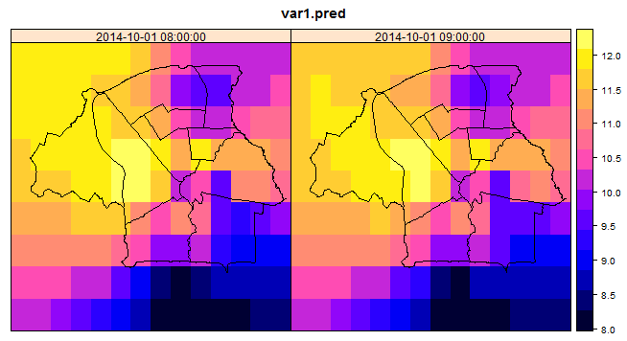
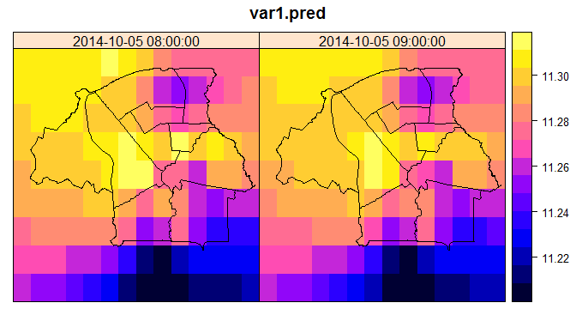
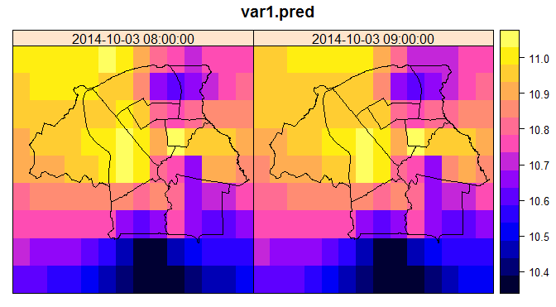
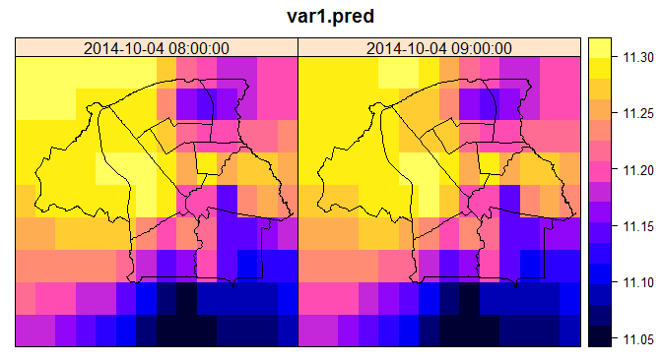
Prediction Maps – 8 am to 10 am Wed - Sat
Oct 1 – Wed
Oct 2 – Thu
Oct 3 – Fri
Oct 4 – Sat
Oct 5 – Sun
Oct 6 – Mon
Oct 7 – Tue
Oct 8 – Wed
Oct 9 – Thu
Oct 10 – Fri
Oct 11 – Sat
Oct 12 – Sun
Oct 13 – Mon
Oct 14- Tue
High values in the North –west persistently
Typically low in the south central part

Slide 13
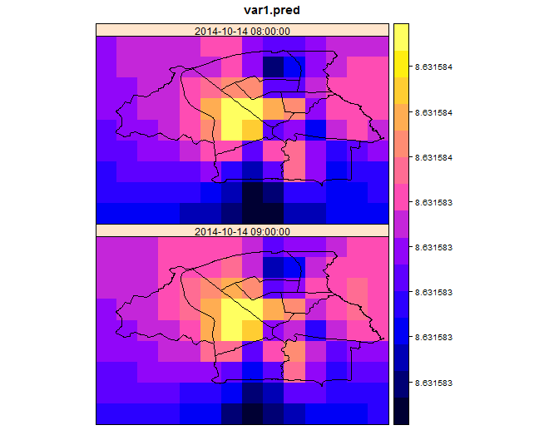
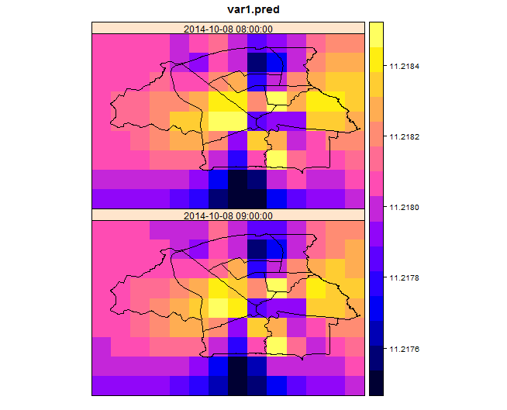
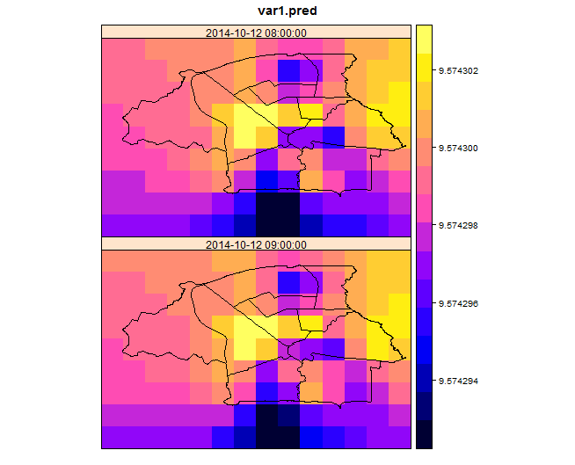
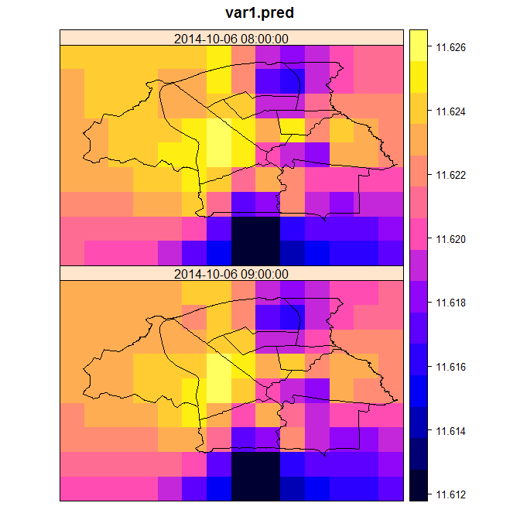
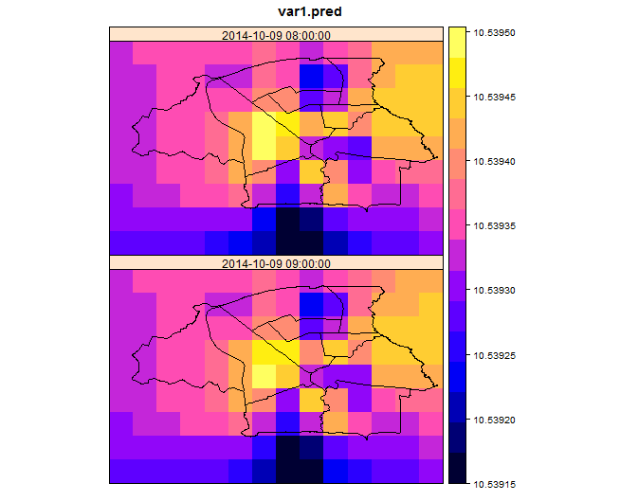
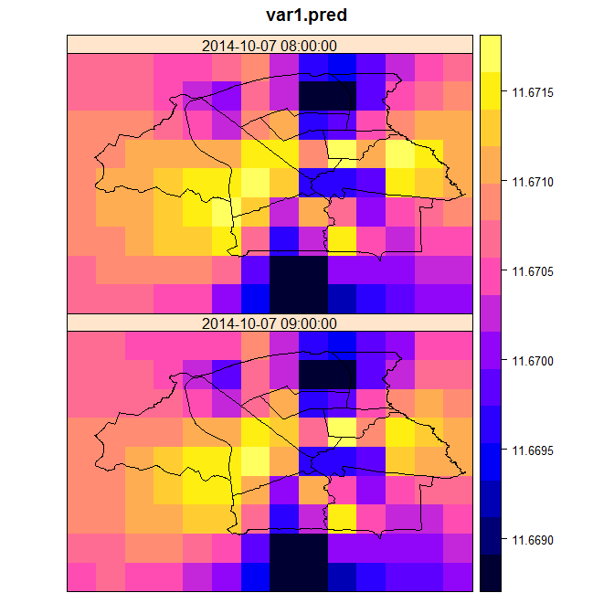
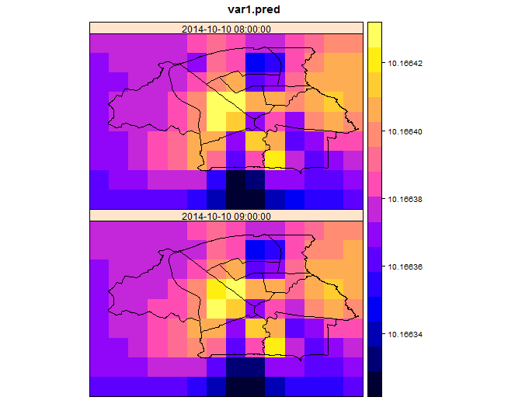

Mon-Sat
Sun- Teu
Oct 1 – Wed
Oct 2 – Thu
Oct 3 – Fri
Oct 4 – Sat
Oct 5 – Sun
Oct 6 – Mon
Oct 7 – Tue
Oct 8 – Wed
Oct 9 – Thu
Oct 10 – Fri
Oct 11 – Sat
Oct 12 – Sun
Oct 13 – Mon
Oct 14- Tue
High values in the North –west persistently :Trend remains for the second week
However there is a shift from north west to north east!
Typically low in the south central part

Slide 14
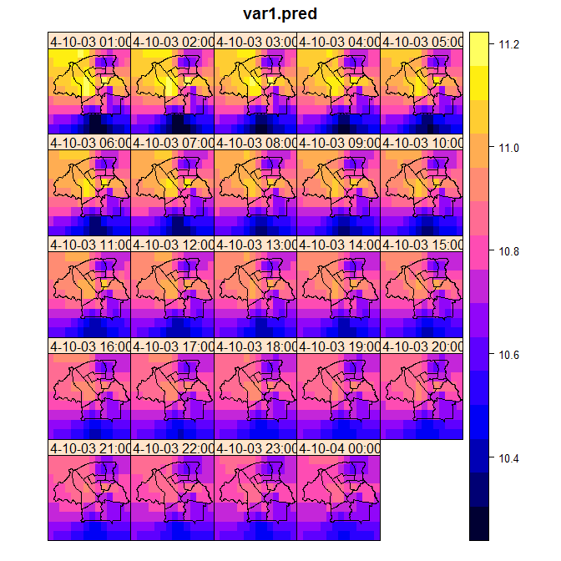
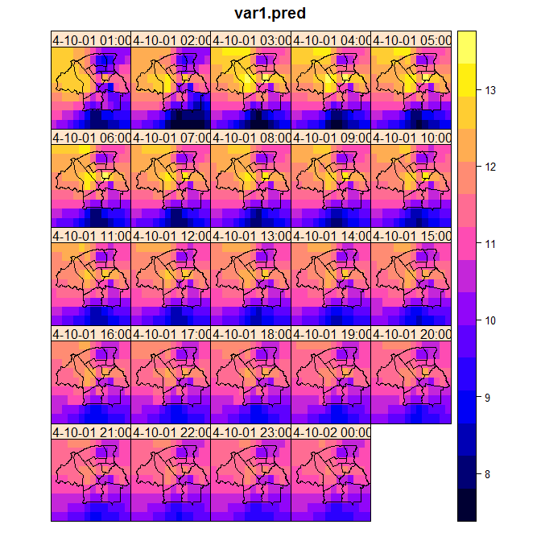
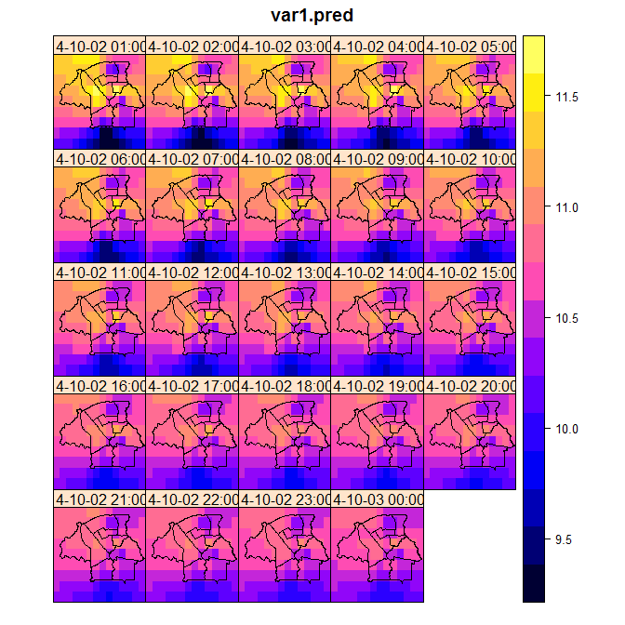
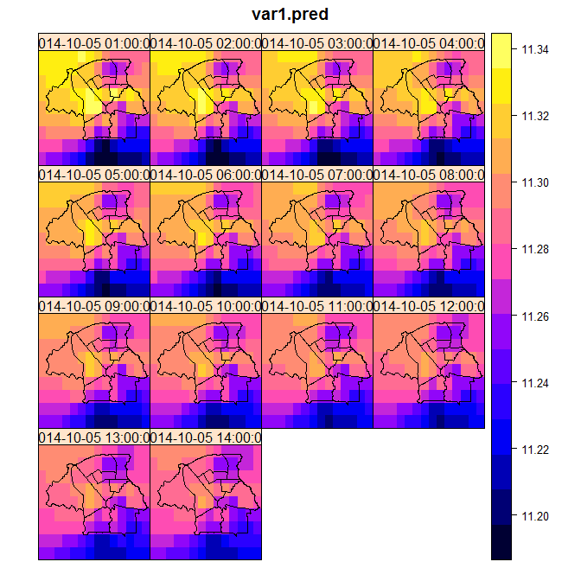
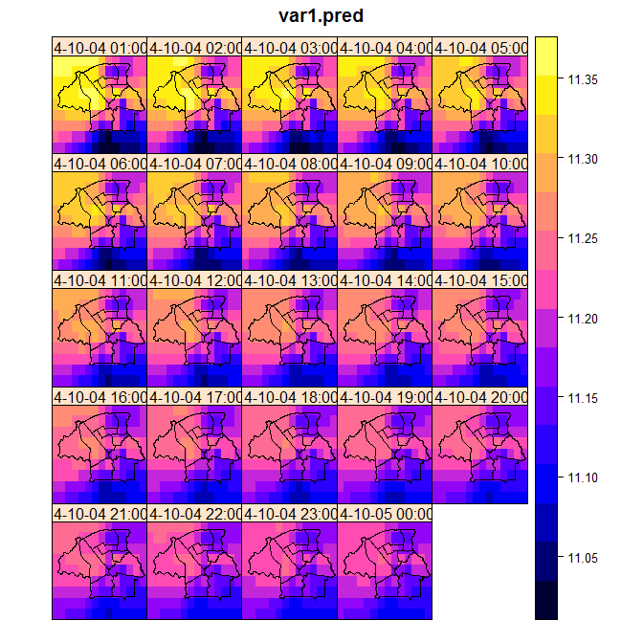
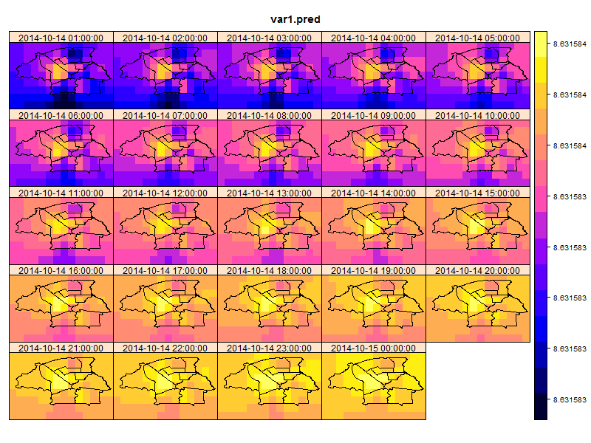
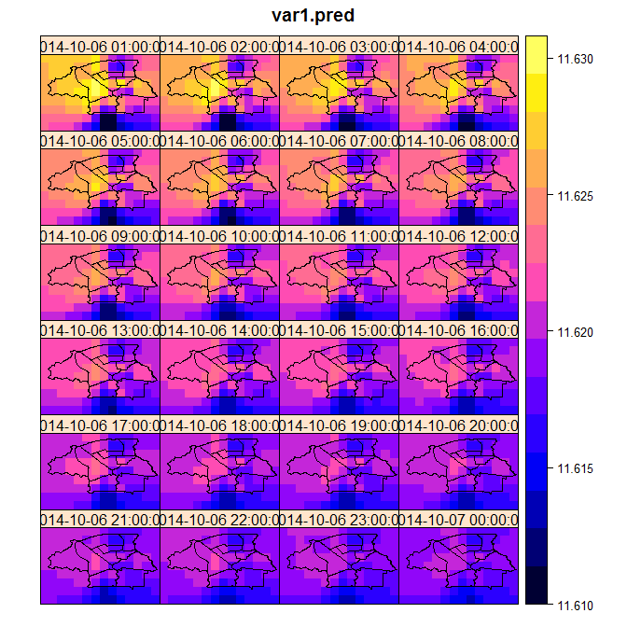
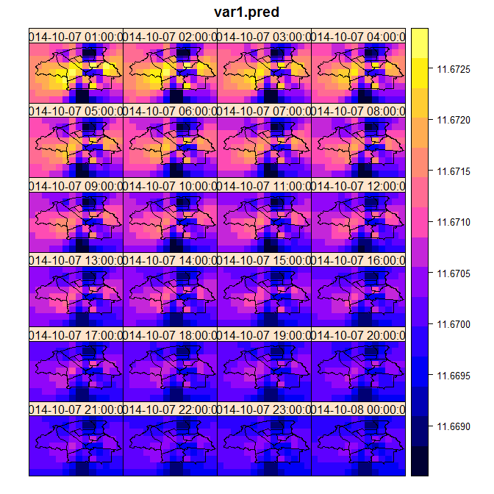
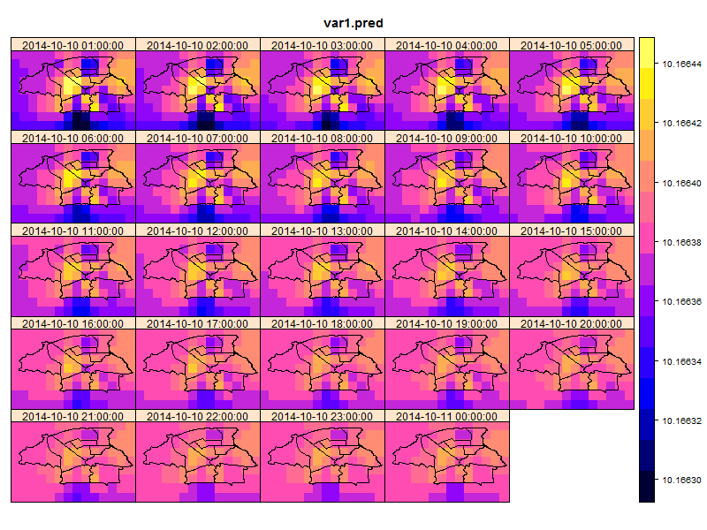
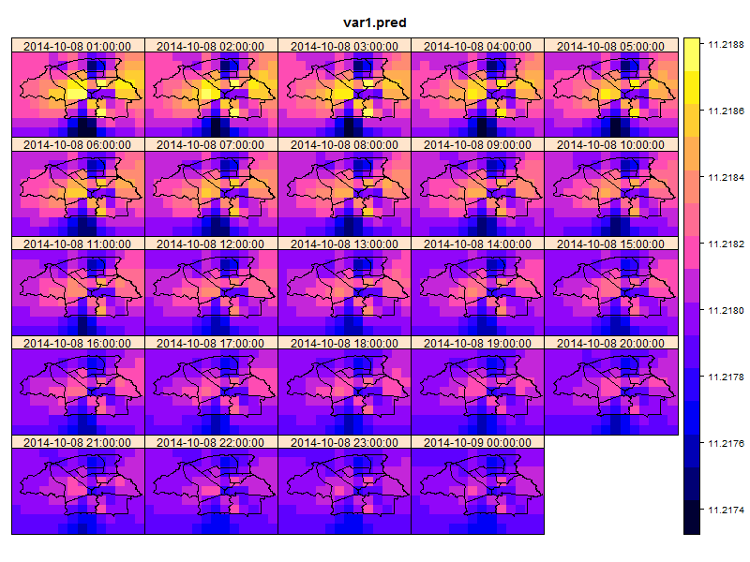
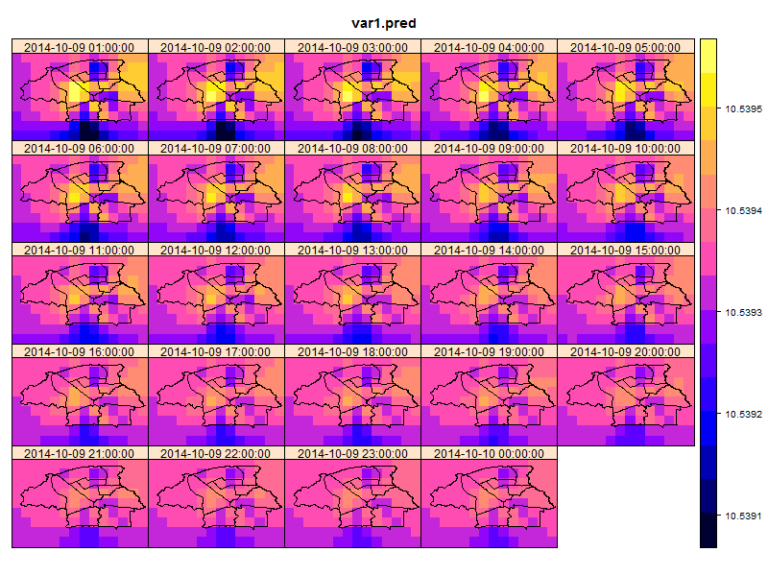
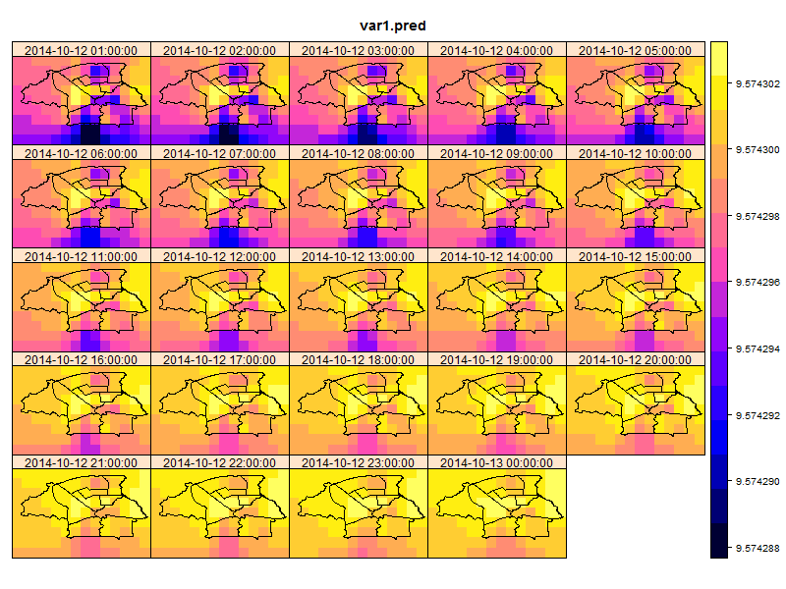

Trend : 24 hours
Oct 1 – Wed
Oct 2 – Thu
Oct 3 – Fri
Oct 4 – Sat
Oct 5 – Sun
Oct 6 – Mon
Oct 7 – Tue
Oct 8 – Wed
Oct 9 – Thu
Oct 10 – Fri
Oct 11 – Sat
Oct 12 – Sun
Oct 13 – Mon
Oct 14- Tue

Slide 15
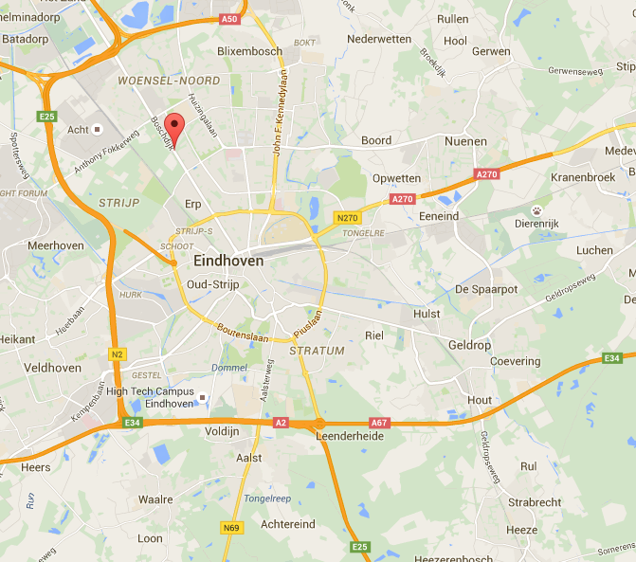
Boschdijk Eindhoven
Traffic hub and comparatively high levels of particulate matter recorded.[1]
Evident from the prediction maps
[1] https://www.ecn.nl/news/item/clean-air-where-you-live/

Slide 16
What?
To investigate potential of Spatio-temporal kriging approaches for hourly mean PM10 and PM2.5 concentration data.
Prediction and forecasting concentration levels of PM10 and PM2.5 for Eindhoven city and suburbs.
Incorporating other geo-ancilliary information like land cover, temperature to improve accuracy of prediction / validation
Evaluation of quality and comparision of spatio-temporal approaches

Slide 17
Till now.. & further work
Answer 1 & 4:
Cross validation by removing 3 stations and its observations and comparing the predicted value and observed value. Commenting on the accuracy of the process.
Method to estimate stAni parameter and to utilize metric modelling for prediction for PM1.
Answer 2:
Proper fitting for PM10 dataset – utilizing log values and proceed with kriging.
Answer 3:
Literature review- scope and time constraints

Slide 18
Thank you for your attention!
Questions (if any)

