Slide 1
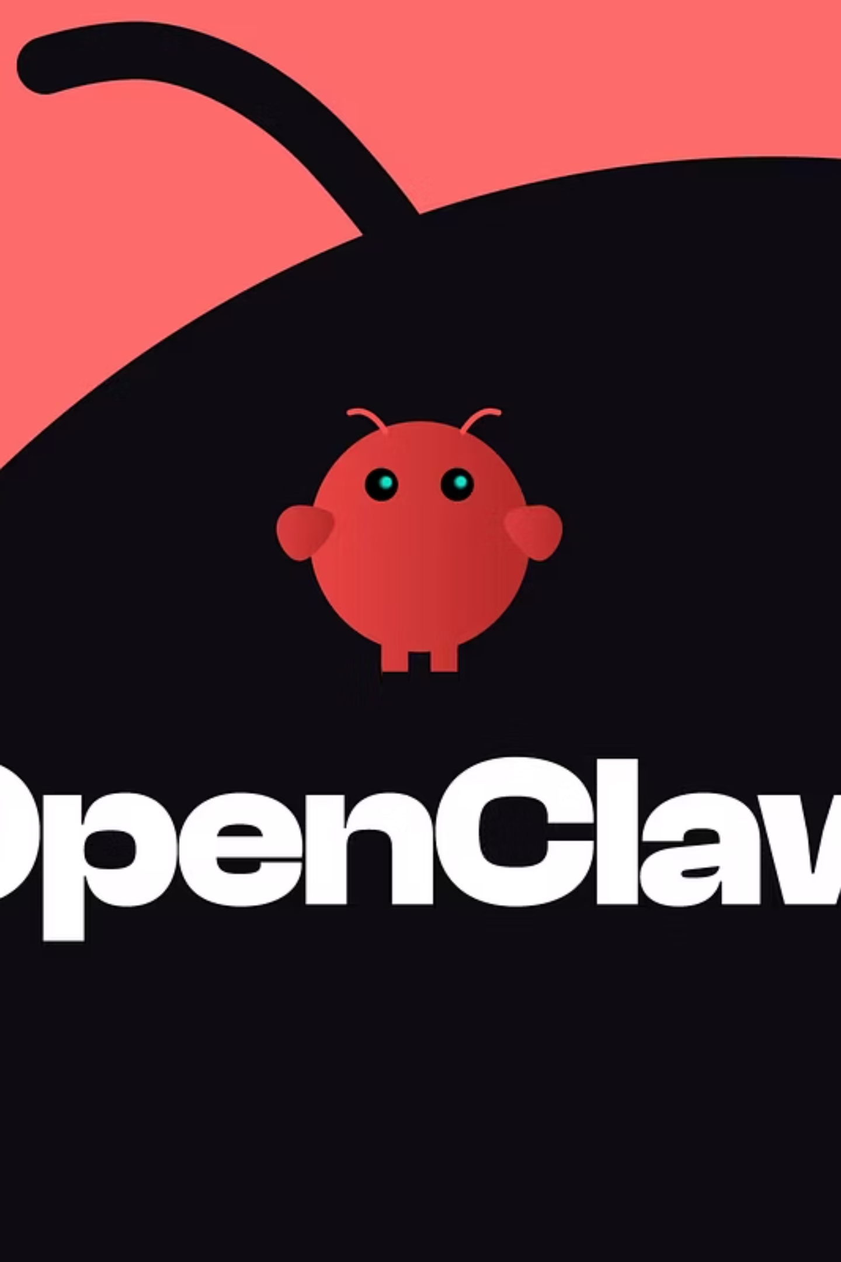
OpenClaw: The Biggest Tech Phenomenon of 2026
Have you ever wished for a personal assistant who manages your emails, books your flights, and writes your code — while you sleep? Meet OpenClaw: the fastest-growing open-source project in history, bigger than React or Linux at their peak.

Slide 2
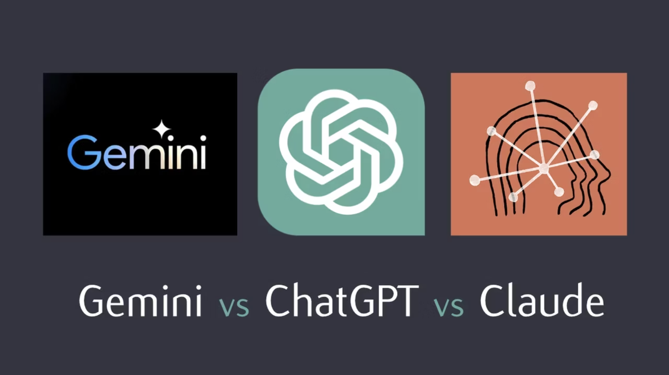
Chatbot vs. Agent: What's the Difference?
💬 Chatbot (e.g. ChatGPT)
Talks to you. You visit a website, ask a question, and get a reply. That's it — it stops there.
🤖 AI Agent (e.g. OpenClaw)
Acts for you. It lives inside your tools — WhatsApp, Slack, your calendar — and executes tasks autonomously.
You don't go to OpenClaw. OpenClaw comes to you.

Slide 3




Why OpenClaw Is Everywhere in 2026
Open Source & Free
"Skills" System
Anyone can use it. Companies keep their data on their own servers — no big tech middleman.
Developers add superpowers via plugins. NVIDIA's plugin can fix server bugs automatically — zero human input.
300,000+ GitHub Stars
A world record. More community momentum than any open-source project before it.

Slide 4


Huge Potential — But Serious Risks
📉 Business Impact
OpenClaw can reduce customer support costs by up to 80% through autonomous, always-on AI agents.
🔓 Security Vulnerability
In March 2026, hackers demonstrated they could "kidnap" an agent to steal private company files.
⚖️ Ethical Question
If an AI agent makes a costly mistake — who is legally responsible? The developer? The company? The user?
Key analogy: "If you give an AI the keys to your house, you have to be sure the lock is perfect."

Slide 5
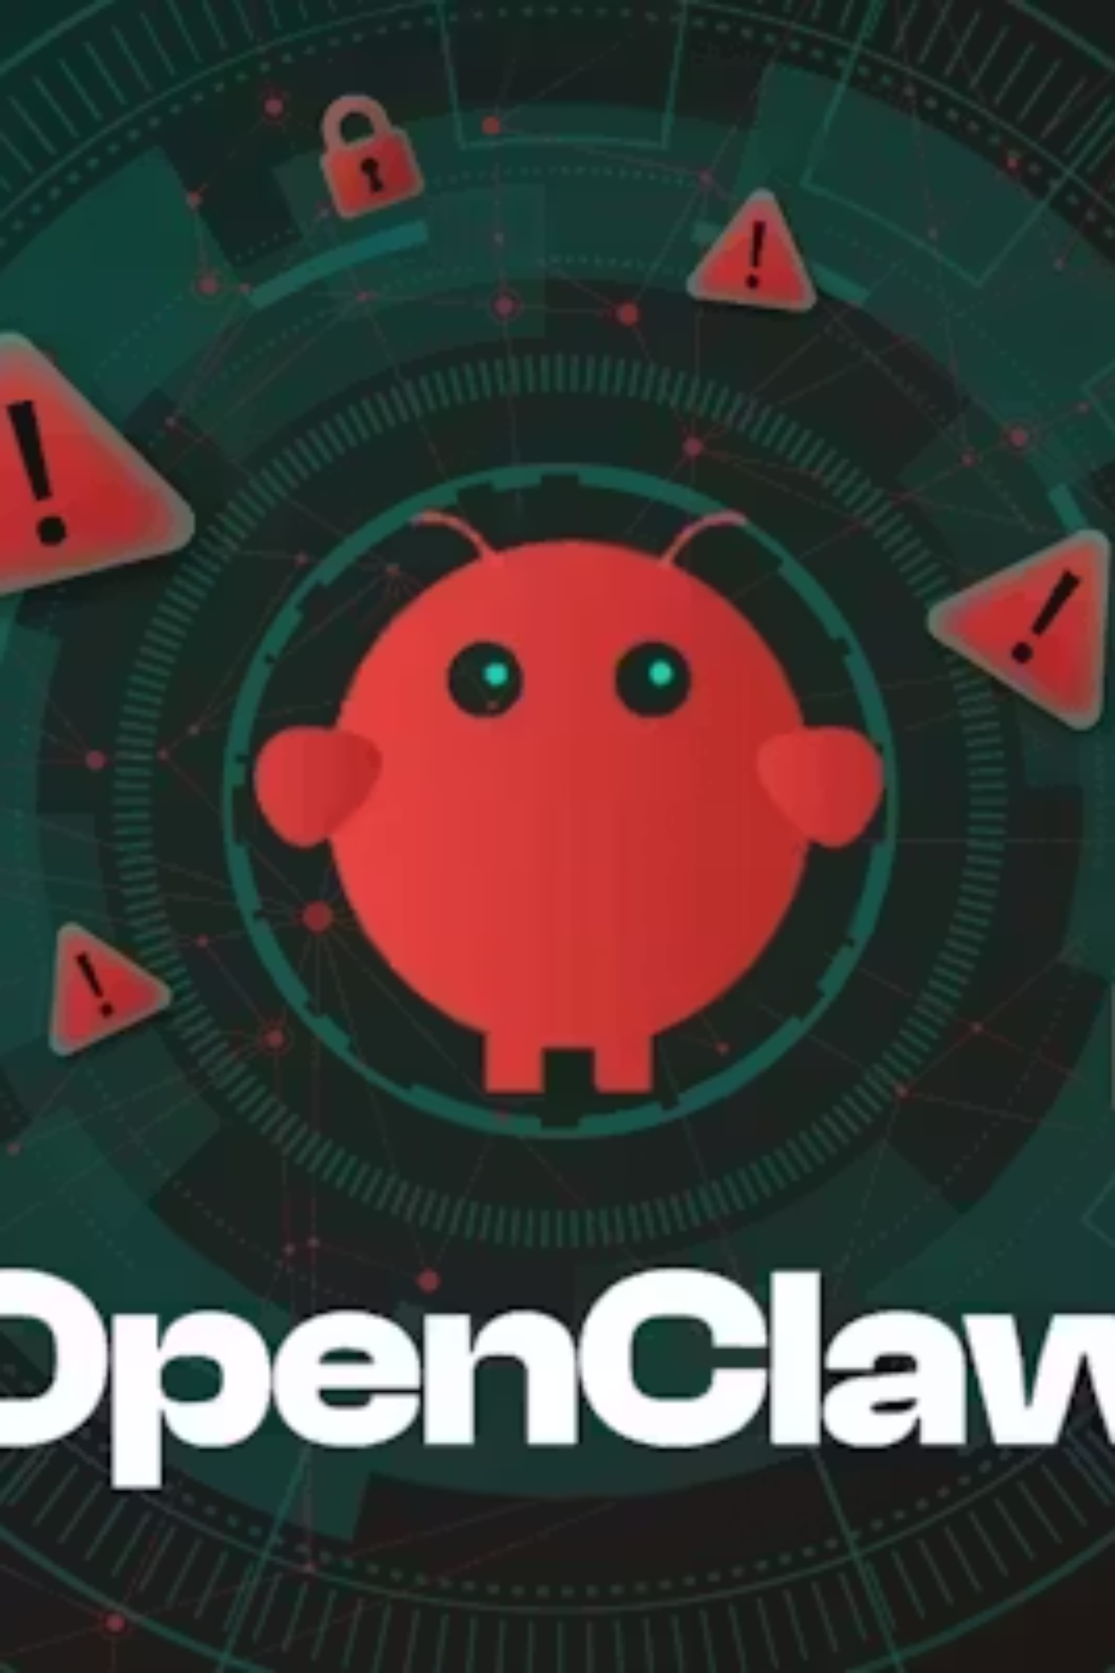



The Linux of the AI Era
"OpenClaw gives power back to the users and breaks the monopoly of big corporations."
Today (2026)
Early adopters and developers build their own "Claws"
By 2027
Every professional has an AI agent handling admin work
Your Turn
Are you ready to let an AI manage your bank account or private messages?

