Slide 1
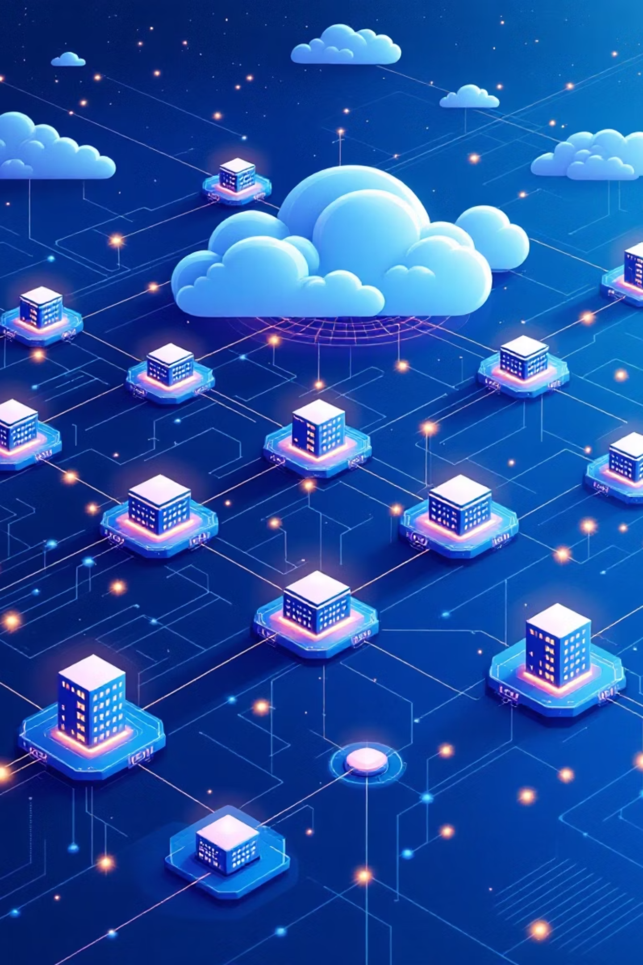
Google Cloud Platform: A Global Overview
Exploring the foundations of Google's powerful cloud services.

Slide 2
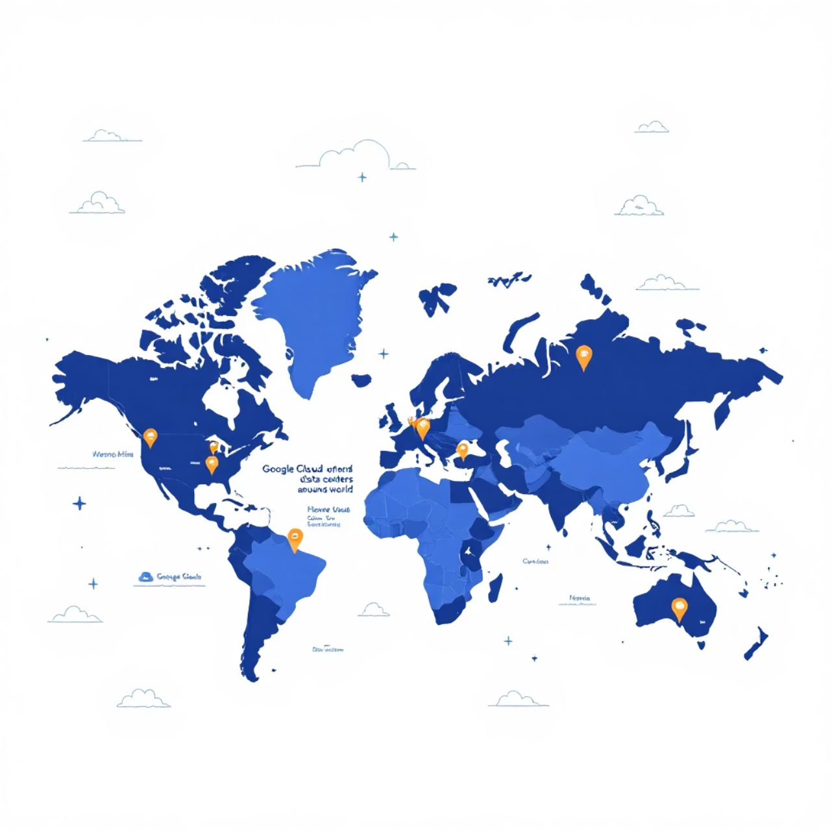
Global Infrastructure: A Network of Power
GCP is built upon a vast global network of interconnected data centres, much like a single, colossal hard drive.
Worldwide Presence
Strategically located data centres ensure low latency and high availability globally.
Interconnected Servers
Seamless data flow and resource sharing across regions.

Slide 3
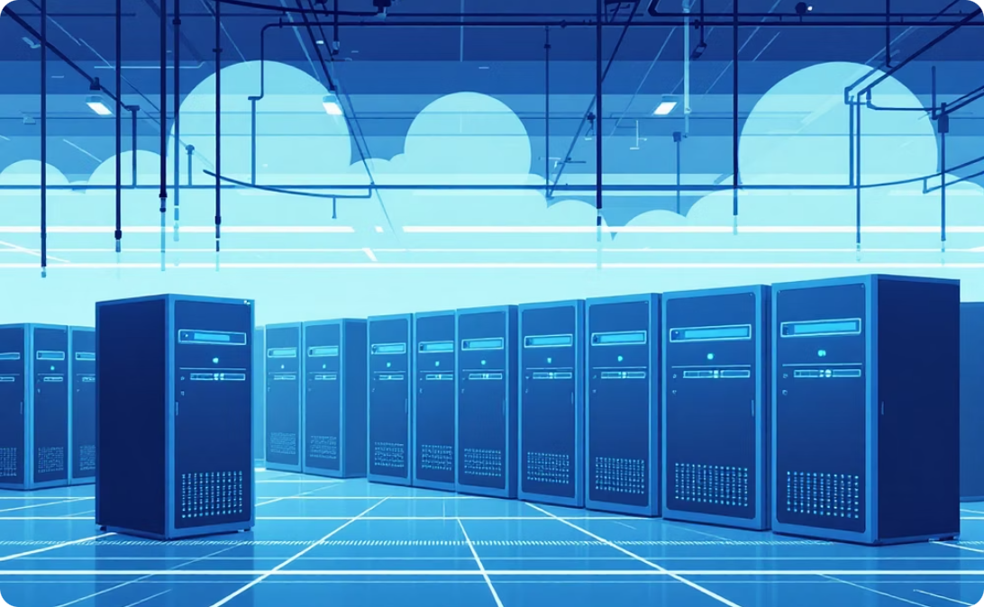

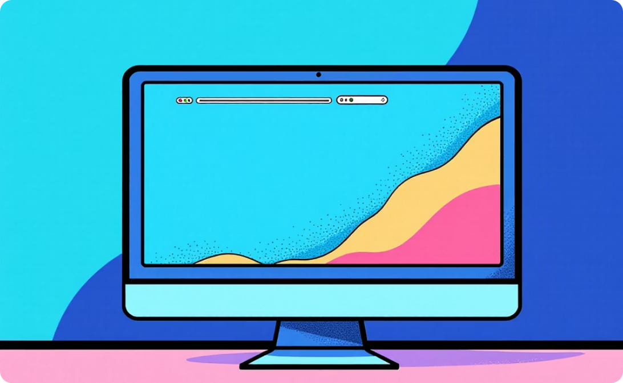
On-Demand Resources: Your Virtual Data Centre
No Hardware Investment
Unlimited Storage
Instant Access
Eliminate upfront costs for physical servers and maintenance.
Store an unlimited amount of information securely online.
Provision computing power and services as needed, when needed.

Slide 4

Scalability & Cost-Efficiency
01
Subscription Model
Pay only for the services and resources you consume, typically on a monthly basis.
02
Flexible Scaling
Effortlessly scale resources up or down to meet fluctuating demands.
03
Optimised Performance
Access Google's cutting-edge infrastructure without proprietary ownership.

