Slide 1
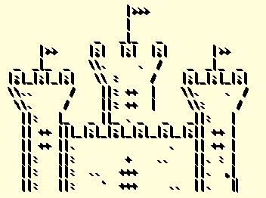
Kirill’s Kastle
Team 16

Slide 2
Introduction
We set it up as a quest
Pulled quotes, characters and descriptions from loved movies
Started with an escape room idea - we built on this and Kirill’s Kastle was subsequently formed.

Slide 3
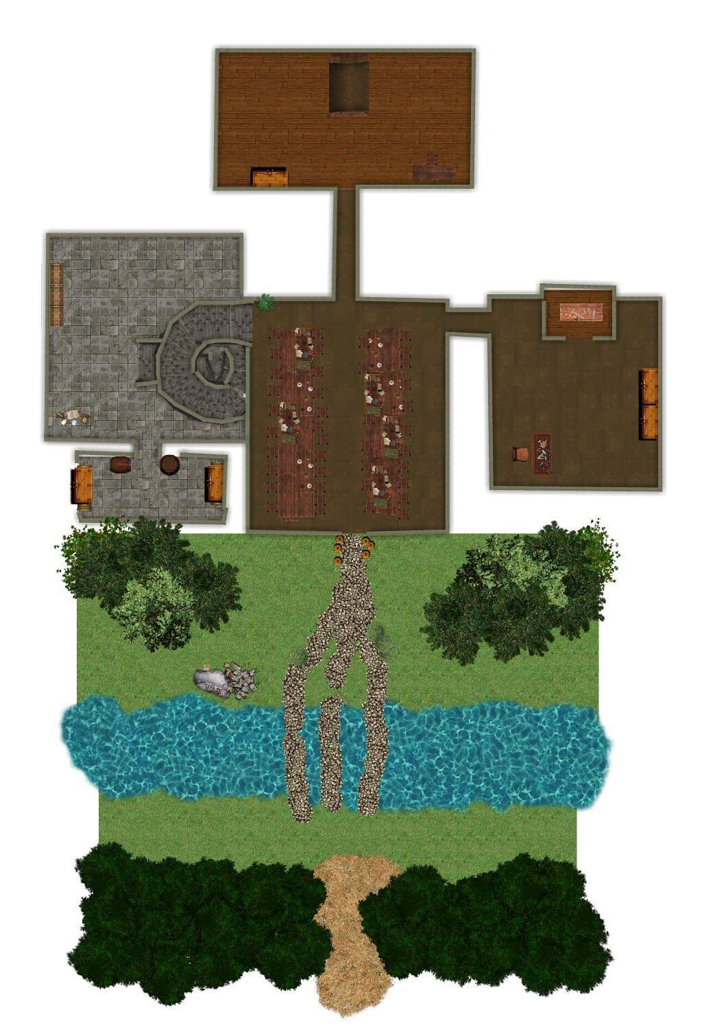
Design
Ideas pulled from movies, easy for user to build up an image
Using different puzzles for each room gives each room a unique theme
Multiple endings
Personalise you character

Slide 4
Implementation details
We added a features file for objects in the game that the user can interact with but do not constitute as items, such as the bookcase cannot be picked up but can acted upon
Added use and inspect options for items these allow us to interact with each feature

Slide 5
Key Features

Slide 6
Purchasing
Target audience set at 11 – 30 year olds
Pulling characters and descriptions from movies in different genres means more consumers within this bracket
Personalising the game by creating your own character to play with makes the game more relatable
The puzzles, as you progress through the game, don’t repeat keeping users interested
There’s multiple endings to the game which means the game can be played many times

Slide 7
Testing
Created and used doctests, to ensure the game runs smoothly
Play tested game:
  On computer science students
  On university students
Used feedback to edit the game making it more enjoyable to users

Slide 8
Any Questions?

