Slide 1
UT Dallas CS6301 Special Topics in Computer Science
Road to Recommendation System
An-Yu Liu axl180015@utdallas.edu
‹#›

Slide 2
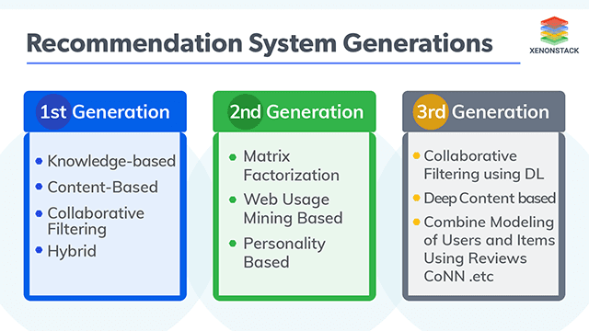
UT Dallas CS6301 Special Topics in Computer Science
Motivation
Recommendation system not only benefit the company but also users to alleviate the information overload problem and explore what they are interested in from the vast sea of items.
To achieve this goal, accurately modeling users’ preferences from their historical interactions is the foundation of an effective recommender system.
However, the system itself face many challenges, such as scalability, cold-start. Different system design also indicate different assumption from designer for users preference.
‹#›
picture source:https://www.google.com/url?sa=i&url=https%3A%2F%2Fwww.xenonstack.com%2Fblog%2Frecommender-systems%2F&psig=AOvVaw3CWwaClJBgITgrtzI3HSuD&ust=1620750342283000&source=images&cd=vfe&ved=0CAIQjRxqFwoTCMiittvDv_ACFQAAAAAdAAAAABAD

Slide 3
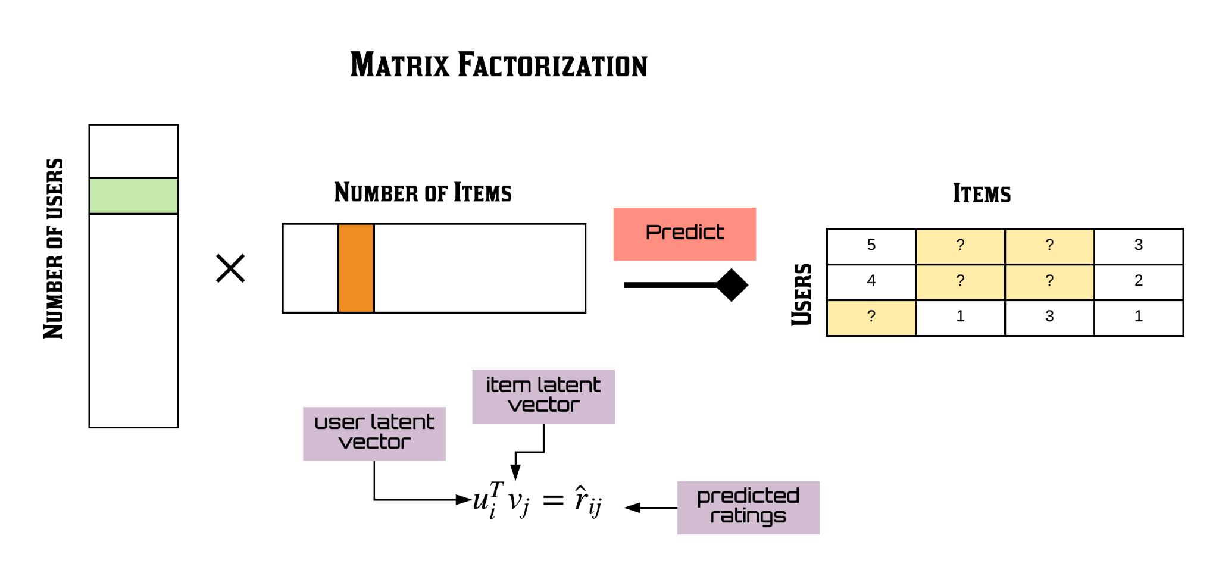
UT Dallas CS6301 Special Topics in Computer Science
Previous Work
Matrix factorization commonly used in early model as the foundation of latent factor model.
The most common paradigm for collaberative filter is to learn latent features.(a.k.a. embedding) to represent users and items as separate matrix and multiple them to predict the unknown.
Matrix factorization is the key to win Netflix competition (2006) for $1 million.
Later, researchers found using users interaction history as input can improve the quality of embedding: SVD++. [1]
‹#›
source: https://miro.medium.com/max/5130/1*b4M7o7W8bfRRxdMxtFoVBQ.png

Slide 4
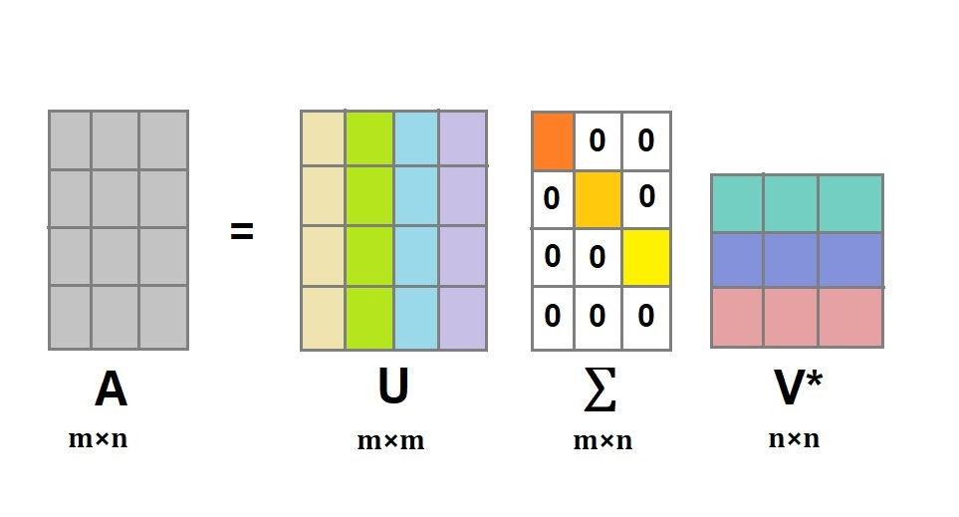
UT Dallas CS6301 Special Topics in Computer Science
Background
Key concept you should know:
What is the rank of a matrix A?
the maximal number of linearly independent columns of A
dimensionality reduction:
Assume data lies on or near a low d-dimensional space.
Remove redundant and noise data.
easier storage and processing.
Singular Value Decomposition(SVD):
A real matrix can be decomposed to 3 smaller matrix
foundation of latent factor model.
‹#›
source:https://www.google.com/url?sa=i&url=https%3A%2F%2Fwww.askpython.com%2Fpython%2Fexamples%2Fsingular-value-decomposition&psig=AOvVaw0GNScgZ5gb4N9cknWDJOoK&ust=1620751232056000&source=images&cd=vfe&ved=0CAIQjRxqFwoTCPiW9YLHv_ACFQAAAAAdAAAAABAJ

Slide 5
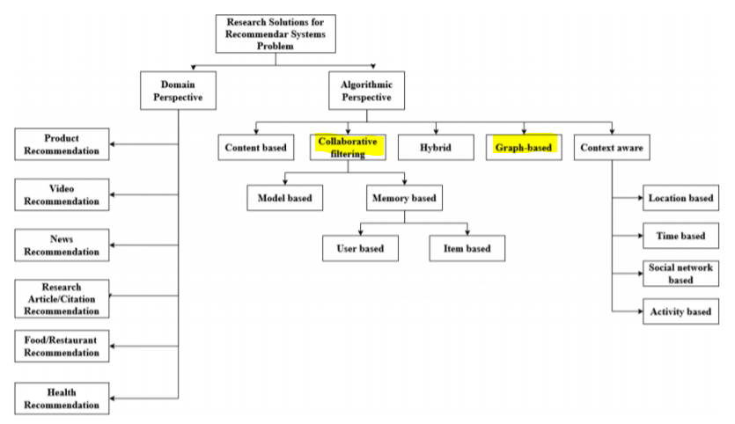
UT Dallas CS6301 Special Topics in Computer Science
Taxonomy of recommender systems
Collaborative filtering and Graph based are heavily focused in the following slides.
‹#›
source:[8]:Link prediction approach to recommender systems https://arxiv.org/abs/2102.09185

Slide 6
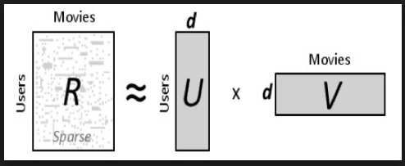
UT Dallas CS6301 Special Topics in Computer Science
Neural Collaborative Filtering
With the popularity of Neural Network in speech recognition, computer vision and natural language processing. It started being implemented in recommendation system as well.
The foundation of the recommendation system is the matrix factorization (MF).Popularized by the Netflix Prize, it has become the de facto approach to latent factor model-based recommendation.
Despite the effectiveness of MF for collaborative filtering, it is well-known that its performance can be hindered by the simple choice of the interaction function — inner product.
However, the inner product, which simply combines the multiplication of latent features linearly, may not be sufficient to capture the complex structure of user interaction data.
‹#›
source: [2]https://arxiv.org/abs/1708.05031 and https://miro.medium.com/max/988/1*tiF4e4Y-wVH732_6TbJVmQ.png

Slide 7
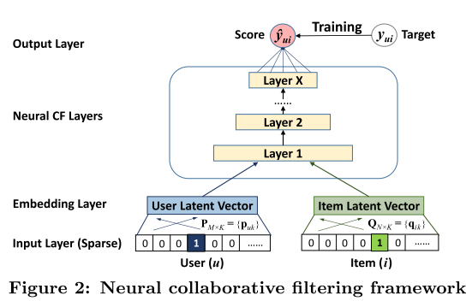
UT Dallas CS6301 Special Topics in Computer Science
Neural Collaborative Filtering
Therefore, some proposed to replacing the inner product with a neural architecture that can learn an arbitrary function from data, we present a general framework named Neural network-based Collaborative Filtering (NCF)
The main contributions of this framework are:
model latent features of users and items and devise a general framework NCF for collaborative filtering based on neural networks
MF can be interpreted as a specialization of NCF and utilize a multi-layer perceptron to endow NCF modelling with a high level of non-linearities.
Prove the effectiveness of NCF approaches and the promise of deep learning for collaborative filtering.
‹#›
source: [2]https://arxiv.org/abs/1708.05031

Slide 8
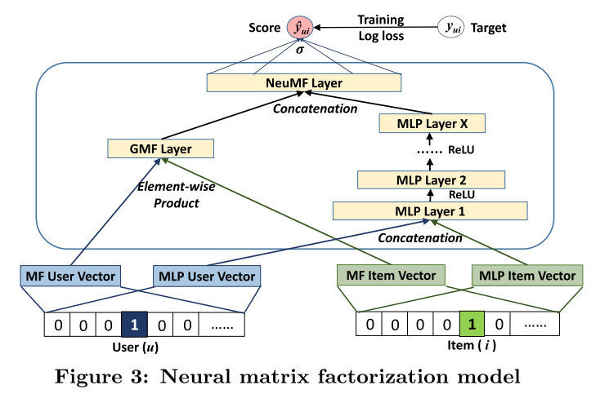
UT Dallas CS6301 Special Topics in Computer Science
Neural Collaborative Filtering
Neural network-based Collaborative Filtering (NCF) instances:
Generalized Matrix Factorization (GMF): MF can be interpreted as a special case of the NCF framework
Multi-Layer Perceptron (MLP):Since NCF adopts two pathways to model users and items,it is intuitive to combine the features of two pathways by concatenating them using hidden layers.
Fusion of GMF and MLP: performance is the best.
Issues left: Neural network-based Collaborative Filtering Framework is an unidirectional models requires a rigidly ordered sequence of data which is not always practical.
On top of that, such unidirectional models restrict the power of hidden representation for items in the historical sequences, where each item can only encode the information from previous items.
solution: derived from Natural Language Processing model: Transformer (BERT)
‹#›
source: [2]https://arxiv.org/abs/1708.05031

Slide 9
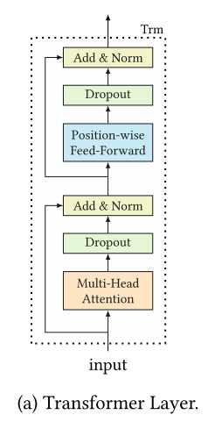
UT Dallas CS6301 Special Topics in Computer Science
BERT4Rec
Sequential Recommendation with Bidirectional Encoder Representations from Transformer
BERT4Rec, which employs the deep bidirectional self-attention to model user behavior sequences.
Using Cloze task [5] to train this model
it can produce more samples to train a more powerful model in multiple epochs. However, a downside of the Cloze task is that it is not consistent with the final task
‹#›
source:[4] BERT4Rec: sequential recommendation with bidirectional encoder representations from transformer

Slide 10
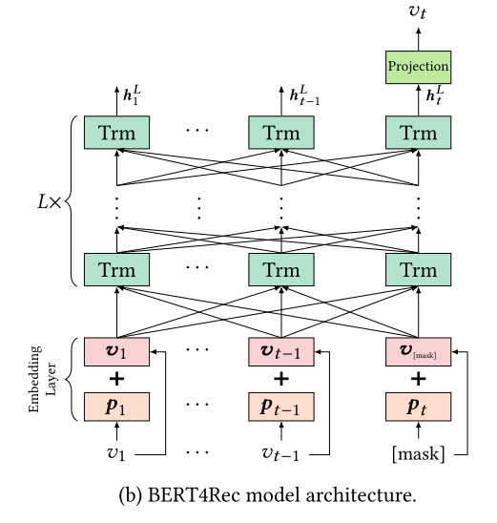
UT Dallas CS6301 Special Topics in Computer Science
BERT4Rec
Accuracy is one step ahead of Neural Collaborative Filtering.
different from NLP BERT:
The most critical difference is that BERT4Rec is an end-to-end model for sequential recommendation, while BERT is a pre-training model for sentence representation.
Remove the next sentence loss and segment embeddings since BERT4Rec models a user’s historical behaviors as only one sequence in sequential recommendation task.
‹#›
source:[4] BERT4Rec: sequential recommendation with bidirectional encoder representations from transformer

Slide 11
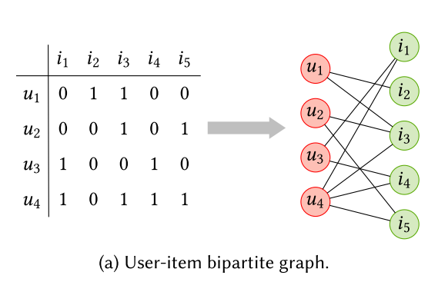
UT Dallas CS6301 Special Topics in Computer Science
BERT4Rec to Graph Neural Networks
BERT4Rec [4] leverage self-attention technique to model item interactions, which allows more flexibility to item-to-item transitions.
With the emerging of GNN, utilizing GNN to capture complex transition patterns of items has become popular in sequential recommendation.
Graph neural network (GNN) techniques which can naturally integrate node information and topological structure have gained considerable interests.
‹#›
source:[4] BERT4Rec: sequential recommendation with bidirectional encoder representations from transformer

Slide 12
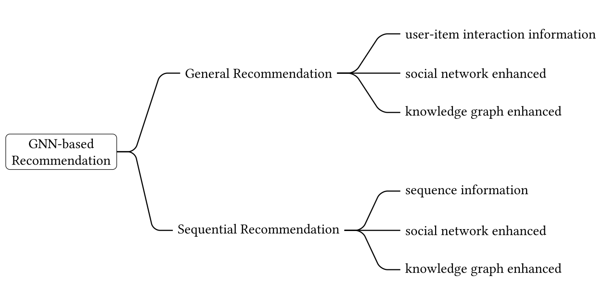
UT Dallas CS6301 Special Topics in Computer Science
Graph Neural Networks in Recommender Systems
GNN-based categories:
General recommendation: usually assumes the users have static preferences and models them based on either implicit (e.g., clicks, reads, or purchases) or explicit (i.e., ratings) feedbacks.
Sequential recommendation, in addition to general recommendation, is another mainstream research direction in recommender systems, which believes the user’s preference is dynamic and evolving.
Session-based recommendation can be viewed as a sub-type of sequential recommendation with anonymous and session assumptions.
In sequential recommendation, users’ historical interactions are organized into sequences in a
chronological order
‹#›
source:[2] Graph neural networks in recommender systems: a survey https://arxiv.org/abs/2011.02260

Slide 13
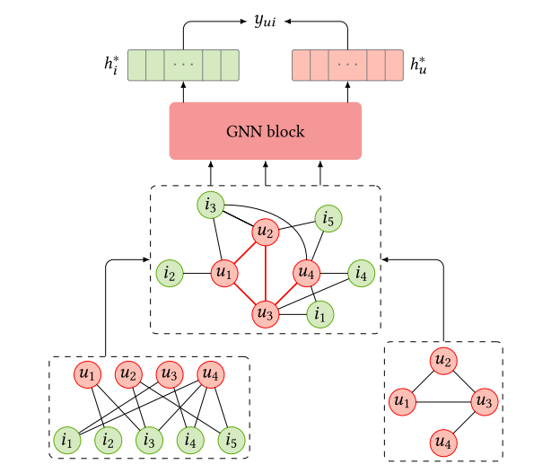
UT Dallas CS6301 Special Topics in Computer Science
Graph Neural Networks in Recommender Systems
GNN provides powerful and systematic tools to explore multi-hop relationships which have been proven to be beneficial to the recommender systems.
why GNN is so effective?
Different from traditional methods that only implicitly capture the collaborative signals (i.e., using user-item interactions as the supervised signals for model training)
GNN can naturally and explicitly encode the crucial collaborative signal (i.e., topological structure) to improve the user and item representations.
Remaining issue: GNN takes a long time to train
a)The framework of GNN on the unified graph of user-item interactions and social network.[5]
‹#›
source:[2] Graph neural networks in recommender systems: a survey https://arxiv.org/abs/2011.02260

Slide 14
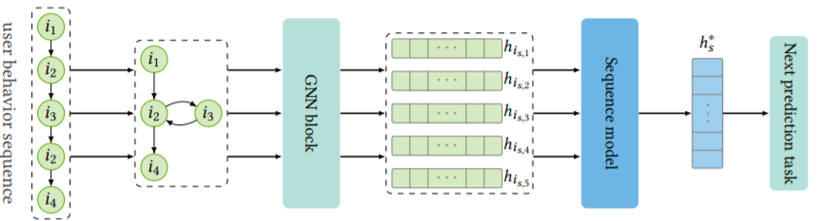
UT Dallas CS6301 Special Topics in Computer Science
Graph Neural Networks losing weight
LightGCN: Simplifying and Powering Graph Convolution Network for Recommendation
Empirically find that the two most common designs in GCNs — feature transformation and nonlinear activation — contribute little to the performance of collaborative filtering.
Even worse, including them adds to the difficulty of training and degrades recommendation performance.
Therefore, we introduce LightGCN, including only the most essential component in GCN — neighborhood aggregation — for collaborative filtering.
‹#›
source:[6] LightGCN: Simplifying and Powering Graph Convolution Network for Recommendation https://arxiv.org/abs/2002.02126

Slide 15
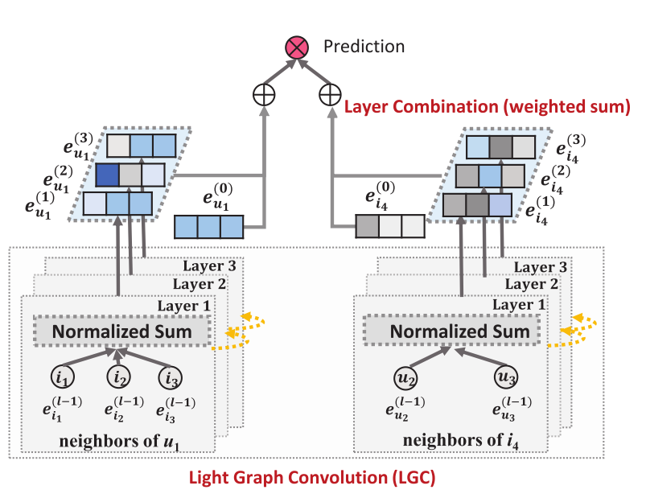
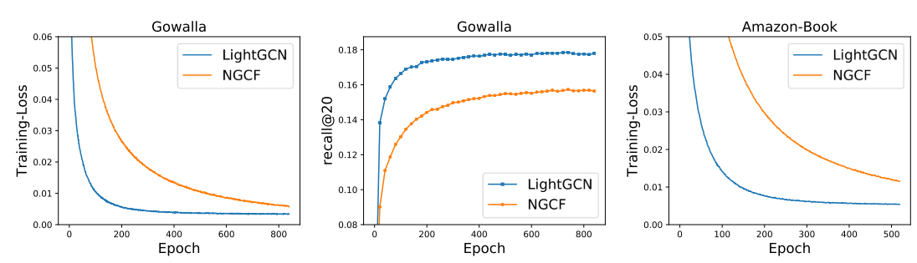
UT Dallas CS6301 Special Topics in Computer Science
LightGCN
learns user and item embeddings by linearly propagating them on the user-item interaction graph, and uses the weighted sum of the embeddings learned at all layers as the final embedding.
Consists of two essential components — light graph convolution and layer combination.
Not just lighter but better as well.
‹#›
source:[6] LightGCN: Simplifying and Powering Graph Convolution Network for Recommendation https://arxiv.org/abs/2002.02126

Slide 16
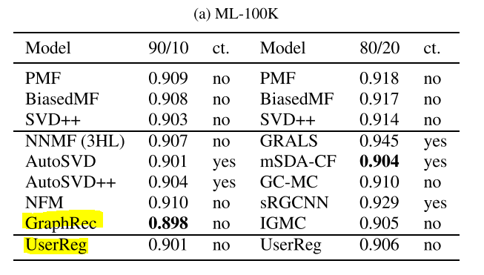
UT Dallas CS6301 Special Topics in Computer Science
USERREG: Matrix Factorization counter strike?
With the raise of GNN, does that mean the end of matrix factorization? Not yet!
A simple linear model based on Matrix Factorization (MF), called UserReg, which regularizes users’ latent representations with explicit feedback information for rating prediction.
Result like the right figure, deep learning does not guarantee a stronger model while also being computational complex.
The first group are baselines, whereas the second group are newly proposed models, all are shown in ascending order by year of publication. ct. indicates whether content information is needed for the corresponding model.[7]
‹#›
source:[7]:USERREG: A SIMPLE BUT STRONG MODEL FOR RATING PREDICTION: https://arxiv.org/abs/2102.07601

Slide 17
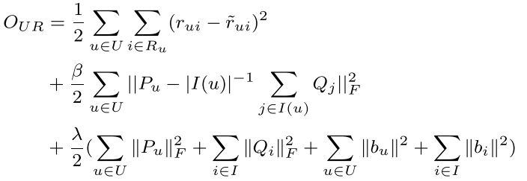
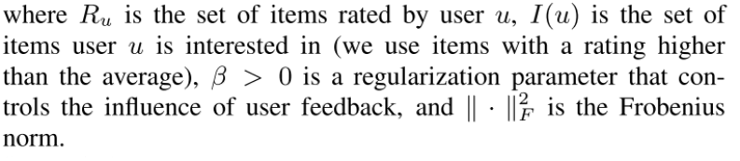
UT Dallas CS6301 Special Topics in Computer Science
USERREG: Matrix Factorization counter strike?
Similar to the previous works,(1) rating is not only related to user u and item i but also to other items that user u has shown interest in (e.g. items that received high ratings by user u )(2) the latent feature vector of user u should be close to the set of items of interest to that user
why is userreg so effective?
UserReg effectively makes use of user explicit feedback to regularize user representation in MF in order to improve recommendation accuracy.
‹#›
source:[7]:USERREG: A SIMPLE BUT STRONG MODEL FOR RATING PREDICTION: https://arxiv.org/abs/2102.07601

Slide 18
UT Dallas CS6301 Special Topics in Computer Science
Link Prediction Approach to Recommender Systems
Remaining issue: The standard recommender system methods suffer from the problems of sparsity and scalability.
Link prediction measures involve computations pertaining to small neighborhoods in the network, this approach would lead to a scalable solution to recommendation.
Problem within the link prediction model: link prediction problem is modelled as a binary classification task whereas the problem of recommender systems is solved as a regression task in which the rating of the link is to be predicted.
Solution: Predicting top k links as recommendations with high ratings without predicting the actual rating.
‹#›
source:[8]:Link prediction approach to recommender systems https://arxiv.org/abs/2102.09185

Slide 19
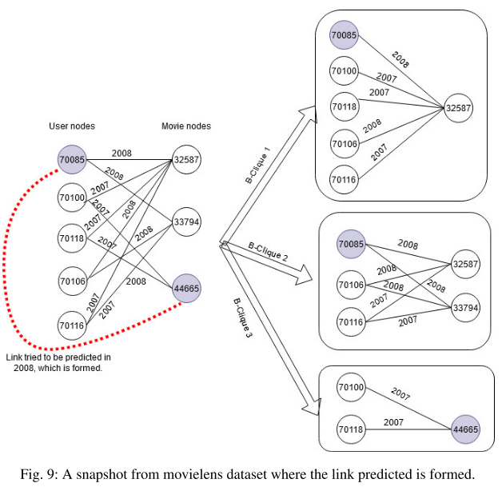
UT Dallas CS6301 Special Topics in Computer Science
Link Prediction Approach to Recommender Systems
Link prediction model can not predict actual rating of the link.
Issue left for the recommendation system: cold-start problem.
Solution: Neural content-aware collaborative filtering
‹#›
source:[8]:Link prediction approach to recommender systems https://arxiv.org/abs/2102.09185

Slide 20
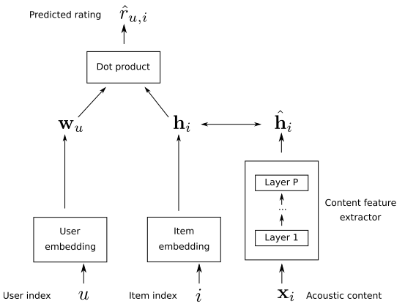
UT Dallas CS6301 Special Topics in Computer Science
Neural content-aware collaborative filtering for cold-start music recommendation
Content-aware recommendation addresses cold-start issue by incorporating content information about the songs on top of collaborative filtering
However, methods falling in this category rely on a shallow user/item interaction that originates from a matrix factorization framework
Solution: a generative model which leverages deep learning for both extracting content information from low-level acoustic features and for modeling the interaction between users and songs embeddings.
Proposed NCACF models in the specific case where the interaction model reduces to a product between the user and item embeddings, in its relaxed variant. [9]
‹#›
source:[9]Neural content-aware collaborative filtering for cold-start music recommendation https://arxiv.org/abs/2102.12369

Slide 21
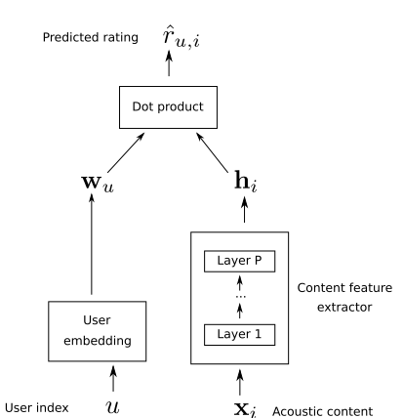
UT Dallas CS6301 Special Topics in Computer Science
Neural content-aware collaborative filtering for cold-start music recommendation
The deep content feature extractor can either directly predict the item embedding, or serve as a regularization prior, yielding two variants (strict and relaxed) of our model.
In the strict variant, the deep content feature extractor directly predicts the item embedding while In the relaxed variant, it serves as a regularization prior for the item embedding.
Proposed NCACF models in the specific case where the interaction model reduces to a product between the user and item embeddings, in its stricted variant. [9]
‹#›
source:[9]Neural content-aware collaborative filtering for cold-start music recommendation https://arxiv.org/abs/2102.12369

Slide 22
UT Dallas CS6301 Special Topics in Computer Science
References
[1] Yehuda Koren. 2008. Factorization meets the neighborhood: a multifaceted collaborative filtering model. In KDD. 426–434.
https://dl.acm.org/doi/10.1145/1401890.1401944
[2]Graph neural networks in recommender systems: a survey
https://arxiv.org/abs/2011.02260
[3]Neural collaborative filtering
https://arxiv.org/abs/1708.05031
[4] BERT4Rec: sequential recommendation with bidirectional encoder representations from transformer
https://arxiv.org/abs/1904.06690
[5] Jacob Devlin, Ming-Wei Chang, Kenton Lee, and Kristina Toutanova. 2018. BERT: Pre-training of Deep Bidirectional Transformers for Language Understanding. CoRR abs/1810.04805 (2018).
[6] LightGCN: Simplifying and Powering Graph Convolution Network for Recommendation
https://arxiv.org/abs/2002.02126
[7]:USERREG: A SIMPLE BUT STRONG MODEL FOR RATING PREDICTION:
https://arxiv.org/abs/2102.07601
[8]:Link prediction approach to recommender systems
https://arxiv.org/abs/2102.09185
[9]Neural content-aware collaborative filtering for cold-start music recommendation
https://arxiv.org/abs/2102.12369
‹#›

