Slide 1
Cesium: Cardiac Toxin and Radiological Threat
Bob Hoffman
New York City Poison Center, NY, USA

Slide 2
Overview
Chemistry
  Elemental
  Inorganic salts
  Radiological
Toxicity
Diagnosis
Treatment

Slide 3
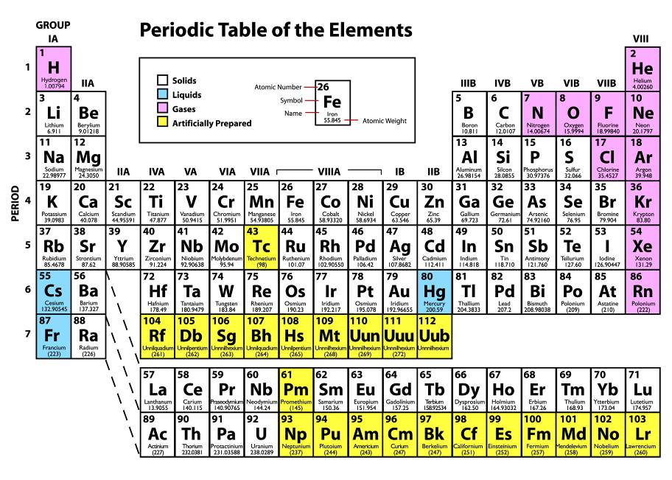

Slide 4
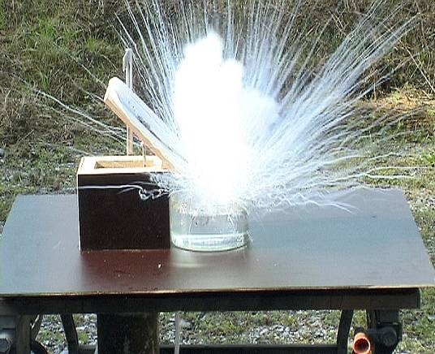
Elemental Cesium
Solid at 298K
Liquid slightly above that
Highly reactive with water

Slide 5
Chemistry
Alkali Metal
  Similar to potassium
  Very strong base – dissolves glass
Period 6
  Similar to thallium
Most Important Radioisotope
  ¹³⁷Cs (also ¹³⁴Cs)
  γ and β⁻ to ¹³⁷Ba
  Radiological half-life about 30 years

Slide 6
Toxicity
Popularized by alternative medicine groups
Reported to be effective against a variety of cancers
Mechanism:
  Altering intracelluar pH of cancer cells???
Also promoted for general detoxification

Slide 7
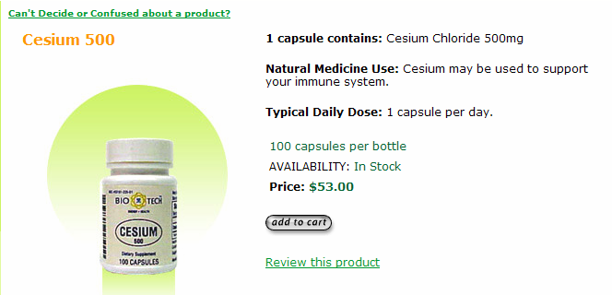

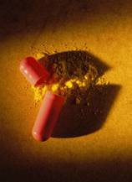

Slide 8
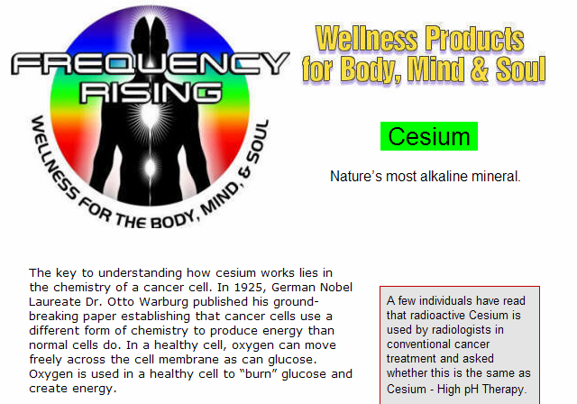

Slide 9
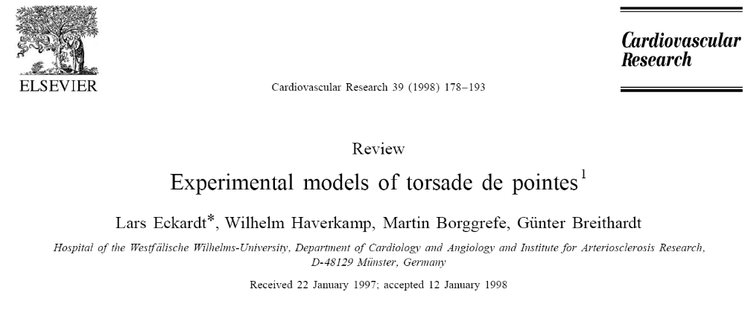

Slide 10
Mechanism
Cesium delays repolarization
  Reduces potassium rectifying currents (I_{k})
Produces two types of early after-depolarizations (EADs)
  Prolonged phase 2 (-30mv)
  During phase 3 (-60mv)
  Suppressed by K channel openers
    Pinacidil

Slide 11
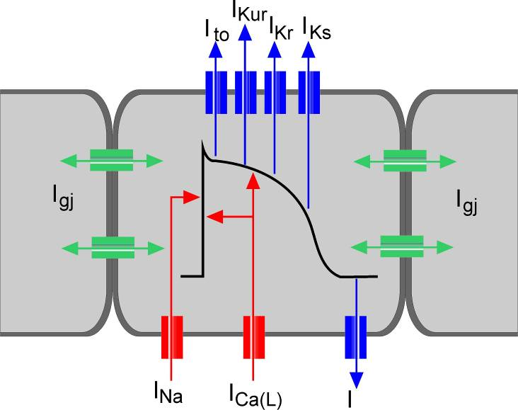

Slide 12
Net Result
Variety of arrhythmias
  Atrial fibrillation
  Ventricular tachycardia
  Torsades de pointes

Slide 13
A 62-year-old man with recurrent syncope
2000 mg of CsCl QID IV x 2 weeks for prostate CA then 1000 mg PO TID
ECG showed a QT of 700 msec
Runs of TdP were recorded on telemetry
Level: 830 μmol/L (0.0045- 0.0105)
Stoped taking cesium chloride
6 months later QTc was normal

Slide 14
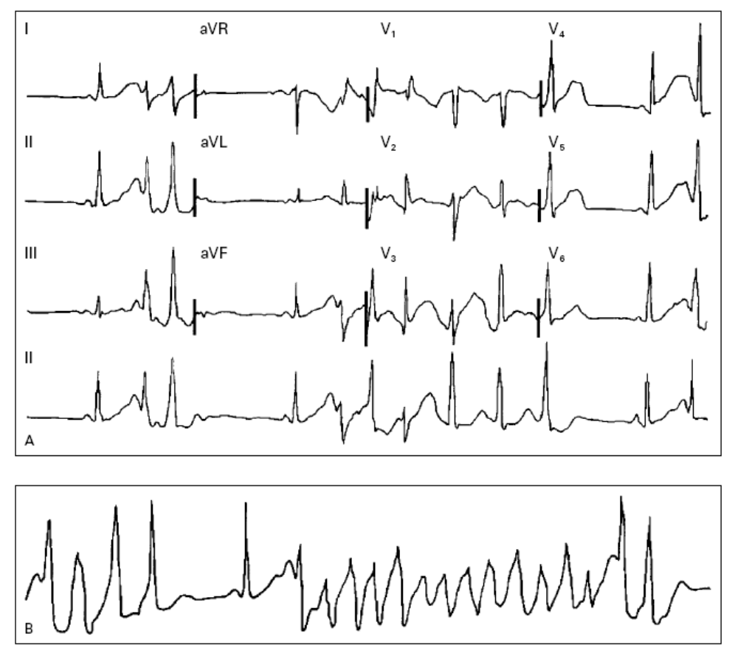
Pinter A: Cesium-induced torsades de pointes. N Engl J Med 2002;346:383-4.

Slide 15
Literature Review
6 papers documenting 6 case individual reports
All patients used cesium salts as either alternative therapy for cancer, prevention of cancer, or detoxification
Typical doses around 1-3 gram/day
  As much as 9 gram/day
Tendency for hypokalemia

Slide 16
Vyas H: Acquired long QT syndrome secondary to cesium chloride supplement. J Altern Complement Med 2006;12:1011
Curry TB: Acquired long QT syndrome and elective anesthesia in children. Paediatr Anaesth 2006;16:471
Dalal AK: Acquired long QT syndrome and monomorphic ventricular tachycardia afteralternative treatment with cesium chloride for brain cancer. Mayo Clin Proc. 2004;79:1065
Lyon AW: Cesium toxicity: a case of self-treatment by alternate therapy gone awry. Ther Drug Monit 2003;25:114
Pinter A: Cesium-induced torsades de pointes. N Engl J Med 2002;346:383
Saliba W: Polymorphic ventricular tachycardia in a woman taking cesium chloride. Pacing Clin Electrophysiol 2001;24(4 Pt 1):515

Slide 17
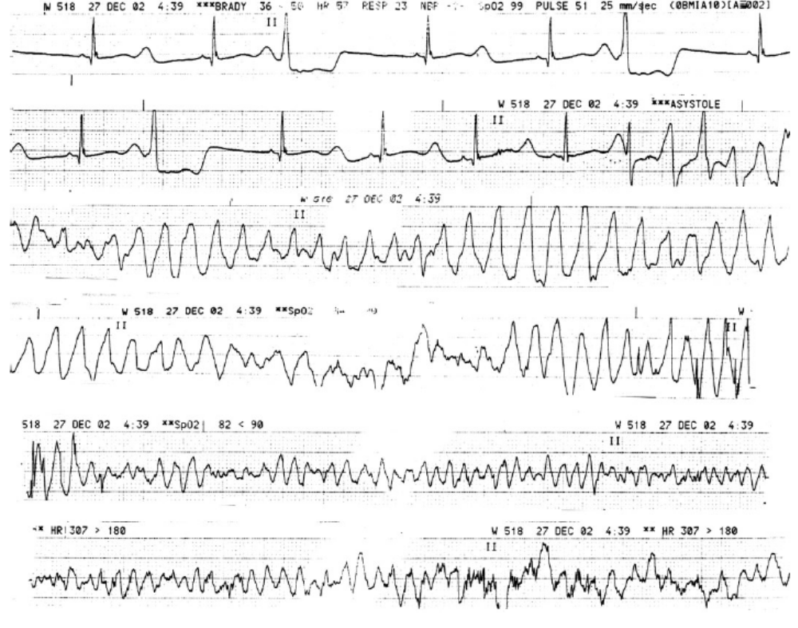

Slide 18
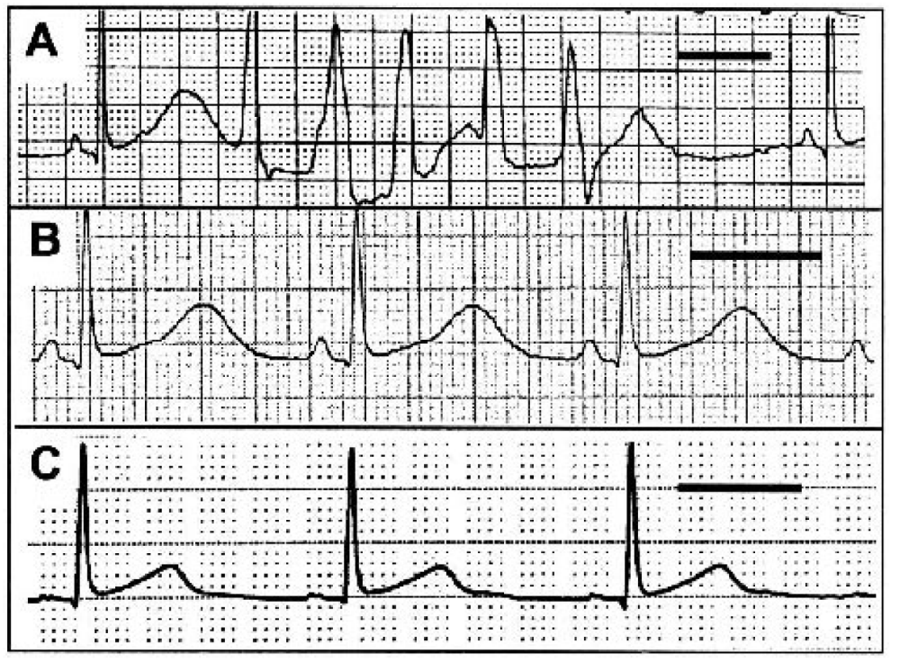

Slide 19
Treatment (experimental)
Good response to magnesium
  Kaseda S: Am Heart J 1989;118:458
  Bailie DS: Circulation 1988;77:1395
May not respond to overdrive pacing
  Nayebpour M: Cardiovascular and metabolic effects of caesium chloride injection in dogs--limitations as a model for the long QT syndrome. Cardiovasc Res 1989;23:756.

Slide 20
Treatment (clinical)
Supplemental potassium: 4/6
Supplemental magnesium: 4/6
Lidocaine: 2/6
Electrical cardioversion/defibrillation: 1/6

Slide 21
Radioactive Cesium

Slide 22
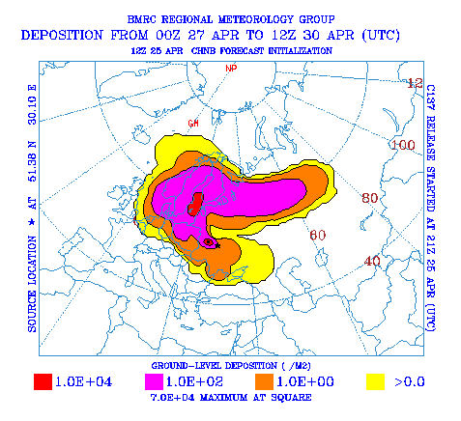
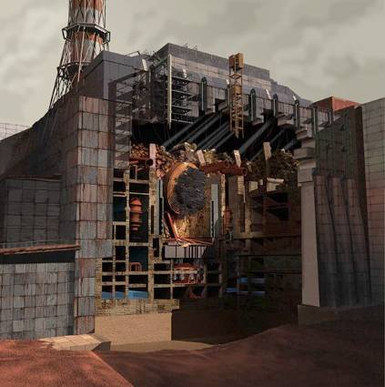
Chernobyl - 1986

Slide 23
The Brazilian Event
In 1985, the Goiania Institute of Radiotherapy discarded an obsolete ¹³⁷Cs teletherapy unit
In September of 1987, scavengers dismantled the machine and sent it to a junk yard
5 days later a junkyard worker pried open the lead canister to reveal a pretty blue, glowing dust: radioactive ¹³⁷Cs (~90 gm)
The material was widely distributed

Slide 24
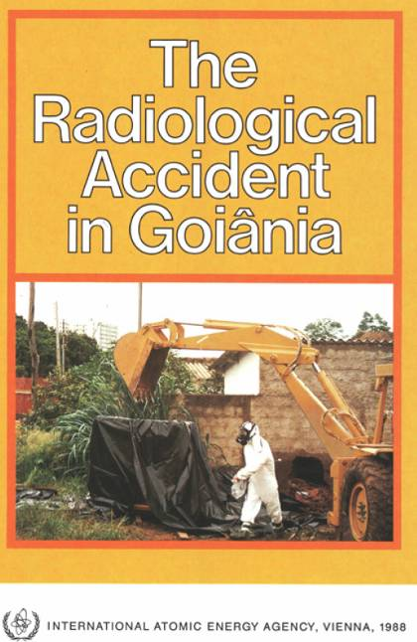
www.pub.iaea.org/MTCD/publications/PDF/Pub815_web.pdf
www.pub.iaea.org/MTCD/publications/PDF/eprmedt/Day_4/Day_4-18.pps

Slide 25
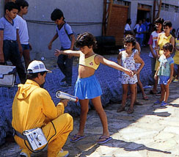
Medical Monitoring
112,000 people (10% of the population)

Slide 26
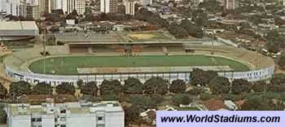
Consequences
250 were identified as contaminated
  50 were isolated inside the Olympic Stadium
  20 were hospitalized or transferred to special housing with medical and nursing assistance
  8 were transferred to the Navy Hospital in Rio de Janeiro
  4 died

Slide 27
Dose assessment by cytogenetics
Dose (Gy)
Number of individuals
< 0.1 - 0.49
105
0.50 - 0.99
8
1.00 - 1.99
8
2.00 - 2.99
3
3.00 - 3.99
2
4.00 - 4.99
2
5.00 - 5.99
1
Total
129
Notes:
The type of exposure of the people involved in the Goiânia accident was complicated to evaluate, since two weeks had elapsed between the breaching of the source and the discovery of the accident. Most of the affected individuals received the exposure during a prolonged period, either fractionated or protracted at varying dose rates. Thus, the exposure was chronic rather than acute, and their total doses were, in many cases, also due to exposure from caesium external and internal contamination. In order to assess the absorbed radiation doses of individuals involved in the accident, peripheral blood lymphocytes from 129 persons were scored, using the technique of cytogenetic dosimetry, for unstable chromosomal aberrations.
No dose response curve for low dose rate ¹³⁷Cs was available during the course of the critical, emergency period of the accident. The doses were assessed through a dose-response curve generated for ⁶⁰Co g-rays at a dose rate of 0.12 Gy min⁻¹. The main limitation for the use of this curve is the fact that it was built for a dose range of 0.5-4 Gy. Some individuals had received higher doses.
After the critical period of the accident, a new in vitro calibration curve was generated for ⁶⁰Co. The doses were then reassessed, using the frequencies of unstable aberrations initially observed in the subjects.

Slide 28
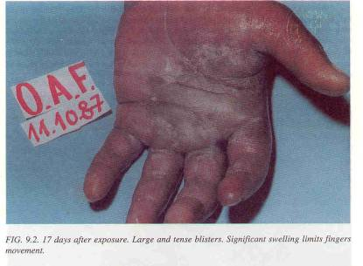
Consequences
Radiation induced skin injuries observed in 28 patients

Slide 29
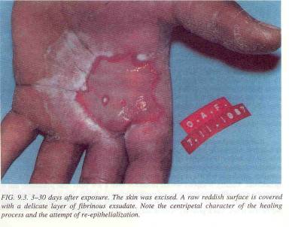
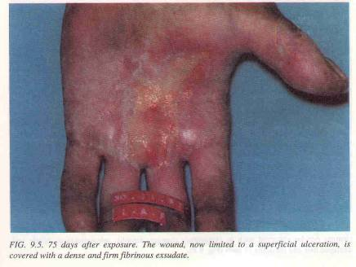

Slide 30
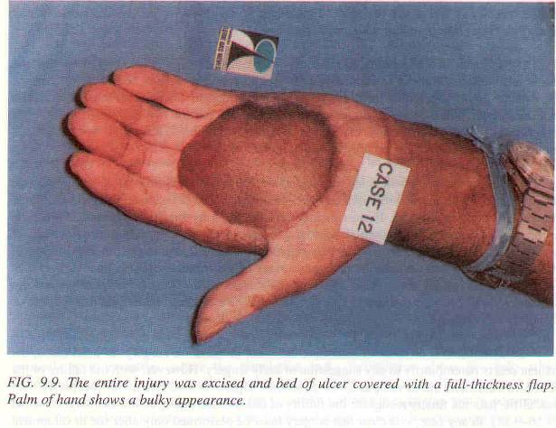

Slide 31
Consequences
Widespread contamination of downtown Goiania
External exposure to members of the public
Four main foci of contamination identified:
  3 junkyard
  1 residence
  Total 5000 m³ of waste
85 residences found to have significant levels of contamination
  41 of these were evacuated and a few were completely or partially demolished

Slide 32
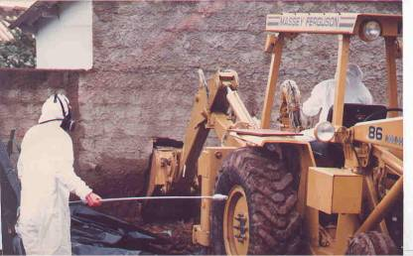
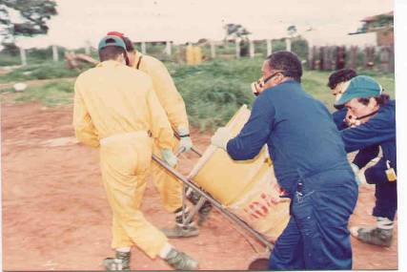
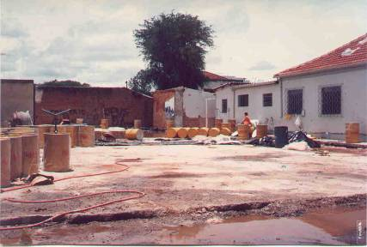

Slide 33
Nuclear Terrorism
In 1995 a Chechen military commander arranged for a dispersal bomb containing ¹³⁷Cs to be found in a Moscow park
Bomb never detonated – scare tactic
  It was real device, though

Slide 34
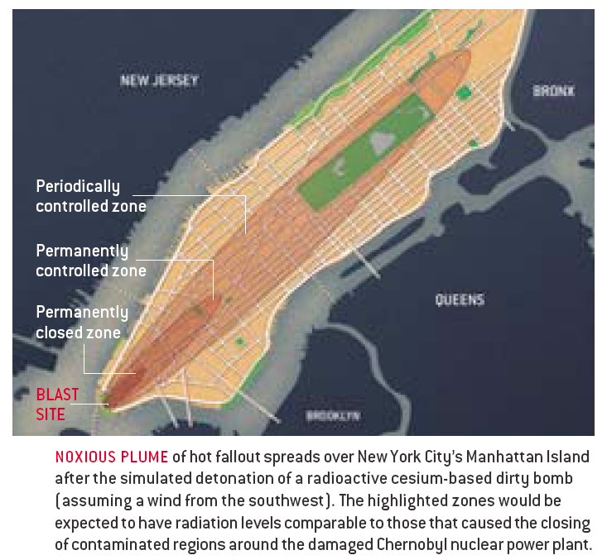

Slide 35
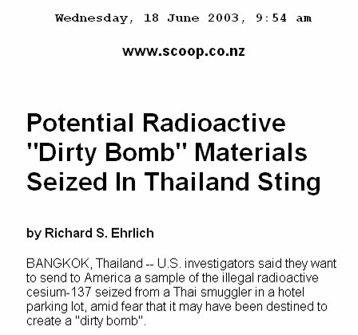

Slide 36
Cesium Kinetics
Well absorbed in the small bowel
Distributes like potassium
Undergoes enteric recirculation
Elimination
  80% in the urine
  20% in the feces

Slide 37
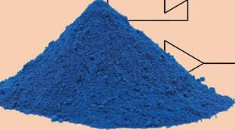
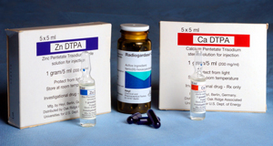

Treatment
(Also possible for non radioactive Cs)

Slide 38
Prussian Blue
Crystal lattice
Takes up cationic potassium ions from the surrounding environment
Affinity increases as the ionic radius of the monovalent cation increases

Slide 39
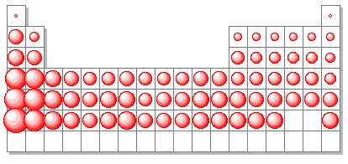
Ionic Radii
K
Cesium
Thallium

Slide 40
Binding
Prussian blue preferentially binds:
  Cesium (ionic radius 0.169 nm)
  Thallium (ionic radius 0.147 nm)
  Rubidium (ionic radius 0.148 nm)
Over potassium (ionic radius 0.133 nm)
  Kravzov J: J Appl Toxicol 1993;13:213-216
In vitro MAC 238 mg ¹³⁷Cs/gm Prussian blue

Slide 41
Small Animal Data
Prussian blue therapy
  Reverses the urine to stool elimination ratio from 8:1 to 0.3:1
  Reduces the biological half-life
  Reduces total body AUC by as much as 60%
  Reduces retained cesium at a given endpoint

Slide 42
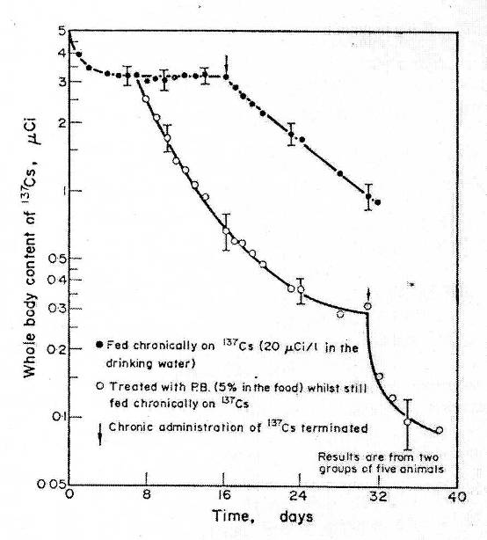
Stather JS: Health Physics 1972;22:1-8

Slide 43
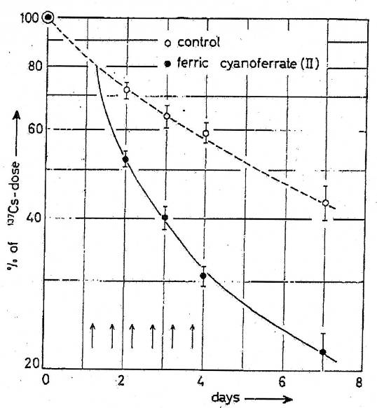
Nigrovic V: Int J Radiat Biol Relat Stud Phys Chem Med 1963;96:307-9

Slide 44
Large Animal Data
Daily Prussian blue therapy
  Reduced radiocesium in sheep by as much as 42%
  Reduced radiocesium transfer to milk in cows by 85%
  Reduced the amount of radiocesium in meat from pigs fed contaminated whey

Slide 45
Human Volunteers
Two human volunteers feed ¹³⁴Cs
Control
  At 14 days they retained 94.7% of the ingested dose
Prussian blue
  At 14 days they retained 5.1% and 4.9% of the ingested dose
  Dresow B: J Toxicol Clin Toxicol 1993;31:563-569.

Slide 46
Human Volunteers
Two volunteers given ¹³⁴Cs
Prussian given 10 minutes before
  Absorption decreased from 100% to 3-10%.
Prussian given simultaneously
  Absorption decreased from 100% to 38-63%
Prussian blue given 0.5 g Q8H post absorption
  Biological half-life of reduced from 106 to 44 days
  Nielsen P: Arzneimittelforschung 1991;18:821-826.

Slide 47
Goiânia Victims
37 patients given Prussian blue
  3g/day in children up to 10g/day in adults
Untreated, half-lives
  39 to 106 days in adults
    Mean 65.5 days in women and 83 days in men
Treatment
  Reduced half-lives by a mean of 32%
  Reduced the retained cesium dose 51-84%
  Oliveira AR: Health Phys 1991;60:17-24.

Slide 48
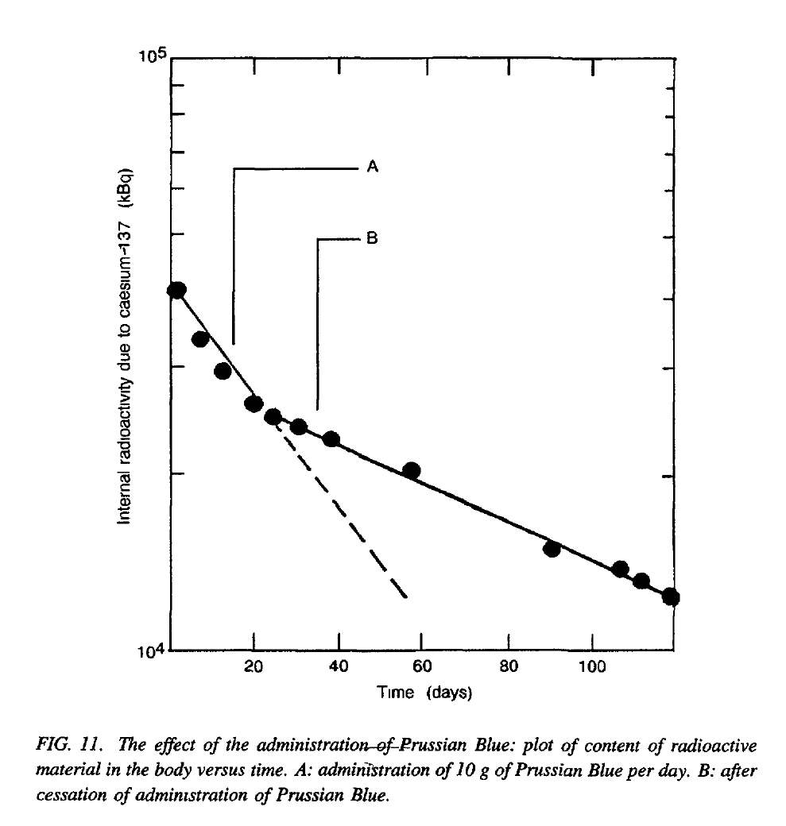

Slide 49
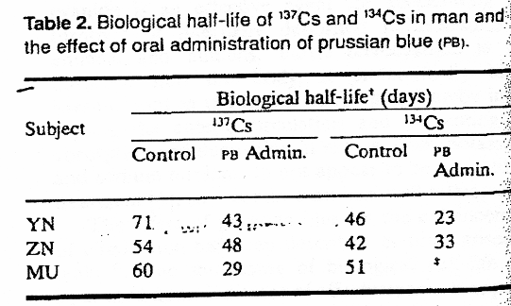
Chernobyl Victims
3 Chinese victims of radiocesium incorporation treated many weeks after their exposure
  Ming-Hua T: J Radiol Protect 1988;8:25-28

Slide 50
Prussian Blue
Dosing Recommendations
  Adults: 9 grams daily (3 grams TID)
  Children: 3 grams daily (1 gram TID)
Duration
  30 day minimum (radiocesium)
  Longer based on monitoring
  No clear endpoint

Slide 51
From Olshansky
(but for Zilker)
Cesium, ‘tis of thee.
Thy ‘positivity, Of thee I sing.
Thou whose hydroxide
Dissolved my wife, when she died.
Glorious too, for suicide
Here . . death, is thy sting.—

