Slide 1
cesium
BAMBASOVÁ LENKA

Slide 2
cesium
Symbol: Cs
number: 55
Atomic weight: 132.90545 (2)
name: Alkali metal
Period number: 6
Block: s-block

Slide 3
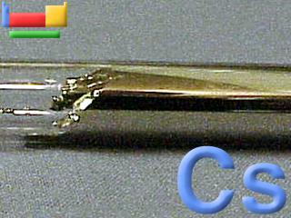
Here is a brief description of cesium
Standard state:
solid at 298 K
Colour: silvery gold
Classification: Metallic

Slide 4
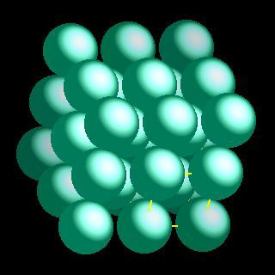
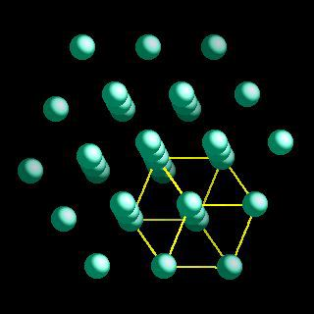
Crystal Structure

Slide 5
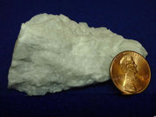
MINERALS
Cesium has only one mineral-
POLUCIT
Formula:
Cs₄Al₄Si₉O₂₆ .H₂O
Another type of formula:
2Cs₂O*2Al₂O_{3 *}9SiO_{2 *}H₂O

Slide 6
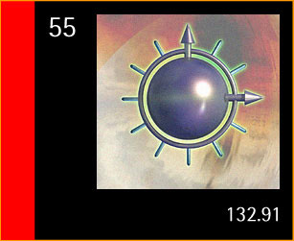
Cs-atomic clock
Discovered :
1860 by R. Bunsen and G. R. Kirchhoff in Heidelberg, Germany
The ‘caesium clock’ (atomic clock) is the standard measure of time:
the electron resonance frequency is 9,192,631,770 cycles per second.

Slide 7
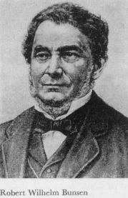
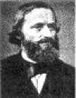
Discoverers

Slide 8
Vocabulary
molten=roztavéná
measure=míra
resonance frequancy=rezonanční kmitočet
formula=vzorec
atomic clock=atomové hodiny

Slide 9
References
http://cs.wikipedia.org/wiki/Cesium
http://www.tabulka.cz/prvky/ukaz.asp?id=55
http://xerius.jergym.hiedu.cz/../cs.html
http://wikipedia.infostar.cz/c/ca/caesium.html

Slide 10

GOODBYE

