Slide 1
phonegap
By John 2012/07/06

Slide 2
Intro
What’s phonegap ?
Getting start ( Android )
Make your own plugin
Supports
Reference

Slide 3
What is phonegap?
An easier way to make mobile apps
Build mobile using web-tech
HTML for layout
CSS and Image for rich look and feel
Make your JavaScript do more

Slide 4
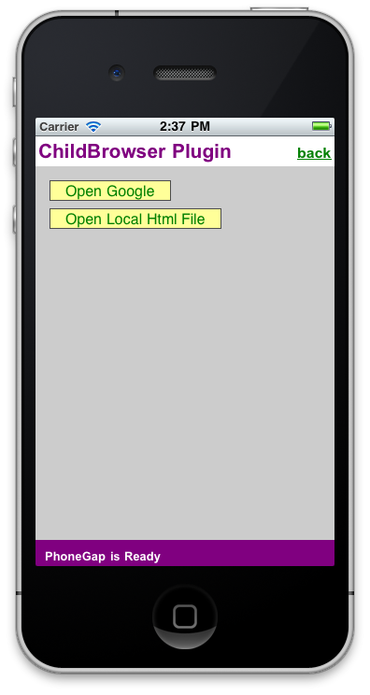
What is phonegap?
Phonegap’s app
OS) 是在寫網頁嗎?
OS) 好low啊
OS) 拜托不要用這個

Slide 5

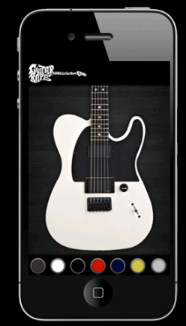
What is phonegap?
OS) 好像有好一點點了
OS) 這也是phonegap ?

Slide 6
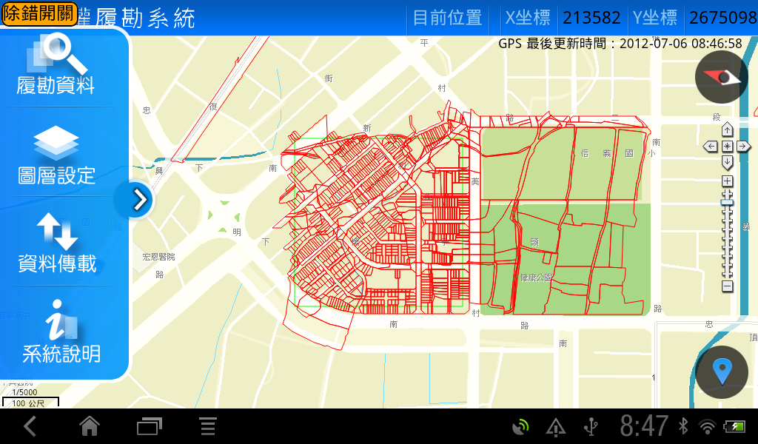
What is phonegap?
Easymap 真是中心一大資產～好東西不繼續用真可惜～～

Slide 7
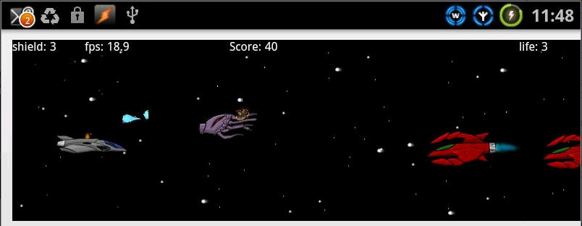
What is phonegap?
A FPS Game !?

Slide 8

What is phonegap?
HTML5 Game (OS : 看起來又不怎好玩~)
GAME LINK

Slide 9
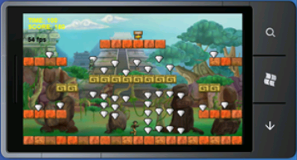
What is phonegap?
弄上手機了!!!!!???

Slide 10
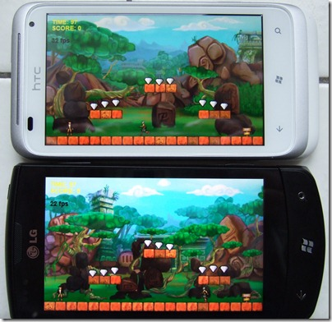
What is phonegap?
How To ?

Slide 11

So…HTM5 Angry Bird !?
?
http://chrome.angrybirds.com/

Slide 12
What is phonegap?
PhoneGap 宗旨：Write once , and deploy it to any mobile device
HomePage : http://phonegap.com/
Now Release : 1.9.0
License : Apache License V2.0
  It will always remain free and open source
  under the Apache License.
Start Weight : 1~1.5MB (Android)
API Docs : http://docs.phonegap.com/en/1.9.0/index.html
PhoneGap is a standards-based, open-source development framework for building cross-platform mobile apps with HTML, CSS and JavaScript for iPhone/iPad, Google Android, Windows Phone 7, Palm, Symbian, BlackBerry and more.
Write a PhoneGap app once with HTML and Javascript and deploy it to any mobile device without losing features of a native app.

Slide 13
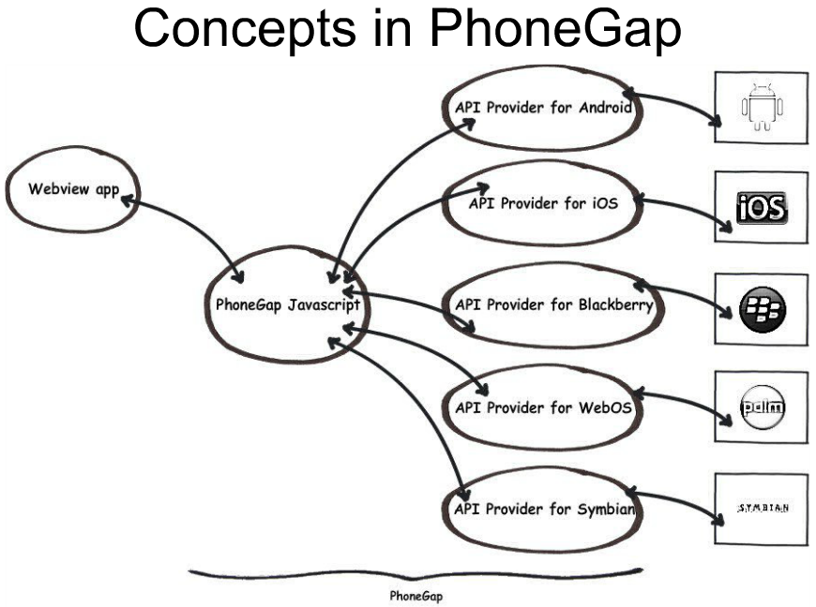
What is phonegap?

Slide 14
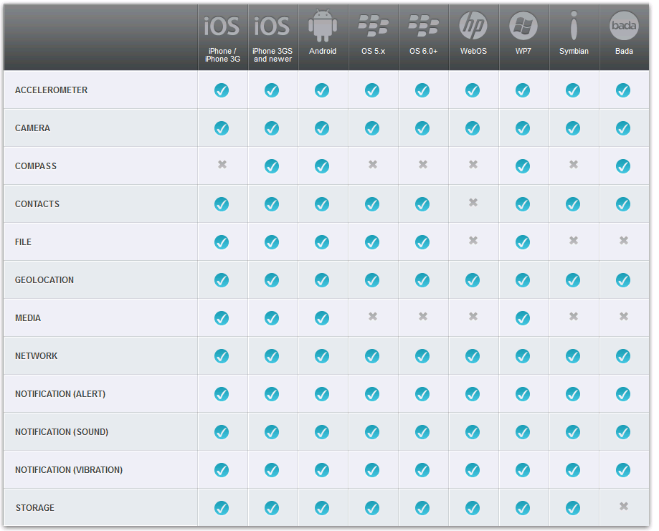
Now Supports

Slide 15
Getting Start (Android) -1
參考
編輯器：Eclipse 3.4+
  請平凡的建置 Android 的開發環境
  (AVD、Android manager…)
新增或使用舊專案
  建立二個目錄
    /libs
    /assets/www
Download phonegap && unzip
Copy cordova-1.9.0.js to assets/www
Copy cordova-1.9.0.jar to /libs
Copy xml to /res

Slide 16
Getting Start (Android) -2
調整AndroidManifest.xml
<uses-permission android:name="android.permission.VIBRATE" />
<uses-permission android:name="android.permission.ACCESS_COARSE_LOCATION" />
<uses-permission android:name="android.permission.ACCESS_FINE_LOCATION" />
……..
設定 assets/www/index.html
<!DOCTYPE HTML>
<html>
<head>
<title>Cordova</title>
<script type=“text/javascript” charset=“utf-8”
src=“cordova-1.9.0.js”></script>
</head>
<body>
<h1>Hello World, 世界你好</h1>
</body>
</html>

Slide 17
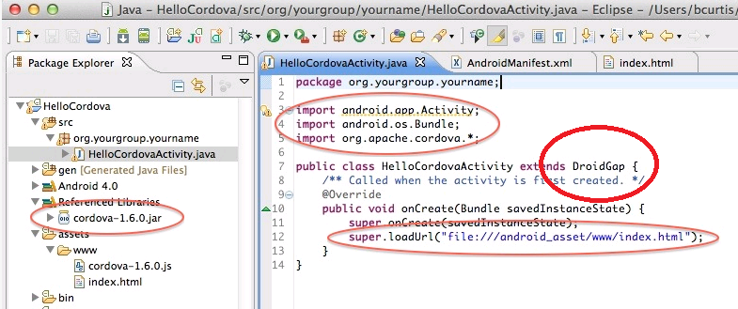
Getting Start (Android) -3
Java Build Path 要指名加掛 cordova

Slide 18
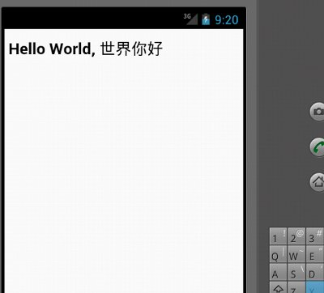
結果…

Slide 19
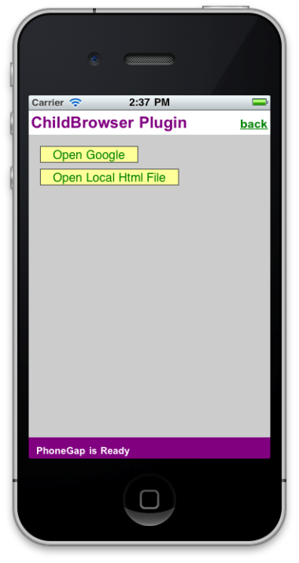
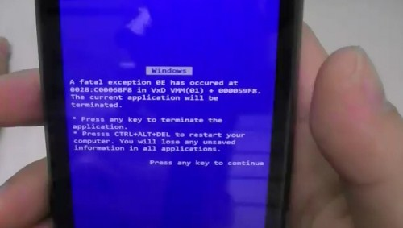
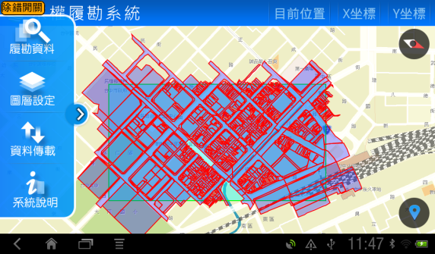
於是～～～

Slide 20

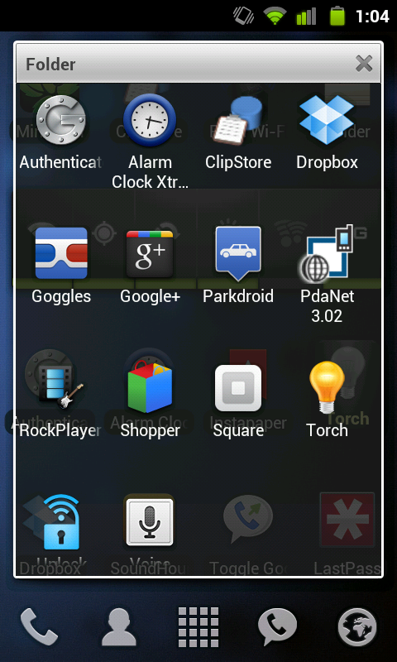
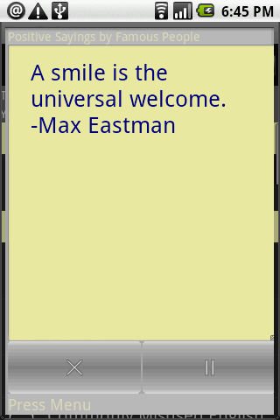
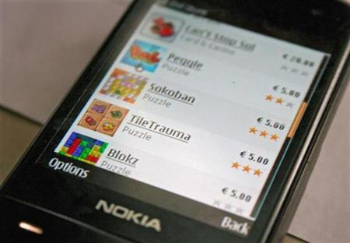
創意與感受

Slide 21
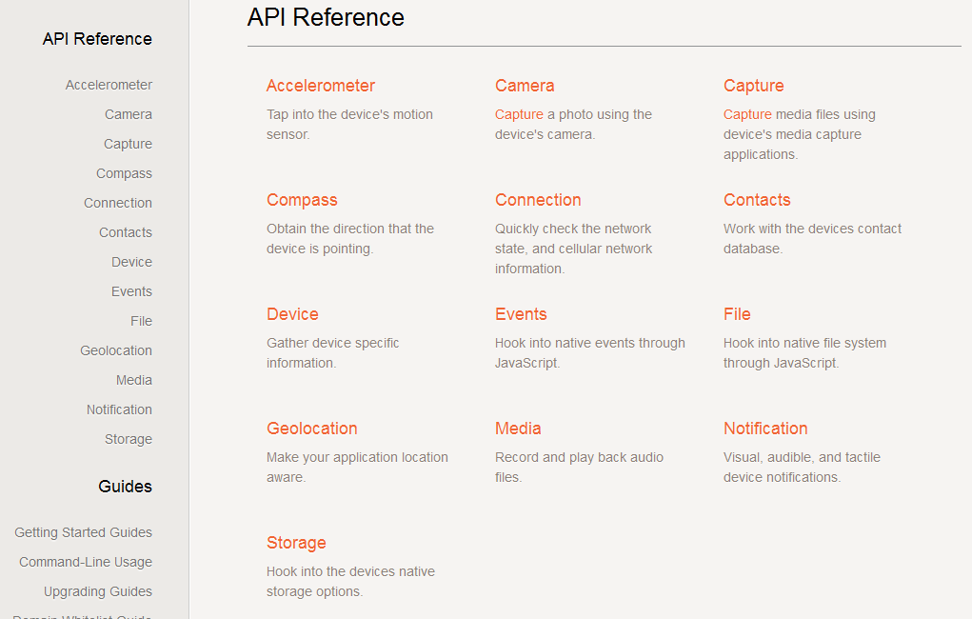
Docs
http://docs.phonegap.com/en/1.9.0/index.html

Slide 22
Make your own plugin-1
試想之～
<script language=“javascript”>
  var SQL=“SELECT * FROM `datas`”;
  $(“#output”).html(dbArray(SQL));
</script>
</head>
<body>
  <div id=“output”></div>
</body>

Slide 23
Make your own plugin-2
試想之～
<script language=“javascript”>
  var data_json=getJson(‘web_service’);
  $(“#name”).html(data_json[0][‘姓名’]);
</script>
</head>
<body>
  姓名：<div id=“name”></div>
</body>

Slide 24
Make your own plugin-3
<script language=“javascript”>
saveToDb(“man_data”,$(“#datas”));
  upload(“http….”,”#datas”,function(data){
  showProcessBar(data.value);
  },function(err){
  alert(err.message();
  });
</script>
<form id=“#datas”>
姓名：<div id=“name”></div>
電話：<div id=“tel”></div>
<input type=“submit” value=“送出”>
</form>

Slide 25
Make your own plugin-4

Slide 26
Make your own plugin-4..
Maps to (From) SQLite
Base64 string images
ContentProvider
Sync、Async Javascript Plugin
Compass
GPS
File assets、sdcard
Http upload、download
……

Slide 27
Make your own plugin-HowTo
1. 寫 native java 接口
2. 於 plugin 註冊該函式
3. 於 javascript 登入使用函式

Slide 28
自編plugin: Native Java Plugin
public class helloWorld extends Plugin {
public PluginResult execute(String action, JSONArray args, String callinglbackId) {
//PluginResult
try{
if(action==“helloWorld”){
String name = args.getString(0);
// sendJavascript(“alert(‘Hello, World!!!’);
PluginResult result = new PluginResult(PluginResult.Status.OK,”Hello World!!”);
return result;
} catch(Exception e) {
return new PluginResult(PluginResult.Status.INVALID_ACTION, "hello missing parameter!");
}
}
public boolean isSynch(String action) {
return true;
}
}

Slide 29
自編plugin:於 plugin 註冊該函式
res/xml/plugins.xml
<plugin name="helloWorld" value="com.phonegap.plugins.helloWorld.helloWorld"/>

Slide 30
自編plugin:於 jscript 註冊該函式
window.plugins.helloWorld. helloWorld(value,
function(win){
data=print_r(win,true);
}
);
如此一來，就有自己定的函式可以使用了~
<script language=“javascript”>
helloWorld();
</script>

Slide 31
自編plugin:於 jscript 註冊該函式
window.plugins.helloWorld. helloWorld(value,
Var data=“”;
function(win){
data=win,true;
}
return data;
);
如此一來，就有自己定的函式可以使用了~
<script language=“javascript”>
helloWorld();
alert(“test”);
</script>

Slide 32
Supports
使用Html、javascript、css 的支援：
有超級多的 framework 如 jQuery、phpjs、extps…。
從古至今很多 javascript 特效，且免費的。
可以自定 javascript 的 plugin 與後端JAVA、硬體溝通，那等同於你的介面幾乎可以作任何事，如 javascript 開、關新的activity 、 檔案 IO、資料庫連線、相機呼叫、指南針、GPS、各種資訊…
且 java 也可以直接 sendJavascript(“alert([json data]);”);
與 webview 溝通!!
原本的webview : webview.load(“javascript:….”);

Slide 33
Supports

Slide 34
心得
PhoneGap 的優勢在於快速成型 UI 的調整。
將畫面以 HTML 編寫至裝置中，也方便與客戶討論。
速度仍輸 Native code，但同時考驗開發者熟悉程度。
Dreamweaver CS 5.5 已支援 phonegap 的開發了。
滑鼠與觸控事件的關係要非常熟悉，平移、雙指縮放、三指使用，也不成問題。
盡可能將預先載入的內容減少。

Slide 35
Reference
Nokia Stars
PhoneGap
EnyoJS
How to create HTML5 applications
Images From Google Search

