Slide 1

Webpack

Slide 2
打包工具
模組化開發

Slide 3




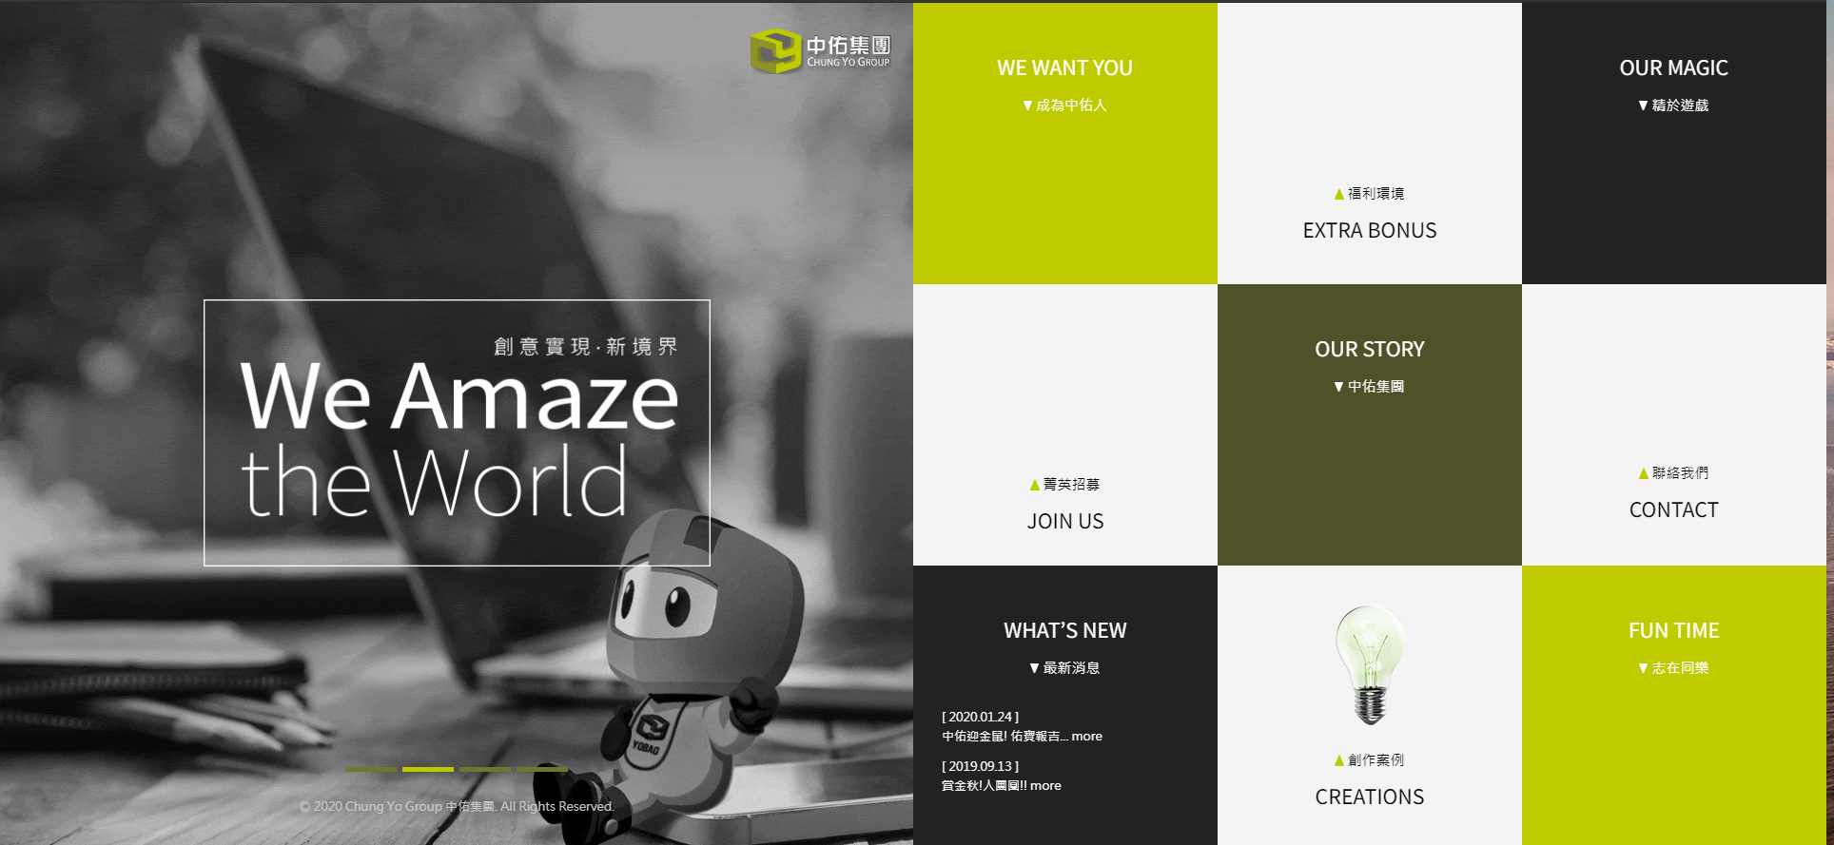

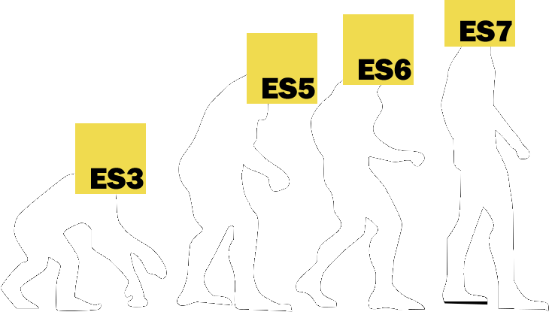


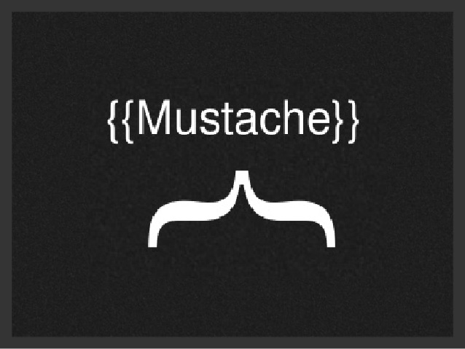
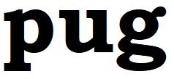

Slide 4
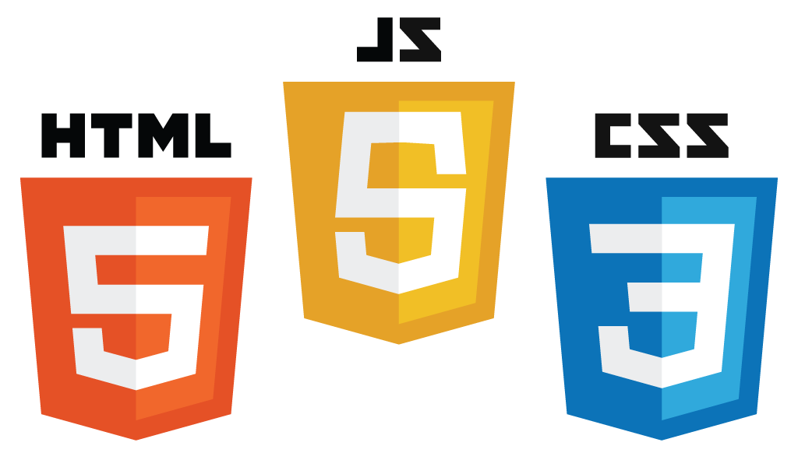


Webpack
NPM
Babel

Slide 5
套件管理工具
安裝、移除、更新套件(ESLint…etc)
查詢、紀錄套件資訊
執行其他 CLI

Slide 6
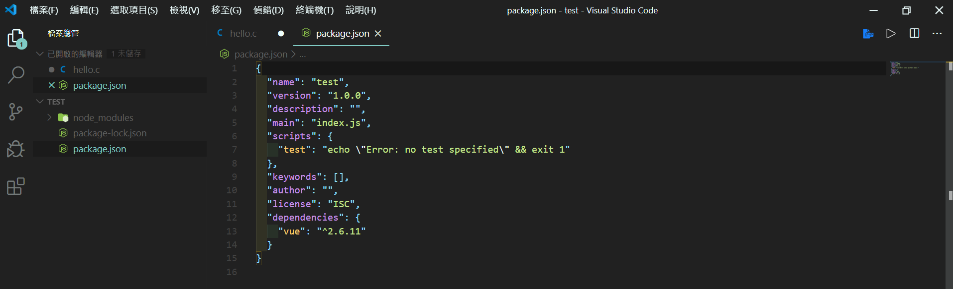
 | 功能
node_modules/ | 存放所有函式庫原始碼
package-lock.json | 紀錄函式庫詳細資訊
package.json | 記錄主程式相關資訊

Slide 7
轉譯器
轉換不同版本的JavaScript

Slide 8
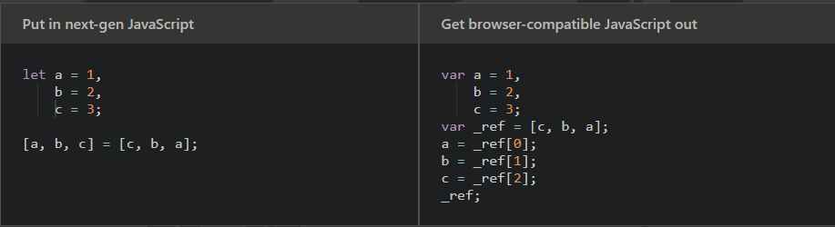
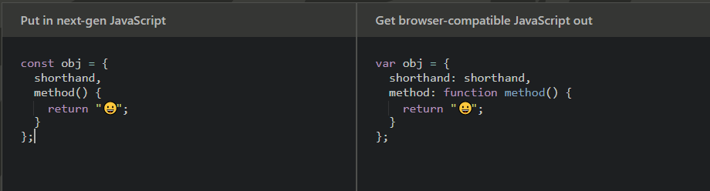

Slide 9
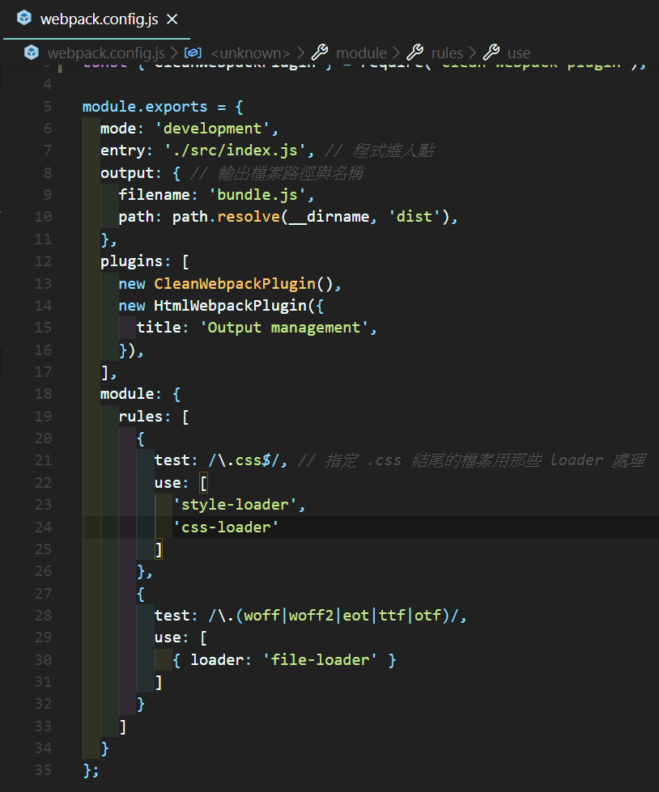
Webpack.config.js
entry
程式的進入點
Output
打包好的程式輸出的位置
plugin
額外的功能套件
loader
針對特定檔案的處理工具

Slide 10
hello!
I am Jayden Smith
I am here because I love to give presentations.
You can find me at @username

Slide 11
1.
Transition headline
Let’s start with the first set of slides

Slide 12
Quotations are commonly printed as a means of inspiration and to invoke philosophical thoughts from the reader.

Slide 13
This is a slide title
Here you have a list of items
And some text
But remember not to overload your slides with content
Your audience will listen to you or read the content, but won’t do both.

Slide 14
Big concept
套件管理工具

Slide 15
You can also split your content
White
Is the color of milk and fresh snow, the color produced by the combination of all the colors of the visible spectrum.
Black
Is the color of coal, ebony, and of outer space. It is the darkest color, the result of the absence of or complete absorption of light.

Slide 16
In two or three columns
Yellow
Is the color of gold, butter and ripe lemons. In the spectrum of visible light, yellow is found between green and orange.
Blue
Is the colour of the clear sky and the deep sea. It is located between violet and green on the optical spectrum.
Red
Is the color of blood, and because of this it has historically been associated with sacrifice, danger and courage.

Slide 17
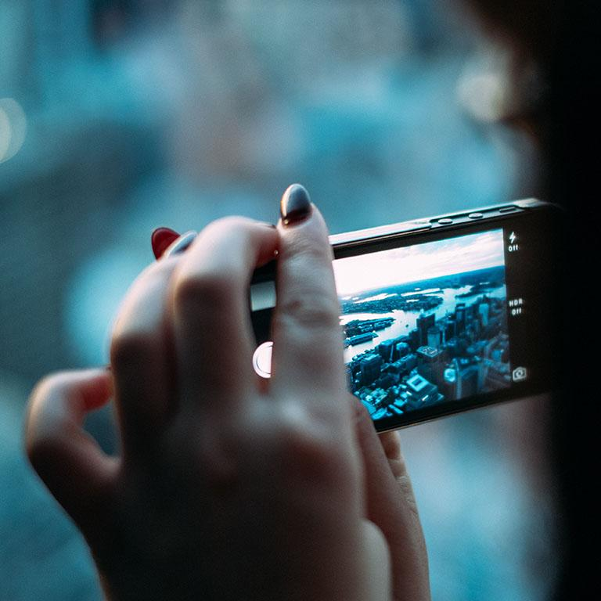
A picture is worth a thousand words
A complex idea can be conveyed with just a single still image, namely making it possible to absorb large amounts of data quickly.

Slide 18
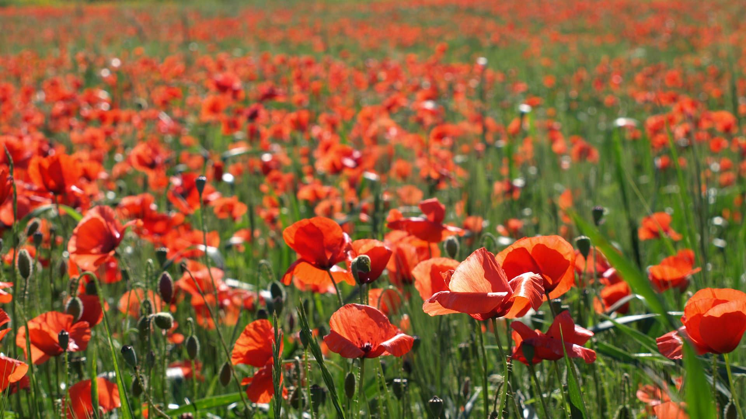
Want big impact?
Use big image.

Slide 19
Use charts to explain your ideas
White
Gray
Black

Slide 20
And tables to compare data
 | A | B | C
Yellow | 10 | 20 | 7
Blue | 30 | 15 | 10
Orange | 5 | 24 | 16

Slide 21
Maps
our office

Slide 22
89,526,124
Whoa! That’s a big number, aren’t you proud?

Slide 23
89,526,124$
185,244 users
100%
That’s a lot of money
And a lot of users
Total success!

Slide 24
Our process is easy
first
second
last

Slide 25
Let’s review some concepts
Yellow
Is the color of gold, butter and ripe lemons. In the spectrum of visible light, yellow is found between green and orange.
Blue
Is the colour of the clear sky and the deep sea. It is located between violet and green on the optical spectrum.
Red
Is the color of blood, and because of this it has historically been associated with sacrifice, danger and courage.
Yellow
Is the color of gold, butter and ripe lemons. In the spectrum of visible light, yellow is found between green and orange.
Blue
Is the colour of the clear sky and the deep sea. It is located between violet and green on the optical spectrum.
Red
Is the color of blood, and because of this it has historically been associated with sacrifice, danger and courage.

Slide 26
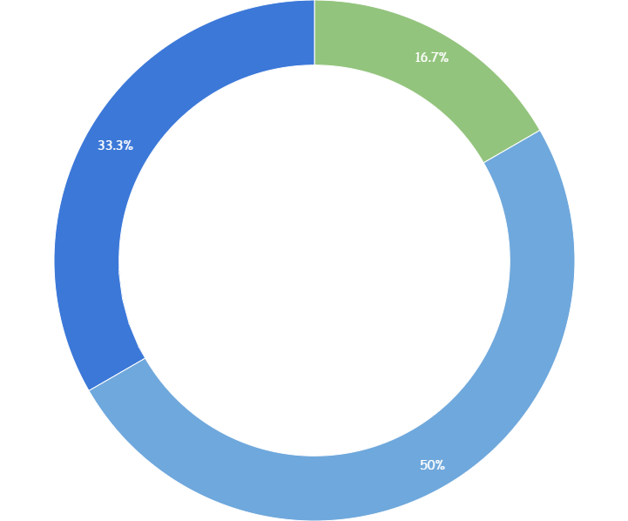
You can copy&paste graphs from Google Sheets

Slide 27
Place your screenshot here
Android project
Show and explain your web, app or software projects using these gadget templates.

Slide 28
Place your screenshot here
iPhone project
Show and explain your web, app or software projects using these gadget templates.

Slide 29
Place your screenshot here
Tablet project
Show and explain your web, app or software projects using these gadget templates.

Slide 30
Place your screenshot here
Desktop project
Show and explain your web, app or software projects using these gadget templates.

Slide 31
thanks!
Any questions?
You can find me at
@username
user@mailme

Slide 32
Credits
Special thanks to all the people who made and released these awesome resources for free:
Presentation template by SlidesCarnival
Photographs by Unsplash

Slide 33
Presentation design
This presentation uses the following typographies:
Titles: Walter Turncoat
Body copy: Sniglet
You can download the fonts on these pages:
https://www.fontsquirrel.com/fonts/walter-turncoat
https://www.fontsquirrel.com/fonts/sniglet
You don’t need to keep this slide in your presentation. It’s only here to serve you as a design guide if you need to create new slides or download the fonts to edit the presentation in PowerPoint®

Slide 34
Extra graphics

Slide 35
SlidesCarnival icons are editable shapes.
This means that you can:
Resize them without losing quality.
Change fill color and opacity.
Isn’t that nice? :)
Examples:

Slide 36
😉
Now you can use any emoji as an icon!
And of course it resizes without losing quality and you can change the color.
How? Follow Google instructions https://twitter.com/googledocs/status/730087240156643328
✋👆👉👍👤👦👧👨👩👪💃🏃💑❤😂😉😋😒😭👶😸🐟🍒🍔💣📌📖🔨🎃🎈🎨🏈🏰🌏🔌🔑 and many more...

Slide 37

Free templates for all your presentation needs
For PowerPoint and Google Slides
100% free for personal or commercial use
Ready to use, professional and customizable
Blow your audience away with attractive visuals

