Slide 1
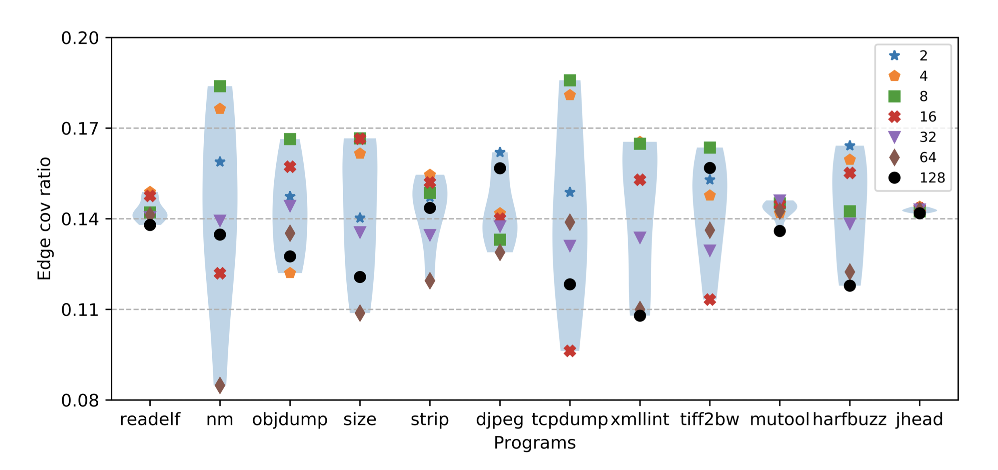
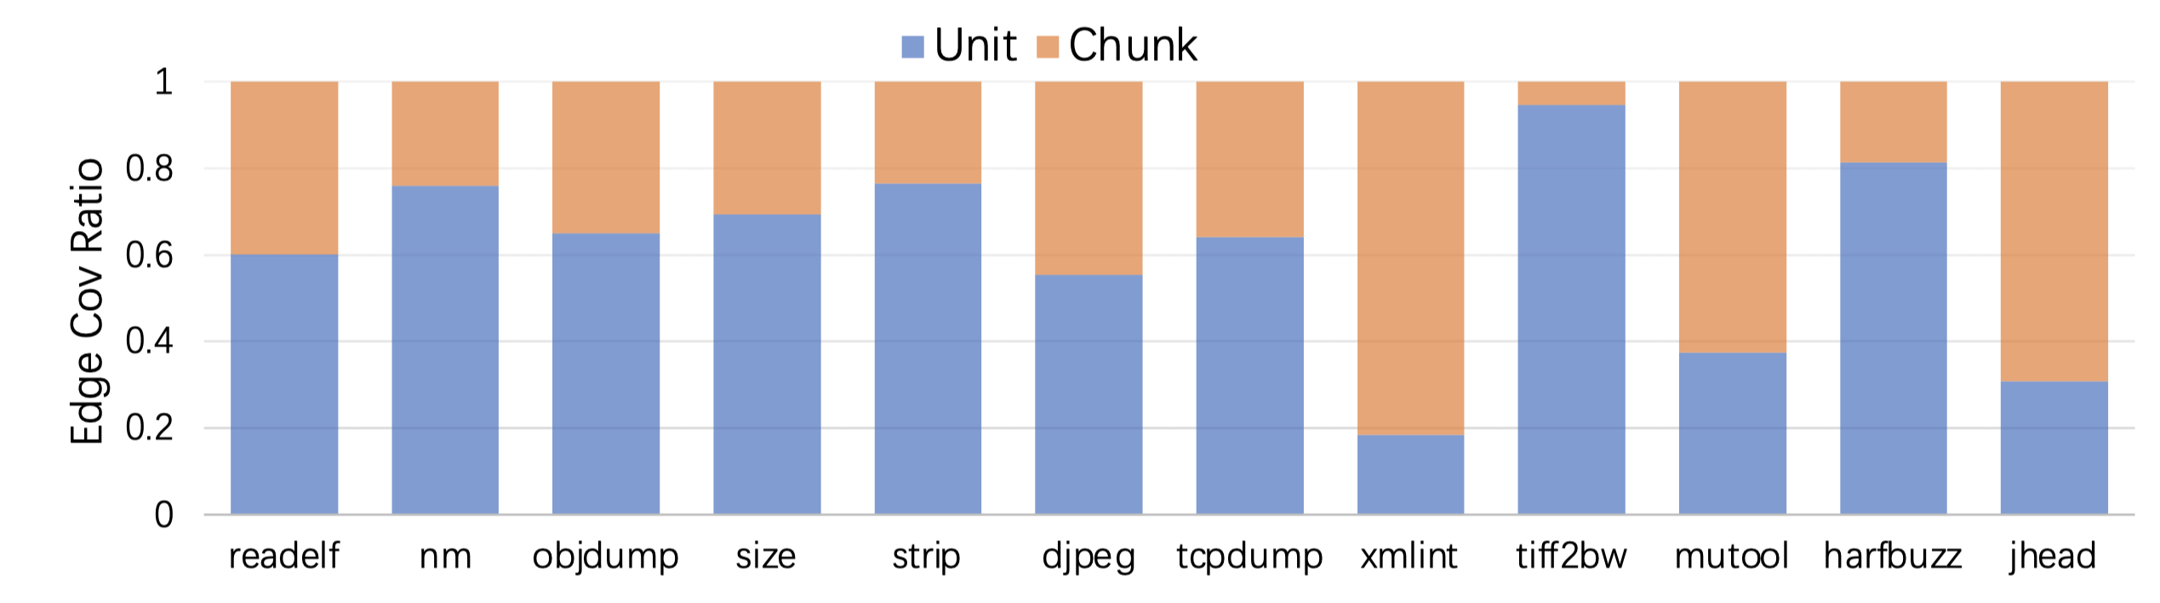
Performance Impact of the Mutator Stacking
Divergent stacking size bias between objdump and djpeg
stacking size
Mutator Stacking determines
and
mutators
Evaluating Havoc under a fixed stacking size.
Stacking size causes divergent optimal edge coverage performance for each project.
Computing edge coverage ratio by either chunk mutators or unit mutators.
Different projects enables divergent distribution of edge coverage ratio.
Divergent mutator bias between xmllint and tiff2bw
Notes:
总起：Note that as a simplified mutation strategy, the mutator stacking mechanism contains two steps: determining stacking size and randomly selecting mutators, to impact the performance of Havoc. We then investigate the performance impact caused by each step
栈大小：We first attempt to investigate the performance impact of stacking size and implement Havoc under a fixed stacking size for all its mutations. This figure presents our evaluation results of the edge coverage ratio results in terms of all the possible fixed stacking size, i.e., 2, 4, 8,...128, on top of all the studied benchmark projects. We can observe that overall, the stacking size which causes the optimal edge coverage performance for each studied project can be quite divergent, e.g., selecting stacking size 8, 2, and 32 can optimize the edge coverage in tcpdump, djpeg, and mutool respectively
Mutator类型：Next, we uniformly select chunk mutators or unit mutators and then randomly select their inclusive mutators under the given stacking size for mutating one seed. This figure presents the edge
coverage ratio results in terms of the selected mutator types on top of all the studied benchmark projects. We can observe that overall, the distribution of the edge coverage ratio performance can be quite divergent among different projects, e.g., the edge coverage ratio of the unit mutators ranges from 18.39% (xmllint) to 94.53% (tiff2bw).

Slide 2



Resource-Efficient Edge Selection Mechanism
Resource-Efficient Edge Selection mechanism identifies the edge worthy being explored for later selecting and mutating its corresponding byte.
b1
Basic blocks
e1
b2
e2
b3
Explored edge
Selected Target Edge
e3
b4
b5
Unexplored edge
Edge Selection Mechanism
Notes:
Basically is about choosing existing edge to calculate gradient.
Intuitively, when one edge can identify the number of its “sibling” edges, such edge number can be a potential indicator whether the given edge should be included for further gradient computation. More specifically, the more “sibling” edges have been explored, the less likely new “sibling” edges can be explored via the gradient computation for the given edge.
For example we have three edges here, which is e1, e2 and e3. basic block here is marked by node and solid line here refers to explored edge, dotted line refers to unexplored edge. For e1 and e2, their sibling edges are all explored so that retrieve gradient information from them might be useless. However, e3 still has an unexplored edge which indicates that mutate the promising byte of e3 can potentially switch to an unexplored edge. Therefore, we add edge e3 to our candidate edge set instead of e1 and e2.
读框

Slide 3
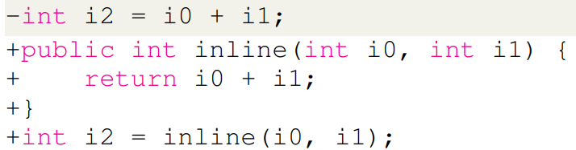


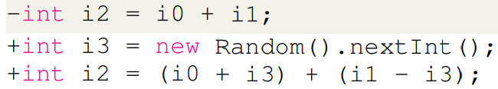
Optimization-activating mutators
Function inlining: merging the instructions of small-scale functions into their callers to reduce the cost of function calls.
Simplification: simplifying an arithmetic expression.
Notes:
In addtion to evolutionary-based fuzzers, researchers proposed neural program-smoothing-based fuzzers to facilitate fuzzing efficacy.
读motivation
读流程图，which requires
读两个图
Recently researchers have proposed two typical neural program-smoothing fuzzers, 读框

Slide 4

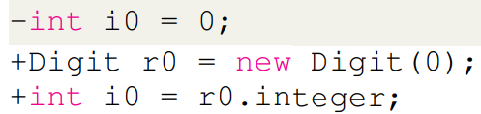

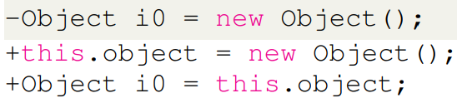
Optimization-activating mutators
Scalar replacement: investigating whether a stack variable can replace an object allocated in the heap in order to save memory resources.
Escape analysis: determining whether an object may escape the method, i.e., is not local to the method.
Notes:
In addtion to evolutionary-based fuzzers, researchers proposed neural program-smoothing-based fuzzers to facilitate fuzzing efficacy.
读motivation
读流程图，which requires
读两个图
Recently researchers have proposed two typical neural program-smoothing fuzzers, 读框

Slide 5

Control-flow-enriching mutators
Statement-wrapping mutator: wrapping a given statement within if and/or loop statement(s) for enriching the control flow and preventing early termination.
int limitation = CNT;
while (CNT >= 0) {
if (true expression) {
Statement;
}
CNT --;
}
if (true expression) {
Statement;
}
Statement;
Notes:
In addtion to evolutionary-based fuzzers, researchers proposed neural program-smoothing-based fuzzers to facilitate fuzzing efficacy.
读motivation
读流程图，which requires
读两个图
Recently researchers have proposed two typical neural program-smoothing fuzzers, 读框

Slide 6
Control-flow-enriching mutators
Transition-injecting mutator: enriching the transitions among basic blocks, i.e., creating new transitions among existing basic blocks.
However, it is likely to cause early-terminated program execution, i.e., the verification error caused by undefined variables.
f1
f2
f7
For example, if we randomly create a transition from to
, this transition definitely causes an undefined variable error and prevents further testing on the deep states of JIT, e.g., the optimization techniques, if depends on the variables defined in its predecessors.
f8
f3
f4
f5
f5
f6
f8
f5
Notes:
In addtion to evolutionary-based fuzzers, researchers proposed neural program-smoothing-based fuzzers to facilitate fuzzing efficacy.
读motivation
读流程图，which requires
读两个图
Recently researchers have proposed two typical neural program-smoothing fuzzers, 读框

Slide 7
Control-flow-enriching mutators
Target: redirecting the transition between two randomly selected basic blocks without causing any errors.
Note that any variables used by basic block is defined either in itself or its dominators. Therefore, the new sink node should be its dominator. But which one we should choose?
, or ?
the immediate post-dominator of their common dominator !
f5
f1
f1
f1
f2
f3
f2
f7
Redirecting to still causes errors if defines variables used in it.
f3
f4
f3
f2
f5
f6
f8
Redirecting to is good but potentially loses diversities.
f1

Slide 8
Phantom creation
How do we reduce dependencies to create a phantom program?
Dominator: a node d of a control-flow graph dominates a node n if every path from the entry node to n must go through d.
①
int a = input(), b = input();
bool cmp1 = (b == 1);
F
②
a = 2; bool cmp2 = (a + b == 3);
T
For example, ① dominates ⑤ and ② dominates ③.
F
T
③
bool cmp3 = (a + b == 4);
Ideally, we aim to relocate all conditional instructions and the instructions affecting them to the program entry point, BUT we cannot!
F
T
⑤
④
T
// do something
bool cmp4 = (a == 2);
⑥
// do something
F
⑦
return 0;
Notes:
research questions in section 3

Slide 9
Phantom creation
①
Question: can we move the instructions in basic block ② to the program entry, which is basic block ①?
int a = input(), b = input();
bool cmp1 = (b == 1);
F
②
a = 2; bool cmp2 = (a + b == 3);
T
F
NO! The semantics of conditional instruction in ⑤ can be changed!
T
③
bool cmp3 = (a + b == 4);
F
⑤ can be relocated to ①, ③ can be relocated to ②.
T
⑤
④
T
// do something
bool cmp4 = (a == 2);
⑥
// do something
F
⑦
return 0;
Solution: we identify the farthest dominator in CFG to which the instructions can be relocated without violating semantics on the conditional instruction.
Notes:
research questions in section 3

Slide 10
Seed scheduling: diversity guidance
We adopt the executed instruction list of a given class file, namely EntryInstruction, as the representative instructions to efficiently measure the diversity (via distance metrics) between JVM class files.
BUT how to measure the distance between JVM class files?
C1
Levenshtein Distance: a metric widely used to derive the “minimum number of single-character edits (insertions, deletions, or substitutions)” between two strings.
I1, I2, I3, I4, ... , In
C2
I1, I3, I4, ... , In
We consider an instruction from EntryInstruction as a “charactler” to calculate Levenshtein distance for different JVM class files.
C1 can be transformed from C2 by only inserting one instruction I2 between I1 and I3. Therefore, their Levenshtein Distance is computed as 1.
Notes:
In addition to evolutionary-based fuzzers, researchers proposed neural program-smoothing-based fuzzers to facilitate fuzzing efficacy.
读motivation
读流程图，which requires
读两个图
Recently researchers have proposed two typical neural program-smoothing fuzzers, 读框

