Slide 1

ECE 445 Group 1
December 2, 2011
George Karavaev – Alex Suchko

Slide 2
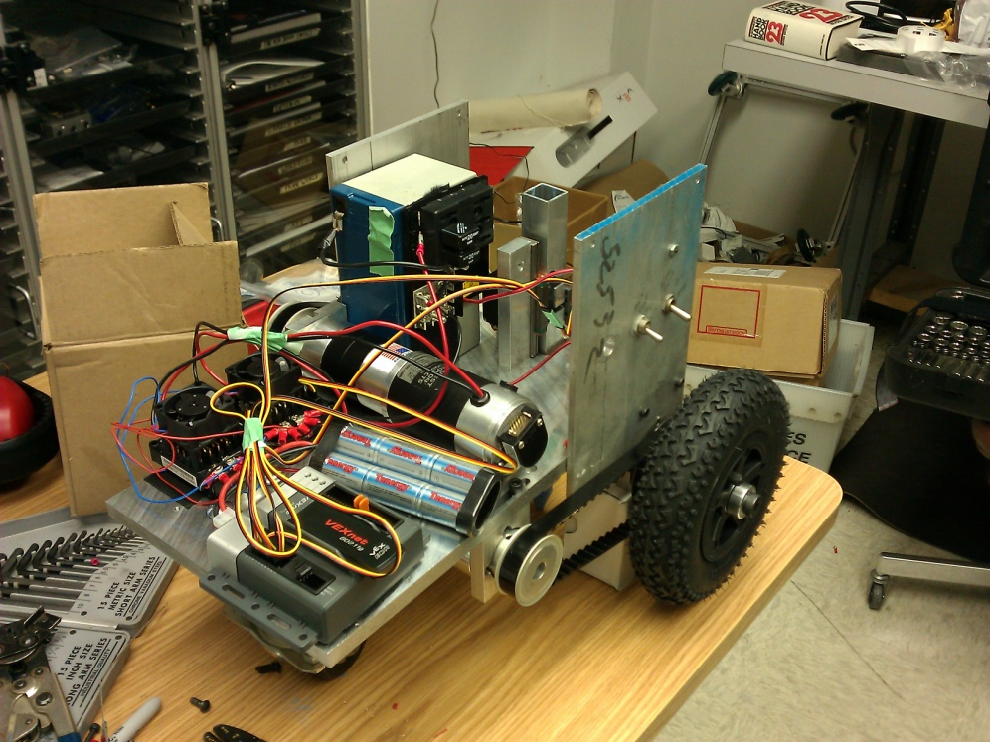
Introduction
ChalkBot is a semi-autonomous chalk drawing system.
Produces vector graphics.
Uses common, off the shelf sidewalk chalk.

Slide 3
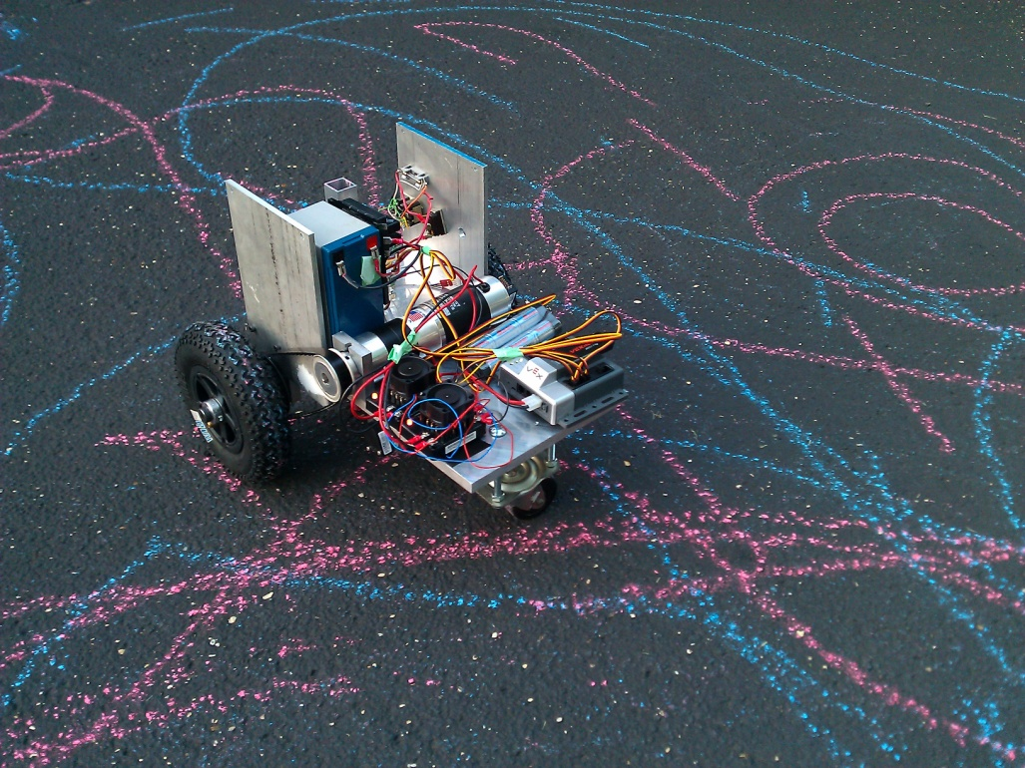
Outline
Mechanical Platform
GoBot Base and Chalk Feed
Electronics System
Overview
Power Supply Subsystem
Dynamics Control Subsystem
High Level Control
Software
Reset Sequencing and Supervision
Dynamics and Body Control
High Level Interface and Directive Control

Slide 4
Mechanical Platform

Slide 5
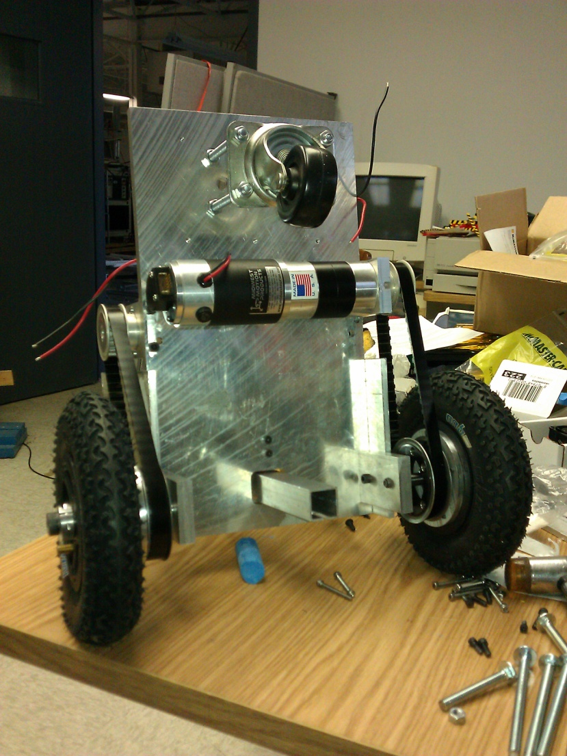
Mechanical Platform\\ GoBot Base and Chalk Feed
Two brushed drive motors, coupled to rear drive tires via synchronous belt.
Forward idler ‘caster’ wheel.
Rear mounted chalk feed mechanism, actuated by two positioning servo-motors.
One 12VDC nominal sealed lead-acid battery.

Slide 6
Electronics System\\ Overview

Slide 7

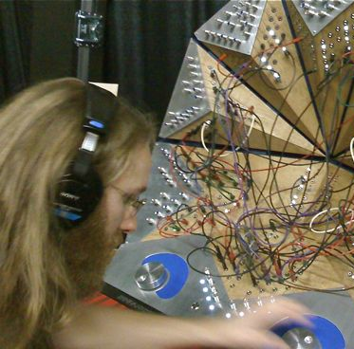

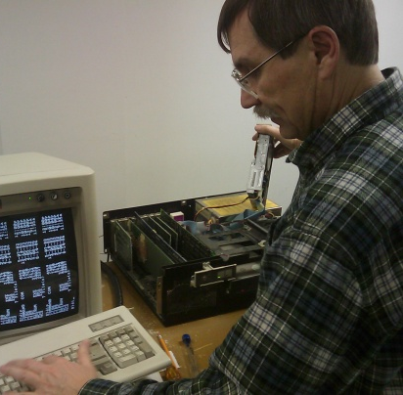
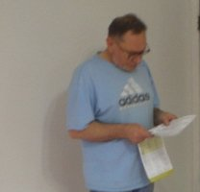
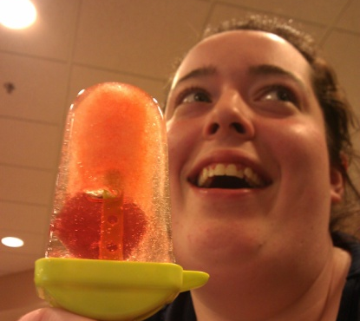


Special Thanks\\
Mark Smart
Skot Wiedmann
Dan Mast
Adam Suchko
Mikhail Karavaev
Kaitlin Minogue
Jane Tu
Tom Engibous (TI)
From top left: University of Illinois, TJ for Califaudio, University of Illinois, Alex Suchko, George Karavaev, Alex Suchko, University of Illinois, Brandon Wade for The Chronicle

