Slide 1

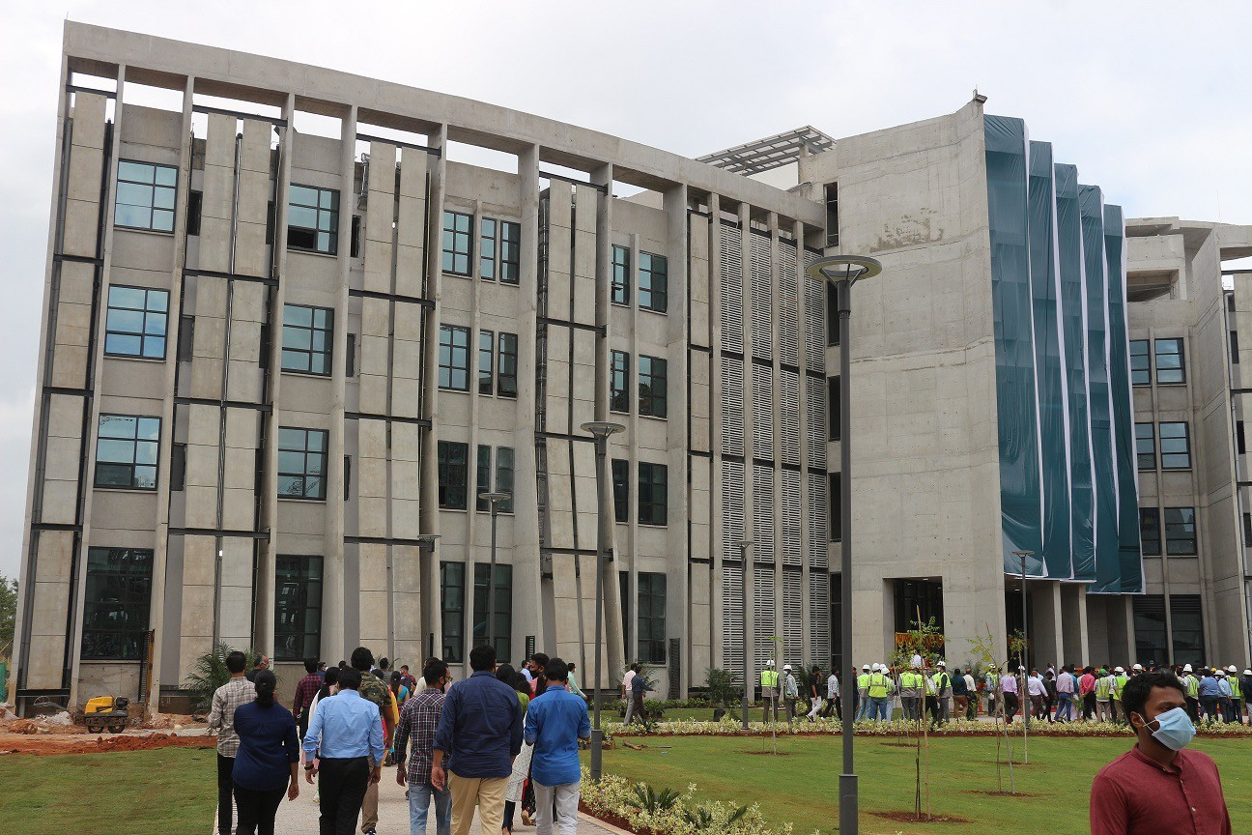
Department of
Biomedical
Engineering
m-PainAttnNet: Multimodal Transformer Encoder with Multiscale Deep Learning for Pain Classification using Physiological Signals
Chintalapudi Abhiroop - AI20BTECH11005
Nelakuditi Rahul Naga - AI20BTECH11029
Dr. Nagarajan Ganapathy
Research Supervisor
28.04.24
1

Slide 2
Introduction
Pain is a serious health problem that affects a vast proportion of the population worldwide.
International Association for the Study of Pain (IASP) estimates that 20% of adults worldwide experience pain daily and that 10% of adults are formally diagnosed with chronic pain each year.
Pain can be categorized on various criteria such as
Pathophysiological mechanism (nociceptive, neuropathic pain etc.)
Pattern of duration (acute, chronic, recurring)
Anatomical location involved (neck, back, knee)
The etiology (malignant associated with cancer, pinched nerve, dislocated joint etc.)
Accurate pain assessments are vital for effective pain management, as it enables health care providers to determine the most suitable treatments for everyone.

Slide 3
Literature review
Zhenyuan Lu et al.
In this paper, the authors propose PainAttnNet, a novel deep-learning model designed for precise pain intensity classification using physiological signals. The model integrates MSCN, squeeze-and-excitation residual networks, and a transformer encoder block.
Thiam et al.
This study proposed a deep learning model that utilizes a deep CNN framework followed by a block of fully connected layers (FCL) for the pain recognition.
Walter et al.
In this paper, the authors collected a database named BioVid using visual and biopotential signals to advance an automated pain recognition system, to determine its theoretical testing quality, and to optimize its performance. For this purpose, participants were subjected to painful heat stimuli under controlled conditions.
Werner et al.
In this paper, the authors propose an automatic pain recognition system by combining information from video and biomedical signals obtained from the BioVid Heat Pain Database.

Slide 4
Aim and Objective
Traditional techniques for measuring pain intensity, e.g., self-report scales, are susceptible to bias and unreliable in some instances.
As a result, there is a need for more objective and automated methods for assessing pain intensity.
One common approach to meet this need is the use of physiological signals, e.g., electrodermal activity (EDA), electrocardiography (ECG), electromyography (EMG), electroencephalography (EEG) etc. to classify pain intensity.
PainAttnNet is one such model that classifies pain intensity levels based on physiological signals. It was proposed by Zhenyuan Lu et al. PainAttnNet uses only EDA signals for pain classification.
We propose a multimodal extension of PainAttnNet called Multimodal PainAttnNet. It is abbreviated as m-PainAttnNet.

Slide 5
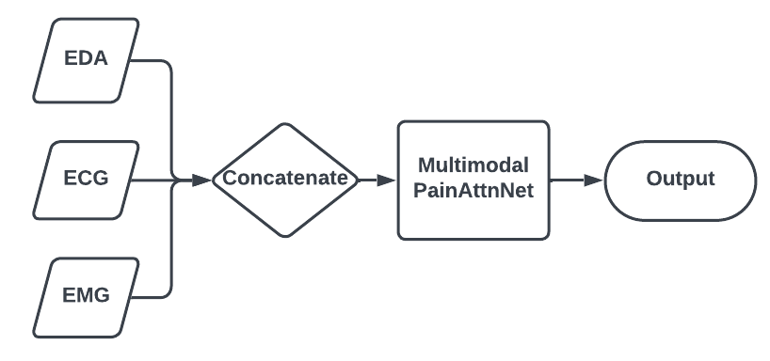
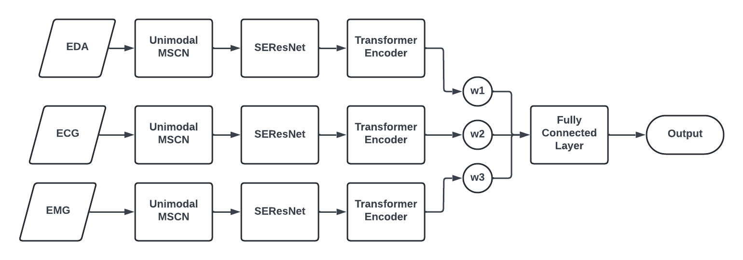
Proposed Architecture
Early Fusion Architecture
Late Fusion Architecture

Slide 6
Methodology
The original PainAttnNet model consists of three main blocks:
Multiscale Convolutional Network (MSCN)
Squeeze and Excitation Residual Network (SEResNet)
Transformer Encoder
For our MSCN model, we made sure that it can support multiple modality signals. The input size of fully connected neural network layers in MSCN is appropriately decided based on the modality of the input signals. When the modality is one, the model boils down to the original MSCN model utilized in Zhenyuan Lu et al.
In Early fusion, multiple signals are concatenated together before they are input to the PainAttnNet model.
In Late fusion, multiple unimodal PainAttnNet models are used to process multi-modal input. The number of models used is equal to the modality of the input, which must be greater than one.
For our experiments, we used the filtered Electro Dermal Activity (EDA), Electrocardiogram (ECG) and Electromyogram (EMG) signals from Part A of BioVid Heat Pain Database.

Slide 7
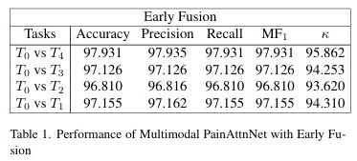
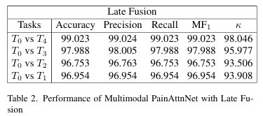
Results - Multimodal Fusion

Slide 8
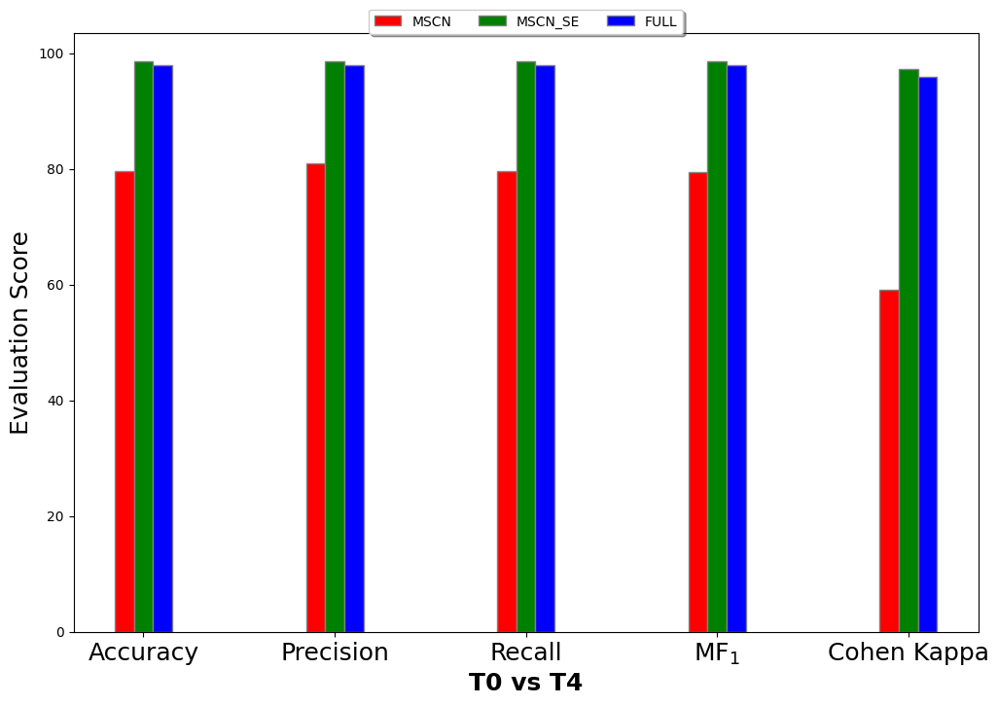
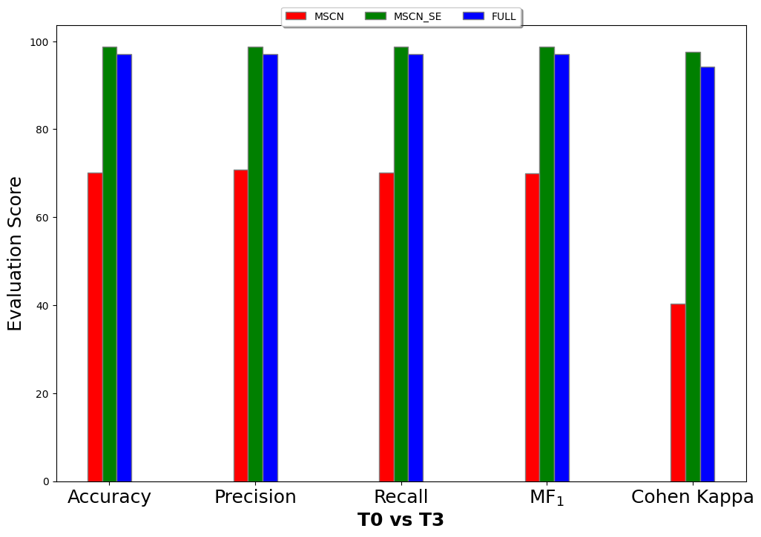
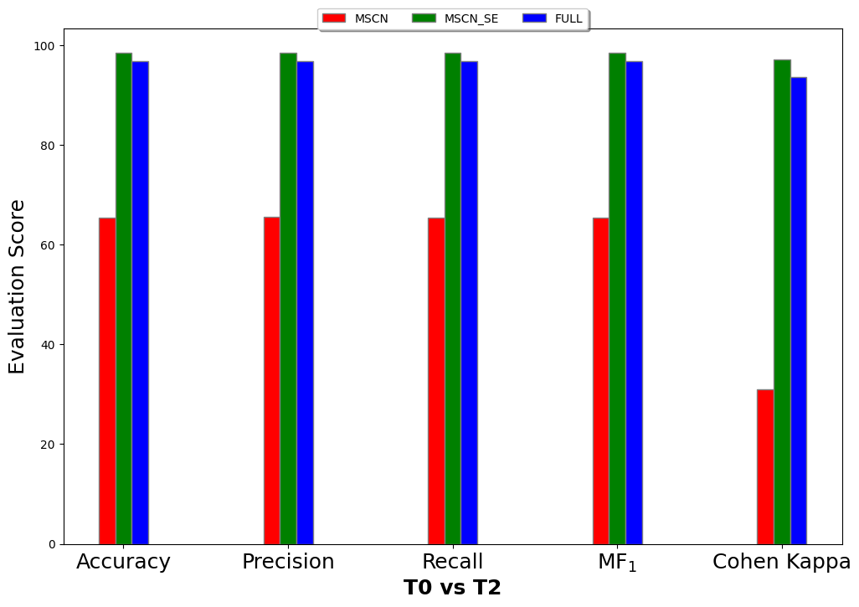
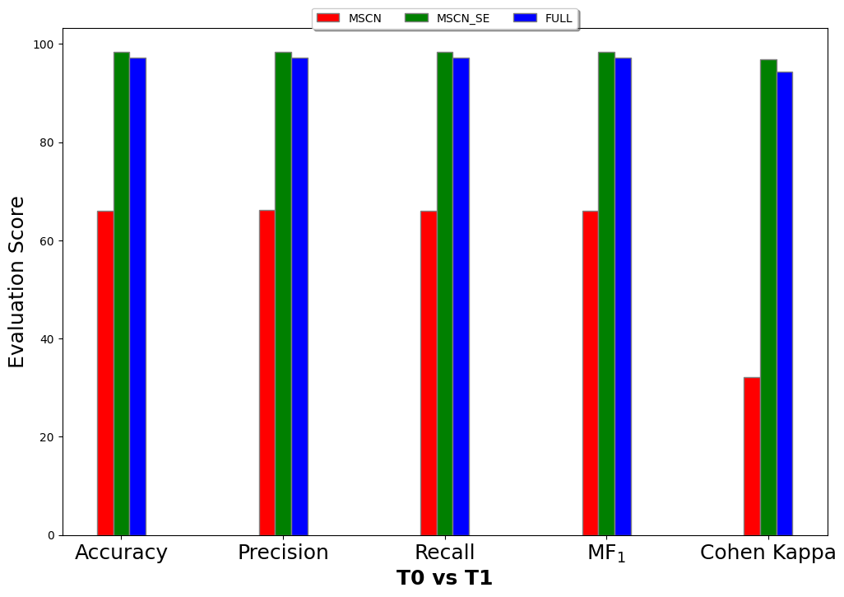
Results - Ablation Study

Slide 9
Conclusion
Pain is a very common symptom of many diseases. It can be of many kinds. It is important to quantify the intensity of pain level that a person is experiencing to decide what further steps can be taken. Automated classification of pain intensity using Artificial Intelligence based models can be a plausible solution to this problem.
We proposed Multimodal PainAttnNet (m-PainAttnNet) model that is a multimodal extension of the PainAttnNet model that was proposed by Zhenyuan Lu et al. Multimodal PainAttnNet can take multiple types of signals such as EDA, ECG and EMG as inputs and classify between various pain intensity levels.
m-PainAttnNet can perform two types of fusion - Early and Late. We also performed ablation study on the model by comparing the performance of various blocks of the m-PainAttnNet model to the full model's performance.
The performance of our m-PainAttnNet model is exceeding the benchmarks reported by the authors of Zhenyuan Lu et al. on almost all the classification tasks.

Slide 10
References
Transformer encoder with multiscale deep learning for pain classification using physiological signals, Zhenyuan Lu and Burcu Ozek and Sagar Kamarthi, Frontiers in Physiology, 2023.
The biovid heat pain database data for the advancement and systematic validation of an automated pain recognition system, Steffen Walter and Sascha Gruss and Hagen Ehleiter and Jun-Wen Tan and Harald C. Traue and Stephen Clive Crawcour and Philipp Werner and Ayoub Al-Hamadi and Adriano de Oliveira Andrade, IEEE International Conference on Cybernetics (CYBCO), 2013.
Automatic Pain Recognition from Video and Biomedical Signals, Philipp Werner and Ayoub Al-Hamadi and Robert Niese and Steffen Walter and Sascha Gruss and Harald C. Traue, Proc. Int'l Conf. on Pattern Recognition (ICPR), 2014.
Exploring Deep Physiological Models for Nociceptive Pain Recognition, Patrick Thiam and Peter Bellmann Hans A. Kestler and Friedhelm Schwenker, Sensors, 2019.
PainAttnNet GitHub Code

