Slide 1
Communications

Slide 2
Learning Outcomes
0
Explain why communication is essential for effective management and describe how nonverbal behavior and listening affect communication among people.
Describe the concept of channel richness, and explain how communication channels influence the quality of communication.
Understand how gender differences, nonverbal communication, and listening affect the effectiveness of communication
Explain the difference between formal and informal organization communications and the importance of each for organizational management.
Identify how structure influences team communication outcomes.
Appreciate the role of personal communication channels in enhancing organizational communication.
Recognize the manager's role in creating dialogue, managing crisis communication, offering feedback, and creating a climate of trust.

Slide 3
Are You Building a Personal Network?
0
Personal networking is an important skill for managers
Networking enables managers to get things done
Networking builds social, work, and career relationships that are mutually beneficial
Today’s organizations depend on effective communication that starts with managers

Slide 4
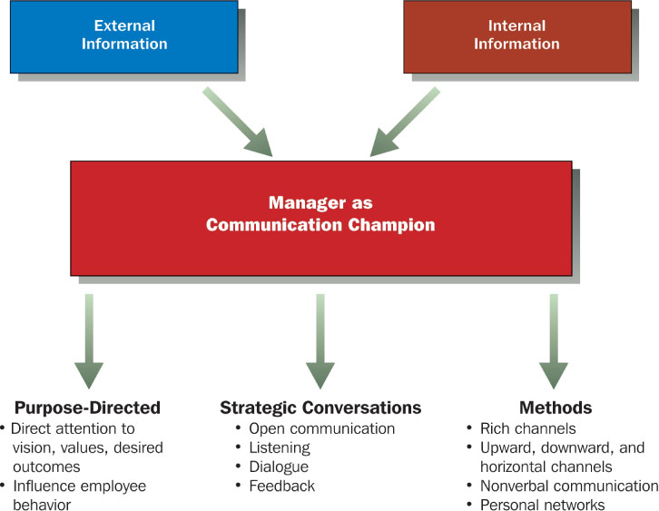
The Manager as Communication Champion
0

Slide 5
What is Communication?
0
Communication is the manager’s job
Managers facilitate strategic conversations
Open communication
Active listening
Dialogue
Feedback and learning to induce change
Communication means “sharing”, not speaking
Communication is the process by which information is exchanged and understood by two or more people

Slide 6
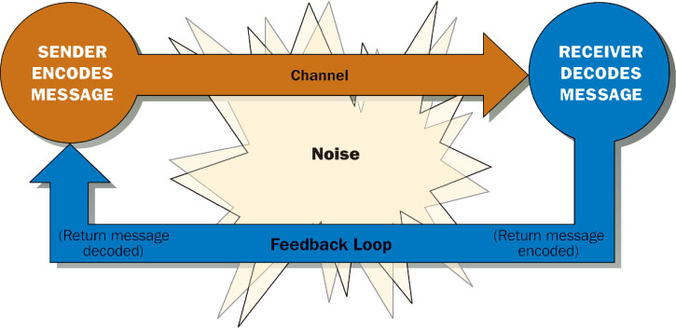
A Model of the Communication Process
0

Slide 7
Communicating Among People
0
Communication can easily break down
Today’s managers are communicating globally
Many variables impact the potential breakdown of communication
Channel selection
Persuasion
Gender differences
Nonverbal behavior
Listening

Slide 8
Communication Channels
0
Managers must choose from a variety of communication channels
Channels differ in their effectiveness and richness
Channel richness is the amount of information that can be transmitted during a communication episode
Managers must select a channel that fits the message

Slide 9
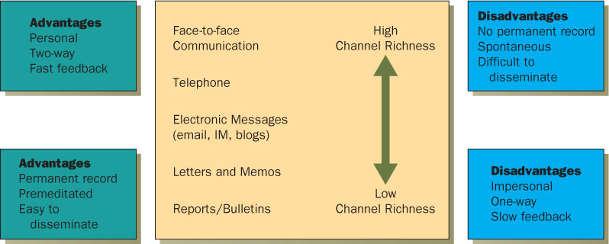
A Continuum of Channel Richness
0

Slide 10
Communications to Persuade and Influence
0
The ability for managers to persuade and influence is becoming more critical
Directives are no longer the task of managers
Managers must communicate frequently and easily with others
Many managers have communication apprehension and avoid communicating
To effectively persuade and influence, managers must show they care

Slide 11
Gender Differences in Communication
0
For many women, communicating means conversation
Women follow a language of rapport, establishing connections and negotiating relationships
Women interrupt less and work hard to continue conversations
Men use verbal language to exhibit knowledge and skill, telling stories, joking or passing information
Women downplay their accomplishments rather than displaying them
Women and men differ in body language
Women tend to use more submissive gestures
Men stare, point and use more sweeping gestures

Slide 12
Nonverbal Communication
0
Nonverbal communication are messages sent through human actions and behavior
Body Language
Behavior
Appearance
Actions
Attitudes
Nonverbal communication happens mostly face-to-face
Verbal – 7%
Nonverbal
Voice – 38%
Body Language, Actions – 55%

Slide 13
Listening
0
One of the most important tools of manager communication
Requires grasping facts and feelings for meaning
Information flows from the bottom-up
Managers must listen to employees and customers
Some companies have specific processes for listening to employees and customers
Some companies use blogs to listen to customers and employees

Slide 14
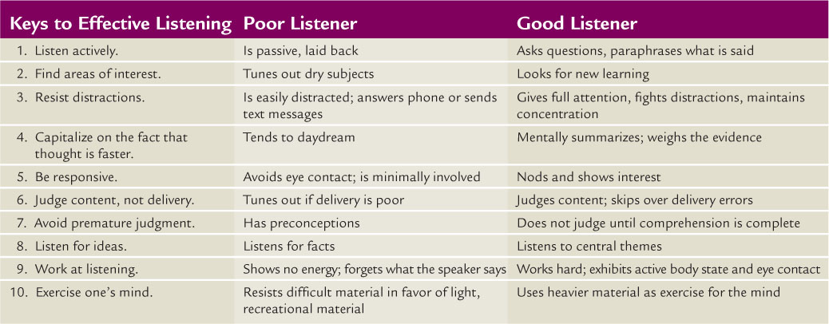
The Keys to Effective Listening
0

Slide 15
Organizational Communication
0
Formal Communication Channels
Downward Communication Channels
Upward Communication Channels
Horizontal Communication Channels

Slide 16
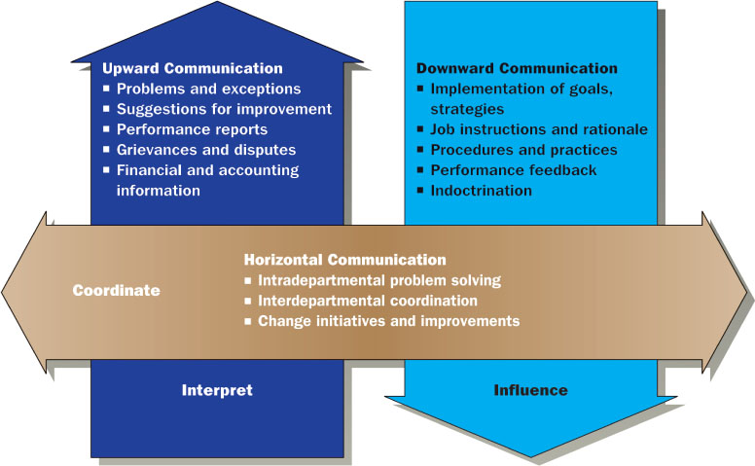
Downward, Upward, and Horizontal Communication
0

Slide 17
Team Communication Channels
0
Form of horizontal communication channel
Team members work together to accomplish tasks
In a centralized network, team members must communicate through one individual
In a decentralized network, individuals can communicate freely with other team members
Team communication depends upon the complexity and difficulty of the problem

Slide 18
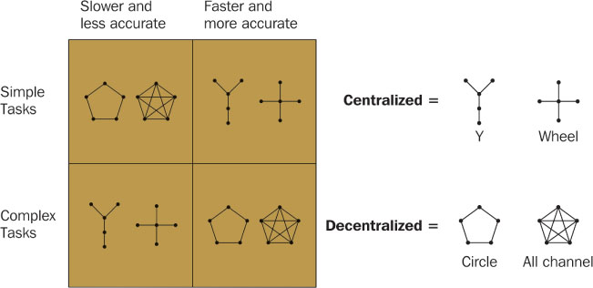
Effectiveness of Team Communication Networks
0

Slide 19
Personal Communication Channels
0
Personal communication channels are not formal
Personal networks
The Grapevine
Written communication
Develop a personal communication network:
Build it before you need it
Never eat lunch alone
Make it win-win
Focus on diversity
The grapevine links employees in all directions. Employees use the grapevine to fill in gaps and clarify management decisions.

Slide 20
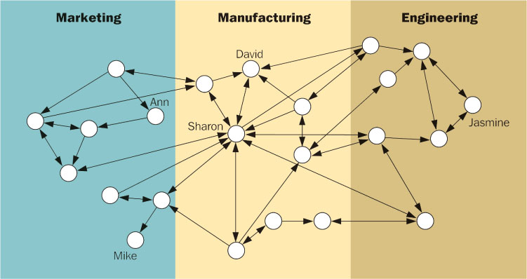
An Organizational Communication Network
0

Slide 21
Written Communication
0
Written communication is growing in importance
The inability to communicate in writing will limit opportunities
Managers can improve their writing by following these guidelines:
Respect the reader
Know your point and get to it
Write clearly rather than impressively
Get a second opinion

Slide 22
Innovations in Organizational Communication
0
Today’s environment requires knowledge workers and relationships with employees
The uncertainty of the business environment require an ability to manage crisis
Key innovations in organizational communication include:
Dialogue
Crisis Communication
Feedback and Learning
Climate of Trust and Openness

Slide 23
Crisis Communication
0
Organizations face small crisis ever day
Crisis are like fires, and effective communications are the best way to douse them
Four skills for communicating in a crisis:
Maintain your focus
Be visible
Get the awful truth out
Communicate a vision for the future

Slide 24
Climate of Trust and Openness
0
Open communication and dialogue to encourage honesty
Managers should develop and use formal communication
Encourage the use of multiple channels, both formal and informal
Create communication structures that fit the communication needs

