Slide 1
LEADERSHIP
Power
Influence
Manager to Leader

Slide 2
Major Questions You Should Be Able to Answer
What’s the difference between a manager and a leader?
What does it take to be a successful leader?
Do effective leaders behave in similar ways?
How might effective leadership vary according to the situation on hand?

Slide 3
Major Questions You Should Be Able to Answer
What does it take to truly inspire people to perform beyond their normal levels?
If there are many ways to be a leader, which one would describe me best?

Slide 4
The Nature of Leadership
Leadership
the ability to influence employees to voluntarily pursue organizational gains

Slide 5
Managers & Leaders
Management is about coping with complexity
Management is about task orientation
Leadership is about coping with change
Leadership is about people orientation

Slide 6
Being a Manager: Coping with Complexity
Determining what needs to be done - planning and budgeting
Creating arrangements of people to accomplish an agenda - organizing and staffing
Ensuring people do their jobs - controlling and problem solving

Slide 7
Being a Leader: Coping with Change
Determining what needs to be done - setting a direction
Creating a vision for others to follow - direction/aligning
Creating arrangements of people to accomplish an agenda - aligning people
Ensuring people do their jobs - motivating and inspiring

Slide 8
Five Sources of Power First 3 are Position related
Legitimate power
results from managers’ formal positions within the organization, vested authority
Reward power
results from managers’ authority to reward their subordinates
Coercive power
results from managers’ authority to punish their subordinates

Slide 9
Five Sources of Power (Personal Power)
Expert power
results from one’s specialized information or expertise
Referent power
derived from one’s personal attraction

Slide 10
Tactics for Influencing Others
Rational persuasion
Inspirational appeals
Consultation
Ingratiating tactics
Personal appeals
Exchange tactics
Coalition tactics
Pressure tactics
Legitimating tactics
Notes:
The ability to get others to follow your wishes is influence
There are nine ways to try to influence others:
-rational persuasion - convincing someone by using logic, reason, or facts
-inspirational appeals - building enthusiasm or confidence by appeals to emotions, ideals, or values
-consultation - getting others to participate in a decision or change
ingratiating tactics - acting humble or friendly before making a request
-personal appeals - referring to friendship and loyalty when making a request
-exchange tactics - reminding someone of past favors or offering to make a trade
-coalition tactics - getting others to support your effort
-pressure tactics - using demands, threats, or intimidation
-legitimating tactics - basing a request on implied support from superiors, or on rules or policies

Slide 11
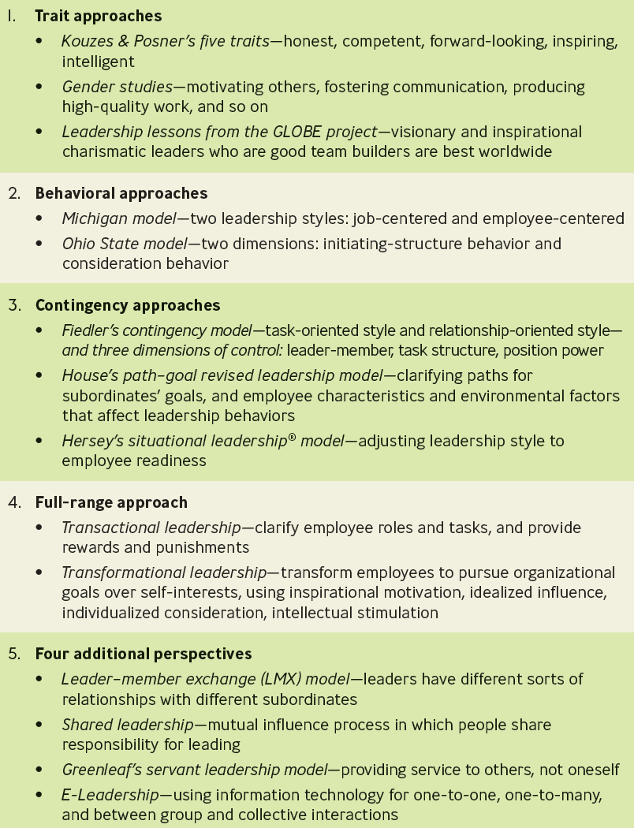
Approaches to Leadership

Slide 12
Do Leaders Have Distinctive Personality Characteristics?
What are the traits you admire in a Leader?
75,000 people 3 times over 15 years (Kouzes and Posner)
Honest
Forward Looking/Visionary
Competent
Hard Working
Intelligent
This is what we say…but other traits are important as well…

Slide 13
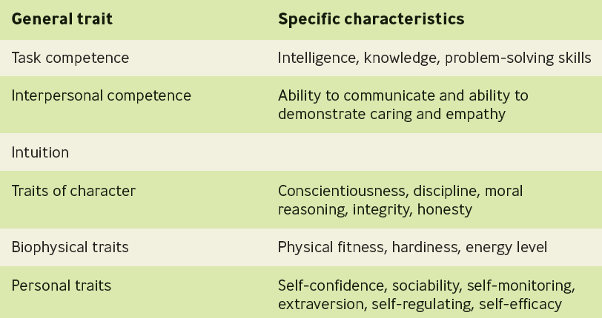
Key Positive Leadership Traits

Slide 14
Do Women Have Traits that Make Them Better Leaders?
Studies show that women executives score higher than their male counterparts on a variety of measures - from producing high quality work to goal-setting to mentoring employees
Notes:
Women tend to have more leadership traits than men, but hold fewer leadership positions
CEOs believe this may be because women lack significant general management experience, and have not been around long enough to be selected
Women believe that male stereotyping and exclusion from important informal networks contribute to the problem
Other reasons may be because women are not willing to compete as hard as men, or make the necessary personal sacrifices

Slide 15
Leadership Lessons from the GLOBE Project
Project GLOBE
ongoing attempt to develop an empirically based theory to “describe, understand, and predict the impact of specific cultural variables on leadership and organizational processes and the effectiveness of these processes

Slide 16
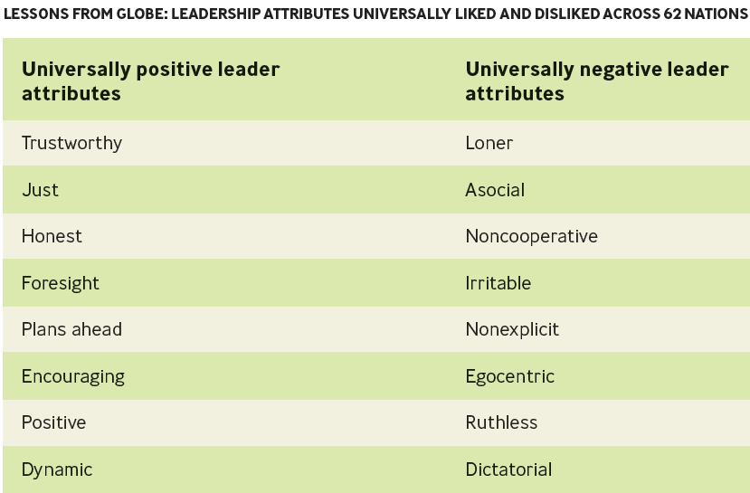
Leadership Lessons from the GLOBE Project

Slide 17
Behavioral Approaches
Behavioral leadership
approaches attempt to determine the distinctive styles used by effective leaders

Slide 18
Contingency Approaches
Contingency leadership model
determines if a leader’s style is task oriented or relationship-oriented and if that style is effective for the situation at hand

Slide 19
The Path-Goal Leadership Model
Path-Goal Leadership Model
holds that the effective leader makes available to followers desirable rewards in the workplace and increases their motivation by clarifying the paths, or behavior, that will help them achieve those goals and providing them with support

Slide 20
The Situational Leadership Model
Situational Leadership theory
leadership behavior reflects how leaders should adjust their leadership style according to the readiness of the followers
Notes:
Readiness is defined as the extent to which a follower possesses the ability and willingness to complete a task.

Slide 21
Full-Range Model
Transactional leadership
focuses on clarifying employees’ roles and task requirements and providing rewards and punishments contingent on performance

Slide 22
Full-Range Model
Transformational leadership
transforms employees to pursue organizational goals over self-interests
influenced by individual characteristics and organizational culture
Inspires change

Slide 23
Key Behaviors of Transformational Leaders
Inspirational motivation
Idealized influence
Individualized consideration
Intellectual stimulation

Slide 24
Implications of Transformational Leadership
It can improve results for both individuals and groups
It can be used to train employees at any level
It requires ethical leaders

Slide 25
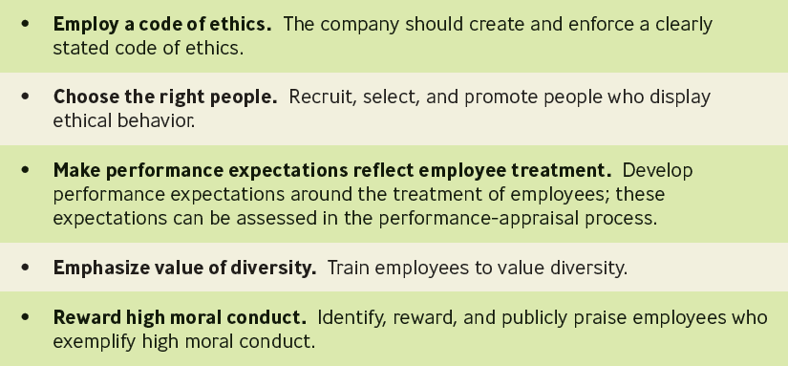
Things Managers Should do to be Effective Transformational Leaders

Slide 26
New Perspective
Servant leaders – Level 5 Leader – Jim Collins
focus on providing increased service to others - meeting the goals of both followers and the organization - rather than to themselves
Complete lack of ego – Humble, but they are…
Extremely driven
Mirror and the Window

Slide 27
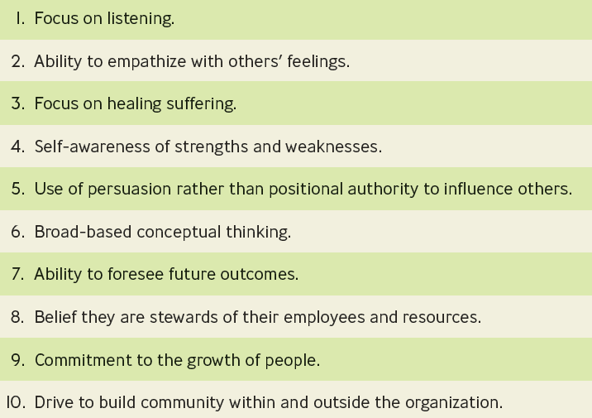
Characteristics of the Servant Leader

