Slide 1
Closure Properties of Regular Languages

Slide 2
For regular languages and
we will prove that:
Union:
Concatenation:
Are regular
Languages
Star:
Reversal:
Complement:
Intersection:

Slide 3
We say: Regular languages are closed under
Union:
Concatenation:
Star:
Reversal:
Complement:
Intersection:

Slide 4
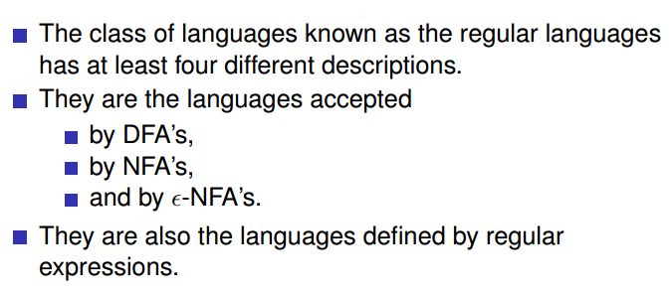
Our proof will be based on the following facts:
Therefore if we can prove that there is an DFA,NFA or RE for a language L, then we will prove that L is regular

Slide 5
A useful transformation: use one accept state
NFA
2 accept states
Equivalent
NFA
1 accept state
ε
ε

Slide 6
In General
NFA
Equivalent NFA
ε
Single
accepting
state
ε
ε

Slide 7
Extreme case
NFA without accepting state
Add an accepting state
without transitions

Slide 8
Take two languages
Regular language
Regular language
NFA
NFA
Single accepting state
Single accepting state

Slide 9
Example

Slide 10
Union
NFA for
ε
ε

Slide 11
Example
NFA for
ε
ε

Slide 12
Concatenation
NFA for
ε

Slide 13
Example
NFA for
ε

Slide 14
Star Operation
NFA for
ε
ε
ε
ε

Slide 15

Example
NFA for
ε
ε
ε
ε

Slide 16
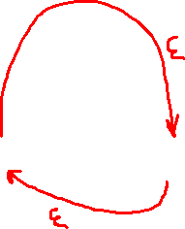

Star Operation (ALT. Construction)
NFA for
ε

Slide 17

Reverse
NFA for
1. Reverse all transitions
2. Make initial state accepting state
and vice versa

Slide 18
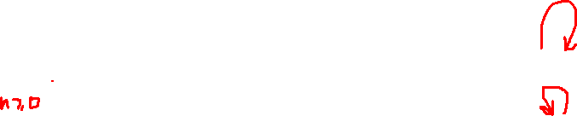
Example

Slide 19
Complement
1. Take the DFA that accepts
2. Make accepting states non-final,
and vice-versa

Slide 20
Example

Slide 21
Intersection
regular
We show
regular
regular

Slide 22
DeMorgan’s Law:
regular
regular
regular
regular
regular

Slide 23
Example
regular
regular
regular

