Slide 1
Lecture 07 Dynamic Programming
CSE373: Design and Analysis of Algorithms

Slide 2
Fibonacci Numbers
0, 1, 1, 2, 3, 5, 8, 13, 21, 34, 55, 89, …
Computing the n^{th} Fibonacci number recursively:
F(n) = F(n-1) + F(n-2)
F(0) = 0
F(1) = 1
Top-down (recursive) algorithm
int Fib(int n)
{ if (n <= 1) return n; else return Fib(n - 1) + Fib(n - 2); }
F(n)
F(n-1) + F(n-2)
F(n-2) + F(n-3) F(n-3) + F(n-4)

Slide 3
Fibonacci Numbers
Why is the top-down approach so inefficient?
Recomputes many sub-problems.
Fib(5) +
Fib(4) +
Fib(3) +
Fib(3) +
Fib(2) +
Fib(2) +
Fib(1)
Fib(2) +
Fib(1)
Fib(1)
Fib(0)
Fib(1)
Fib(0)
Fib(1)
Fib(0)

Slide 4
Fibonacci Numbers
F(9)
F(8)
F(7)
F(7)
F(6)
F(6)
F(5)
h = n
h = n/2
F(6)
F(5)
F(5)
F(4)
F(5)
F(4)
F(4)
F(3)
Time complexity between 2^{n/2} and 2^{n}

Slide 5
A Top-down Algorithm that memorizes previous solutions (memoized top-down approach)
Algorithm fib(n):
F[0] = F[1] = 1
for i = 2 to n
F[i] = -∞
fib_rec(n)
Algorithm fib_rec(n):
if F[n]≥0 then
return F[n]
else
F[n] = fib_rec(n-1)+fib_rec(n-2)
return F[n]
Time complexity?
Each of the F[i] values (i={0, 1,…, n}) is computed only once. So time is O(n).

Slide 6
A Bottom-up (Iterative) Algorithm
Algorithm fib(n):
F[0] = F[1] = 1
for i = 2 to n
F[i] = F[i-1] + F[i-2]
return F[n]
Time complexity?
The for loop here runs O(n) times and all the other (first and last) statements takes O(1) time. So total time is O(n).

Slide 7
Summary
Problem with the recursive Fib algorithm:
Each subproblem was solved for many times!
Solution: avoid solving the same subproblem more than once
(1) pre-compute all subproblems that may be needed later (bottom-up)
(2) Compute on demand, but memorize the solution to avoid recomputing (memoized top-down)
Can you always speedup a recursive algorithm by making it an iterative algorithm?
E.g., merge sort
No. since there is no overlap between the two sub-problems

Slide 8
Dynamic Programming
Dynamic Programming (DP) is an algorithm design technique for optimization problems.
Like divide and conquer (D&C), DP solves problems by combining solutions to sub-problems.
Unlike D&C, sub-problems are not independent.
Sub-problems may share sub-sub-problems

Slide 9
Dynamic Programming
The term Dynamic Programming comes from Control Theory, not computer science. Programming refers to the use of tables (arrays) to construct a solution.
In dynamic programming we usually reduce time by increasing the amount of space
We solve the problem by solving sub-problems of increasing size and saving each optimal solution in a table (usually).
The table is then used for finding the optimal solution to larger problems.
Time is saved since each sub-problem is solved only once.

Slide 10
Designing a DP Algorithm
1. Characterize the structure of an optimal solution.
2. Recursively define the value of an optimal solution.
3. Compute the value of an optimal solution in a bottom up fashion.
4. Construct an optimal solution from computed information.

Slide 11
Example: Rod Cutting
You are given a rod of length n ≥ 0 (n in inches)
A rod of length i inches will be sold for p_{i} dollars
Cutting is free (simplifying assumption)
Problem: given a table of prices p_{i} determine the maximum revenue r_{n} obtainable by cutting up the given rod (of length n) and selling the pieces.
Length i | 1 | 2 | 3 | 4 | 5 | 6 | 7 | 8 | 9 | 10
Price p_{i} | 1 | 5 | 8 | 9 | 10 | 17 | 17 | 20 | 24 | 30

Slide 12
Example: Rod Cutting
Problem: given a table of prices p_{i} determine the maximum revenue r_{n} obtainable by cutting the given rod (of length n) and selling the pieces.
Can we use a greedy algorithm (like fractional knapsack) that always takes the length with highest price/length value?
No, for e.g. by greedy algorithm, optimal revenue of a 4 inch rod should be 33+1=34 which we get by cutting a rod of length 3 first (which has the maximum value of 11) and then taking the remaining rod of length 1 (i.e., the cutting lengths here are in order: (3,1)).
However, the optimal cutting is: (2,2) which gives us optimal revenue of 20+20 = 40.
Length i | 1 | 2 | 3 | 4
Price p_{i} | 1 | 20 | 33 | 36
Value p_{i}/i | 1 | 10 | 11 | 9

Slide 13
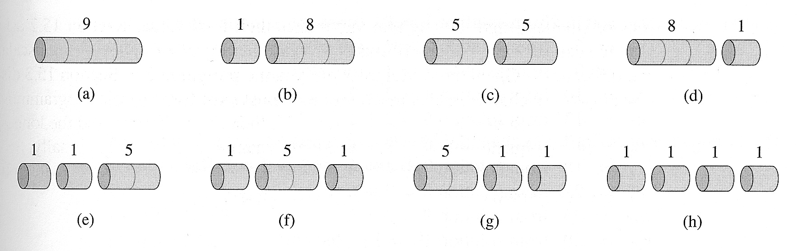
Example: Rod Cutting
Can we use a brute-force/exhaustive algorithm that tries all possible cuts of a rod of length n?
Question: in how many different ways can we cut a rod of length n?
For a rod of length 4:
2⁴ ⁻ ¹ = 2³ = 8
Yes but the cost would be too high!!! There are 2^{n-1} possible ways to cut a rod of length n (Exponential). We cannot try all possibilities for "large“ n; the exhaustive approach isn’t practically feasible.
Notes:
What kind of Notes??

Slide 14
Example: Rod Cutting
Let us find a way to solve the problem recursively:
Let r_{n} = the maximum revenue obtainable from a rod of length n
How can we construct a recurrence relation for r_{n}?
Advice: when you don’t know what to do next, start with a simple example and hope that some idea will click…

Slide 15

Example: Rod Cutting
Maximum revenue obtainable by cutting a rod of length n, r_{n} = ? (for n = 1)
r₁ = p₁ = 1
Notes:
What kind of Notes??

Slide 16


Example: Rod Cutting
Maximum revenue obtainable by cutting a rod of length n, r_{n} = ? (for n = 2)
r₂ = max(p₂, p₁+r₁) = max(5, 1+1) = 5
Notes:
What kind of Notes??

Slide 17



Example: Rod Cutting
Maximum revenue obtainable by cutting a rod of length n, r_{n} = ? (for n = 3)
r₃ = max(p₃, p₁+r₂ , p₂+r₁) = max(8, 1+5, 5+1) = 8
Notes:
What kind of Notes??

Slide 18

Example: Rod Cutting
Maximum revenue obtainable by cutting a rod of length n, r_{n} = ? (for n =4)
r₄ = max(p₄, p₁+r₃, p₂+r₂, p₃+r₁) = max(9, 1+8, 5+5, 8+1) = 10
Notes:
What kind of Notes??

Slide 19
Example: Rod Cutting
In general, for any n:
r_{n} = max(p_{n,} p₁+ r_{n-1,} p₂+ r_{n-2,} p₃+ r_{n-3,} …, p_{n-1}+ r₁)
r_{n} = max(p_{n}+r₀, p₁+ r_{n-1,} p₂+ r_{n-2,} p₃+ r_{n-3,} …, p_{n-1}+ r₁) :[Let, r₀ = 0]
r_{n} = max_{1≤i≤n}(p_{i} + r_{n-i})
In other words,
maximal revenue r_{n} is obtained by cutting the rod into smaller pieces of lengths: i and (n-i), for some value of i (for which p_{i}+r_{n-i} is maximum) where1≤i≤n and
r_{i} = p_{i}, i.e., the piece of length i need no more cut (because cutting it into smaller pieces will not increase its revenue) whereas
the piece of length (n-i) may need more cut; but we have already calculated the maximal revenue, r_{n-i} of a rod of length (n-i) before calculating r_{n.} We can use that value of r_{n-i} to calculate r_{n}

Slide 20
Optimal Substructure Property of Rod Cutting Problem
The recurrence relation: r_{n} = max_{1≤i≤n}(p_{i} + r_{n-i}) shows that the Rod Cutting problem has optimal substructure property:
an optimal solution to the problem (here r_{n}) contains within it optimal solution to sub problems (here r_{n-i}).
This recurrence relation can be implemented as a simple top-down recursive procedure

Slide 21
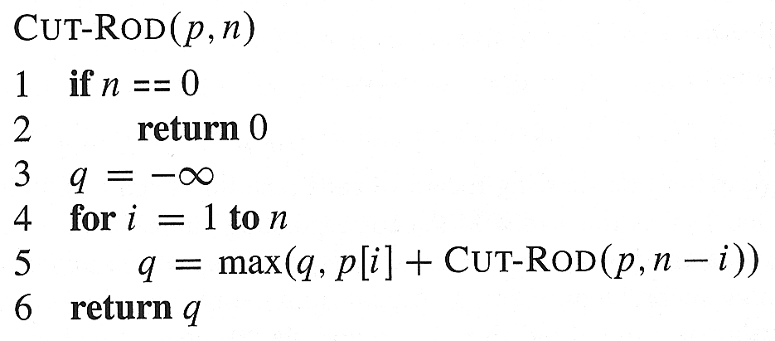
Top Down algorithm for Rod Cutting
Computing the recursion leads to re-computing some numbers (overlapping subproblems) again and again – how many?

Slide 22
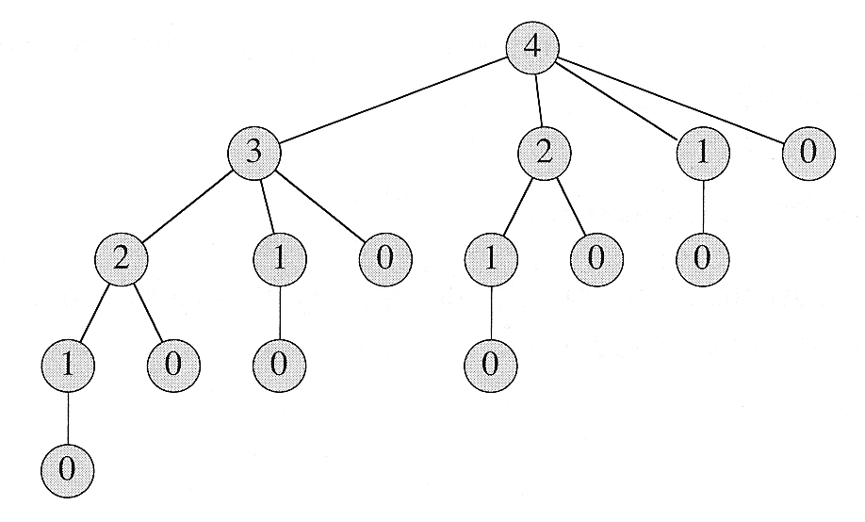
Time Complexity of Top Down algorithm
Let’s call Cut-Rod(p, 4), to see the effects on a simple case:
T(n) = total # of calls made to CUT-ROD for an initial call of CUT-ROD(p,n)
= The # of nodes for a recursion tree corresponding to a rod of size n = ?
Solution: CUT-ROD(p,n) calls CUT-ROD(p, n-i) for i = 1,2,3, …, n, i.e., CUT-ROD(p,n) calls CUT-ROD(p, j) for j = 0,1,2, …, n-1

Slide 23
How to decrease time?
We have a problem: “reasonable size” problems are not solvable in “reasonable time” (but, in this case, they are solvable in “reasonable space”).
Specifically:
Note that navigating the whole tree requires 2^{n} function calls
However, no more than n different values need to be computed or used.
We exploit these observations to come up with two ways to decrease time:
Memoized Top-down algorithm: store the value of r_{k} (once computed by a call of CUT-ROD) in a table and reuse it in later calls of CUT-ROD as needed. This technique allows us to compute r_{k} only once.
The technique of storing and reusing values computed by a previous call of a recursive function is called “memoizing” (i.e., writing yourself a memo).
Bottom Up Algorithm: Compute small subproblems first, then gradually solve larger and larger subproblems by using the pre-computed solutions of smaller subproblems. For e.g., for rod-cutting problem: compute r₀, r₁, r₂, …., r_{n}

Slide 24
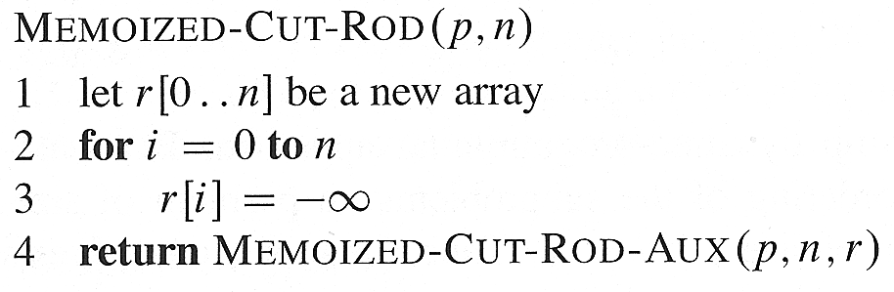

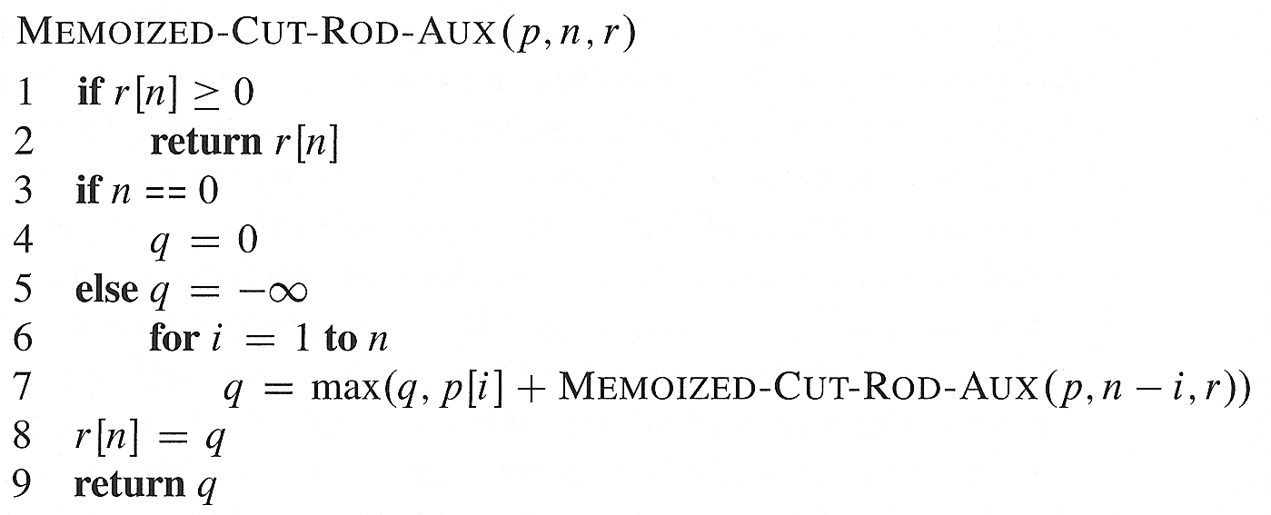
Memoized Top-down Algorithm for Rod-Cutting Problem
X
X
X
X

Slide 25
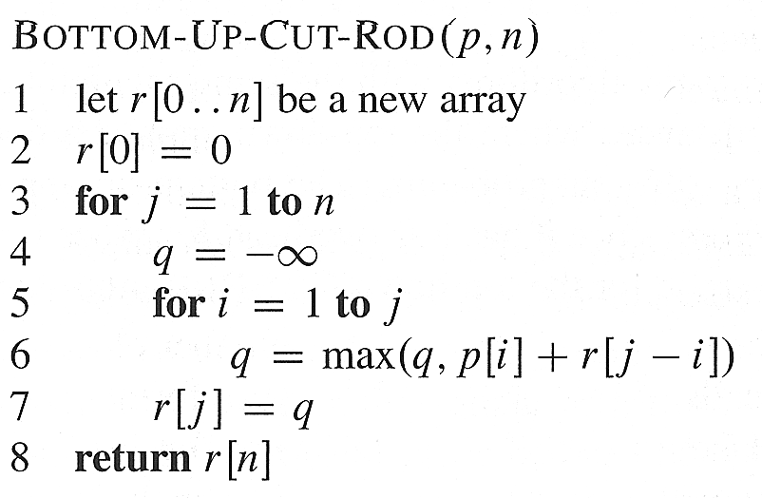
Bottom Up Algorithm
Both memoized top-down and bottom-up approach takes Θ(n²) time.
Why??
The most heavily executed statement in bottom-up approach is line 6 which is executed j times for each value of jɛ {1, 2,…, n}. So it is executed 1+2+…+n = Θ(n²) times. Similarly, memoized top-down

Slide 26
Simulation: Rod Cutting
Length i | 1 | 2 | 3 | 4 | 5 | 6 | 7
Price p_{i} | 1 | 5 | 8 | 9 | 10 | 12 | 17
We begin by constructing (by hand) the optimal solutions for i = 1, …, 10:
r₀ = 0
r₁ = p₁ = 1 (no cuts)
r₂ = max(p₂, p₁+r₁) = max(5,1+1) = 5 (no cuts)
r₃ = max(p₃, p₂+r₁, p₁+r₂) = max(8,5+1,1+5) = 8 (no cuts)
r₄ = max(p₄, p₃+r₁, p₂+r₂, p₁+r₃) = max(9, 8+1, 5+5, 1+8) = 10
r₅ = ?
r₆ = ?
r₇ = ?

Slide 27
Simulation: Rod Cutting
Length i | 1 | 2 | 3 | 4 | 5 | 6 | 7
Price p_{i} | 1 | 5 | 8 | 9 | 10 | 12 | 17
We begin by constructing (by hand) the optimal solutions for i = 1, …, 10:
r₀ = 0
r₁ = p₁ = 1 (no cuts)
r₂ = max(p₂, p₁+r₁) = max(5,1+1) = 5 (no cuts)
r₃ = max(p₃, p₂+r₁, p₁+r₂) = max(8,5+1,1+5) = 8 (no cuts)
r₄ = max(p₄, p₃+r₁, p₂+r₂, p₁+r₃) = max(9, 8+1, 5+5, 1+8) = 10
r₅ = max{p₅, p₄+r₁, p₃+r₂, p₂+r₃, p₁+r₄}
= max(10, 9+1, 8+5, 5+8, 1+10) = 13
r₆ = max{p₆, p₅+r₁, p₄+r₂, p₃+r₃, p₂+r₄, p₁+r₅}
= max{12,11,14,16,15,14} = 16
r₇ = p2 + r5 = 5 + 13 = 18

Slide 28
Reconstructing a Solution

Slide 29
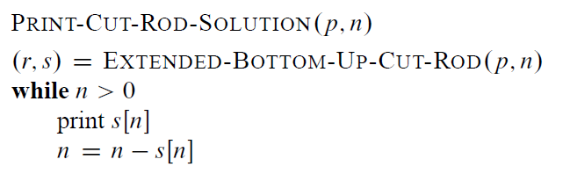
Reconstructing a Solution
Notes:
Print-Cut-Rod-Solution(p, 8)= 2, 6

Slide 30
Simulation: Rod Cutting
Length i | 1 | 2 | 3 | 4 | 5 | 6 | 7
Price p_{i} | 1 | 5 | 8 | 9 | 10 | 12 | 17
s_{i} | 1 | 2 | 3 | 2 | 2 | 3 | 2
We begin by constructing (by hand) the optimal solutions for i = 1, …, 10:
r₀ = 0
r₁ = p₁ = 1 (no cuts)
r₂ = max(p₂, p₁+r₁) = max(5,1+1) = 5 (no cuts)
r₃ = max(p₃, p₂+r₁, p₁+r₂) = max(8,5+1,1+5) = 8 (no cuts)
r₄ = max(p₄, p₃+r₁, p₂+r₂, p₁+r₃) = max(9, 8+1, 5+5, 1+8) = 10
r₅ = max{p₅, p₄+r₁, p₃+r₂, p₂+r₃, p₁+r₄}
= max(10, 9+1, 8+5, 5+8, 1+10) = 13
r₆ = max{p₆, p₅+r₁, p₄+r₂, p₃+r₃, p₂+r₄, p₁+r₅}
= max{12,11,14,16,15,14} = 16
r₇ = p2 + r5 = 5 + 13 = 18

Slide 31
Simulation: Rod Cutting
Length i | 1 | 2 | 3 | 4 | 5 | 6 | 7
Price p_{i} | 1 | 5 | 8 | 9 | 10 | 12 | 17
s_{i} | 1 | 2 | 3 | 2 | 2 | 3 | 2
Optimal Cutting lengths of a rod of length 7:
s₇ = 2
2, optimal cutting of a rod of remaining length (7-2) is: s₇₋₂ = s₅
s₅ = 2, optimal cutting of a rod of remaining length (5-2) is: s₅₋₂ = s₃
s₃= 3, remaining length = 3-3 = 0; so stop
Therefore optimal cutting lengths of a rod of length 7 is: 2,2,3

Slide 32
Multiple Rod Cutting
You are given m rods of different lengths
A rod of length i inches will be sold for p_{i} dollars
Problem: given a table of prices p_{i} determine the maximum revenue obtainable by cutting m rods and selling the pieces.
Idea: apply the DP algorithm for rod-cutting on the longest rod and then use its solution (r,s) to compute optimal cutting and optimal revenue of each rod.
Length i | 1 | 2 | 3 | 4 | 5 | 6 | 7 | 8 | 9 | 10
Price p_{i} | 1 | 5 | 8 | 9 | 10 | 17 | 17 | 20 | 24 | 30

Slide 33
Rod Cutting having cutting-cost
You are given a rod of length n
A rod of length i inches will be sold for p_{i} dollars
Each cut costs you c dollars.
Problem: given a table of prices p_{i} determine the maximum revenue obtainable by cutting a rod of length n and selling the pieces.
Idea: Add cutting cost in the recurrence relation of rod-cutting:
r_{n} = max_{1≤i≤n}(p_{i} + r_{n-i} - c) for n>0; r₀ = 0
Length i | 1 | 2 | 3 | 4 | 5 | 6 | 7 | 8 | 9 | 10
Price p_{i} | 1 | 5 | 8 | 9 | 10 | 17 | 17 | 20 | 24 | 30
Notes:
http://ranger.uta.edu/~huang/teaching/CSE5311/HW3_Solution.pdf

Slide 34
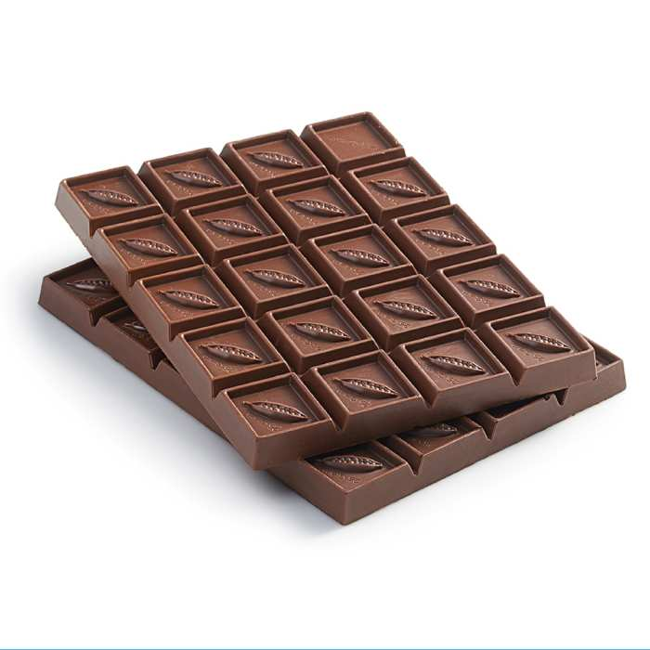
Chocolate Cutting/Breaking
You are given a Mimi chocolate having m*n blocks
In each step, we can break one piece of chocolate into two rectangular pieces horizontally/vertically (so no L shaped piece ever appears). A chocolate of i*j blocks can be sold for p_{i,j} dollars. Given p_{i,j} determine the maximum revenue r_{m,n} obtainable by breaking a chocolate with m*n blocks and then selling the pieces.
Price p_{i,j} | 1 | 2 | 3 | 4 | 5 | 6 | 7 | 8 | 9 | 10
1 | 1 | 5 | 8 | 9 | 10 | 17 | 17 | 20 | 24 | 30
2 | 5 | 6 | 18 | 22 | 31 | 35 | 37 | 39 | 40 | 45
3 | 8 | 18 | 22 | 34 | 37 | 39 | 42 | 43 | 45 | 48
4 | 9 | 22 | 34 | 40 | 44 | 47 | 48 | 50 | 52 | 53

Slide 35
Chocolate Cutting
Recurrence relation:
r_{m,n} = max{max{p_{i,n}+r_{m-i,n}}, max{p_{m,j}+r_{m,n-j}}}, when n>0
What are the base cases?
1 ≤ i ≤ n
1 ≤ j ≤ n
j
n-j
A possible cut
i
m-i

Slide 36
Chocolate Cutting
Recurrence relation:
r_{m,n} = max{max{p_{i,n}+r_{m-i,n}}, max{p_{m,j}+r_{m,n-j}}}, when n>0
Can you write memoized top-down and bottom-up algorithms to solve this problem?
1 ≤ i ≤ n
1 ≤ j ≤ n
j
n-j
A possible cut
i
m-i

