Slide 1
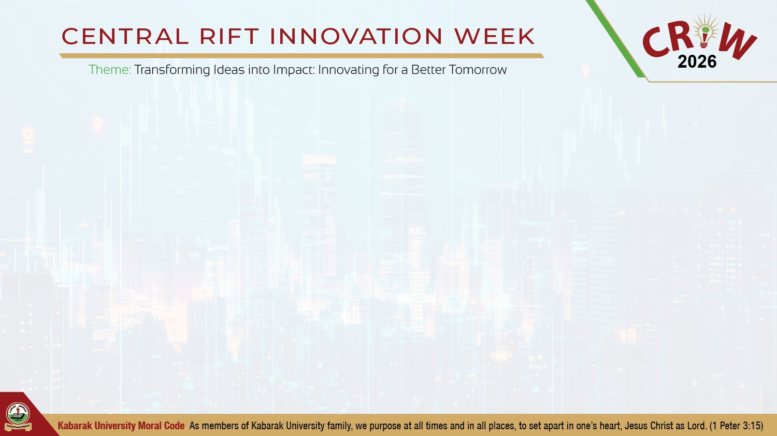
Research-in-a-Stick (RIS)
READY TO SCALE
KABARAK UNIVERSITY · CRIW 2026
Working product. Business model ready. Investment to scale.
Notes:
Open: ‘Zero internet. Full research stack on one stick.’ Introduce RIS in one sentence: an offline AI research lab on a USB drive for students who cannot rely on constant internet. Point to Kabarak / CRIW. Keep this slide ~20 seconds.

Slide 2

Research stops when internet runs out
PROBLEM STATEMENT
Cloud AI and online encyclopedias need a live connection and paid internet.
When internet is expensive or Wi-Fi drops, students skip sources, reuse old notes, or abandon assignments.
Notes:
Open the constraint. This is the gap RIS already solves on a working stick.

Slide 3
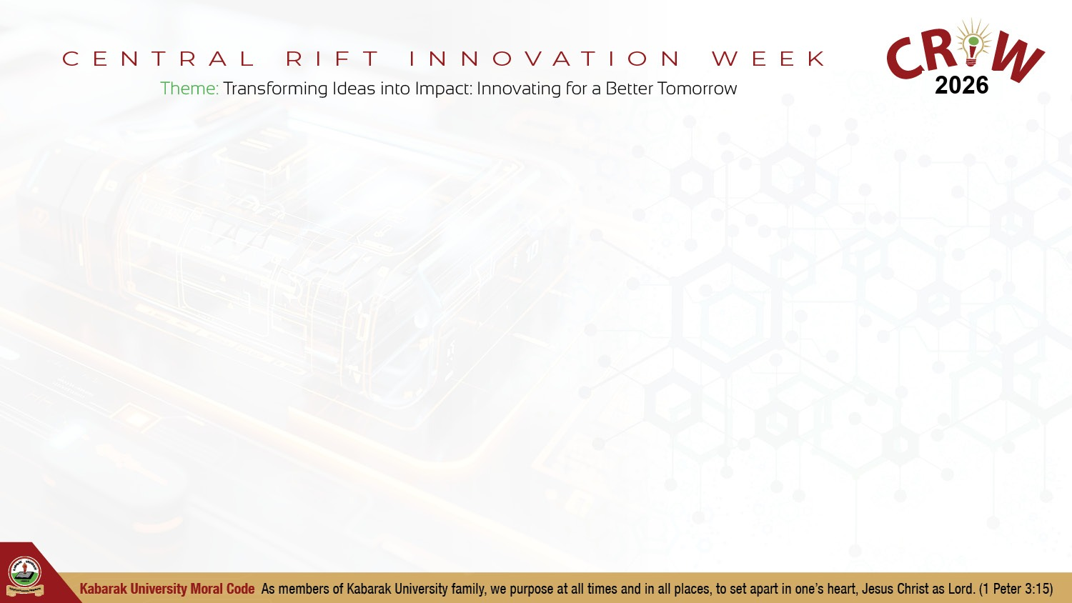
We already built it: offline research on a USB stick
THE SOLUTION
Working prototype: local AI chat, notes, offline encyclopedia, citations, data tools.
Plug in, double-click launcher, browser opens. No cloud. No account.
Demo-ready on ordinary Windows laptops.
Notes:
This is not a mock-up. The stick on the table runs the product.

Slide 4
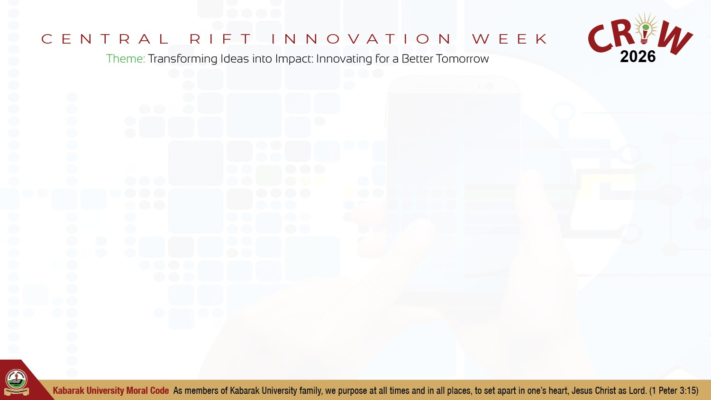
Ready product: offline, private, one click
VALUE PROPOSITION
• Fully offline. No account, no API key
• Chat, library, wiki, citations, data tools on one stick
• CPU-only. Works on ordinary Windows laptops
• Files stay on the device for thesis and field work
Notes:
Product is proven. Next is brand, packs, and campus rollout.

Slide 5
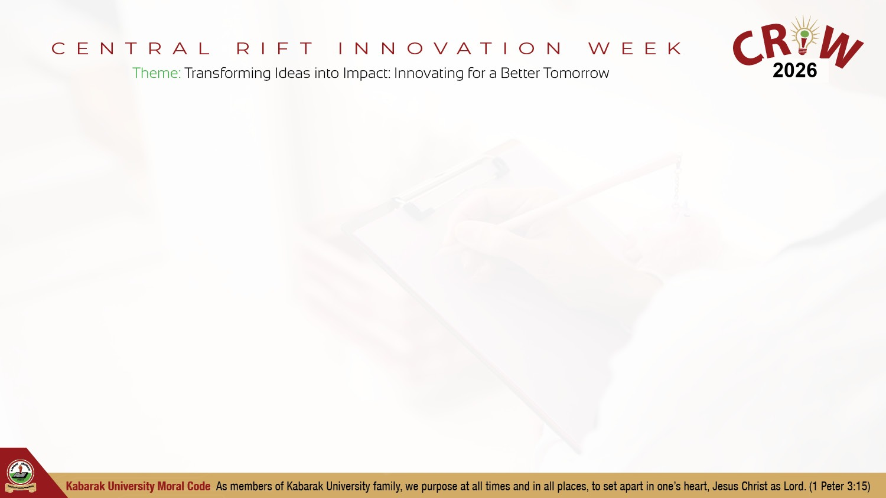
Clear buyers: students, then campuses
MARKET OPPORTUNITY
Primary: undergrads and postgrads who need research without daily internet costs.
Secondary: health and agriculture teams; schools sharing lab PCs.
Beachhead: 3 universities, ~1,500 seats in year one.
Notes:
We know who pays. Investment expands reach, not product discovery.

Slide 6
Revenue model already defined
BUSINESS MODEL
• Free: core stick for demos and trials
• Student Pro: ~KSh 650-2,000 / year for larger packs
• Campus: ~KSh 130,000-520,000 / year for imaging and training
• Unit build: ~KSh 1,500-2,900 per stick
Notes:
Business model is set. Capital funds sticks, brand, and campus partners.

Slide 7
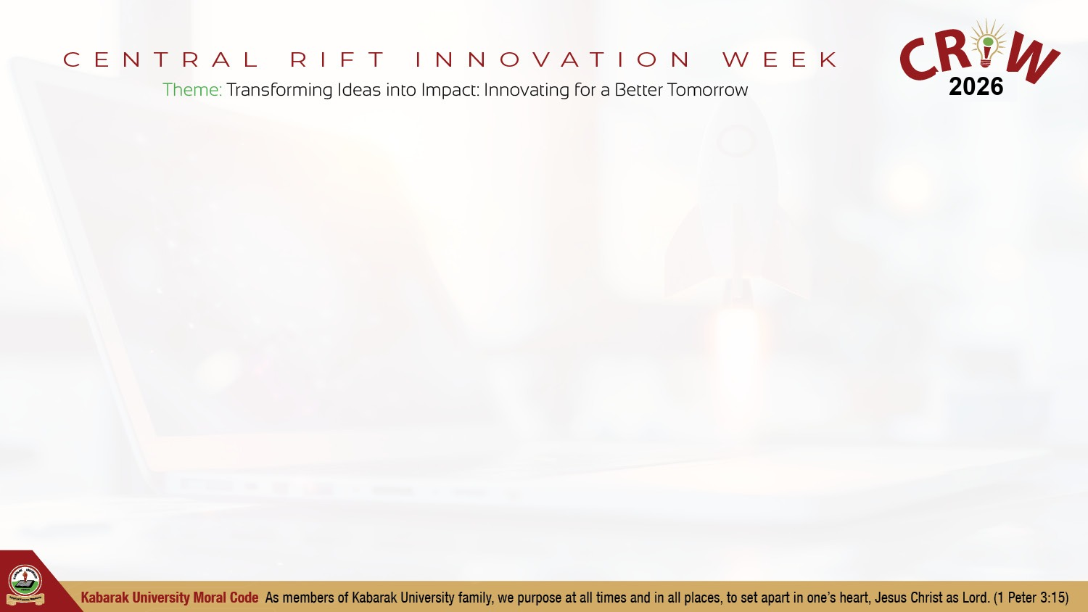
Scale plan: pilots, then campuses
GO-TO-MARKET STRATEGY
1. CRIW and campus demos: collect pilot commitments
2. 12-month pilot: 3 campuses, student champions
3. Convert one paid campus licence from usage proof
4. Brand push via research offices, clubs, NGO programmes
Notes:
Execution plan. Investment buys sticks, champions, and brand presence.

Slide 8
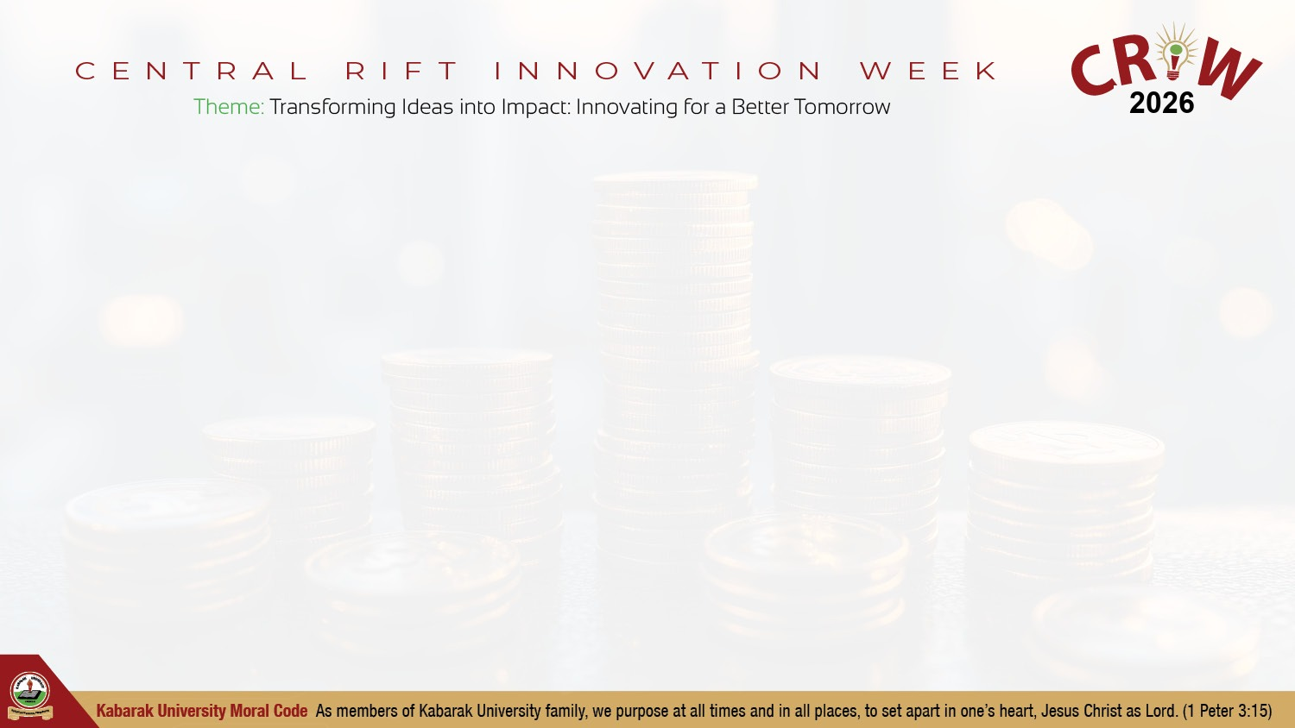
Investment: ~KSh 3.2-6.7M to scale
FINANCIAL OVERVIEW
Sticks KSh 2.3-4.3M · Content and QA KSh 0.4-1.0M
Champions and travel KSh 0.3-0.8M · Support KSh 0.3-0.6M
Outcome: 200+ sticks in market, brand assets, one paid campus licence
Notes:
Scale capital, not R&D. Product exists. Brand and distribution need funding.

Slide 9

Team of four ready to execute
TEAM
We are a team of four.
Member 1 · Name: [Full name] · Role: Impact and story
Member 2 · Name: [Full name] · Role: Product demo
Member 3 · Name: [Full name] · Role: Tech stack
Member 4 · Name: [Full name] · Role: Business and pilot
Advisor · Name: [Name] · [University / partner]
Notes:
Open: we are a team of four. Swap names before the event.

Slide 10
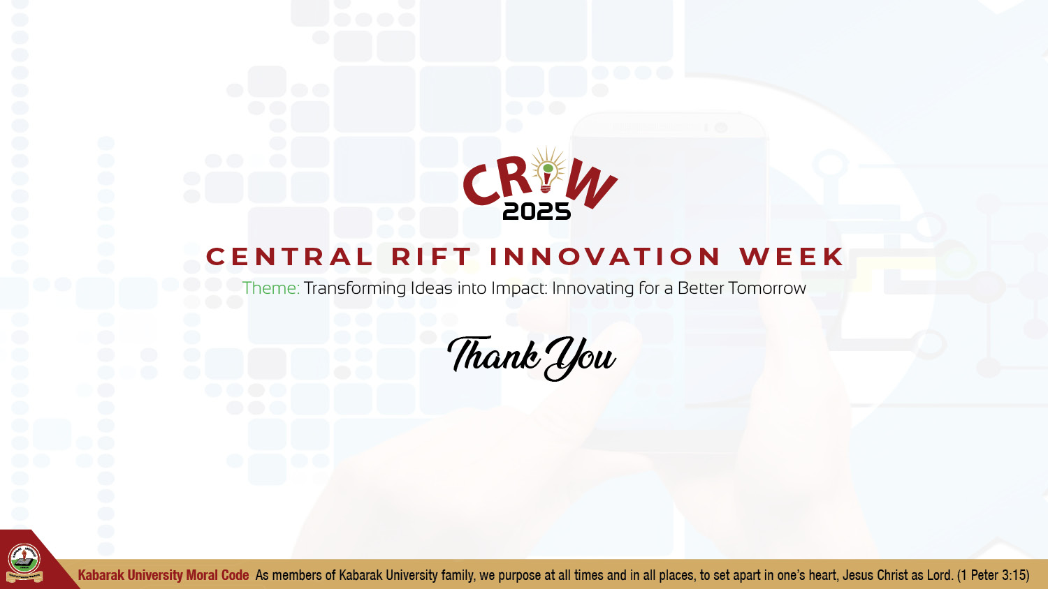
Invest to scale RIS
Ask: seed funding + one host-university MOU.
We have the stick, the stack, and the model. You fund brand and scale.
Notes:
Close on the investment ask. Product exists. Brand and scale need capital.

