Slide 1

CSE 216 Presentation
Knight’s
Tour

Slide 2
Group no-08
Md. Fahim Shahryer
201914019
Syed Taha Yeasin
201914023
Md. Shad Reza
201914024
Md. Abdullah Al Masum
201914044
Md. Samir Hasan
201914045
Md. Mizbaul Haque
201914022

Slide 3
Description
Finding the optimal path for a knight from source to destination considering obstacles on the chess board (By using directional array for generating next move)
Input
We Will take the knight’s position and the destination position .
We may also add obstacles to make the game more complex.
[inputs will be taken from indexing 1 to 8]
Output
Our programme will show the minimum number of moves for the knight to reach the destination and also show the traversing path.

Slide 4
FACTS
In chess, we know that the knight can jump in a special manner. It can move either two squares horizontally and one square vertically or two squares vertically and one square horizontally in each direction, So the complete movement looks like English letter ‘L’.
A knight's tour is a sequence of moves of a knight on a chessboard such that the knight visits every square only once. If the knight ends on a square that is one knight's move from the beginning square (so that it could tour the board again immediately, following the same path), the tour is closed, otherwise it is open.
In this knight tour problem , we use Breadth First Search(BFS)
If a knight has 8 free spaces to move then it can reach up-to 8 new positions.

Slide 5
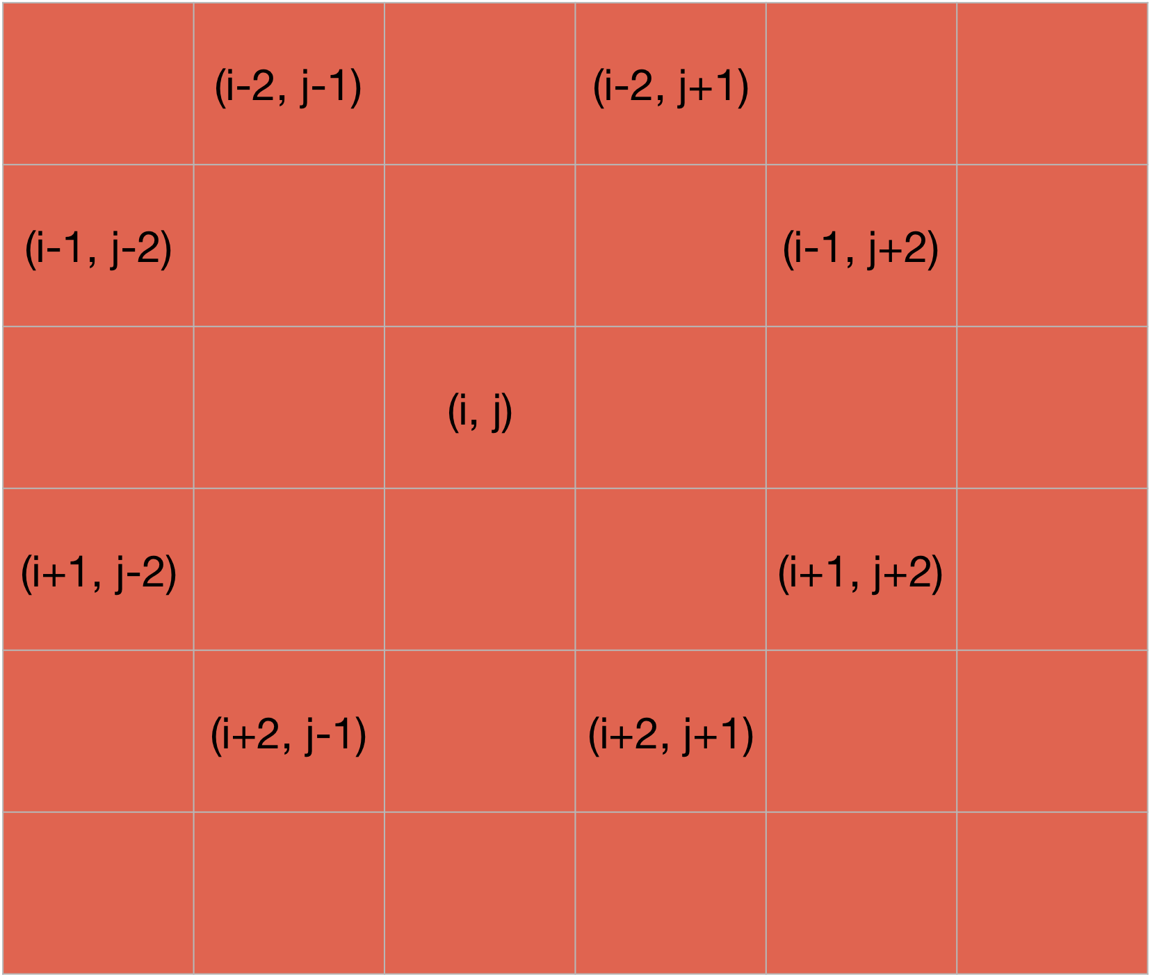
int DirectionX[8] = {+2, +2, -2, -2, +1, +1, -1, -1};
int DirectionY[8] = {+1, -1, +1, -1, +2, -2, +2, -2};
BFS (G, s) //Where G is the graph and s is the source node
let Q be queue.
Q.enqueue( s ) //Inserting s in queue until all its neighbour vertices are marked.
mark s as visited.
while ( Q is not empty)
//Removing that vertex from queue,whose neighbour will be visited now
v = Q.dequeue( )
//processing all the neighbours of v
for all neighbours w of v in Graph G
if w is not visited
Q.enqueue( w ) //Stores w in Q to further visit its neighbour
mark w as visited.

Slide 6
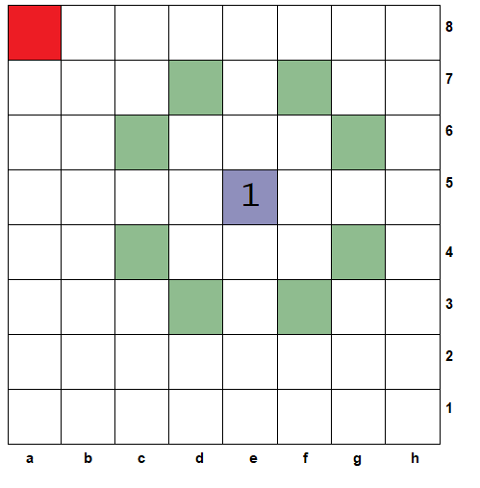
SIMULATION 00

Slide 7

SIMULATION 01

Slide 8
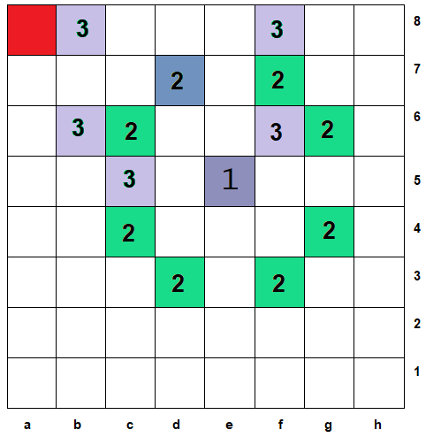
SIMULATION 02

Slide 9
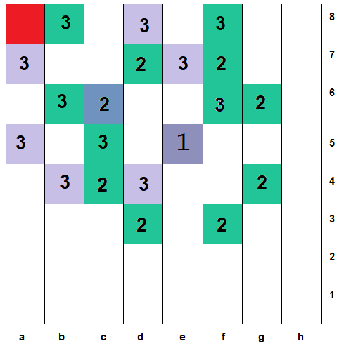
SIMULATION 03

Slide 10
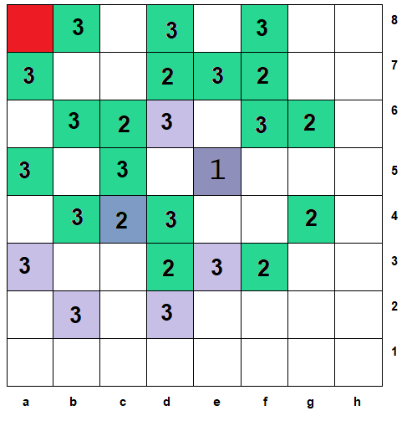
SIMULATION 04

Slide 11
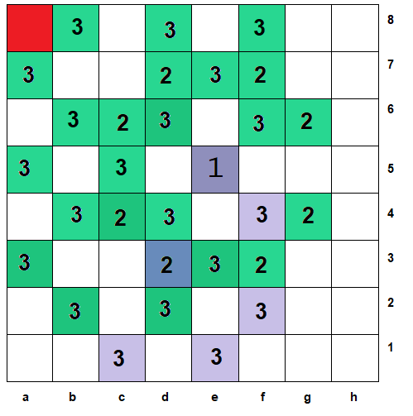
SIMULATION 05

Slide 12
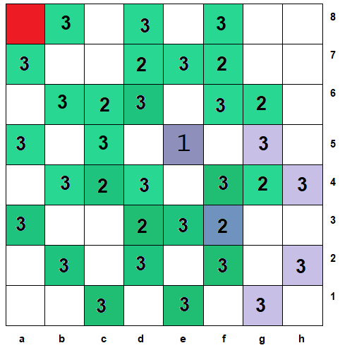
SIMULATION 06

Slide 13
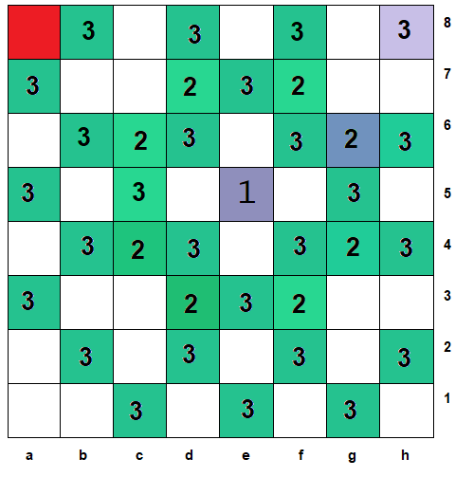
SIMULATION 07

Slide 14
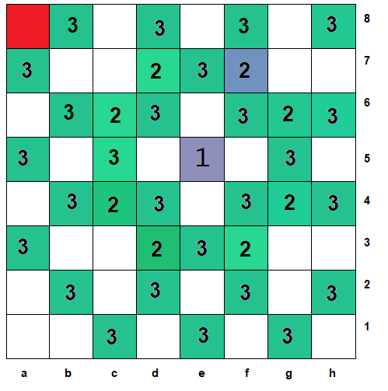
SIMULATION 08

Slide 15
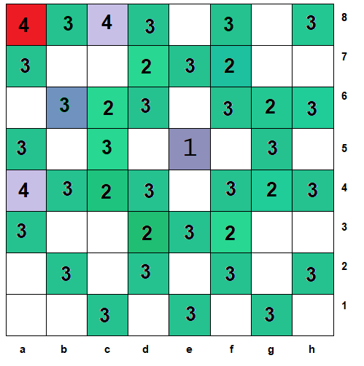
SIMULATION 09

Slide 16
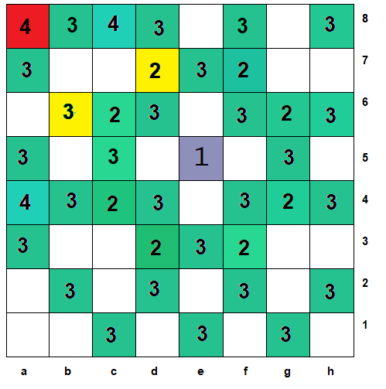
SIMULATION 10

Slide 17
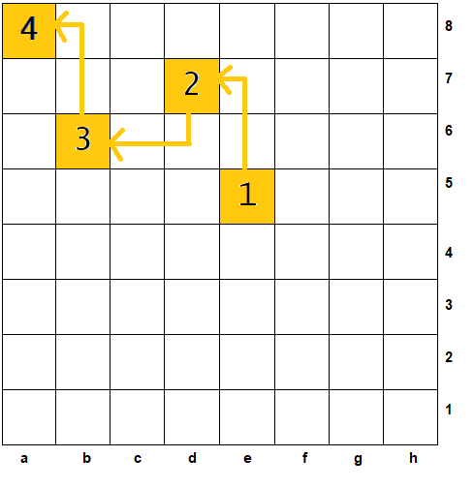
SIMULATION 11

Slide 18
List Of Functions
void RemoveObstacles()
void PlayBoardInitialize()
void Show()
bool IsMoveValid(int x, int y)
void EmptyTheQueue()
void PlayingWithQueue()
void PathFinder()
void Play()
void BoardNullify()
void ShowBoard()
void SetObstacles()
void SetKnightPosition()
void ChangeKnightPosition()
void SetDestinationPosition()
void ChangeDestinationPosition()

Slide 19
Time Complexiety
void RemoveObstacles() →O(1)
void PlayBoardInitialize() →O(n^2)
void Show() →O(n^2)
bool IsMoveValid(int x, int y) →O(1)
void EmptyTheQueue() →O(n^2)
void PlayingWithQueue() →O(n^2)
void PathFinder() →O(2n)
void Play()→O(n^2)+O(n^2)+O(n^2)+
O(n) = O(n^2)
void BoardNullify() →O(n^2)
void ShowBoard() →O(n^2)
void SetObstacles() →O(n)
void SetKnightPosition() →O(1)
void ChangeKnightPosition() →O(1)
void SetDestinationPosition() →O(1)
Void ChangeDestinationPosition()→O(1)

Slide 20
Time Complexity
O(n^2)

Slide 21
Applications
We can find minimum number of moves and the sequence of path needed to go from source to destination in chessboard
We can perform Web Crawling using BFS
We can relate flights having the minimum number of transits
BFS can also be used to find all the neighboring nodes which is beneficial for GPS and Broadcasting Network
Notes:
© Copyright Showeet.com – Creative & Free PowerPoint Templates

Slide 22
PROBLEM LINK
codechef
https://www.codechef.com/problems/PRGCUP01
leetcode
https://leetcode.com/problems/maximum-depth-of-n-ary-tree/
hackerearth
https://www.hackerearth.com/practice/algorithms/graphs/breadth-first-search/practice-problems/algorithm/monk-and-the-islands/

Slide 23
PROBLEM LINK
leetcode
https://leetcode.com/problems/number-of-islands/
leetcode
https://leetcode.com/problems/word-search/
leetcode
https://leetcode.com/problems/rotting-oranges/

Slide 24
PROBLEM LINK
leetcode
https://leetcode.com/problems/surrounded-regions/
cses
https://cses.fi/problemset/task/1689
hackerearth
https://www.hackerearth.com/practice/algorithms/graphs/breadth-first-search/practice-problems/algorithm/big-p-and-party-1/description/?fbclid=IwAR0Er7VSzntkkdM918epkH88sbzlYzXAMUssKFnaFIj7nMuB8taOTsSlhgI

Slide 25
PROBLEM LINK
hackerearth
https://www.hackerearth.com/practice/algorithms/graphs/breadth-first-search/practice-problems/algorithm/oliver-and-the-battle-1/submissions/
codeforces
https://codeforces.com/problemset/problem/939/A
hackerearth
https://www.hackerearth.com/practice/algorithms/graphs/breadth-first-search/practice-problems/algorithm/oliver-and-the-battle-1/

Slide 26
PROBLEM LINK
leetcode
https://leetcode.com/problems/word-ladder/
hackerearth
https://www.hackerearth.com/problem/algorithm/move-the-knight/
vjudge
https://vjudge.net/problem/LightOJ-1010

Slide 27
PROBLEM LINK
hackerearth
https://www.hackerearth.com/practice/algorithms/graphs/breadth-first-search/practice-problems/algorithm/social-networking-graph/

