Slide 1
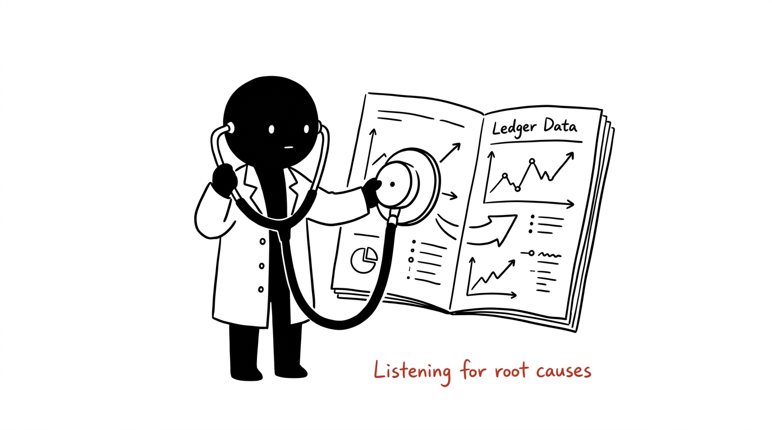
WHYQUIET • CAUSE DESK
Stop Blasting SMS. Start Diagnosing Churn.
Mobile Financial Services have millions of dormant accounts. Today, operators treat dormancy as a single symptom with blanket "We Miss You" SMS spam.
• Replaces blanket spam with causal diagnosis & calibrated refusal.
5
DISTINCT ROOT CAUSES
Each requires a tailored remedy, not spam.
26 Wks
DECLINE TRAJECTORY
Diagnosed via 20 mathematical shape ratios.
WhyQuiet Pitch Deck | Slide 01 / 07

Slide 2
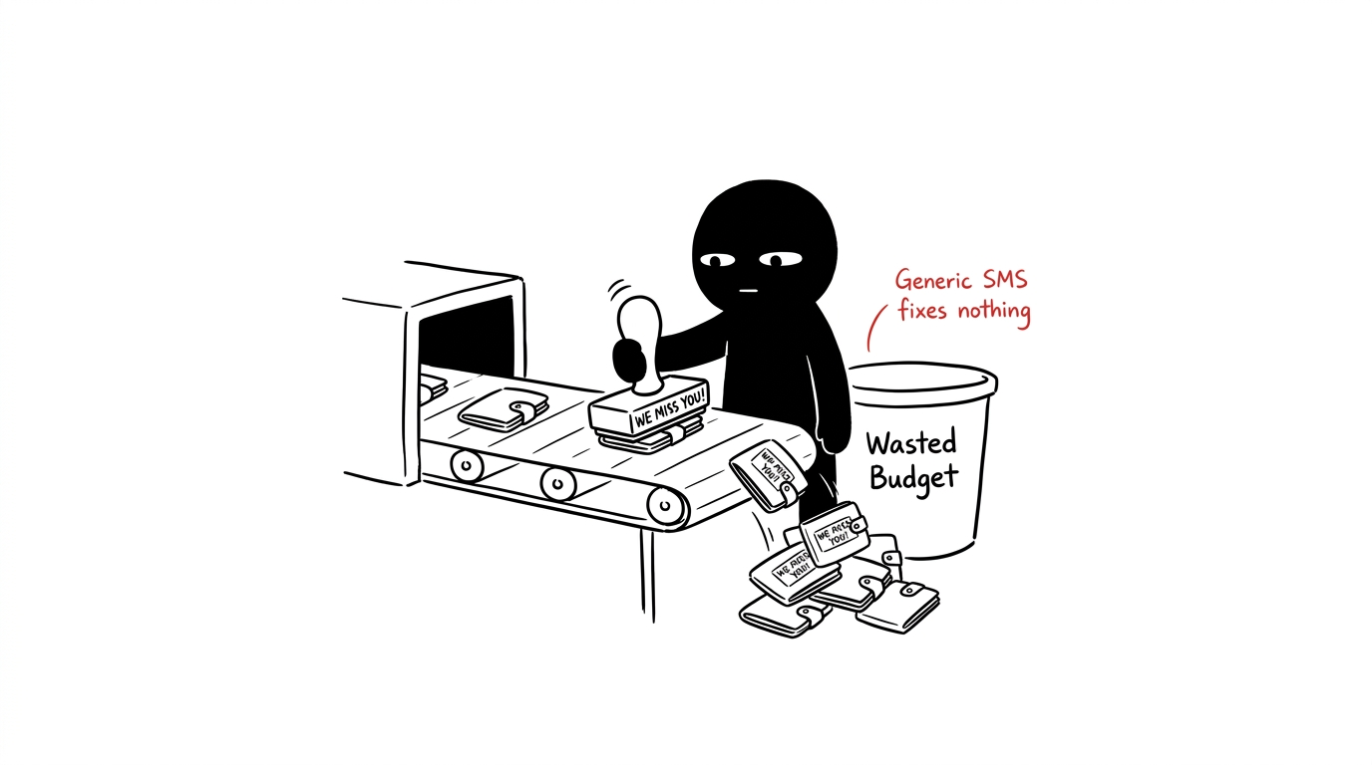
THE FLAWED INDUSTRY BASELINE
The 3-Week Blanket Rule Wastes Budget on Unfixable Churn
The standard heuristic ("silent ≥ 3 weeks → send mass SMS") blindly treats every inactive user identically.
• Mass SMS annoys customers and wastes marketing budget on zero-return cases.
8.2%
BASELINE DIAGNOSTIC F1
Rule fails on out-of-distribution users.
100%
FORCED GUESSWORK
Spends money on completed & unfixable churn.
WhyQuiet Pitch Deck | Slide 02 / 07

Slide 3
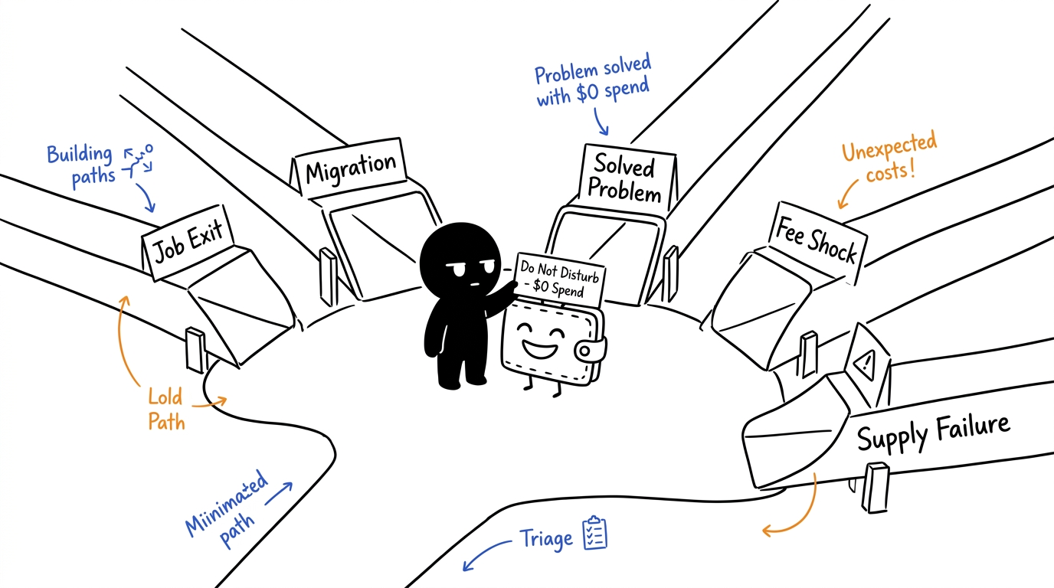
DIAGNOSTIC TAXONOMY
Five Distinct Churn Causes Behind Every Silent Wallet
• Job Exit → Payroll discontinued; send re-link guide (৳15).
• Migration → Relocated district; send nearby agent map (৳10).
• Solved Problem → One-time goal done; ৳0 spend (Do not disturb!).
• Fee Shock → Left after high fee; send cash-out fee voucher (৳25).
• Supply Failure → Agent out of float; alert field ops (৳5).
WhyQuiet Pitch Deck | Slide 03 / 07

Slide 4
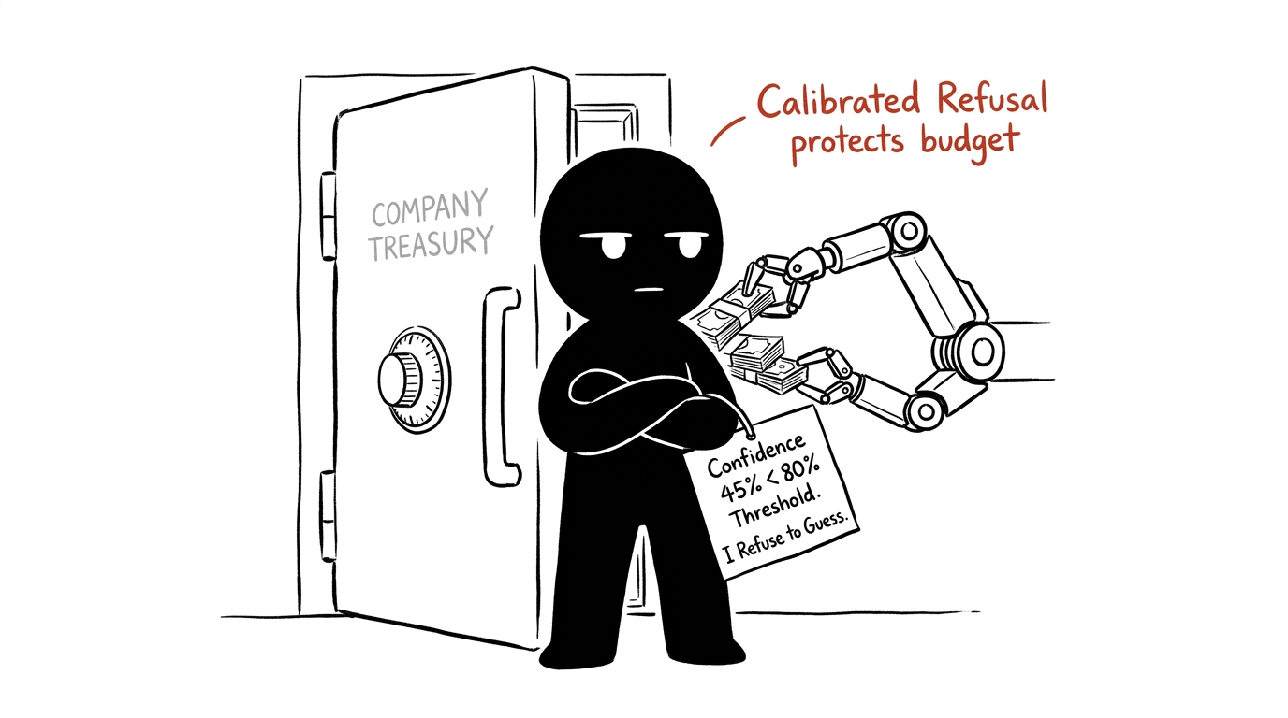
THE INNOVATION MOAT
Calibrated Refusal: "I Will Not Spend Your Money Here"
When signals are ambiguous, standard ML forces a guess. WhyQuiet refuses attribution if confidence < 80% (τ) or top margin < 10% (δ).
• Refusal is a first-class output with transparent mathematical proofs.
21.7%
REFUSAL RATE ON POP B
Automatic refusal when data is noisy.
+৳7,172
BUDGET SAVED
Eliminated wasteful spend on 652 ambiguous wallets.
WhyQuiet Pitch Deck | Slide 04 / 07

Slide 5
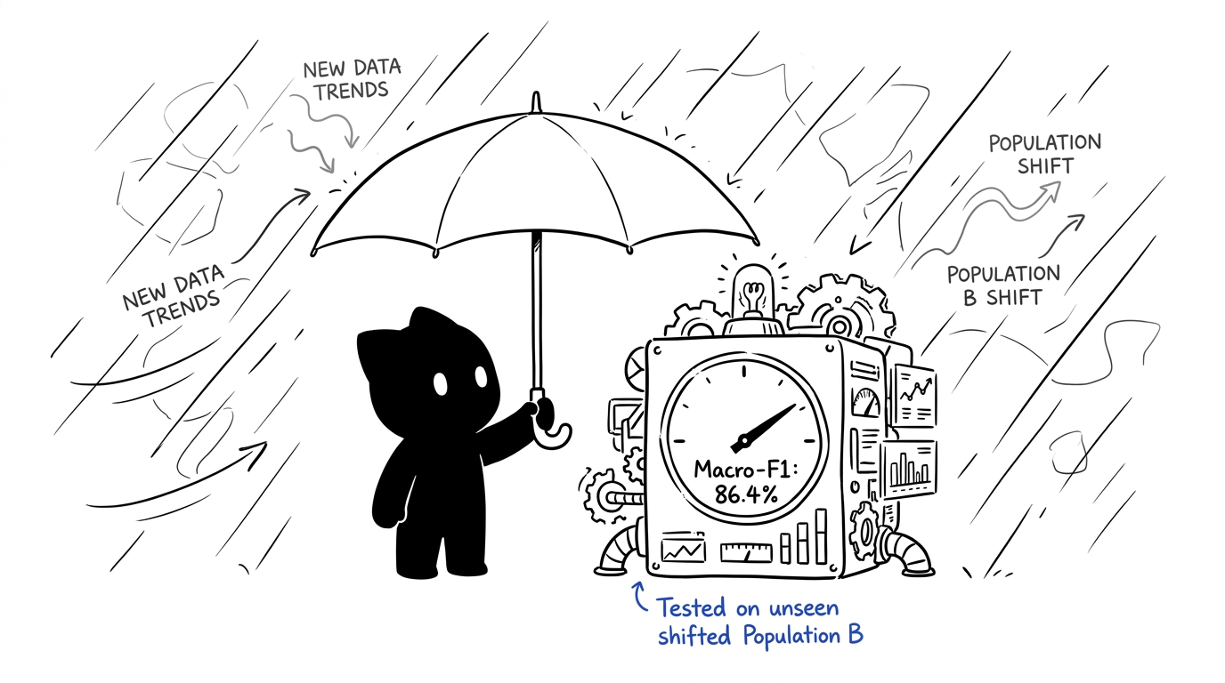
EMPIRICAL VERIFICATION
86.4% Macro-F1 Proven Under Heavy Distribution Shift
Trained on Population A (4.8k train) and evaluated strictly on unseen, shifted Population B (3k eval) with 2.5× higher noise and altered pay cycles.
• 0.100 Calibration Error (ECE) with native Tree SHAP explainability.
86.4%
WHYQUIET MODEL F1
vs 8.2% Rule & 16.2% Shuffled Control.
84% - 89%
SUBGROUP FAIRNESS
Parity across garment, domestic, retail & transport.
WhyQuiet Pitch Deck | Slide 05 / 07

Slide 6
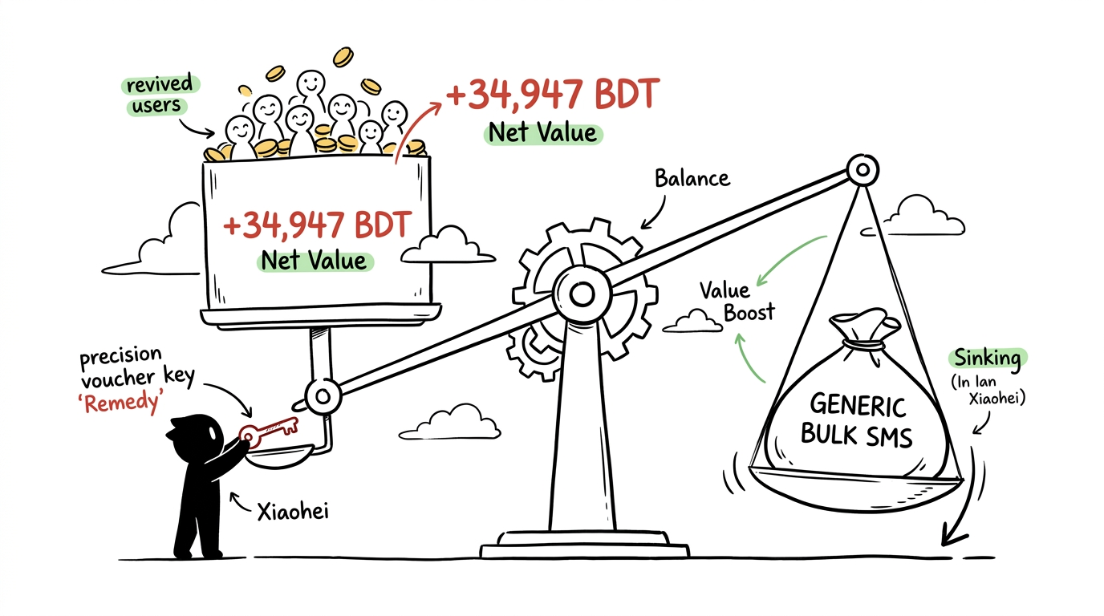
FINANCIAL RETURN
Targeted Remedies Deliver +74% Higher Net Profitability
Evaluated on Population B (3,000 wallets) across 1%, 4%, and 8% response sweeps under explicit economic assumptions (৳120 ARPU, 3.0x Ramp).
• Targeted high-touch remedies beat spam SMS as customer lifetime value ramps.
+৳34,947
NET VALUE AT 8%
vs ৳20,100 for the mass SMS rule (+74% win).
2.8×
USER VOLUME RECOVERY
168.8 active users recovered vs 60.0 for rule.
WhyQuiet Pitch Deck | Slide 06 / 07

Slide 7
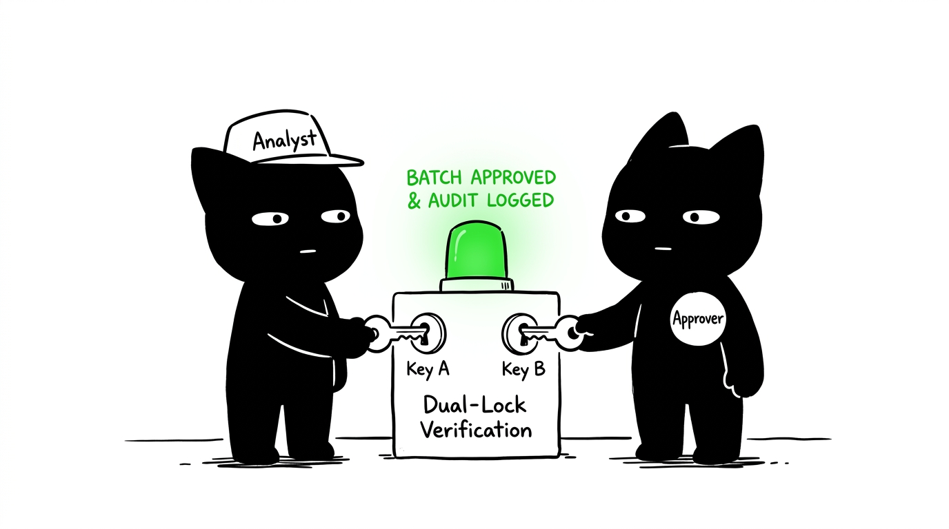
ENTERPRISE GOVERNANCE & PRODUCTION
Two-Person Maker-Checker Rules with Zero-PII Compliance
Built for enterprise compliance: analysts propose batches, approvers authorize them. Self-approval is blocked at the database trigger level.
• Two-Person Gate: proposer != approver strictly enforced in PostgreSQL.
• Immutable Audit Log: Triggers block all UPDATE and DELETE operations.
• Zero-PII Tokenization: Pure W-XXXXXX pseudonymous identifiers.
• Live Production Console: Active at whyquiet.vercel.app
WhyQuiet Pitch Deck | Slide 07 / 07

