Slide 1
Database Normalization Rules
How to design tables correctly in a Database
Shad Sluiter

Slide 2
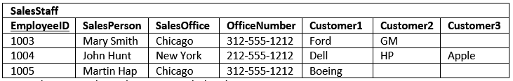
Example of Problem in Database Design…
What is the sales person has more than 3 customers???

Slide 3
Database Normalization
The main goal of Database Normalization is to:
Eliminate redundancy in tables
Organize data efficiently
Reduce the potential for data anomalies.

Slide 4
Data Anomalies
Data anomalies are inconsistencies in the data stored in a database as a result of an operation such as update, insertion, and/or deletion.
Such inconsistencies may arise when have a particular record stored in multiple locations and not all of the copies are updated.

Slide 5
Duplicate Data Example
Employee ID | Employee Address | Skill
992 | 88 McDowell | Welding
992 | 88 McDowell | Electrical
023 | 1002 Hwy #19 | PHP Programming
854 | 900 South Main | Excel
854 | 900 South Main | Access
854 | 900 South Main | Photoshop

Slide 6
1st Normal Form
The Requirements
  Each table has a primary key: minimal set of attributes which can uniquely identify a record
  The values in each column of a table are atomic (No multi-value attributes allowed).
  There are no repeating groups: two columns do not store similar information in the same table.

Slide 7
1st Normal Form
Example
Un-normalized Students table:
Normalized Students table:
Student# | AdvID | AdvName | AdvRoom | Class1 | Class2
123 | 123A | James | 555 | 102-8 | 104-9
124 | 123B | Smith | 467 | 209-0 | 102-8
Student# | AdvID | AdvName | AdvRoom | Class#
123 | 123A | James | 555 | 102-8
123 | 123A | James | 555 | 104-9
124 | 123B | Smith | 467 | 209-0
124 | 123B | Smith | 467 | 102-8

Slide 8
2nd Normal Form
The Requirements
The requirements to satisfy the 2nd NF:
  All requirements for 1st NF must be met.
  Redundant data across multiple rows of a table must be moved to a separate table.
    The resulting tables must be related to each other by use of foreign key.

Slide 9
2nd Normal Form
Example
Students table
Registration table
Student# | AdvID | AdvName | AdvRoom
123 | 123A | James | 555
124 | 123B | Smith | 467
Student# | Class#
123 | 102-8
123 | 104-9
124 | 209-0
124 | 102-8
The two tables share a common key value, student#.

Slide 10
3rd Normal Form
The Requirements
The requirements to satisfy the 3rd NF:
  All requirements for 2nd NF must be met.
  Eliminate fields that do not depend on the primary key;
    That is, any field that is dependent not only on the primary key but also on another field must be moved to another table.

Slide 11
3rd Normal Form
Example
Students table:
Student table: Advisor table:
Student# | AdvID | AdvName | AdvRoom
123 | 123A | James | 555
124 | 123B | Smith | 467
Student# | AdvID
123 | 123A
124 | 123B
AdvID | AdvName | AdvRoom
123A | James | 555
123B | Smith | 467

Slide 12
3rd Normal Form
Example Cont.
Students table:
Registration table: Advisor table:
Student# | AdvID
123 | 123A
124 | 123B
Student# | Class#
123 | 102-8
123 | 104-9
124 | 209-0
124 | 102-8
AdvID | AdvName | AdvRoom
123A | James | 555
123B | Smith | 467

Slide 13
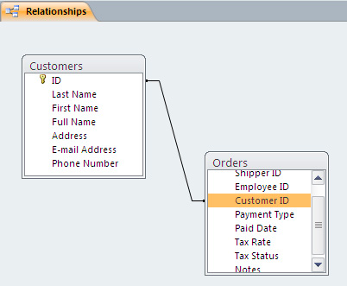
Relationship between two tables

Slide 14
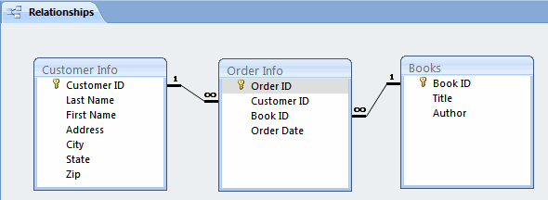
Three tables…

Slide 15
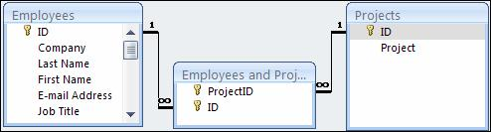
Projects Database Example

Slide 16
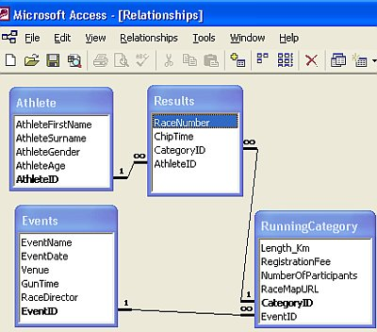
Track Meet

Slide 17
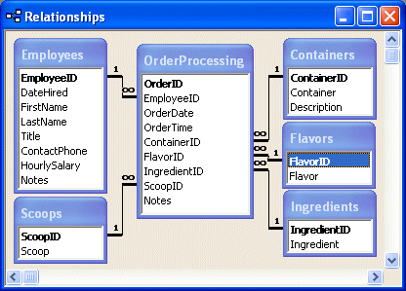
Ice Cream Store Orders

Slide 18
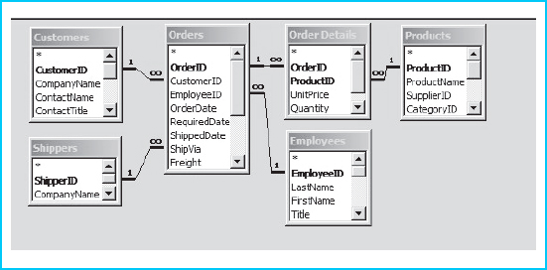
Store Order System

Slide 19
Conclusion
We have seen how Database Normalization can decrease redundancy, increase efficiency and reduce anomalies by implementing three of seven different levels of normalization called Normal Forms. The first three NF’s are usually sufficient for most small to medium size applications.

