Slide 1



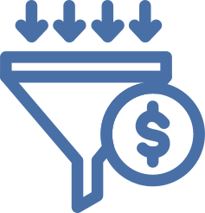

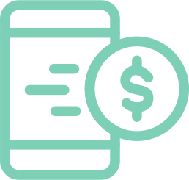
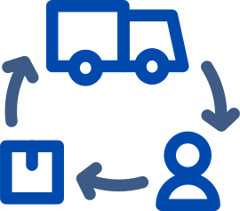
KEY TOUCHPOINTS
List important moments that shape customer perception and satisfaction
Social Media
Checkout Process
Customers interact with content, messages, and community discussions.
Customers complete payment and receive confirmation of their purchase.
02
04
01
03
05
Website Visit
Customer Support
Post Purchase
Customers explore information, pricing, and product details online.
Customers contact service teams for questions or problem resolution.
Customers receive follow up communication and support after buying.

Slide 2








Discover Touchpoints
JOURNEY PROCESS
01
Show the main stages from first contact to loyal customer
Identify all points where customers interact with the organization.
Engage Channels
02
Deliver consistent messaging across digital and physical platforms.
Support Actions
03
Provide assistance during evaluation and purchase moments.
Collect Feedback
Gather insights to improve future customer interactions continuously.
05
Deliver Experience
Ensure smooth service during and after the transaction stage.
04

Slide 3







JOURNEY OVERVIEW
Show the main stages from first contact to loyal customer
Loyalty Stage
.05
Customers return, recommend, and engage in long term relationships.
04.
Purchase Stage
Customers complete the transaction and begin product or service use.
Decision Stage
.03
Customers compare options and prepare to make a purchase choice.
02
Interest Stage
Customers seek more information about offerings and value propositions.
Awareness Stage
01
Customers discover the brand through initial exposure and communication channels.

Slide 4



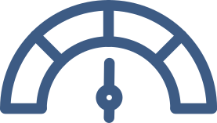



EXPERIENCE ROADMAP
Outline a strategic plan to improve journey stages over time
STAGE
STAGE
05
STAGE
04
STAGE
03
STAGE
02
Optimize processes to sustain consistent and positive customer journeys.
01
Measure performance using defined experience and satisfaction metrics.
Implement changes across teams and systems with clear responsibilities.
Design improvements for key touchpoints and communication channels.
Map current journey and identify major gaps in customer experience.

Slide 5


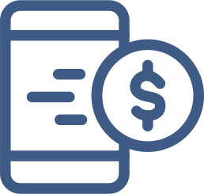







JOURNEY TIMELINE
Show the sequence of customer interactions across time periods
Awareness
Purchase
Customer first encounters the brand through marketing or referral sources.
Customer completes transaction and begins using the product or service.
Loyalty
Day-1
Day-7
Day-14
Day-30
Day-90
Customer repeats purchases and shares positive recommendations.
Evaluation
Engagement
Customer compares options and seeks detailed product information.
Customer receives onboarding and ongoing communication messages.

Slide 6







PAIN POINT ANALYSIS
Highlight common obstacles that reduce satisfaction and retention
PAIN POINTS
SOLUTIONS
Slow Response
Improve Response
Delayed support reduces trust and increases frustration during interactions.
Use faster communication tools to resolve issues quickly.
Complex Checkout
Simplify Checkout
Complicated payment steps reduce conversion rates and increase abandonment.
Streamline forms and payment options to improve completion rates.

Slide 7






EMOTION MAPPING
Visualize how customer feelings change across journey stages
Confidence Phase
Customers feel assured after comparing options and reading reviews.
Curiosity Phase
Customers feel interested and explore available information sources.
Excitement Phase
Customers feel positive during purchase and onboarding interactions.
02
01
03
Satisfaction Phase
Customers feel pleased when product meets expectations consistently.
04

Slide 8

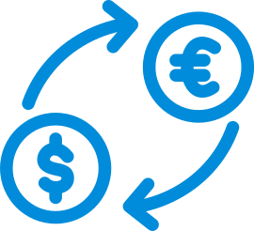








JOURNEY OVERVIEW
Show the main stages from first contact to loyal customer
Quality
Delivery
Personalized
Offers
Provide consistent product or service quality across all interactions.
Reward
Programs
Deliver tailored recommendations based on customer preferences and behavior.
Community Building
Offer incentives for repeat purchases and long term engagement.
Ongoing
Support
Create spaces for customers to share experiences and feedback.
Maintain responsive assistance throughout the customer lifecycle.

Slide 9

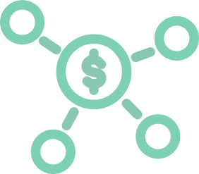
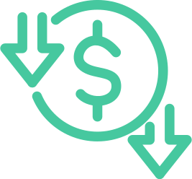

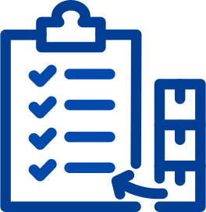

PERFORMANCE METRICS
Compare key indicators used to measure journey effectiveness
Conversion Rate
Retention Rate
Percentage of visitors who complete a desired action or purchase.
Percentage of customers who continue using products over time.
Referral Rate
Number of customers who recommend the brand to others.
Satisfaction Score
Customer rating of experience quality across different touchpoints.

Slide 10

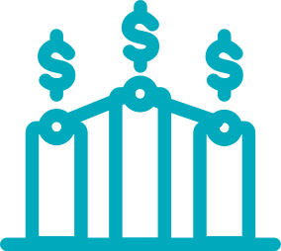
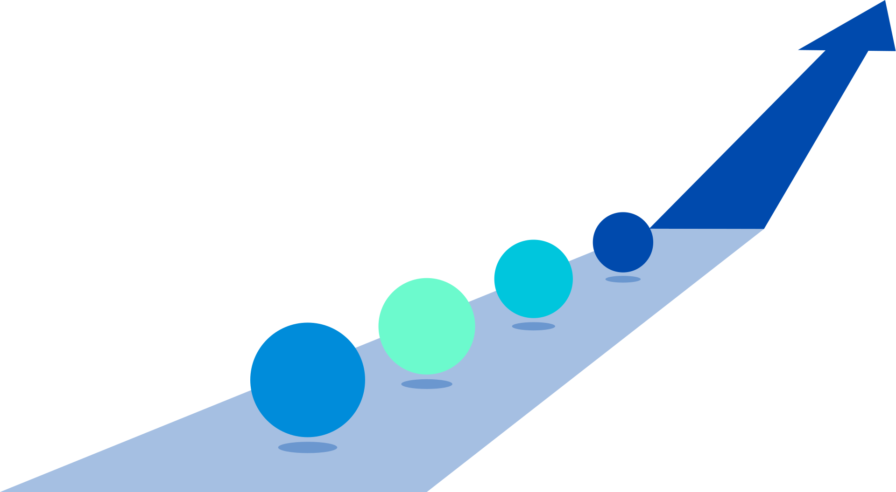


JOURNEY SUMMARY
Summarize insights and actions to strengthen customer loyalty strategy
Plan Next
Measure Impact
Define future enhancements to maintain long term customer loyalty.
Track metrics to validate changes and improvements.
Improve Experience
Address gaps and optimize key moments in the journey.
Map Journey
Document all touchpoints and customer interactions across channels.

