Slide 1

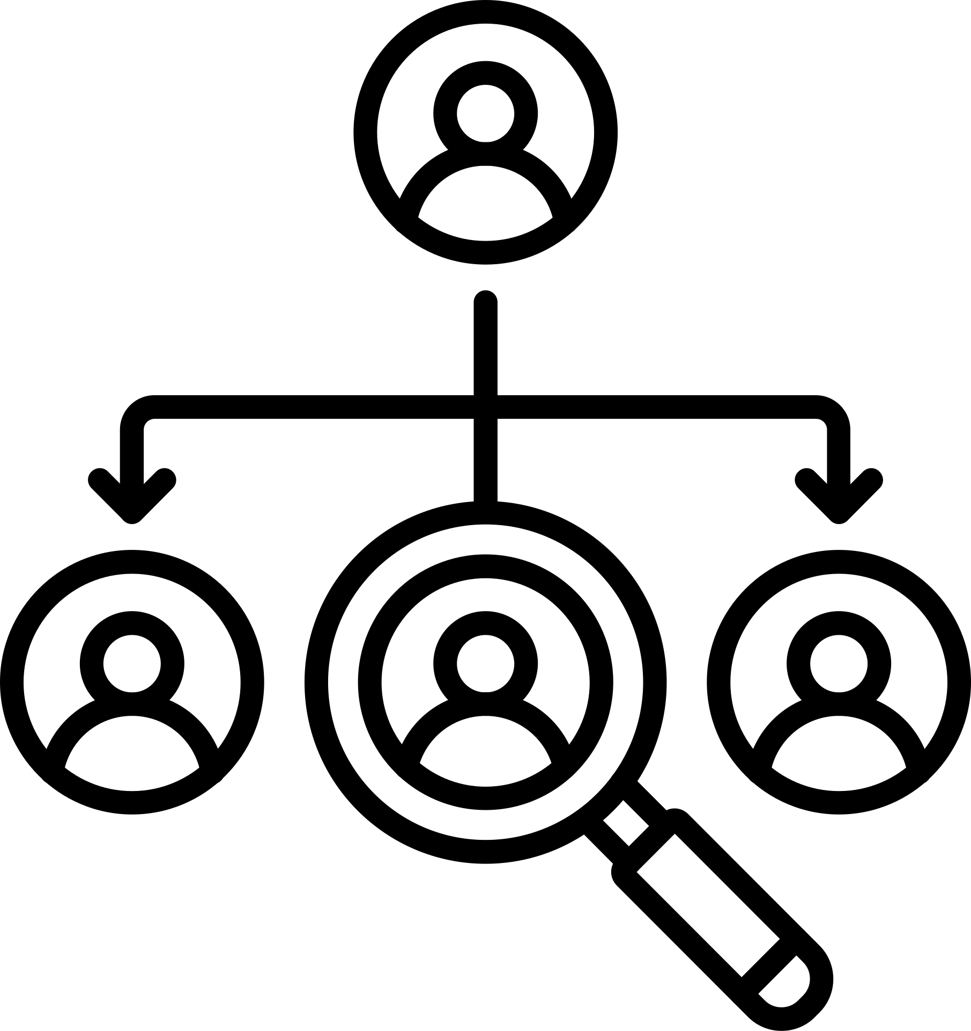

Decision Input Constellation
Decisions are shaped by many signals, not a single factor
Internal Signals
Cognitive Factors
External Signals
Operational data
Resource availability
Team capability
Organizational culture
Bias and assumptions
Past experience
Risk perception
Time pressure
Market trends
Competitive moves
Customer behavior
Regulatory changes

Slide 2
Information Distillation Pipeline
How raw data becomes insight
Raw Data Streams
Noise & Outliers
Contextual Framing
Pattern Recognition
Signal Validation
Insight Synthesis
Confidence Scoring
Side notes showing data loss and quality gain

Slide 3






Cognitive Bias Interference
Why rational decisions often fail
Confirmation Bias
Anchoring Effect
Loss Aversion
Status Quo Bias
Overconfidence
Availability Heuristic

Slide 4



Trade-Off Density Field
Every decision sacrifices something
Confirmation Bias
Cost vs Quality
Flexibility vs Control
Short-Term vs Long-Term
Innovation vs Stability

Slide 5

Systems
1
Solutions implemented in real conditions
Hidden Dependency Graph
Processes
2
Solutions implemented in real conditions
Roles
Unseen connections drive outcomes
3
Solutions implemented in real conditions
External Actors
4
Solutions implemented in real conditions

Slide 6
Constraint Pressure Map
Where constraints accumulate and intensify
Time compression
Skill scarcity
Governance overhead
Solutions implemented in real conditions
Solutions implemented in real conditions
Solutions implemented in real conditions
Low Pressure
More Pressure
Budget ceilings
Tool limitations
Market volatility
Solutions implemented in real conditions
Solutions implemented in real conditions
Solutions implemented in real conditions

Slide 7
Policy adjustment
Decision rights
Incentive design
Leverage
Cascade
Feedback speed
Small changes that trigger large effects
Information access
Standardization
Automation

Slide 8

Scenario Expansion Map
One decision, many futures
Market response
Internal capacity
Competitor reaction
External shocks

Slide 9
Execution Reality Stack
Why plans change in the real world
Strategic Intent
1
4
Formal Plans
Operational Reality
2
5
Human Behavior
Environmental Noise
3
6
Actual Outcome

Slide 10
5
Documentation
4
Cultural Norms
Learning Integration Network
Reflection
3
How experience becomes institutional knowledge
2
Result
1
Action

