Slide 1

简约大气毕业答辩PPT模板
Simple atmospheric graduation defense PPT template
答辩人：小泉同学
指导老师：稻壳儿

Slide 2
目 录
CONTENTS
选题背景和意义
研究成果与应用
The background and significance of the topic
Research results and applications
研究方法及过程
论文归纳与总结
Research methods and processes
The induction and summary of the thesis

Slide 3
选题背景和意义
The background and significance of the topic
Event planning is an effective behavior to increase market share. An action plan with executable, actionable and creative ideas can effectively enhance the company's reputation and brand reputation.

Slide 4

单击此处添加标题
TITLE HERE
Event planning is an effective behavior to increase market share.
TITLE HERE
Event planning is an effective behavior to increase market share.

Slide 5
单击此处添加标题
01
TITLE HERE
TITLE HERE
Event planning is an effective behavior to increase market share.
Event planning is an effective behavior to increase market share.
04
02
03
TITLE HERE
TITLE HERE
Event planning is an effective behavior to increase market share.
Event planning is an effective behavior to increase market share.

Slide 6
The intention of undergraduate on travel

Slide 7
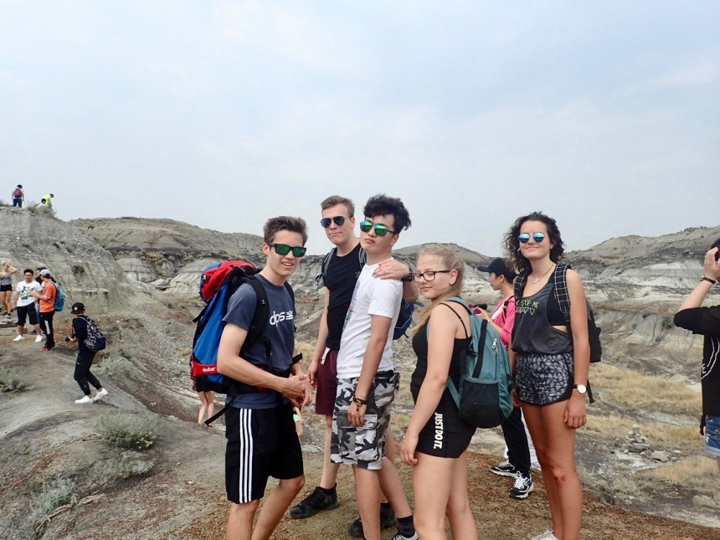

In terms of travel intention, nearly 95% of college students say they like traveling very much, and another 5% say they like traveling in general. However, there is a significant difference between urban and rural students. Almost 100% of urban students have the intention to travel, while only nearly 85% of rural students have the intention to travel.The main reason for this difference may be the difference between the economic conditons of students from urban and rural areas. 66 percent of college students who have no feelings about travel are mainly due to lack of money, and 74 percent of them come from rural areas.

Slide 8
单击此处添加标题
The purpose of travel
Sixty-two percent of students travel to broaden their horizon. Twenty-one percent travel to relieve thenselves.Sixteen travel to play with their acquaintance. Only one percent travel for simple entertainment.
20%
40%
65%
85%
20%
Factors which influence their travel
40%
Eighty percent of students think money is the most influential factor. Fifteen think it is time. The rest think it is up to parters’ thoughts.
65%
85%

Slide 9
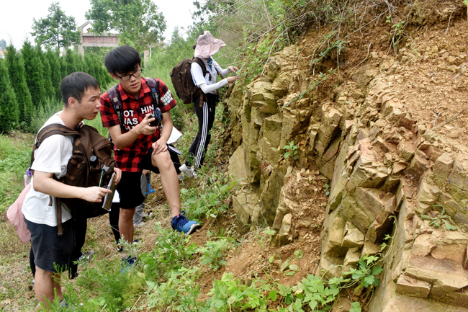
Besides, we find that the difference on majors also influences students’ intention on travel. For example, students who major tourist management or exploration refer to some natural landscape.
The above survey results show that college students have different perferences for travel due to the pressure from school, family and society. But most people like to travel to enjoy the landscape and broaden their horizons, and money is the main factor affecting most college students to travel.

Slide 10
研究成果与应用
Research results and applications
Event planning is an effective behavior to increase market share. An action plan with executable, actionable and creative ideas can effectively enhance the company's reputation and brand reputation.

Slide 11

单击此处添加标题
1
TITLE HERE
An action plan with executable, actionable and creative ideas can effectively enhance the company's reputation and brand reputation.
2
TITLE HERE
An action plan with executable, actionable and creative ideas can effectively enhance the company's reputation and brand reputation.
3
TITLE HERE
An action plan with executable, actionable and creative ideas can effectively enhance the company's reputation and brand reputation.
4
TITLE HERE
An action plan with executable, actionable and creative ideas can effectively enhance the company's reputation and brand reputation.

Slide 12





单击此处添加标题
Step
1
An action plan with executable, actionable and creative ideas can effectively enhance the company's reputation and brand reputation.
An action plan with executable, actionable and creative ideas can effectively enhance the company's reputation and brand reputation.
Step
4
Step
2
An action plan with executable, actionable and creative ideas can effectively enhance the company's reputation and brand reputation.
An action plan with executable, actionable and creative ideas can effectively enhance the company's reputation and brand reputation.
An action plan with executable, actionable and creative ideas can effectively enhance the company's reputation and brand reputation.
Step
5
Step
3

Slide 13
论文归纳与总结
The induction and summary of the thesis
Event planning is an effective behavior to increase market share. An action plan with executable, actionable and creative ideas can effectively enhance the company's reputation and brand reputation.

Slide 14



单击此处添加标题
01
02
03
TITLE HERE
An action plan with executable, actionable and creative ideas can effectively enhance the company's reputation and brand reputation. An action plan with executable, actionable and creative ideas can effectively enhance the company's reputation and brand reputation.
An action plan with executable, actionable and creative ideas can effectively enhance the company's reputation and brand reputation.
TITLE HERE
TITLE HERE
TITLE HERE
Event planning is an effective behavior to increase market share.
Event planning is an effective behavior to increase market share.
Event planning is an effective behavior to increase market share.

Slide 15




单击此处添加标题
An action plan with executable, actionable and creative ideas can effectively enhance the company's reputation and brand reputation.
TITLE HERE
TITLE HERE
TITLE HERE
Event planning is an effective behavior to increase market share.
Event planning is an effective behavior to increase market share.
Event planning is an effective behavior to increase market share.

Slide 16
感谢您的欣赏与指导
Simple atmospheric graduation defense PPT template
答辩人：小泉同学
指导老师：稻壳儿

